Slide 1


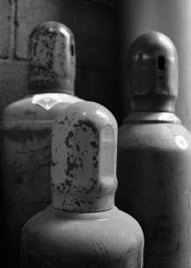

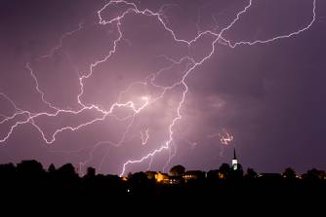
Chemistry
Unit 9:
The Gas Laws

Slide 2

The Atmosphere
→ an “ocean” of gases
mixed together
Composition
nitrogen (N₂)…………..
~78%
oxygen (O₂)……………
~21%
argon (Ar)……………...
~1%
carbon dioxide (CO₂)…
~0.04%
Trace amounts of:
He, Ne, Rn, SO₂,
CH₄, N_{x}O_{x}, etc.
water vapor (H₂O)…….
~0.1%

Slide 3



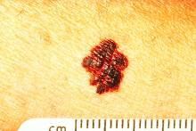

Depletion of the Ozone Layer
O₃ depletion is caused by chlorofluorocarbons (CFCs).
Ozone (O₃) in upper atmosphere
blocks ultraviolet (UV) light from Sun.
UV causes skin cancer and cataracts.
Uses for CFCs:
refrigerants
CFCs
aerosol propellants
-- banned in U.S. in 1996
O₃ is replenished with each strike of lightning.

Slide 4
The Greenhouse Effect
Upon contact with objects, some of light’s energy
is released
as heat.
High energy, short
λ light passes easily
through atmosphere.
CO₂ MOLECULES
Lower energy, longer λ light
is blocked by CO₂ and CH₄; energy doesn’t escape into space; atmosphere heats up.
Energy from Sun has short wavelengths (λs) and high energy.
CO₂ and methane (CH₄) let this light in. Reflected light has longer
λs and less energy. CO₂ and CH₄ (“greenhouse gases”) prevent
reflected light from escaping, thus warming the atmosphere.

Slide 5
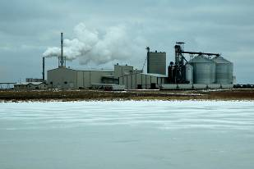
Why more CO₂ in atmosphere
now than 500 years ago?
burning of fossil fuels
deforestation
__________________ _____________
--
coal
--
urban sprawl
--
petroleum
--
wildlife
areas
--
natural gas
--
wood
--
rain forests
*
The burning of ethanol
won’t slow greenhouse effect.

Slide 6
What can we do?
1. Reduce consumption of fossil fuels.
At home:
insulate home; run dishwasher full;
avoid temp. extremes (A/C & furnace);
wash clothes on “warm,” not “hot”
On the road:
bike instead of drive;
carpool; energy-efficient vehicles
2. Support environmental organizations.
3. Rely on alternate energy sources.
solar, wind energy,
hydroelectric power

Slide 7
The Kinetic Molecular Theory (KMT)
--
explains why gases behave as they do
-- deals w/“ideal” gas particles…
1. …are so small that they are
assumed to have zero volume
2. …are in constant, straight-line motion
3. …experience elastic collisions in which
no energy is lost
4. …have no attractive or repulsive forces toward
each other
…have an average kinetic energy (KE) that is
proportional to the absolute temp. of gas
(i.e., Kelvin temp.)
as Temp. , KE

Slide 8

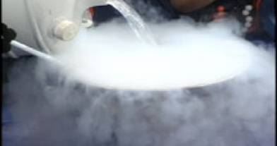
Theory “works,” except at
high pressures and low temps.
(attractive forces
become significant)
KMT “works”
KMT starts to break down
N₂ can be pumped into
tires to increase tire life
liquid nitrogen (N₂);
the gas condenses into
a liquid at –196ºC
liquid
N₂
H₂O
freezes
body
temp.
H₂O
boils
–196ºC
0ºC
37ºC
100ºC

Slide 9
**
Two gases w/same # of particles and at same
temp. and pressure have the same kinetic energy.
KE is related to mass and velocity (KE = ½ m v²).
same
temp.
KE₁
= ½
m₁
v₁
²
KE₂
= ½
m₂
v₂
²
To keep same KE, as m , v must
OR as m , v must .
More massive gas particles
are _______ than
less massive gas
particles (on average).
slower

Slide 10
H₂
Particle-Velocity Distribution
(various gases, same T and P)
N₂
CO₂
CO₂
(44 g/mol)
# of
particles
N₂
(28 g/mol)
H₂
(2 g/mol)
(SLOW)
Velocity of
particles (m/s)
(FAST)

Slide 11
O₂ @ 10ºC
Particle-Velocity Distribution
(same gas, same P, various T)
O₂ @ 50ºC
O₂ @ 100ºC
O₂ @ 10ºC
# of
particles
O₂ @ 50ºC
O₂ @ 100ºC
(SLOW)
Velocity of
particles (m/s)
(FAST)

Slide 12
Graham’s Law
Consider two gases at same temp.
Gas 1: KE₁ = ½ m₁ v₁²
Gas 2: KE₂ = ½ m₂ v₂²
Since temp. is same, then…
KE₁ = KE₂
½ m₁ v₁² = ½ m₂ v₂²
m₁ v₁² = m₂ v₂²
Divide both sides by m₁ v₂²…
Take sq. rt. of both sides to get Graham’s Law:
** To use Graham’s Law, both gases
must be at same temp.

Slide 13
diffusion:
effusion:
particle movement
from high to
low conc.
diffusion of gas
particles through
an opening
NET MOVEMENT
NET MOVEMENT
For gases, rates of diffusion
& effusion obey Graham’s law:
more massive = slow;
less massive = fast

Slide 14
(CO₂)
On avg., carbon dioxide travels at 410 m/s at 25ºC.
Find avg. speed of chlorine at 25ºC.
(Cl₂)
irrelevant, so
long as they
are the same
= 320 m/s
**Hint: Put whatever you’re looking
for in the numerator.
(the algebra
is easier)

Slide 15

(F₂)
mm = 38 g/mol
2
He
At a certain temp., fluorine gas travels at
582 m/s and a noble gas travels at
394 m/s. What is the noble gas?
4.003
10
Ne
20.180
18
Ar
39.948
36
Kr
83.80
54
Xe
131.29
= 82.9 g/mol
86
Rn
(222)
best guess = Kr

Slide 16
CH₄ moves 1.58 times faster than which noble gas?
mm = 16 g/mol
2
He
4.003
10
Ne
20.180
Ne₂
or Ar?
18
Ar
39.948
36
= 39.9 g/mol
Kr
83.80
54
Ar
“Ar?”
Xe
131.29
86
“Aahhrrrr! Buckets o’ blood!
Swab de decks, ye scurvy dogs!”
Rn
(222)

Slide 17
HCl and NH₃ are released at same time from
opposite ends of 1.20 m horiz. tube.
Where do gases meet?
HCl
A
B
C
NH₃
mm = 36.5 g/mol
mm = 17 g/mol
more massive
less massive
travels slower
travels faster
A

Slide 18
Gas Pressure
Pressure occurs when a force is
dispersed over a given surface area.
If F acts over a large area…
F
=
P
A
(e.g., your weight)
But if F acts over a small area…
F
P
=
A

Slide 19
At sea level, air pressure is standard pressure:
1 atm = 101.3 kPa = 760 mm Hg = 14.7 lb/in²
Find force of air pressure
acting on a baseball
field tarp…
100 ft.
100 ft.
²
A = 10,000 ft.ft
A = 10,000 ft²
= 1.44 x 10⁶ in²
F = P A
= 14.7 lb/in² (1.44 x 10⁶ in²)
= 2 x 10⁷ lb.
F = 2 x 10⁷ lb.
= 10,000 tons
Key:
Gases exert pressure
in all directions.

Slide 20
Atmospheric pressure changes with altitude:
As altitude , pressure .
barometer:
device to measure
air pressure
vacuum
mercury (Hg)
air
pressure

Slide 21
Bernoulli’s Principle
For a fluid traveling // to a surface:
--
FAST-moving fluids
exert ______ pressure
LOW
LIQUID
OR GAS
--
SLOW-moving fluids
exert ______ pressure
HIGH
LOW P
FAST
SLOW
NET
FORCE
HIGH P

Slide 22
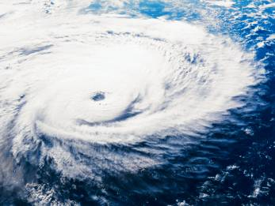
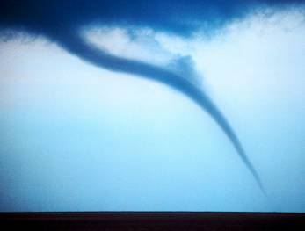
roof in hurricane
FAST
LOW P
SLOW
HIGH P

Slide 23
airplane wing / helicopter propeller
FAST
Resulting Forces
LOW P
(BERNOULLI’S
PRINCIPLE)
AIR
PARTICLES
SLOW
HIGH P
(GRAVITY)
frisbee
FAST, LOW P
SLOW, HIGH P

Slide 24

creeping shower curtain
CURTAIN
COLD
WARM
SLOW
FAST
HIGH P
LOW P

Slide 25
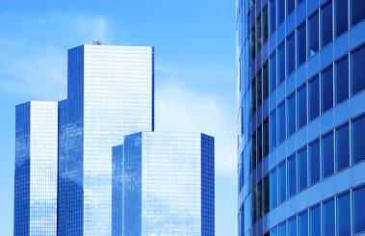
windows and
high winds
TALL BUILDING
FAST
LOW P
SLOW
windows
burst outwards
HIGH P

Slide 26
Pressure and Temperature
STP (Standard Temperature and Pressure)
standard temperature standard pressure
0ºC
273 K
1 atm
101.3 kPa
760 mm Hg
Equations / Conversion Factors:
K = ºC + 273
1 atm = 101.3 kPa = 760 mm Hg

Slide 27
K = ºC + 273
1 atm = 101.3 kPa = 760 mm Hg
Convert 25ºC to Kelvin.
K = ºC + 273
= 25 + 273
= 298 K
How many kPa is 1.37 atm?
1.37 atm
= 138.8 kPa
How many mm Hg is 231.5 kPa?
231.5 kPa
= 1737 mm Hg

Slide 28
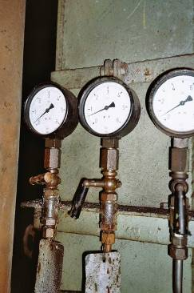
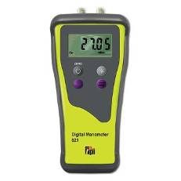
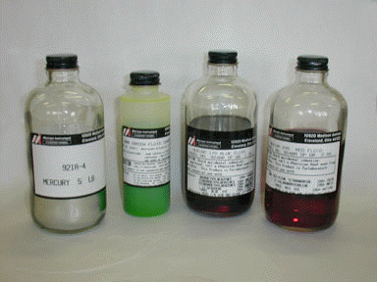
AIR
PRESSURE
manometer:
measures the pressure
of a confined gas
CONFINED
GAS
Hg HEIGHT
DIFFERENCE
SMALL + HEIGHT = BIG
differential
manometer
manometers can be filled
with any of various liquids

Slide 29
Atmospheric pressure is 96.5 kPa;
mercury height difference is
233 mm. Find confined gas
pressure, in atm.
S
96.5 kPa
X atm
233 mm Hg
B
SMALL + HEIGHT = BIG
96.5 kPa
+
233 mm Hg
=
X atm
0.953 atm
+
0.307 atm
=
1.26 atm

Slide 30
The Ideal Gas Law
P V = n R T
P = pres. (in kPa)
T = temp. (in K)
V = vol. (in L or dm³)
n = # of moles of gas (mol)
R = universal gas constant = 8.314 L-kPa/mol-K
32 g oxygen at 0ºC is under 101.3 kPa of pressure.
Find sample’s volume.
T = 0ºC + 273 = 273 K
P V = n R T
P
P
= 22.4 L

Slide 31
0.25 g carbon dioxide fills a 350 mL
container at 127ºC. Find pressure
in mm Hg.
T = 127ºC + 273 = 400 K
P V = n R T
V
V
V = 0.350 L
= 54.0
kPa
54.0 kPa
= 405 mm Hg

Slide 32
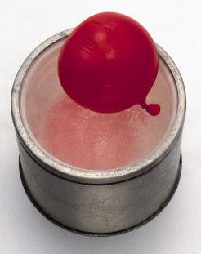
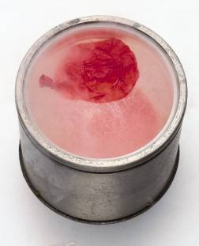
P, V, T Relationships
At constant P, as gas T , its V ___ .
At constant P, as gas T , its V ___ .
balloon placed in liquid nitrogen
(T decreases from 20ºC to –200ºC)

Slide 33
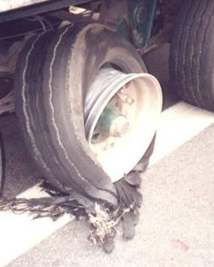
P, V, T Relationships (cont.)
At constant V, as gas T , its P ___ .
At constant V, as gas T , its P ___ .
blown-out truck tire

Slide 34
P, V, T Relationships (cont.)
At constant T, as P on gas , its V ___ .
At constant T, as P on gas , its V ___ .
Gases behave a bit like jacks-in-
the-box (or little-brothers-in-the-box)

Slide 35
The Combined Gas Law
P = pres. (any unit) 1 = initial conditions
V = vol. (any unit) 2 = final conditions
T = temp. (K)
A gas has vol. 4.2 L at 110 kPa. If temp. is constant,
find pres. of gas when vol. changes to 11.3 L.
P₁V₁ = P₂V₂
110(4.2) = P₂(11.3)
11.3
11.3
P₂ = 40.9
kPa

Slide 36

423 K
Original temp. and vol. of gas are 150ºC
and 300 dm³. Final vol. is 100 dm³.
Find final temp. in ºC, assuming
constant pressure.
300(T₂) = 423(100)
300
300
T₂ = 141
K
T₂ = –132ºC

Slide 37
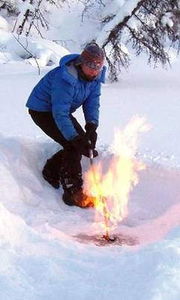
A sample of methane occupies 126 cm³ at –75ºC
and 985 mm Hg. Find its vol. at STP.
198 K
985(126)(273) = 198(760)(V₂)
198(760)
198(760)
V₂ = 225
cm³
Researchers at U of AK, Fairbanks, say
methane has surfaced in the Arctic due to
global warming. This methane could
account for up to 87% of the observed
spike in atmospheric methane.

Slide 38
Density of Gases
Density formula for any substance:
For a sample of gas, mass is constant, but pres.
and/or temp. changes cause gas’s vol. to change.
Thus, its density will change, too.
ORIG. VOL.
NEW VOL.
ORIG. VOL.
NEW VOL.
If V (due to P or T ),
then… D
If V (due to P or T ),
then… D

Slide 39
Density of Gases
Equation:
** As always,
T’s must be in K.
A sample of gas has density 0.0021 g/cm³ at –18ºC
and 812 mm Hg. Find density at 113ºC
and 548 mm Hg.
255 K
386 K
812
548
=
255
(0.0021)
386
(D₂)
812(386)(D₂) = 255(0.0021)(548)
812
(386)
812
(386)
D₂ = 9.4 x 10^{–4} g/cm³

Slide 40

A gas has density 0.87 g/L at 30ºC and 131.2 kPa.
Find density at STP.
303 K
131.2
101.3
=
303
(0.87)
273
(D₂)
131.2(273)(D₂) = 303(0.87)(101.3)
131.2
(273)
131.2
(273)
D₂ = 0.75 g/cm³
Find density of argon at STP.

Slide 41
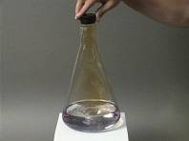
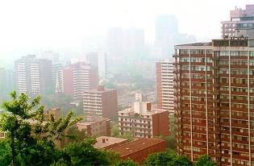
Find density of nitrogen dioxide
at 75ºC and 0.805 atm.
NO₂
348 K
D of NO₂ @ STP…
1
0.805
=
273
(2.05)
348
(D₂)
1(348)(D₂) = 273(2.05)(0.805)
1
(348)
1
(348)
D₂ = 1.29 g/L
NO₂ participates in reactions
that result in smog (mostly O₃)

Slide 42
A gas has mass 154 g and density 1.25 g/L at 53ºC
and 0.85 atm. What vol. does
sample occupy at STP?
326 K
Find D @ STP…
0.85
1
=
326
(1.25)
273
(D₂)
0.85(273)(D₂) = 326(1.25)(1)
D₂ = 1.756 g/L
0.85
(273)
0.85
(273)
Find vol. when gas has that density.
= 87.7 L

Slide 43
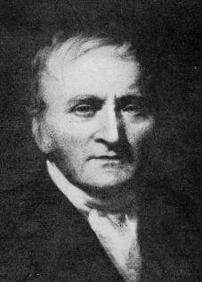
Dalton’s Law of Partial Pressure
In a gaseous mixture, a gas’s
partial pressure is the one
the gas would exert if it were
by itself in the container.
The mole ratio in a mixture of
gases determines each gas’s
partial pressure.
John Dalton (1766–1844)
Since air is ~80% N₂, (i.e., 8 out of every 10 air-gas moles is
a mole of N₂), then the partial pressure of N₂ accounts for ~80%
of the total air pressure.
At sea level, where P ~100 kPa, N₂ accounts for ~80 kPa.

Slide 44
Total pressure of mixture (3.0 mol He and 4.0 mol Ne)
is 97.4 kPa. Find partial pressure of each gas.
= 41.7 kPa
= 55.7 kPa
Dalton’s Law: the total pressure exerted by a mixture
of gases is the sum of all the partial pressures
P_{Z} = P_{A,Z} + P_{B,Z} + …

Slide 45
80.0 g each of He, Ne, and Ar are in a container.
The total pressure is 780 mm Hg. Find each gas’s
partial pressure.
P_{He} = ²⁰/₂₆
of total
80 g He
= 20 mol He
Total:
26 mol
P_{Ne} = ⁴/₂₆
of total
80 g Ne
= 4 mol Ne
80 g Ar
= 2 mol Ar
P_{Ar} = ²/₂₆
of total
P_{He} = 600 mm Hg
P_{Ne} = 120 mm Hg
P_{Ar} = 60 mm Hg
Total pressure is 780 mm Hg

Slide 46
Two 1.0 L containers, A and B, contain gases under
2.0 and 4.0 atm, respectively. Both gases are forced
into Container Z (^{w}/vol. 2.0 L). Find total pres. of
mixture in Z.
1.0 L
1.0 L
2.0 L
A
B
Z
2.0 atm
4.0 atm
PRESSURES
IN ORIG.
CONTAINERS
VOLUMES
OF ORIG.
CONTAINERS
VOLUME
OF FINAL
CONTAINER
PARTIAL
PRESSURES IN
FINAL CONTAINER
 | P_{X} | V_{X} | V_{Z} | P_{X,Z}
A
B
=
2.0 atm
1.0 L
1.0 atm
2.0 L
4.0 atm
1.0 L
2.0 atm
TOTAL PRESSURE IN LAST CONTAINER
3.0 atm

Slide 47
Find total pressure of mixture in Z.
A
B
C
Z
1.3 L 2.6 L 3.8 L 2.3 L
3.2 atm 1.4 atm 2.7 atm X atm
 | P_{X} | V_{X} | V_{Z} | P_{X,Z}
A
B
C
=
3.2 atm
1.3 L
1.81 atm
1.4 atm
2.6 L
2.3 L
1.58 atm
2.7 atm
3.8 L
4.46 atm
7.85 atm

Slide 48
Gas Stoichiometry
Find vol. hydrogen gas made when 38.2 g zinc react
w/excess hydrochloric acid. Pres.=107.3 kPa;
temp.= 88ºC.
Zn (s) + 2 HCl (aq) → ZnCl₂ (aq) + H₂ (g)
38.2 g Zn excess V = X L H₂
P = 107.3 kPa
T = 88ºC
Zn
H₂
Not at STP!
361 K
38.2 g Zn
= 0.584 mol H₂
P V = n R T
= 16.3 L

Slide 49
What mass solid magnesium is req’d to react ^{w}/250 mL
carbon dioxide at 1.5 atm and 77ºC to produce solid
magnesium oxide and solid carbon?
2 Mg (s) + CO₂ (g) → 2 MgO (s) + C (s)
X g Mg V = 250 mL
0.25 L
P = 1.5 atm
151.95 kPa
T = 77ºC
350 K
CO₂
Mg
P V = n R T
= 0.013 mol CO₂
0.013 mol CO₂
= 0.63 g Mg

Slide 50
Vapor Pressure
-- a measure of the tendency for liquid particles
to enter gas phase at a given temp.
-- a measure of “stickiness” of liquid particles
to each other
more
“sticky”
less likely to
vaporize
In general:
LOW v.p.
not very
“sticky”
more likely to
vaporize
In general:
HIGH v.p.

Slide 51
NOT all liquids have same v.p. at same temp.
100
CHLOROFORM
80
PRESSURE
(kPa)
60
ETHANOL
40
WATER
20
0
0
20
40
60
80
100
TEMPERATURE (ºC)
Volatile
____________ substances evaporate easily
(have high v.p.’s).
BOILING →
vapor pressure = confining pressure
(usually from
atmosphere)

Slide 52
At sea level and 20ºC…
NET
PRESSURE
(~95 kPa)
NET
PRESSURE
(~90 kPa)
AIR PRESSURE
(~100 kPa)
V. P.
(~10 kPa)
VAPOR
PRES.
(~5 kPa)
ETHANOL
WATER

Slide 53
P
T
V
h
h

Slide 54
h
h

