Slide 1

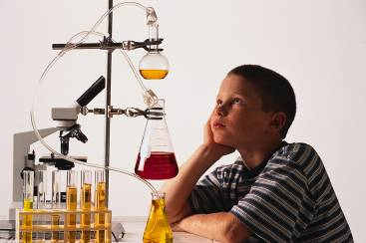
Unit 8: Stoichiometry
-- involves finding amts.
of reactants & products
in a reaction

Slide 2
What can we do with stoichiometry?
For generic equation: R_{A} + R_{B} P₁ + P₂
Given the…
…one can find the…
amount of R_{A}
(or R_{B})
amount of R_{B} (or R_{A}) that is needed to react with it
amount of R_{A}
or R_{B}
amount of P₁ or
P₂ that will be produced
amount of P₁
or P₂ you need
to produce
amount of R_{A}
and/or R_{B}
you must use

Slide 3
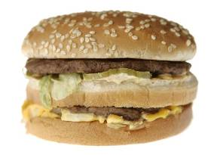
Governing Equation:
2 patties + 3 bread 1 Big Mac®
4 patties + ?
6 bread
excess + 18 bread ?
6 Big Macs®
? + ? 25 Big Macs®
50 patties
75 bread

Slide 4
Stoichiometry Island Diagram
SUBSTANCE “A”
SUBSTANCE “B”
1 mol = molar mass (in g)
1 mol = molar mass (in g)
Mass
(g)
Use coefficients from balanced equation
Mass
(g)
Volume
(L or dm³)
1 mol = 22.4 L
MOLE
(mol)
MOLE
(mol)
1 mol = 22.4 L
Volume
(L or dm³)
1 mol = 22.4 dm³
1 mol = 22.4 dm³
Particle
(at. or m’c)
Particle
(at. or m’c)
1 mol = 6.02 x 10²³ particles
1 mol = 6.02 x 10²³ particles

Slide 5
2
4
3
2
1
2
__TiO₂ + __Cl₂ + __C __TiCl₄ + __CO₂ + __CO
How many mol chlorine will react with 4.55 mol carbon?
(
)
4 mol Cl₂
4.55 mol C
= 6.07 mol Cl₂
C
Cl₂
3 mol C
What mass titanium (IV) oxide will react with 4.55 mol carbon?
(
)
(
)
2 mol TiO₂
79.9 g TiO₂
4.55 mol C
C
TiO₂
3 mol C
1 mol TiO₂
= 242 g TiO₂

Slide 6
How many molecules titanium (IV) chloride can be made
from 115 g titanium (IV) oxide?
1 mol
1 mol
1 mol
coeff.
1 mol
1 mol
1 mol
TiO₂
TiCl₄
(
)
(
)
(
)
1 mol TiO₂
2 mol TiCl₄
6.02 x 10²³ m’c TiCl₄
115 g TiO₂
79.9 g TiO₂
2 mol TiO₂
1 mol TiCl₄
= 8.7 x 10²³ m’c TiCl₄
Island Diagram helpful reminders:
2. The middle bridge conversion factor is the only one
that has two different substances in it. The conversion
factors for the other six bridges have the same
substance in both the numerator and denominator.
3. The units on the islands at each end of the bridge being
crossed appear in the conversion factor for that bridge.
1. Use coefficients from the equation only when crossing
the middle bridge. The other six bridges always have
“1 mol” before a substance’s formula.

Slide 7
2 Ir + Ni₃P₂ 3 Ni + 2 IrP
If 5.33 x 10²⁸ m’cules nickel (II) phosphide
react w/excess iridium, what mass iridium (III)
phosphide is produced?
Ni₃P₂
IrP
(
)
(
)
(
)
5.33 x 10²⁸ m’c Ni₃P₂
1 mol Ni₃P₂
2 mol IrP
223.2 g IrP
6.02 x 10²³ m’c Ni₃P₂
1 mol Ni₃P₂
1 mol IrP
= 3.95 x 10⁷ g IrP
How many grams iridium will react with
465 grams nickel (II) phosphide?
Ni₃P₂
Ir
(
)
(
)
(
)
465 g Ni₃P₂
1 mol Ni₃P₂
2 mol Ir
192.2 g Ir
238.1 g Ni₃P₂
1 mol Ni₃P₂
1 mol Ir
= 751 g Ir

Slide 8
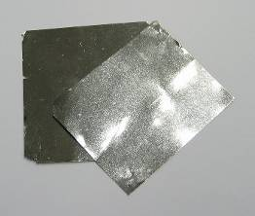
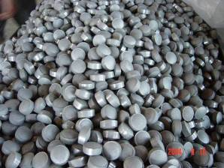
2 Ir + Ni₃P₂ 3 Ni + 2 IrP
How many moles of nickel are produced
if 8.7 x 10²⁵ atoms of iridium are consumed?
Ir
Ni
(
)
(
)
8.7 x 10²⁵ at. Ir
1 mol Ir
3 mol Ni
6.02 x 10²³ at. Ir
2 mol Ir
= 217 mol Ni
iridium (Ir)
nickel (Ni)

Slide 9
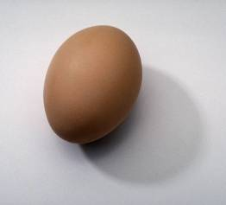
What volume hydrogen gas is liberated
(at STP) if 50 g zinc react w/excess
hydrochloric acid (HCl)?
Zn
H₂
1
2
1
1
__ Zn + __ HCl
__ H₂
+ __ ZnCl₂
50 g
excess
X L
(
)
(
)
(
)
50 g Zn
1 mol Zn
1 mol H₂
22.4 L H₂
65.4 g Zn
1 mol Zn
1 mol H₂
= 17.1 L H₂

Slide 10
At STP, how many m’cules oxygen react
with 632 dm³ butane (C₄H₁₀)?
C₄H₁₀
O₂
1
4
5
2
13
8
10
__ C₄H₁₀ + __ O₂
__ CO₂ + __ H₂O
(
)
(
)
(
)
632 dm³ C₄H₁₀
1 mol C₄H₁₀
13 mol O₂
6.02 x 10²³ m’c O₂
22.4 dm³ C₄H₁₀
2 mol C₄H₁₀
1 mol O₂
= 1.10 x 10²⁶ m’c O₂
Suppose the question had been “how many ATOMS of O₂…”
(
)
1.10 x 10²⁶ m’c O₂
2 atoms O
= 2.20 x 10²⁶ at. O
1 m’c O₂

Slide 11
Energy and Stoichiometry
CH₄(g) + 2 O₂(g) CO₂(g) + 2 H₂O(g) + 891 kJ
A balanced eq. gives the ratios of moles-to-moles
AND moles-to-energy.
E
CH₄
E
How many kJ of energy are released
when 54 g methane are burned?
(
)
(
)
54 g CH₄
1 mol CH₄
891 kJ
= 3007 kJ
16 g CH₄
1 mol CH₄

Slide 12
CH₄(g) + 2 O₂(g) CO₂(g) + 2 H₂O(g) + 891 kJ
At STP, what volume oxygen is consumed
in producing 5430 kJ of energy?
E
E
O₂
(
)
(
)
5430 kJ
2 mol O₂
22.4 L O₂
= 273 L O₂
891 kJ
1 mol O₂
What mass of water is made if
10,540 kJ are released?
E
E
H₂O
(
)
(
)
10,540 kJ
2 mol H₂O
18 g H₂O
= 426 g H₂O
891 kJ
1 mol H₂O

Slide 13
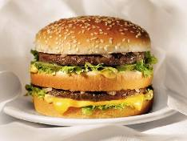
The Limiting Reactant
A balanced equation for making
a Big Mac® might be:
3 B + 2 M + EE B₃M₂EE
With…
…and…
…one can make…
30 M
excess B and excess EE
15 B₃M₂EE
30 B
excess M and excess EE
10 B₃M₂EE
30 M
30 B and excess EE
10 B₃M₂EE

Slide 14
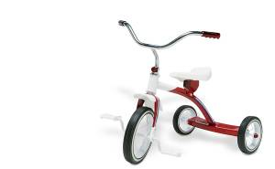
A balanced equation for making
a tricycle might be:
3 W + 2 P + S + H + F W₃P₂SHF
With…
…and…
…one can make…
50 P
excess of all other reactants
25 W₃P₂SHF
50 S
excess of all other reactants
50 W₃P₂SHF
50 P
50 S + excess of all other reactants
25 W₃P₂SHF

Slide 15
Solid aluminum reacts w/chlorine gas to yield solid
aluminum chloride.
2 Al(s) + 3 Cl₂(g) 2 AlCl₃(s)
If 125 g aluminum react w/excess chlorine,
how many g aluminum chloride are made?
Al
AlCl₃
(
)
(
)
(
)
125 g Al
1 mol Al
2 mol AlCl₃
133.5 g AlCl₃
27 g Al
2 mol Al
1 mol AlCl₃
= 618 g AlCl₃
If 125 g chlorine react w/excess aluminum,
how many g aluminum chloride are made?
Cl₂
AlCl₃
(
)
(
)
(
)
125 g Cl₂
1 mol Cl₂
2 mol AlCl₃
133.5 g AlCl₃
71 g Cl₂
3 mol Cl₂
1 mol AlCl₃
= 157 g AlCl₃

Slide 16
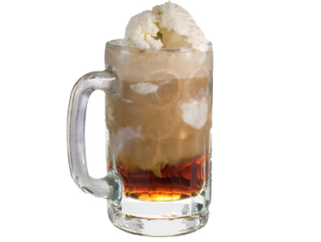
2 Al(s) + 3 Cl₂(g) 2 AlCl₃(s)
If 125 g aluminum react w/125 g chlorine,
how many g aluminum chloride are made?
157 g AlCl₃
(We’re out of Cl₂.)
limiting reactant (LR): the reactant that runs out first
--
amount of product is based on LR
Any reactant you don’t run out
of is an excess reactant (ER).
In a root beer float, the LR
is usually the ice cream.
(What’s the product?)
Your enjoyment!

Slide 17
With…
…and…
…one can make…
30 M
30 B and excess EE
10 B₃M₂EE
50 P
50 S + excess of all other reactants
25 W₃P₂SHF
125 g Al
125 g Cl₂
157 g AlCl₃
From Examples Above…
Limiting Reactant
Excess Reactant(s)
Big Macs
B
M, EE
tricycles
P
W, S, H, F
Al / Cl₂ / AlCl₃
Cl₂
Al

Slide 18
How to Find the Limiting Reactant
For the generic reaction
R_{A} + R_{B} P,
assume that the amounts
of R_{A} and R_{B} are given.
Should you use R_{A} or R_{B}
in your calculations?
1. Calc. # of mol of R_{A} and R_{B} you have.
2. Divide by the respective coefficients in
balanced equation.
3. Reactant having the smaller
result is the LR.

Slide 19
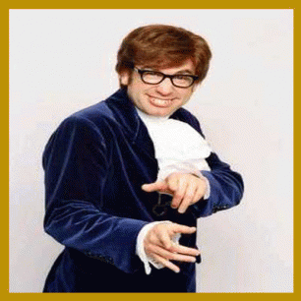
For the Al / Cl₂ / AlCl₃ example:
2 Al(s) + 3 Cl₂(g) 2 AlCl₃(s)
(
)
.
_
125 g Al
1 mol Al
= 4.63 mol Al
(HAVE)
.
2
= 2.31
27 g Al
(
)
.
125 g Cl₂
1 mol Cl₂
_
LR
= 1.76 mol Cl₂
(HAVE)
.
3
= 0.58
71 g Cl₂
Step #2
Step #1
Step #3
“Oh, bee- HAVE !”
(And start every calc. with the LR.)

Slide 20
2 Fe(s) + 3 Cl₂(g) 2 FeCl₃(s)
223 g Fe 179 L Cl₂
Which is the limiting reactant: Fe or Cl₂?
(
)
.
_
LR
223 g Fe
1 mol Fe
= 4.0 mol Fe
(HAVE)
.
2
= 2.0
55.8 g Fe
= Fe
(
)
.
179 L Cl₂
1 mol Cl₂
_
= 8.0 mol Cl₂
(HAVE)
.
3
= 2.66
22.4 L Cl₂
How many g FeCl₃ are produced?
(“Oh, bee-HAVE!”)
Fe
FeCl₃
(
)
(
)
4.0 mol Fe
2 mol FeCl₃
162.3 g FeCl₃
= 649 g FeCl₃
2 mol Fe
1 mol FeCl₃

Slide 21
2 H₂(g) + O₂(g) 2 H₂O(g)
13 g H₂ 80 g O₂
Which is LR: H₂ or O₂?
(
)
.
_
13 g H₂
1 mol H₂
.
= 3.25
= 6.5 mol H₂
(HAVE)
2
2 g H₂
(
)
.
80 g O₂
1 mol O₂
_
LR
.
1
= 2.50
= 2.5 mol O₂
(HAVE)
32 g O₂
= O₂
How many g H₂O are formed?
(“Oh, bee-HAVE!”)
O₂
H₂O
(
)
(
)
2.5 mol O₂
2 mol H₂O
18 g H₂O
= 90 g H₂O
1 mol O₂
1 mol H₂O

Slide 22
How many g O₂ are left over?
zero; O₂ is the LR and
therefore is all used up
How many g H₂ are left over?
We know how much H₂ we started with (i.e., 13 g).
To find how much is left over, we first need to figure
out how much was USED UP in the reaction.
(
)
(
)
O₂
H₂
2.5 mol O₂
2 mol H₂
2 g H₂
= 10 g H₂ used up
1 mol O₂
1 mol H₂
Started with 13 g, used up 10 g…
3 g H₂ left over

Slide 23
2 Fe(s) + 3 Br₂(g) 2 FeBr₃(s)
181 g Fe 96.5 L Br₂
Find LR.
(
)
.
_
181 g Fe
1 mol Fe
= 3.24 mol Fe
(HAVE)
.
2
= 1.62
55.8 g Fe
(
)
LR
.
96.5 L Br₂
1 mol Br₂
_
= 4.31 mol Br₂
(HAVE)
.
3
= 1.44
22.4 L Br₂
= Br₂
How many g FeBr₃ are formed?
(“Oh, bee-HAVE!”)
Br₂
FeBr₃
(
)
(
)
4.31 mol Br₂
2 mol FeBr₃
295.5 g FeBr₃
= 849 g FeBr₃
3 mol Br₂
1 mol FeBr₃

Slide 24
2 Fe(s) + 3 Br₂(g) 2 FeBr₃(s)
181 g Fe 96.5 L Br₂
How many g of the ER are left over?
(
)
(
)
Br₂
Fe
4.31 mol Br₂
2 mol Fe
55.8 g Fe
= 160 g Fe
used up
3 mol Br₂
1 mol Fe
Started with 181 g, used up 160 g…
21 g Fe left over

Slide 25
Al³⁺
O^{2–}
Percent Yield
Na¹⁺
O^{2–}
solid
aluminum
oxide
solid
sodium
oxide
molten
sodium
solid
aluminum
6
+ Al₂O₃(s)
1
2
+ Na₂O(s)
Na(l)
Al(l)
3
Find mass of aluminum produced if you start ^{w}/575 g sodium
and 357 g aluminum oxide.
(
)
.
_
575 g Na
.
= 4.17
1 mol
= 25 mol Na
(HAVE)
6
23 g
(
)
.
_
LR
357 g Al₂O₃
1 mol
= 3.5 mol Al₂O₃
(HAVE)
.
1
= 3.5
102 g
(
)
(
)
Al₂O₃
Al
3.5 mol Al₂O₃
2 mol Al
27 g Al
= 189 g Al
1 mol Al₂O₃
1 mol Al

Slide 26
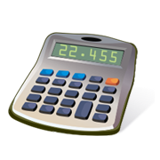
189 g
This amt. of product (______)
is the theoretical yield.
--
--
amt. we get if reaction is perfect
found by calculation
Now suppose that we perform
this reaction and get only 172
grams of aluminum. Why?
--
--
--
couldn’t collect all Al
not all Na and Al₂O₃ reacted
some reactant or product spilled and was lost

Slide 27
--
% yield can never be > 100%.
Find % yield for previous problem.
= 91.0%

Slide 28
Reaction that powers space shuttle is:
2 H₂(g) + O₂(g) 2 H₂O(g) + 572 kJ
From 100 g hydrogen and 640 g oxygen, what amount of
energy is possible?
(
)
.
_
100 g H₂
1 mol H₂
.
2
= 25
= 50 mol H₂
(HAVE)
2 g H₂
(
)
.
640 g O₂
1 mol O₂
_
LR
.
1
= 20
= 20 mol O₂
(HAVE)
32 g O₂
E
O₂
E
(
)
20 mol O₂
572 kJ
= 11,440 kJ
1 mol O₂

Slide 29
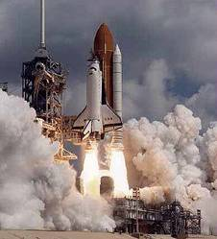
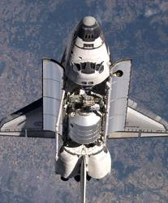
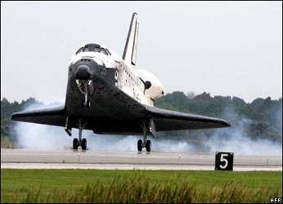
2 H₂(g) + O₂(g) 2 H₂O(g) + 572 kJ
What mass of excess reactant is left over?
(
)
(
)
O₂
H₂
20 mol O₂
2 mol H₂
2 g H₂
= 80 g H₂
used up
1 mol O₂
1 mol H₂
Started with 100 g, used up 80 g…
20 g H₂ left over

Slide 30
On NASA spacecraft, lithium hydroxide “scrubbers” remove
toxic CO₂ from cabin.
CO₂(g) + 2 LiOH(s) Li₂CO₃(s) + H₂O(l)
For a seven-day mission, each of four individuals exhales
880 g CO₂ daily. If reaction is 75% efficient, how many g LiOH
should be brought along?
(
)
880 g CO₂
x (4 p) x (7 d)
= 24,640 g CO₂
person-day
CO₂
LiOH
(
)
(
)
(
)
24,640 g CO₂
1 mol CO₂
2 mol LiOH
23.9 g LiOH
44 g CO₂
1 mol CO₂
1 mol LiOH
(Need more
than this!)
(if reaction
is perfect)
= 26,768 g LiOH
.
= 35,700 g LiOH
_
.
( 0.75)
REALITY: TAKE 100,000 g

Slide 31
Automobile air bags inflate with nitrogen via the decomposition
of sodium azide:
2 NaN₃(s) 3 N₂(g) + 2 Na(s)
At STP and a % yield of 85%, what mass sodium azide
is needed to yield 74 L nitrogen?
Shoot for…
74 L
= 87.1 L N₂
.
_
.
( 0.85)
N₂
NaN₃
(
)
(
)
(
)
87.1 L N₂
1 mol N₂
2 mol NaN₃
65 g NaN₃
= 169 g
NaN₃
22.4 L N₂
3 mol N₂
1 mol NaN₃
Conceptual question (How would you do it?)
__C₃H₈ + __O₂ __CO₂ + __H₂O + __kJ
X g Y g ? kJ
Strategy: 1.
2.
Find LR.
E
Calc. ? kJ.
LR
E

Slide 32
B₂H₆ + 3 O₂ B₂O₃ + 3 H₂O
10 g 30 g X g
(
)
.
_
10 g B₂H₆
1 mol
= 0.362 mol B₂H₆
(HAVE)
.
1
= 0.362
27.6 g
(
)
.
30 g O₂
1 mol
_
LR
= 0.938 mol O₂
(HAVE)
.
3
= 0.313
32 g
O₂
B₂O₃
(
)
(
)
0.938 mol O₂
1 mol B₂O₃
69.6 g B₂O₃
= 21.8 g B₂O₃
3 mol O₂
1 mol B₂O₃

Slide 33
2
3
2
2
___ZnS + ___O₂ ___ZnO + ___SO₂
100 g 100 g X g (assuming
81% yield)
Strategy: 1.
2.
3.
Balance and find LR.
Use LR to calc. X g ZnO (theo. yield)
Actual yield is 81% of theo. yield.
(
)
.
_
LR
100 g ZnS
1 mol
= 1.026 mol ZnS
(HAVE)
.
2
= 0.513
97.5 g
(
)
.
100 g O₂
1 mol
_
= 3.125 mol O₂
(HAVE)
.
3
= 1.042
32 g
(
)
(
)
ZnS
ZnO
1.026 mol ZnS
2 mol ZnO
81.4 g ZnO
= 83.5 g ZnO
2 mol ZnS
1 mol ZnO
Actual g ZnO = 83.5 (0.81)
= 68 g ZnO

Slide 34
2
1
2
1
___Al + ___Fe₂O₃ ___Fe + ___Al₂O₃
X g X g 800 g needed **Rxn. has an
80% yield.
Shoot for…
800 g Fe
= 1000 g Fe
.
_
.
( 0.80)
Fe
Al
(
)
(
)
(
)
1000 g Fe
1 mol Fe
2 mol Al
27 g Al
= 484 g
Al
55.8 g Fe
2 mol Fe
1 mol Al
Fe
Fe₂O₃
(
)
(
)
(
)
1000 g Fe
1 mol Fe
1 mol Fe₂O₃
159.6 g Fe₂O₃
= 1430 g
Fe₂O₃
55.8 g Fe
2 mol Fe
1 mol Fe₂O₃

Slide 36
0
0

