Slide 1
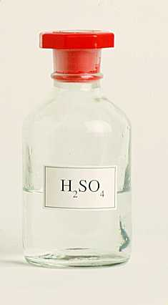
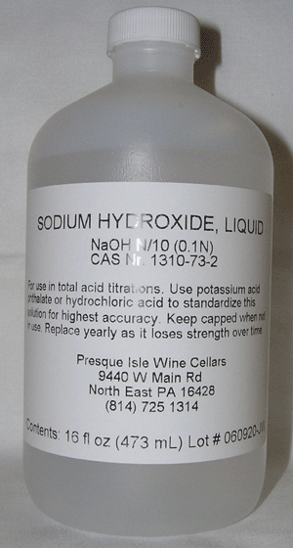
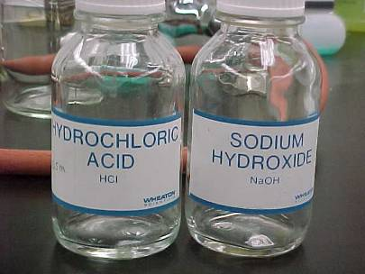
Unit 11: Equilibrium / Acids and Bases
reversible reaction: R P and P R
Acid dissociation is a reversible reaction.
H₂SO₄ 2 H¹⁺ + SO₄^{2–}

Slide 2
equilibrium:
rate at which
R P
rate at which
P R
=
-- looks like nothing is happening, however…
system is dynamic, NOT static
--
equilibrium does NOT mean “half this & half that”

Slide 3
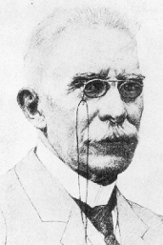
Le Chatelier’s principle:
When a system at equilibrium is
disturbed, it shifts to a new equili-
brium that counteracts the disturbance.
N₂(g) + 3 H₂(g) 2 NH₃(g)
Disturbance Equilibrium Shift
Add more N₂………………
Add more H₂………………
Add more NH₃…………….
Remove NH₃………………
Add a catalyst……………..
no shift
Increase pressure…………

Slide 4
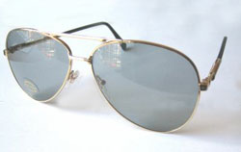
Light-Darkening Eyeglasses
AgCl + energy Agº + Clº
(clear)
(dark)
Go outside…
Sunlight more intense than inside light;
“energy”
shift to a new equilibrium:
GLASSES
DARKEN
Then go inside…
“energy”
shift to a new equilibrium:
GLASSES
LIGHTEN

Slide 5
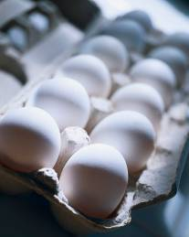
In a chicken…
CaO + CO₂ CaCO₃
(eggshells)
In summer, [ CO₂ ] in a chicken’s
blood due to panting.
--
shift ;
eggshells are thinner
How could we increase eggshell thickness in summer?
--
give chickens carbonated water
[ CO₂ ] , shift
--
put CaO additives in chicken feed
[ CaO ] , shift

Slide 6
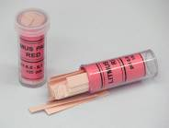
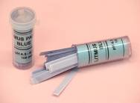
Acids and Bases
litmus paper
pH
< 7
pH
> 7
sour
bitter
taste ______
taste ______
bases
acids
react with ______
react with ______
proton (H¹⁺) donor
proton (H¹⁺) acceptor
turn litmus
red
turn litmus
blue
lots of H¹⁺/H₃O¹⁺
lots of OH^{1–}
react w/metals
don’t react w/metals
Both are electrolytes.
(they conduct electricity in soln)

Slide 7












pH scale: measures acidity/basicity
ACID
BASE
0 1 2 3 4 5 6 7 8 9 10 11 12 13 14
NEUTRAL
10
Each step on pH scale represents a factor of ___.
pH 5 vs. pH 6
10
(___X more acidic)
pH 3 vs. pH 5 (_______X different)
100
100,000
pH 8 vs. pH 13 (_______X different)

Slide 8
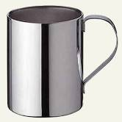
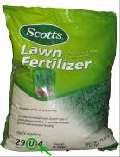
Common Acids
Strong Acids
(dissociate ~100%)
hydrochloric acid: HCl H¹⁺ + Cl^{1–}
--
stomach acid;
pickling: cleaning metals ^{w}/conc. HCl
sulfuric acid: H₂SO₄ 2 H¹⁺ + SO₄^{2–}
--
#1 chemical;
(auto) battery acid
nitric acid: HNO₃ H¹⁺ + NO₃^{1–}
--
explosives;
fertilizer

Slide 9
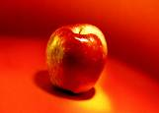

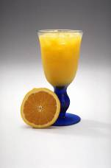
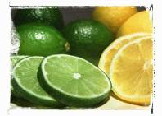

Common Acids (cont.)
Weak Acids
(dissociate very little)
acetic acid: CH₃COOH H¹⁺ + CH₃COO^{1–}
--
vinegar; naturally made by apples
hydrofluoric acid: HF H¹⁺ + F^{1–}
--
used to etch glass
citric acid, H₃C₆H₅O₇
--
lemons or limes; sour candy
ascorbic acid, H₂C₆H₆O₆
--
vitamin C
lactic acid, CH₃CHOHCOOH
--
waste product of muscular exertion

Slide 10
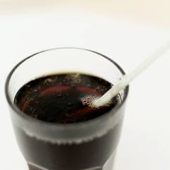

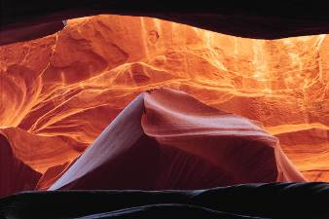
carbonic acid, H₂CO₃
-- carbonated beverages
--
CO₂ + H₂O H₂CO₃
rainwater
H₂CO₃: beverage carbonation
in air
dissolves
limestone
(CaCO₃)
H₂CO₃: cave formation
H₂CO₃: natural acidity of lakes

Slide 11
Dissociation and Ion Concentration
Strong acids or bases dissociate ~100%.
For “strongs,” we
often use two arrows
of differing length
OR
just a single arrow.
HNO₃ H¹⁺ + NO₃^{1–}
HNO₃ H¹⁺ + NO₃^{1–}
NO₃^{1–}
+
NO₃^{1–}
H¹⁺
H¹⁺
1
1
+
1
2
2
+
2
100
100
+
100
1000/L
1000/L
+
1000/L
0.0058 M
0.0058 M
+
0.0058 M

Slide 12
HCl
H¹⁺ + Cl^{1–}
monoprotic
acid
4.0 M
4.0 M
+
4.0 M
H₂SO₄
2 H¹⁺ + SO₄^{2–}
H¹⁺
diprotic
acid
SO₄^{2–}
+
SO₄^{2–}
H¹⁺
H¹⁺
H¹⁺
2.3 M
4.6 M
+
2.3 M
Ca(OH)₂
Ca²⁺
+
2 OH^{1–}
0.025 M
0.025 M
+
0.050 M

Slide 13
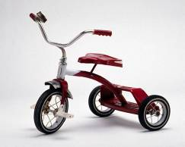
pH Calculations
Recall that the hydronium ion (H₃O¹⁺) is the species
formed when hydrogen ion (H¹⁺) attaches to water
(H₂O). OH^{1–} is the hydroxide ion.
The number of
front wheels is the
same as the number
of trikes…
H¹⁺
H₃O¹⁺
…so whether we’re counting front wheels (i.e., H¹⁺)
or trikes (i.e., H₃O¹⁺) doesn’t much matter.
For this class, in any aqueous sol’n,
[ H₃O¹⁺ ] [ OH^{1–} ] = 1 x 10^{–14}
( or [ H¹⁺ ] [ OH^{1–} ] = 1 x 10^{–14} )

Slide 14
If hydronium ion concentration = 4.5 x 10^{–9} M,
find hydroxide ion concentration.
[ H₃O¹⁺ ] [ OH^{1–} ] = 1 x 10^{–14}
–
.
–
1
EE
1
4
–
4
.
5
EE
9
=
.
= 2.2 x 10^{–6} M
10^{x}
2.2^{–6} M
y^{x}
= 0.0000022 M

Slide 15
Given: Find:
A. [ OH^{1–} ] = 5.25 x 10^{–6} M [ H¹⁺ ] = 1.90 x 10^{–9} M
B. [ OH^{1–} ] = 3.8 x 10^{–11} M [ H₃O¹⁺ ] = 2.6 x 10^{–4} M
C. [ H₃O¹⁺ ] = 1.8 x 10^{–3} M [ OH^{1–} ] = 5.6 x 10^{–12} M
D. [ H¹⁺ ] = 7.3 x 10^{–12} M [ H₃O¹⁺ ] = 7.3 x 10^{–12} M
Find the pH of each sol’n above.
pH = –log [ H₃O¹⁺ ] ( or pH = –log [ H¹⁺ ] )
A.
pH = –log [ H₃O¹⁺ ]
= –log [1.90 x 10^{–9} M ]
–
log
1
.
9
EE
–
9
=
8.72
B.
3.59
C.
2.74
D.
11.13

Slide 16
A few last equations…
[ H₃O¹⁺ ] = 10^{–pH}
( or [ H¹⁺ ] = 10^{–pH} )
pOH = –log [ OH^{1–} ]
pH + pOH = 14
[ OH^{1–} ] = 10^{–pOH}
[ H₃O¹⁺ ] = 10^{–pH}
pH
[ H₃O¹⁺ ]
pH = –log [ H₃O¹⁺ ]
pH + pOH = 14
[ H₃O¹⁺ ] [ OH^{1–} ] = 1 x 10^{–14}
[ OH^{1–} ] = 10^{–pOH}
pOH
[ OH^{1–} ]
pOH = –log [ OH^{1–} ]

Slide 17
[ H₃O¹⁺ ] = 10^{–pH}
[ H₃O¹⁺ ] = 10^{–pH}
pH
pH
[ H₃O¹⁺ ]
[ H₃O¹⁺ ]
pH = –log [ H₃O¹⁺ ]
If pH = 4.87,
find [ H₃O¹⁺ ].
pH = –log [ H₃O¹⁺ ]
pH + pOH = 14
pH + pOH = 14
[ H₃O¹⁺ ] [ OH^{1–} ] = 1 x 10^{–14}
[ H₃O¹⁺ ] [ OH^{1–} ] = 1 x 10^{–14}
[ H₃O¹⁺ ] = 10^{–pH}
[ OH^{1–} ] = 10^{–pOH}
= 10^{–4.87}
[ OH^{1–} ] = 10^{–pOH}
pOH
pOH
[ OH^{1–} ]
[ OH^{1–} ]
pOH = –log [ OH^{1–} ]
pOH = –log [ OH^{1–} ]
On a graphing calculator…
2nd
log
–
4
.
8
7
=
10^{x}
[ H₃O¹⁺ ] = 1.35 x 10^{–5} M

Slide 18
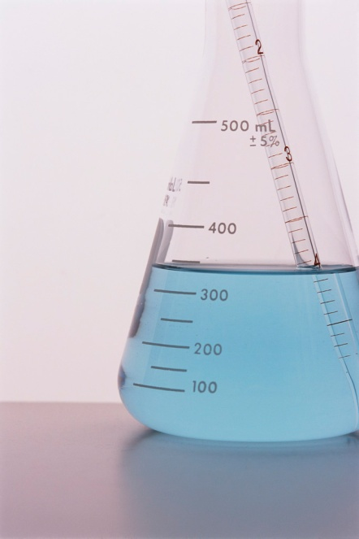
If [ OH^{1–} ] = 5.6 x 10^{–11} M,
find pH.
[ H₃O¹⁺ ] = 10^{–pH}
[ H₃O¹⁺ ] = 10^{–pH}
pH
pH
[ H₃O¹⁺ ]
[ H₃O¹⁺ ]
pH = –log [ H₃O¹⁺ ]
pH = –log [ H₃O¹⁺ ]
pH + pOH = 14
pH + pOH = 14
[ H₃O¹⁺ ] [ OH^{1–} ] = 1 x 10^{–14}
[ H₃O¹⁺ ] [ OH^{1–} ] = 1 x 10^{–14}
[ OH^{1–} ] = 10^{–pOH}
[ OH^{1–} ] = 10^{–pOH}
pOH
pOH
[ OH^{1–} ]
[ OH^{1–} ]
pOH = –log [ OH^{1–} ]
pOH = –log [ OH^{1–} ]
Find [ H₃O¹⁺ ]
= 1.79 x 10^{–4} M
Find pOH
= 10.25
Then find pH…
pH = 3.75
pH = 3.75

Slide 19
For the following problems, assume 100% dissociation.
Find pH of a 0.00057 M nitric acid (HNO₃) sol’n.
HNO₃
H¹⁺ + NO₃^{1–}
0.00057 M
0.00057 M
0.00057 M
(GIVEN)
(affects pH)
(“Who cares?”)
[ H₃O¹⁺ ] = 10^{–pH}
[ H₃O¹⁺ ] = 10^{–pH}
pH
pH
[ H₃O¹⁺ ]
[ H₃O¹⁺ ]
pH = –log [ H₃O¹⁺ ]
pH = –log [ H₃O¹⁺ ]
pH = –log [ H₃O¹⁺ ]
= –log (0.00057)
pH + pOH = 14
pH + pOH = 14
[ H₃O¹⁺ ] [ OH^{1–} ] = 1 x 10^{–14}
[ H₃O¹⁺ ] [ OH^{1–} ] = 1 x 10^{–14}
= 3.24
[ OH^{1–} ] = 10^{–pOH}
[ OH^{1–} ] = 10^{–pOH}
pOH
pOH
[ OH^{1–} ]
[ OH^{1–} ]
pOH = –log [ OH^{1–} ]
pOH = –log [ OH^{1–} ]

Slide 20
Find pH of a 3.2 x 10^{–5} M barium hydroxide (Ba(OH)₂)
sol’n.
Ba(OH)₂
Ba²⁺ + 2 OH^{1–}
3.2 x 10^{–5} M
3.2 x 10^{–5} M
6.4 x 10^{–5} M
(GIVEN)
(“Who cares?”)
(affects pH)
[ H₃O¹⁺ ] = 10^{–pH}
[ H₃O¹⁺ ] = 10^{–pH}
pH
pH
[ H₃O¹⁺ ]
[ H₃O¹⁺ ]
pH = –log [ H₃O¹⁺ ]
pH = –log [ H₃O¹⁺ ]
pOH = –log [ OH^{1–} ]
= –log (6.4 x 10^{–5})
pH + pOH = 14
pH + pOH = 14
[ H₃O¹⁺ ] [ OH^{1–} ] = 1 x 10^{–14}
[ H₃O¹⁺ ] [ OH^{1–} ] = 1 x 10^{–14}
= 4.19
pH = 9.81
[ OH^{1–} ] = 10^{–pOH}
[ OH^{1–} ] = 10^{–pOH}
pOH
pOH
[ OH^{1–} ]
[ OH^{1–} ]
pOH = –log [ OH^{1–} ]
pOH = –log [ OH^{1–} ]

Slide 21
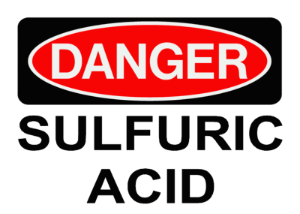
Find the concentration of an H₂SO₄ sol’n ^{w}/pH 3.38.
H₂SO₄
2 H¹⁺ + SO₄^{2–}
X M
4.2 x 10^{–4} M
(“Who cares?”)
(space)
2.1 x 10^{–4} M
[ H¹⁺ ] = 10^{–pH}
= 10^{–3.38}
= 4.2 x 10^{–4} M
[ H₃O¹⁺ ] = 10^{–pH}
[ H₃O¹⁺ ] = 10^{–pH}
[ H₂SO₄ ] =
2.1 x 10^{–4} M
pH
pH
[ H₃O¹⁺ ]
[ H₃O¹⁺ ]
pH = –log [ H₃O¹⁺ ]
pH = –log [ H₃O¹⁺ ]
pH + pOH = 14
pH + pOH = 14
[ H₃O¹⁺ ] [ OH^{1–} ] = 1 x 10^{–14}
[ H₃O¹⁺ ] [ OH^{1–} ] = 1 x 10^{–14}
[ OH^{1–} ] = 10^{–pOH}
[ OH^{1–} ] = 10^{–pOH}
pOH
pOH
[ OH^{1–} ]
[ OH^{1–} ]
pOH = –log [ OH^{1–} ]
pOH = –log [ OH^{1–} ]

Slide 22
Find pH of a sol’n with 3.65 g HCl in 2.00 dm³ of sol’n.
HCl
H¹⁺ + Cl^{1–}
(space)
0.05 M
0.05 M
0.05 M
3.65 g
[ HCl ]
= M_{HCl}
=
2.00 L
[ H₃O¹⁺ ] = 10^{–pH}
[ H₃O¹⁺ ] = 10^{–pH}
pH
= 0.05 M HCl
pH
[ H₃O¹⁺ ]
[ H₃O¹⁺ ]
pH = –log [ H₃O¹⁺ ]
pH = –log [ H₃O¹⁺ ]
pH = –log [ H¹⁺ ]
pH + pOH = 14
pH + pOH = 14
[ H₃O¹⁺ ] [ OH^{1–} ] = 1 x 10^{–14}
[ H₃O¹⁺ ] [ OH^{1–} ] = 1 x 10^{–14}
= –log (0.05)
[ OH^{1–} ] = 10^{–pOH}
[ OH^{1–} ] = 10^{–pOH}
pOH
= 1.3
pOH
[ OH^{1–} ]
[ OH^{1–} ]
pOH = –log [ OH^{1–} ]
pOH = –log [ OH^{1–} ]

Slide 23
What mass of Al(OH)₃ is req’d to make 15.6 L of a
sol’n with a pH of 10.72?
Al(OH)₃
Al³⁺ + 3 OH^{1–}
(space)
1.75 x 10^{–4} M
(“w.c.?”)
5.25 x 10^{–4} M
pOH = 3.28
[ OH^{1–} ] = 10^{–pOH}
= 10^{–3.28}
= 5.25 x 10^{–4} M
[ H₃O¹⁺ ] = 10^{–pH}
[ H₃O¹⁺ ] = 10^{–pH}
pH
pH
[ H₃O¹⁺ ]
[ H₃O¹⁺ ]
mol_{Al(OH)} = M L
pH = –log [ H₃O¹⁺ ]
pH = –log [ H₃O¹⁺ ]
3
mol = 1.75 x 10^{–4}(15.6)
pH + pOH = 14
pH + pOH = 14
[ H₃O¹⁺ ] [ OH^{1–} ] = 1 x 10^{–14}
[ H₃O¹⁺ ] [ OH^{1–} ] = 1 x 10^{–14}
= 0.00273
mol Al(OH)₃
[ OH^{1–} ] = 10^{–pOH}
[ OH^{1–} ] = 10^{–pOH}
pOH
pOH
[ OH^{1–} ]
[ OH^{1–} ]
= 0.213 g Al(OH)₃
pOH = –log [ OH^{1–} ]
pOH = –log [ OH^{1–} ]

Slide 24
Acid-Dissociation Constant, K_{a}
For the generic reaction in sol’n: A + B C + D
For strong acids, e.g., HCl…
HCl H¹⁺ + Cl^{1–}
~0
lots
lots
= “BIG.”
Assume 100% dissociation;
K_{a} not applicable for strong acids.

Slide 25
For weak acids, e.g., HF…
HF H¹⁺ + F^{1–}
lots
~0
~0
= “SMALL.”
(6.8 x 10^{–4} for HF)
K_{a}’s for other weak acids:
CH₃COOH H¹⁺ + CH₃COO^{1–}
K_{a} = 1.8 x 10^{–5}
HC₃H₅O₃ H¹⁺ + C₃H₅O₃^{1–}
K_{a} = 1.4 x 10^{–4}
HNO₂ H¹⁺ + NO₂^{1–}
K_{a} = 4.5 x 10^{–4}
The weaker the acid, the smaller the K_{a}.
“ stronger “ “ , “ larger “ “ .

Slide 26
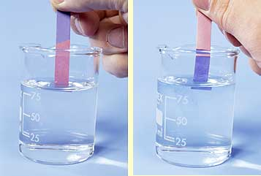
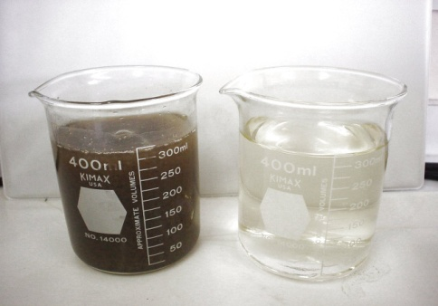
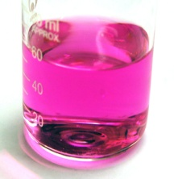
chemicals that change color,
depending on the pH
Indicators
Two examples, out of many:
litmus…………………
red in acid,
blue in base
acid
base
phenolphthalein……..
clear in acid,
pink in base
acid
base
l
p
b
o
e
ink
a
r

Slide 27
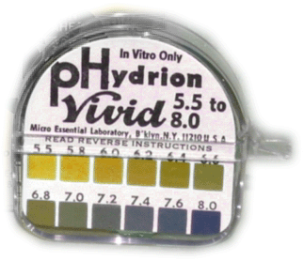
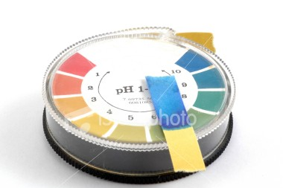
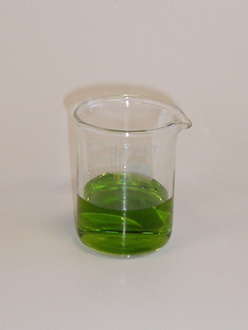
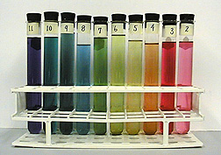
Measuring pH
litmus paper
Basically, pH < 7 or pH > 7.
phenolphthalein
pH paper -- contains a mixture of various indicators
--
each type of paper
measures a range of pH
--
pH anywhere from 0 to 14
universal indicator -- is a mixture of several indicators
--
pH 4 to 10
4 5 6 7 8 9 10
R O Y G B I V

Slide 28
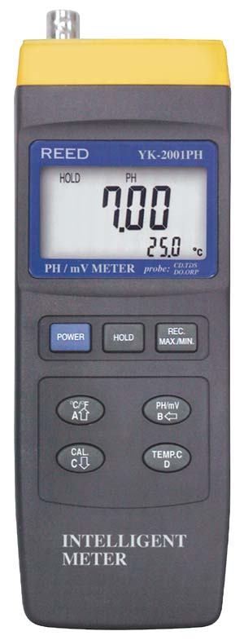
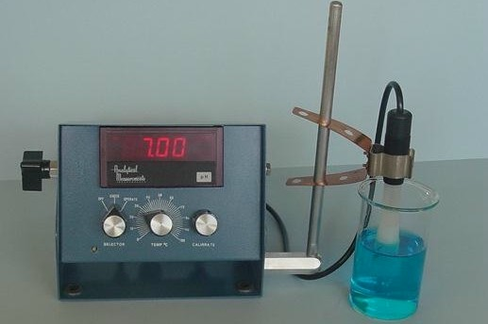
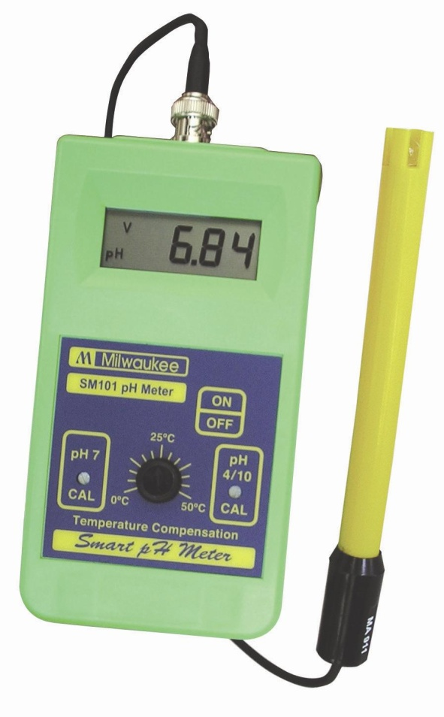
Measuring pH (cont.)
pH meter -- measures small voltages in solutions
-- calibrated to convert voltages into pH
--
precise measurement of pH

Slide 29
Neutralization Reaction
ACID + BASE SALT + WATER
1
NaCl
1
H₂O
__HCl + __NaOH ________ + ______
1
1
1
K₃PO₄
3
H₂O
__H₃PO₄ + __KOH ________ + ______
1
3
1
2
1
Na₂SO₄
2
H₂O
__H₂SO₄ + __NaOH ________ + ______
3
1
1
Al(ClO₃)₃
3
H₂O
__HClO₃ + __Al(OH)₃ ________ + ______
3
HCl
1
Al(OH)₃
1
3
H₂O
________ + ________ __AlCl₃ + ______
3
H₂SO₄
2
Fe(OH)₃
1
6
H₂O
________ + ________ __Fe₂(SO₄)₃ + ______

Slide 30
Titration
If an acid and a base are mixed together in the right
amounts, the resulting solution will be perfectly
neutralized and have a pH of 7.
-- For pH = 7……………..
mol H₃O¹⁺ = mol OH^{1–}
then mol M L.
In a titration, the above equation helps us to use…
a KNOWN conc. of acid (or base) to determine
an UNKNOWN conc. of base (or acid).

Slide 31
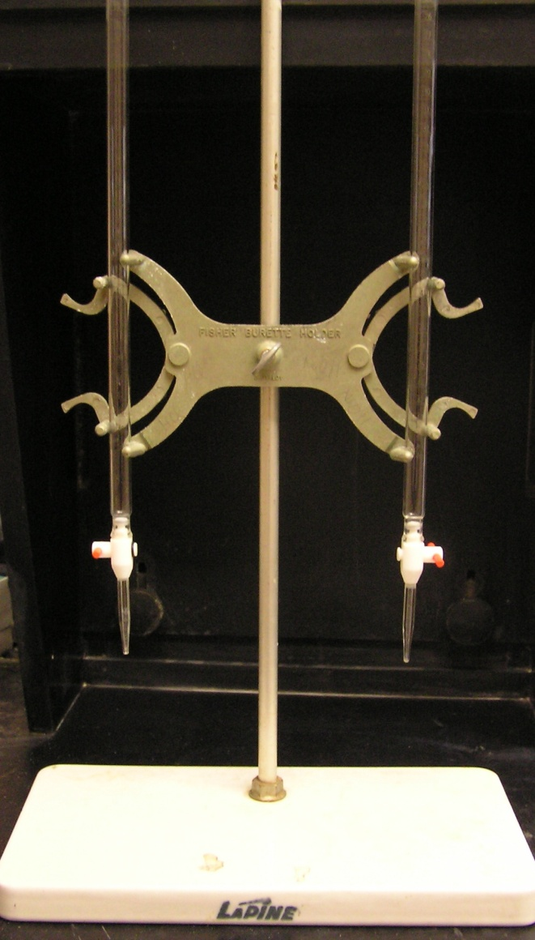
2.42 L of 0.32 M HCl are used to titrate 1.22 L of an
unknown conc. of KOH. Find the molarity of the KOH.
HCl
H¹⁺ + Cl^{1–}
0.32 M
0.32 M
KOH
K¹⁺ + OH^{1–}
X M
X M
[ H₃O¹⁺ ] V_{A} = [ OH^{1–} ] V_{B}
0.32 M
(2.42 L)
=
[ OH^{1–} ]
(1.22 L)
1.22 L
1.22 L
[ OH^{1–} ]
= M_{KOH}
= 0.63 M

Slide 32
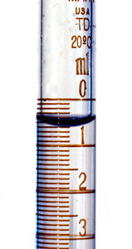
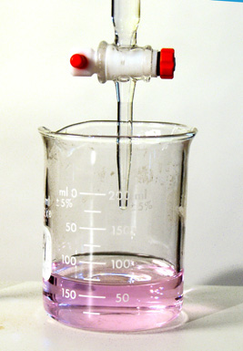
458 mL of HNO₃ (^{w}/pH = 2.87) are neutralized
^{w}/661 mL of Ba(OH)₂. What is the pH of the base?
[ H₃O¹⁺ ] V_{A} = [ OH^{1–} ] V_{B}
OK
OK
[ H₃O¹⁺ ] = 10^{–pH}
If we find this,
we can find the
base’s pH.
= 10^{–2.87}
= 1.35 x 10^{–3} M
(1.35 x 10^{–3})(458 mL) = [ OH^{1–} ] (661 mL)
[ OH^{1–} ] = 9.35 x 10^{–4} M
pOH = –log (9.35 x 10^{–4})
= 3.03
pH = 10.97

Slide 33
(NaOH)
How many L of 0.872 M sodium hydroxide will
titrate 1.382 L of 0.315 M sulfuric acid?
(H₂SO₄)
[ H₃O¹⁺ ] V_{A} = [ OH^{1–} ] V_{B}
?
?
0.630 M
(1.382 L)
=
0.872 M
(V_{B})
H₂SO₄
2 H¹⁺ + SO₄^{2–}
NaOH
Na¹⁺ + OH^{1–}
0.315 M
0.630 M
0.872 M
0.872 M
V_{B} = 0.998 L

Slide 34
Buffers
mixtures of chemicals that resist changes in pH
Example: The pH of blood is 7.4.
Many buffers are present to keep
pH stable.
H¹⁺ + HCO₃^{1–} H₂CO₃ H₂O + CO₂
hyperventilating: CO₂ leaves blood too quickly
[ CO₂ ]
[ H¹⁺ ]
shift
right
pH
(more
basic)
alkalosis: blood pH is too high (too basic)

Slide 35
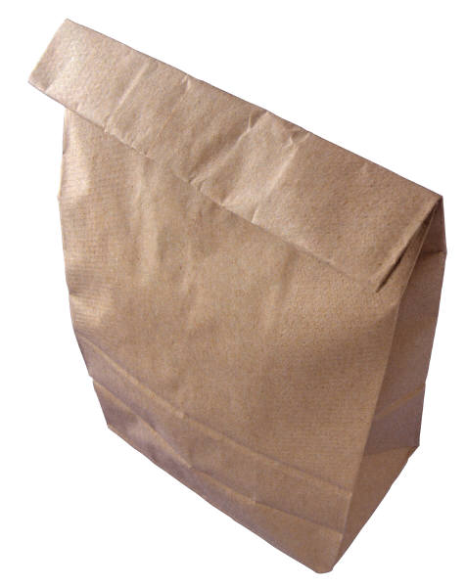
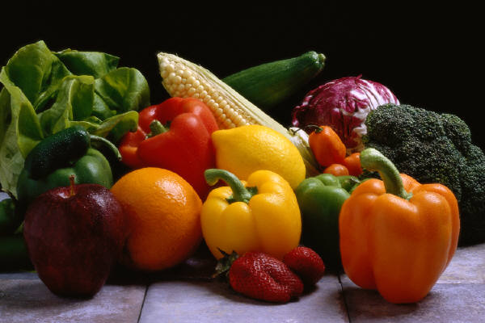
H¹⁺ + HCO₃^{1–} H₂CO₃ H₂O + CO₂
Remedy:
Breathe into bag.
[ CO₂ ]
[ H¹⁺ ]
(more acidic;
closer to normal)
shift
left
pH
acidosis: blood pH is too
low (too acidic)
Maintain blood pH with a healthy diet and regular exercise.

Slide 36
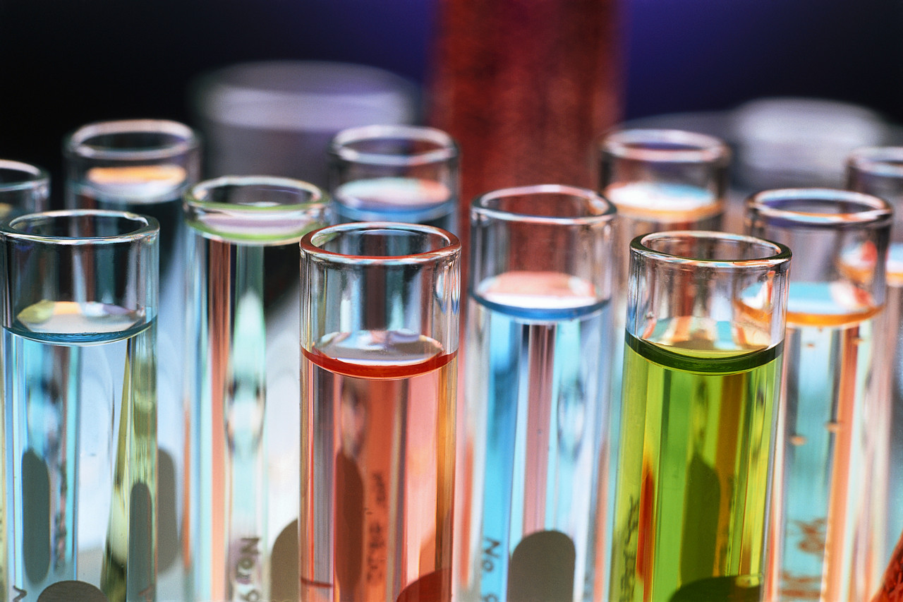
More on buffers:
-- a combination of a weak acid and a salt
-- together, these substances resist changes in pH

Slide 37
(A) weak acid: CH₃COOH CH₃COO^{1–} + H¹⁺
(lots) (little) (little)
(B) salt: NaCH₃COO Na¹⁺ CH₃COO^{1–}
+
(little) (lots) (lots)
If you add acid… (e.g., HCl H¹⁺ + Cl^{1–})
large amt. of CH₃COO^{1–} (from (B)) consumes
extra H¹⁺, so (A) goes
1.
2. **Conclusion:
pH remains relatively unchanged.
If you add base…(e.g., KOH K¹⁺ + OH^{1–})
extra OH^{1–} grabs H¹⁺ from the large amt. of
CH₃COOH and forms CH₃COO^{1–} and H₂O
1.
2. **Conclusion:
pH remains relatively unchanged.

Slide 38
Amphoteric Substances
can act as acids OR bases
e.g., NH₃
(BASE)
accepts H¹⁺
NH₂^{1–}
NH₃
NH₄¹⁺
donates H¹⁺
(ACID)
e.g., H₂O
(BASE)
accepts H¹⁺
OH^{1–}
H₂O
H₃O¹⁺
donates H¹⁺
(ACID)

Slide 39
Partial Neutralization
2.15 L of
0.22 M HCl
1.55 L of
0.26 M KOH
pH = ?
Procedure:
1. Calc. mol of substance, then mol H¹⁺ and mol OH^{1–}.
2. Subtract smaller from larger.
3. Find [ ] of what’s left over, and calc. pH.

Slide 40
2.15 L of
0.22 M HCl
1.55 L of
0.26 M KOH
mol
M
L
mol KOH =
0.26 M (1.55 L)
= 0.403 mol KOH
= 0.403 mol OH^{1–}
mol HCl =
0.22 M (2.15 L)
= 0.473 mol HCl
= 0.473 mol H¹⁺
LEFT OVER
= 0.070 mol H¹⁺
0.070 mol H¹⁺
[ H¹⁺ ] =
= 0.0189 M H¹⁺
1.55 L + 2.15 L
pH = –log [ H¹⁺ ]
= –log (0.0189)
= 1.72

Slide 41
(HCl)
4.25 L of 0.35 M hydrochloric acid is mixed ^{w}/3.80 L of
0.39 M sodium hydroxide. Find final pH. Assume
100% dissociation.
(NaOH)
mol HCl =
0.35 M (4.25 L)
= 1.4875 mol HCl
= 1.4875 mol H¹⁺
mol NaOH =
0.39 M (3.80 L)
= 1.4820 mol NaOH
= 1.4820 mol OH^{1–}
LEFT OVER
= 0.0055 mol H¹⁺
0.0055 mol H¹⁺
[ H¹⁺ ] =
= 6.83 x 10^{–4} M H¹⁺
4.25 L + 3.80 L
pH = –log [ H¹⁺ ]
= –log (6.83 x 10^{–4})
= 3.17

Slide 42
(H₂SO₄)
5.74 L of 0.29 M sulfuric acid is mixed ^{w}/3.21 L of
0.35 M aluminum hydroxide. Find final pH.
Assume 100% dissociation.
(Al(OH)₃)
mol H₂SO₄ =
0.29 M (5.74 L)
= 1.6646 mol H₂SO₄
= 3.3292 mol H¹⁺
mol Al(OH)₃ =
0.35 M (3.21 L)
= 1.1235 mol Al(OH)₃
= 3.3705 mol OH^{1–}
LEFT OVER
= 0.0413 mol OH^{1–}
0.0413 mol OH^{1–}
[ OH^{1–} ] =
= 0.00461 M OH^{1–}
5.74 L + 3.21 L
pOH = –log (0.00461)
= 2.34
pH = 11.66

Slide 43
A. 0.038 g HNO₃ in 450 mL of sol’n. Find pH.
(
1 L
)
= 0.45 L
1000 mL
mol
M
L
(
)
0.038 g HNO₃
1 mol
= 6.03 x 10^{–4} mol HNO₃
63 g
= 6.03 x 10^{–4} mol H¹⁺
6.03 x 10^{–4} mol H¹⁺
[ H¹⁺ ] =
= 1.34 x 10^{–3} M H¹⁺
0.45 L
pH = –log [ H¹⁺ ]
= –log (1.34 x 10^{–3})
= 2.87

Slide 44
B. 0.044 g Ba(OH)₂ in 560 mL of sol’n.
Find pH.
(
1 L
)
= 0.56 L
mol
1000 mL
M
L
(
)
0.044 g Ba(OH)₂
1 mol
= 2.57 x 10^{–4} mol Ba(OH)₂
171.3 g
= 5.14 x 10^{–4} mol OH^{1–}
5.14 x 10^{–4} mol OH^{1–}
[ OH^{1–} ] =
= 9.18 x 10^{–4} M OH^{1–}
0.56 L
pOH = –log (9.18 x 10^{–4})
= 3.04
pH = 10.96

Slide 45
C. Mix them. Find pH of
resulting sol’n.
From acid… 6.03 x 10^{–4} mol H¹⁺
From base… 5.14 x 10^{–4} mol OH^{1–}
LEFT OVER
= 8.90 x 10^{–5} mol H¹⁺
8.90 x 10^{–5} mol H¹⁺
[ H¹⁺ ] =
= 8.81 x 10^{–5} M H¹⁺
0.45 L + 0.56 L
pH = –log [ H¹⁺ ]
= –log (8.81 x 10^{–5})
= 4.05

Slide 46
0
0

