Slide 1
Chemistry: Half-Life of Radioactive Isotopes Introduction:
The half-life is a measure of how much time it takes for ½ of a sample of radioactive atoms to decay into stable, or non-radioactive, atoms. After one half-life passes, only ½ of the atoms are still radioactive – the other half are stable. After a second half-life passes, another ½ of the remaining radioactive atoms have decayed into stable nuclei.
Copy of LAB
(virtual lab)
UNSTABLE
Isotope
(radioactive)
STABLE
Isotope
(non-radioactive)
What is the current year?
How old are you?

Slide 2
Graph of Radioactive Decay
0 1 2 3 4
(half-life)
Each group needs 32 pennies. Place them on a desk in a 4 x 8 grid with heads up. Each heads-up penny
represents one gram of radioactive strontium-90 (sr-90), which means you will start with 32 g of radioactive
material. Each tails-up penny represents one gram of stable, non-radioactive yttrium-90 (Y-90). Sr-90 has a
half-life of 28 years.
Sr-90
KEY
Y-90

Slide 3
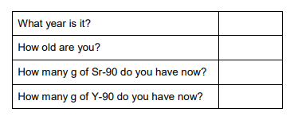
Graph of Radioactive Decay
0 1 2 3 4
(half-life)
A. One half-life passes. Turn over (to tails-up) ½ of the pennies.
Sr-90
KEY
Y-90

Slide 4
Graph of Radioactive Decay
0 1 2 3 4
(half-life)
B. Another half-life passes. Turn over (to tails-up) ½ of the remaining Sr-90.
Sr-90
KEY
Y-90

Slide 5
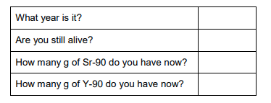
Graph of Radioactive Decay
0 1 2 3 4
(half-life)
C. Another half-life passes. Turn over the proper number of pennies.
Sr-90
KEY
Y-90

Slide 6
Graph of Radioactive Decay
0 1 2 3 4
(half-life)
D. Another half-life passes. Turn over the proper number of pennies.
Sr-90
KEY
Y-90

Slide 7
Graph of Radioactive Decay
0 1 2 3 4 5
(half-life)
E. Another half-life passes. Turn over the proper number of pennies.
Sr-90
KEY
Y-90

Slide 8
In our simulation, 32 grams of Sr-90 is equal to 220,000,000,000,000,000,000,000 pennies
(assuming each penny represents an atom of Sr-90)
More crazy calc’s:
The pennies would have
a volume of 3.74 x 10²¹ inch³
or 8 x 10¹⁶ yards³.
It would take 2.67 x 10¹⁶
pickup trucks full of pennies
to hold this many pennies.
Assuming a pickup truck can
hold 3 cubic yards of pennies.
In reality, 32 grams of Sr-90 is actually equal to 2.2 x 10²³ atoms of Sr-90.
It would take you many, many, many life times to turn over all those pennies.
A penny weighs 2.5 g. That means you would have 5.5 x 10³⁶ g of pennies of Sr-90 if you had 2.2 x 10²³ atoms of Sr-90.
That mass is equal to > 6 x 10¹⁴ kilotons [ or 605000000000000000 tons].
5,500,000,000,000,000,000,000,000,000,000,000,000 grams of pennies
In 560 years (20 half-life) you would still have 2.1 x 10¹⁷ pennies to turn over.

Slide 9
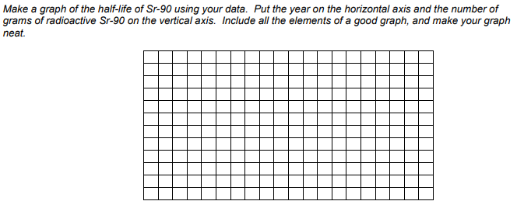

Slide 10
