Slide 1
Solubility

Slide 2
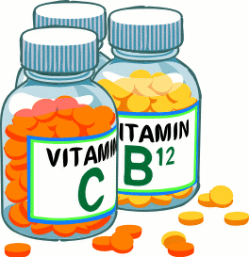
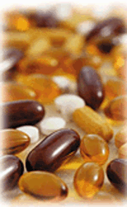
Vitamins
Multi Vitamin
  Provides many essential vitamins
  “Expensive urine”
Water Soluble
  Vitamin C
  Must be replenished regularly
Fat Soluble
  Can overdose
  Vitamin A, D, E, and K
  Can be ingested periodically, stored in body fat
Notes:
– The difference between hydrophilic and hydrophobic substances has substantial consequences in biological systems.
– Vitamins can be classified as either fat soluble or water soluble.
1. Fat-soluble vitamins are nonpolar, hydrophobic molecules and tend to be absorbed into fatty tissues and stored there. Fat-soluble vitamins are stored in the body's fatty tissue. The four fat-soluble vitamins are vitamins A, D, E, and K. These vitamins are absorbed more easily by the body in the presence of dietary fat. ... Vitamin B12 is the only water-soluble vitamin that can be stored in the liver for many years
2. Water-soluble vitamins (Vitamin C) are polar, hydrophilic molecules that circulate in the blood and intracellular fluids and are excreted from the body and must be replenished in the daily diet.

Slide 3
Molecular Polarity
H
H–C–H
nonpolar molecules:
-- e– are shared equally
H–C–H
-- tend to be symmetric
H–C–H
e.g.,
fats and oils
H–C–H
H
polar molecules:
-- e– NOT shared equally
H
H
e.g.,
water
O
“Like dissolves like.”
polar + polar = solution
nonpolar + nonpolar = solution
polar + nonpolar = suspension (won’t mix evenly)

Slide 4


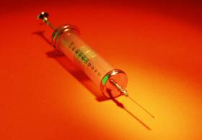


Using Solubility Principles
Chemicals used by body obey solubility principles.
-- water-soluble vitamins: e.g.,
vitamin C
-- fat-soluble vitamins: e.g.,
vitamins A & D
Anabolic steroids and HGH are
fat-soluble, synthetic hormones.

Slide 5

Using Solubility Principles (cont.)
Dry cleaning employs nonpolar liquids.
-- polar liquids damage wool, silk
-- also, dry clean for stubborn stains
(ink, rust, grease)
-- tetrachloroethylene was in longtime use
Cl
Cl
C=C
Cl
Cl

Slide 6
emulsifying agent (emulsifier):
--
molecules ^{w}/both a polar AND a nonpolar end
--
allows polar and nonpolar substances to mix
e.g., soap
eggs
lecithin
detergent
MODEL OF A SOAP MOLECULE
Na¹⁺
NONPOLAR
HYDROCARBON
TAIL
POLAR
HEAD

Slide 7
soap vs. detergent
-- --
made from animal
and vegetable fats
made from petroleum
--
works better in hard
water
Na¹⁺
NONPOLAR
HYDROCARBON
TAIL
POLAR HEAD
Hard water contains minerals ^{w}/ions like Ca²⁺, Mg²⁺,
and Fe³⁺ that replace Na¹⁺ at polar end of soap
molecule. Soap is changed into an insoluble
precipitate (i.e., soap scum).
H₂O
H₂O
micelle: a liquid droplet covered
^{w}/soap or detergent molecules
oil
H₂O
H₂O

Slide 8
Solubility Table
Solubility vs. Temperature for Solids & Gases
  shows the dependence
  of solubility on temperature
140
KI
130
120
110
NaNO₃
gases
solids
100
Solubility
  maximum grams of solute that will dissolve
  in 100 g of solvent at a given temperature
  varies with temperature
  based on a saturated solution
KNO₃
90
80
HCl
NH₄Cl
70
Solubility (grams of solute/100 g H₂O)
60
NH₃
KCl
50
40
30
NaCl
KClO₃
20
10
SO₂
0 10 20 30 40 50 60 70 80 90 100 (º C)
LeMay Jr, Beall, Robblee, Brower, Chemistry Connections to Our Changing World , 1996, page 517
Notes:
“Solubility Curves for Selected Solutes”
Description: This slide is a graph of solubility curves for 10 solutes. It shows the number of grams of solute that will dissolve in 100 grams of water over a temperature range of 0^{c}C to 10 ^{c}C.
Basic Concepts
The maximum amount of solute that will dissolve at a given temperature in 100 grams of water is given by the solubility curve for that substance.
When the temperature of a saturated solution decreases, a precipitate forms.
Most solids become more soluble in water as temperature increases, whereas gases become less soluble as temperature increases.
Teaching Suggestions
Use this slide to teach students how to use solubility curves to determine the solubilities of various substances at different temperatures. Direct their attention to the dashed lines; these can be used to find the solubility of KClO₃ at 50 ^{c}C (about 21 g per 100 g of H₂O). Make sure students understand that a point on a solubility curve represents the maximum quantity of a particular solute that can be dissolved in a specified quantity of solvent or solution at a particular temperature. Point out that the solubility curve for a particular solute does not depend on whether other solutes also are present in the solution (unless there is a common-ion effect; this subject usually is covered at a later stage in a chemistry course).
Questions
Determine the solubilities (in water) of the following substance at the indicated temperatures: NH₃ at 50 ºC; KCl at 90 ºC; and NaNO₃ at 0 ºC.
Which of the substances shown on the graph is most soluble in water at 20 ºC? Which is lease soluble at that temperature? For which substance is the solubility lease affected by changes in temperature?
Why do you think solubilities are only shown between 0 ºC and 100 ºC?
In a flask, you heat a mixture of 120 grams of KClO₃ and 300 grams of water until all of the KClO₃ has just been dissolved. At what temperature does this occur? You then allow the flask to cool. When you examine it later, the temperature is 64 ºC and you notice a white powder in the solution. What has happened? What is the mass of the white powder?
Compare the solubility curves for the gases HCl, NH₃, and SO₂) with the solubility curves for the solid solutes. What generalizations(s) can you make about the relationship between solubility and temperature?
According to an article in an engineering journal, there is a salt whose solubility in water increases as the water temperature increases from 0 ºC to 65 ºC. The salt’s solubility then decreases at temperatures above 65 ºC, the article states. In your opinion, is such a salt likely to exist? Explain your answer. What could you do to verify the claims of the article?

Slide 9

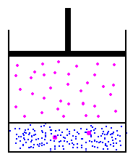
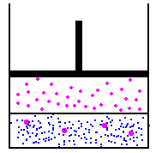
Solubility
Solids are more soluble at...
  high temperatures.
Gases are more soluble at...
  low temperatures &
  high pressures (Henry’s Law).
  EX: nitrogen narcosis, the “bends,” soda
Notes:
External pressure has very little effect on the solubility of liquids and solids, but the solubility of gases increases as the partial pressure of the gas above a solution increases.
The concentration of molecules in the gas phase increases with increasing pressure, and the concentration of dissolved gas molecules in the solution at equilibrium is also higher at higher pressures.
Relationship between pressure and the solubility of a gas is described quantitatively by Henry’s Law: C = kP, where C is the concentration of dissolved gas at equilibrium; P is the partial pressure of the gas; and k is the Henry’s law constant, which must be determined experimentally for each combination of gas, solvent, and temperature and has units of mol/(L•atm) = M/atm.
Concentration of a dissolved gas in water at a given pressure depends strongly on its physical properties.
For a series of related substances, London dispersion forces increase as molecular mass increases with the Henry’s law constants increasing smoothly.
Gases that react chemically with water do not obey Henry’s law; all of these gases are much more soluble than predicted by Henry’s law

Slide 10
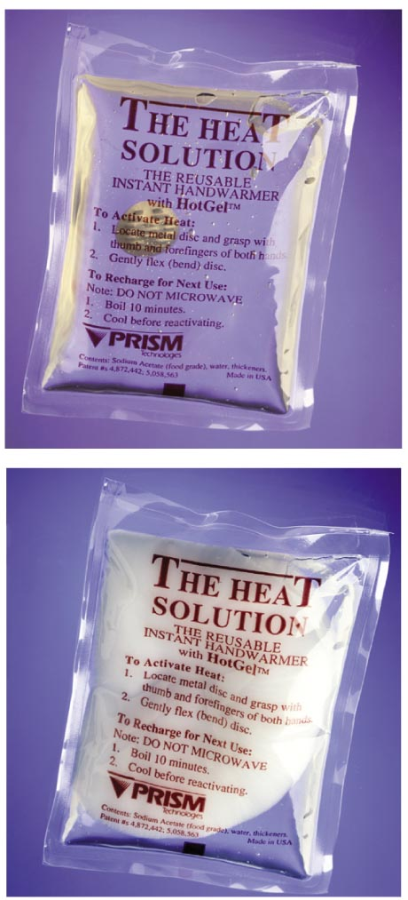
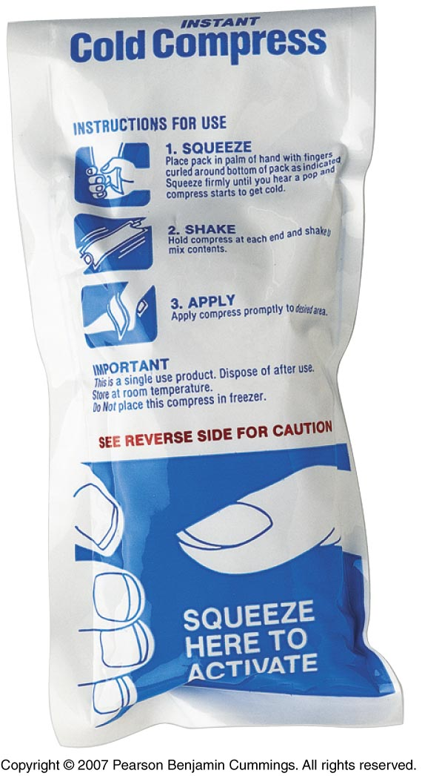

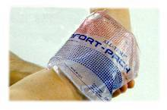
Hotpack / Coldpack
Notes:
Image on right Copyright © Pearson Benjamin Cummings. All rights reserved.

Slide 11
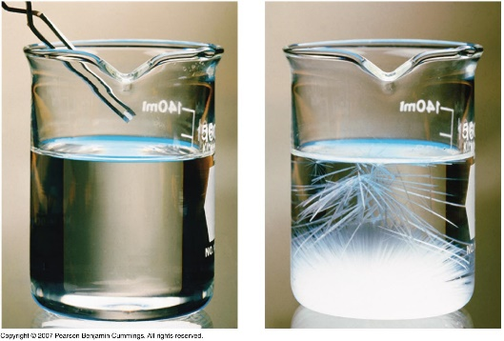
Solubility of Sodium Acetate
150
Supersaturated
solution
Saturated
Video Clip
100
Solubility(g/100 g H₂O)
Unsaturated
solution
50
0
The small crystal causes extensive
crystallization, and eventually
25
50
75
100
A single crystal of sodium acetate,
NaC₂H₃O₂, is dropped into a
supersatureated solution
Temperature (ºC)
the solute forms a
solid mass of NaC₂H₃O₂.
Charles H.Corwin, Introductory Chemistry 2005, page 378
https://youtu.be/9XMfR0taF4M
Notes:
A supersaturated solution is unstable, so adding a small particle of the solute, a seed crystal, causes the excess solute to rapidly precipitate or crystallize.
Add 100 g sodium acetate into 100 g of water at 55ºC.
Allow to cool to 20ºC. Only 82 g of sodium acetate should remain in solution at this temperature.
Place a seed crystal in the supersaturated solution and ~18 g of sodium acetate will precipitate out of solution.
The resulting solution will be saturated.
Include a table of data for students to graph.
DEMONSTRATION:
Add 8 g of sodium thiosulfate pentahydrate, Na₂S₂O₃. 5H₂O, to a large test tube containing 3 mL of water.
Heat gently until all of the solid has dissolved.
Set the tube aside and allow it to remain undisturbed as it slowly cools to room temperature (~30 min). If this solution cools to room temperature without the separation of crystals, it is supersaturated.
Add one small crystal of Na₂S₂O₃ .5H₂O and record our observations.
Rate of crystallization is greater than the rate of dissolution, so crystals or a precipitate form.
• Adding a seed crystal to a saturated solution reestablishes the dynamic equilibrium, and the net quantity of dissolved solute no longer changes.
• Crystallization is the reverse of dissolution, so a substance that requires an input of heat to form a solution (ΔH_{soln} > 0) releases that heat when it crystallizes from solution (ΔH_{crys} < 0), and the amount of heat released is proportional to the amount of solute that exceeds its solubility.

Slide 12
Solubility
UNSATURATED SOLUTION
more solute dissolves
SATURATED SOLUTION
no more solute dissolves
SUPERSATURATED SOLUTION
becomes unstable, crystals form
increasing concentration
Notes:
Maximum amount of a solute that can dissolve in a solvent at a specified temperature and pressure is its solubility.
– Solubility is expressed as the mass of solute per volume (g/L) or mass of solute per mass of solvent (g/g) or as the moles of solute per volume (mol/L).
– Solubility of a substance depends on energetic factors and on the temperature and, for gases, the pressure.
• A solution that contains the maximum possible amount of solute is saturated.
• If a solution contains less than the maximum amount of solute, it is unsaturated.
When a solution is saturated and excess solute is present, the rate of dissolution is equal to the rate of crystallization.
• Solubility increases with increasing temperature — a saturated solution that was prepared at a higher temperature contains more dissolved solute than it would contain at a lower temperature, when the solution is cooled, it can become supersaturated.

Slide 13
SOLUBILITY
CURVE
sudden stress
causes this
much ppt
Solubility
how much solute
dissolves in a given
amt. of solvent at a
given temp.
KNO₃ (s)
KCl (s)
Solubility
(g/100 g H₂O)
HCl (g)
Temp. (ºC)
unsaturated: sol’n could hold more
solute;
below the line
saturated: sol’n has “just right” amt.
of solute;
on the line
supersaturated: sol’n has “too much” solute
dissolved in it;
above the line

Slide 14
Solids dissolved Gases dissolved
in liquids in liquids
Sol.
[O₂]
Sol.
Tº
Tº
As Tº ,
solubility ___
As Tº ,
solubility ___

Slide 15
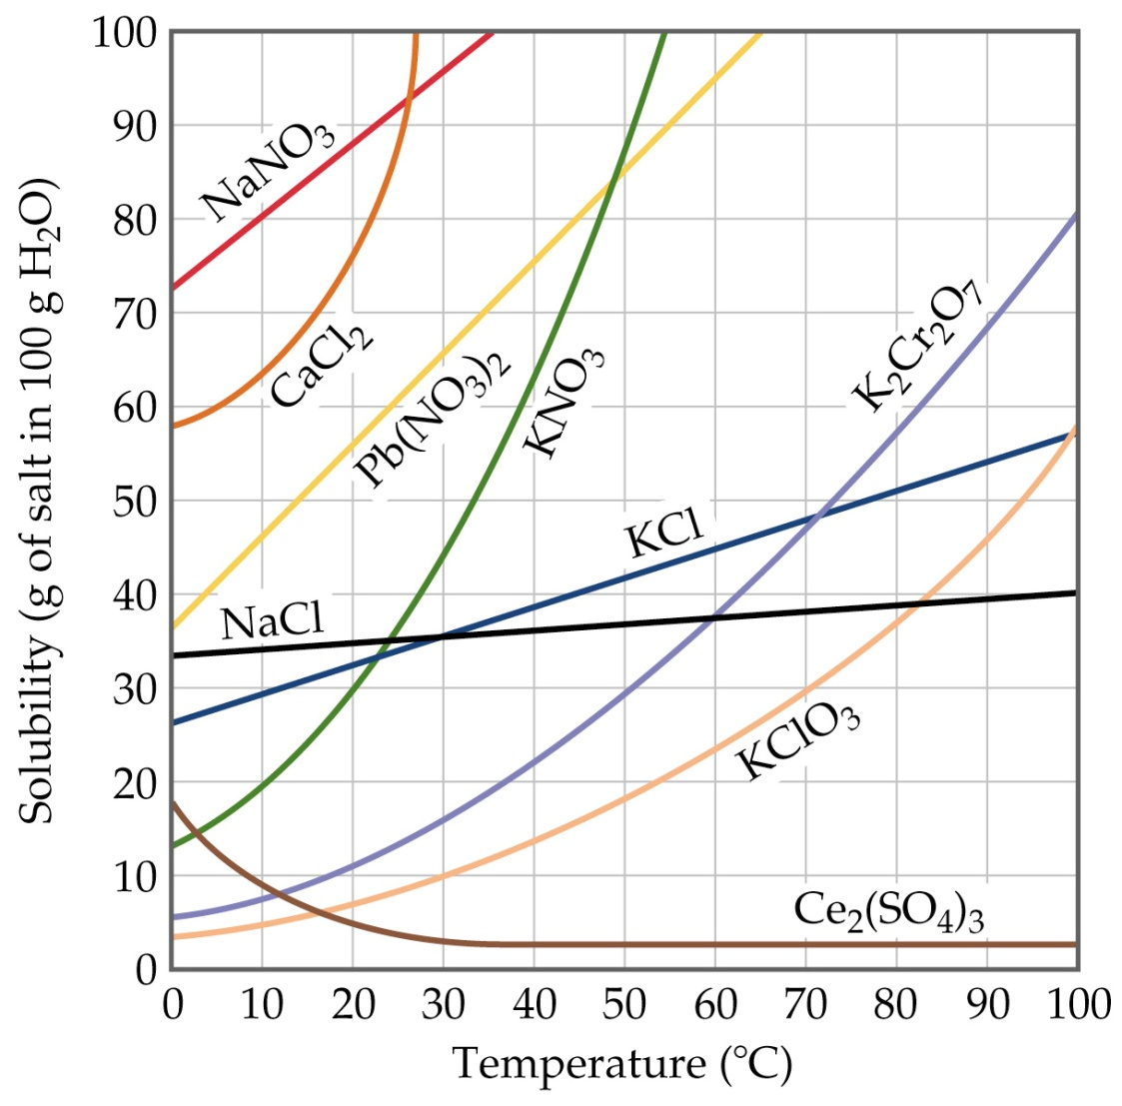
Using an available solubility
curve, classify as
unsaturated, saturated,
or supersaturated.
80 g NaNO₃ @ 30ºC
unsaturated
45 g KCl @ 60ºC
per 100 g H₂O
saturated
30 g KClO₃ @ 30ºC
supersaturated
70 g Pb(NO₃)₂ @ 60ºC
unsaturated

Slide 16
(Unsaturated, saturated, or supersaturated?)
Per 500 g H₂O,
100 g KNO₃ @ 40ºC
saturation point
@ 40ºC for 100 g H₂O
= 63 g KNO₃
So saturation pt.
@ 40ºC for 500 g H₂O
= 5 x 63 g
= 315 g
100 g < 315 g
unsaturated

Slide 17
Describe each situation below.
(A) Per 100 g H₂O,
100 g NaNO₃ @ 50ºC.
unsaturated;
all solute dissolves;
clear sol’n.
(B) Cool sol’n (A) very
slowly to 10ºC.
supersaturated;
extra solute remains
in sol’n; still clear
(C) Quench sol’n (A) in
an ice bath to 10ºC.
saturated; extra solute (20 g)
can’t remain in sol’n and becomes visible

Slide 18
Solubility → how much solute dissolves in a given amount
of solvent at a given temp.
SOLUBILITY
CURVE
KNO₃ (s)
KCl (s)
Solubility
(g/100 g H₂O)
HCl (g)
Temp. (ºC)
unsaturated…………… solution could hold more solute; below line
saturated……………….solution has “just right” amt. of solute; on line
supersaturated………..solution has “too much” solute dissolved in it; above the line

Slide 19
Solubility vs. Temperature for Solids
140
KI
130
120
Describe each situation below.
110
NaNO₃
gases
solids
100
(A) Per 100 g H₂O, 100 g Unsaturated; all solute
NaNO₃ @ 50ºC. dissolves; clear solution.
KNO₃
90
80
HCl
NH₄Cl
70
Solubility (grams of solute/100 g H₂O)
(B) Cool solution (A) very Supersaturated; extra
slowly to 10ºC. solute remains in solution;
still clear.
60
NH₃
KCl
50
40
30
NaCl
KClO₃
20
(C) Quench solution (A) in Saturated; extra solute
an ice bath to 10ºC. (20 g) can’t remain in
solution, becomes visible.
10
SO₂
0 10 20 30 40 50 60 70 80 90 100

Slide 20
Using a solubility table: classify as unsaturated, saturated, or supersaturated.
per
100 g
H₂O
80 g NaNO₃ @ 30ºC unsaturated
45 g KCl @ 60ºC saturated
50 g NH₃ @ 10ºC unsaturated
70 g NH₄Cl @ 70ºC supersaturated
Per 500 g H₂O, 120 g KNO₃ @ 40ºC
saturation point @ 40ºC for 100 g H₂O = 66 g KNO₃
So sat. pt. @ 40ºC for 500 g H₂O = 5 x 66 g = 330 g
120 g < 330 g unsaturated

