Slide 1
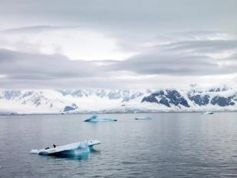
fluid: a material ^{w}/the ability to flow and change shape
Gases
Liquids
Particle spacing
very far apart
very close together
Fixed shape?
no
no
Fixed volume?
no
yes
Compressible?
yes
no
www.teachnlearnchem.com

Slide 2
mass
m
(mass) density, ρ =
Equation:
ρ =
volume
V
For a particular object:
For a particular fluid:
m_{o}
m_{f}
ρ_{o} =
ρ_{f} =
V_{o}
V_{f}
-- Unless we say otherwise, when we say “density,”
we mean “mass density.”
-- In SI, the unit for density is…
kg/m³
-- In proper SI units, the
density of water is…
1000 kg/m³
(MEMORIZE!)
Liquids and solids have “fixed” densities; gases don’t.

Slide 3
A substance’s specific gravity (γ)
is a unitless number that
compares the density of
that substance relative to
the density of…
Equation:
ρ
γ =
ρ_{water}
water.
γ_{fresh water}
1.00
γ_{iron or steel}
7.8
γ_{aluminum}
2.70
γ_{salt water}
1.03
γ_{mercury}
13.6
γ_{ethanol}
0.79
Given the specific gravities of steel and ethanol above,
determine the densities of these materials, using the
proper SI units.
ρ_{steel}
ρ_{steel}
steel: 7.8 =
=
→
ρ_{steel}
=
7800 kg/m³
ρ_{water}
1000 kg/m³
Similarly for ethanol…
→
ρ_{ethanol}
=
790 kg/m³

Slide 4

pressure:
the effect of a force
being distributed
over a surface area
F
Equation:
P =
A
SI unit for pressure:
pascal (Pa)
N
1 Pa = 1
m²
At sea level, air
pressure is about…
100,000 Pa
(which is ~1 atm)

Slide 5
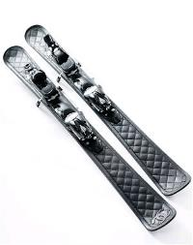
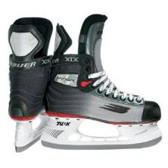

F
F
P =
=
P
A
A
F
P
=
A
Using a brick to compare
force, area, and pressure
A
P
F
P
P
F
A
F
A
www.teachnlearnchem.com

Slide 6
Atmospheric Pressure
and Altitude:
Which Graph is Best?
altitude
altitude
P
P
altitude
LINEAR?
P

Slide 7
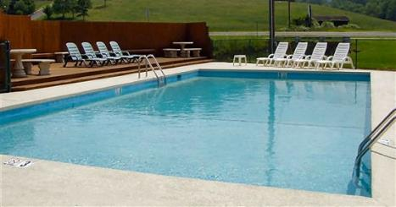
Pressure in Fluids
increases
Fluid pressure ________ with depth because…
the fluid at a given
depth must support
the weight of the
fluid above it.
-- For gases in the atmosphere, pressure
is greatest at…
Earth’s surface.
→
P decreases with increasing
altitude
, but NOT linearly.
→
gas nearer surface is compressed due
to gas above it, and so is denser

Slide 8
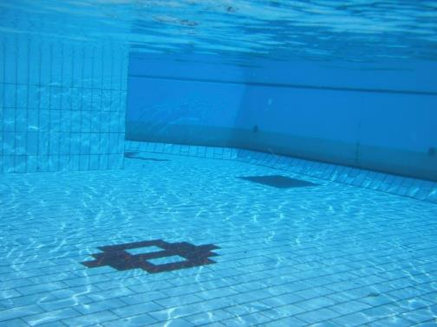
-- For liquids, the pressure-depth relationship is linear
because liquids are…
incompressible.
→
aside from slight temp. effects, ρ is constant
?
surface
depth
P

Slide 9
Determine the pressure on the bottom surface of each
tank, due to the water.
1 m x
1 m x
1 m
2 m x
1 m x
1 m
F_{w} = m g
F_{w} = m g
= 1000 kg (9.81)
= 2000 kg (9.81)
= 9810 N
= 19620 N
A_{bot} = 1 m²
A_{bot} = 2 m²
P = 9810 Pa
P = 9810 Pa
** The pressure at equal depths in the
same liquid is everywhere the same.

Slide 10
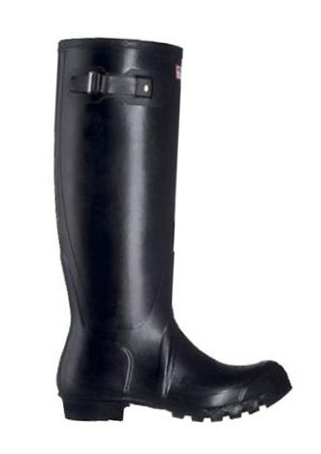
For this boot filled with water:
Of the points that are labeled,
which has/have the lowest
pressure? The highest?
A
Point A has the lowest
pressure.
B and C are tied for
the highest pressure.
B
C

Slide 11
Gauge pressure equation:
P = ρ g h
P = gauge pressure (Pa)
ρ = density of liquid (kg/m³)
g = 9.81 m/s²
h = depth below surface (m)
P does NOT depend on total volume of liquid,
only type of liquid, gravity, and depth.
The P in the equation P = ρ g h (i.e., the gauge
pressure) does NOT account for the pressure AT the
liquid’s surface (from gases above it). To find the total
pressure (P_{tot}) at a given depth, simply add the surface
pressure (P_{o}) to the gauge pressure at that depth.
Total pressure equation:
P_{tot} = P_{o} + ρ g h

Slide 12
surface pressure, P_{o}
gauge pressure, P = ρ g h
(is linear with depth)
P_{tot} = P_{o} + ρ g h
Total pressure
at a given depth
surface
pressure
(constant)
gauge
pressure
(variable)
=
+

Slide 13
Given that the specific gravity of gasoline is 0.68, find
both the gauge AND total pressures 1.4 m below the
surface of a tank of gasoline that has air space at the
top. Assume the air pressure to be 101.3 kPa.
gauge:
P = ρ g h
= 680 kg/m³ (9.81) (1.4 m)
= 9300 Pa
= 9.3 kPa
total:
P_{tot} = P_{o} + ρ g h
= 101.3 kPa + 9.3 kPa
= 110.6 kPa
Repeat the calcs for a depth of 2.8 m in gasoline.
P_{tot} = P_{o} + ρ g h
= 101.3 kPa + 18.7 kPa
= 120.0 kPa

Slide 14

submerged
object
floating
object
hole in side
of container
P
P
P
In a fluid, the pressure at
a given depth is exerted…
in all directions.
→ And pressure always
acts ___________
to any surface.
perpendicular
Does the orientation of your head
affect the pressure on your ears
underwater?
NOPE.
What DOES affect pressure?
DEPTH.

Slide 15
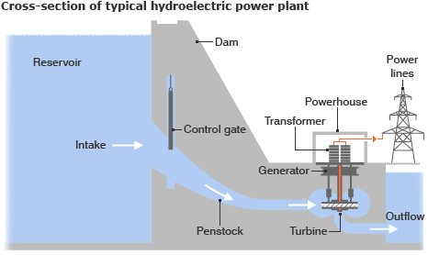
Why does a dam have the cross-section it does?

Slide 16
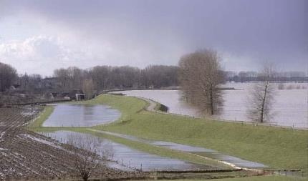
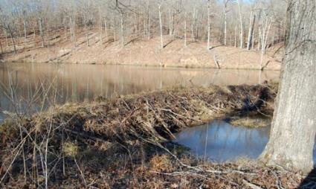
Which must resist a larger water pressure: a 1-m-high
dike that holds back the ocean, or a 1-m-high dam that
holds back a small pond on a private farm?
P_{tot} = P_{o} + ρ g h
P_{tot} = P_{o} + ρ g h
SUMMARY for this lesson: The pressure at a given
depth in a liquid is exerted equally in
every direction, and perpendicular to any surface.

Slide 17
higher
Fluids flow away from points of ______ P toward points
of _____ P (even though there might be quirky things
happening ^{w}/P in btwn these pts; more on this later).
lower
level of water in tower
water
tower
At first, faucet is off.
What happens when faucet is turned on?
What happens when faucet is turned off again?
h₁
level of faucet
h₂
P
FLOW
P
P

Slide 18
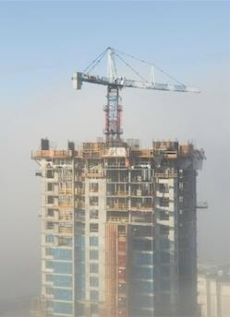
level of water in tower
water
tower
Δh
h₁
level of faucet
h₂
The pres. at a particular faucet in a city depends on the DIFFERENCE btwn the height of water in the tower and the elevation of the faucet. A faucet in the basement delivers water with more force than one on the top floor of a bldg. Buildings that are taller than the water tower require pumps to move water to the upper floors of the building.

Slide 19
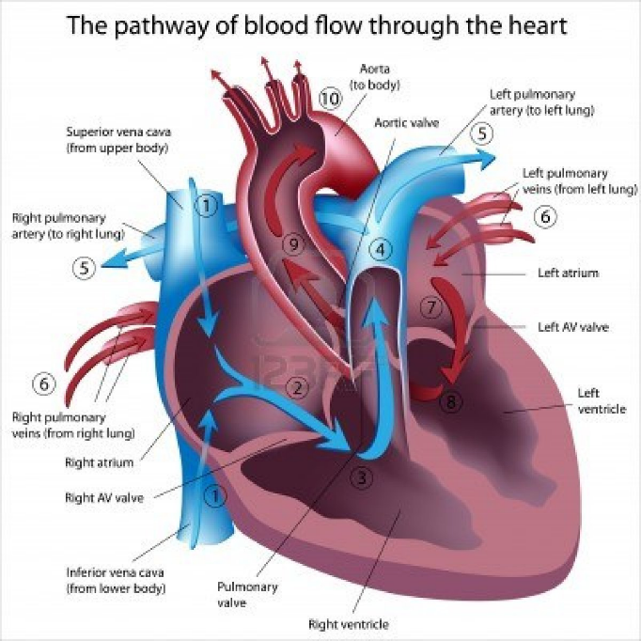
Your heart muscles move the walls of your heart, changing the volume of the various heart cavities. When V goes up, P goes down, and blood flows in. When V goes down, P goes up, and blood flows out.

Slide 20
How a Straw Works
atmosphere
Liquid flows from
high to low pres.

Slide 21
bouyant force, F_{B}:
the upward force a fluid exerts on
an object that is fully or partially
submerged in it
gauge Ps
on the top and bottom surfaces of an object.
-- F_{B} is the result of the difference in…
-- Pressures on the sides of the object…
cancel.
sunken
object
floating
object

Slide 22

What
Factors
Affect
the
Buoyant
Force?

Slide 23
Depth?
2 m deep
19620 Pa
2 m x 1 m x 1 m
Net P = 9810 Pa
3 m deep
29430 Pa
Net F = Net P x Area
Net F = 9810 Pa x (2 m x 1 m)
Net F = 19620 N
5 m deep
49050 Pa
2 m x 1 m x 1 m
Net P = 9810 Pa
6 m deep
58860 Pa
“Nope.”

Slide 24
Orientation?
2 m deep
19620 Pa
2 m
x 1 m
x 1 m
2 m x 1 m x 1 m
4 m deep
39240 Pa
Net P = 9810 Pa
Net F = Net P x Area
Net P = 19620 Pa
Net F = 9810 Pa x (2 m x 1 m)
Net F = 19620 N
Net F = Net P x Area
Net F = 19620 Pa x (1 m x 1 m)
“Nope.”
Net F = 19620 N

Slide 25

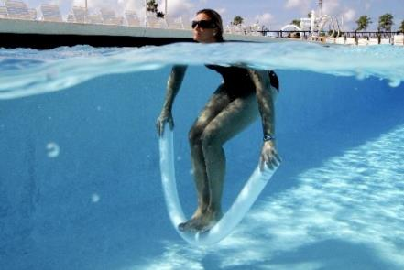
-- The F_{B} on a completely submerged object is
NOT affected by…
depth or obj. orientation
-- F_{B} IS affected by…
type of fluid and vol. of obj.
that is submerged (i.e., vol.
of fluid that is displaced)
The Dead Sea is the lowest place on Earth
(elev. 423 m below sea level). It is about 31%
salt by mass and has a density of 1240 kg/m³,
which makes it REALLY easy to float in.
“Da’ Noodle.”

Slide 26
Because of buoyancy, the net force on an immersed
object is always the object’s weight.
<
(i.e., < m_{o}g)
This net force we call the apparent weight (F_{app}).
Equation:
F_{app} = m_{o}g – F_{B}
Objects that are floating:
m_{o}g
=
weight buoyant force
→ m_{o}g = F_{B}, so F_{app}
= 0
F_{B}
Objects that aren’t:
m_{o}g
>
weight buoyant force
→ m_{o}g > F_{B}, so F_{app}
> 0
F_{B}

Slide 27
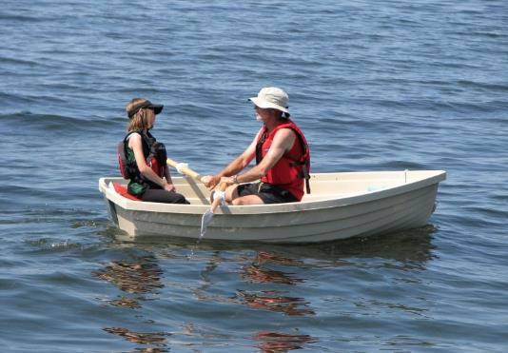
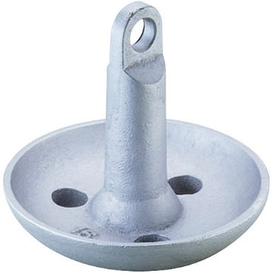
Compared to the force required to lift a typical steel anchor to
the surface, it takes roughly an additional 17% more “oomph”
to lift it out of the water and into the boat.

Slide 28

A 43 kg rowboat is loaded with 185 kg worth of fishers
and fishing equipment. What is the buoyant force on
the boat when it is out on the lake?
Boat is floating, so…
F_{B} = m_{o}g
So… F_{B} = (43 kg + 185 kg) (9.81)
= 2240 N
A 28.4 g lead sinker used by a fisherman has an
apparent weight of 0.254 N in water. Find the buoyant
force on the sinker.
F_{app} = m_{o}g – F_{B}
→ F_{B} = m_{o}g – F_{app}
F_{B} = (0.0284 kg) (9.81) – 0.254 N
= 0.025 N

Slide 29
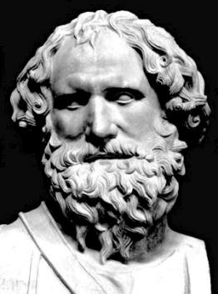
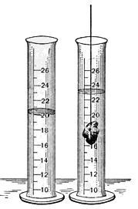
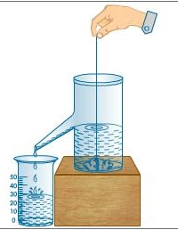

Archimedes’ Principle
Any object in a fluid experiences
an upward buoyant force equal
to the weight of the fluid that the
object displaces.
Archimedes
287 B.C. – 212 B.C.
Finding volume by
water-displacement.

Slide 30
-- For a floating object:
→ the displaced fluid’s weight
=
the object’s weight
→ the displaced fluid’s volume
<
the object’s volume
floating
object
THIS MUCH fluid
is displaced.
THIS MUCH fluid
weighs the SAME
as the object.

Slide 31
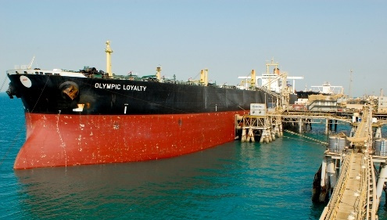
When this tanker is loaded with oil, the red waterline
will be submerged, leaving only the black part of the
hull above water.

Slide 32
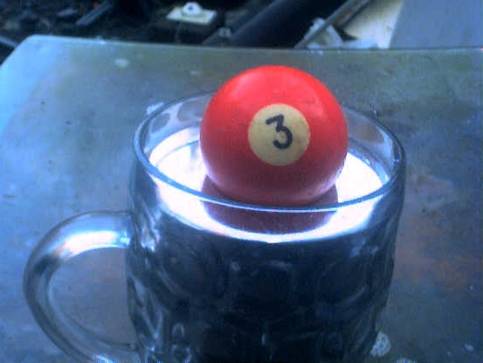
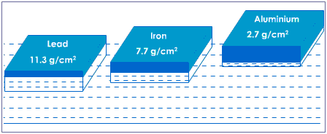
For a floating object, the
object and fluid densities
are proportional to the
displaced and object
volumes, i.e., to V_{disp} and V_{o}.
Handy equation
for floating objects:
ρ_{o} V_{o} = ρ_{f} V_{disp}
(“Floatie-rovee-rovee” eq.)
Mercury (Hg, from the Latin
“hydrargarum”) is a liquid at
room temp. and is highly
dense (13,600 kg/m³). Strange
things – like pool cues, iron,
and even lead – float in
mercury.

Slide 33
-- For a sunken object:
→ the displaced fluid’s weight
<
the object’s weight
→ the displaced fluid’s volume
=
the object’s volume
THIS MUCH fluid
is displaced.
sunken
object
THIS MUCH fluid
weighs LESS
than the object.
**
We could call the buoyant force
“the Archimedes’ force.”

Slide 34
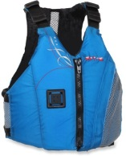
Equation for buoyant force:
F_{B} = m_{df} g
m_{df} = mass of displaced fluid (in kg)
g = 9.81 m/s²
From density, we see that… m_{df} = ρ_{f} V_{disp}, and so…
F_{B} =
ρ_{f} V_{disp} g
volume
** It is the _______ of the immersed
object, NOT its __________, that
affects the buoyant force.
weight/mass
A life preserver greatly increases
“your” ______ but barely increases
increases “your” __________.
volume
weight/mass

Slide 35
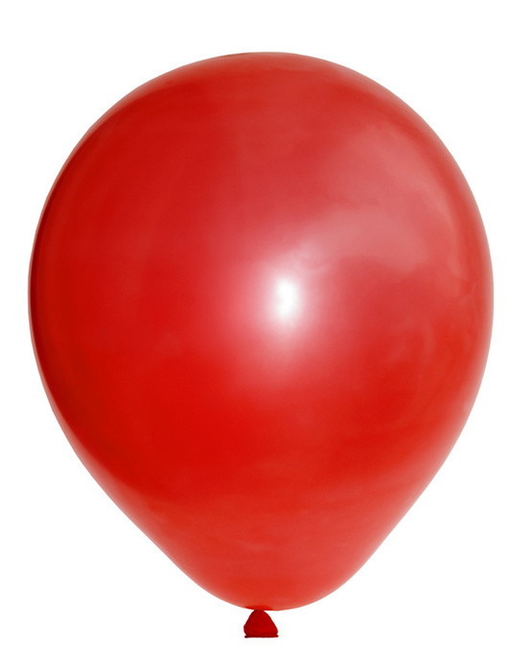
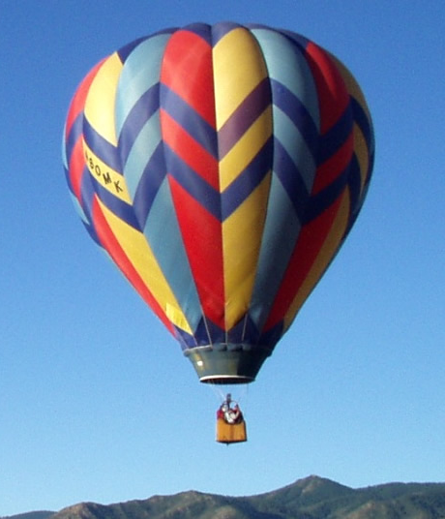
A balloon rises if its weight is less than the weight of the air it displaces.

Slide 36
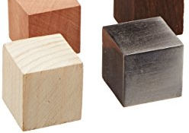


If equal volumes of lead and wood
are dropped into a bucket of
water, which cube experiences
the larger buoyant force?
Thought-process #1…
“The lead sinks and the wood floats, so the
wood experiences the larger buoyant force.”
Thought-process #2…
“The lead sinks and the wood floats, so the
lead displaces more water. The buoyant
force equals the weight of the fluid displaced.
More fluid displaced thus means more buoyant
force, so the lead has the larger buoyant force.”

Slide 37
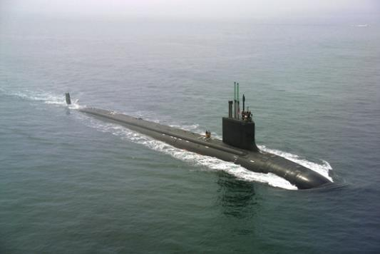
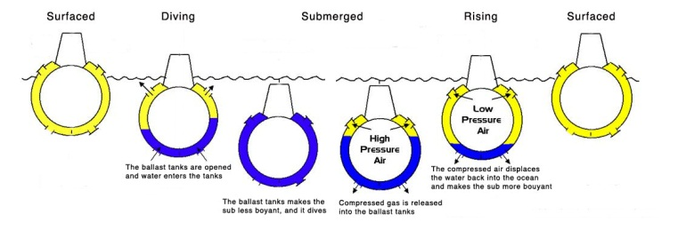
When a submarine is at the surface,
its ballast tanks are filled with normal-pressure air. In addition, air flasks store extra, compressed air at a high pressure (and very small volume) To dive, the sub increases its overall density by opening its ballast tanks; the water forces the normal-pressure air out. To rise, the sub reduces its overall density by pumping the stored, compressed air from the air flasks into the ballast tanks, forcing the seawater out.

Slide 38
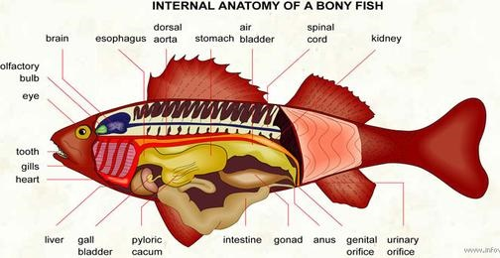
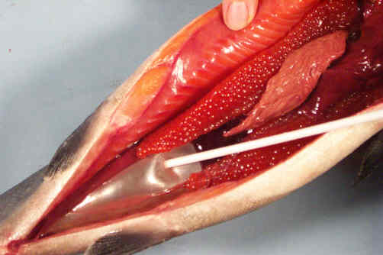
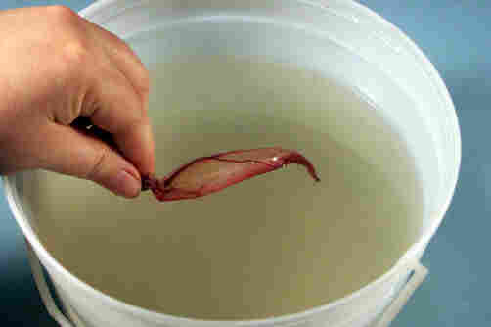
Fish rise and sink by expanding and contracting an air sac, called the “swim bladder.” The swim bladder often remains full of gas, even after the fish has died.

Slide 39
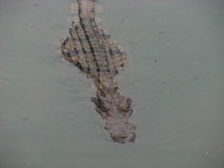
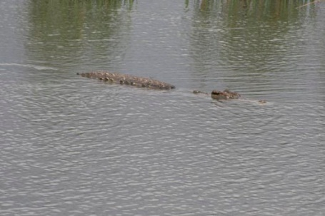
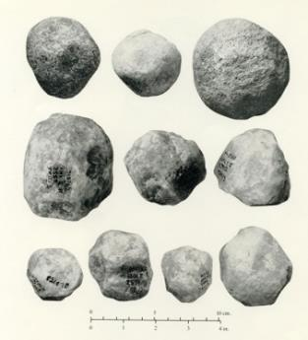
Crocodiles swallow stones to float lower in the water and make themselves less visible to potential prey.
Photo of stones retrieved from the stomachs of dead crocs. The outer edges are worn away, giving a more rounded shape; a croc’s stomach grinds the stones together and, over time, wears them down.

Slide 40
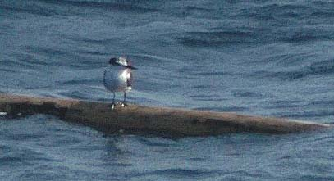
A floating tree trunk has specific gravity 0.41 and a
volume of 0.79 m³. Find the log’s apparent weight, the
buoyant force on it, and the volume of water it displaces.
Log floats, so F_{app} =
0 N
Buoyant force F_{B} =
weight of log
= m_{o}g
= ρ_{o}V_{o}g
(
kg
)
(
m
)
So… F_{B} = 410
(0.79 m³)
9.81
= 3200 N
m³
s²
(Range for answer?
Less than 0.79 m³.)
ρ_{o} V_{o} = ρ_{f} V_{disp}
410 (0.79) = 1000 V_{disp}
V_{disp} = 0.33 m³

Slide 41
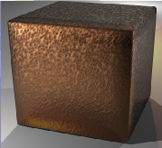
A solid copper cube – 0.112 m on a side –
is under water. Its apparent weight is
109.16 N. Find copper’s specific gravity.
Cube sinks, so V_{disp} =
V_{cube}
= (0.112 m)³
= 1.405 x 10^{–3} m³
So now…
F_{B} = ρ_{f} V_{disp} g
= 1000 (1.405 x 10^{–3}) (9.81)
= 13.78 N
109.16
13.78
F_{app} + F_{B}
F_{app} = m_{o}g – F_{B}
→ m_{o} =
= 12.53 kg
g
9.81
m_{Cu}
12.53 kg
kg
ρ_{Cu} =
=
= 8920
γ = 8.92
V_{Cu}
1.405 x 10^{–3} m³
m³

Slide 42
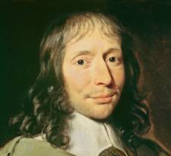

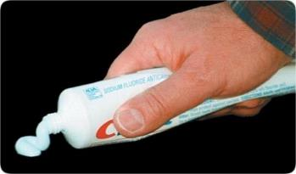
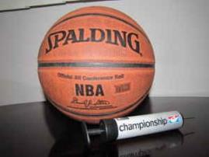

Pascal’s Principle
i.e., a CHANGE in P
External pressure applied to a
confined fluid is transmitted
equally to every point in the fluid.
Blaise Pascal
e.g.,
squeezing tube of
toothpaste; pumping
air into a ball or tire
1623 – 1662

Slide 43
A hydraulic lift has two
pistons, one that is
much larger in surface
area than the other.
F₁
F₂
Equation:
=
A₁
A₂
F₁,
A₁
F₂,
A₂
F₁
ΔP
ΔP
ΔP
ΔP
ΔP
F₂
ΔP
ΔP
ΔP
=
ΔP
ΔP
ΔP
ΔP
A₁
A₂
ΔP
ΔP
ΔP
ΔP
ΔP
ΔP
ΔP
ΔP
ΔP
ΔP
ΔP
ΔP
ΔP
ΔP
ΔP
ΔP
ΔP
ΔP
ΔP
ΔP
ΔP
ΔP
ΔP
ΔP
ΔP
ΔP
ΔP
ΔP
The effect of a hydraulic lift is that we get to input a
small force and transform it into a larger one, but the
price we pay is that…
the small force must travel
through a larger distance than the big force does.

Slide 44
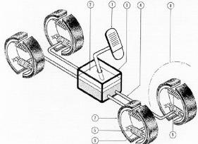
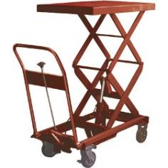
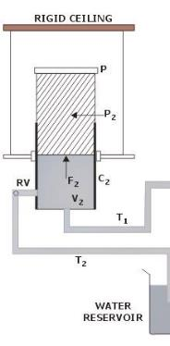

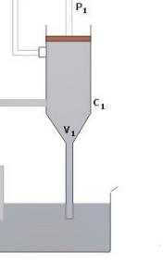
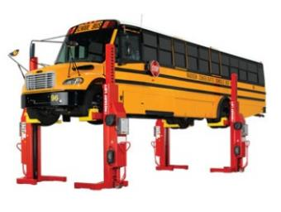
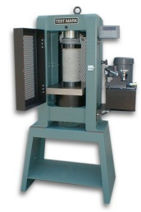
** In physics, this is analogous to the
behavior exhibited by…
levers.
Would the TYPE of liquid in a
hydraulic device affect the amount
by which the force was multiplied?

Slide 45
REVIEW: Pascal’s Principle
F₁
F₂
Equation:
=
A₁
A₂
F₁,
A₁
F₂,
A₂
F₁
ΔP
ΔP
ΔP
ΔP
ΔP
F₂
ΔP
ΔP
ΔP
=
ΔP
ΔP
ΔP
ΔP
A₁
A₂
ΔP
ΔP
ΔP
ΔP
ΔP
ΔP
ΔP
ΔP
ΔP
ΔP
ΔP
ΔP
ΔP
ΔP
ΔP
ΔP
ΔP
ΔP
ΔP
ΔP
ΔP
ΔP
ΔP
ΔP
ΔP
ΔP
ΔP
ΔP

Slide 46
A hydraulic lift’s pistons have areas of 0.0254 m² and
1.33 m². What minimum force is needed for us to
elevate a 1420 kg car with the aid of the hydraulic lift?
F₁
F₂
F₁
1420 (9.81)
=
→
=
A₁
A₂
0.0254 m²
1.33 m²
F₁ = 266 N
For the problem above, find
the pressure on each piston.
F
P =
A
266 N
1420 (9.81)
P =
P =
0.0254 m²
1.33 m²
= 10.5 kPa
= 10.5 kPa
www.teachnlearnchem.com

Slide 47
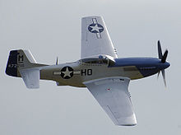
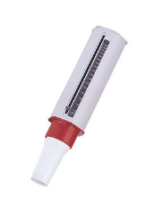
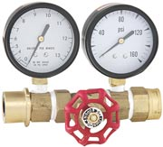
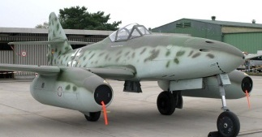
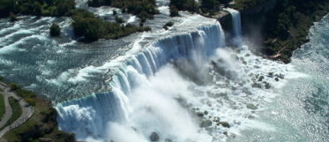
Fluids in Motion
flow rate:
the mass (or volume) of a fluid that
passes a fixed point each, say, second
-- units could be either
kg/s
OR
m³/s
P-51 Mustang
water flow rate meter
peak flow meter
Messerschmidt ME 262
Niagara Falls

Slide 48
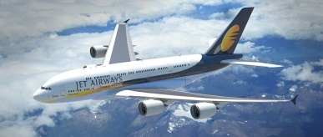
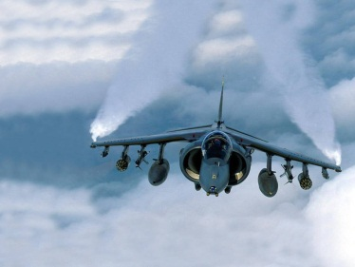


Jets go much faster than propeller-powered planes because they pull huge volumes of air/oxygen into their engines to be used in the combustion process. In other words, the flow rate of air into a jet engine far exceeds the flow rate into the engine of a propeller-powered aircraft.
www.teachnlearnchem.com

Slide 49




Two Types of Fluid Flow
laminar flow: each fluid “particle” perfectly follows
the particle just ahead of itself along a
smooth trajectory called a streamline
--
limited to relatively low fluid speeds
--
Streamlines DON’T change with time.
v_{avg}
flow direction
model profile of
laminar flow in a pipe

Slide 50



Two Types of Fluid Flow, cont.
turbulent flow:
irregular, chaotic flow
--
occurs at higher speeds
and/or if there are
obstacles in the flow path
-- eddies (or vortices) are clear
indicators of turbulent flow
--
locations and
patterns of
eddies change
w/time, even if
flow rate is
constant

Slide 51

The Niagara River flows north, connecting Lakes Erie and Ontario.

Slide 52
Principles of Fluid Flow
For a fluid confined in a pipe:
flow rate at
“EARLIER” POINT
=
flow rate at
“LATER” POINT
V₁
V₂
Using volumes…
=
Δt₁
Δt₂
The units here would be…
m³/s

Slide 53
An equivalent expression, then, which deals with the
cross-sectional areas of two different points along the
pipe – and the speeds of the fluids through those
cross-sections – is called the continuity equation:
What are the units here?
A₁ v₁ = A₂ v₂
m²
. m/s
→ m³/s (again!)
v₁
A₂
A₁
v₂
Conceptual examples:
--
water runs faster in the narrow parts of rivers
--
poured liquid narrows as it falls

Slide 54




The cross-sectional area of any falling liquid decreases as it falls. As time passes, the liquid’s speed increases, and so the area must decrease in order for the flow rate to remain constant.
As rivers get shallower and/or narrower, they speed up b/c the cross-sectional area is smaller. It is no coincidence that river rapids are narrower and shallower than other parts of the river.

Slide 55


In a water-treatment plant, water flows at 0.86 m/s
through a 0.64 m diameter pipe. Find the water’s speed
when this flow narrows into a pipe of diameter 0.28 m.
A₁ v₁ = A₂ v₂
where A = π r²
(
)
(
)
π
0.64
²
π
0.28
²
(0.86) =
(v₂)
m
2
2
v₂ = 4.5
s
(0.64)²(0.86) = (0.28)²(v₂)

Slide 56
Bernoulli’s Principle
For a fluid traveling // to a surface:
--
LOW
FAST-moving fluids exert ______ pressure
--
HIGH
SLOW-moving fluids exert ______ pressure
LOW P
FAST
SLOW
NET
FORCE
HIGH P
** Bernoulli applies when a fluid moves
ACROSS, NOT AGAINST, a surface.

Slide 57

airplane wing / helicopter propeller
FAST
LOW P
Resulting Forces
AIR
PARTICLES
(BERNOULLI’S
PRINCIPLE)
SLOW
HIGH P
(GRAVITY)
There is also an action-reaction
effect when the wings are tilted.
frisbee
FAST, LOW P
SLOW, HIGH P

Slide 58

windows and
high winds
(e.g., tornadoes)
TALL BUILDING
FAST
windows
burst outwards
LOW P
SLOW
HIGH P

Slide 59

roof in a windstorm
FAST
LOW P
SLOW
HIGH P
Because A is large,
ΔP doesn’t have to
be very much to have
big effects.

Slide 60

A photo of a freely-rotating plastic
spoon caught in a water stream.
The large number of water molecules
on the right, all moving in the same
direction, give a net HIGH velocity
(and hence, by Bernoulli, a low
pressure) on that side. The gas
molecules on the left, while each
moving faster than the falling water
molecules, are moving in random
directions, giving a net LOW velocity
(and hence, high pressure) on the
right. Thus, the spoon leans (and
stays leaning) into the water stream.

Slide 61


Bernoulli’s principle can be rationalized in two ways:
1. Newton’s 2nd law
a level pipe of varying diameter
acceleration!
A
P
v
v
P
A
low
high
_____ speed
_____ speed
high
low
_____ pressure
_____ pressure

Slide 62

2. conservation of “energy”
½ ρ v²
½ ρ v²
ρ g h
slower faster
ρ g h
P
P
For each pipe section, the sum
of the following is a constant.
-- “KE” from fluid’s motion
½ ρ v²
-- “PE_{g}” due to elevation of fluid
ρ g h
-- “PE” due to fluid’s pressure
P
www.teachnlearnchem.com

Slide 63
REVIEW: Rationalizing Bernoulli’s Principle,
Conservation of “Energy” Method
A v = A v
½ ρ v²
½ ρ v²
ρ g h
slower faster
ρ g h
P
P
For each pipe
section, the
sum of the
following is
a constant:
-- “KE” from fluid’s motion
½ ρ v²
-- “PE_{g}” due to elevation of fluid
ρ g h
-- “PE” due to fluid’s pressure
P

Slide 64



The conservation of energy idea brings us nicely to
the Bernoulli Equation (which IS the conservation of
energy, but with units of pascals instead of _____).
joules
P₁ + ρgh₁ + ½ ρv₁² = P₂ + ρgh₂ + ½ ρv₂²
Daniel Bernoulli
1700 – 1782

Slide 65

A level pipe carries water under pressure. At one
point, the water’s speed is 0.48 m/s and its pressure
is 24,500 Pa. In an adjacent section, the pipe is
constricted; the water’s speed increases to 3.27 m/s.
Find the pressure in the adjacent section.
PREDICT: HIGHER P LOWER P
P₁ + ρgh₁ + ½ ρv₁² = P₂ + ρgh₂ + ½ ρv₂²
24,500 +
½ (1000) (0.48)²
= P₂
+ ½ (1000) (3.27)²
24,500 + 115 = P₂ + 5346
P₂ = 19,300 Pa
For splitter on a garden hose, if the inflow- and outflow- cross-sectional areas are different, the water speeds and pressures will also be different, according to Bernoulli.
www.teachnlearnchem.com

Slide 66
REVIEW: The Bernoulli Equation
P₁ + ρgh₁ + ½ ρv₁² = P₂ + ρgh₂ + ½ ρv₂²

Slide 67
A pipe carries water under pressure in a factory. At one
point, the speed is 2.46 m/s and the pressure is
31,500 Pa. In an adjacent section, the pipe is 1.75 m
lower; there, the pressure is 26,700 Pa. Find the speed
in the adjacent section.
PREDICT: FASTER SLOWER
P₁ + ρgh₁ + ½ ρv₁² = P₂ + ρgh₂ + ½ ρv₂²
A
B
P
31,500
26,700
ρgh
(1000) (9.81) (1.75)
0
½ ρv²
½ (1000) (2.46)²
½ (1000) (v₂)²
31,500 + 17168 + 3026
=
26,700 + 500 v₂²
m
v₂ = 7.07
s
www.teachnlearnchem.com

Slide 68


faster air = lower P
dir. smoke moves
Bernoulli’s principle is the primary reason smoke goes out a chimney.
slower air
=
higher P
It should be noted that ordinary convection
(i.e., “hot air rises”) also plays a role.

Slide 69



There is some debate as to whether or not Bernoulli’s principle adequately explains the motion of a curve ball. What ISN’T being debated is that the ball’s seams and its spin change the air pressure distribution around the ball, causing it to curve.

Slide 70
“Railway Sway”
the phenomenon of passing trains
leaning towards each other
N
70 mph
Due to friction, there is, in effect, a “film” of
air that covers the outside of the train and
is pulled along with it.
“70 mph”
“70 mph”
Assume (wrongly) that the same air particles
are always a part of that “film.”
Now assume (weirdly) that YOU are one of
those air particles on the east side of a
northbound train.
0 mph
P
70 mph
NET
FORCE
Q: Relative to you, how does the train move?
it doesn’t
70 mph
northbound
train
Q: Relative to you, how does the air just east
of you move?
70 mph, south

Slide 71

“Railway Sway”
the phenomenon of passing trains
leaning towards each other
N
70 mph
southbound
train
“70 mph”
“70 mph”
70 mph
“140 mph”
NET
FORCE
70 mph
northbound
train
Q: Relative to you, how does the air just east
of you move?
70 mph, south
“140 mph” south

Slide 72


Railway Sway
In addition to many other considerations, transportation engineers must take Bernoulli’s principle into account – and include a significant safety factor – when designing railway lines.

Slide 73

Other Phenomena related to Railway Sway
If you’re in a small car on a two-lane highway, be careful when a truck goes past you, moving in the opposite direction.
You might have noticed that “sideways” forces are not nearly as noticeable if you and the truck are going in the same direction, such as when you are passing a truck on the interstate.

Slide 74


Other Phenomena related to Railway Sway
When ships pass each
other going opposite
directions, they give
each other a wide berth.
Ships going the same
direction? Much less to
worry about, with regard
to Bernoulli.

