Slide 1
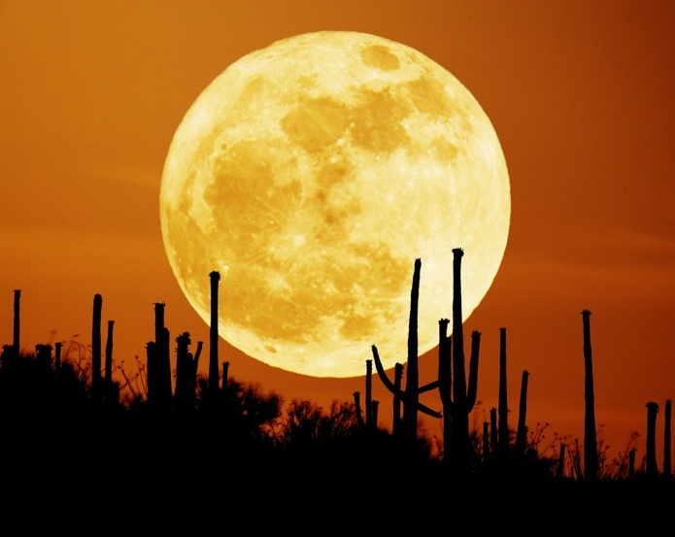
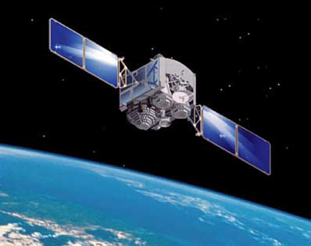
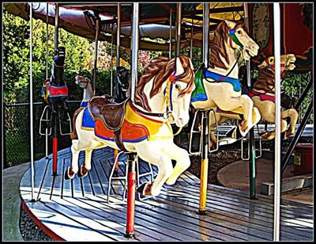
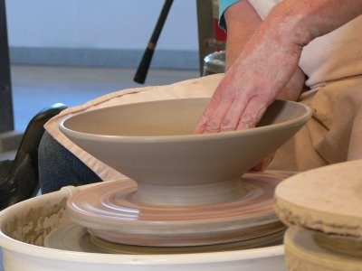
Circular Motion and Gravity

Slide 2


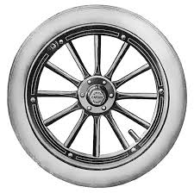
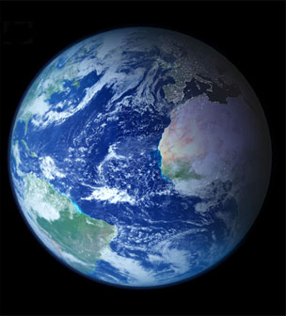
axis: line about which circular motion occurs
rotation:
axis is within object; “spinning”
revolution:
axis is outside object
Earth rotates on its axis (this causes day and night) and revolves around the Sun (this, coupled with the tilt of Earth’s axis, causes the seasons)

Slide 3
line // to Earth’s axis
of revolution
N
equator
23.5º
On or about June 21
NH: summer solstice
SH: winter solstice

Slide 4
line // to Earth’s axis
of revolution
N
equator
23.5º
On or about December 21
NH: winter solstice
SH: summer solstice

Slide 5
line // to Earth’s axis
of revolution
N
equator
23.5º
On or about March 21
NH: vernal equinox
SH: autumnal equinox

Slide 6
FINAL THOUGHTS: Rotation, Revolution,
and the Seasons
1. An axis of rotation is an imaginary line about
which circular motion occurs.
2. If the axis of rotation is within the object under
consideration, the object is rotating. If the axis of
rotation is outside the object, the object is revolving.
3. Day and night are due to Earth’s rotation. The
seasons are caused by Earth’s revolution around
the Sun, in conjunction with the non-perpendicular
tilt of Earth’s axis relative to the plane of Earth’s
revolution.

Slide 7
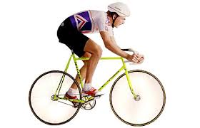
Angular Kinematics Equations
Δd
Δv
v_{f} – v_{i}
v_{avg} =
= ½ (v_{f} + v_{i})
a =
=
Δt
Δt
Δt
Δθ
Δω
ω_{f} – ω_{i}
ω_{avg} =
= ½ (ω_{f} + ω_{i})
α =
=
Δt
Δt
Δt
v_{f}² = v_{i}² + 2 a Δd
Δs = Δθ r
ω_{f}² = ω_{i}² + 2 α Δθ
Δd = v_{i} Δt + ½ a (Δt)²
Δθ = ω_{i} Δt + ½ α (Δt)²

Slide 8
Angular Kinematics
angular displacement:
the angle “turned through” by
an object in circular motion
A spinning
circle of
radius r…
Δs = Δθ r
Δθ
Δs
Δs = arc length (m)
Δθ = angular
displacement
(radians)
The angular displacement Δθ of any
part (or ALL) of a rotating object…
is everywhere the same.
(This will
apply for ang. vel. and accel., too.)

Slide 9
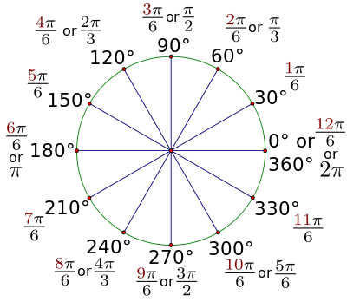
radian: the angle subtended
by an arc that is the
same length as the
circle’s radius
r
1 rad
r
2π rad = 360º
π rad = 180º
2π (i.e., 6.28…) radians
make one revolution.

Slide 10
REVIEW: Angular Displacement
1. Angular displacement Δθ is the angle that an object
in circular motion turns through. In SI, Δθ is
measured in radians. 2π – or about 6.28 – radians
are equivalent to 360º: one time around a circle.
2. Something that is a distance r away from the axis of
rotation will move through an arc length (i.e., a
linear distance) given by:
3. All points on a rotating body experience an identical
angular displacement Δθ in a given time interval.
Δs = Δθ r

Slide 11
If arc subtended
by basket between
loadings is 3.8 m,
find angular
displacement, in rad.
r = 11.5 m
r = 7.5 m
Δs
Δs = Δθ r
→ Δθ =
r
Ferris wheel
= 0.33 rad
Through what arc length does
bear move, between stops?
KEY: All points on a
rotating body undergo
IDENTICAL Δθ.
Δs = Δθ r
= 0.33 rad (7.5 m)
= 2.5 m

Slide 12
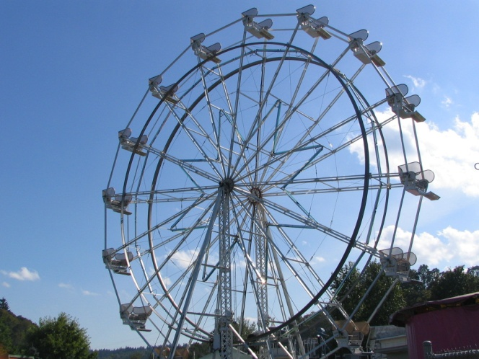
If Ferris wheel rotates at constant
angular speed, it takes
18 s to go around once.
Find avg. ang. speed.
Δt
Δθ
ω_{avg}
Δd
In linear kinematics…
v_{avg} =
= ½ (v_{f} + v_{i})
Δt
X
Δθ
In angular kinematics…
ω_{avg} =
= ½ (ω_{f} + ω_{i})
Δt
Here, we want…
Δθ
ω_{avg} =
Δt

Slide 13
Δt
ω_{i}
Same Ferris wheel takes 2.2 s to go from rest to the
ang. vel. from previous problem. Find mag. of its
ang. acceleration.
ω_{f}
α
Δv
v_{f} – v_{i}
In linear kinematics…
a =
=
Δt
Δt
X
Δω
ω_{f} – ω_{i}
In angular kinematics…
α =
=
Δt
Δt
Here, we want…
ω_{f} – ω_{i}
α =
Δt

Slide 14
FINAL THOUGHTS: Angular Velocity and
Angular Acceleration
1. While an angular displacement Δθ (in rad) is the
angle that an object in circular motion turns through,
angular velocity or angular speed ω is the RATE at
which the Δθ is turned through. The unit is rad/s.
Angular acceleration α is the rate of change of
angular velocity ω; the unit is rad/s².
2. All but one of the equations for angular kinematics
correspond exactly with the equations for linear
kinematics.

Slide 15
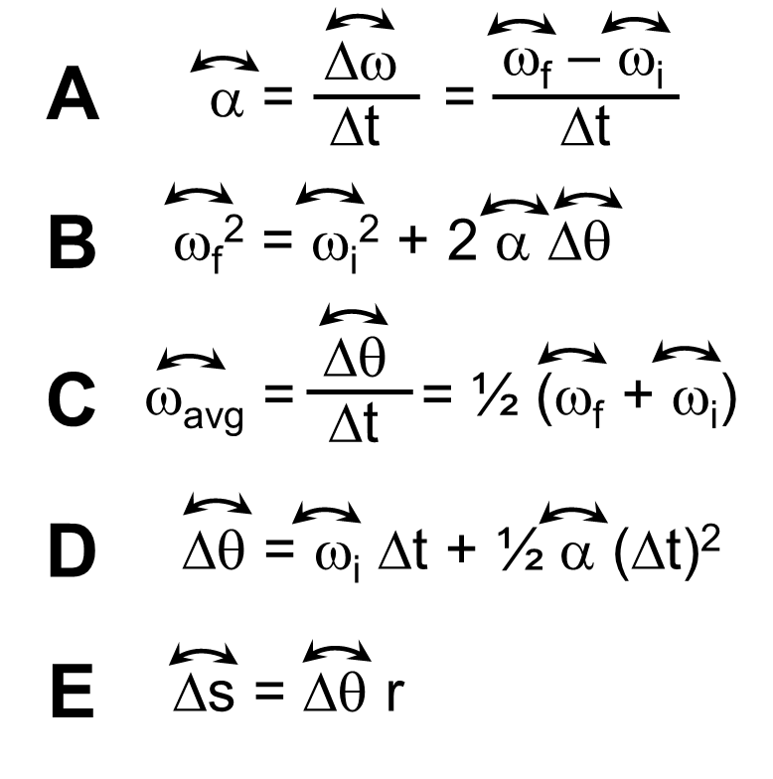
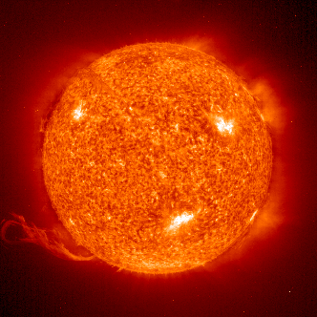
X
Find ang. speed of Earth:
ω_{avg}
-- spinning on its axis
X
Δθ
ω_{avg} =
Δt
X
X
= 7.3 x 10^{–5} rad/s
-- revolving around Sun
Δθ
ω_{avg} =
Δt
= 2.0 x 10^{–7} rad/s

Slide 16
Sign Conventions for
Δθ, ω, and α...
CW
–
+
CCW
These conventions
have their origin
in the “right-hand rule.”

Slide 17
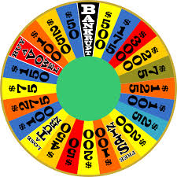
Angular Kinematics Equations
Δω
ω_{f} – ω_{i}
α =
=
Δt
Δt
ω_{f}² = ω_{i}² + 2 α Δθ
Δθ
ω_{avg} =
= ½ (ω_{f} + ω_{i})
Δt
Δθ = ω_{i} Δt + ½ α (Δt)²
Δs = Δθ r

Slide 18
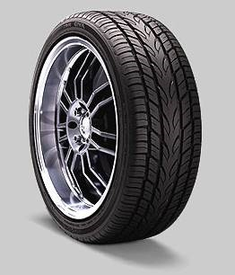
ω_{i}
X
Car wheel initially
rotates at 52 rad/s.
After braking for 7.3 s,
wheel is at rest.
Find…
Δt
X
X
ω_{f}
α
X
a. …wheel’s avg. ang. accel.
X
X
Δω
ω_{f} – ω_{i}
rad
α =
=
= –7.1
Δt
Δt
s²
Δθ
b. …wheel’s ang. displ.

Slide 19
ω_{i}
X
Car wheel initially
rotates at 52 rad/s.
After braking for 7.3 s,
wheel is at rest.
Find…
Δt
ω_{f}
α
a. …wheel’s avg. ang. accel.
X
X
Δω
ω_{f} – ω_{i}
rad
α =
=
= –7.1
Δt
Δt
s²
Δθ
???
b. …wheel’s ang. displ.
Δθ
ω_{avg} =
= ½ (ω_{f} + ω_{i})
→
Δθ
= ½ (ω_{f} + ω_{i}) Δt
Δt
Δθ = ½ (0 rad/s + 52 rad/s)(7.3 s)

Slide 20
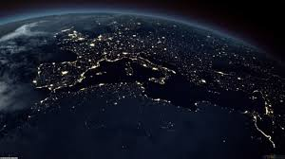
Find mag. of ang. accel. of Earth…
…spinning on its axis.
…revolving around Sun.
Δω
ω_{f} – ω_{i}
α =
=
Δt
Δt
“HA!”

Slide 21
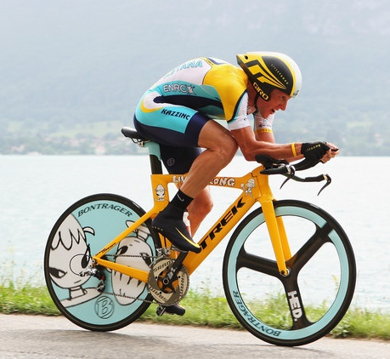
Bike wheel ^{w}/outer radius 36 cm
has init. ang. speed 5.2 rad/s.
Wheel’s speed increases to
9.8 rad/s. The ang. accel.
has mag. 0.68 rad/s².
Try GUESSing:
Given
Unknown
Equation
Solve for variable
Substitute quantities
a. How much time elapses?
?
G:
r = 0.36 m
, ω_{i} = 5.2 rad/s
, ω_{f} = 9.8 rad/s,
U:
Δt = ?
α = 0.68 rad/s²
X
Δω
ω_{f} – ω_{i}
E:
α =
=
Δt
Δt
ω_{f} – ω_{i}
S:
Δt =
α
S:
Δt
= 6.8 s

Slide 22

X
b. Find ang. displ. over this time.
Δθ
ω_{f}² – ω_{i}²
ω_{f}² = ω_{i}² + 2 α Δθ
→
Δθ =
2 α
(9.8 rad/s)² – (5.2 rad/s)²
Δθ =
2 (0.68 rad/s²)
X
= 51 rad
c. Wheel goes around how many times?
= 8.1 revs
d. What linear distance is covered?
Δs = Δθ r
= 51 rad (0.36 m)
= 18 m

Slide 23
FINAL THOUGHTS: Angular Kinematics Problems, 4
Solving angular kinematics problems is identical to
what you’ve already done for linear problems. The
formal GUESS method is great, but in any case,
the essential process is always the same:
1. Identify given quantities, from units and problem
context. Convert to proper SI units, if needed.
2. Identify the quantity you are asked to find.
3. Based on (1) and (2), choose the right equation.
4. Solve the equation for the Unknown variable.
5. Substitute quantities and round to the proper
sig figs. DONE!

Slide 24
linear distance
v_{t}
tangential speed =
time
v_{t} = r ω
ω
r
period, T: time (in s) to go around once
frequency, f: # of cycles in one second (Hz)
Δθ
2π
Since
ω =
, then…
ω =
= 2πf
Δt
T
and…
2πr
v_{t} =
= 2πrf
T

Slide 25
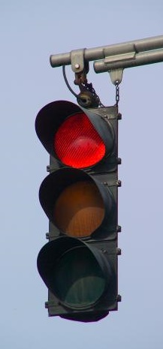
a_{t}
tangential acceleration:
a_{t} = r α
α
r
(For a_{t} and α to be something
other than zero, ang. vel. ω
must be changing.)

Slide 26
Tangential Speed and Tangential Acceleration
Unlike angular quantities – which hold their value no
matter which point on a rigid body we are
considering – tangential quantities depend on how far
the point in question is from the rotational axis. The
farther away, the larger the values, as shown below:
Tangential speed and accel.
have the units we first learned
for these quantities: m/s and
m/s², respectively.
v_{t} = r ω
2π
ω =
= 2πf
T
2πr
v_{t} =
= 2πrf
T
a_{t} = r α

Slide 27
Bike wheel spinning initially at
5.8 rad/s speeds up to 9.3 rad/s
over 15 s. Find tangential accel-
eration for reflector and valve stem.
(r_{stem} = 41 cm; r_{reflector} = 32 cm)
0.41 m
0.32 m
a_{t,refl}
valve stem…
Δω
a_{t,stem}
a_{t} = r α
= r
Δt
= 0.096 m/s²
reflector…
= 0.075 m/s²

Slide 28
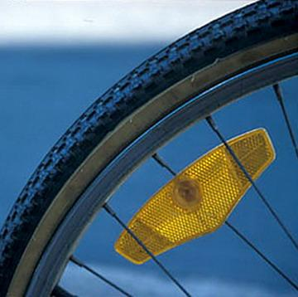
Find tangential speed after 15 s for
both valve stem and reflector.
0.41 m
0.32 m
valve stem…
v_{t} = r ω
v_{t,refl}
v_{t,stem}
= 3.8 m/s
reflector…
= 3.0 m/s

Slide 29
v_{t}
Earth-Sun distance is
1.5 x 10¹¹ m. Find Earth’s
linear speed around Sun, in m/s.
2πr
v_{t} =
T

Slide 30
REVIEW: Tangential Speed and Acceleration
For a rotating body, the tangential speed and
tangential accelerations are
the LINEAR speed and
and acceleration of a
specified point on the
body. The perpendicular
distance between the
specified point and the
axis of rotation is designated
by r. The equations that apply are shown here.
v_{t} = r ω
2π
ω =
= 2πf
T
2πr
v_{t} =
= 2πrf
T
a_{t} = r α

Slide 31
Normal, IL is at 40.5º N latitude.
Find tangential speed of
Normal around Earth’s
axis. Earth’s radius
is 6.38 x 10⁶ m.
r
Normal
40.5º
40.5º
equator
6.38 x 10⁶ m
axis
r = 6.38 x 10⁶ m (cos 40.5)
= 4.85 x 10⁶ m
Δθ
v_{t} = r ω
= r
Δt
1 day

Slide 32
centripetal acceleration (a_{c}):
acceleration toward the center
v_{t}
v_{t}²
ω
a_{c} =
= r ω²
a_{c}
r
r
For circular motion,
tangential acceleration (a_{t})
may be zero or nonzero…
(i.e., when α = 0)
but…
a_{c} is always nonzero.

Slide 33
Earth-Moon distance
is 3.84 x 10⁸ m.
r
a_{t}
a_{c}
a. Find tangential and centripetal
accelerations of Moon around
Earth.
Since ω = constant (i.e., α = 0),
a_{t} = 0 m/s²
( )
Δθ
²
a_{c} = r ω²
= r
Δt
2,592,000 s
= 2.26 x 10^{–3} m/s² toward Earth

Slide 34
b. Find resultant (i.e., the net) acceleration of Moon.
a_{t} and a_{c} are component vectors of the net accel.
a_{t}
Add like any two vectors.
object
a_{c}
a_{t}
again,
toward
Earth
a_{c}
a_{r}
axis of
motion
Since a_{t} = 0, a_{r} = a_{c} = 2.26 x 10^{–3} m/s²
c. Find tangential speed of Moon around Earth.
v_{t}²
a_{c} =
r
= 932 m/s

Slide 35
d. With what force does Earth pull on Moon?
Mass of Moon is 7.36 x 10²² kg.
Recall Newton’s 2nd Law:
Σ F = m a
centripetal force:
F_{c} = m a_{c}
ω
v_{t}
m v_{t}²
F_{c} = m a_{c} =
= m r ω²
r
r
a_{c}, F_{c}
F_{c} = m a_{c}
= 7.36 x 10²² kg (2.26 x 10^{–3} m/s²)
= 1.66 x 10²⁰ N toward Earth

Slide 36
2.6 kg stone at end of 0.74 m rope is whirled in
horizontal circle at constant rate. Period is 1.1 s.
Find rope’s tension.
T = 1.1 s
m = 2.6 kg
tension = F_{c}
r = 0.74 m
m v_{t}²
( )
Δθ
²
F_{c} = m a_{c} =
= m r ω²
= m r
r
Δt
= 63 N

Slide 37
REVIEW: Centripetal Acceleration
and Centripetal Force
1. Each bit of a revolving object – whether its angular
speed ω is changing or not –
is always experiencing
centripetal acceleration a_{c},
directed toward the axis. The distance r that the
“bit” is from the axis impacts this acceleration.
2. Centripetal force F_{c} is the center-directed force
responsible for an
object’s centripetal
acceleration a_{c}.
v_{t}²
a_{c} =
= r ω²
r
m v_{t}²
F_{c} = m a_{c} =
= m r ω²
r

Slide 38
At bottom of circular loop
of radius 16 m, roller
coaster car (m = 250 kg)
travels at 13 m/s. Find
force of track on car.
F_{track} = F + F_{c}
F
mg
F_{c}
= 5.1 x 10³ N
( )

Slide 39
FINAL THOUGHTS: Centripetal Force
Centripetal forces come in many shapes and sizes:
the tension in a rope or string, the pull of gravity on
a celestial object, the force of a curved track on a
bobsled, the pull of an atom’s nucleus on the orbiting
electrons, friction between the road and the wheels of
of a turning vehicle, and many more. Basically, any
time something is traveling in a circle (or just simply
curving), there is a centripetal force at work causing
a centripetal acceleration.

Slide 40
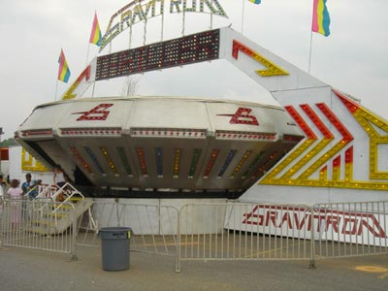
centrifugal = “away from the center”
“Centrifugal force”:
--
is an apparent force
--
exists only in a local reference frame
--
is an effect of inertia
(aerial
view)
Consider an amusement park ride:
axis
you

Slide 41
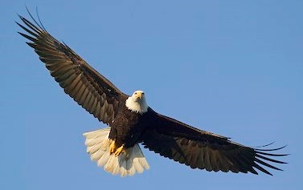
FROM YOUR FRAME
OF REFERENCE
FROM A BIRD’S FRAME
OF REFERENCE
You feel a “centrifugal force” pushing you into pads.
axis
axis
Bird sees pads pushing on you (centripetal force), changing your motion.
(What is pushing you?)
???
Magnitude of “centrifugal force” you feel
=
Magnitude of centripetal force that actually exists

Slide 42
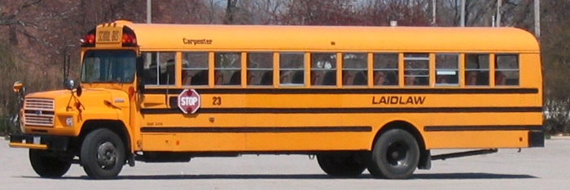
Student (m = 55 kg) rides bus moving 15 m/s around
curve of radius 16 m and is pressed against
window. Find “centrifugal force” student senses.
m v_{t}²
F_{c} = m a_{c} =
= m r ω²
r
= 770 N

Slide 43
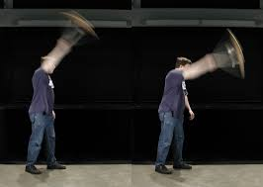

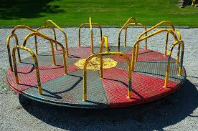
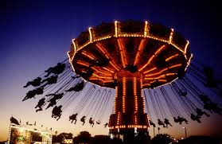
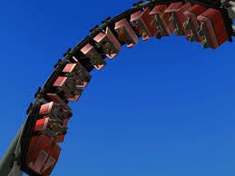
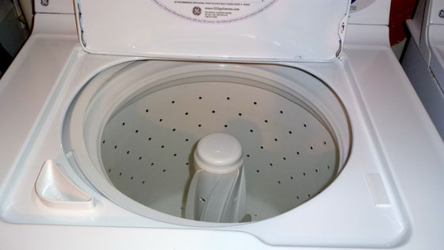
C
E
N
T
R
I
F
U
G
A
L
F
O
R
C
E
?

Slide 44
FINAL THOUGHTS: “Centrifugal Force”
“Centrifugal force” is a force one perceives due to
some kind of circular motion. It involves an object’s
inertia (i.e., its tendency to maintain a constant state
of motion) and the circular motion of either the object
itself or the surroundings. When examined from a
more global reference frame, “centrifugal force” can
be shown to be either the very real centripetal force
that keeps an observer in a circular path, or the
ABSENCE of such a force while the surroundings
rotate away from the observer.

Slide 45
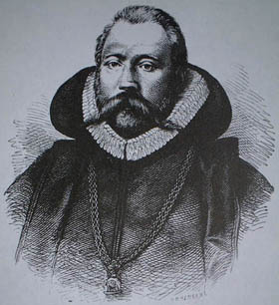
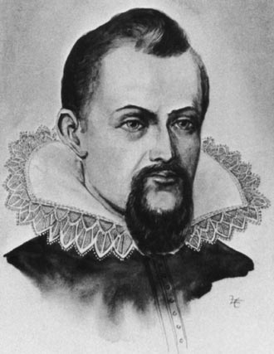
Gravity
Brahe:
measured planetary motions
Kepler:
tried (but failed) to make
Brahe’s data fit the
theory for circular orbits
1546-1601
Kepler’s Laws:
1.
Planets’ orbits are ellipses.
1571-1630
2.
A line from planet to Sun sweeps
out equal areas in equal times.
v_{fast}
When t₁ = t₂,
A₁ = A₂.
r
t₁
t₂
v_{slow}
A₁
A₂
3.

Slide 46
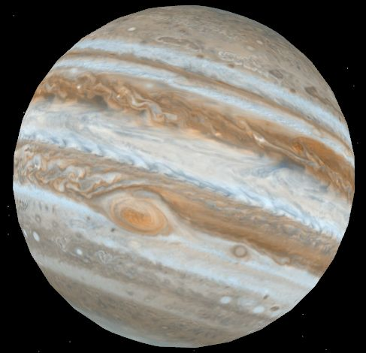
Earth is 1.50 x 10¹¹ m from
Sun; Jupiter is 7.78 x 10¹¹ m
from Sun. How long does it
take Jupiter to go once
around the Sun?
= 11.8 y

Slide 47
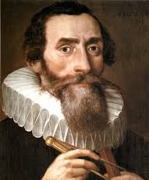
FINAL THOUGHTS: Kepler’s Laws
Brahe’s precise data allowed Kepler
to formulate his three laws of
planetary motion:
1. The planets travel in ellipses,
not circles.
2. A planet sweeps out equal areas in equal times.
3. The cube of a planet’s mean distance from the
Sun over its orbital period squared yields the same
value for all planets.

Slide 48
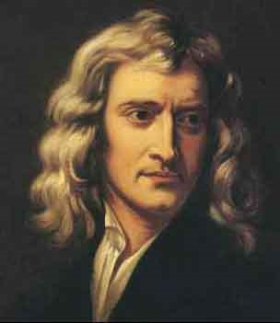
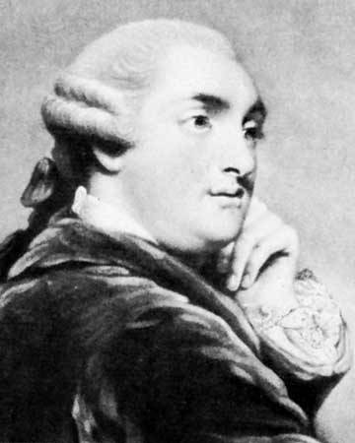
Newton:
gravity is universal
Every object in the universe attracts every other object by gravity.
1643–1727
Newton’s Law
of Gravity
m = objects’ masses (kg)
r = separation between
objects’ centers of
mass (m)
G =
Cavendish:
established value of G
1731–1810

Slide 49
m₁
m₂
45 kg girl and 53 kg boy are 14 m
apart at jr. high dance. Find force of gravity acting to
bring them together.
r
= 8.1 x 10^{–10} N

Slide 50
Earth has mass 5.97 x 10²⁴ kg and
radius 6.38 x 10⁶ m. Find force of
gravity on 34.0 kg rock.
E
r
= m_{r} g
= m g
= 333 N
This is the object’s weight, just like…
F_{w} = m g
= 34.0 kg (9.81 m/s²)
= 333 N
For any object of mass m
and mean radius r:

Slide 51
Mars has radius 3.40 x 10⁶ m. If a
12.0 kg rover weighs 44.5 N on Mars,
find mass of Mars.
= 6.43 x 10²³ kg
What is g on Mars?

Slide 52
REVIEW: Newton’s Law of Gravity
Newton’s law of gravity states that the gravitational
attraction between any two
objects is directly proportional
to the product of the objects’
masses and inversely proportional to the square
of the distance between their centers of mass.
Later, Henry Cavendish determined the value
of the universal gravitational constant G to be
6.67 x 10^{–11} N m² / kg², which turned Newton’s
proportionality into an equality.

Slide 53
Gravitational Field
-- arrow direction shows how
a dropped object would
accelerate
--
density of lines shows
strength of field
At the Earth’s surface…
…field lines are nearly parallel
and field has a nearly
constant value.

Slide 54
Einstein’s Idea of Gravity: The General Theory of Relativity
Masses don’t attract other masses via gravity. Masses (especially, large ones) alter the “curvature” of space (and time) around them. The paths of nearby objects are then affected by this curvature of space. Thus, a dropped pencil falls – NOT because there is a force between its mass and that of the Earth – but because the space around the Earth is “curved” in a particular direction (i.e., downward) and the pencil must follow the curvature of space.
GENERAL RELATIVITY DOESN’T QUITE WORK FOR BLACK HOLES...
ACTUAL
STAR
LOCATION
SUN
…BUT LIGHT IS AFFECTED BY
GRAVITATIONAL FIELDS.
APPARENT STAR
LOCATIONS

Slide 55
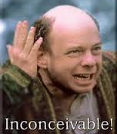
SUMMARY: Gravitational Fields and General Relativity
Gravity is such a part of our everyday experience
that we often don’t bother to think about it very much.
But when we do – and we have someone explain a
few things – an awareness of gravity and other ideas
in science makes us realize that this is a pretty
amazing universe we live in. How lucky we are to be
here, and how lucky we are to be
able to make sense of a good deal
of the natural world around us. That
fact is so remarkable that, along with
Vizzini, we say: “Inconceivable!”

Slide 56
v = 0 m/s
g = 9.81 m/s²
(rate of speeding up is decreasing)
(speeding up)
(i.e., g < 9.81 m/s²)
v = max
g = 0 m/s²
(rate of
slowing down is increasing)
(slowing down)
v = 0 m/s
g = 9.81 m/s²

Slide 57
Space station, radius 8.0 m.
At what rate must station spin so
occupants feel Earth’s gravity?
force on person
Earth’s gravity
F_{w} = m g
(i.e., T = 5.7 s)
Find g at eye level, if avg. person height is 1.7 m.
FYI:
Body can handle head-to-foot diff. in g of only ~1%.

Slide 58
So:
and
In circular motion, for constant ω,
accel. depends only on r.
Since r_{f} > r_{e}, then g_{f} > g_{e}.
For g_{f} and g_{e} to be 1% diff., r_{f} and r_{e} must be 1% diff.
Since a person’s height is ~ 2 m,
1% of station’s radius must be ~ 2 m.
Therefore, r_{min} = 200 m.

Slide 59
?
Q: Why do people weigh less at the equator
than they would if they were at the poles?
Ans. #1: Earth bulges at equator. Therefore, distance
btwn mass centers is greater, so force is less.
Ans. #2: Earth spins.
BATHROOM SCALE
VELCROED
TO EARTH
The faster the Earth spins, the lower the scale reads.
If Earth spins fast enough, the scale reads zero.

Slide 60
Abbreviated Explanation
Earth’s pull on Moon = F_{g}
Earth
F_{g}
Moon
Centripetal force to keep Moon moving in a circle = F_{c}
?
= F_{g} – F_{c}
Apparent weight of Moon =
ZERO
On Earth’s surface, gravity pulls on 71 kg mass with…
F_{g} = F_{w} = m g
= 71 kg (9.81 m/s²)
= 696.5 N
At equator…
At equator, scale reads… 696.5 N – 2.4 N = 694.1 N.

Slide 61
Consider a hydrogen atom…
m_{P+} = 1.673 x 10^{–27} kg
q_{P+} = 1.60 x 10^{–19} C
m_{e–} = 9.109 x 10^{–31} kg
5.3 x 10^{–11} m
q_{e–} = 1.60 x 10^{–19} C
F_{g} = 3.6 x 10^{–47} N (attractive)
F_{elec} = 8.2 x 10^{–8} N (attractive)
F_{elec} is 2.3 x 10³⁹ X larger.
2,300,000,000,000,000,000,000,000,000,000,000,000,000

Slide 62
Then why don’t electrostatic forces rule the heavens?
Consider a typical proton and electron on Earth and Moon
+_{E}
–_{E}
+_{M}
–_{M}
Moon
Earth
Electrostatic Force |  |  |  | Gravitational Force
 | +_{E} | –_{E} |  |  | +_{E} | –_{E}
+_{M} |  |  |  | +_{M}
–_{M} |  |  |  | –_{M}
repel
attract
attract
attract
attract
repel
attract
attract
www.teachnlearnchem.com

