Slide 1
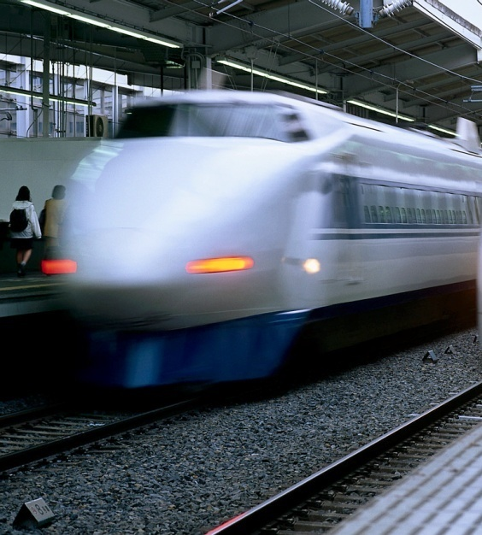
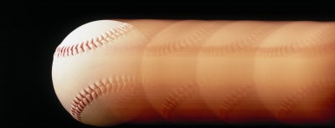
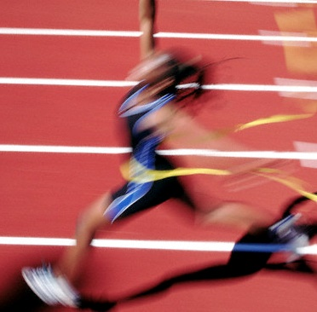
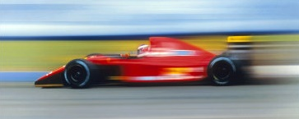
Momentum

Slide 2
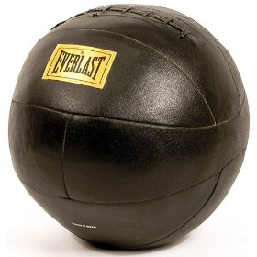
Momentum →
product of mass and velocity
m = mass (kg)
p = m v
v = velocity (m/s)
p = momentum (kg-m/s)
Unlike energy, momentum is a vector.
Direction matters.
EX. What is the momentum of a 3.5 kg
medicine ball traveling 4.3 m/s north?
p = m v
= 3.5 kg (4.3 m/s N)
= 15 kg-m/s N

Slide 3
FINAL THOUGHTS: Introduction to Momentum
1. An object’s momentum is the product of its
mass and its velocity.
2. The SI unit for momentum is the kg-m/s.
3. Because momentum is a vector quantity, we
must always specify a direction. This will
be very important for us to
remember in future lessons.
p = m v

Slide 4
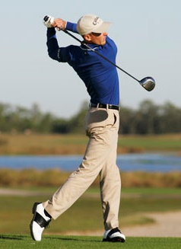
The Impulse-Momentum Theorem
F Δt = m Δv
impulse:
a net force multiplied
by the time it acts
CHANGES
OBJECT’S
MOMENTUM
Derived from Newton’s 2nd Law:

Slide 5


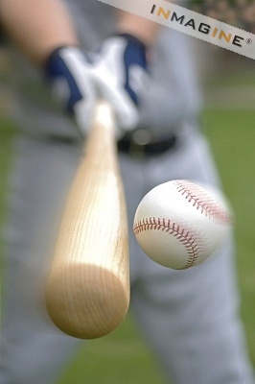
F Δt = m Δv

Slide 6
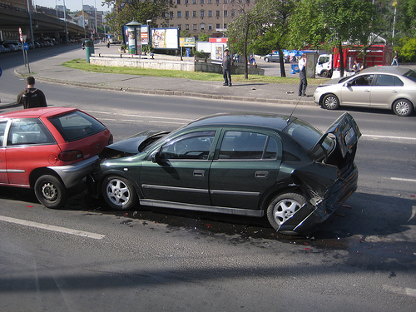
F Δt = m Δv

Slide 7
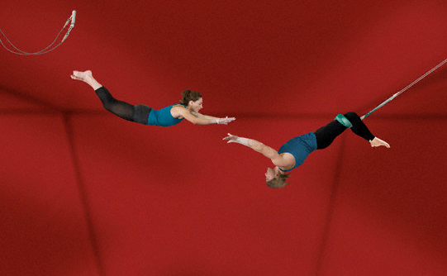
F Δt = m Δv

Slide 8
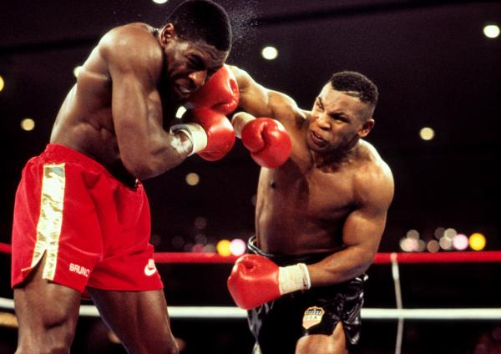
F Δt = m Δv

Slide 9
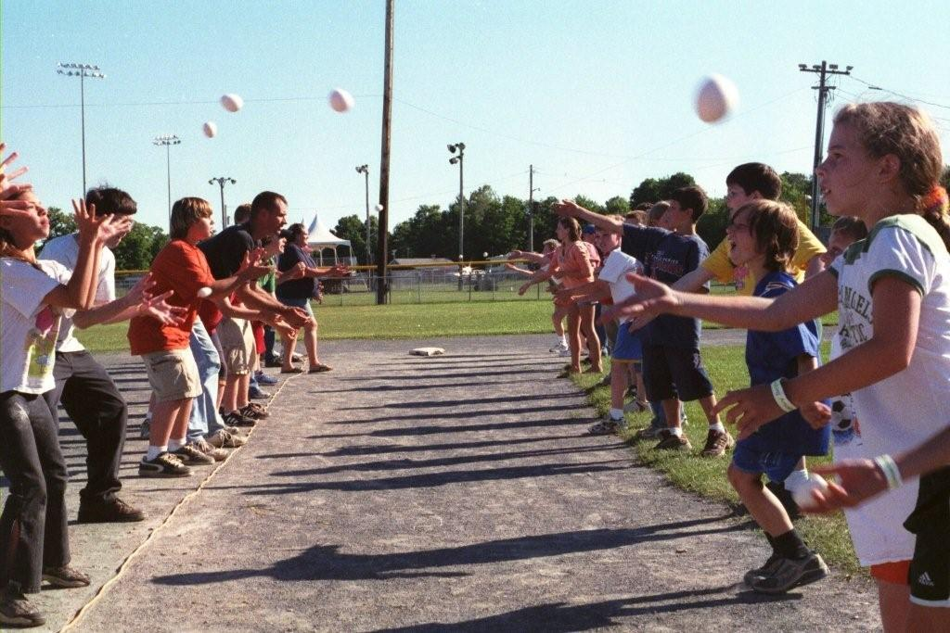
F Δt = m Δv

Slide 10
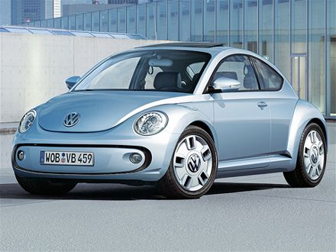
1320 kg car traveling 40.0 m/s. 68 kg
passenger applies brakes 8.5 s to
bring car (and himself) to rest. Find
avg. force seatbelt must exert on
person over this time.
We assumed
v was (+), so F
turns out (–).
= –320 N
Suppose Δt = 0.12 s instead.
= –2.3 x 10⁴ N

Slide 11
255 g ball traveling 12 m/s hits
wall and rebounds at 12 m/s .
If ball contacts wall for 0.18 s,
find force of wall on ball.
+ = →
= ???
(v is a VECTOR!)
= –34 N

Slide 12
FINAL THOUGHTS: The Impulse-Momentum
Theorem
1. The impulse-momentum theorem says that a NET
force applied to an object over a certain time interval
will change the momentum of the object. It is a
restatement of Newton’s 2nd law.
A better name might be the
“impulse-CHANGE-IN-momentum theorem.”
2. For a given change in momentum, a large time
interval means a smaller net force; a tiny time
interval means a larger net force.
F Δt = m Δv

Slide 13
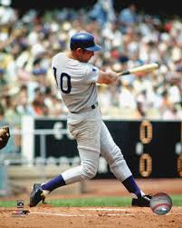
MORE FINAL THOUGHTS: The Impulse-Momentum
Theorem
When doing calculations involving
momentum, it is very important
to keep in mind that both velocity
and momentum are vectors.
The choice of which direction
is (+) is arbitrary, but realize
that your choice of which
direction is (+) and which is (–)
applies to BOTH velocity AND
momentum for that problem.

Slide 14
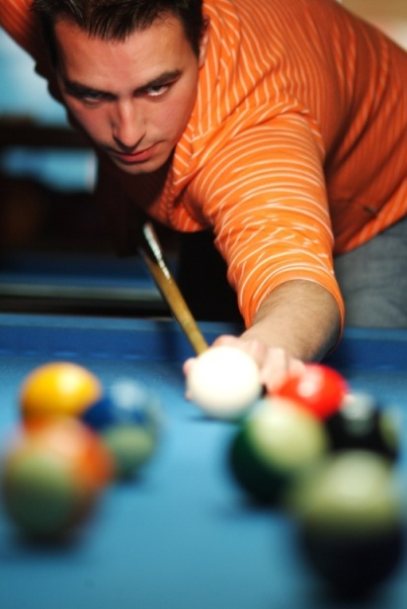

Three Types of Collisions
1. elastic:
objects bounce; no energy lost
-- mechanical energy is conserved
Σ ME_{f} = Σ ME_{i}
-- momentum is conserved
Σ p_{f} = Σ p_{i}
-- best approximate examples:
billiards; a super ball
-- best nearly-perfect example:
gas particles at high temp.
and low pressure

Slide 15
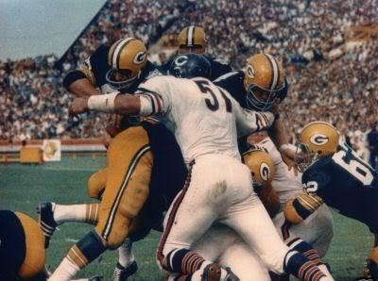
Three Types of Collisions (cont.)
2. perfectly inelastic:
objects stick together
-- some energy is “lost” as heat or deformation
“energy not easily
recovered” OR
“energy no longer useful”
“energy
dis-
appeared.”
“Energy
lost”
MEANS
NOT
-- momentum is conserved
Σ p_{f} = Σ p_{i}
-- e.g.,
railroad cars
coupling; a “good”
tackle in football

Slide 16
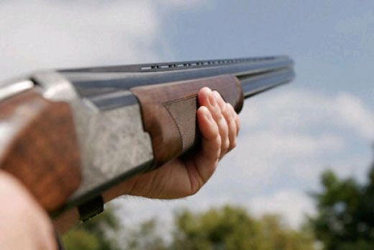
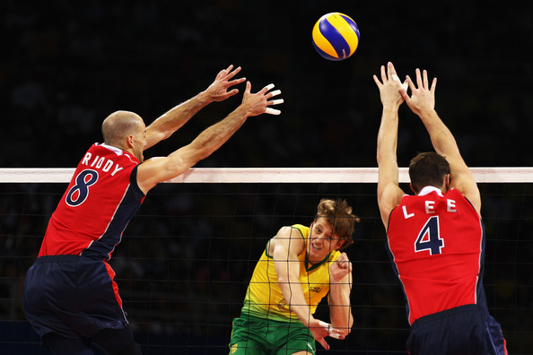
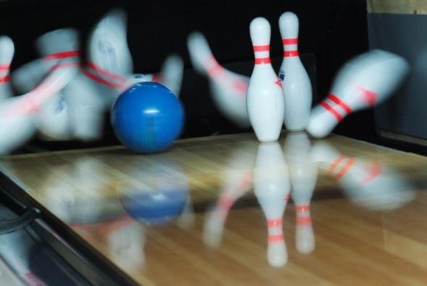
Three Types of Collisions (cont.)
3. inelastic:
objects bounce, but
some energy is “lost”
-- momentum is conserved
Σ p_{f} = Σ p_{i}
In any closed system,
momentum is ALWAYS conserved.
Σ p_{f} = Σ p_{i}

Slide 17
FINAL THOUGHTS: Collisions
1. In an elastic collision, objects bounce off each other
with no loss of mechanical energy (ME). BOTH ME
and momentum (p) are conserved. Elastic collisions
are rare in the macroscopic world, but are common
btwn gas particles at normal temps and pressures.
2. In a perfectly inelastic collision, objects collide and
stick together. ME is NOT conserved, but p is.
3. In an inelastic collision, objects bounce off one
another but there is net a loss of ME. Once again,
momentum
is conserved.
Σ p_{f} = Σ p_{i}
John Bergmann
www.teachnlearnchem.com

Slide 18
14 kg toddler throws 0.38 kg
football 4.7 m/s .
Find recoil velocity of child.
Σ p_{f} = Σ p_{i}
0
m_{child}v_{child} + m_{ball}v_{ball} =
14 kg (v_{child}) + 0.38 kg (4.7 m/s) = 0
v_{child} = –0.13 m/s (i.e., 0.13 m/s ← )

Slide 19
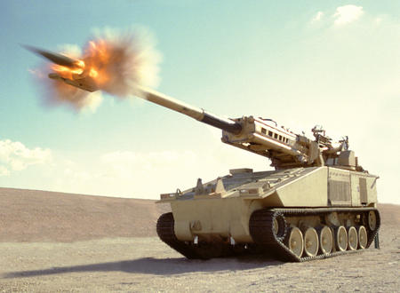
Σp_{i} = Σp_{f}

Slide 20
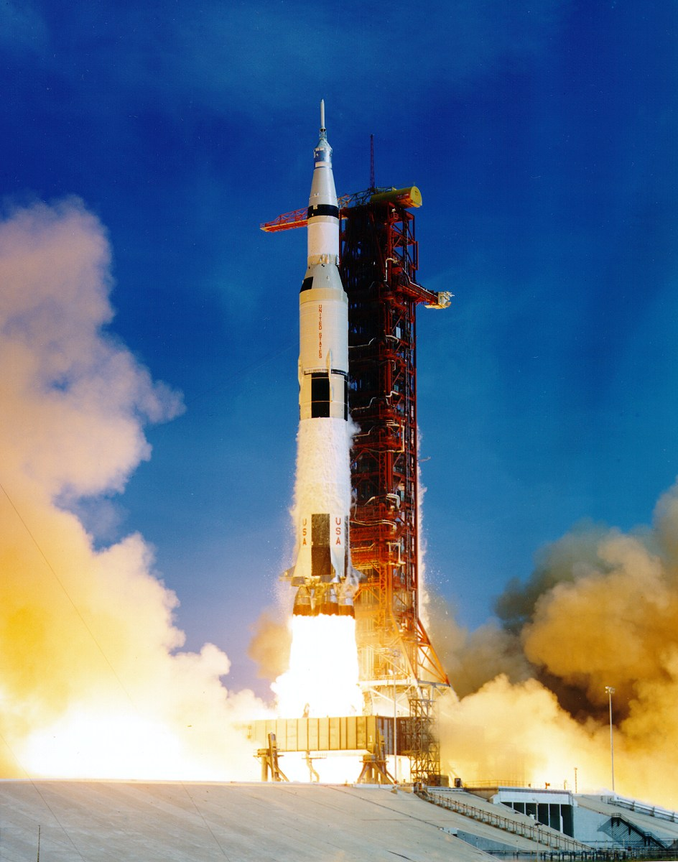
Σp_{i} = Σp_{f}

Slide 21
8.0 ton rocket travels at 3.0 mi/s . After firing
engines, rocket’s mass drops to 7.0 tons and it
travels at 5.0 mi/s . Has momentum been
conserved? Explain.
m = 8.0 T
v = 3.0 mi/s →
(engines fire)
m = 7.0 T
v = 5.0 mi/s →
Ans. #1: YES; p is ALWAYS conserved.
???
Ans. #2: YES, and don’t forget the exhaust gas.
v_{gas} = –11 mi/s

Slide 22
FINAL THOUGHTS: Conservation of
1-D Momentum, 1
For a closed system, the total momentum at the
end equals the total momentum at the beginning.
Even if there is no motion initially, that simply means
that the total initial momentum is zero and that, at
the end, one part of the system must go “this way”
(with, say, positive velocity and momentum) while
another part of the system must
go “that way” (with negative
velocity and momentum).
Σ p_{f} = Σ p_{i}

Slide 23
Train Car A has mass 25,000 kg and init. vel.
5.0 m/s → . Car B, ^{w}/mass 15,000 kg, is initially
at rest. Cars collide and couple. Find vel. at which
cars move off together.
A
B
A
B
=
p_{i}
p_{f}
=
25,000 kg (5 m/s →)
40,000 kg (v_{f})
v_{f} = 3.1 m/s →

Slide 24
Is kinetic energy conserved?
Ans. #1: NO; ME isn’t conserved for
perfectly inelastic collisions.
Ans. #2: NO. (Show me!)
“HA!”
How much energy was lost as heat
(and/or used to deform coupling mechanism)?
“Lost” energy = (3.1 x 10⁵ – 1.9 x 10⁵) J
= 1.2 x 10⁵ J

Slide 25
55 kg shopping cart travels at
3.0 m/s . 19 kg child, moving
5.0 m/s , jumps onto end of cart.
Find final vel. of cart/child system.
+ = →
p_{i}
p_{f}
=
19(5) + 55(–3)
74 v_{f}
v_{f} = –0.95 m/s (i.e., ←)

Slide 26
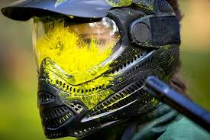
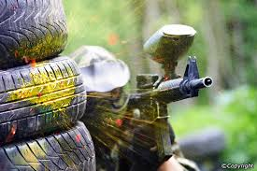
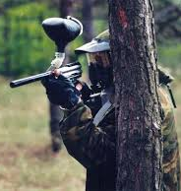
“Why Does it Hurt More When
the Paintballs DON’T Break?”
2
?
2
mv
0
mv
(little
owie)
YOU
paintball
breaks
incoming
paintball
3
2
–
?
1
mv
mv
–
(bigger
owie)
mv
YOU
incoming
paintball
paintball
doesn’t
break

Slide 27
Handcarts A and B are on train track. “A” ^{w}/passenger
has mass 185 kg and moves at 3.5 m/s . “B”
^{w}/passenger has mass 150 kg and moves at
2.0 m/s . B starts out 15 m ahead of A.
A
185 kg
B
150 kg
3.5 m/s →
2.0 m/s →
15 m
a. How long before A catches B?
15 m to make up; 1.5 m/s “closing speed”
→ 10. s
b. How far do A and B go in this time?
A: 3.5 m/s (10. s) = 35 m
B: 2.0 m/s (10. s) = 20. m

Slide 28
c. What % of initial KE is “lost” if handcarts couple?
185 kg
150 kg
335 kg
3.5 m/s →
2.0 m/s →
v_{f}
p_{i}
p_{f}
=
(2.83 m/s)
185 (3.5) + 150 (2.0)
335 (v_{f})
= 1433 J
= 1341 J
% lost = 92 J / 1433 J
6.4% lost

Slide 29
FINAL THOUGHTS: Conservation of
1-D Momentum, 4
In this problem with carts A and B, we know right from
the beginning that the final velocity of the coupled carts
must be between 2.0 m/s and 3.5 m/s. Here’s how:
When Cart A smacks into the back of B, A receives an
impulse from B that acts to slow A down. When Cart B
gets rammed by A, B receives an equal impulse that
acts to speed B up. Since the two carts stick together,
they must end up with the same velocity at the end;
namely, a velocity between 2.0 m/s
and 3.5 m/s.

Slide 30
Car A, ^{w}/mass 1340 kg, travels east at 21.3 m/s.
Car B, ^{w}/mass 2150 kg, travels north at 18.4 m/s.
Vehicles collide and couple. Find resultant vel. of
coupled vehicles.
A
v_{f} = ?
1340 kg
For a system, total
momentum is conserved,
and so are components
of momentum.
21.3 m/s
2150 kg
18.4 m/s
B
Σ p_{f} = Σ p_{i}
◊ Σ p_{xf} = Σ p_{xi}
AND Σ p_{yf} = Σ p_{yi}

Slide 31
A
v_{f} = ?
1340 kg
21.3 m/s
2150 kg
Σ p_{xi} = Σ p_{xf}
18.4 m/s
1340 (21.3)
=
3490 (v_{xf})
B
v_{xf} = 8.18 m/s
Σ p_{yi} = Σ p_{yf}
v_{f}
11.34 m/s
2150 (18.4)
=
3490 (v_{yf})
θ
v_{yf} = 11.34 m/s
8.18 m/s
v_{f} = 14.0 m/s @ 54.2º N of E

Slide 32
Car A, ^{w}/mass 1500 kg, goes 22 m/s at 63º S of E.
Car B, ^{w}/mass 1900 kg, goes 12 m/s W. Vehicles
collide and couple. Find resultant vel. of two-car object.
A
63º
+ = →
1500 kg
22 m/s
1900 kg
12 m/s
B
Σ p_{xi} = Σ p_{xf}
v_{f} = ?
1500 (22 cos 63)
+ 1900(–12)
=
3400 (v_{xf})
–7818.3 = 3400 (v_{xf})
v_{xf} = –2.30 m/s
(i.e., 2.30 m/s )

Slide 33
A
63º
+ =
→
1500 kg
22 m/s
1900 kg
12 m/s
B
Σ p_{yi} = Σ p_{yf}
1500 (22 sin 63)
=
3400 (v_{yf})
2.30 m/s
v_{yf} = 8.65 m/s
θ
8.65 m/s
v_{f}
v_{f} = 9.0 m/s @ 75º S of W

Slide 34
FINAL THOUGHTS: Conservation of
2-D Momentum, 2
Not only is total momentum conserved in any
collision, but the components
of momentum are
conserved as well.
In equation form, we have:
In dealing with components of momentum, we
necessarily deal with components of velocities,
and so it is necessary to get those trig functions
out again. And never forget to
choose + and – directions!
Σ p_{xf} = Σ p_{xi}
Σ p_{f} = Σ p_{i}
AND
Σ p_{yf} = Σ p_{yi}

Slide 35
Car A, ^{w}/mass 1260 kg, goes east. Car B, ^{w}/mass
1630 kg, goes 30.º N of E. Vehicles collide and couple.
The skid marks are 44 m long at 18º N of E. Coeff. of
friction is 0.80. Find initial speeds of A and B.
v_{Ai} = ?
44 m
1260 kg
18º
A
μ_{k} = 0.80
30.º
B
1630 kg
v_{Bi} = ?

Slide 36
Draw FBD of coupled cars… (ground-level view,
NOT bird’s-eye view)
F_{n} = mg
= 2890 (9.81)
v
= 28351 N
F_{k} = μ_{k} F_{n}
= 0.80 (28351)
F_{k}
22681 N
= 22681 N
F_{net} and d
are in
opposite
senses!
W_{net} = ΔKE
F_{n}
mg
28351 N
0
F_{net} d = ½ m (v_{f}² – v_{i}²)
–22681 (44)
= ½ (2890) (–v_{i}²)
v_{i} = 26.3 m/s (@ 18º)
This is vel. of (A+B) immediately after impact.

Slide 37
v_{Ai} = ?
44 m
1260 kg
18º
A
26.3
m/s
μ_{k} = 0.80
1630 kg
v_{Bi} = ?
30.º
B
Σ p_{yf} = Σ p_{yi}
2890 (26.3 sin 18)
= 1630 (v_{Bi} sin 30)
v_{Bi} = 28.8 m/s
v_{Bi} = 29 m/s
(~64 mph)
Σ p_{xf} = Σ p_{xi}
2890 (26.3 cos 18)
= 1630 (28.8 cos 30) + 1260 v_{Ai}
v_{Ai} = 25 m/s
(~56 mph)
v_{Ai} = 25.1 m/s

Slide 38
FINAL THOUGHTS: Conservation of
2-D Momentum, 3
Here, we tried our hand at a problem that integrated
concepts from several units of study in Mechanics:
-- from 2-D kinematics: ideas with regard to motion
-- from Newton’s laws: drawing a free-body diagram
-- from work/energy studies: the work-KE theorem
-- from momentum: conservation of 2-D momentum
There was a lot going on here. If you could navigate
your way through this, you’re well on your way to a
thorough understanding of Mechanics!
John Bergmann
www.teachnlearnchem.com

