Slide 1
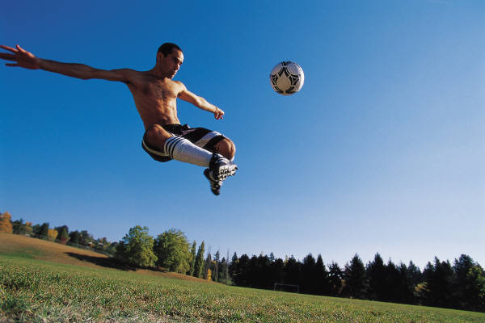
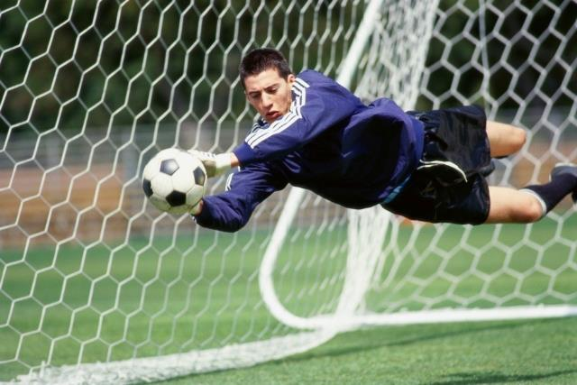
Newton’s Laws
kinematics: the describing of HOW things move
(i.e., how far, how fast, accelerating or not, etc.)
dynamics:
the study of…
WHY things move
(i.e., the effects of forces on objects)

Slide 2
The Beginnings of Dynamics
Aristotle (384–322 B.C.E.)
didn’t experiment, but claimed:
-- heavier things fall faster
-- forces arise from matter…seeking to return to
its “natural” place
e.g.,
smoke drifting upward, rivers flowing to
the sea, boulders rolling down a mountain

Slide 3
Galileo Galilei (1564–1642)
Among other things, he rolled spheres down inclined planes.
h
h
When would sphere stop?
h
In theory: NEVER.
Galileo saw that, as long as its environment remained
constant, the sphere would continue rolling…and rolling...

Slide 4
Newton’s First Law of Motion (Law of Inertia)
An object at rest tends to stay at rest – and an object in motion tends to stay in motion at constant velocity – unless the object is acted upon by an unbalanced, external force.
The Law of Inertia is universal: It applies to all
objects, moving and nonmoving, massive or not.

Slide 5

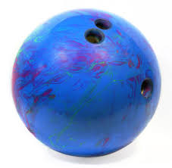
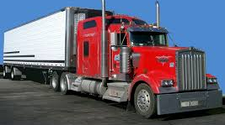
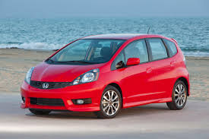
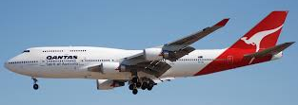
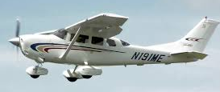

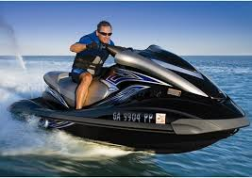

Slide 6
FINAL THOUGHTS: Introduction to Dynamics
1. Kinematics deals with motion’s “whats”: Δd, v, a, Δt.
Dynamics deals with the WHY of motion: forces.
Of course, forces influence the whats of kinematics.
2. Aristotle said that forces in nature were the result of
things seeking their natural place.
3. Galileo realized that continually-applied forces were
not necessary to keep an object in motion.
4. Newton’s Law of Inertia says that objects tend to
maintain their state of motion. The more inertia they
have (due to their mass), the more they “want” to
maintain that state of motion.
www.teachnlearnchem.com

Slide 7
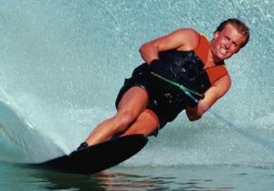

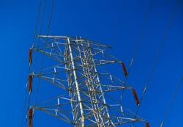
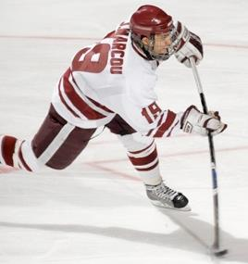

An Introduction to Forces
force: a push or pull; forces are vectors
contact forces
field forces
require physical contact
transmitted without
physical contact
e.g.,
push/pull
e.g.,
gravity
friction
electric
electromagnetism
?
?
?
?
magnetic
?
LOVE
?
?
?
?
?

Slide 8

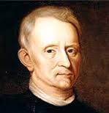

Springs exert forces, but
ONLY when they are
stretched or compressed.
If stretched, springs…
If compressed, springs…
pull (i.e., try to contract).
push (i.e., try to expand).
The FARTHER they are
stretched (or compressed),
the ________ the elastic force
with which they pull (or push) back.
Springs conform to
Hooke’s law:
LARGER
F_{elas} = –k Δx
k = spring constant (N/m)
Δx = change in length (m)
Robert Hooke
(1635–1703)
(–) sign means F and Δx
are in opposite senses.

Slide 9
Forces, 1
1. A force is a push or pull. Contact forces require physical
contact between objects or surfaces; field forces can
act between objects even if the objects aren’t touching.
2. Springs push or pull, depending on how they are
displaced. Hooke’s law governs forces in springs.
F_{elas} = –k Δx
John Bergmann
www.teachnlearnchem.com

Slide 10
weight (F_{w}): gravity’s effect on object;
always acts
m
m
F_{w}
F_{w}
θ
Equation for weight:
F_{w} = weight (N)
m = mass (kg)
g = 9.81 m/s²
F_{w} = m g

Slide 11
On “incline” problems, it is convenient to
resolve all forces into and // components.
For weight F_{w}…
m
F_{w //}
= F_{w} sin θ
= mg sin θ
mg cos θ
θ
F_{w}
θ
F_{w}
F_{w}
= F_{w} cos θ
= mg cos θ
F_{w //}
mg sin θ

Slide 12
normal force (F_{n}): the force a surface exerts on
object normal (i.e., ) to surface
F_{a}
F_{a}
m
m
m
g
g
g
F_{n}
F_{n}
F_{n}
m
F_{n} changes with surface
angle and ^{w}/applied force
(dir. & mag.), but remains
at right angles to surface.
F_{n}
θ
mg cos θ
mg sin θ

Slide 13
Forces, 2
Weight is the gravitational pull on an object. It always
acts straight downward, but can be resolved into
components for ease of use in solving certain problems.
The normal force is one force a surface exerts on an
object. It is always perpendicular to a surface, no
matter the orientation of the surface.
F_{w} = m g
John Bergmann
www.teachnlearnchem.com

Slide 14
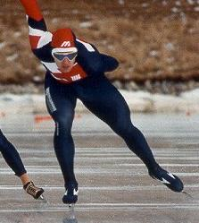
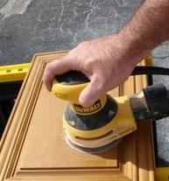
Friction
--
the force a surface exerts on an object // to surface
-- depends on: 1. nature of contact surfaces
roughness, material, geometry
2. the normal force
i.e.,
the one pressing
the surfaces together
Surface B (e.g., a book)
Surface A (e.g., a table)

Slide 15
Static Friction
(F_{s})
-- when objects are NOT moving
relative to each other
F_{a} = 0 N
m
F_{s} = 0 N
F_{a}
F_{s}
F_{a}
F_{s}
F_{a}
F_{s,max}
μ_{s} = coeff. of static friction
F_{s} can take any value from zero to F_{s,max}.

Slide 16
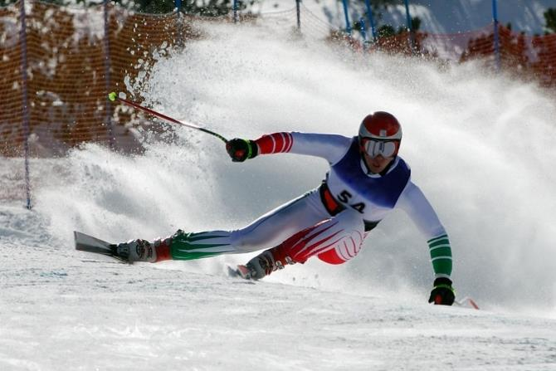
(F_{k})
Kinetic Friction
--
“sliding” friction
-- has only one value for a
given set of conditions
It doesn’t matter if you have “speeding-up sliding,”
“slowing-down sliding,” or “constant-speed sliding:”
F_{k} is F_{k} is F_{k} for a given set of conditions.
μ_{k} = coeff. of kinetic friction
For a given set of conditions,
F_{k} is always less than F_{s,max}.

Slide 17
FINAL THOUGHTS: Forces, 3
1. While a normal force is the force exerted by a
surface on an object perpendicular to the surface,
friction acts on the object PARALLEL to the surface.
No matter the orientation of the surface, normal and
friction forces are at right angles to each other.
2. With static friction, there is no relative motion btwn
surface and object, despite sideways forces acting.
3. Kinetic friction is sliding friction.
4. A coefficient of friction is a number that accounts for
the nature of the two contact surfaces. Bigger coeffs
of friction mean “stickier” surfaces.

Slide 18

free body diagram (FBD):
shows object and the
forces acting on it
We do NOT show surfaces in FBDs.
-- For now, we will assume that all forces act at
the body’s center of mass.
F_{a}
F_{a}
m
mg
F_{n}

Slide 19
v > 0
F_{a}
F_{av}
m
F_{ah}
μ_{k} F_{n}
F_{n}
mg
v = 0
F_{a}
F_{a}
m
F_{s}
F_{n}
mg

Slide 20
m
v > 0
frictionless
θ
F_{n}
mg cos θ
mg sin θ

Slide 21
SUMMARY: Free Body Diagrams
1. A free body diagram (FBD) is a simple picture that
models an object and shows all the forces acting on
the object. Resist the initial urge to draw surfaces in
an FBD, but PLEASE DO draw in the force(s) that
a surface exerts on the object.
2. It is usually most convenient to resolve all forces
into two mutually perpendicular directions. If there
is a surface, the two directions should be parallel to
and perpendicular to the surface.

Slide 22
Equilibrium
On an object in equilibrium...
all forces are balanced.
Situation: FBD:
In deep space…
On Earth…
F_{n}
mg

Slide 23
Situation: FBD:
F_{a}
Still on Earth…
F_{s}
F_{n}
mg
An object in equilibrium is either…
1.
standing still, or
2.
moving at a constant, nonzero velocity.
i.e.,
it is NOT accelerating
The net force on such an object is...
zero (ΣF = 0).

Slide 24
20 N
(assume we’re
out in
deep space)
m
already moving ←
already moving →
At moment force is applied, box is… | What happens?
at rest
moving 20 m/s →
moving 20 m/s ←
begins moving →
speeds up →
begins to slow down

Slide 25
30 N
30 N
(still in
deep space)
m
(say, already moving →)
What if box is… | What happens?
at rest
already moving
remains at rest
continues at
constant velocity

Slide 26
Sometimes, net force is zero in one direction but NOT zero in another.
F_{a} = 80. N
m
ΣF_{x} =
30 N →
F_{k} = 50. N
ΣF_{y} =
0 N
F_{n} = F_{w} = 100. N
VERTICAL
-- _________ equilibrium ONLY

Slide 27
FINAL THOUGHTS: Equilibrium
1. For now, an object is in equilibrium if there is zero
net force acting on it. An object in equilibrium could
have many forces acting on it, but they would cancel
to yield a net of ZERO. For any given direction, we
must assign a (+) and a (–) sense so we know
when to add forces and when to subtract them.
2. It is a common misconception that a moving object
must have a net force acting on it. If the object is
moving at constant velocity (and that includes a
velocity of zero), it is in equilibrium, and the net
force on it is…ZERO.

Slide 28
Newton’s Second Law of Motion
ΣF = m a
ΣF = m a
//
//
By Newton’s 2nd Law, objects…
…in equilibrium (i.e., experiencing NO net force)...
40 N
40 N
are NOT accelerating.
m
…experiencing a net force...
ARE accelerating.
i.e.,
they are speeding up, slowing down, and/or changing direction.
70 N
20 N
m

Slide 29
To solve Newton’s 2nd Law problems
(i.e., “force” problems):
1. Draw a correct FBD. Don’t forget any forces.
2. For direction “A,” write ΣF_{A} = m a_{A}. If there is a
surface, direction “A” should generally be the
one perpendicular to the surface. Solve for
whatever you can.
3. For direction “B,” write ΣF_{B} = m a_{B}. Solve for
whatever you need to. You will probably
be able to substitute in something you
solved for in the ΣF_{A} = m a_{A} part.
4. You should be done. Round your
answer properly and make sure
it has the correct unit (if any).

Slide 30
A __ kg mass moving along horiz. surface is acted upon by a ___ N force in direction of its motion. If coeff. of kinetic friction is ___, find mass’s acceleration.
v
F_{a}
a = ?
m
μ_{k}
0
ΣF :
F_{a}
F_{n}
– mg
= m a
m
μ_{k} F_{n}
F_{n} = mg
F_{n}
mg
ΣF//:
F_{a}
– μ_{k} F_{n}
= m a//

Slide 31
To solve Newton’s 2nd Law problems
(i.e., “force” problems):
1. Draw a correct FBD. Don’t forget any forces.
2. For direction “A,” write ΣF_{A} = m a_{A}. If there is a
surface, direction “A” should generally be the
one perpendicular to the surface. Solve for
whatever you can.
3. For direction “B,” write ΣF_{B} = m a_{B}. Solve for
whatever you need to. You will probably
be able to substitute in something you
solved for in the ΣF_{A} = m a_{A} part.
4. You should be done. Round your
answer properly and make sure
it has the correct unit (if any).

Slide 32
A ___ kg mass moving horizontally is acted upon by a ___ N force inclined up and to-the-right at ___º above horizontal. Coeff. of kinetic friction is ___. Find mass’s acceleration.
a = ?
v
F_{a}
θ
m
μ_{k}
F
0
ΣF :
F_{n}
– mg
+
= m a
m
F
μ_{k} F_{n}
F//
F_{n} = mg –
F
F_{n}
mg
ΣF//:
– μ_{k} F_{n}
F//
= m a//

Slide 33
A ___ kg mass hangs vertically at rest from a spring.
If the spring displaces ___ cm, find the force constant.
FBD…
0
ΣF :
k Δx – m g = m a
F_{elas}
= k Δx
We took the
(–) sign into
account by
pointing F_{elas}
the way we
KNOW it goes.
So… k Δx = m g
m
F_{w}
= m g

Slide 34
A ___ kg mass is at rest on horizontal surface. Rope tied to mass has
tension ___ N and is angled ___º
above horizontal. Also, a ___ N force presses mass into surface. Find normal & friction forces.
F_{a}
F_{n} = ?
T
F_{s} = ?
v = 0
m
θ
0
ΣF :
T sin θ
T sin θ + F_{n} – F_{a} – mg
= m a
F_{a}
T cos θ
m
0
ΣF//:
F_{s}
T cos θ – F_{s}
= m a//
mg
F_{n}

Slide 35
A ___ kg mass at rest on horiz. surface requires a ___ N applied horiz. force to make it begin moving. Find coeff. of static friction between mass and surface.
v = 0
F_{a}
m
μ_{s} = ?
0
ΣF :
= m a
F_{n} – mg
F_{a}
F_{n} = mg
m
0
F_{s,max}
ΣF//:
F_{a} – F_{s,max}
= m a//
F_{n}
F_{s,max} = F_{a}
mg
F_{a}
=
mg

Slide 36
To keep ___ kg mass moving at constant velocity, only ___ N
is req’d. Find coeff. of kinetic friction.
v = constant →
F_{a}
m
μ_{k} = ?
0
ΣF :
F_{n} – mg
= m a
F_{n} = mg
F_{a}
m
0
μ_{k} F_{n}
ΣF//:
F_{a} – μ_{k} (mg)
= m a//
F_{n}
F_{a} = μ_{k} mg
mg
F_{a}
μ_{k}
=
mg

Slide 37

A ___ kg mass hangs from ceiling by
a single rope. Find tension in rope.
T = ?
0
m
ΣF:
T – mg
= m a
T = mg
T
m
mg

Slide 38
Same ___ kg mass hangs now from two ropes, each having angle of ___º above horiz. Find tension in each rope.
T_{L} = ?
T = ?
T_{R} = ?
T = ?
θ
θ
If ropes are same mat’l and
thickness, then T_{L} = T_{R} when the θs are equal. Rename both tensions as “T.”
m
T_{y}
T_{y}
T
T
ΣF_{y}:
2T_{y} – mg
0
= m a_{y}
θ
θ
T_{x}
T_{x}
2 T_{y} = mg
m
So…T_{y} = ½ mg
= T sin θ
mg
mg
And… T =
2 sin θ
www.teachnlearnchem.com

Slide 39
A ___ kg mass is being pushed upwards along a vert. surface by a force of ___ N at an angle of ___º above the horizontal. If the coeff. of kinetic friction is ___, find the mag. of the mass’s acceleration.
v
a = ?
m
μ_{k}
0
F_{a}
ΣF : F_{a} cos θ – F_{n} = m a
θ
F_{n} = F_{a} cos θ
μ_{k} F_{n}
F_{n}
m
ΣF//: F_{a} sin θ – μ_{k} F_{n} – mg = m a//
F_{a} sin θ
mg
F_{a} cos θ

Slide 40
F_{dattr}
A ___ kg mass moving along
horiz. surface is acted upon by a ___ N
force (down and to-the-right) at __º below
horizontal. Coeff. of kinetic friction is ___.
What applied horiz. force is req’d for
acceleration to be ___ m/s² ?
θ
v
F_{a} = ?
m
μ_{k}
a//
0
F_{dattr} cos θ
ΣF :
F_{n} – F_{dattr} sin θ – mg
= m a
F_{dattr} sin θ
F_{a}
F_{n} = F_{dattr} sin θ + mg
m
μ_{k} F_{n}
mg
ΣF//:
F_{dattr} cos θ – F_{a} – μ_{k}F_{n}
= m a//
F_{n}

Slide 41
A block of mass ___ kg is at rest on an incline of ___º. Also, a ___ N force is pulling on the mass down the ramp and a ___ N force is pressing the mass into the surface. Find the normal force and the friction force on the mass.
F_{pmis}
v = 0
m
F_{n} = ?
F_{dtr}
F_{s} = ?
θ
F_{pmis}
0
ΣF : F_{n} – F_{pmis} – mg cos θ = m a
m
F_{n}
F_{dtr}
F_{n} = F_{pmis} + mg cos θ
mg cos θ
F_{s}
0
mg sin θ
ΣF//: mg sin θ + F_{dtr} – F_{s} = m a//
F_{s} = mg sin θ + F_{dtr}

Slide 42
F_{a}
A ___ N force acts downward along a
___º inclined plane on a ___ kg mass. The
force is parallel to the plane, the coefficient
of kinetic friction is ___, and the mass is
already moving. Find the acceleration of the mass.
v ?
μ_{k}
m
a = ?
0
θ
ΣF : F_{n} – mg cos θ = m a
F_{a}
F_{n} = mg cos θ
m
F_{n}
mg cos θ
μ_{k}F_{n}
ΣF//: mg sin θ + F_{a} – μ_{k}F_{n} = m a//
mg sin θ

Slide 43
A ___ kg mass at rest on a horizontal
surface is acted upon by two external
applied forces: a ___ N force at
___º up and to-the-left and a
___ N force at ___º up and to-the-
right. The coefficient of static friction
is ___. Will the mass move?
F_{uattr}
v = 0
F_{uattl}
θ
φ
m
μ_{s}
0
ΣF : F_{n} + F_{uattl} sin θ + F_{uattr} sin φ – mg = m a
F_{uattr} sin φ
F_{uattl} sin θ
F_{s,max} = μ_{s} F_{n}
F_{uattl} cos θ
m
F_{uattr} cos φ
If F_{s,req} < F_{s,max}... “NO.”
If F_{s,req} > F_{s,max}...“YES.”
F_{s,req} = ?
F_{n}
0
mg
ΣF//: F_{uattr} cos φ – F_{uattl} cos θ + F_{s,req} = m a//

Slide 44
To solve Newton’s 2nd Law problems
(i.e., “force” problems):
1. Draw a correct FBD. Don’t forget any forces.
2. For direction “A,” write ΣF_{A} = m a_{A}. If there is a
surface, direction “A” should generally be the
one perpendicular to the surface. Solve for
whatever you can.
3. For direction “B,” write ΣF_{B} = m a_{B}. Solve for
whatever you need to. You will probably
be able to substitute in something you
solved for in the ΣF_{A} = m a_{A} part.
4. You should be done. Round your
answer properly and make sure
it has the correct unit (if any).

Slide 45
A 13 kg mass moving along a horiz.
surface is acted upon by an 87 N
force in direction of its motion. If
coeff. of kinetic friction is 0.22,
find mass’s acceleration.
v
F_{a}
a = ?
m
μ_{k}
0
ΣF :
F_{n}
– 127.53
= 13 a
87 N
13 kg
F_{n} = 127.53 N
μ_{k} F_{n}
ΣF//:
F_{n}
127.53 N
87
– 0.22(127.53)
= 13 a//
87 – (0.22)(127.53)
a//
=
13

Slide 46
An 18 kg mass moving horizontally is acted upon by a 165 N force inclined up and to-the-right at 33º above horizontal. Coeff. of kinetic friction is 0.26. Find mass’s acceleration.
a = ?
v
F_{a}
θ
m
μ_{k}
89.9 N
0
ΣF :
F_{n}
+ 89.9
– 176.6
= 18 a
18 kg
μ_{k} F_{n}
138.4 N
F_{n} = 86.7 N
F_{n}
ΣF//:
138.4
– 0.26(86.7)
= 18 a//
176.6 N
138.4 – (0.26)(86.7)
m
a//
=
= 6.4
18
s²

Slide 47
A 2.30 kg mass hangs vertically at rest from a spring.
If the spring displaces 15.4 cm, find the force constant.
0
FBD…
ΣF :
k (0.154) – 22.56 = 2.30 a
F_{elas}
= k Δx
k (0.154) = 22.56
We took the
(–) sign into
account by
pointing F_{elas}
the way we
KNOW it goes.
22.56 N
k
=
m
0.154 m
N
k = 146
m
22.56 N

Slide 48
An 8.4 kg mass is at rest on horizontal surface. Rope tied to mass has
tension 73 N and is angled 43º
above horizontal. Also, a 58 N force presses mass into surface. Find normal & friction forces.
F_{a}
F_{n} = ?
T
F_{s} = ?
v = 0
m
θ
0
ΣF :
49.8 + F_{n} – 58 – 82.4
= 8.4 a
49.8 N
58 N
F_{n} = 91 N
53.4 N
8.4 kg
0
F_{s}
ΣF//:
53.4 – F_{s}
= 8.4 a//
82.4 N
F_{n}
F_{s} = 53 N
www.teachnlearnchem.com

Slide 49
A 38 kg mass at rest on horiz. surface requires a 153 N applied horiz. force to make it begin moving. Find coeff. of static friction between mass and surface.
v = 0
F_{a}
m
μ_{s} = ?
0
ΣF :
F_{n} – 372.8
= 38 a
153 N
38 kg
F_{n} = 372.8 N
F_{s,max}
0
ΣF//:
153 N – F_{s,max}
= 38 a//
F_{n}
F_{s,max} = 153 N
372.8 N
153 N
=
= 0.41
372.8 N

Slide 50
To keep 38 kg mass moving at constant velocity, only 87 N
is req’d. Find coeff. of kinetic friction.
v = constant
F_{a}
m
μ_{k} = ?
0
ΣF :
F_{n} – 372.8
= 38 a
87 N
38 kg
F_{n} = 372.8 N
μ_{k}F_{n}
0
ΣF//:
87 – μ_{k}(372.8)
= 38 a//
F_{n}
87 = μ_{k}(372.8)
372.8 N
μ_{k} = 0.23

Slide 51
A 55 kg mass hangs from ceiling by
a single rope. Find tension in rope.
T = ?
0
m
ΣF:
T – 539.6
= 55 a
T = 540 N
T
55 kg
539.6 N

Slide 52
Same 55 kg mass hangs now from two ropes, each having angle of 60.º above horiz. Find tension in each rope.
T_{L} = ?
T = ?
T_{R} = ?
T = ?
θ
θ
If ropes are same mat’l and
thickness, then T_{L} = T_{R} when the θs are equal. Rename both tensions as “T.”
m
T_{y}
T_{y}
T
T
60º
60º
0
T_{x}
T_{x}
ΣF_{y}:
2T_{y} – 539.6
= 55 a_{y}
55 kg
2 T_{y} = 539.6 N
T_{y} = 269.8 N
= T sin 60
539.6 N
So… T = 310 N
www.teachnlearnchem.com

Slide 53
A 7.82 kg mass is being pushed upwards along a vert. surface by a force of 175 N at an angle of 55.0º above the horizontal. If the coeff. of kinetic friction is 0.142, find the mag. of the mass’s acceleration.
v
a = ?
m
μ_{k}
0
ΣF : 100.38 – F_{n} = 7.82 a
F_{a}
F_{n} = 100.38 N
θ
ΣF//: 143.35 – 0.142(100.38) – 76.71 = 7.82 a//
μ_{k} F_{n}
52.39 = 7.82 a//
7.82
kg
F_{n}
143.35 N
m
a = 6.70
s²
76.71 N
100.38 N

Slide 54
F_{dattr}
A 31 kg mass moving along
horiz. surface is acted upon by a 218 N
force (down and to-the-right) at 40.º below horizontal. Coeff. of kinetic friction is 0.24. What applied horiz. force is req’d for acceleration to be 3.32 m/s² ?
θ
v
F_{a} = ?
m
μ_{k}
a//
0
ΣF :
F_{n} – 140.1 – 304.1
= 31 a
167.0 N
F_{n} = 444.2 N
F_{a}
140.1 N
31 kg
ΣF//:
167.0 – F_{a} – 0.24(444.2)
= 31(3.32)
167.0 – F_{a} – 106.6 = 102.9
μ_{k} F_{n}
304.1 N
F_{a} = –43 N (←)
i.e., 43 N →
F_{n}
www.teachnlearnchem.com

Slide 55
A block of mass 17 kg is at rest on an incline of 25º. Also, a 21 N force is pulling on the mass down the ramp and an 82 N force is pressing the mass into the surface. Find the normal force and the friction force on the mass.
F_{pmis}
v = 0
m
F_{n} = ?
F_{dtr}
F_{s} = ?
θ
82 N
0
ΣF : F_{n} – 82 – 151.1 = 17 a
17 kg
F_{n} = 230 N
F_{n}
21 N
151.1 N
F_{s}
0
ΣF//: 70.5 + 21 – F_{s} = 17 a//
70.5 N
F_{s} = 92 N

Slide 56
F_{a}
A 52 N force acts downward along a
41º inclined plane on a 22 kg mass. The
force is parallel to the plane, the coefficient
of kinetic friction is 0.49, and the mass is
already moving. Find the acceleration of the mass.
v ?
μ_{k}
m
a = ?
0
θ
ΣF : F_{n} – 162.9 = 22 a
52 N
F_{n} = 162.9 N
22 kg
ΣF//: 141.6 + 52 – 0.49(162.9) = 22 a//
113.8 = 22 a//
F_{n}
162.9 N
μ_{k}F_{n}
m
a = 5.2
s²
141.6

Slide 57
A 56 kg mass at rest on a horizontal
surface is acted upon by two external
applied forces: a 275 N force at
18º up and to-the-left and a
418 N force at 42º up and to-the-
right. The coefficient of static friction
is 0.31. Will the mass move?
F_{uattr}
v = 0
F_{uattl}
θ
φ
m
μ_{s}
0
ΣF : F_{n} + 85.0 + 279.7 – 549.4 = 56 a
F_{n} = 184.7 N
85.0 N
279.7 N
F_{s,max} = μ_{s} F_{n}
= 0.31(184.7)
261.5 N
56 kg
310.6 N
= 57.3 N
0
F_{s,req} = ?
ΣF//: 310.6 – 261.5 – F_{s,req} = 56 a//
F_{n}
F_{s,req} = 49.1 N ←
549.4 N
F_{s,req} < F_{s,max}, so… “NOPE, it won’t move.”

Slide 58
A 26 kg mass is on an adjustable incline. Mass is at
rest when incline is horiz. and remains at rest as
incline is angled more steeply. It is found that
max. angle for which mass stays put is 28º.
Find the coeff. of static friction between
mass and incline.
26 kg
v = 0
μ_{s} = ?
0
28º
ΣF : F_{n} – 225.2 = 26 a
So F_{n} = 225.2 N
0
ΣF//: 119.7 – F_{s,max} = 26 a//
F_{n}
225.2 N
F_{s,max}
So F_{s,max} = 119.7 N
119.7 N
= 0.53

Slide 59
A 58 kg mass must remain at rest along a
48º inclined plane. The coefficient of static
friction is 0.14 and the coefficient of kinetic
friction is 0.08. What applied horizontal force is required to keep the mass in place?
v = 0
58 kg
F_{a} = ?
μ_{s} = 0.14
48º
0
ΣF : F_{n} – 380.72 – F_{a} sin 48 = 58 a
(*)
0
(**)
48º
ΣF//: 422.83 – 0.14 F_{n} – F_{a} cos 48 = 58 a//
Solve (*) for F_{n}...
F_{a} sin 48
58 kg
F_{a} cos 48
F_{n} = F_{a} sin 48 + 380.72
F_{n}
380.72 N
Plug into (**) and solve for F_{a}.
0.14 F_{n}
422.83 N

Slide 60
Plug into (**)...
422.83 – 0.14 (F_{a} sin 48 + 380.72) – F_{a} cos 48 = 0
422.83
– 0.104 F_{a}
– 53.30
– 0.669 F_{a}
= 0
369.53 = 0.773 F_{a}
F_{a} = 480 N
www.teachnlearnchem.com

Slide 61
A 3.9 kg mass (Mass 1) hangs from a string that is looped over a pulley projecting out from a tabletop. The other end of the string is attached to a 6.5 kg mass (Mass 2) on the tabletop such that, between the pulley and Mass 2, the string is horizontal. Assuming that both masses are already moving together and that the coefficient of kinetic friction between Mass 2 and the table is 0.21, find the acceleration of Mass 1.
v
6.5 kg
T
μ_{k} = 0.21
3.9
kg
3.9
kg
6.5 kg
T
v
μ_{k}F_{n} = 13.39 N
a = ?
F_{n} = mg = 63.77 N
38.26 N

Slide 62
(m₂)
T
6.5 kg
T
μ_{k}F_{n} = 13.39 N
3.9
kg
(m₁)
F_{n} = mg = 63.77 N
For m₂...
ΣF_{x}:
T – 13.39 = 6.5 a
(*)
For m₁...
ΣF_{y}:
38.26 – T = 3.9 a
(**)
38.26 N
Solve (*) for T…
T = 6.5 a + 13.39
Plug into (**)...
38.26 – (6.5 a + 13.39) = 3.9 a
24.87 = 10.4 a
a = 2.4 m/s²

Slide 63
Terminal Velocity
Why do objects fall at the same rate, in
the absence of air resistance?
(or terminal speed)
From Newton’s 2nd Law (ΣF = ma)...
or
SMALL OBJECT LARGE OBJECT
m g
m g
a
=
m
a
=
m

Slide 64
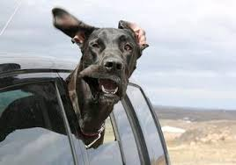
What if air resistance isn’t negligible?
Air resistance (F_{air}) depends on:
1.
geometry of object
v = 0
, a = 9.81 m/s²
2.
speed of object
F_{air} = 0
mg
v = faster
a < 9.81 m/s²
mg
F_{air}
v = FASTER!
mg
F_{air}
a = 0 m/s²
terminal velocity
(v = No faster.)

Slide 65

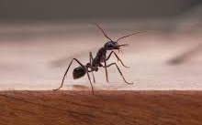
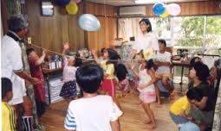
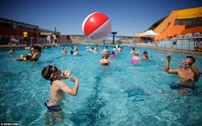
Because air resistance depends on an object’s
speed, the more mass it has, the longer it will have
to fall before the air resistance equals the weight,
i.e.,
the longer it will have the
opportunity to speed up before
terminal speed is reached.
In general, then:
greater mass means
greater terminal speed.

Slide 66
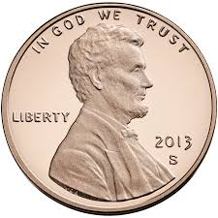

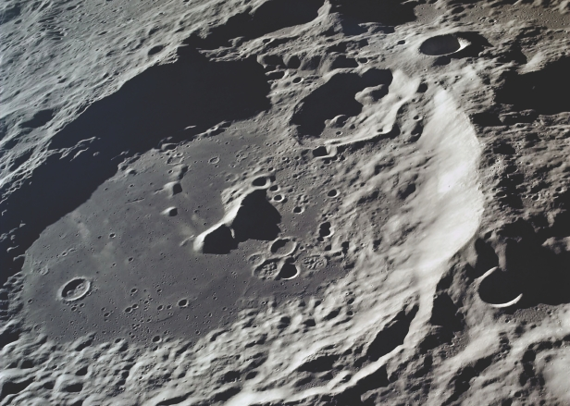
Dropping a penny off the Empire
State Building (v_{term} ~ 20 m/s) vs.
dropping it into the Aitken Basin
on the Moon, which is up to 6 km
deep (v_{term} ~ 140 m/s).

Slide 67
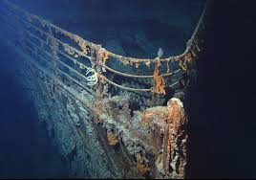
FINAL THOUGHTS: Terminal Velocity
Terminal velocity occurs whenever an object is falling
and there is resistance from the air or some other fluid.
As a falling object accelerates due to gravity (i.e., its
weight), it speeds up, which means the fluid resistance
on it increases. At some
point, the fluid resistance
equals (and, of course,
opposes) the object’s
weight, and the object
no longer picks up speed:
It falls at ‘cruise control.’

Slide 68
Newton’s Third Law of Motion
Newton recognized that forces always occur in pairs.
“If object A exerts a force on object B, then B exerts
an equal force on A, but in the opposite direction.”
or
“For every action, there is
an equal and opposite reaction.”
F_{Earth on Moon}
F_{Moon on Earth}
**The action and reaction forces…
act on different objects.
F_{shoe on floor}
F_{floor on shoe}

Slide 69
“VROOM!”
“BZZZZ....”
“VROOM!”
“BZT.”
F_{bug on car}
a_{car}
m_{car}
=
a_{bug}
F_{car on bug}
=
m_{bug}

Slide 70
Before impact...
After impact...
v_{ball}
v_{ball}
F_{bat on ball}
= F_{ball on bat}
v_{bat}
v_{bat}
F_{cart on horse}
F_{Earth on horse}
F_{w}
F_{horse on cart}
=
F_{cart on horse}
F_{n}

Slide 71
FINAL THOUGHTS: Newton’s Third Law, 1
1. Newton’s third law of motion states that, for every
action, there is an equal and opposite reaction.
A pushed object itself delivers an equal back-push
on the object that pushes it. Conversely, an object
that pushes another receives an equal back-push
from the object it pushes.
2. The action and reaction forces act on different
objects. Because the forces are the same, the
object with the smaller mass experiences a
larger acceleration; the larger mass, a smaller
acceleration.

Slide 72
Consider the ice-skating twins, each of mass 50 kg.
Find acceleration of A if...
1) ...A pushes on B with 50 N.
( )
ΣF: Reaction_{B on A} = m_{A} a
50 N = 50 kg (a)
a = 1 m/s²
2) ...each push on the other ^{w}/50 N.
ΣF: Action_{B on A} + Reaction_{B on A} = m_{A} a
A
B
50 N + 50 N = 50 kg (a)
a = 2 m/s²
www.teachnlearnchem.com

