Slide 1
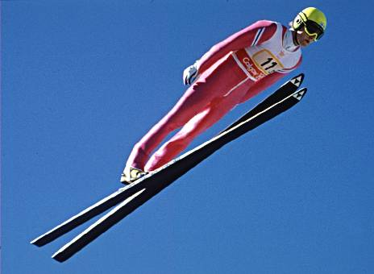
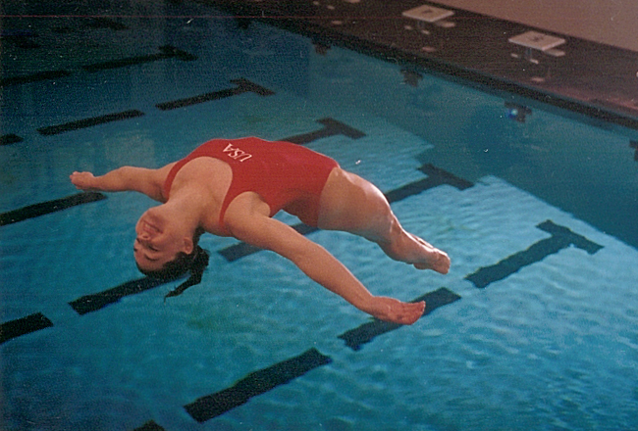
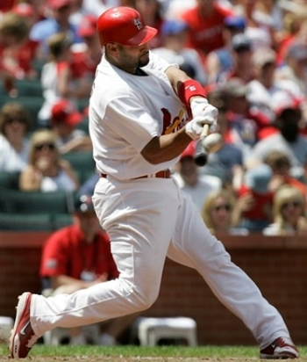

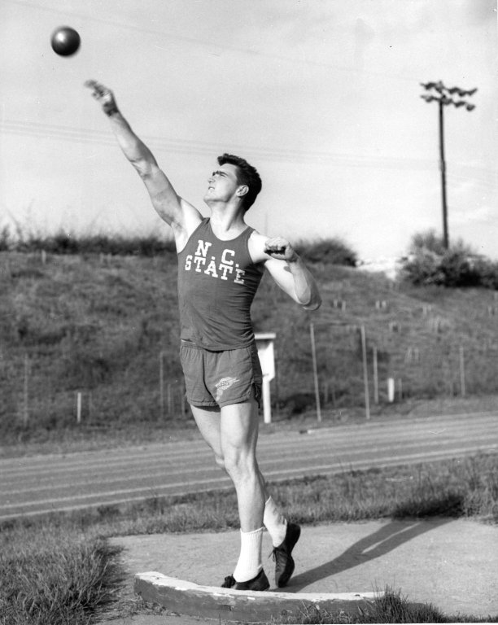
Vectors and 2-D Motion

Slide 2
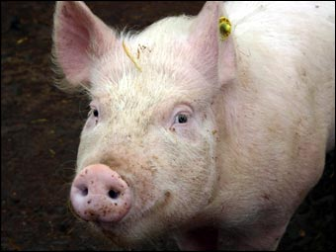

resultant:
the single vector that has the same effect as several vectors added together

Slide 3


Vector Addition: Graphical Method
1. Choose a scale.
2. Use ruler and protractor
to draw first vector to
scale at proper angle.
3. Draw subsequent
vectors tip-to-tail.
4. Draw resultant by connecting tail of
first vector to tip of last.

Slide 4

Add.
d₁ = 420 m horiz.
d₂ = 280 m @ 30.º above horiz.
scale:
1 cm = 100 m
measure length in cm
(say, 6.8 cm)
measure angle
d_{r}
d₂ (2.8 cm)
θ
30º
d₁ (4.2 cm)
d_{r} = 680 m
@ 12º above horiz.

Slide 5
SUMMARY: Graphical Addition of Vectors, 1
Adding vectors graphically to find the resultant is very
algorithmic: follow the steps, and you’re good to go!
a. Choose a convenient scale.
b. With ruler and protractor, draw a vector (it doesn’t
matter which one) to scale and at the proper angle.
c. Start subsequent vectors where the one before ends.
d. Draw the resultant by starting where you started and
ending where you ended.
e. Measure the resultant, convert back with your scale,
and find an angle for the resultant somewhere back
where the whole thing started. Piece of cake!

Slide 6

Add.
v₁ = 53 km/h @ 25º N of W
v₂ = 32 km/h @ 20.º S of W
v₃ = 45 km/h @ 25º E of S
scale:
1 cm = 10 km/h
W
20º
N
v₂ (3.2 cm)
v₁ (5.3 cm)
W
25º
θ
25º
S
v₃ (4.5 cm)
v_{r}
v_{r} = 66 km/h
@ 30º S of W

Slide 7
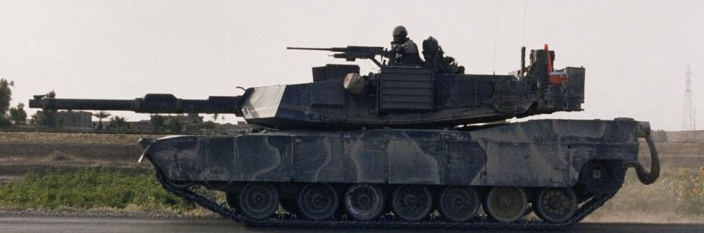
Add.
d₁ = 1160 km @ 20.º N of E
scale:
d₂ = 470 km @ 60.º S of E
1 cm = 100 km
d₃ = 280 km @ 70.º N of W
N
E
60º
d₁ = 11.6 cm
d₂
N
d₃ = 2.8 cm
φ
d_{r} ~13 cm
W
70º
E
θ
20º
d_{r} = 1300 km
@ 12º N of E
d_{r} = 1300 km @ 78º E of N

Slide 8

SUMMARY: Graphical Addition of Vectors, 2
The most common problem students have when
adding vectors graphically is that they have trouble
correctly finding the angle of the resultant. Just
remember that the angle must be measured back
where you started drawing your first vector, and it
must be measured relative
to a FIXED reference
direction, like east or north
or 0º. DON’T measure the
angle relative to one of the
vectors you have drawn.

Slide 10
Add.
d₁ = 65 m @ 15º N of E
d₂ = 48 m @ 63º N of E
scale:
1 cm = 10 m
d_{r} ~11 cm
d₂ = 4.8 cm
N
63º
E
N
φ
θ
d₁ = 6.5 cm
E
15º
d_{r} = 110 m
@ 35º N of E
d_{r} = 110 m @ 55º E of N

Slide 11
Algebraic Method
If vectors are , use Pythagorean theorem and trigonometry (i.e., tan^{–1}).
Add. d₁ = 75 km S
d₂ = 45 km W
d₂
φ
d_{r}
θ
N
d₁
d₁
d_{r} = 87 km @ 31º W of S
(or 59º S of W)
d₂

Slide 12
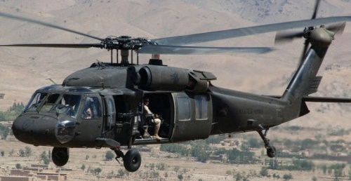
Add. v₁ = 380 km/h N
v₂ = 145 km/h E
v₂
N
v₁
v_{r}
v₁
θ
φ
v₂
v_{r} = 410 km/h @ 21º E of N
(or 69º N of E)

Slide 13
FINAL THOUGHTS: Algebraic Addition
of Perpendicular Vectors
Adding perpendicular vectors algebraically is a matter
of finding the lengths of the two legs of a right triangle
and then using the Pythagorean theorem. We always
need a direction on a result-
ant vector, so use the tan^{–1}
function with the two legs
of the triangle. Be sure to
use reference directions
like north, south, etc., when
reporting the direction.

Slide 14
How to Add Vectors Algebraically
if the Vectors are NOT .
vector resolution: taking a vector and breaking it
down (“resolving” it) into two
component vectors
Use θ along with sin and cos functions, as appropriate.
J_{x}
cos θ =
J
“y”
So… J_{x} = J cos θ
J
J_{y}
“x”
J_{y}
sin θ =
J
θ
And so… J_{y} = J sin θ
J_{x}

Slide 15
Resolve into components.
F = 68 N @ 32º above horiz.
68 N
F_{v}
32º
F_{h}
F_{h} = F cos θ
= 68 cos 32
= 58 N
F_{v} = F sin θ
= 68 sin 32
= 36 N

Slide 16
v = 14.7 m/s @ 15.0º below horiz.
v_{h}
15º
v_{v}
14.7 m/s
v_{h} = v cos θ
= 14.7 cos 15
= 14.2 m/s
v_{v} = v sin θ
= 14.7 sin 15
= 3.80 m/s

Slide 17
a = 3.2 m/s² @ 38º S of W
a_{w}
W
38º
N
a_{s}
3.2 m/s²
a_{w} = a cos θ
= 3.2 cos 38
= 2.5 m/s² W
a_{s} = a sin θ
= 3.2 sin 38
= 2.0 m/s² S

Slide 18
SUMMARY: Vector Resolution
The first step in adding non-perpendicular vectors
algebraically is to resolve each of the vectors you are
given into two perpendicular components. Each given
vector is, in effect, the hypotenuse of a right triangle;
resolving a vector means to find the lengths of the
legs with the aid of sine and cosine AND to identify
the correct direction of those ‘leg’ vectors. Next, we’ll
see what to do once we have found the components
of the different vectors we have been asked to add.

Slide 19
To add non-perpendicular
vectors algebraically…
1. Resolve all vectors into “x” and “y” components.
2. Add “x” components, taking into account direction
of each.
3. Add “y” components in the same way.
4. Vectors resulting from Steps 2 and 3 are .
Add them as you would any two vectors,
using Pythagoras and tan^{–1}.

Slide 20
Add algebraically.
d₁ = 65 m @ 15º N of E
d₂ = 48 m @ 63º N of E
d₁ = 65 m
d₂ = 48 m
d_{1NS}
15º
d_{2NS}
d_{1EW}
d_{1EW} =
63º
d_{1NS} =
d_{2EW}
d_{2EW} =
d_{2NS} =

Slide 21
add
comp.’s
d_{rEW} =
d_{rNS} =
d_{r}
d₂
d_{2NS}
d_{2EW}
d₁
θ
d_{1NS}
d_{1NS}
d_{1EW}
d_{2EW}
d_{r} =
θ =
d_{r} = 1.0 x 10² m @ 35º N of E

Slide 22
SUMMARY: Algebraic Addition of
non-Perpendicular Vectors, 1
To algebraically add non-perpendicular vectors in two
dimensional space, first resolve each given vector into
its perpendicular components. If one or more of the
vectors points entirely in a ‘component’ direction, there
is of course no need to resolve it. Then add (in the
vector sense) ‘like’ components; you will achieve what
amounts to the two perpendicular legs of a new right
triangle, the hypotenuse of which is the resultant
vector. Finally, use tan^{–1} with
these legs, and you’re done!

Slide 23
To add non-perpendicular
vectors algebraically…
1. Resolve all vectors into “x” and “y” components.
2. Add “x” components, taking into account direction
of each.
3. Add “y” components in the same way.
4. Vectors resulting from Steps 2 and 3 are .
Add them as you would any two vectors,
using Pythagoras and tan^{–1}.

Slide 24
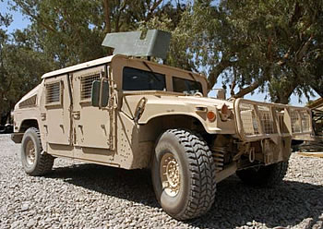
Add algebraically.
d₁ = 425 km @ 12º E of N
d₂ = 182 km @ 28º E of S
d_{1EW}
d₂
d₁
28º
d_{2NS}
d₂
d₁
d_{1NS}
d_{2EW}
N
12º
d_{r}
d_{1EW} =
d_{1NS} =
d_{2EW} =
d_{2NS} =

Slide 25
add comp.’s…
d_{rEW} =
d_{rNS} =
d_{r} =
182
km
173.8 km
= 310 km
425
km
d_{r}
θ =
255
km
255
km
φ
θ
d_{r} = 310 km @ 56º N of E
173.8 km
(or 34º E of N)

Slide 26
SUMMARY: Algebraic Addition of
non-Perpendicular Vectors, 2
v₁
The process we have described to
add non-perpendicular vectors
algebraically can be used to add
any number of vectors. In the
numerical examples here, we have
limited our calculations to adding
two vectors. Let’s go through
conceptually how the principles
apply for more-than-two
vectors.
v₂
v₃

Slide 27
Projectile Motion Equations
Horizontal
Vertical
Δv
v_{f} – v_{i}
Δv
v_{f} – v_{i}
A
a =
=
a =
=
Δt
Δt
Δt
Δt
B
v_{f}² = v_{i}² + 2 a Δd
v_{f}² = v_{i}² + 2 a Δd
Δd
Δd
C
v_{avg} =
= ½ (v_{f} + v_{i})
v_{avg} =
= ½ (v_{f} + v_{i})
Δt
Δt
D
Δd = v_{i} Δt + ½ a (Δt)²
Δd = v_{i} Δt + ½ a (Δt)²

Slide 28
Projectile Motion Equations
Horizontal
Vertical
Δv
v_{f} – v_{i}
Δv
v_{f} – v_{i}
A
a =
=
a =
=
Δt
Δt
Δt
Δt
B
v_{f}² = v_{i}² + 2 a Δd
v_{f}² = v_{i}² + 2 a Δd
Δd
Δd
C
v_{avg} =
= ½ (v_{f} + v_{i})
v_{avg} =
= ½ (v_{f} + v_{i})
Δt
Δt
D
Δd = v_{i} Δt + ½ a (Δt)²
Δd = v_{i} Δt + ½ a (Δt)²

Slide 29


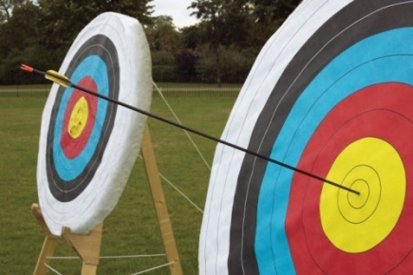
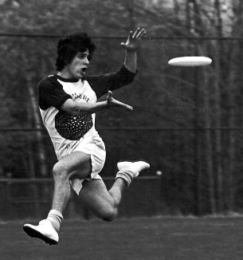


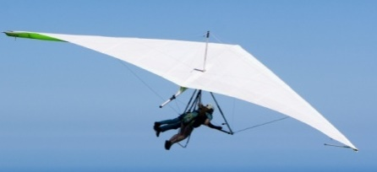
Projectile Motion
projectile: an airborne object acted upon “only”
by gravity
-- other forces are NOT significant
examples:
non-examples:
baseball
arrow
football
golf ball
bird
airplane
frisbee
hang glider
(projectile)

Slide 30

Horizontally-Launched Projectiles
Theory: A projectile is launched horizontally
      ^{w}/velocity v_{x} from height Δd.
v_{x}
An HL’ed proj. stays in
the air for the same
amt. of time as a
dropped proj.
from same
height.
Δd
-- v_{x} is…
constant (assuming no air resistance)
-- a_{x} is…
ZERO!
WHY?
Gravity only acts !
-- v_{y} starts at…
0 m/s, but increases as object falls (i.e., object accelerates at g = 9.81 m/s² )

Slide 31
SUMMARY: Horizontally-Launched
Projectiles (conceptual)
Assuming negligible air resistance (and ignoring
any curvature of the planet’s surface), horizontally-
launched projectiles and ‘dropped’ projectiles that are
launched/dropped from a given height:
1. stay in the air for the same amount of time
2. have identical vertical components of velocity at
at any given time
3. have the same horizontal acceleration (ZERO!)
4. have the same vertical acceleration (–9.81 m/s²)

Slide 32
Point of Note
In my classes, I use the same four equations – what I
call our ‘Equation Toolbox’ – in both 1-D and 2-D
kinematics. If you’ve seen my 1-D kinematics videos,
you might remember having seen them. In any case,
they are shown below. We will use them throughout
this unit of study in 2-D kinematics as well. Good luck!
Δd
v_{avg} =
= ½ (v_{f} + v_{i})
Δd = v_{i} Δt + ½ a (Δt)²
Δt
Δv
v_{f} – v_{i}
a =
=
v_{f}² = v_{i}² + 2 a Δd
Δt
Δt

Slide 33
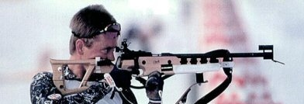
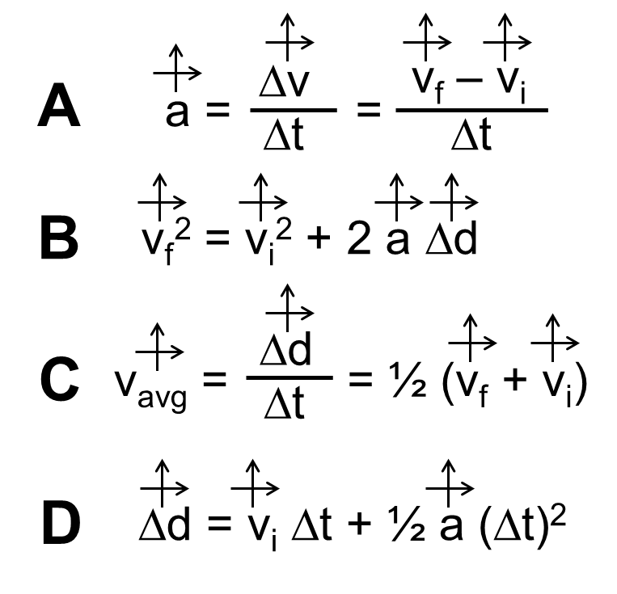

A rifle bullet is
fired horizontally
^{w}/initial speed
850 m/s from height 1.73 m. Find...
a. …time bullet is in air
X
v_{i} = 850 m/s
0
Δd = –1.73 m
Δd = v_{i} Δt + ½ a (Δt)²
a = –9.81 m/s²
Δt = ?
= 0.594 s

Slide 34
b. …bullet’s range (max.
horizontal displacement)
Δd = ?
, v_{i} = 850 m/s,
Δt = 0.594 s
, a = 0 m/s²
0
Δd = v_{i} Δt + ½ a (Δt)²
= 850 m/s (0.594 s)
= 5.0 x 10² m
c. …bullet’s height above ground at t = 0.38 s.
Bullet falls from “vertical rest.” In 0.38 s, it displaces…
0
Δd = v_{i} Δt + ½ a (Δt)²
= ½ (–9.81)(0.38)²
= –0.71 m
So height at t = 0.38 s is…
1.73 m – 0.71 m
= 1.02 m

Slide 35
For how long will
projectile remain airborne?
84 m/s
105 m
105 m
330 m
0
Δd = v_{i} Δt + ½ a (Δt)²
OR…
Find Δd @ 4.6 s…
0
Δd = v_{i} Δt + ½ a (Δt)²
= 84 m/s (4.6 s)
= 390 m

Slide 36
SUMMARY: Horizontally-Launched
Projectiles: Calculations, 2
We have seen that 2-D projectile motion is a bit more
complicated than 1-D motion. We use the same
equations as in 1-D motion, but we use them in two
independent directions – the horizontal AND the
vertical – rather than just one. Furthermore, because
gravity acts straight downward (and assuming air
resistance is negligible), the projectile accelerates in
the up-down direction only. The horizontal acceleration
is zero, meaning the horiz. velocity remains constant.

Slide 37
Assuming negligible air resistance,
horizontally-launched projectiles and
‘straight-up dropped’ projectiles:
-- stay in the air for the same time

Slide 38
Projectile is launched horizontally from
height 62 m. Range is measured to be
238 m. Find
launch speed.
v_{i} = ?
62 m
238 m
0
Find time in air…
Δd = v_{i} Δt + ½ a (Δt)²
= 3.56 s
Use range and time to find launch speed…
0
Δd
Δd = v_{i} Δt + ½ a (Δt)²
v_{i} =
= 67 m/s
Δt

Slide 39
Projectile is launched
horizontally from height
62 m. Its range is
measured to be 238 m.
Find launching speed.
v_{i} = ?
62 m
238 m
Δd
v_{i} =
Δt
Where?
a = ?
Δt to fall 62 m
req’d v_{i}
Earth
–9.81 m/s²
3.56 s
67 m/s
Moon
–1.60 m/s²
8.80 s
27 m/s
Mars
–3.71 m/s²
5.78 s
41 m/s
Jupiter
–24.8 m/s²
2.24 s
110 m/s

Slide 40
SUMMARY: Horizontally-Launched
Projectiles: Calculations, 3
Learning to focus on EITHER the horizontal aspect of
motion OR on the vertical aspect of motion is the key
to tackling projectile motion problems. Or, said another
way, learning to ignore either the horizontal OR the
vertical aspect of motion is the key to tackling projectile
motion problems. This key will carry over to when we
meet projectiles launched NOT horizontally, but at an
angle. But before we go there, let’s do one more horiz.
problem first; that’s the subject of our next lesson.

Slide 41



Military plane flies horizontally at altitude
8000. m at speed 100. m/s. As measured
along ground, how far from target must
plane be when it releases target’s provisions?
v_{x}
besieged city
of G.G.
Δd
B.G.
B.G.
Δd = ?
0
0
Δd = v_{i} Δt + ½ a (Δt)²
Δd = v_{i} Δt + ½ a (Δt)²
= 100 m/s (40.4 s)
= 40.4 s
4.04 x 10³ m

Slide 42

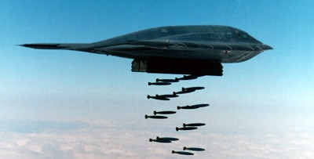
How fast are provisions
moving when they land?
100 m/s
0
X
Δv
v_{f} – v_{i}
v_{yf}
a =
=
396 m/s
Δt
Δt
v_{r}
v_{f} = a Δt
= –9.81 m/s² (40.4 s)
= –396 m/s
v_{r} = 408 m/s
(@ 75.8º below horiz.)

Slide 43
SUMMARY: Horizontally-Launched
Projectiles: Calculations, 4
For horizontally-launched projectiles, the launch
velocity (which is horizontally-directed) remains the
horizontal component of velocity throughout the flight
path because the horizontal acceleration is zero. The
vertical velocity begins at 0 m/s, but increases in
magnitude over time at a rate of 9.81 m/s per second,
due to Eath’s gravity. Next, we move on to projectiles
that are launched at some angle above (and later
below) horizontal. See you there!

Slide 44
Kinematics Equation Toolbox
Δd
v_{avg} =
= ½ (v_{f} + v_{i})
Δd = v_{i} Δt + ½ a (Δt)²
Δt
Δv
v_{f} – v_{i}
a =
=
v_{f}² = v_{i}² + 2 a Δd
Δt
Δt

Slide 45

Review Problem from
1-D Motion
An object is launched
^{w}/initial vel. 37.0 m/s .
a. Find time object is in air.
Time to
top…
0
Δv
v_{f} – v_{i}
a =
=
Δt
Δt
–v_{i}
→ Δt =
a
Notes:
Talk through vy after 1 sec (37-9.81), after two seconds (27.19-9.81), etc.

Slide 46

b. Find max. height object attains.
i)
Δd = v_{i} Δt + ½ a (Δt)²
= 37 (3.77) + ½ (–9.81) (3.77)²
= 69.8 m
0
ii)
v_{f}² = v_{i}² + 2 a Δd
= 69.8 m
0
X
Δd
iii)
v_{avg} =
= ½ (v_{f} + v_{i})
Δt
Δd = ½ v_{i} Δt
= ½ (37.0)(3.77)
= 69.8 m

Slide 47
Projectiles Launched at an Angle
Theory: A projectile is launched
      at initial angle θ with
      initial velocity v_{i}.
v_{i}
v_{yi}
θ
v_{x}
-- v_{x} is…
constant (assuming no air resistance)
-- a_{x} is…
ZERO!
WHY?
Gravity only acts !
-- v_{y} starts at…
v_{yi} = v_{i} sin θ, but changes as object accelerates at g = 9.81 m/s²

Slide 48

Projectile is launched w/initial
velocity 56.4 m/s at
41.0º above horizontal.
37.0 m/s
56.4 m/s
X
a. Find time object is in air.
41.0º
42.6 m/s
v_{yi} = v_{i} sin θ
= 56.4 m/s (sin 41.0)
X
v_{x} = v_{i} cos θ
= 56.4 m/s (cos 41.0)
7.54 s
(See blender prob.)
b. Find max. height object attains.
69.8 m
(See blender prob.)

Slide 49
c. Find projectile’s range.
X
37.0 m/s
56.4 m/s
41.0º
42.6 m/s
0
Δd = v_{i} Δt + ½ a (Δt)²
= 42.6 m/s (7.54 s)
= 321 m
An angled projectile...
stays in the air as long as – and goes as
high as – a “straight up” projectile
launched upward at the v_{yi} of
the angled projectile.
v_{yi}
v_{i}

Slide 51
SUMMARY: Projectiles Launched at an Angle, 1
Projectiles launched at an angle other than 0º or 90º
are subject to the same laws that govern those more
specific cases:
1. the init. horiz. component of vel. is maintained
2. the vert. component of vel. is constantly changing,
and at a rate of –9.81 m/s per second.
One main difference is that the init. components of
vel. are found by using trig functions, in conjunction
with the given initial velocity. More to come!
John Bergmann
www.teachnlearnchem.com

Slide 52
Projectile is launched ^{w}/initial velocity 18.6 m/s at 28.0º above horizontal.
a. Find time object is in air.
18.6 m/s
8.73
m/s
28.0º
16.4 m/s
init.
comps
of vel…
v_{yi} = v_{i} sin θ
= 18.6 m/s (sin 28)
v_{x} = v_{i} cos θ
= 18.6 m/s (cos 28)
0
Time to
top…
Δv
v_{f} – v_{i}
a =
=
Total time
in air:
1.78 s
Δt
Δt
X 2
–v_{i}
→ Δt =
a

Slide 53
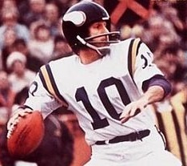
b. Find max. height object attains.
18.6 m/s
8.73
m/s
28.0º
16.4 m/s
Δd = v_{i} Δt + ½ a (Δt)²
= 8.73 (0.89) + ½ (–9.81) (0.89)²
= 3.88 m
c. Find projectile’s range.
0
Δd = v_{i} Δt + ½ a (Δt)²
Δd = 16.4 m/s (1.78 s)
= 29.2 m

Slide 54
FINAL THOUGHTS: Projectiles
Launched at an Angle, 2
A projectile that is launched upward at some acute
angle above the horizontal will stay in the air for the
same length of time as would a ‘straight-up’ projectile
that is launched at the initial vertical component of
velocity of the angled projectile.
The init. vert. component of velocity determines how
long the proj. will be in the air AND how high it goes.
The horiz. component of vel. (which is CONSTANT)
comes into play in determining the proj.’s range.
www.teachnlearnchem.com

Slide 55

25º
Projectile is launched from height 575 m
^{w}/initial velocity 87 m/s @ 25º below
horizontal.
87 m/s
575 m
a. Find time object is in air.
Δv
v_{f} – v_{i}
a =
=
Δt
Δt
v_{f}² = v_{i}² + 2 a Δd
(-575)
(-36.77)²
(-9.81)
v_{f} – v_{i}
Δt =
a

Slide 56
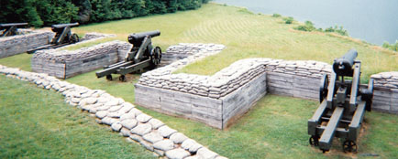
b. Find projectile’s range.
0
Δd = v_{i} Δt + ½ a (Δt)²
Δd = 78.85 m/s (7.7 s)
= 610 m

Slide 57
At Any Time Δt After Launch, WHERE is a Projectile?
Use THIS equation...
Δd = v_{i} Δt + ½ a (Δt)²
...twice.
The x-position will have CHANGED by the amount...
Δd = v_{i} Δt + ½ a (Δt)²
The y-position will have CHANGED by the amount...
These changes, along with the initial x- and y-positions...
tell us the x- and y-positions at Δt.
Δd = v_{i} Δt + ½ a (Δt)²

Slide 58

An object is launched from the ground w/init. velocity 35.58 m/s @ 55.80º above the horizontal. Find its location relative to its starting point 2.43 s after launch.
0
Δd = v_{i} Δt + ½ a (Δt)²
35.58 m/s
v_{yi}
29.43 m/s
= 20 m/s (2.43 s)
55.80º
= 48.6 m →
v_{x}
20.00 m/s
Δd = v_{i} Δt + ½ a (Δt)²
= (29.43)(2.43) + ½ (–9.81)(2.43)²
→
= 71.515 m + (–28.964 m)
= 42.6 m

Slide 59
Proj. is launched horizontally at 36 m/s from height 92 m. Find its location 3.24 s after launch.
0
v_{i} = 36 m/s
Δd = v_{i} Δt + ½ a (Δt)²
92 m
= 36 m/s (3.24 s)
0
= 120 m →
Δd = v_{i} Δt + ½ a (Δt)²
= ½ (–9.81)(3.24)²
= –51.49 m
Proj. started 92 m above ground, so now it is...
92 m – 51.49 m
= 41 m above ground
STOP

Slide 60
At Any Time Δt After Launch, What’s a Projectile’s VELOCITY?
Use THIS equation...
Δv
v_{f} – v_{i}
a =
=
Δt
Δt
...once
(for the y-dir. ONLY).
v_{x}:
Horiz. (v_{x}) is…
constant.
NOT!
v_{x}
v_{y}:
Vert. (v_{y}) is…
To find
resultant v_{r}
at any time Δt:
θ
v_{r}
v_{yf}
Δv
v_{f} – v_{i}
a =
=
Δt
Δt
pythagorize v_{x} and v_{yf}.

Slide 61
An object is launched from the ground w/init. velocity 35.58 m/s @ 55.80º above the horizontal. Find its velocity 2.43 s after launch.
35.58 m/s
v_{yi}
29.43 m/s
55.80º
v_{x}
20.00 m/s
v_{x} = 20.00 m/s →
At Δt = 2.43 s...
Δv
v_{f} – v_{i}
v_{r}
a =
=
Δt
Δt
θ
5.59 m/s
v_{f} = v_{i} + a Δt
20.00 m/s
v_{yf} = 29.43 m/s + (–9.81)(2.43)
v_{r} = 20.8 m/s
@ 15.6º
above horiz.
v_{yf} = +5.59 m/s (+ = “upward”)

Slide 62
Projectile is launched horizontally at 36 m/s from height 92 m. Find its velocity 3.24 s after launch.
v_{i} = 36 m/s
92 m
STOP
v_{x} = 36 m/s →
At Δt = 3.24 s...
36 m/s
Δv
v_{f} – v_{i}
a =
=
θ
Δt
Δt
v_{r}
31.78 m/s
v_{f} = v_{i} + a Δt
v_{yf} = 0 m/s + (–9.81)(3.24)
v_{r} = 48 m/s @ 41º
below horiz.
v_{yf} = –31.78 m/s (i.e., downward)

Slide 63
At any time Δt after launch, WHERE is a projectile?
Use THIS equation...
Δd = v_{i} Δt + ½ a (Δt)²
...twice.
The x-position will have CHANGED by the amount...
Δd = v_{i} Δt + ½ a (Δt)²
The y-position will have CHANGED by the amount...
These changes, along with the initial x- and y-positions...
tell us the x- and y-positions at Δt.
Δd = v_{i} Δt + ½ a (Δt)²

Slide 64
At any time Δt after launch, what’s a projectile’s VELOCITY?
Use THIS equation...
Δv
v_{f} – v_{i}
a =
=
Δt
Δt
...once
(for the y-dir. ONLY).
v_{x}:
Horiz. (v_{x}) is…
constant.
NOT!
v_{y}:
Vert. (v_{y}) is…
v_{x}
To find
resultant v_{r}
at any time Δt:
θ
Δv
v_{f} – v_{i}
a =
=
v_{r}
Δt
Δt
v_{yf}
v_{f} = v_{i} + a Δt
pythagorize v_{x} and v_{yf}.

Slide 65
A cannonball is launched off the edge of a cliff at an
init. speed of 49.5 m/s at 25.6º above horiz. The ball is
in the air for 9.75 s. Find height of cliff, the range, and
the impact speed of the cannonball.
49.5 m/s
49.5 m/s
21.39
m/s
25.6º
25.6º
44.64 m/s
height
Δd = v_{i} Δt + ½ a (Δt)²
= (21.39)(9.75) + ½ (–9.81)(9.75)²
= –258 m
…so height = 258 m

Slide 66
(range…)
0
49.5 m/s
21.39
m/s
25.6º
Δd = v_{i} Δt + ½ a (Δt)²
44.64 m/s
Δd = 44.64 m/s (9.75 s)
= 435 m
(impact speed…)
44.64 m/s
v_{f} = v_{i} + a Δt
θ
= 21.39 + (–9.81)(9.75)
v_{y} @ 9.75 s = ?
74.26 m/s
v_{r} = ?
Pythagorize to get… v_{r} = 86.6 m/s
STOP

Slide 67
Δt (s) | x_{coord} (m) | y_{straight} (m) | y_{fall} (m) | y_{coord} (m) | v_{x} (m/s) | v_{y} (m/s) | v_{r} (m/s)
0
1
2
3
4
5
6
0
0
0
0
20
29.43
35.58
20
29.43
–4.91
24.52
20
19.62
28.02
40
58.86
–19.62
39.24
20
9.81
22.28
60
88.29
–44.15
44.14
20
0.00
20.00
PYTHAGORIZE!
80
117.72
–78.48
39.24
20
–9.81
22.28
100
147.15
–122.63
24.52
20
–19.62
28.02
120
176.58
–176.58
0
20
–29.43
35.58
( v_{x} = 20 m/s)
(v_{yi} = 29.43 m/s)
d_{f} = v_{x} Δt
v_{f} = v_{i} + a Δt
d_{f} = v_{yi} Δt + ½ a (Δt)²
x_{coord} is “how far
horizontally” at
each time
y_{straight} is “y_{coord}
of projectile
without gravity”
y_{fall} is “how far
object falls” in
each Δt

Slide 68

y_{straight}
29.43
m/s
35.58 m/s
55.8º
20 m/s
80
y_{fall}
y (m)
60
20 m/s
40
22.28 m/s
22.28 m/s
20
28.02 m/s
28.02 m/s
35.58 m/s
35.58 m/s
0
0
20
40
60
80
100
120
x (m)

Slide 69
SUMMARY: Coordinates of Angled Projectiles
Here are the equations for finding coords and vel’s at
any time Δt of a projectile launched at an angle:
x-coord:
d_{f} = v_{x} Δt
y-coord:
d_{f} = v_{yi} Δt + ½ a (Δt)²
Remember that
the sine and
cosine functions
must be used to
determine v_{x} and v_{yi}.
x-vel:
v_{x} = CONSTANT
y-vel:
v_{yf} = v_{yi} + a Δt
www.teachnlearnchem.com

Slide 70
SUMMARY: Projectiles Launched at an Angle, 4
Here, we put everything we have learned about
projectiles launched at an angle together, looking at
a few new types of problems dealing with projectiles
launched at an angle. This concludes our studies
with the kinematics of projectiles. In the next unit,
we’ll investigate not HOW things move (kinematics),
but WHY things move – specifically, forces – which is
the subject matter of dynamics. Our knowledge of
vectors will be crucial in those studies.
John Bergmann
www.teachnlearnchem.com

Slide 71
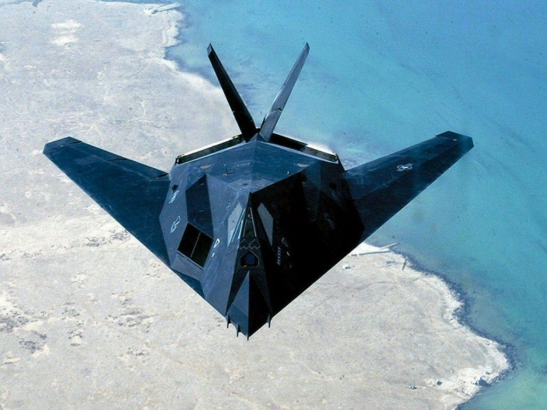


Coordinates of Horizontally-Launched Projectiles
(and Velocity at Any Time)
For the previous problem,
what are the coordinates
of the provisions (and
their speed) at any time Δt?
8000
Δd = –8000. m
7000
v_{x} = 100. m/s
6000
Δt = 40.4 s
5000
Δd = 4040 m
y (m)
4000
3000
2000
1000
0
0
1000
2000
3000
4000
5000
x (m)

Slide 72
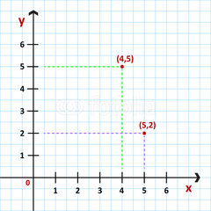
To find coordinates at any time Δt:
0
x:
Δd = v_{i} Δt + ½ a (Δt)²
0
But Δd = d_{f} – d_{i}
= v_{x} Δt
0
y:
Δd = v_{i} Δt + ½ a (Δt)²
But Δd = d_{f} – d_{i}
= ½ a (Δt)²
y_{straight}
y_{fall}
init. height
x-coord:
d_{f} = v_{x} Δt
y-coord:
d_{f} = d_{i} + ½ a (Δt)²

Slide 73
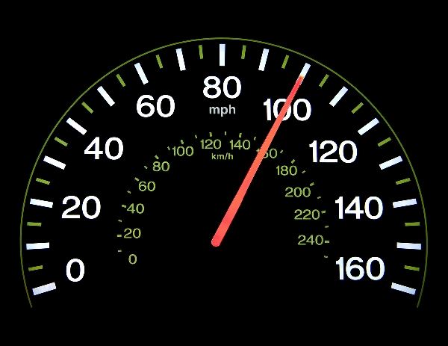
To find velocity
at any time Δt:
v_{x}…
Horizontal (v_{x}) is…
constant!
v_{y}…
Vertical (v_{y}) is…
not constant.
0
v_{x}
Δv
v_{f} – v_{i}
θ
a =
=
Δt
Δt
v_{r}
v_{y}
To find
resultant v_{r}
at any time Δt:
v_{y} = a Δt
pythagorize v_{x} and v_{y}.

Slide 74
Δt (s) | x_{coord} (m) | y_{straight} (m) | y_{fall} (m) | y_{coord} (m) | v_{x} (m/s) | v_{y} (m/s) | v_{r} (m/s)
0
10
20
30
40
50
0
8000
0
8000
100
0
100
1000
8000
–491
7509
100
–98.1
140
2000
8000
–1962
6038
100
–196.2
220
3000
8000
–4415
3585
100
–294.3
311
4000
8000
–7848
152
100
–392.4
405
5000
8000
–12263
–4263
100
–490.5
501
d_{f} = v_{x} Δt
d_{f} = d_{i} + ½ a (Δt)²
v_{y} = a Δt
( v_{x} = 100 m/s)
x_{coord} is “how far
horizontally” at
each time
y_{straight} is “y_{coord}
of projectile
without gravity”
y_{fall} is “how far
object falls” in
each Δt
PYTHAGORIZE!

Slide 75
100 m/s
(0 m, 8000 m)
8000
(1000 m, 7509 m)
7000
140 m/s
6000
(2000 m, 6038 m)
220 m/s
5000
y (m)
4000
(3000 m, 3585 m)
3000
311 m/s
2000
1000
(4000 m, 152 m)
0
0
1000
2000
3000
405 m/s
4000
5000
x (m)

Slide 76
8000
7000
y_{fall}
6000
5000
y (m)
y_{straight}
4000
½ a (Δt)²
3000
y_{coord}
2000
1000
0
0
1000
2000
3000
4000
5000
x (m)

Slide 77
x-coord:
d_{f} = v_{x} Δt
v_{x}
init. height
θ
y_{straight}
y_{fall}
v_{r}
v_{y}
y-coord:
d_{f} = d_{i} + ½ a (Δt)²
x-vel:
v_{x} = CONSTANT
RESULTANT
VELOCITY
y-vel:
v_{y} = a Δt

Slide 78
SUMMARY: Coordinates of Horizontally-
Launched Projectiles
When finding the x and y coordinates of horizontally-
launched projectiles, we are simply applying the basic
kinematics equations for the x and y directions
independently (just like before), but we are doing it at
several (usually regularly-spaced) time intervals. The
horizontal velocity remains constant, while the vertical
velocity changes with time. The resultant velocity at any
time is found by pythagorizing the horiz. and vertical
velocities. We can also use tan^{–1} to find the direction
of these resultant velocities.
www.teachnlearnchem.com

Slide 79

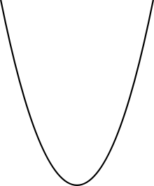
Coordinates of Projectiles Launched at an Angle
Object is launched from ground w/init. vel. 35.58 m/s @ 55.80º above horizontal.
Find its x and y coordinates at
each second it is in the air.
80
y (m)
60
35.58 m/s
40
20
55.80º
0
0
20
40
60
80
100
120
x (m)

Slide 80
To find coordinates at any time Δt:
v_{x}
0
x:
Δd = v_{i} Δt + ½ a (Δt)²
v_{i}
0
v_{yi} = v_{i} sin θ
But Δd = d_{f} – d_{i}
= v_{x} Δt
θ
(0, 0)
v_{x} = v_{i} cos θ
y:
Δd = v_{i} Δt + ½ a (Δt)²
0
y_{straight}
But Δd = d_{f} – d_{i}
= v_{yi} Δt + ½ a (Δt)²
y_{fall}
x-coord:
d_{f} = v_{x} Δt
y-coord:
d_{f} = v_{yi} Δt + ½ a (Δt)²

Slide 81
To find velocity
at any time Δt:
v_{x}:
Horizontal (v_{x}) is…
constant!
v_{y}:
Vertical (v_{y}) is…
not constant.
v_{x}
Δv
v_{f} – v_{i}
θ
a =
=
Δt
Δt
v_{r}
v_{yf}
To find
resultant v_{r}
at any time Δt:
v_{yf} = v_{yi} + a Δt
pythagorize v_{x} and v_{yf}.

Slide 82
Object is launched from ground w/init. vel. 35.58 m/s @ 55.80º above horizontal.
Find its x and y coordinates at
each second it is in the air.
80
35.58 m/s
v_{yi}
y (m)
60
29.43 m/s
40
55.80º
20
v_{x}
20.00 m/s
0
0
20
40
60
80
100
120
x (m)

Slide 83
Δt (s) | x_{coord} (m) | y_{straight} (m) | y_{fall} (m) | y_{coord} (m) | v_{x} (m/s) | v_{y} (m/s) | v_{r} (m/s)
0
1
2
3
4
5
6
0
0
0
0
20
29.43
35.58
20
29.43
–4.91
24.52
20
19.62
28.02
40
58.86
–19.62
39.24
20
9.81
22.28
60
88.29
–44.15
44.14
20
0.00
20.00
PYTHAGORIZE!
80
117.72
–78.48
39.24
20
–9.81
22.28
100
147.15
–122.63
24.52
20
–19.62
28.02
120
176.58
–176.58
0
20
–29.43
35.58
( v_{x} = 20 m/s)
(v_{yi} = 29.43 m/s)
d_{f} = v_{x} Δt
v_{yf} = v_{yi} + a Δt
d_{f} = v_{yi} Δt + ½ a (Δt)²
x_{coord} is “how far
horizontally” at
each time
y_{straight} is “y_{coord}
of projectile
without gravity”
y_{fall} is “how far
object falls” in
each Δt

Slide 84
y_{straight}
29.43
m/s
35.58 m/s
55.8º
20 m/s
80
y_{fall}
y (m)
60
20 m/s
40
22.28 m/s
22.28 m/s
20
28.02 m/s
28.02 m/s
35.58 m/s
35.58 m/s
0
0
20
40
60
80
100
120
x (m)

Slide 85
SUMMARY: Coordinates of Angled Projectiles
Here are the equations for finding coords and vel’s at
any time Δt of a projectile launched at an angle:
x-coord:
d_{f} = v_{x} Δt
y-coord:
d_{f} = v_{yi} Δt + ½ a (Δt)²
Remember that
the sine and
cosine functions
must be used to
determine v_{x} and v_{yi}.
x-vel:
v_{x} = CONSTANT
y-vel:
v_{yf} = v_{yi} + a Δt
www.teachnlearnchem.com

