Slide 1
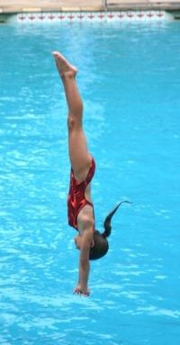

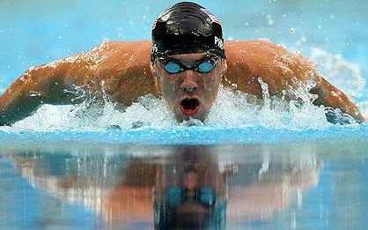
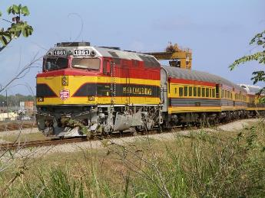
1-D Motion
-- motion in a straight line
→ i.e., straight up/down or straight left/right

Slide 2
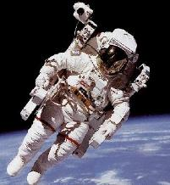
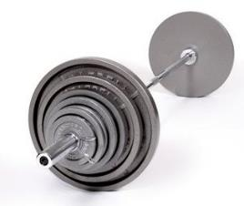
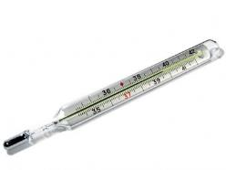
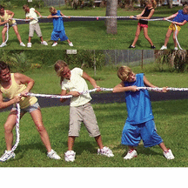
Introductory Concepts
scalar
vector
magnitude
(# + unit)
magnitude AND direction
e.g.,
mass (125 kg)
e.g.,
weight (300 lbs. )
force (480 N )
temperature (283 K)

Slide 3
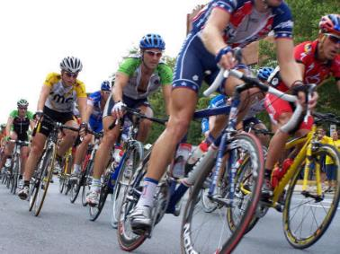
distance (d)
displacement (Δd)
how far an object travels
the straight-line difference between the starting and ending points
-- it depends on the
path taken
-- it is independent of
the path taken
e.g.,
45 miles
e.g.,
23 miles east
Map for a bicycle race
4
5
s
m
e
N
i
l
START
23 miles
FINISH

Slide 4
A displacement Δd is easily found if we are given two
x (or y) coordinates. We simply subtract the two,
in the order… …and instead
of Δd, we might write…
FINAL – INITIAL
Δx (or Δy).
y₂
Δx
Δy
x₁
x₂
y₁
Δx = x₂ – x₁
Δy = y₂ – y₁
To show that Δd could mean L/R, up/down,
N/S, E/W, etc., motion, I like to represent it as:
Δd
Equations to calculate Δd are valid for ANY direction.

Slide 5
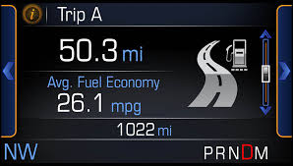


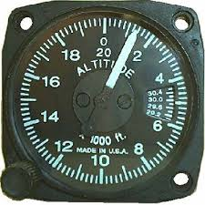
The starting and ending coordinates, by themselves, are NOT enough information to find distance, unless the object goes…
AND…
in a straight line only
does NOT reverse direction at all.
Sometimes, we’re given
coords; sometimes, Δds.
Δds are reported with a direction.
A term like “how far,” though, refers
to a distance, not a Δd, so we don’t
need a direction in our answer.

Slide 6
FINAL THOUGHTS: Distance and Displacement
1. A scalar is a quantity with magnitude only (i.e., a
number with a unit), while a vector is a quantity
having both magnitude AND direction.
2. Distance d is a scalar; displacement Δd is a vector.
3. Because displacements could be up/down, left/right,
north/south, east/west, x, y, etc., and because the
equations for calculating such displacements
are independent of direction, I like the notation Δd.
When written in an equation, this notation
reinforces that the equation works for, say, both x-
and y-motion. This will be more important later on.

Slide 7
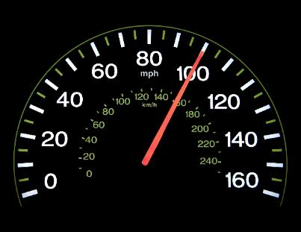
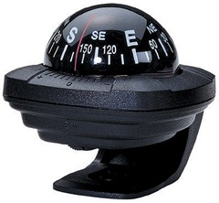
average velocity ( )
average speed (v)
v_{avg}
(scalar)
(vector)
e.g.,
8.4 m/s
e.g.,
23.0 m/s east
Δd
v_{avg} =
= ½ (v_{f} + v_{i})
Δt
for
uniform
motion

Slide 8
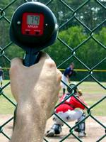
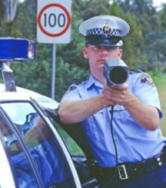
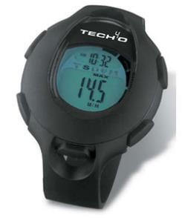
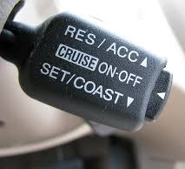

instantaneous speed/velocity:
speed/velocity at a
given moment of time
constant speed:
speed isn’t changing
-- but direction CAN be
constant velocity:
vel. isn’t changing
(‘kinda’
rare)
-- NEITHER speed NOR
direction are changing

Slide 9
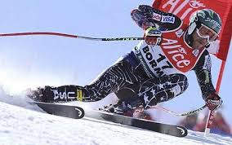
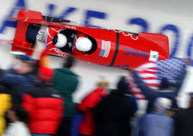
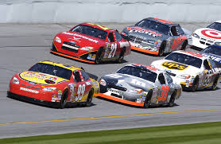
Unless we state otherwise,
“velocity” means “instantaneous velocity” and
“speed” means “instantaneous speed.”
If we want “average speed/velocity,”
we’ll say “average speed/velocity.”
Velocities are reported with a direction.
A term like “how fast,” though, refers
to a speed, not a velocity, so we don’t
need a direction in our answer.

Slide 10
FINAL THOUGHTS: Velocity and Speed
1. Speed is a scalar; velocity is a vector. Both have
magnitude, but velocity also has a direction.
2. Average velocity is displacement over time (average
speed is distance over
time). If the motion is
uniform, i.e., has a
constant acceleration (we’ll talk about this more
later), then average velocity can be found by
simply averaging the initial and final velocities.
Δd
v_{avg} =
= ½ (v_{f} + v_{i})
Δt

Slide 11
0.00 m,
0.0 s
0.25 m,
9.2 s
0.75 m,
3.8 s
Calc. the following:
a. total distance traveled
d_{tot} = 0.75 m + 0.50 m =
1.25 m
b. displacement for time intervals t₁–t₂, t₂–t₃, t₁–t₃
Δd_{t1-t2} =
0.75 m →
Δd_{t2-t3} =
0.50 m ←
Δd_{t1-t3} =
0.75 m → “+” 0.50 m ←
= 0.25 m →

Slide 12
c. average speed for time intervals t₁–t₂, t₂–t₃, t₁–t₃
v_{avg,t1-t2} =
0.75 m/3.8 s
= 0.20 m/s
v_{avg,t2-t3} =
0.50 m/5.4 s
= 0.093 m/s
v_{avg,t1-t3} =
1.25 m/9.2 s
= 0.14 m/s
d. average velocity for time intervals t₁–t₂, t₂–t₃, t₁–t₃
Δd
= 0.75 m →/3.8 s
= 0.20 m/s →
Δd
v_{avg} =
v_{avg} =
Δt
Δt
= 0.50 m ←/5.4 s
= 0.093 m/s ←
= 0.25 m →/9.2 s
= 0.027 m/s →

Slide 13





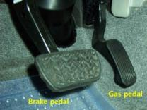
acceleration:
the rate at which velocity is changing
--
rate of speeding up
--
rate of slowing down
--
rate of changing direction
Equation:
Δv
v_{f} – v_{i}
a =
=
Δt
Δt
unit →

Slide 14

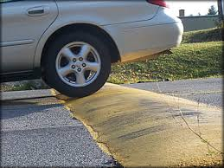


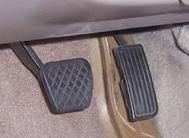

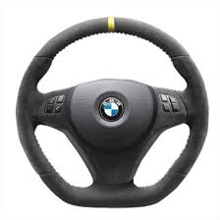
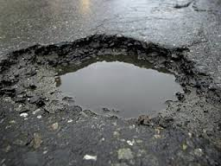
“Gimme a gut feel for acceleration.” PART I
Imagine you are
driving your car,
holding an open
cup of coffee...
Any time the coffee tries
to come out of the cup…
the cup and you and the
car are accelerating.

Slide 15

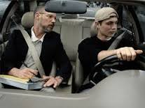
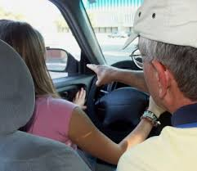

“Gimme a gut feel for acceleration.” PART II
Remember
when you
were learning
to drive?
Dad was in the car, trying not to
be too critical. Any time Dad
said, “Whoa!”… you and Dad
and the car were accelerating.

Slide 16
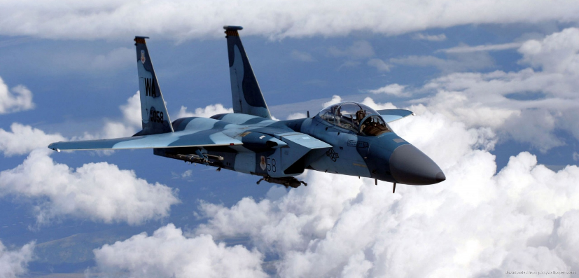
FINAL THOUGHTS: Acceleration
Acceleration is a vector
quantity; it is the rate at
which velocity changes.
Δv
v_{f} – v_{i}
a =
=
Δt
Δt

Slide 17

Negative Velocities and/or Accelerations
Rule One-and-Only:
“FEAR NOT!”
A (–) velocity simply means that an
object is moving in a direction opposite
to what we chose as (+). Had we
chosen the other way to be (+), the
object would now have a (+) velocity.
v
a
“What’s happening?”
v
a
+
+
obj. is speeding up
+
–
obj. is slowing down
–
+
obj. is slowing down
–
–
obj. is speeding up

Slide 18
FINAL THOUGHTS:
Negative Velocities and Accelerations
1. A negative velocity describes an object moving in
the NOT-positive direction. That’s it.
2. When the signs of velocity and acceleration are the
same, the object is speeding up. When the signs are
opposite, the object is slowing down.

Slide 19
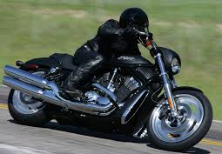

In previous lessons, we went through the concepts of
velocity and acceleration. The equations for these
quantities are shown here:
Δd
v_{avg} =
= ½ (v_{f} + v_{i})
Δt
Δv
v_{f} – v_{i}
a =
=
Δt
Δt
Now, we’ll practice using
these equations, and we’ll be
introduced to Dr. Jon Scott’s
GUESS method of solving problems.

Slide 20

An arrow is accelerated by a
bowstring to 36 m/s in 0.31 s.
Find arrow’s acceleration.
Try GUESSing:
Given
Unknown
Equation
Solve for variable
Substitute quantities
G:
v_{f} = 36 m/s
, Δt = 0.31 s
, v_{i} = 0 m/s
U:
a = ?
X
E:
Δv
v_{f} – v_{i}
a =
=
Δt
Δt
v_{f} – v_{i}
S:
a =
Δt
S:
a

Slide 21
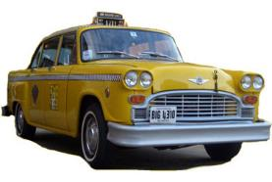

Car traveling 65 m/s
approaches stop sign.
Driver applies brakes
for 8.2 s. Find car’s
acceleration.
G:
v_{i} = 65 m/s
, Δt = 8.2 s
, v_{f} = 0 m/s
U:
a = ?
X
(velocity gets 7.9 m/s LESS POSITIVE
each second for 8.2 s)
E:
Δv
v_{f} – v_{i}
a =
=
Δt
Δt
v_{f} – v_{i}
S:
a =
Δt
m
S:
a
= –7.9
s²

Slide 22
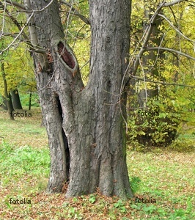
Car traveling 65 m/s slams into a large tree and comes to a stop in 0.082 s. Find car’s (and occupants’) acceleration.
v_{f} – v_{i}
m
a =
= –790
Δt
s²
acceleration kills.
Please be careful.
Speed doesn’t kill;

Slide 23
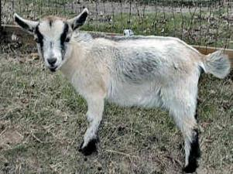
Pygmy goat runs toward a feeding
trough with initial speed 2.5 m/s. If
goat slows down at 0.42 m/s², how
long will it take goat to reach trough?
We chose v_{i} + and we
have ‘slowing down’…
G:
v_{i} = 2.5 m/s
, a = –0.42 m/s²
, v_{f} = 0 m/s
U:
Δt = ?
X
E:
Δv
v_{f} – v_{i}
a =
=
Δt
Δt
v_{f} – v_{i}
v_{f} – v_{i}
S:
a =
→ Δt =
Δt
a
S:
Δt

Slide 24
Boy runs from inside garage and slides
down icy driveway. At top, he moves at
2.3 m/s. He slides down in 4.5 s,
accelerating at 0.75 m/s².
a. How fast is he moving at the bottom?
G:
v_{i} = 2.3 m/s
, Δt = 4.5 s
, a = 0.75 m/s²
U:
v_{f} = ?
X
Δv
v_{f} – v_{i}
E:
a =
=
Δt
Δt
S:
v_{f} – v_{i}
a =
→ v_{f} – v_{i} = aΔt
→ v_{f} = aΔt + v_{i}
Δt
S:
v_{f} =

Slide 25
b. How long is the driveway?
Δt = 4.5 s
v_{i} = 2.3 m/s
Δd = ?
a = 0.75 m/s²
Δd = v_{i} Δt + ½ a (Δt)²
Δd = v_{i} Δt + ½ a (Δt)²
= 2.3(4.5) + ½ (0.75)(4.5)²
= 18 m
c. Assuming same acceleration, find the time for him
to reach the bottom if he starts at the top from rest.
0
Δd = v_{i} Δt + ½ a (Δt)²
2 Δd
= 6.9 s

Slide 26
FINAL THOUGHTS: 1-D Motion Problems, 4
1. Here, we went through a multi-part problem in
1-D kinematics. We started out using the formal
GUESS method, and then showed how one can
approach problems in a slightly less formal way.
2. We also met the third equation that we’ll need in
kinematics. We need only
one more to complete our
Equation Toolbox that will
get us through the rest of 1-D and 2-D kinematics,
and we’ll meet that one next time.
Δd = v_{i} Δt + ½ a (Δt)²

Slide 27
Penguin moves with initial speed
0.65 m/s. At a later time, he has speed
1.9 m/s. During this interval, penguin
travels 7.3 m.
Find his acceleration.
v_{i}
v_{f}
a = ?
Δd
(the “no time” equation)
v_{f}² = v_{i}² + 2 a Δd
v_{f}² = v_{i}² + 2 a Δd
v_{f}² – v_{i}²
a =
2Δd

Slide 28
FINAL THOUGHTS: 1-D Motion Problems, 5
1. Here, instead of using GUESS, we simply labeled the
givens and unknowns right in the problem statement.
2. Our Equation Toolbox (what we need for the rest of
1-D and 2-D kinematics) is now complete.
Δd
v_{avg} =
= ½ (v_{f} + v_{i})
Δd = v_{i} Δt + ½ a (Δt)²
Δt
Δv
v_{f} – v_{i}
a =
=
v_{f}² = v_{i}² + 2 a Δd
Δt
Δt

Slide 29
Graphical Analysis of 1-D Motion
Consider the following position-time curve.
15
10
position (m)
5
0
0
1
2
3
4
5
6
7
time (s)
Slope of a P-t curve at any time is object’s v at that time.
slope of curve is:
Δd

Slide 30
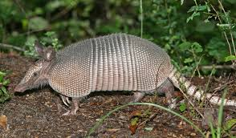
Find armadillo’s velocity at
t = 2.0 s and at t = 6.5 s.
(3 s, 15 m)
15
(6 s, 15 m)
10
(i.e., find slope
at those times)
position (m)
5
(7 s, 0 m)
(0 s, 0 m)
0
0
1
2
3
4
5
6
7
time (s)
Δd
v
Δd
v
(–) sign indicates that the object is moving opposite to how it started
(which we assumed was the (+) direction).

Slide 31
FINAL THOUGHTS: 1-D Graphical Analysis, 1
1. Here, we introduced graphical analysis of 1-D
motion. We mentally put all of our moving objects
on a balance beam in order to reinforce that their
motion was one-dimensional. (The objects are
NOT on a treasure hunt!)
2. We saw that the slope of a position-time graph at
any time is the velocity of the object at that time.
These velocities can be compiled for all times and
shown on a velocity-time graph.
3. We saw that the sign of velocity gave information
about the direction in which the object was moving.

Slide 32
(2 s, 20 m)
(4 s, 20 m)
20
Another P-t curve:
15
(6 s, 10 m)
P (m)
10
5
(8 s, 0 m)
(0 s, 0 m)
0
t (s)
0
1
2
3
4
5
6
7
8
10
5
v (m/s)
0
Δd
v
-5
-10
?
t (s)
0
1
2
3
4
5
6
7
8

Slide 33
Consider the following v-t curve.
10
5
v (m/s)
0
-5
-10
t (s)
0
1
2
3
4
5
6
7
8
Slope of a v-t curve at any time is object’s acceleration at that time.
slope of curve is:

Slide 34
Consider the following a-t curve.
Δv
a
2
Δv = a Δt
1
a (m/s²)
0
-1
-2
0
1
2
3
4
5
6
t (s)
If the object starts at
rest, the associated
v-t curve looks like…
(3 s,
6 m/s)
(5 s,
6 m/s)
6
4
(6 s,
5 m/s)
v (m/s)
2
0
(0 s, 0 m/s)
0
1
2
3
4
5
6
t (s)

Slide 35
Find object’s average velocity.
Area under v-t curve
IS displacement.
Δd
6
v_{avg} =
, so…
Δt
4
v (m/s)
2
Δd = v_{avg}Δt
0
0
1
2
3
4
5
6
t (s)
Δd_{0→3 s} = 3 m/s (3 s)
= 9 m
Δd_{3→5 s} = 6 m/s (2 s)
= 12 m
Δd_{0→6 s} = 26.5 m
Δd_{5→6 s} = 5.5 m/s (1 s)
= 5.5 m
Δd_{0→6 s}
26.5 m
v_{avg, 0→6 s} =
=
= 4.4 m/s →
Δt_{0→6 s}
6 s

Slide 36
FINAL THOUGHTS: 1-D Graphical Analysis, 3
1. Here, we saw that the slope of a velocity-time graph
at any time is the acceleration at that time. These
accelerations can be compiled for all times and
shown on an acceleration-time graph. We also saw
that the area under each section of an a-t graph
gives the change in velocity for that time interval.
2. Similarly, we saw that the area under each section
of the v-t graph yields the object’s change in
position (i.e., the displacement) for that
time interval.

Slide 37
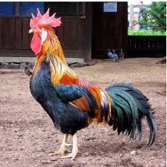
P
t
v
Δd
v
0
t
a
Δv
a
0
t

Slide 38

A
B
C
P
P
P
t
t
t
Δd
v
v
v
v
0
0
0
t
t
t
Δv
a
a
a
a
0
0
0
t
t
t
constant velocity
speeding up
slowing down

Slide 39

Now consider a cat on a
balance beam…
P
t
An object is in free fall if the “only” force acting on it is gravity.
v
0
t
a
a = g = –9.81 m/s²
0
t

Slide 40
FINAL THOUGHTS: Introduction to Free Fall
This lesson ties together some ideas from previous
lessons on 1-D graphical analysis with what we will
tackle in the next couple of lessons: objects in 1-D free
fall. The analysis here suggested that an object in
free fall has a constant acceleration; that is, the
object’s velocity is always changing at a constant rate.
We will take the value of Earth’s free-fall acceleration
to be a constant –9.81 m/s² (assuming, of course, that
air resistance is negligible).

Slide 41
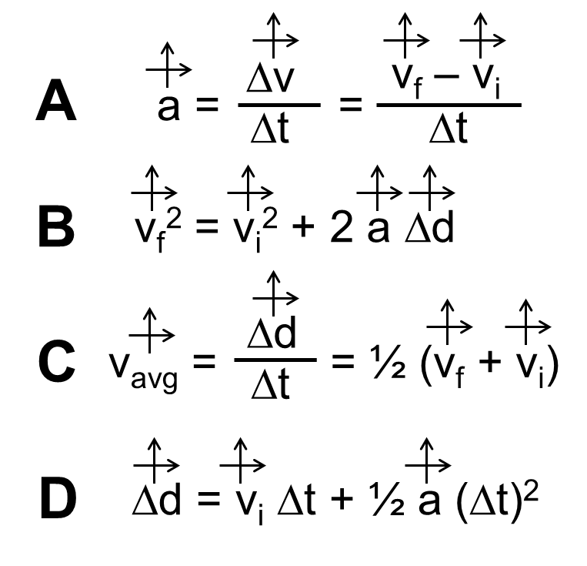
Free Fall
X
X
a = g =
X
An alarm clock is “fire-escaped”
from rest from height 38.0 m.
a. How long is clock in the air?
0
Δd = v_{i} Δt + ½ a (Δt)²
Solve for…
= 2.78 s

Slide 42
X
We know:
a
v_{i}
Δd
b. Find velocity of
clock at impact.
We know:
a
v_{i}
Δd
Δt
0
X
Δv
v_{f} – v_{i}
a =
=
Δt
Δt
X
→ v_{f} = aΔt
= –9.81 m/s² (2.78 s)
= –27.3 m/s (i.e., )
c. Find velocity of clock halfway down.
0
We DON’T know Δt (!).
v_{f}² = v_{i}² + 2 a Δd
= –19.3 m/s (i.e., )

Slide 43
FINAL THOUGHTS: 1-D Free Fall Problems, 1
In this lesson, we began to look at one-dimensional
motion for objects in free fall; that is, objects that are
acted upon only by the force of gravity. Here, we have
assumed that air resistance is negligible. In such a
case, any object will accelerate at –9.81 m/s², or
9.81 m/s² in the downward direction. This means that,
if an object is falling downward, it is speeding up; if
traveling upward, it is slowing down. The same 1-D
equations we have already met apply equally well to
free fall. We’ll see this some more in the next lesson.

Slide 44
v = 0 m/s
v
v
Δd
v_{avg} =
= ½ (v_{f} + v_{i})
Δt
v
v
Δv
v_{f} – v_{i}
a =
=
Δt
Δt
v getting smaller by 9.81 m/s each sec.
v
v
v getting larger by 9.81 m/s each sec.
Δd = v_{i} Δt + ½ a (Δt)²
v
v
v_{f}² = v_{i}² + 2 a Δd
v
v

Slide 45
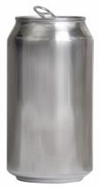
A full beverage can is launched
upward with initial velocity
22.8 m/s. Find…
X
X
a. …total time in air
X
Find time to top…
0
Δv
v_{f} – v_{i}
a =
=
Δt
Δt
–v_{i}
Malted and carbonated
hydroxyl-group-containing
liquid refreshment
→ Δt =
a

Slide 46
b. …maximum height
attained
X
We know:
a v_{i}
v_{f} Δt
Δd = v_{i} Δt + ½ a (Δt)²
X
= 22.8(2.32) + ½ (–9.81)(2.32)²
X
= 26.4 m
c. …location of can when its speed
is half its original speed
Malted and carbonated
hydroxyl-group-containing
liquid refreshment
We know:
a v_{i} v_{f}
but NOT Δt.
v_{f}² = v_{i}² + 2 a Δd

Slide 47
FINAL THOUGHTS: 1-D Free Fall Problems, 2
We have seen here that the equations we brought out
for horizontal 1-D motion apply equally well for objects
in free fall. While 1-D free fall problems have the
complication that we must consider both upwards and
downwards motion, they also have distinct advantages
over horizontal 1-D motion problems. For one thing,
the acceleration is always known: –9.81 m/s². We also
know the speed of the object at the top of its trajectory:
0 m/s. Finally, if it lands at the same elevation at which
it was launched, the initial and final speeds are the
same.

Slide 48
Linear Regression
(Linear Least Squares Fit)
a mathematical procedure that gives the “best” straight line through data points that don’t make a
straight line
y = m x + b
y
x

Slide 49
Using the Linear Regression Equation
P
v
P
t
t
t²
slope = v
slope = a

Slide 50
FINAL THOUGHTS: Linear Regression
The linear regression, or linear least-squares fit, is a
method for determining the ‘best’ straight line through
data points that don’t quite line up in a straight line.
While there is a way to figure out the equation of the
line ‘by hand,’ most of the time now we simply plug the
coordinates into a graphing calculator or a spreadsheet
and “POOF!” out comes the slope and y-intercept. If
you will be spending any amount of time in a physics
lab, you would be wise to invest a little time in learning
how to find the equation of the regression
line using those tools.
John Bergmann
www.teachnlearnchem.com

