Slide 1
POINT OF NOTE:
At Normal Community High School, we use the
CASTLE curriculum to introduce the concepts of
electricity to our physics students. CASTLE is an
acronym for Capacitor-Aided System for Teaching
and Learning Electricity. In my classes, we work for
about six or seven weeks on CASTLE before going
back to a more traditional classroom format with
electricity. Lessons 7-9 in these lectures summarize
the key concepts from CASTLE that I employ in
teaching subsequent lessons. You can find much
information about this excellent program online.

Slide 2
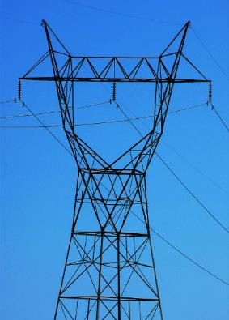
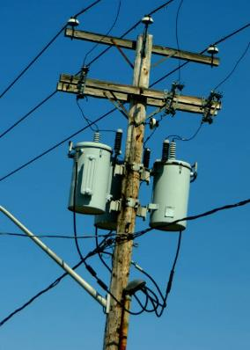
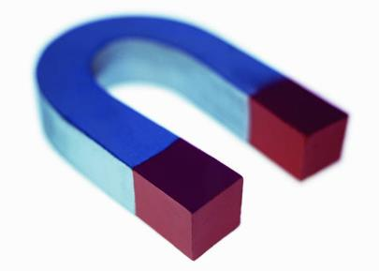
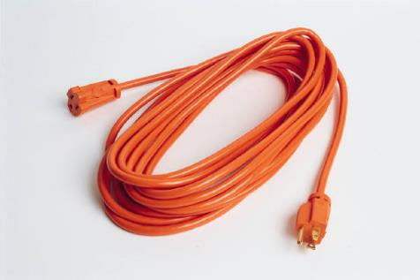
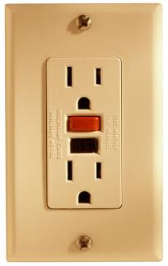
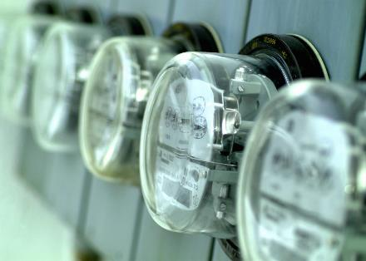
Electromagnetism

Slide 3
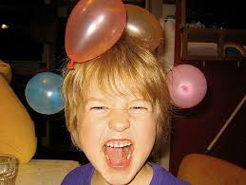
Electrostatics: electric charges at rest
Electric charge is quantized:
it exists in certain
specified amounts
-- charge is measured in coulombs (C)
-- charge on one p⁺ or e– =
1.60 x 10^{–19} C
-- WHICH of these particles tend to move?
e–
-- WHY?
p⁺ are bound within nuclei;
e– are more easily transferred
law of conservation
of charge:
the total amount of
charge is fixed

Slide 4

When a balloon is rubbed against denim, the denim
loses 6.56 x 10⁸ electrons. What is the net charge
on the balloon? On the denim?
–
6.56 x 10⁸ e–
= 1.05 x 10^{–10} C
denim:
+1.05 x 10^{–10} C
Assume that we measure that a conductor loses
–1.05 x 10^{–18} C of charge. How many e– did it lose?
1.05 x 10^{–18} C
= 6.56 e–
“Jack…you’re doing it wrong.”
-- we can’t have fractions of e–s
-- e–s are quantized entities

Slide 5
SUMMARY: The Nature of Electric Charge
We introduced some basic ideas in electrostatics:
1. An electron and a proton have opposite signs, but
the same magnitude of charge (1.60 x 10^{–19} C).
2. The smallest amount of charge that is possible is
1.60 x 10^{–19} C is, because charge is quantized.
3. The law of conservation of charge says that the
total amount of charge in the universe is fixed.
John Bergmann
www.teachnlearnchem.com

Slide 6
REVIEW: The Nature of Electric Charge
Previously, we introduced these ideas in electrostatics:
1. An electron and a proton have opposite signs, but
the same magnitude of charge (1.60 x 10^{–19} C).
2. The smallest amount of charge that is possible is
1.60 x 10^{–19} C is, because charge is quantized.
3. The law of conservation of charge says that the
total amount of charge in the universe is fixed.

Slide 7
Electrostatic force can be:
ATTRACTIVE REPULSIVE
+
–
+
+
–
–
Magnitude of elec. force
between two charges is
found using Coulomb’s law:
k_{c} = 9 x 10⁹ N.m²/C²
q = magnitude of
charge (C)
r = separation between
charges (m)

Slide 8
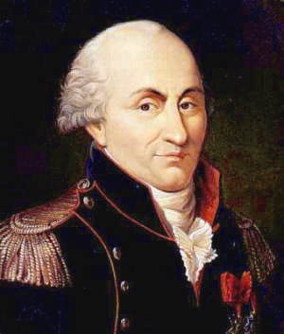
A +4.0 x 10^{–8} C charge and a
+7.6 x 10^{–9} C charge are 28 cm apart.
Find the magnitude and direction of
the electric force between them.
+
+
Charles Coulomb
(1736-1806)
= 3.5 x 10^{–5} N (repulsive)

Slide 9
How far apart must two protons be for them to
repel each other with a force of 7.6 x 10^{–26} N?
+
+
= 0.055 m
= 5.5 cm

Slide 10
capacitor: stores electrical energy by virtue of
separated charges
insulator
(dielectric)
conductors
(metal plates)
capacitance: a measure of capacitor’s ability to
store charge/energy
Depends on: 1.
2.
geometry of capacitor
insulating mat’l (dielectric)

Slide 11
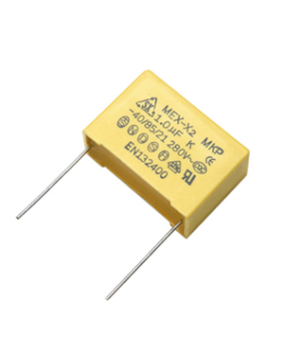
values of dielectric constant κ:
vacuum… 1.00000
air………. 1.00059
water…….80
For different types
of plastic, glass,
and rubber, κ ~ 2–7.
**
One equation for capacitance:
C = capacitance (F)
ε_{o} = 8.85 x 10^{–12} C²/N.m²
A = area of one plate (m²)
d = plate separation (m)
A
d

Slide 12
Capacitance can be measured another way. A
potential difference ΔV applied to the plates causes:
one plate to get
a charge of +Q
one plate to get
a charge of –Q
and
Circuit A
Circuit B
ΔV
ΔV
The capacitance of a capacitor…
IS what it is.
C
C
Q
Q
Second equation
for capacitance:

Slide 13
FINAL THOUGHTS: Capacitors
1. A capacitor stores electrical energy when a voltage
difference causes charge to move from one plate to
the other through the circuit. One plate now has
more than the normal amount of charge; the other
plate has less than the normal amount.
2. The capacitance of a capacitor depends on the
geometry and materials of its construction. While a
given capacitor can store any number of amounts of
energy due to various amounts of charge being
transferred between plates, its capacitance is fixed.

Slide 14
ΔV
REVIEW: Capacitors
insulator
d
C
A
conductors
Q
C = capacitance (F)
Q = amt. of charge moved (C)
ΔV = voltage (V)
κ = dielectric constant
ε_{o} = 8.85 x 10^{–12} C²/N.m²
A = area of one plate (m²)
d = plate separation (m)

Slide 15
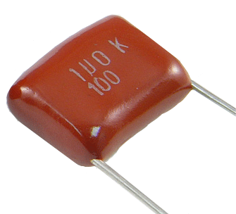
Capacitor of capacitance 5.5 μF is connected to a
potential difference of 18 V. How many e– will move
from one plate to the other?
= (5.5 x 10^{–6} F) (18 V)
= 9.9 x 10^{–5}
C
9.9 x 10^{–5} C
= 6.2 x 10¹⁴ e–

Slide 16
Capacitor ^{w}/rubber as dielectric (κ = 4.8) has plate
area 2.0 cm² and plate separation 1.0 mm. For a
9.0 V potential difference, how much charge will
each plate store?
A = 2.0 cm.cm
²
A = 2.0 cm²
= 2.0 x 10^{–4} m²
Also, d = 1.0 x 10^{–3} m
= 7.6 x 10^{–11} C

Slide 17
REVIEW: Capacitors
ΔV
1. A capacitor stores electrical
energy when a voltage
difference causes charge
to move from one plate to
the other through the circuit.
2. The capacitance of a
capacitor depends on
the geometry and
materials of its
construction.
C
Q
insulator
(dielectric)
conductors
(metal plates)

Slide 18
Because it takes work to separate electric charges,
capacitors store…
energy.
--
unit is…
joules (J)
Equation:
Find energy stored when a 0.33 μF capacitor is
connected across a 120 V potential difference.
= 2.4 x 10^{–3} J

Slide 19
Equations for...Capacitors
C = capacitance (F)
Q = amt. of charge moved (C)
ΔV = voltage (V)
κ = dielectric constant (no unit)
ε_{o} = 8.85 x 10^{–12} C²/N.m²
A = area of one plate (m²)
d = plate separation (m)

Slide 20

Electric Current and Circuits
current: the rate of charge flow
(NOT the speed of charge flow)
Amount of Charge Flow | Time of Flow | Rate of Charge Flow
100 charges | 2 s
500 charges | 25 s
50 ch/s
20 ch/s
One equation for current:

Slide 21
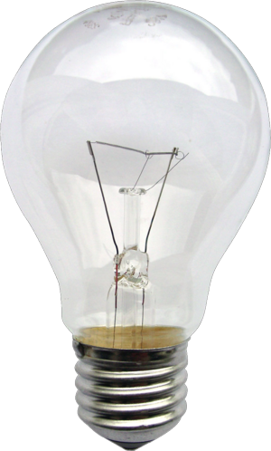
5.8 C of charge flow through a bulb
filament in 3.1 s. Find current.
= 1.9 A
How many e– flow through the bulb in one hour?
→ X = 6735.5 C
6735.5 C
= 4.2 x 10²² e–

Slide 22
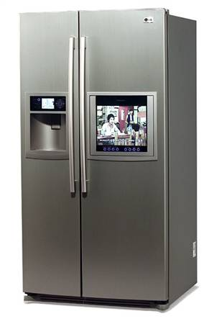
If 1.0 mole of e– flow through
an appliance in 5.6 hours, find
current pulled by appliance.
6.02 x 10²³ e–
= 96,320 C
= 4.8 A

Slide 23
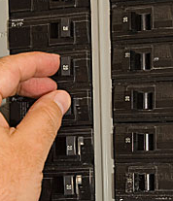
FINAL THOUGHTS: Electric Current
1. Current is the amount of charge flow per unit time;
specifically, the number of coulombs of charge that
pass a fixed point in a given number of seconds, i.e.,
2. We measure current in amperes (A).
3. A typical household circuit breaker
trips at, say, 20 amps. So huge
numbers for current calculations
are usually way off base.
John Bergmann
www.teachnlearnchem.com

Slide 24
Ohm’s Law
Voltage is an electric…
pressure.
L
R
L
L
ΔV
ΔV
ΔV
R
R
R
I
I
I

Slide 25
Equation for Ohm’s law:
R = resistance,
in ohms (Ω)
(or… ΔV = I R)
R₂
ΔV
ΔV
R
R₁
I
I
ohmic resistor
non-ohmic resistor
--
R is constant over
a large range of ΔV
--
R varies,
depending on ΔV

Slide 26

Hair dryer ^{w}/resistance 280 Ω
is plugged into a standard
outlet. What current flows
through hair dryer?
** memorize: standard outlet = 120 V
= 0.43 A
Suppose hair dryer is plugged into an outlet with
potential difference 220 V. Find current.
= 0.79 A
(“zzztt…POP!”)
“The Great Plug Conspiracy”

Slide 27
FINAL THOUGHTS: Ohm’s Law
1. Ohm’s law gives the relationship between the
potential difference (i.e., the voltage) across a
resistor, the resistance of the resistor, and the
current through it.
or ΔV = I R
2. Resistance is measured in ohms (Ω).
3. Ohmic resistors maintain the same resistance over
a wide range of potential differences, while the
resistance of a non-ohmic resistor depends
greatly on the applied ΔV.
John Bergmann
www.teachnlearnchem.com

Slide 28
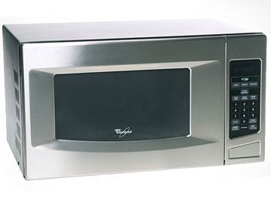
Electric Power
Equation:
P = I ΔV
P = power rating /
power consumed (W)
A microwave has power rating 1.0 x 10³ W.
What current flows through it?
P = I ΔV
= 8.3 A
A refrigerator “pulls” 6.25 A. What is its power rating?
P = I ΔV
= 6.25 A (120 V)
= 750 W

Slide 29
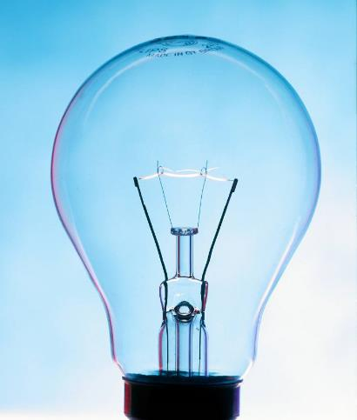
What is the resistance of
a 75 W light bulb?
Since…
So
P
R
and
= 190 Ω
For a 100 W bulb…
= 140 Ω

Slide 30
SUMMARY: Electric Power
The electric power consumed by a resistor
is the product of the current flowing through
the resistor and the potential difference
across it.
P = I ΔV
(P is in W, I in A, and ΔV in V)
John Bergmann
www.teachnlearnchem.com

Slide 31
Cost of Electricity
Equation:
COST = POWER x TIME x $RATE
(Recall: P = I ΔV)
kW h $/kWh
A drying oven in a chemistry lab pulls 4.0 A and runs
constantly. Electricity costs $0.080/kWh. Find the
cost to run the oven for one year.
( )
1 kW
P = IΔV
= 4.0 A (120 V)
= 480 W
= 0.48 kW
1000 W
TIME = 1 y
= 8760 h
COST =
0.48 kW
(8760 h)
= $340

Slide 32

voltmeter: measures…
TARGET
CIRCUIT
potential difference
low resistance
high resistance
series
parallel
voltmeter →
high resistance; connect in parallel

Slide 33
ammeter: measures…
TARGET
CIRCUIT
current
low resistance
high resistance
series
parallel
ammeter →
low resistance; connect in series

Slide 34
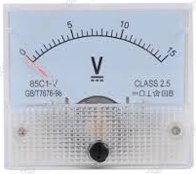
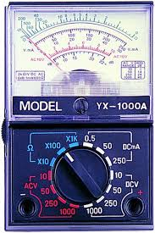
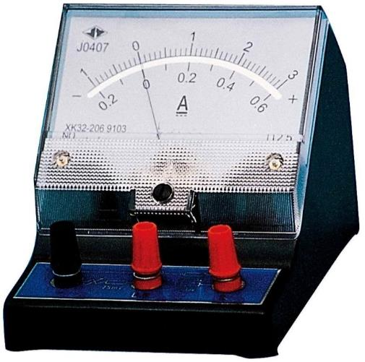
Analog meters have a movable
needle that is read by the user.
analog voltmeter display
analog multimeter
analog ammeter

Slide 35
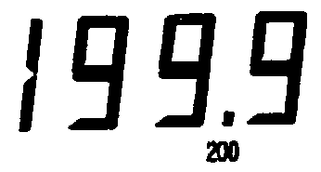
Digital
Multimeter
2.32
0.44
DC
V
Hz
OFF
F
DC
V
Hz
OFF
F
20K
2K
2n
20n
20K
2K
2n
20n
DC1000
200K
200n
cx
DC1000
200K
200n
cx
AC750
2u
AC750
2u
AC
200
20u
AC
200
20u
20
200M
20
200M
2
20M
2
20M
200m
2M
200m
2M
200m
200K
200m
200K
20m
20K
20m
20K
10A
2m
2K
10A
2m
2K
A
200u
200
A
200u
200
PNP
NPN
OFF
Ω
PNP
NPN
OFF
Ω
E
E
HFE
LOGIC
HFE
LOGIC
B
C
E
E
B
C
10A
mA
COM
VΩHz
10A
mA
COM
VΩHz
!
!
!
!
!
!
10A
MAX
200mA
MAX
500V MAX
DC1000V
AC700V
MAX
LOGIC
(+)
10A
MAX
200mA
MAX
500V MAX
DC1000V
AC750V
MAX
LOGIC
(+)
Notes:
Set Voltage scale to 20V. Set AC/DC switch to DC. Black lead stays in COM, Red lead should be in far right socket of DMM labeled 10A and should be connected into the circuit in series nearest the (+) terminal.
On the Triplett 9000 models, there are different ranges for AC and DC…be sure to select the DC range. Red and Black lead placement is identical to the BK Precision model.

Slide 36
FINAL THOUGHTS: Voltmeters and Ammeters
1. Voltmeters have a high resistance. They measure
the potential difference between two parts of a
circuit, which is why they must be connected in
parallel, around circuit elements, where they can
touch wires of different pressure (i.e., different colors).
Voltmeters are comparatively difficult to damage.
2. Ammeters have a very low resistance, like a wire, and
so are rather easy to damage. They must be wired in
series with circuit elements because in order to
measure current, that current must
flow through the ammeter.
John Bergmann
www.teachnlearnchem.com

Slide 37
Ohm’s Law and CASTLE
“12 V”
“12 V”
ΔV_{batt} =
R_{A} = 2 Ω
12 V
“6 V”
12 V
R_{A}
R_{B}
R_{B} = 2 Ω
“0 V”
“0 V”
I_{A} = 6 V / 2 Ω = 3 A
I_{A} = 12 V / 2 Ω = 6 A
I_{B} = 6 V / 2 Ω = 3 A
I_{B} = 12 V / 2 Ω = 6 A
I_{BATT} = I_{A} = I_{B} = 3 A
I_{BATT} = I_{A} + I_{B} = 12 A

Slide 38
Ohm’s Law and CASTLE (cont.)
“12 V”
ΔV_{batt} =
12 V
R_{A} = 4 Ω
R_{B} = 6 Ω
“0 V”
I_{A} = 12 V / 4 Ω = 3 A
I_{B} = 12 V / 6 Ω = 2 A
I_{BATT} = I_{A} + I_{B} = 5 A

Slide 39
FINAL THOUGHTS: Coulomb’s Law and CASTLE
1. Ohm’s law expresses the relationship
between pressure difference (voltage),
flow rate (current), and resistance.
2. In CASTLE, students learn to color-code wires
according to pressure and to assign ballpark-
quantitative values for currents based on pressure
differences and resistances; i.e., MORE arrowtails
or FEWER arrowtails. Here, we took the next step
of assigning numbers to voltages and then
used Ohm’s law to compute
currents.
John Bergmann
www.teachnlearnchem.com

Slide 40
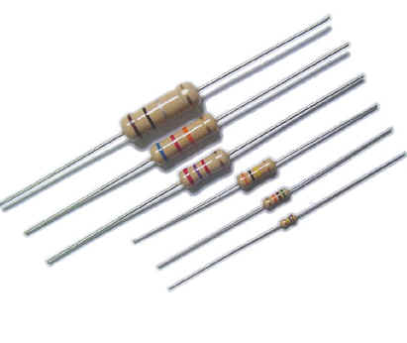
Series Circuits
equivalent resistance: the resistance of several
resistors taken together;
it depends on the value of
each resistor and on the
configuration of resistors
carbon
resistors
For series circuits:
R_{eq} = R₁+ R₂ + …
R₁
R₂
R₃
R₄

Slide 41
ΔV (V)
I (A)
R (Ω)
“24 V”
R₁
“20 V”
Batt.
24
2
12
ΔV
R₂
R₁
4
2
2
R₂
12
2
6
“0 V”
R₃
“8 V”
R₃
8
2
4
ΔV (V)
I (A)
R (Ω)
“15 V”
R₁
“6 V”
Batt.
15
1.5
10
ΔV
R₂
R₁
9
1.5
6
“0 V”
R₂
6
1.5
4
Also for series circuits:
I = I₁ = I₂ = …
ΔV_{batt} = ΔV₁ + ΔV₂ + …

Slide 42
FINAL THOUGHTS: Series Circuits
1. In a series circuit, the resistance elements are in a
one-after-the-other configuration; the current has no
choice but to go through one resistor, then another,
and so on. There is only one path for charge flow.
2. The equivalent resistance is the combined resistance
of two or more resistors connected (somehow). For
series circuits, the equivalent resistance is the sum
of the individual resistances.
3. Because there is only one path for charge flow, all
circuit elements in series circuits have the same
current.

Slide 43
Parallel Circuits
For parallel circuits:
“12 V”
ΔV (V)
I (A)
R (Ω)
R₁
Batt.
12
6
2
ΔV
R₂
R₁
12
2
6
R₂
12
4
3
“0 V”
I = I₁ + I₂ + …
Also for parallel circuits:
ΔV_{batt} = ΔV₁ = ΔV₂ = …

Slide 44
ΔV
“0 V”
“16 V”
ΔV (V)
I (A)
R (Ω)
8 A
R₁
Batt.
16
16.67
0.96
R₁
16
8
2
R₂
4 A
R₂
16
4
4
R₃
R₃
16
2.67
6
2.67 A
R₄
16
2
8
R₄
2 A
R_{eq} = 0.96 Ω

Slide 45
FINAL THOUGHTS: Parallel Circuits
1. In a parallel circuit, the resistance elements are in a
this-way-or-that-way configuration; the current splits
and goes through multiple resistors at the same time.
That is, there are multiple paths for charge flow.
2. For parallel circuits, the
equivalent resistance is
found from what I call
the “one-over” relation:
3. Anywhere in the circuit, the total current flowing
INTO a junction must equal the total current
flowing OUT of the junction.

Slide 46
REVIEW: Series and Parallel Circuit Rules
For series circuits:
For parallel circuits:
R₁
R₁
ΔV
ΔV
R₂
R₂
R_{eq} = R₁+ R₂ + …
I = I₁ = I₂ = …
I = I₁ + I₂ + …
ΔV_{batt} = ΔV₁ + ΔV₂ + …
ΔV_{batt} = ΔV₁ = ΔV₂ = …

Slide 47

Combination Circuits
Solve the following problems.
R_{eq} = 4 Ω
R₁
“24 V”
“12 V”
ΔV (V)
I (A)
R (Ω)
R₂
Batt.
24
3
8
R₁
12
1.5
8
ΔV
R₂
12
1.5
8
R₃
3 A
3 A
R₃
12
3
4
“0 V”

Slide 48
3.68 Ω
1.85 Ω
ΔV (V)
I (A)
R (Ω)
R₁
“27.3 V”
Batt.
36
2.35
15.31
“36 V”
R₂
R₁
8.7
1.34
6.5
R₂
8.7
1.02
8.5
R₃
4.3
1.02
4.2
R₃
R₄
R₅
R₄
4.3
0.90
4.8
ΔV
R₅
4.3
0.41
10.6
“23 V”
R₆
R₆
17.63
2.35
7.5
R₇
R₇
5.37
0.94
5.7
R₈
R₈
5.37
1.41
3.8
“0 V”
“5.37 V”
R_{eq} = 3.68 + 1.85 + 7.5 + 2.28
2.28 Ω
R_{eq} = 15.31 Ω

Slide 49
FINAL THOUGHTS: Combination Circuits, 1
1. Combination circuits have both series and parallel
elements. The challenge in analyzing these is to use
the appropriate rules (series or parallel) at the
appropriate times, for each section of the circuit.
2. There is no prescribed order for analyzing circuits,
which is why I call them “Circuit Sudoku” problems;
you and I can attempt the same problem and should
come up with the same answers, regardless of the
order in which we figure out the various quantities.

Slide 50
2.14 Ω
ΔV (V)
I (A)
R (Ω)
R₂
Batt.
25
“8.68 V”
2.89
8.64
R₃
R₁
10.12
2.89
3.5
“14.88 V”
R₂
6.20
1.13
5.5
“6.28 V”
R₃
6.20
1.77
3.5
R₁
R₄
8.68
1.93
4.5
R₅
“25 V”
R₅
2.40
0.96
2.5
R₄
ΔV
R₆
6.24
0.96
6.5
R₆
3.00 Ω
“0 V”
R_{eq} = 3.5 + 2.14 + 3
R_{eq} = 8.64 Ω

Slide 51
ΔV (V)
I (A)
R (Ω)
R₁
Batt.
12
2.58
4.66
R₂
R₃
R₄
R₁
6.84
0.86
8
R₂
2.02
0.202
10
R₅
R₆
R₃
2.42
0.202
12
R₇
R₄
2.42
0.202
12
“5.16 V”
R₅
3.80
0.38
10
“12 V”
R₈
R₆
3.04
0.38
8
ΔV
R₇
6.84
1.14
6
“0 V”
R₈
5.16
2.58
2
R_{eq,1-7} = 2.66 Ω

Slide 52
FINAL THOUGHTS: Combination Circuits, 3
Certainly, one doesn’t need a chart to analyze circuit
problems. Often, we are asked only to solve for
particular values. Even so, my students have had
success using the “Circuit Sudoku” charts, as they
make it easier to identify what can be readily
calculated and what else needs to be found. One
nice thing (for students) about Circuit Sudoku is that
there doesn’t have to be much work to show (unless
you have a stickler for a teacher). Anyway, find some
circuit problems, chart it up, and have fun!

Slide 53

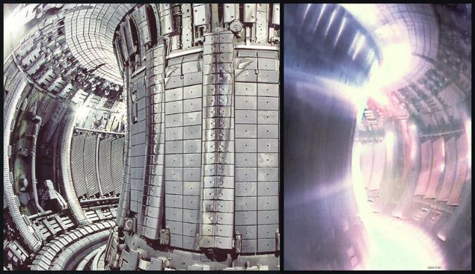
Magnetism
A magnetic field (B) is generated by…
moving electric charges.
-- Magnets have a north pole and a south pole.
ATTRACTIVE REPULSIVE
N
S
N
N
S
S
A tokamak is a machine that
generates a B field to confine
plasma for fusion research.

Slide 54
The Earth acts like a big magnet.
--
due to convection currents
in molten core
true north:
S
geographic north
magnetic north:
the direction a
compass points
(i.e., the S pole
of the Earth-magnet)
N
magnetic declination:
the difference between true and magnetic north
(it depends on one’s global location)

Slide 55
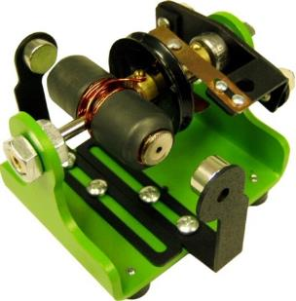

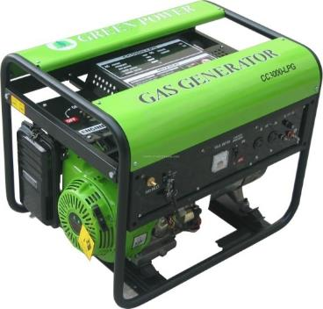
motor:
electric
current
magnetic
field
mechanical
energy
I x B F
generator:
mechanical
energy
magnetic
field
electric
current
F x B I

Slide 56
FINAL THOUGHTS: Introduction to Magnetism
1. Magnetic (i.e., B) fields are generated by moving
charges, e.g., electrons around the nuclei of atoms.
Most materials aren’t normally magnetic because the
B fields of “this-way-moving” e– are exactly canceled
by the B fields of “that-way-moving” e –. Materials
like – often – iron, have an unequal # of “this” and
“that” e –, and so manifest a measureable B field.
2. motor → when a current interacts with a B field,
mechanical energy results. generator → when
mechanical energy spins a conductor
in a B field, current is produced.
John Bergmann
www.teachnlearnchem.com

Slide 57
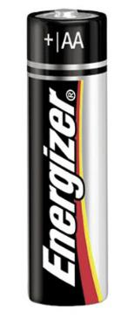
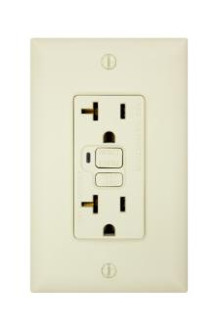
two types of current:
direct current (DC) alternating current (AC)
current flows in
one direction only
current flows
back and forth
+I
+I
0
0
TIME
TIME
–I
–I
e.g.,
batteries
e.g.,
electrical
outlets

Slide 58
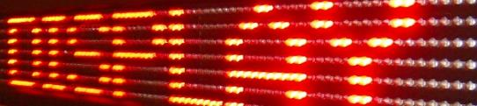
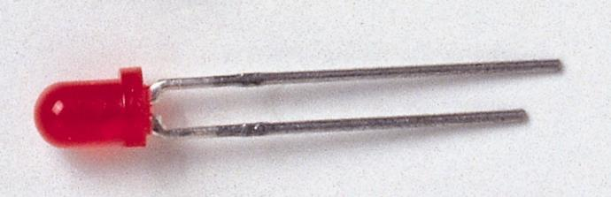
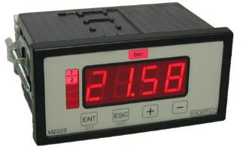
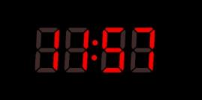
diode: allows current to pass more easily in
one direction than another
--
converts AC to DC
+I
0
–I
The light-emitting diode (LED)
has a wide variety of applications.

Slide 59
SUMMARY: Alternating Current vs. Direct Current
1. In DC circuits, current flows only in one direction. It
might flow constantly or it might flow in fits and starts,
but it only flows, say, clockwise. This happens
because the electric pressure (i.e., voltage) in one
part of the circuit is always greater than (or maybe
equal to) the pressure in another part of the circuit.
2. In AC circuits, current goes first one way, then the
other because the electric pressure changes from
greater-here, to greater-there, now greater-here
again, and so on.
3. Diodes convert AC to DC.
John Bergmann
www.teachnlearnchem.com

Slide 60
Lenz’s Law
With AC, the current in WIRE 1 is constantly changing
in magnitude and direction.
ΔI₁
This causes B field in WIRE 1
to change constantly.
ΔB₁
ΔB₂
ΔI₂
When WIRE 2
– a separate, closed loop – senses WIRE 1’s
changing B field, a current is induced in WIRE 2.
The induced current in WIRE 2 generates its own
B field, which opposes the B field from WIRE 1.
This last statement is called Lenz’s law.

Slide 61
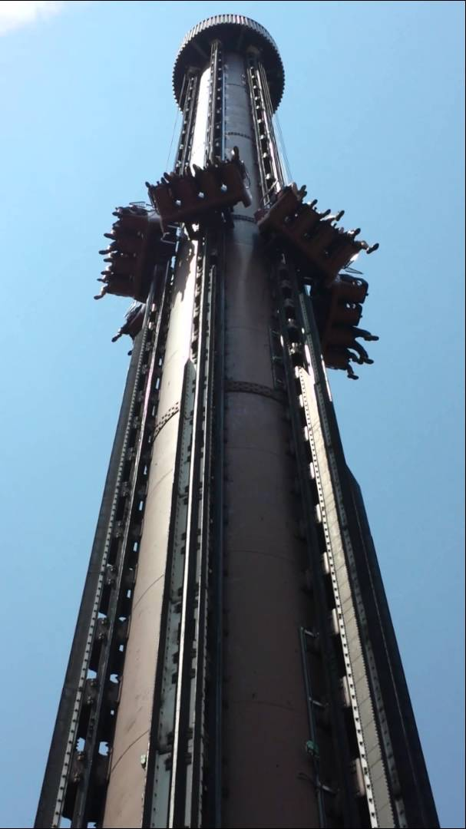
FINAL THOUGHTS: Lenz’s Law
Lenz’s law is a consequence of the
law of energy conservation. If the
changing B field around an AC
conductor induced an AC current in
a nearby conductor, which then
produced a B field additive to the
first one, that would be like getting
something for nothing. Check out
some of the cool demos of Lenz’s
law on YouTube.
Pretty neat stuff!
pic
John Bergmann
www.teachnlearnchem.com

Slide 62
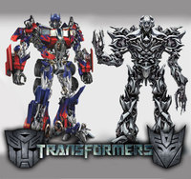
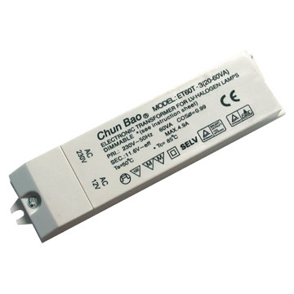
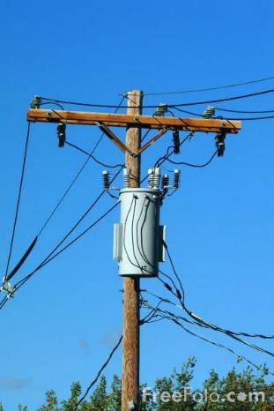
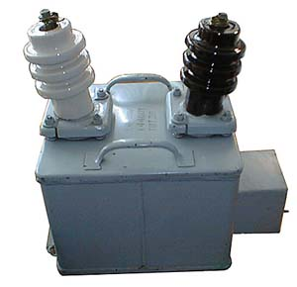
Transformers
A transformer is a device that allows
voltage to be increased or decreased.
-- The voltage must be…
changing.
--
For all practical purposes, this requires AC.

Slide 63
A step-up transformer ________ the voltage;
increases
the secondary has MORE turns than the primary.
insulated
wire 1
insulated
wire 2
iron core
primary secondary
N₁ turns N₂ turns
voltage ΔV₁ voltage ΔV₂
current I₁ current I₂
decreases
A step-down transformer _________ the voltage;
the secondary has FEWER turns than the primary.

Slide 64

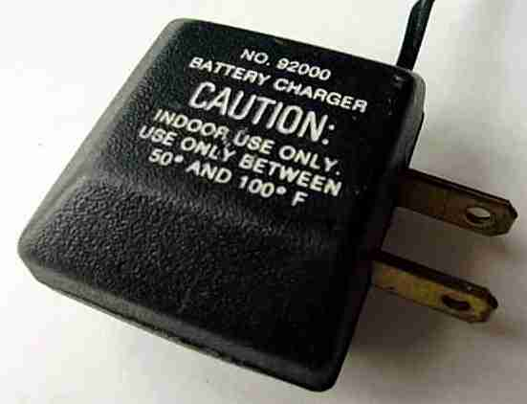
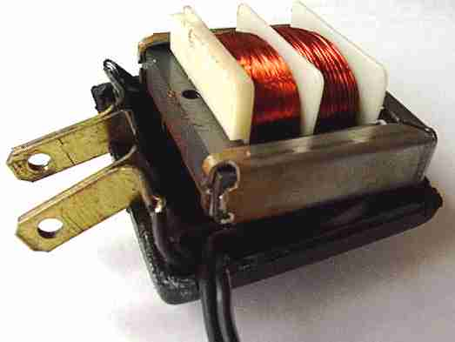
Change in voltage is directly
proportional to ratio of
number of turns.
Change in current is inversely
proportional to change in voltage.
Change in current is inversely
proportional to ratio of
number of turns.
“I’ve got to get
centered…so
I weave.”

Slide 65
Transformers are used in
transporting electrical power.
HIGH-VOLTAGE
POWER LINES
step-down
transformer
(~2,000 V)
step-down
transformer
(120/220 V)
step-up
transformer
(~150,000 V)
(more efficient, less “I²R loss”,
i.e., less HEAT lost)
POWER
GENERATING
PLANT
RESIDENTIAL
CONSUMER

Slide 66
FINAL THOUGHTS: Transformers
1. Transformers can increase or decrease voltage,
but only when the inducing voltage is constantly
changing. This means AC current is preferable
in stepping voltage up or down.
2. Because there is no free lunch, a stepped-up
voltage is accompanied by a lower current, and
vice-versa. This ensures that the “power-in”
(i.e., I ΔV) equals the “power-out,”
or “energy-per-unit-time-in” equals
“energy-per-unit-time-out.”
John Bergmann
www.teachnlearnchem.com

Slide 67
POINT OF NOTE:
At Normal Community High School, we use the
CASTLE curriculum to introduce the concepts of
electricity to our physics students. CASTLE is an
acronym for Capacitor-Aided System for Teaching
and Learning Electricity. In my classes, we work for
about six or seven weeks on CASTLE before going
back to a more traditional classroom format with
electricity. Lessons 7-9 in these lectures summarize
the key concepts from CASTLE that I employ in
teaching subsequent lessons. You can find much
information about this excellent program online.

Slide 68
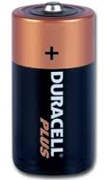
1. Via internal chemical reactions, batteries maintain
an electric pressure difference between their
terminals. It is assumed that the (+) terminal is held
at a higher electric pressure than the (–) terminal.
+ terminal
(high elec.
press.)
CASTLE color-
code conventions:
high P = RED
low P = BLUE
Schematic diagram
showing a two-battery
pack, two wires, and
a light bulb (resistor)
– terminal
(low elec.
press.)

Slide 69
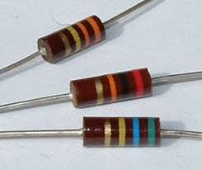
2. When connected into a circuit ^{w}/resistance elements,
the pressures of the wires connected to the
battery immediately become equal to the
electric pressures at the terminals.
3. Because wires have little resistance,
they can’t maintain any difference in
pressure from one part of the wire
compared to another, i.e., a given
wire has a uniform pressure. There-
fore, any pressure differences
between wires will be observed
only if there is a resistor (or
battery) between those wires.

Slide 70
4. In circuits, we color the different wires to indicate
the electric pressure in each.
RED
highest pressure (touching + batt. term.)
ORANGE
YELLOW
normal pressure
GREEN
BLUE
lowest pressure (touching – batt. term.)
5. In a circuit, current flows
from points of higher to
points of lower pressure.
R
B
O
G
For each combo here,
current would flow L to R.
G
B

Slide 71
FINAL THOUGHTS: Basics from CASTLE, 1
All electric circuits are based on the relationship between
three main quantities: electric pressure (voltage),
electrical resistance, and flow rate of charge (current).
1. Batteries have a high pressure at their (+) terminals, low P at
their (–) terminals. Wires have low resistance, so these Ps
are transmitted to any wires connected to the battery terminals.
2. Highest-pressure wires are colored red; higher-than-normal,
orange; normal, yellow; lower-than-normal, green; and lowest-
pressure wires are colored blue.
3. Charge flow (current) is from higher- to lower-pressure regions.

Slide 72
6. When a resistor is added into a circuit in series with
the other resistor(s), the total resistance ________.
increases
STRAW
some R to
breathing
more R to
breathing
ANY RESISTOR
some R to current
more R to current

Slide 73
7. When a resistor is added into a circuit in parallel with
the other resistor(s), the total resistance _________.
decreases
STRAW
ANY RESISTOR
some R to breathing
some R to current
less R to breathing
less R to current
R
L
8. Round bulbs have less
resistance than long bulbs.
round bulbs:
low resistance
long bulbs:
high resistance

Slide 74
FINAL THOUGHTS: Basics from CASTLE, 2
Electric circuits are based on the relationship between
three main quantities: electric pressure (voltage),
electrical resistance, and flow rate of charge (current).
1. Adding resistors in series increases the resistance
perceived by the battery; adding resistors in parallel
decreases the resistance perceived by the battery.
2. The round bulbs used in the CASTLE program have
low resistance; long bulbs have a higher resistance.
www.teachnlearnchem.com

Slide 75
9. In a series circuit, the flow rate of charge (i.e., the
current) is the SAME everywhere in a given circuit,
and its value depends on the total resistance of the
circuit. In such a case, for multiple resistors…
A…identical resis. values require identical pres. diffs.
R
R
HIGH P
O
R
R
Y
G
R
R
B
LOW P
R
R
R
R
R
R
R

Slide 76
B…different resis. values require different pres. diffs.
R
HIGH P
O
R
L
Y
G
L
R
B
LOW P
a
b
c
ΔP_{ab} < ΔP_{bc}
These ideas hold
true as well for
portions of
circuits that are
wired in series.
R
L
ΔP_{bc} = ΔP_{de}
R
R
e
d
L

Slide 77
10. In a parallel circuit (or a portion of a parallel circuit),
the pressure difference across the various parallel
resistors is the same. Thus, for circuits with multiple
resistors…
A…identical resis. values yield identical currents
R
HIGH P
O
Y
R
R
G
B
LOW P

Slide 78
B…different resis.
values yield
different currents
L
R
a
R
HIGH P
R
O
Y
L
R
G
B
LOW P
b
R

Slide 79
SUMMARY: Basics from CASTLE, 3
1. The current is the same for resistors in series. If the
resistors have the same value of resistance (R), then
the pressure difference (ΔP) across each of them is
also the same. If they have different Rs, then the ΔP
is greater across the higher Rs, less across lower Rs.
2. The ΔP is the same for resistors in parallel. If the
parallel resistors have the same R, then the current
through them will be the same. If they have different
Rs, then the current will be LESS through resistors
with higher Rs, MORE through those with lower Rs.

