Slide 1
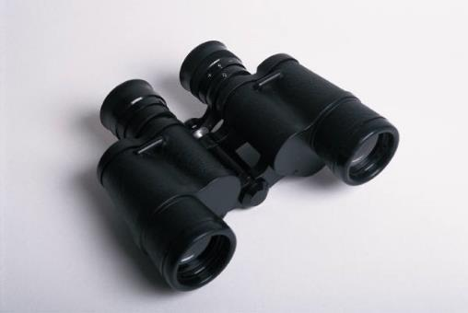
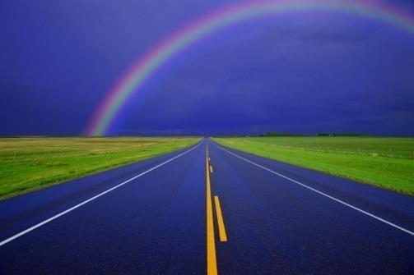
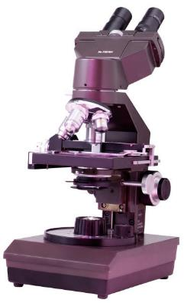
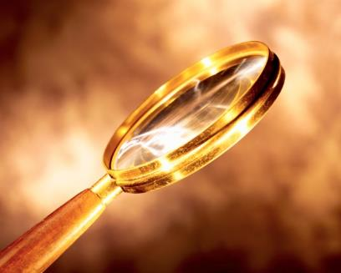
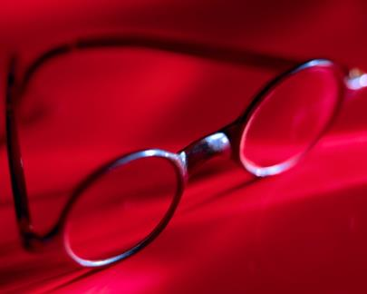
Refraction and Lenses

Slide 2
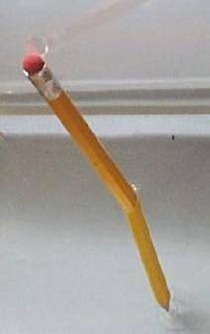
refraction: the bending of light as it travels at an
angle from one transparent medium into another
less
When light goes from a… optically dense medium
more
more
to a… optically dense medium,
less
toward
it bends… the normal.
away from
It has been found that light obeys
the principle of least time
(also called Fermat’s principle).

Slide 3
bologna-
sandwich
thief
BEACH
lifeguard
path of least time
normal
path of least distance
OCEAN
YOU
drowning
person
BEACH
lifeguard
OCEAN

Slide 4
LESS OPTICALLY
DENSE MEDIUM
“laser”
.
path of least time
normal
path of least distance
.
MORE OPTICALLY
DENSE MEDIUM
target

Slide 5
angle of incidence, θ_{i}
normal
incident ray
AIR (less dense)
refracted ray
θ_{i} for 2nd boundary
angle of refraction, θ_{r}
GLASS (more dense)
AIR (less dense)
θ_{r} for 2nd boundary

Slide 6

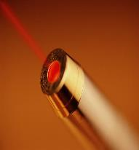
“ZAP!”
AIR (less dense)
GLASS (more dense)
“LASER…”
AIR (less dense)
“Costing
one MILLION
dollars…”

Slide 7
SUMMARY: Introduction to Refraction
1. Refraction is the bending of light as travels at an
angle between different transparent media.
Refraction occurs because light adheres to the
principle of least time, or Fermat’s principle.
2. Angles of incidence and angles of refraction are
measured relative to an imaginary line (the normal)
that is everywhere perpendicular to the boundary.
3. When light goes from a less (MORE) optically
dense medium to a more (LESS) optically dense
one, it bends toward (AWAY FROM) the normal.

Slide 8
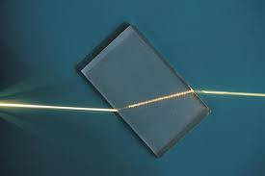
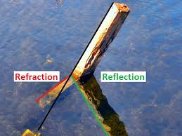
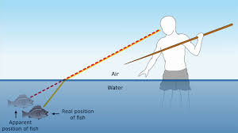

Slide 9
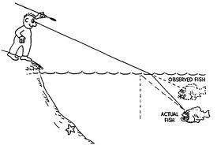

Slide 10
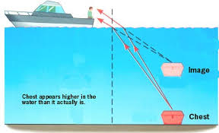

Slide 11
Index of Refraction
n = index of refraction;
c = 3.00 x 10⁸ m/s;
v = speed of light in mat’l (m/s)
In general...
n > 1.000
normal
Snell’s Law
θ_{i}
incident
medium (n_{i})
n_{i} sin θ_{i} = n_{r} sin θ_{r}
refracting
medium (n_{r})
θ_{r}

Slide 12
n₁ sin θ₁ = n₂ sin θ₂
Come listen and learn;
I’ve a story I tell.
I sing of the genius of Willebrord Snell,
A mathematician who lived long ago
In the Netherlands,
Where the Rhine river does flow.
He set for his mind occupations of worth,
Improved navigation,
And measured the Earth.
He gave us the sine law, that wonderful guy,
And he made more precise calculation of pi.
Singin’ n1 sine theta-sub-1, hey, hey, hey,
Equals n2 sine theta-sub-2, hip hooray.
His greatest feat came in 1621,
When optics as science was really begun.
While flashes of lightning illumined his page,
He wrote down Snell’s law,
His great gift to the age.
So if you wear glasses or like to fry ants,
Be grateful your lenses
Were not made by chance.
Astronomers hail him
With each new-found star.
Microscopists toast him from each sleazy bar.
Singin’ n1 sine theta-sub-1, hey, hey, hey,
Equals n2 sine theta-sub-2, hip hooray.
Now some credit Harriot,
Others Descartes.
Both studied refraction,
And both were real smart,
But we prefer
Willebrord van Roijen Snell.
He laid down the law,
And he did it darn well.
Singin’ n1 sine theta-sub-1, hey, hey, hey,
Equals n2 sine theta-sub-2, hip hooray.
http://www.haverford.edu/physics/songs/resnell.mp3

Slide 13
SUMMARY: Index of Refraction and Snell’s Law
1. The index of refraction is the ratio of the speed of
light through a vacuum compared to its speed
through some transparent medium. Because
light propagates at its highest speed
through a vacuum, indices
of refraction are usually > 1.
2. Snell’s law expresses the relationship between the
incident and refractive angles and the indices of
refraction at a boundary. You’ll
want your calculator in degree-
mode when using Snell’s law.
n_{i} sin θ_{i} = n_{r} sin θ_{r}

Slide 14
REVIEW: Index of Refraction and Snell’s Law
1. The index of refraction is the ratio of the speed of
light through a vacuum compared to its speed
through some transparent medium. Because
light propagates at its highest speed
through a vacuum, indices
of refraction are usually > 1.
2. Snell’s law expresses the relationship between the
incident and refractive angles and the indices of
refraction at a boundary. You’ll
want your calculator in degree-
mode when using Snell’s law.
n_{i} sin θ_{i} = n_{r} sin θ_{r}

Slide 15
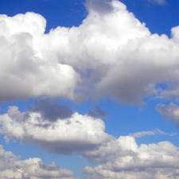
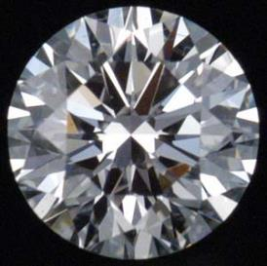
Light in air is incident on diamond (n = 2.419)
at 43.0º. Find the angle of refraction.
43.0º
n_{i} sin θ_{i} = n_{r} sin θ_{r}
n = 1.000
n = 2.419
n_{i}
sin θ_{r} =
sin θ_{i}
n_{r}
θ_{r}
[ ]
n_{i}
θ_{r} =
sin^{–1}
sin θ_{i}
= 16.4º
n_{r}

Slide 16
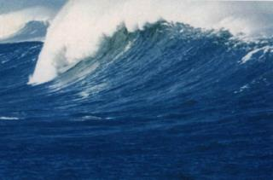
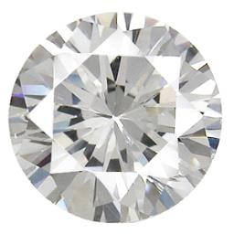
Light in water is incident on cubic zirconia at 31.5º.
Angle of refraction is 18.5º. Water’s index of refraction
is 1.333. Find speed of light in cubic zirconia.
n_{H2O} sin θ_{i} = n_{c.z.} sin θ_{r}
1.333 sin 31.5 = n_{c.z.} sin 18.5
31.5º
n_{c.z.} = 2.195
n = 1.333
n_{r} = n_{c.z.} = ?
18.5º
= 1.37 x 10⁸ m/s

Slide 17
Examples of Refraction
atmospheric refraction
We continue to see the Sun after it has set.
perceived
image
Earth
actual path
of light
object
n increases in lower atmosphere,
so light bends continually until it
reaches the observer.

Slide 18
o , o , NORMAL, ILLINOIS Applications Dept.
Location: W088 59, N40 31 Rise and Set for the Sun for 2011
20392-5420
Central Standard Time
Jan. Feb. Mar. Apr. May June July Aug. Sept. Oct. Nov. Dec.
Day Rise Set Rise Set Rise Set Rise Set Rise Set Rise Set Rise Set Rise Set Rise Set Rise Set Rise Set Rise Set
h m h m h m h m h m h m h m h m h m h m h m h m h m h m h m h m h m h m h m h m h m h m h m h m
01 0719 1640 0706 1714 0630 1747 0540 1820 0455 1851 0428 1920 0429 1930 0453 1911 0523 1828 0552 1739 0626 1653 0700 1630
02 0719 1641 0705 1715 0629 1748 0538 1821 0454 1853 0427 1921 0430 1930 0454 1910 0524 1827 0553 1737 0627 1652 0701 1630
03 0720 1642 0704 1716 0627 1749 0537 1822 0453 1854 0427 1922 0430 1930 0455 1909 0525 1825 0554 1735 0628 1651 0702 1629
04 0720 1642 0703 1717 0626 1751 0535 1823 0452 1855 0427 1922 0431 1930 0456 1908 0526 1823 0555 1734 0629 1649 0703 1629
05 0720 1643 0702 1719 0624 1752 0534 1824 0450 1856 0426 1923 0431 1930 0457 1907 0527 1822 0556 1732 0630 1648 0704 1629
06 0720 1644 0701 1720 0622 1753 0532 1826 0449 1857 0426 1924 0432 1929 0458 1905 0528 1820 0557 1730 0631 1647 0705 1629
07 0719 1645 0700 1721 0621 1754 0530 1827 0448 1858 0426 1924 0432 1929 0459 1904 0529 1819 0558 1729 0633 1646 0706 1629
08 0719 1646 0658 1722 0619 1755 0529 1828 0447 1859 0426 1925 0433 1929 0500 1903 0530 1817 0559 1727 0634 1645 0706 1629
09 0719 1647 0657 1724 0618 1756 0527 1829 0446 1900 0425 1925 0434 1928 0501 1902 0531 1815 0600 1726 0635 1644 0707 1629
10 0719 1648 0656 1725 0616 1757 0526 1830 0445 1901 0425 1926 0434 1928 0502 1900 0532 1814 0601 1724 0636 1643 0708 1629
11 0719 1649 0655 1726 0614 1758 0524 1831 0444 1902 0425 1926 0435 1927 0503 1859 0533 1812 0602 1722 0637 1642 0709 1629
12 0718 1650 0654 1727 0613 1759 0523 1832 0443 1903 0425 1927 0436 1927 0503 1858 0534 1810 0603 1721 0639 1641 0710 1629
13 0718 1651 0652 1728 0611 1800 0521 1833 0442 1904 0425 1927 0437 1926 0504 1857 0535 1809 0605 1719 0640 1640 0711 1630
14 0718 1653 0651 1730 0610 1801 0519 1834 0441 1905 0425 1928 0437 1926 0505 1855 0535 1807 0606 1718 0641 1639 0711 1630
15 0717 1654 0650 1731 0608 1803 0518 1835 0440 1906 0425 1928 0438 1925 0506 1854 0536 1805 0607 1716 0642 1639 0712 1630
16 0717 1655 0649 1732 0606 1804 0516 1836 0439 1906 0425 1928 0439 1925 0507 1852 0537 1804 0608 1715 0643 1638 0713 1630
17 0717 1656 0647 1733 0605 1805 0515 1837 0438 1907 0425 1929 0440 1924 0508 1851 0538 1802 0609 1713 0644 1637 0713 1631
18 0716 1657 0646 1734 0603 1806 0513 1838 0437 1908 0425 1929 0440 1923 0509 1850 0539 1800 0610 1712 0646 1636 0714 1631
19 0716 1658 0645 1736 0601 1807 0512 1839 0436 1909 0425 1929 0441 1923 0510 1848 0540 1759 0611 1710 0647 1636 0715 1631
20 0715 1659 0643 1737 0600 1808 0510 1840 0435 1910 0425 1930 0442 1922 0511 1847 0541 1757 0612 1709 0648 1635 0715 1632
21 0714 1700 0642 1738 0558 1809 0509 1841 0435 1911 0426 1930 0443 1921 0512 1845 0542 1755 0613 1707 0649 1634 0716 1632
22 0714 1702 0640 1739 0557 1810 0508 1842 0434 1912 0426 1930 0444 1920 0513 1844 0543 1753 0614 1706 0650 1634 0716 1633
23 0713 1703 0639 1740 0555 1811 0506 1843 0433 1913 0426 1930 0445 1920 0514 1842 0544 1752 0615 1705 0651 1633 0717 1633
24 0712 1704 0638 1741 0553 1812 0505 1844 0432 1914 0426 1930 0446 1919 0515 1841 0545 1750 0617 1703 0652 1633 0717 1634
25 0712 1705 0636 1743 0552 1813 0503 1845 0432 1915 0427 1930 0446 1918 0516 1839 0546 1748 0618 1702 0653 1632 0718 1635
26 0711 1706 0635 1744 0550 1814 0502 1846 0431 1915 0427 1931 0447 1917 0517 1838 0547 1747 0619 1701 0655 1632 0718 1635
27 0710 1708 0633 1745 0548 1815 0501 1847 0430 1916 0427 1931 0448 1916 0518 1836 0548 1745 0620 1659 0656 1631 0718 1636
28 0709 1709 0632 1746 0547 1816 0459 1848 0430 1917 0428 1931 0449 1915 0519 1835 0549 1743 0621 1658 0657 1631 0719 1637
29 0708 1710 0545 1817 0458 1849 0429 1918 0428 1931 0450 1914 0520 1833 0550 1742 0622 1657 0658 1630 0719 1637
30 0708 1711 0543 1818 0457 1850 0429 1919 0429 1930 0451 1913 0521 1832 0551 1740 0623 1655 0659 1630 0719 1638
31 0707 1713 0542 1819 0428 1919 0452 1912 0522 1830 0625 1654 0719 1639
Add one hour for daylight time, if and when in use.

Slide 19
FINAL THOUGHTS: Atmospheric Refraction
Sunlight refracts while traveling through
Earth’s atmosphere. Unless the Sun is
directly overhead, it isn’t quite where you
think it is. In the morning, we see the Sun
for several minutes before it actually appears
above the horizon, and in the evening, we
see it for a few minutes after it has actually set.
John Bergmann
www.teachnlearnchem.com

Slide 20
Examples of Refraction (cont.)
mirages
object
actual path of light
image
-- NOT an optical illusion;
can be photographed
-- “water” on road is an image of the sky

Slide 21
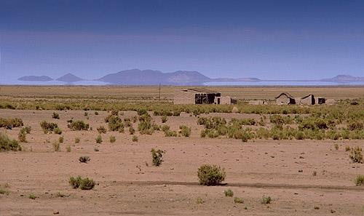
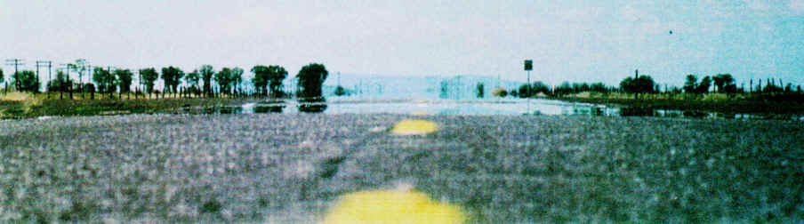
Inferior mirages are formed when the air below the line of sight is warmer
than the air above. Inferior mirages are NOT stable (i.e., they shimmer)
because of the constant mixing
between the warm air below
(which tends to rise) and the
cooler air above (which tends
to sink). Light reflecting off the
object going toward the
ground levels off and then
bends back up to the eye level
of the observer.

Slide 22
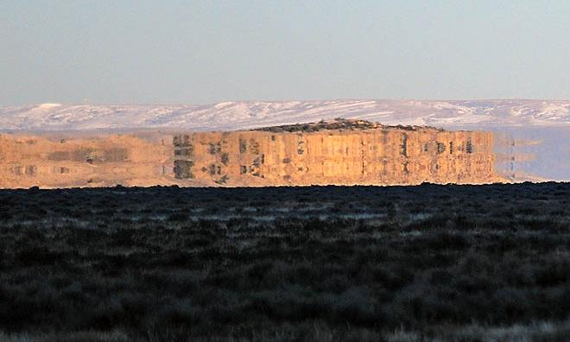
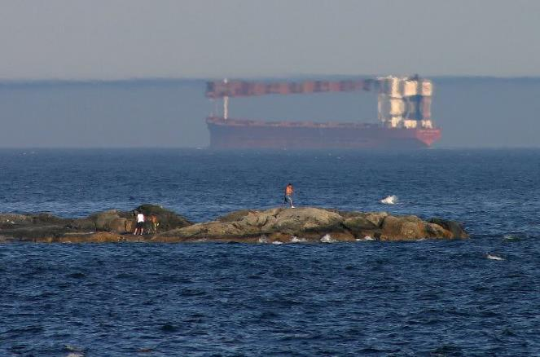
Superior mirages are formed when the air below the line of sight is colder than the air above. This is called a temperature inversion, and is a fairly rare occurrence. When superior mirages DO form, however, they tend to be stable because the more-dense, cold air stays below the less-dense,
warmer air. Depending on the observer’s distance from the object, superior mirages may be either upright (if the observer is farther away) or inverted (if the observer is closer).

Slide 23
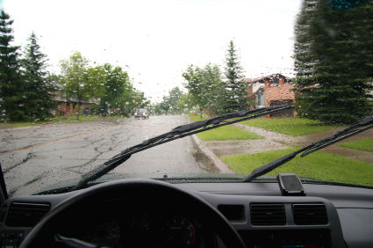
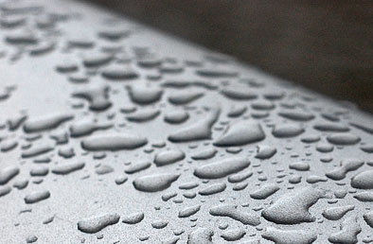
Two Reasons We Need
Windshield Wipers
Windshield wipers push much water away and flatten
out the rest, reducing the number of curved surfaces
(due to beading) and improving visual clarity.

Slide 24
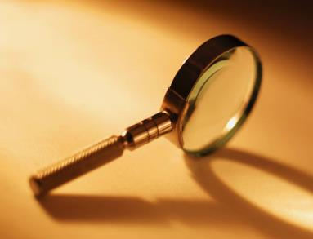
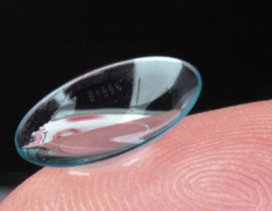
Lenses
Types of Lenses
converging lenses diverging lenses
double convex double concave
plano-convex plano-concave
concavo-convex convexo-concave

Slide 25

Lens Ray Diagrams
First… 1. Draw a centerline vertically through lens.
2. Draw two F’s, measured from centerline.
principal
axis
(P.A.)
F
F
F
F
Line up top of object… | Draw ray from top of object to lens’ centerline. Keeping in mind the type of lens… | …the light ray refracts and continues toward the right along a line from its pt. of intersection ^{w}/centerline…
// to P.A.
^{w}/F
^{w}/center of lens
…in line ^{w}/F.
// to P.A.
NO; just keep going.

Slide 26
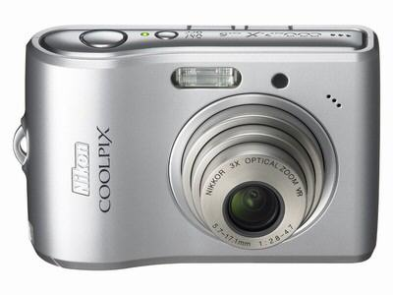
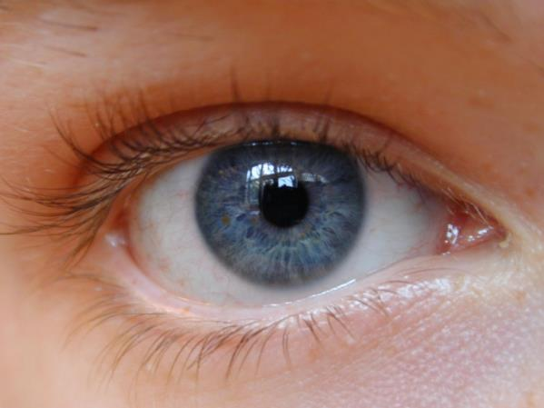
Only two rays are needed to locate the image.
real image: rays actually intersect; can project it
on a screen
virtual image: rays appear to intersect, but don’t;
cannot project it on a screen
A camera uses a lens to produce an inverted, real image on a light-
sensitive material. The eye uses two lenses – the cornea and “the lens” –
to produce an inverted, real image on the light-sensitive retina.

Slide 27
Lens Variables
p = object dist. → always +
always on left
measured L/R from
centerline of lens
q = image dist. → +, real, RIGHT
–, virtual, LEFT
h = object height → always +
always upright
measured UP/DOWN
from P.A.
h’ = image height → +, upright
–, inverted
converging, +
diverging, –
f = focal length
R = radius of curvature

Slide 28
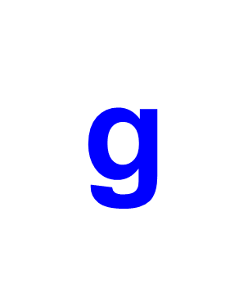
Mnemonic for
Lens Variables
p and q
object
b
g
image
p
q

Slide 29

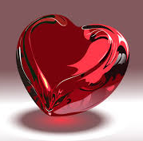
inverted, (i.e., h’ is
–)
real, (i.e., q is
+)
h
F
F
h’
f
f
p
q
h’
h
F
F
p
upright,
(i.e., h’ is
+)
f
f
virtual, (i.e., q is
–)
q

Slide 30
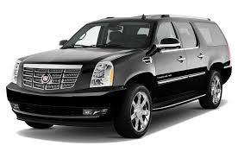

NO IMAGE
(i.e., image at infinity)
h
F
F
upright,
(i.e., h’ is
+)
h’
virtual, (i.e., q is
–)
h
F
F

Slide 31
FINAL THOUGHTS: Lens Ray Diagrams
1. For ray diagrams with converging lenses, three
results are possible. If the object distance p is > the
focal length f, we get an IR image. If p = f, we get
no image. If p < f, we get a LUV image.
2. For diverging lenses, only one answer is possible,
no matter how p compares to f: SUV.
3. Here, the object distance p and object height h are
assumed to be +. Therefore, real images (^{w}/+q) are
inverted (^{w}/–h’) and virtual images (^{w}/–q) are upright
(^{w}/+h’). For any image, q and
h’ have opposite signs.
John Bergmann
www.teachnlearnchem.com

Slide 32
Thin Lens Equation and Magnification
p = object dist. → always +
always on left
measured L/R from
centerline of lens
q = image dist. → +, real, RIGHT
–, virtual, LEFT
h = object height → always +
always upright
measured UP/DOWN
from P.A.
h’ = image height → +, upright
–, inverted
converging, +
diverging, –
f = focal length
R = radius of curvature

Slide 33
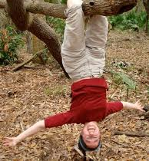
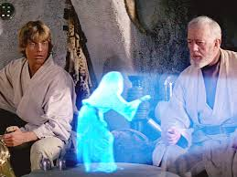
Mnemonic for
“Who Goes With Whom?”
electromagnetic spectrum
IR
ROYGBV
UV
X-rays
radio waves
microwaves
cosmic rays
gamma rays
INVERTED
REAL
UPRIGHT
VIRTUAL

Slide 34


Diverging lens has focal length of
mag. 10.0 cm. A wiener-dog puppy
15.0 cm tall is 22.0 cm from lens.
Describe image.
(f = –10.0 cm;
h = +15.0 cm;
p = +22.0 cm)
= – 6.88 cm
image is virtual
= 0.313
→ image is upright
image is smaller
SUV; on the left

Slide 35
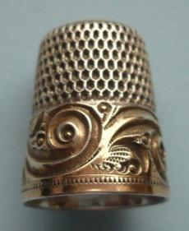
Converging lens has focal length of mag.
7.7 cm. A 0.38 cm-tall real image of a thimble
is formed 9.1 cm from lens. How far from
lens is thimble? How tall is thimble?
p
h
f = +7.7 cm
h’ = –0.38 cm
q = +9.1 cm
= 50. cm
→ h = 2.1 cm

Slide 36
FINAL THOUGHTS: Lens Problems
1. You must know the sign conventions for focal
length in order to solve lens problems. Converging
lenses have a +f; diverging lenses have a –f.
2. In using the thin lens equation, be
sure to solve for variables carefully.
Under NO circumstance should you
begin by writing… p + q = f. THAT IS WRONG.
3. Also, be careful not to overlook or lose track of (–)
signs. There is an “extra” one in the magnification
equation, and double-negatives
crop up every so often.
John Bergmann
www.teachnlearnchem.com

Slide 37
Correcting Vision with Lenses
farsighted nearsighted
What is in focus?
incoming
rays from
far-away objects
incoming
rays from
nearby objects
retina
cornea

Slide 38
What is blurred?
nearby
objects
far-away
objects
How do we correct the condition?
diverging lens
converging lens

Slide 39
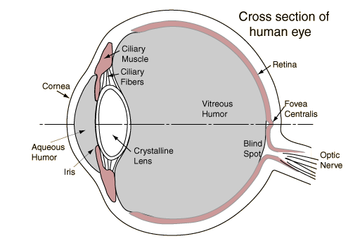
The human eye has two
lens-like tissues: the
cornea and the
“crystalline lens.”
We are able to
focus on objects
at various
distances
because muscles in
the eye can change the
shape of the crystalline lens.
As we age, the crystalline lens loses some of its flexibility.
This is why older people with perfect vision eventually need
reading glasses, and also why older people with glasses
eventually transition to bi- or tri-focals.

Slide 40
“What happens
in LASIK?”
incident light rays
cornea
retina

Slide 41
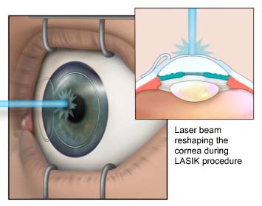

Slide 42
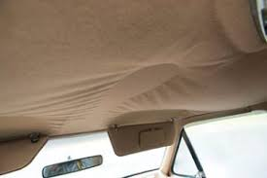
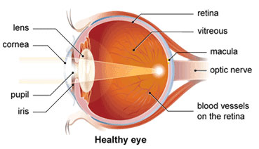
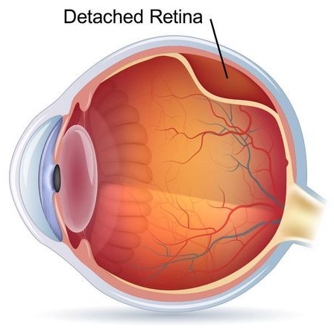
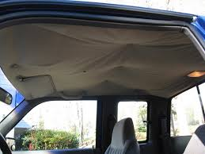

Slide 43
FINAL THOUGHTS: Vision Correction
1. To see close-up objects, farsighted eyes need help
converging the light rays, and so we use converging
lenses, such as reading glasses. To see far-away
objects, nearsighted eyes need help spreading the
rays apart, which requires diverging lenses.
2. LASIK works best on nearsighted eyes, the corneas
of which need “flattening.” After an outermost layer
of the cornea is folded aside, the inner layers are
vaporized with high precision by a laser. The outer
layer is folded back in place and reconnects with the
tissue below.

Slide 44
The Critical Angle, θ_{c} →
the θ_{i} for which θ_{r} = 90º
refracted rays
normal
LESS optically
dense medium
(i.e., the ‘faster’ medium)
boundary
MORE optically
dense medium
ALL light
(not just some)
is reflected
(i.e., the ‘slower’ medium)
θ_{c}

Slide 45
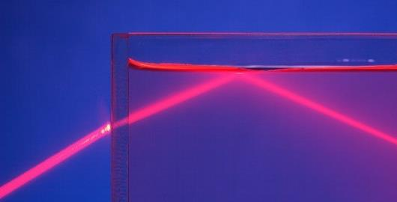
At θ_{i} < 48.6º, light in water is partially reflected and partially
refracted. At θ_{i} = 48.6º, the refracted beam has a θ_{r} of 90º.
At θ_{i} > 48.6º, NO light is refracted; ALL light is reflected,
and the angle of incidence is equal to the angle of reflection.

Slide 46
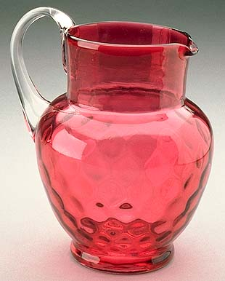
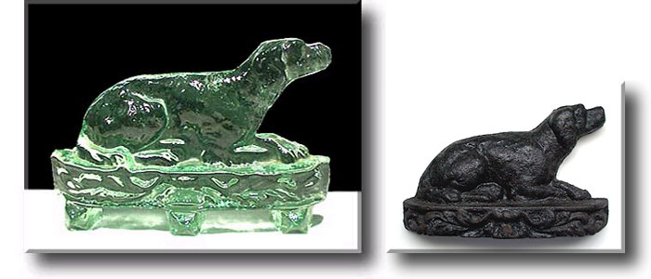
( )
n_{r}
Equation for the Critical Angle:
θ_{c} = sin^{–1}
n_{i}
Find critical angle for light traveling from flint
glass (n = 1.900) into crown glass (n = 1.522).
( )
n_{r}
θ_{c} = sin^{–1}
= 53.23º
n_{i}
crown
glass
flint
glass

Slide 47
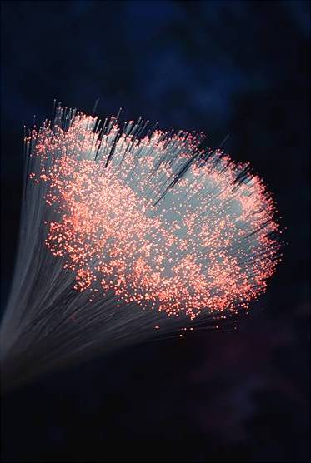
total internal reflection
-- light is incident from a MORE optically dense medium
to a LESS optically dense medium at θ_{i} > θ_{c}
-- no light escapes from the MORE optically dense
medium
e.g., total internal reflection in fiber optic cables
light exiting
light entering

Slide 48
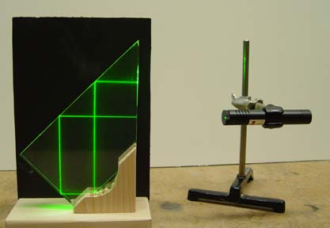
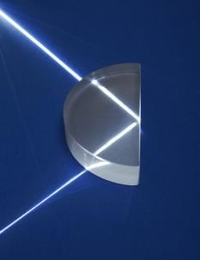
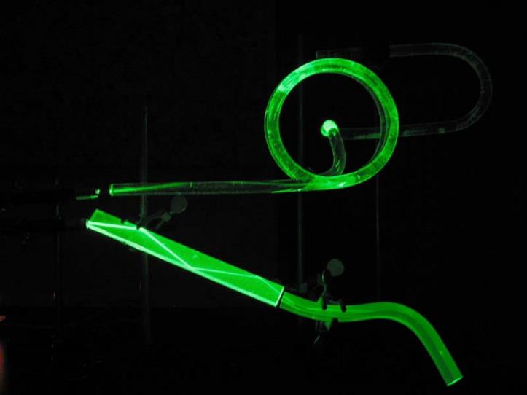
demonstrations of
total internal reflection

Slide 49
The Critical Angle and Total Internal Reflection
1. Total internal reflection occurs when light in a
slower medium is incident on the boundary to a
faster medium, but at an angle greater than the
critical angle. The boundary acts like a perfect
mirror, with no light being refracted…only reflected,
back into the slower medium.
2. In the critical angle equation, the
larger index of refraction goes in the denominator.
3. Total internal reflection CANNOT occur for light
traveling from a faster to a slower medium,
e.g., air to water.
( )
n_{r}
θ_{c} = sin^{–1}
n_{i}

Slide 50
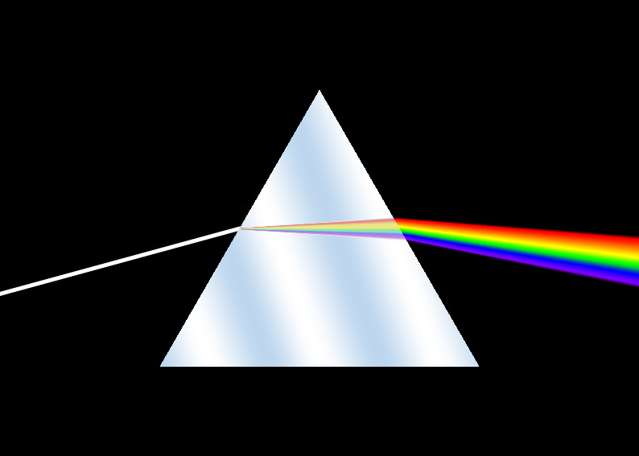
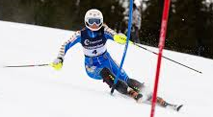
Dispersion
→ when polychromatic light is
separated into its component λs
--
occurs because different λs
interact differently ^{w}/matter
--
i.e., n differs for different λs
-- By convention, the accepted index of refraction
for a material is for λ = 589 nm.

Slide 51
Because n differs for different λs of light, the various
λs traveling through a lens focus at slightly different
points.
The resulting blurring is…
chromatic aberration.
WHITE
F
F
R
V
589 nm
…which is reduced by...
combining converging and
diverging lenses made from
different materials.

Slide 52
FINAL THOUGHTS: Dispersion
1. Dispersion occurs when polychromatic light
separates into its component wavelengths.
Dispersion is the result of wavelengths interacting
differently with the atoms of a given material. For
the visible spectrum, red light interacts least with
matter and is therefore refracted least. Violet light
interacts the most and is refracted the most.
2. The phenomenon of rainbows and the behavior
of light through triangular prisms are two well-
known examples of dispersion.

Slide 53
Refraction, Dispersion, Reflection, and Rainbows
sunlight
Sun
raindrop
The back surface
of a raindrop is NOT
plane (i.e., flat).
The best time to see a rainbow is in
the early morning or late afternoon,
when the Sun is lower in the sky
and more of the rainbow is visible.

Slide 54
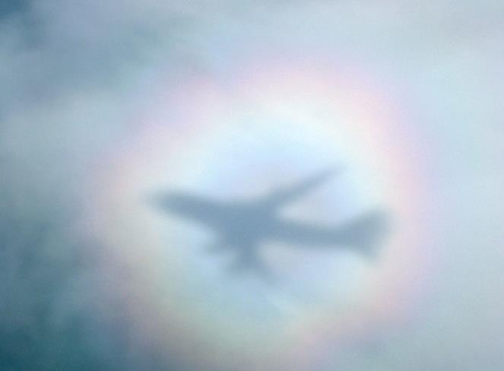
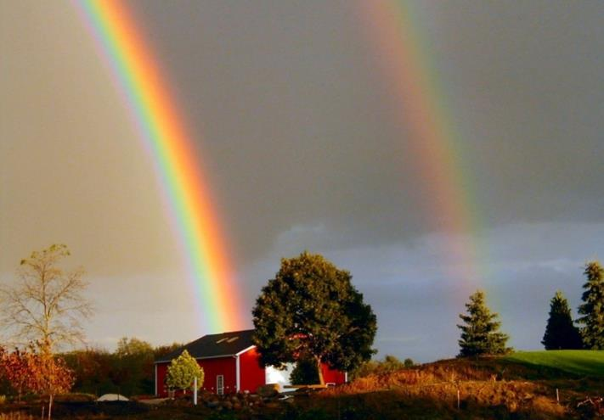
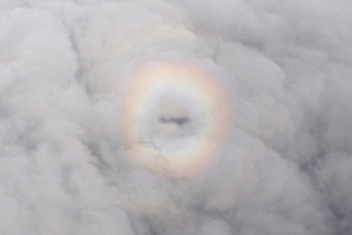
Rainbows are circular, but
we can see the whole bow
only when we are at an
elevated observation point.

Slide 55

The Green Flash
atmosphere
sliver of sunlight
at horizon
Looking to the west at
a not-at-all-dusty horizon…
(i.e., a horizon over an ocean)
Sun

Slide 56


The green flash is caused by the atmospheric dispersion of sunlight.
Only a sliver of the Sun is still visible. The blue/violet rays are refracted
“too much” and hit the ground before reaching the observer. The red/
orange/yellow rays aren’t refracted enough and pass over the observer’s
line of sight. The green wavelengths are refracted “just right,”
resulting in the ephemeral green flash. Because the many dust particles
that are kicked up over land areas during the day block all wavelengths
except oranges/reds, green flashes are most often seen over VERY wide
expanses of water (i.e., oceans). Therefore, your chances of seeing a
green flash in central Illinois are slim-to-none.

Slide 57

a green flash from the Moon (!!!)

