Slide 1

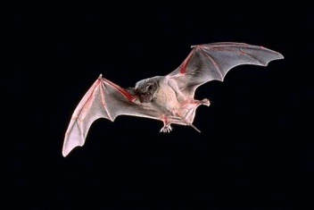
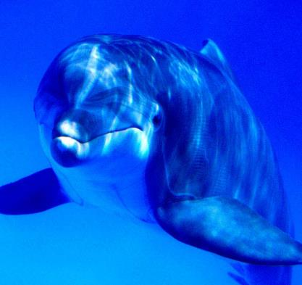
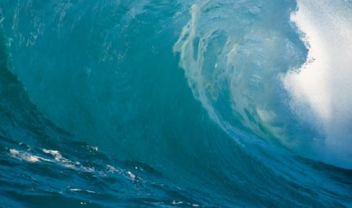
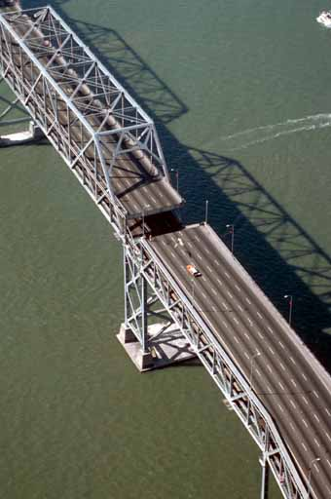

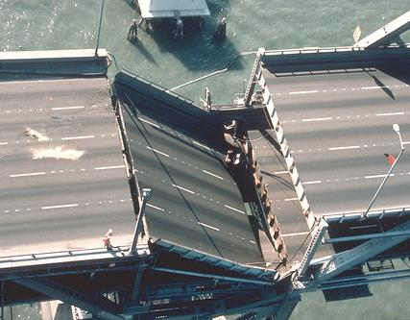
Waves
and
Sound

Slide 2

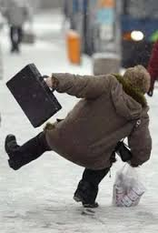
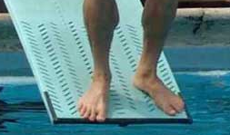
restoring force:
a force that acts to bring things
back to a state of equilibrium
When a stable
system at
equilibrium is
tweaked, often
some kind
of restoring
force naturally
kicks in.
In simple harmonic motion (SHM), the restoring
force is directly proportional to the displacement
from equilibrium, i.e.,
F_{restore}
Δx
As Δx , F . As Δx , F . When Δx = 0, F
= 0.

Slide 3
We will learn about two cases
that exhibit (or nearly so) SHM.
mass-spring system
pendulum
amplitude:
the max. displacement from equilibrium
For m-s systems:
-- symbolized A
-- measured in
For pendulums:
-- symbolized θ
-- measured in
meters
degrees,
in this class (although
radians could work, too)

Slide 4
FINAL THOUGHTS: Simple Harmonic Motion
1. A restoring force is a force that acts to bring a system
back toward a state of equilibrium. When a restoring
force is directly proportional to the displacement, the
system is exhibiting simple harmonic motion (SHM).
2. Two easily-analyzed examples of
SHM are the mass-spring system
and the simple pendulum.

Slide 5
REVIEW: Simple Harmonic Motion
A restoring force is a
force that acts to
bring things back to
a state of equilibrium.
In simple harmonic
motion (SHM), the
restoring force is
directly proportional
to the displacement from equilibrium.
Amplitude is the max. displacement from equilibrium.

Slide 6
Mass-Spring System
If Δx = 0, then
wall
equilibrium
position
F_{elas} = F_{net} on mass =
0
and a =
0.
frictionless floor
F_{net}
(–)
When Δx = 0, then
F_{elas} = F_{net} on mass
= 0
and a
= 0.
Δx
(+)
F_{net}
(+)
As Δx increases,
F_{net}
increases
and
Δx
(–)
a
increases.
All of this shows why Hooke’s law is : F_{elas} = –k Δx

Slide 7
frictionless
A
A
Δx_{max} is better known as the…
amplitude.
At that point, we also have maximum…
forces and
accelerations.
Energy of a Mass-Spring System
total energy
PE_{elas}
= ½ k (Δx)²
x
x
Energy (J)
KE
= ½ m v²
PE_{g}
(arbitrary)
x

Slide 8
FINAL THOUGHTS: Mass-Spring Systems
In an oscillating mass-spring system,
there is a constant interchange between
elastic potential energy and kinetic
energy. Depending on the orientation of
the spring – say, if the spring is oriented
vertically – changes in gravitational
potential energy might also be involved.

Slide 9
Pendulum
θ
T
length, L
T cos θ
amplitude, θ
mass of
bob, m
T sin θ
F_{restore}
mg
θ (deg)
sin θ
θ (rad)
0
0
0
2π rad = 360º
5
0.087
0.087
For θ < 15º, a simple
pendulum closely
approximates SHM,
i.e., since sin θ θ,
10
0.174
0.175
15
0.259
0.262
~
20
0.342
0.349
=
~
25
0.423
0.436
F_{restore} θ.

Slide 10
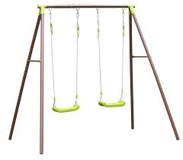
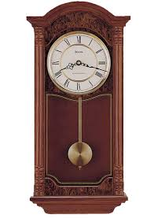

Energy of a Simple Pendulum
?
Energy (J)
total energy
PE_{g}
= mgh
x
KE
PE_{elas}
x
x

Slide 11
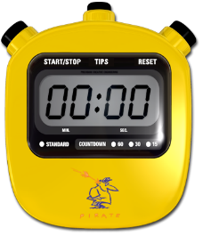

period, T:
time to complete
one cycle
(s)
frequency, f:
# of cycles per
second (Hz)
For mass-spring systems:
Note that amplitude
does NOT affect the
period of a mass-
spring system.
m = mass (kg)
k = spring constant (N/m)

Slide 12
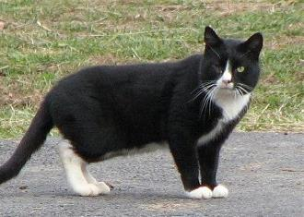
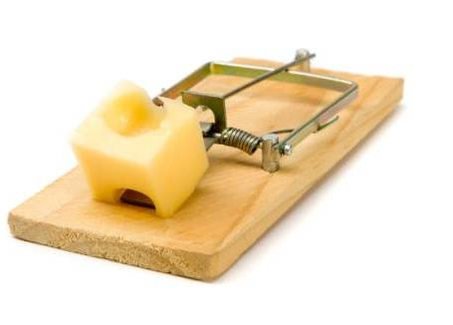
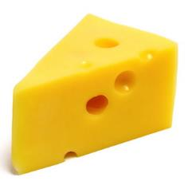
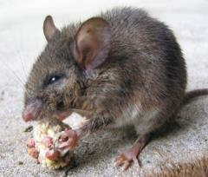
A 5.5 kg cat is attached to a fixed
horizontal spring of stiffness 22.8 N/m
and is set in motion on a frictionless
surface. Find the period of motion of…
…the cat.
= 3.1 s
…a 120 g mouse, with the same spring and surface.
= 0.46 s

Slide 13
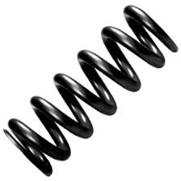
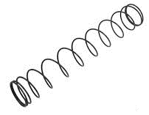
What stiffness must a spring have so that the period
of the mouse’s motion is the same as that of the cat?
= 0.49 N/m

Slide 14
Mass-Spring Systems: Calculations, 1
1. The period of a motion is the time for one
cycle; frequency is the number of cycles
per unit time. For best results in using
equations, use the SI units for period (seconds, s)
and frequency (Hertz, Hz).
2. The period of an oscillating
mass-spring system is given by:
Note that the amplitude of the mass’s motion
does NOT affect the time in which the mass
completes one full cycle.

Slide 15
REVIEW: Mass-Spring Systems
The period (in s) of a motion is the time
for one complete cycle; frequency (in Hz)
is the number of cycles per second.
The period of a mass-spring system is given by:
The amplitude of the
mass’s motion does
NOT affect the period.
m = mass (kg)
k = spring constant (N/m)

Slide 16



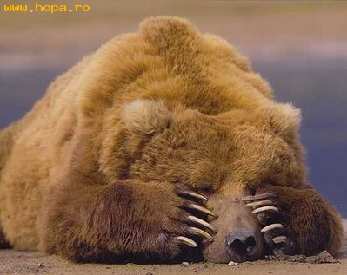
“Mr, B….
I forgot:
What are the units for
frequency?”
That hertz. I mean, that REALLY hertz.
That hurts. I mean, that REALLY hurts.

Slide 17

A 1645 kg car carries two
passengers with masses
75 kg and 86 kg. The car has
four shock absorbers, each
with a spring constant of 1.7 x 10⁴ N/m. Find the freq. of the vehicle’s motion after it hits a pothole.
and so…
= 0.98 Hz

Slide 18
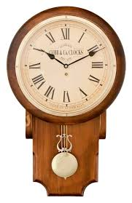
For simple pendulums:
Period T is independent of…
mass
AND
amplitude.
The period of a pendulum is 5.2 s. Find…
A. …its length
= 6.7 m

Slide 19

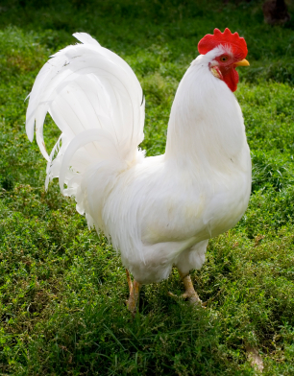

B. …the mass of the bob
NOT ENOUGH INFORMATION
$$≡$$
The Bergmann-Chicken Equivalency

Slide 20
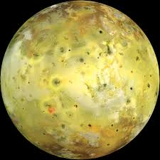
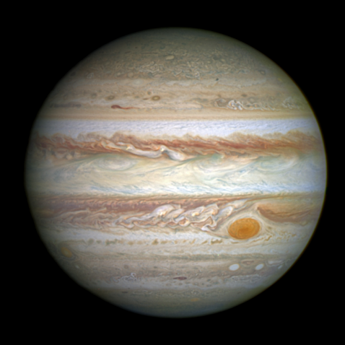
On Io, a moon of Jupiter, a 0.87 m pendulum has a
period of 8.74 s. What is g on Io?
4π² (0.87 m)
g =
(8.74 s)²
m
= 0.45
s²

Slide 21

FINAL THOUGHTS: Pendulum Calculations
1. Neither amplitude nor the
mass of the bob affect the
period of a simple pendulum.
2. For a simple pendulum,
because bobs can never
quite be point masses,
the length of the pendulum
is best measured from the
pivot point to the center of
mass of the bob.

Slide 22
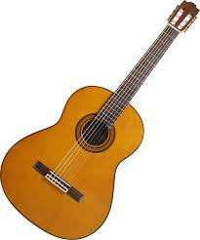
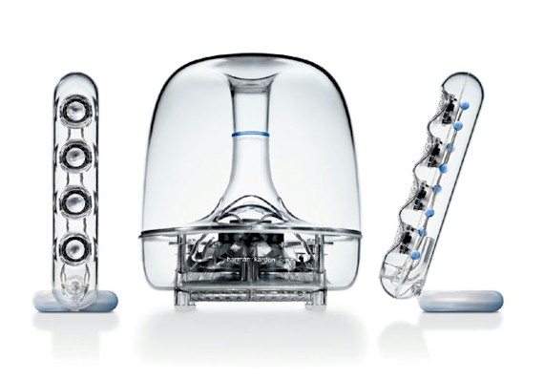
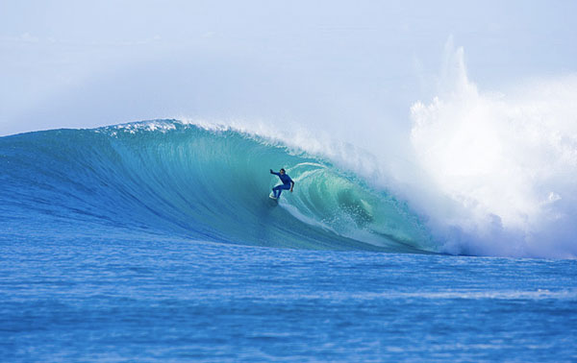
Waves
vibrations moving through space and time
Waves primarily transmit energy, NOT matter.
medium: the matter through
which the energy of
mechanical waves moves
Harman Kardon soundsticks

Slide 23
transverse waves: particles of medium move
to direction of wave travel
crest
amplitude A
trough
wavelength λ

Slide 24
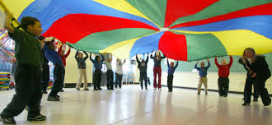
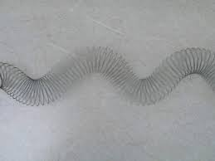
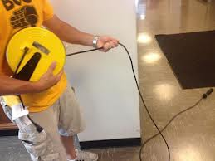
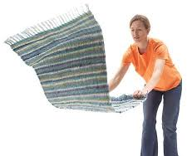

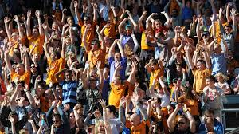
transverse
waves

Slide 25
particles of
medium move // to direction of wave travel
longitudinal (compressional) wave:
Each particle experiences a
jostling, back-and-forth motion.
compression
rarefaction
λ
disturbance velocity
(i.e., the wave)
each particle
pulse wave:
a single vibration
vs. periodic wave:
rhythmic, repeated vibrations

Slide 26
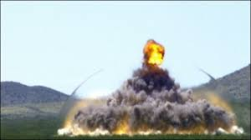
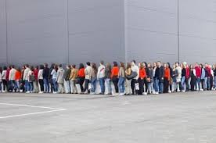
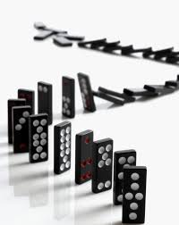
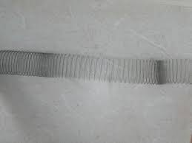
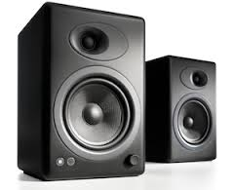
longitudinal
waves
(or close to it)

Slide 27
FINAL THOUGHTS: Waves
1. Waves are vibrations that propagate energy through
space. Energy, not matter, is the principal thing that
travels in any wave motion.
2. Mechanical waves require a physical medium in
order to travel. In a transverse wave, the particles of
the medium vibrate perpendicular to the direction of
wave travel. In a longitudinal wave, the particles
vibrate parallel to the direction of wave travel.

Slide 28
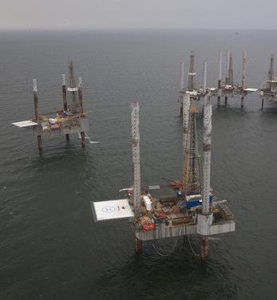
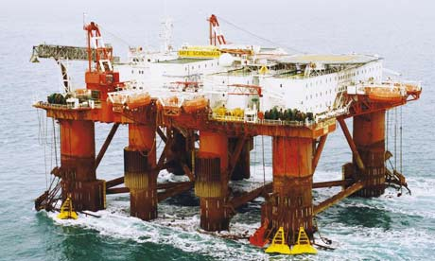
For mechanical waves:
Energy
(Amplitude)²
If A doubles, energy…
increases 4X.
If A triples, energy…
increases 9X.
If A drops to, say, 35% of the original level, energy…
(0.35)² = 0.1225
→ E drops to 12% of the orig.
oil rig in the North Sea
oil rigs in the Gulf of Mexico

Slide 29
Wave Reflection
fixed boundary
vs. free boundary
A
A
v
v
v
v
waves are reflected
and inverted
waves are reflected
and upright

Slide 30
Wave Interference
Two waves (unlike two objects) can occupy
the same place at the same time.
constructive interference:
destructive interference:
amplitudes are
additive
amplitudes have
a canceling effect
A₁
A₂
A₁
A₂
A₁ + A₂
A₁ – A₂
A₂
A₁
A₁
A₂

Slide 31

The interference pattern shown by two wave sources
of the same frequency in a water wave tank.

Slide 32
SUMMARY: Wave Interference
Two or more waves may occupy the same
space at the same instant of time. This results
in wave interference. Constructive interference
occurs when the interfering waves have an
additive effect; destructive interference occurs
when they have a subtractive or canceling effect.

Slide 33
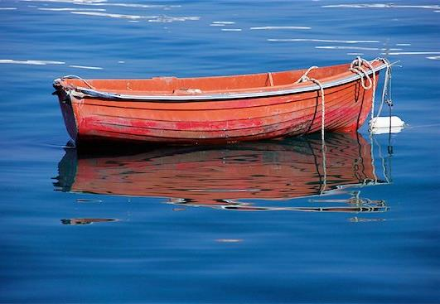
Wave Velocity (or wave speed)
Equation:
v (m/s); f (Hz); λ (m)
λ
A water wave of
wavelength 8.5 m
washes past a boat
at anchor every
4.75 seconds.
Find the wave’s velocity.
T
and so…
= 1.8 m/s

Slide 34

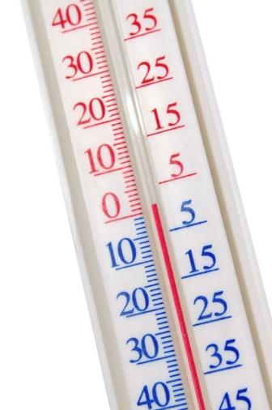
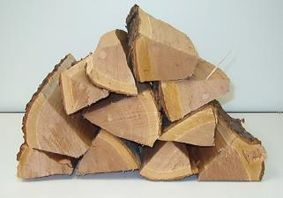
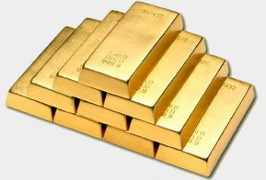
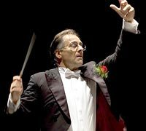
The speed of any mechanical wave
depends only on the properties of the medium
through which it travels.
e.g.,
string tension,
water depth,
air temperature,
material density and
elasticity (i.e.,
the
type of material)
The speed of sound in air is
related to the air temperature:
T_{a} = air temp.
in ºC
v_{sound} = 331 + 0.6T_{a}

Slide 35
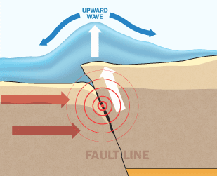
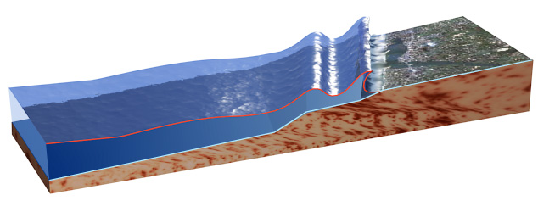
Tsunamis
Fact: Water waves
travel faster in
deeper than in
shallow water.
KE
PE_{g}
PE_{g}
KE

Slide 36
FINAL THOUGHTS: Wave Velocity
1. The velocity/speed of a wave is the product of the
wave’s frequency and wavelength.
2. The speed of a mechanical wave depends solely on
the properties of the medium through which it travels.
It seems, from the above equation, that for a given
medium the wave speed would increase with, say,
frequency. However, when f increases, λ decreases
proportionally, with no change in v. The only way to
change wave speed is to alter the properties of the
medium.

Slide 37
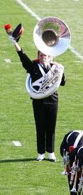


Standing Waves
Incident and reflected waves interfere to produce an
unchanging wave pattern. Antinodes have a max.
amplitude, while nodes have zero amplitude.
Standing waves are most easily visualized on a string,
where nodes remain motionless and antinodes go
from max. (+) to max. (–) displacement.

Slide 38
L
n = 1; 1st harmonic
λ₁ = 2 L
(fundamental)
n = 2; 2nd harmonic
λ₂ = L
(1st overtone)
n = 3; 3rd harmonic
λ₃ = ²/₃ L
(2nd overtone)
n = 4; 4th harmonic
λ₄ = ½ L
(3rd overtone)
wavelength of the n^{th}
harmonic on a string:
(n = 1,2,3,…)

Slide 39
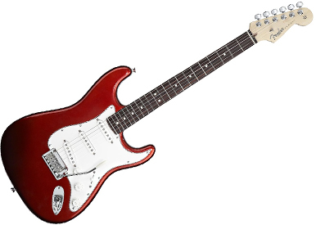
Waves travel along a 96.1 cm
guitar string at 492 m/s. Find the
fundamental frequency of the string.
λ₁ = 2 L
= 2 (0.961 m)
= 1.922 m
v = f λ
= f_{n} λ_{n}
= 256 Hz
Find the frequency of
the 5th harmonic.
λ₅ = ²/₅ L
= 0.3844 m
= 1280 Hz
frequency of the n^{th} harmonic:
f_{n} = n f₁

Slide 40
FINAL THOUGHTS: Standing Waves on Strings
1. A standing wave is the waveform generated when
incident and reflected waves interfere to produce
points of unchanging zero amplitude (nodes) and
points of unchanging max. amplitude (antinodes).
2. The fundamental is the lowest-freq wave that is
possible from a given sound source. Harmonics are
integer multiples of fundamentals. Most sound
sources generate the fundamental plus multiple
harmonics at any one time.
3. The equation for the wavelength
of any harmonic n on a string is:

Slide 41
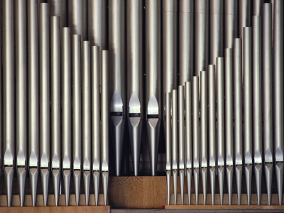
Standing Waves in Open Tubes
L
wavelength of the
n^{th} harmonic of
an open tube:
(n = 1,2,3,…)

Slide 42
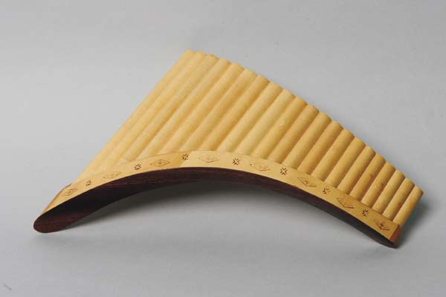

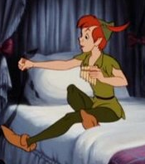
Closed Tubes
L
wavelength of n^{th}
harmonic of
a closed tube:
(n = 1,3,5… ONLY
i.e., the even harmonics
are NOT present)

Slide 43
Find fundamental freq. for an
open tube of length 1.24 m.
Air temp. is 20.0ºC.
λ₁ = 2 L
= 2 (1.24 m)
= 2.48 m
v = f λ
= f_{n} λ_{n}
1.24 m
v = ?
20
v_{sound} = 331 + 0.6T_{a}
= 343 m/s
= 138 Hz

Slide 44
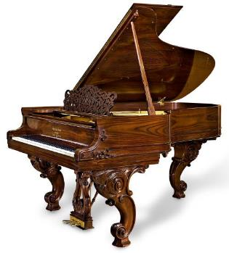
Find fundamental frequency for
a closed tube of length 1.24 m.
Air temp. is 20.0ºC.
λ₁ = 4 L
= 4 (1.24 m)
= 4.96 m
1.24 m
(same as prev. prob.)
= 69.0 Hz
doubling (or halving)
of frequency
=
one octave
100 Hz 200 Hz 400 Hz 800 Hz
(three octaves)

Slide 45
FINAL THOUGHTS: Standing Waves in Tubes
1. Open tubes are open at both ends; closed tubes
are open at one end only, and closed at the other.
2. Find the wavelength of various harmonics using…
OPEN CLOSED
n = 1, 2, 3, … n = 1, 3, 5, …
The differences above are derived from the
observation that, in tubes, nodes are always formed
at closed ends; antinodes are always
formed at open ends.

Slide 46

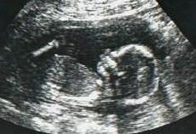



Sound
(a compressional/longitudinal wave)
compression:
high pressure/density
rarefaction:
low pressure/density
audible
frequencies
(human
hearing)
20 Hz
20,000 Hz
infrasonic
ultrasonic

Slide 47






Fundamental frequency determines pitch.
high f =
high pitch
= short λ
low f =
low pitch
= long λ

Slide 48




The # and intensity of a source’s harmonics
give it its unique sound quality, or ______.
timbre
f₁ f₂ f₃ f₄
f₁ f₂ f₃ f₄
f₁ f₂ f₃ f₄
f₁ f₂ f₃ f₄

Slide 49
FINAL THOUGHTS: Sound
1. Sound is a longitudinal wave, consisting of high-
density, high pressure compressions and low-
density, low-pressure rarefactions.
2. Humans can hear from about 20 Hz to 20,000 Hz.
Below 20 Hz are infrasonic sound waves; beyond
20,000 Hz are the ultrasonic sound waves.
3. The pitch of a sound source is determined by its
fundamental freq. The sound quality, or timbre, of a
sound is due to the number and intensity of the
various harmonics.

Slide 50
The Doppler Effect
Relative motion between wave source and observer
causes a change in the ________ frequency.
observed
v = 0
f_{emitted}
f_{emitted}
f_{emitted}
f_{observed}
(lower)
(higher)

Slide 51




Other examples of the Doppler effect:
race cars
police radar
Sun
R O Y G B V
most stars
(“red-shifted”)
dolphins and bats
(echolocation)
expansion of universe

Slide 52
FINAL THOUGHTS: The Doppler Effect
1. To observe the Doppler effect, there must be a wave
source AND a wave observer that are in motion
relative to each other.
-- If the source and observer are moving away from
each other, the observer will record a frequency
that is lower than the emitted frequency. If the two
are moving toward each other, the observer will
record a freq. higher than the emitted frequency.
2. The observed Doppler red-shift of starlight is solid
evidence that our universe is not static,
but rather is expanding.

Slide 53
Traveling Very Fast
v_{bug} = 0
v_{bug} < v_{wave}
wave barrier
bow wave
v_{bug} > v_{wave}
v_{bug} = v_{wave}

Slide 54
supersonic: “faster than sound” (vs. subsonic)
shock wave:
a 3-D bow wave
sonic boom:
caused by high-pressure
air, NOT roaring engine
lion tamer’s whip
cracking bullets
The Matrix

Slide 55





Slide 56

Sound Intensity
Equation:
If a piano’s power output is 0.302 W,
find the sound intensity at a distance of…
A. …1.0 m
= 0.024 W/m²
B. …2.0 m
= 0.0060 W/m²

Slide 57

The intensity (in this
case of sound) is the
power divided by the
area over which that
energy-per-second
is distributed. The
area through which
the power must
travel is a sphere
having the area
4πr². As the distance
from the source, say,
doubles, the radius
of the sphere
doubles…and the
intensity drops to
¼ of what it was.

Slide 58
REVIEW: Sound Intensity
The measured intensity of a sound
depends on the power of the sound
source and the distance the source
is from the observer:

Slide 59
Intensity is related to volume (or relative intensity):
--
how loud we perceive a sound to be
-- measured in decibels (dB)
A difference of 10 dB changes
the sound intensity
by a factor of 10 and
the volume by a factor of 2.
50 dB vs. 40 dB
60 dB vs. 90 dB
half as loud
8X louder
¹/₁₀ as intense
1000X more intense

Slide 60


Slide 61
FINAL THOUGHTS: Volume
Relative intensity, or volume, is how loud we
perceive a sound to be. It is related to the
intensity, but NOT linearly. Our perception
of a sound is roughly logarithmic with regard
to intensity. A good rule of thumb is that any
10 dB change means that the volume changes
by a factor of two, while the intensity
changes by a factor of 10.

Slide 62
Beats → alternating loud-and-soft sounds resulting
from interference between two slightly-
different frequencies
(“ooh-wAAHH-
ooh-wAAHH…”)
Equation:
1 second elapses
1 second elapses
f₁ = 16 Hz
f₁ = 16 Hz
f₂ = 17 Hz
f₂ = 18 Hz
f_{beat} = 1 Hz
f_{beat} = 2 Hz

Slide 63


FINAL THOUGHTS: Beats
Beats are variations in the
loudness and softness we
perceive when two sound
sources have very-nearly
the same frequency, but
not quite. The number of
these variations that we
hear per second is the
beat frequency.

Slide 64




natural frequency:
the frequency at which
an object most easily
vibrates/oscillates
forced vibration:
a vibration due to
an applied force
resonance:
occurs when a force
is repeatedly applied
to an object AT the
object’s natural frequency
-- result of resonance =
LARGE amplitude

Slide 65





Examples:
swing
shattering crystal wine glasses
Tacoma Narrows Bridge (1940)
British regiment (Manchester, 1831)
aeolian harps
“The wind in the wires made a tattletale sound,
as a wave broke over the railing…”

Slide 66

FINAL THOUGHTS: Resonance
1. An object’s natural frequency is the frequency at
which it “wants” to oscillate.
2. An object experiences a forced vibration when an
applied force disturbs its equilibrium. The object
undergoes an oscillation in response.
3. Resonance occurs when the frequency of a
continually-applied force
matches an object’s natural
frequency. The result is a
large (and potentially
dangerous) amplitude.

