Slide 1
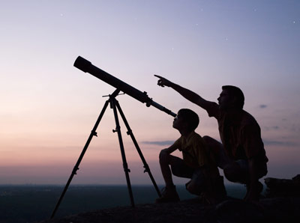
Physics:
the study of the
natural world
few concepts
describe many
phenomena
few equations

Slide 2

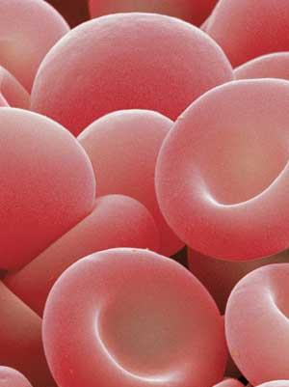
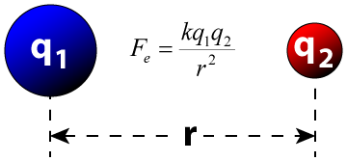
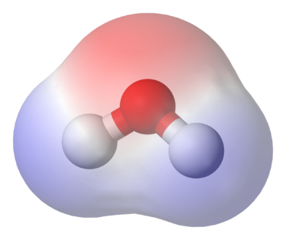
Physics is the most basic of the sciences.
biology
chemistry
physics
mathematics
John Bergmann
www.teachnlearnchem.com

Slide 3
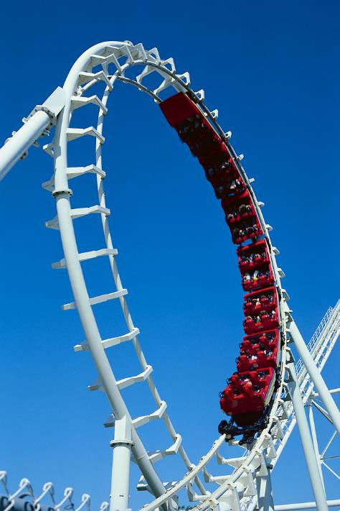
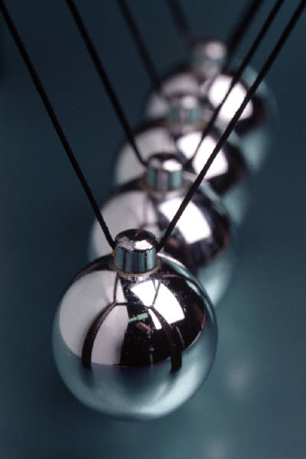
Areas of Physics

Slide 4

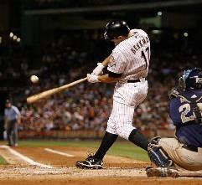
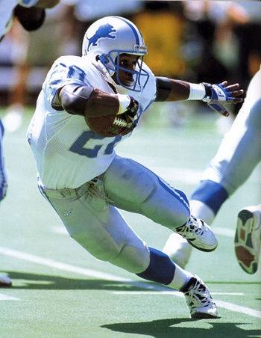
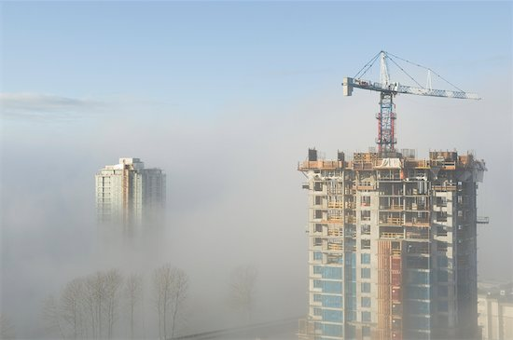
Mechanics:
forces and motion

Slide 5


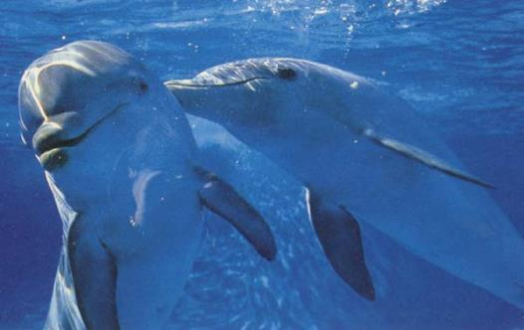
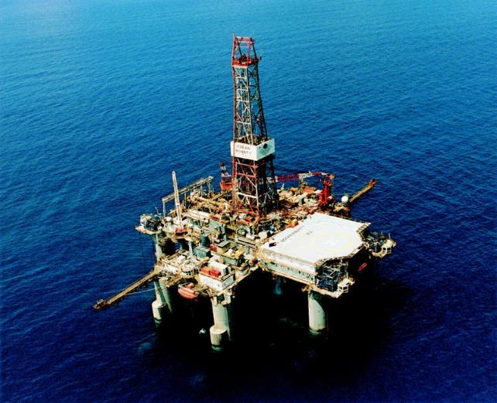
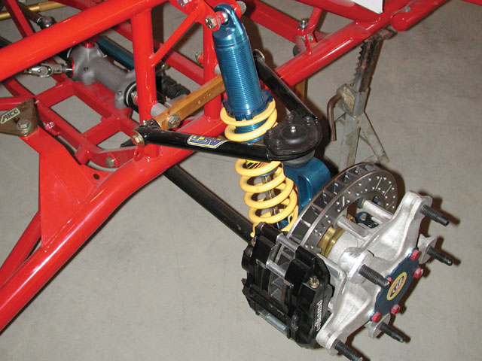
Vibrations and Waves

Slide 6
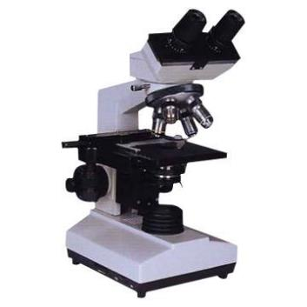
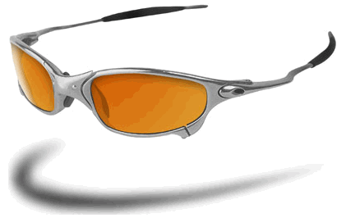
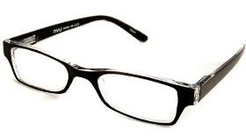
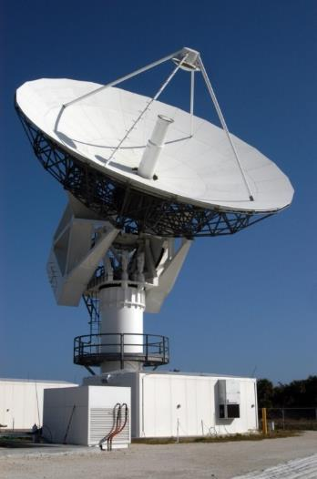
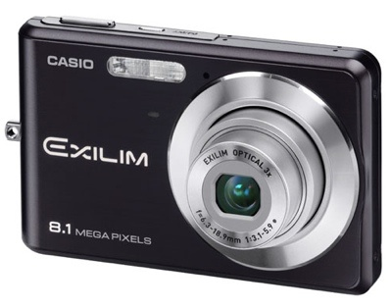
Optics:
light, mirrors, color, lenses

Slide 7
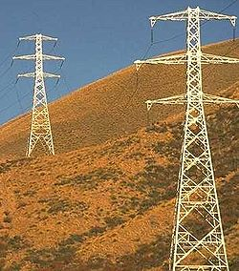
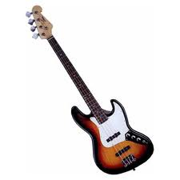
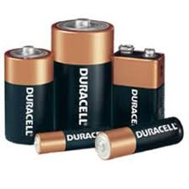
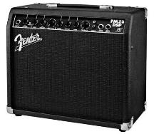
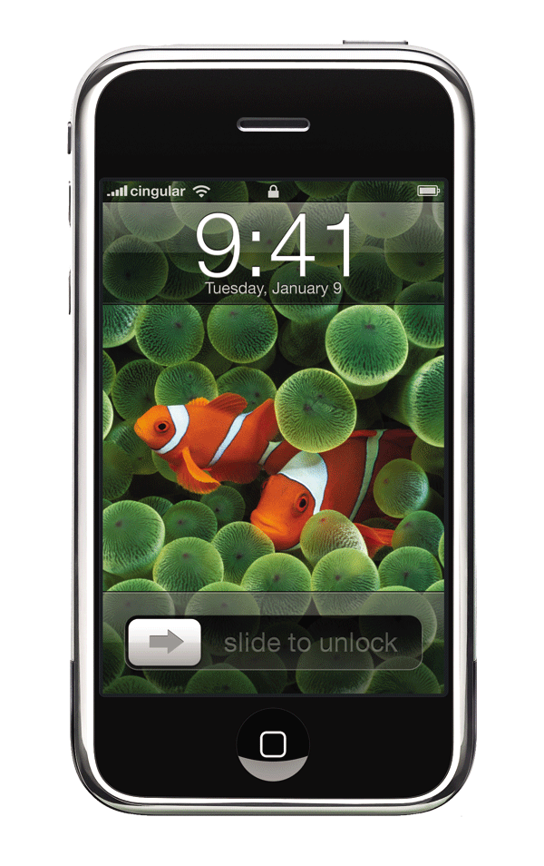

electricity
and
magnetism
Electromagnetism:

Slide 8
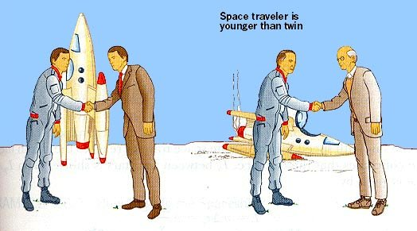
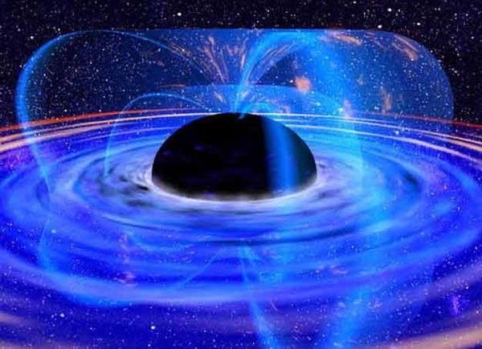
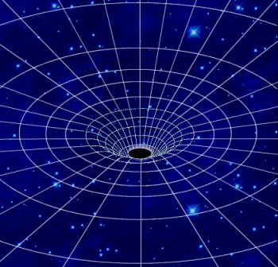
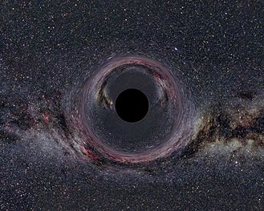
counterintuitive
properties of
space and time
Relativity:

Slide 9

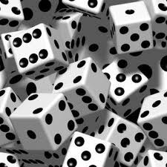
the probabilities
and behavior of the
infinitesimally small
Quantum
Mechanics:
?

Slide 10
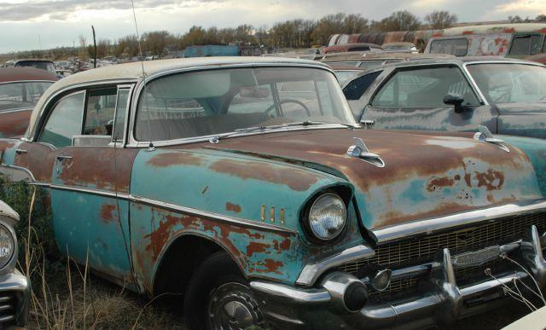
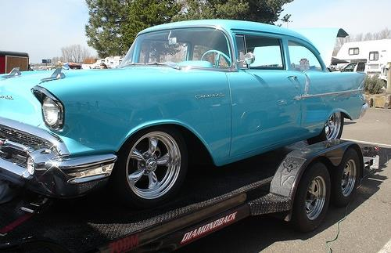
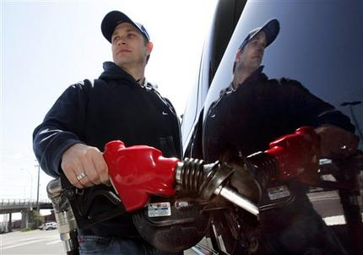
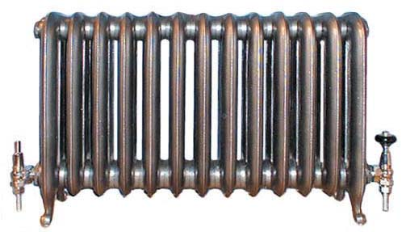
heat, work,
order vs. disorder
Thermodynamics:
www.teachnlearnchem.com

Slide 11
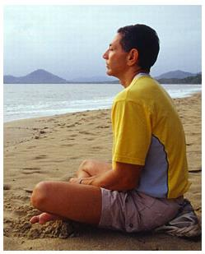
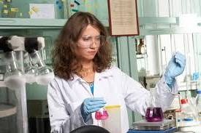
The Nature of Science
Science
vs.
Religion?
science
investigates
observable
universe
religion/philosophy
deals with
cosmic purpose
-- cause-effect
-- why we are here
-- demands evidence
-- what we should do
-- cerebral
-- visceral

Slide 12
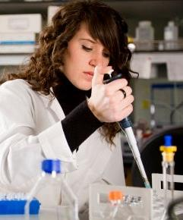

Pure vs. Applied Science
pure science:
the search for knowledge
-- facts
-- relationships between things
-- theories
applied science
(technology):
using knowledge
in a practical way
-- tools
-- techniques
-- using science creatively

Slide 13

Law or Theory?
law:
states what happens
-- states a relationship
between quantities (often via an equation)
e.g., conservation laws, gravity
theory:
tries to explain why or how
something happens
-- based on current evidence
-- can be revised (or thrown out)
e.g., combustion theory of burning,
atomic theory, kinetic-molecular theory,
theory of evolution by natural selection

Slide 14
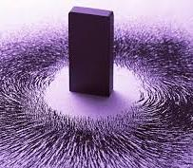
SUMMARY: Science
In this lesson we discussed:
-- how science differs from religion/philosophy
-- how pure science differs from applied science
-- the difference between a scientific law and a
scientific theory
John Bergmann
www.teachnlearnchem.com

Slide 15
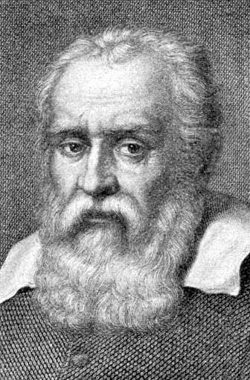
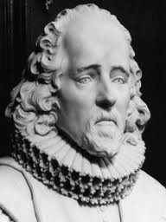
The Scientific Method
Credited to…
Galileo Galilei (1564 – 1642)
and
Sir Francis Bacon (1561 – 1626)

Slide 16
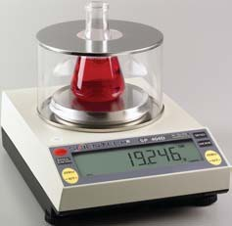
Activities of the Scientific Method
Observe events.
-- Quantitative data
are most useful.
Propose a hypothesis:
a reasonable and testable
answer or explanation
Carry out controlled experiments:
the experimental and control
groups differ by one variable
Draw a valid conclusion.
based on data (Be honest!)

Slide 17
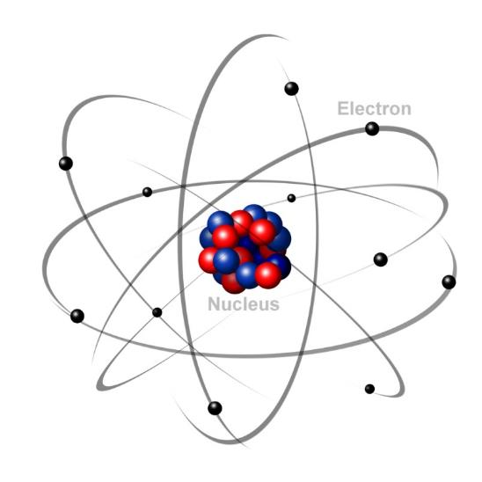

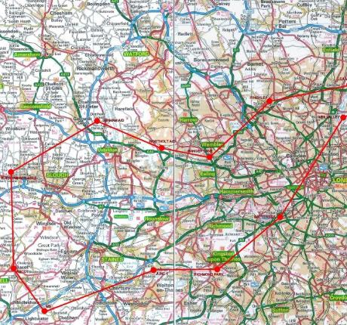
Other Important Terms
We cannot study everything at once.
system:
what we choose to study
surroundings:
everything else
Models simplify phenomena.
To understand,
we must simplify.
www.teachnlearnchem.com

Slide 18
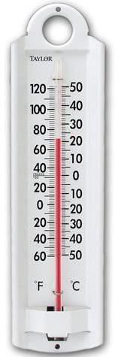

Measurements in Experiments
Measurements have
dimensions and require units.
give the quantity
give the scale
LENGTH………………….
MASS……………………..
TIME………………………
ELECTRIC CURRENT….
meter (m)
kilogram (kg)
second (s)
ampere (A)
SI base units

Slide 19
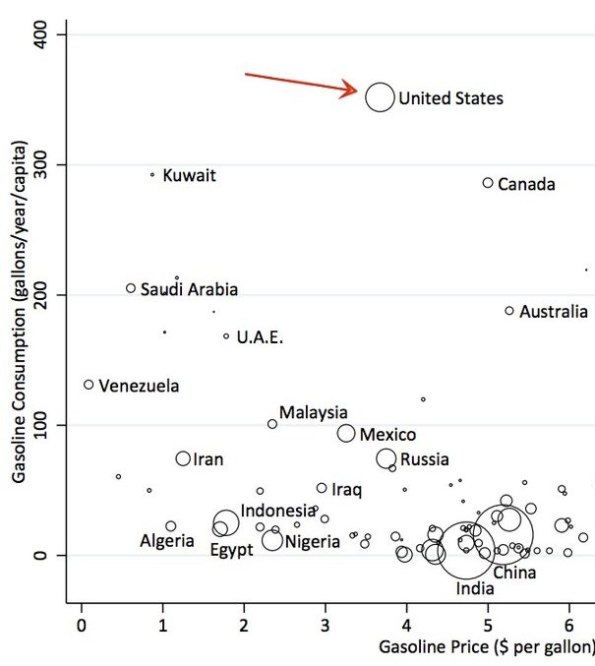
derived units: these result when base units are
combined by X or
.
.
e.g.,
area →
m²
density →
kg/m³
volume →
m³
momentum →
kg.m/s
Some derived quantities
we will meet later on are
force, energy, power,
and sound intensity.
John Bergmann
www.teachnlearnchem.com

Slide 20
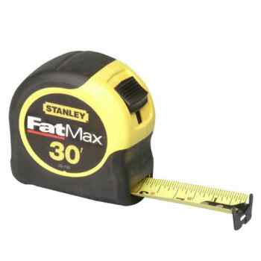
Accuracy and Precision
All numerical data are the result
of uncertain measurements.
precision: a measure of the degree of
fineness of a measurement; it
depends on the extent to which the
instrument is calibrated
e.g.,
10 m
vs. 10.00 m
vs. 10.00000 m

Slide 21
When repeated, precise measurements yield similar answers each time.
e.g., precise…
0.653 m
0.652 m
0.654 m
imprecise…
0.7 m
0.8 m
0.6 m
A good rule of thumb is…
% difference tells the degree of precision.

Slide 22
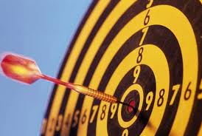
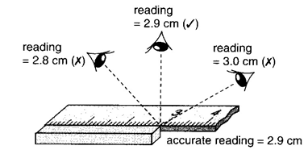
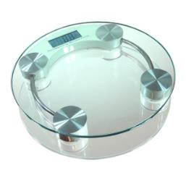
accuracy:
how close a measured
value is to the true value
Three types of error affect accuracy.
human error:
mistake in reading
instrument or recording results
-- minimize with repeated measurements
method error:
using measuring instrument improperly
e.g., parallax in measuring with a meter stick
instrument error:
measuring device is
improperly calibrated
e.g., bathroom scale that reads 5 lbs. too heavy

Slide 23
SUMMARY: Accuracy and Precision
In this lesson we discussed:
-- the difference between precision and accuracy
-- the three types of error that affect accuracy,
and how to minimize them
human error: take repeated measurements
method error: know how to use the measuring
instrumentation
instrument error: treat instruments with care and
properly maintain them
John Bergmann
www.teachnlearnchem.com

Slide 24



Significant Figures:
Is a digit significant?
All non-zeroes are significant.
Zeroes might or might not be.
0 . 0 2 0 8 0 0
Use the box-and-dot method to
determine the sig figs in a given quantity.
?
1. Identify the leftmost AND rightmost non-zeroes.
2. Draw a box around these AND everything in-between.
3. All digits IN the box are significant.
4. Zeroes on the box’s LEFT are NOT significant.
5. If there is a decimal point ANYWHERE, the zeroes on the box’s RIGHT ARE significant. Otherwise, no.

Slide 25
5
1 2 4 . 0 0
3
0 . 0 9 4 4
2
0 . 0 0 3 2
1
2 0 0 0
6
1 3 0 0 . 4 0
3
8 0 0 .
3
0 . 0 0 3 0 4
3
0 . 0 2 5 0
In scientific notation, the
exponent has no effect on
the number of sig. figs.
3
1 . 4 0 x 10⁹
3
5 . 0 6 x 10^{–3}
4
7 . 1 2 0 x 10⁵
John Bergmann
www.teachnlearnchem.com
7.2 x 10⁵
7 2 0 x 10³
2

Slide 26






Rules:
Significant Figures and Mathematical Operations
1. When multiplying or dividing, the answer must have the same number of sig. figs. as does the quantity with the fewest sig. figs.
.
.
1.52 C 3.431 s =
0.443 C/s
.
.
0.0251 N x 4.62 m 3.7 s =
0.031 N.m/s

Slide 27
2. When adding or subtracting, the answer must be
rounded to the place value of the least precise
quantity.
2.53 s
2.53 s + 117.4 s =
+ 117.4 s
119.9 s
2.11 m
2.11 m + 104.056 m + 0.1205 m =
104.056 m
106.29 m
+ 0.1205 m

Slide 28

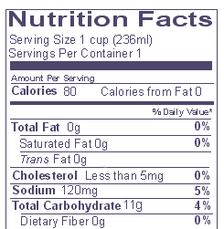
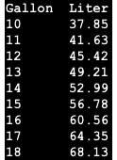
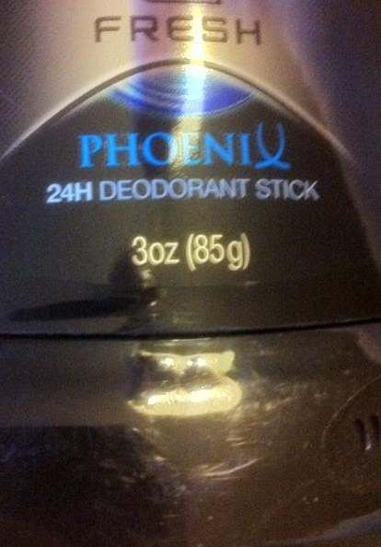
3. Conversion factors are exact numbers, so they do
NOT affect the # of sig. figs. Your answer
should have the same # of sig. figs. as
does the quantity you start with.
www.teachnlearnchem.com
.00
.00
.00
.00
.00
.00
.00
.00
.00

Slide 29
Round to the correct number of significant figures.
Calculator says… | 2 sig. figs. | 3 sig. figs. | 5 sig. figs.
75.6
0.528396
387600
4200
8.4845E-4
76
75.6
75.600
0.53
0.528
0.52840
390,000
388,000
* 3.8760 x 10⁵
4,200
* 4.20 x 10³
4.2000 x 10³
8.5 x 10^{–4}
8.48 x 10^{–4}
8.4845 x 10^{–4}
* = requires scientific notation
www.teachnlearnchem.com

Slide 30
SI Prefixes
to Memorize
tera-
T
10¹²
Prefix | Symbol | Meaning
giga- | G | 10⁹
mega- | M | 10⁶
kilo- | k | 10³
deci- | d | 10^{–1}
centi- | c | 10^{–2}
milli- | m | 10^{–3}
micro- | μ | 10^{–6}
nano- | n | 10^{–9}
pico- | p | 10^{–12}
exp
femto-
f
10^{–15}

Slide 31
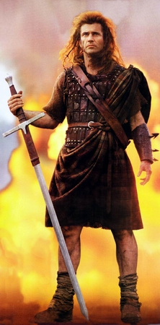
10⁹
10⁶
10³
10^{–1}
10^{–2}
10^{–3}
10^{–6}
10^{–9}
10^{–12}
10^{–15}
G
M
k
d
c
m
μ
n
p
f
iga
ega
ilo
eci
enti
illi
icro
ano
ico
emto
“Got
my
kilt,
Dad!
Can’t
miss
μidsummer’s
no-
pants
Friday!”

Slide 32
Conversions
Convert 4.83 cm to nm.
1 cm = 1 x 10^{–2} m
equivalence statements:
1 nm = 1 x 10^{–9} m
(
)
(
)
1 x 10^{–2} m
1 nm
4.83 cm
1 cm
1 x 10^{–9} m
= 48,300,000 nm
= 4.83 x 10⁷ nm

Slide 33

Convert 418 km/h to m/s.
1 km = 1 x 10³ m
equivalence statements:
1 h = 3600 s
(
)
(
)
km
1 x 10³ m
1 h
418
h
1 km
3600 s
= 116 m/s
John Bergmann
www.teachnlearnchem.com
= 1.16 x 10² m/s

Slide 34

Solving Equations for a Variable
Solve for g.
-- Divide both sides by 2π.
( )
-- Square both sides.
-- Cross-multiply.
-- Divide both sides by T².

Slide 35

Solve for θ_{c}.
n_{i} sin θ_{c} = n_{r}
n_{r}
-- Divide both sides by n_{i}.
sin θ_{c} =
n_{i}
( )
n_{r}
-- Take the sin^{–1} of both sides.
θ_{c} = sin^{–1}
n_{i}
John Bergmann
www.teachnlearnchem.com

Slide 36

displacement, Δd: the straight-line difference
between two points
-- typical SI unit:
meters (m) → PLUS...a direction
-- KEY diff. btwn distance and displacement:
**
displacement is a vector and therefore
must be reported with a direction
Map for a bicycle race
5
2
s
m
e
N
i
l
START
22 miles
FINISH
displacement = 22 miles east

Slide 37
velocity, v: displacement per time
-- typical SI unit:
Δd
-- equation:
v_{avg} =
m/s → PLUS...a direction
Δt
-- KEY diff. btwn speed and velocity:
**
velocity is a vector and therefore
must be reported with a direction
Map for a bicycle race
If Δt = 2.0 h...
5
2
s
m
e
N
i
l
START
22 miles
FINISH
v_{avg} = 11 mi/h east

Slide 38






acceleration, a: the RATE at which something speeds
up, slows down, or changes direction
Δv
-- equation:
a_{avg} =
Δt
-- typical SI unit:
m/s²
→ PLUS...a direction

Slide 39








“Gimme a gut feel for acceleration.”
Imagine you are
driving your car,
holding an open
cup of coffee...
Any time the coffee tries
to come out of the cup…
the cup and you and the
car are accelerating.

Slide 40


mass, m: a measure of the amount
of “stuff” an object contains
-- ** SI base unit:
kilograms (kg)
weight, F_{w}: a measure of
the pull of
gravity on an
object’s “stuff”
-- equation:
F_{w} = m g
where g is the accel. due to gravity
-- typical SI unit:
newtons (N)

Slide 41







force, F: any type of push or pull
-- e.g.,
push, pull, tension in a rope,
gravity, friction, magnetic force,
springs, from waves, weight
-- typical SI unit:
newtons (N)
STOP

