Slide 1
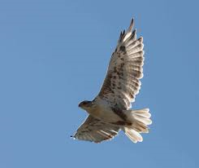
A 7.8 kg hawk is 5.6 m above
the ground and is moving 6.3 m/s.
Relative to the ground, find the total
mechanical energy (ME) of the hawk.
A 2.12 kg mass hangs at rest from
a vertical spring. The spring has a
spring constant of 480. N/m and is
stretched 43.3 cm. The mass is
1.15 m above the ground. Relative
to the ground, find the ME of the
mass/spring system.

Slide 2
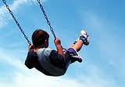
At the instant shown in the picture,
this 24.6 kg child on a swing moves
at 2.43 m/s and is 1.78 m above the
ground. Relative to the ground, find
ME of the child.
At the instant shown in the picture,
this 1.5 kg mass is moving upward
at 2.1 m/s and is 1.3 m above the
ground. In addition, the spring has a
force constant of 760 N/m and is
stretched 18. cm. Relative to the
ground, find the ME of the system.

Slide 3
A 7.8 kg hawk is 5.6 m above
the ground and is moving 6.3 m/s.
Relative to the ground, find the total
mechanical energy (ME) of the hawk.
A 2.12 kg mass hangs at rest from
a vertical spring. The spring has a
spring constant of 480. N/m and is
stretched 43.3 cm. The mass is
1.15 m above the ground. Relative
to the ground, find the ME of the
mass/spring system.
ME = 580 J
ME = 68.9 J

Slide 4
At the instant shown in the picture,
this 24.6 kg child on a swing moves
at 2.43 m/s and is 1.78 m above the
ground. Relative to the ground, find
ME of the child.
At the instant shown in the picture,
this 1.5 kg mass is moving upward
at 2.1 m/s and is 1.3 m above the
ground. In addition, the spring has a
force constant of 760 N/m and is
stretched 18. cm. Relative to the
ground, find the ME of the system.
ME = 502 J
ME = 35 J

