Slide 1
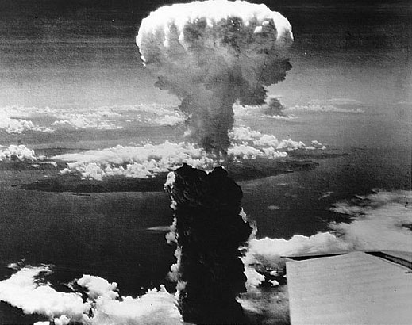
Nuclear Weapons

Slide 2
5113
Number of operational warheads in the U.S. nuclear stockpile, according to the Pentagon.
The figure is down from a peak of 31,225 weapons in 1967.
Bulletin of the Atomic Scientists estimated in 2009 that Russia has 4,830 operational
warheads; the Soviet arsenal topped out at around 45,000 weapons in 1986.
The new Strategic Arms Reduction Treaty would limit both countries to 1,550 operational
Warheads each.
0.1
Approximate percentage of the mass of a uranium atom converted to energy during
nuclear fission. The amount of matter converted to energy in the atomic bomb dropped
on Hiroshima was about 700 milligrams, less that one-third the mass of a U.S. dime.

Slide 3
6.3x10¹³
Estimated energy, in joules, released from the Hiroshima bomb, the equivalent of
15,000 tons of TNT. At low altitudes about half the energy of such a bomb is released
In the air blast, 35 percent as heat and 15 percent as nuclear radiation.
The fireball from the Hiroshima explosion was 50 percent hotter than the surface of the sun.
55
Pounds of weapons-grade uranium required to build a nuclear weapon. The global
stockpile of highly enriched uranium stands at around 1,600 tons, enough for more
than 60,000 nuclear weapons.
Another 60,000 could be constructed from the 500 tons of separated plutonium
estimated to exist in stockpiles around the world.
Notes:
Numbers by Jeremy Jacquot from DISCOVER magazine July/August 2010 pg 18-19.

