Slide 1
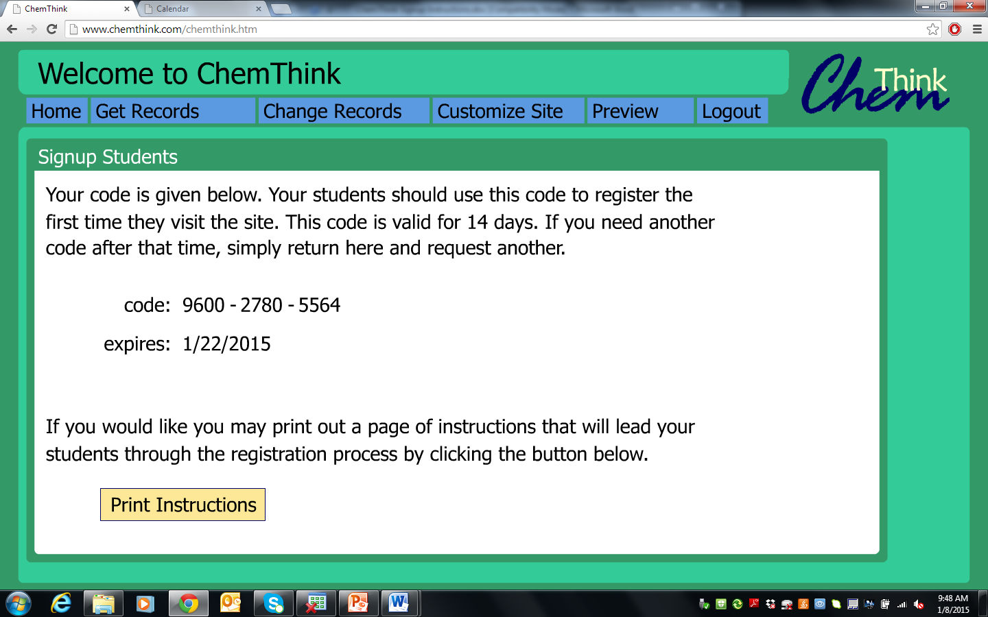

Slide 3
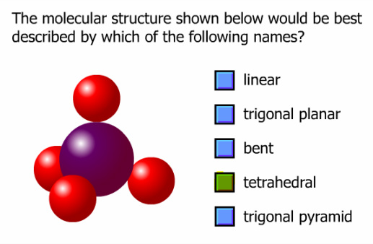
"In this tutorial we will investigate the shapes of simple covalent molecules Specifically, we will be learning about something called VSEPR theory and how it allows us to predict the shapes that covalently bonded molecules will have."
CREATE

Slide 7
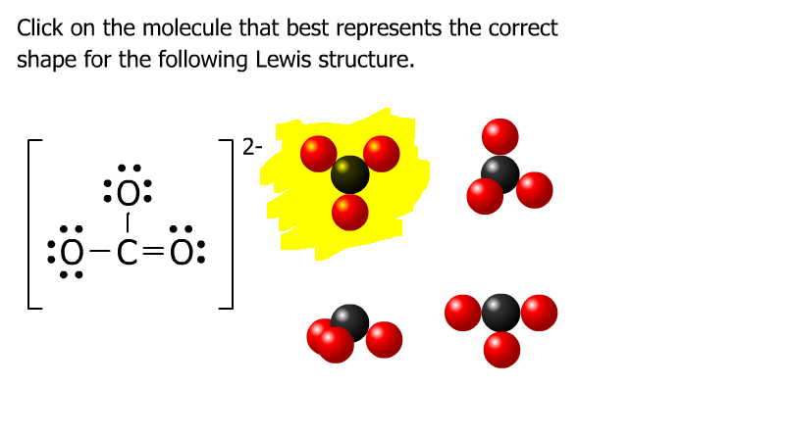
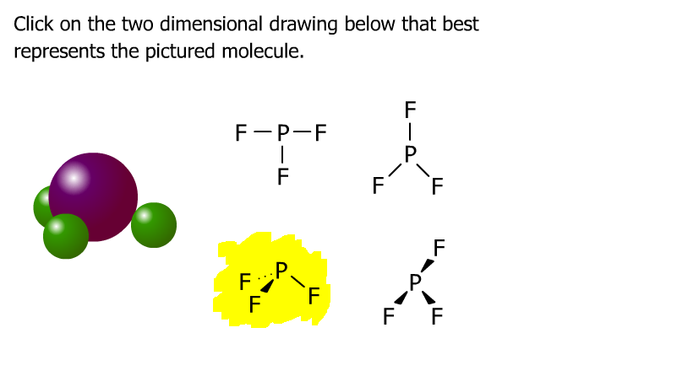
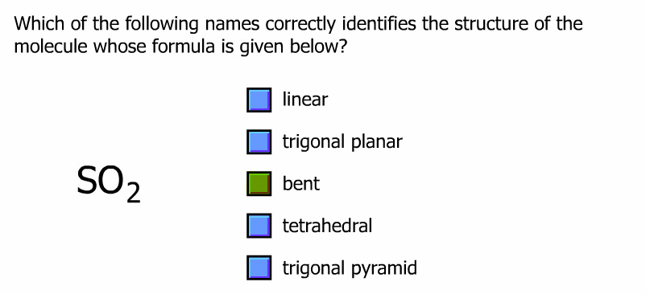
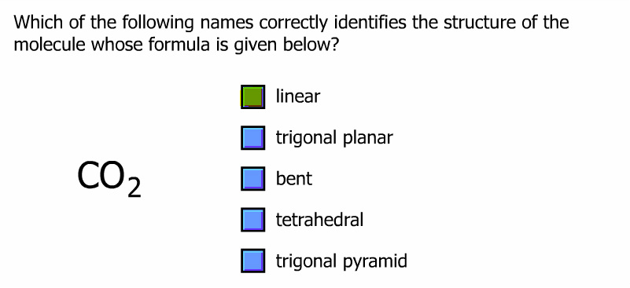
CREATE

Slide 9
CREATE

Slide 13
Molecular Geometry
180º
H
109.5º
109.5º
C
H
H
Linear
Trigonal planar
H
Tetrahedral
104.5º
107.3º
Bent
Trigonal pyramidal
H₂O CH₄ AsCl₃ AsF₅ BeH₂ BF₃ CO₂

Slide 14
H
..
..
C
N
O
H
H
H
H
..
H
109.5º
107º
104.5º
H
H
H
CH₄, methane
NH₃, ammonia
H₂O, water
..
lone pair
electrons
O
O
O
O
O
O
O₃, ozone
Notes:
Oxygen contains two pairs of electrons that don’t bond at all. These electron pairs are referred to as unshared electron pairs, lone pairs or unbonded pairs.

Slide 15
Molecular Shapes
Three atoms (AB₂)
Four atoms (AB₃)
B
Linear (180º)
Bent
Trigonal planar (120º)
Trigonal pyramidal
T-shaped
A
B
A
B
B
B
linear
trigonal planar
B
Five atoms (AB₄)
Tetrahedral (109.47º)
Square planar
Seesaw
tetrahedral
A
B
Bª
B
Six atoms (AB₅)
B
B^{e}
Trigonal bipyramidal (B^{e}AB^{e}, 120º) & (B^{e}ABª, 90º)
Square pyramidal
A
B^{e}
B
B^{e}
Seven atoms (AB₆)
B
B
Trigonal
bipyramidal
A
Bª
Octahedral
B
B
Bailar, Moeller, Kleinberg, Guss, Castellion, Metz, Chemistry, 1984, page 313.
B
Notes:
Molecular formula
– Gives the elemental composition of molecules
Structural formula
Shows which atoms are bonded to one another and the approximate arrangement in space
Enables chemists to create a three-dimensional model that provides information about the physical and chemical properties of the compound
A single bond, in which a single pair of electrons are shared, is represented by a single line (–)
A double bond, in which two pairs of electrons are shared, is indicated by two lines (=)
A triple bond, in which three pairs of electrons are shared, is indicated by three lines (≡)

Slide 16
Bonding and Shape of Molecules
Number
of Bonds
Number of
Unshared Pairs
Covalent
Structure
Shape
Examples
2
3
4
3
2
0
0
0
1
2
-Be-
Linear
Trigonal planar
Tetrahedral
Pyramidal
Bent
BeCl₂
BF₃
CH₄, SiCl₄
NH₃, PCl₃
H₂O, H₂S, SCl₂
B
C
:
N
:
:
O

Slide 17
Molecular Shapes
AB₂
Linear
AB₃
Trigonal planar
AB₂E
Angular or Bent
AB₄
Tetrahedral
AB₃E
Trigonal
pyramidal
AB₂E₂
Angular
or Bent
AB₅
Trigonal bipyramidal
AB₄E
Irregular tetrahedral
(see saw)
AB₃E₂
T-shaped
AB₂E₃
Linear
AB₆
Octahedral
AB₆E
Square pyramidal
AB₅E₂
Square planar
Notes:
A hyperlink to additional information is found on the central atom of the diagrams.

Slide 18
Valence Shell Electron Pair Repulsion Theory
Planar triangular
Tetrahedral
Trigonal bipyramidal
Octahedral

Slide 19
The VSEPR Model
The Shapes of Some Simple AB_{n} Molecules
..
..
..
SO₂
O
S
N
C
F
O
O
O
O
S
F
F
O
O
Linear
Bent
Trigonal
planar
Trigonal
pyramidal
SF₆
F
F
F
F
F
F
F
F
Xe
P
F
S
F
Cl
F
F
F
F
F
F
T-shaped
Square
planar
F
F
Trigonal
bipyramidal
Octahedral
Brown, LeMay, Bursten, Chemistry The Central Science, 2000, page 305
Notes:
Students often confuse electron-domain geometry with molecular geometry.
You must stress that the molecular geometry is a consequence of the electron domain geometry.
The best arrangement of a given number of electron domains is the one that minimizes the repulsions among them.
The VSEPR model can be used to predict the geometry of most polyatomic molecules and ions by focusing on only the number of electron pairs around the central atom and ignoring all other valence electrons present
• The following procedure is used:
1. Draw the Lewis electron structure of the molecule or polyatomic ion
2. Count the number of valence-electron pairs around the atom of interest, treating any multiple bonds or single unpaired electrons as single electron pairs – this number determines the electron-pair geometry around the central atom
3. Identify each electron pair as a bonding pair (BP) or lone (nonbonding) pair (LP)
4. To determine the molecular geometry, arrange the bonded atoms around the central atom to minimize repulsions between electron pairs

Slide 20
Molecular Shapes
AB₂
Linear
AB₃
Trigonal planar
AB₂E
Angular or Bent
AB₄
Tetrahedral
AB₃E
Trigonal
pyramidal
AB₂E₂
Angular
or Bent
AB₅
Trigonal bipyramidal
AB₄E
Irregular tetrahedral
(see saw)
AB₃E₂
T-shaped
AB₂E₃
Linear
AB₆
Octahedral
AB₅E
Square pyramidal
AB₄E₂
Square planar
Notes:
(Source: R.J. Gillespie, J. Chem. Educ., 40, 295, 1963.)
Predicts the structure of nearly any molecule or polyatomic ion that has a nonmetal central atom and the structures of many compounds that contain a central metal atom
In discussions of the structures of molecules or polyatomic ions, species are classified according to the number of atoms (n) of one type (B) attached to the central atom (A) using the notation AB_{n}, but not all AB_{n} species with the same value of n have the same structure
VSEPR model assumes that the electron pairs around the central atom of a Lewis structure occupy space, whether they are bonding pairs or lone pairs, and the most stable arrangement of electron pairs (the one with the lowest energy) is the one that minimizes repulsions between the electrons
VSEPR model distinguishes between the electron-pair geometry, the three-dimensional arrangement of electron pairs around the central atom, and the molecular geometry, the arrangement of the bonded atoms in a molecule or polyatomic ion
Electron-pair geometry
– Describes the arrangement of all valence electrons around the central atom, whether bonding or not
– Electrostatic repulsion between two particles that have the same charge depends on the distance between them
– Repulsions between electron pairs depend strongly on the angle between them — the smaller the angle, the closer they are and the greater the electrostatic repulsion
1. For compounds with two electron pairs around the central atom, the lowest-energy arrangement is linear and has the electron pairs on opposite sides of the central atom with a 180º angle between them
2. For compounds with three electron pairs around the central atom, the lowest-energy arrangement is trigonal planar, with electron pairs at 120º angles from each other
3. In compounds with four electron pairs around the central atom, the electron pairs point toward the vertices of a tetrahedron with 109.5º angles between adjacent electron pairs
4. In compounds with five electron pairs, the electron pairs have a trigonal bipyramidal arrangement, which has two sets of angles between adjacent electron pairs; one set contains three electron pairs at 120º
angles to one another in a plane, and a second set contains two electron pairs positioned at 90º to that plane
5. Lowest-energy arrangement for six electron pairs is an octahedron, in which adjacent electron pairs are positioned at 90º angles to one another

Slide 21
Geometry of Covalent Molecules AB_{n}, and AB_{n}E_{m}
Shared
Electron
Pairs
Unshared
Electron
Pairs
Type
Formula
Ideal
Geometry
Observed
Molecular Shape
Examples
AB₂
AB₂E
AB₂E₂
AB₂E₃
AB₃
AB₃E
AB₃E₂
AB₄
AB₄E
AB₄E₂
AB₅
AB₅E
AB₆
2
2
2
2
3
3
3
4
4
4
5
5
6
0
1
2
3
0
1
2
0
1
2
0
1
0
Linear
Trigonal planar
Tetrahedral
Trigonal bipyramidal
Trigonal planar
Tetrahedral
Triangular bipyramidal
Tetrahedral
Triangular bipyramidal
Octahedral
Triangular bipyramidal
Octahedral
Octahedral
Linear
Angular, or bent
Angular, or bent
Linear
Trigonal planar
Triangular pyramidal
T-shaped
Tetrahedral
Irregular tetrahedral
(or “see-saw”)
Square planar
Triangular bipyramidal
Square pyramidal
Octahedral
CdBr₂
SnCl₂, PbI₂
OH₂, OF₂, SCl₂, TeI₂
XeF₂
BCl₃, BF₃, GaI₃
NH₃, NF₃, PCl₃, AsBr₃
ClF₃, BrF₃
CH₄, SiCl₄, SnBr₄, ZrI₄
SF₄, SeCl₄, TeBr₄
XeF₄
PF₅, PCl₅(g), SbF₅
ClF₃, BrF₃, IF₅
SF₆, SeF₆, Te(OH)₆,
MoF₆
Bailar, Moeller, Kleinberg, Guss, Castellion, Metz, Chemistry, 1984, page 317.
Notes:
VSEPR model distinguishes between the electron-pair geometry, the three-dimensional arrangement of electron pairs around the central atom, and the molecular geometry, the arrangement of the bonded atoms in a molecule or polyatomic ion
Electron-pair geometry
– Describes the arrangement of all valence electrons around the central atom, whether bonding or not
– Electrostatic repulsion between two particles that have the same charge depends on the distance between them
– Repulsions between electron pairs depend strongly on the angle between them — the smaller the angle, the closer they are and the greater the electrostatic repulsion
1. For compounds with two electron pairs around the central atom, the lowest-energy arrangement is linear and has the electron pairs on opposite sides of the central atom with a 180º angle between them
2. For compounds with three electron pairs around the central atom, the lowest-energy arrangement is trigonal planar, with electron pairs at 120º angles from each other
3. In compounds with four electron pairs around the central atom, the electron pairs point toward the vertices of a tetrahedron with 109.5º angles between adjacent electron pairs
4. In compounds with five electron pairs, the electron pairs have a trigonal bipyramidal arrangement, which has two sets of angles between adjacent electron pairs; one set contains three electron pairs at 120º
angles to one another in a plane, and a second set contains two electron pairs positioned at 90º to that plane
5. Lowest-energy arrangement for six electron pairs is an octahedron, in which adjacent electron pairs are positioned at 90º angles to one another
Relationship between the number of electron pairs around a central atom, the number of lone pairs, and the molecular geometry is summarized in the following table
1. For molecules that have no lone pairs on the central atom, molecular geometry is the same as electron-pair geometry
2. For molecules and polyatomic ions that have one or more lone pairs on the central atom, the molecular geometry is not the same as the electron-pair geometry but is derived from it
a. Bent molecule can result from a trigonal-planar arrangement of three electron pairs (with one lone pair) or from a tetrahedral arrangement of four electron pairs (with two lone pairs)
b. Tetrahedral electron-pair geometry can produce a pyramidal AB₃ molecular structure with one lone pair on the central atom
c. Trigonal bipyramidal electron-pair geometry can produce seesaw (AB₄), T-shaped (AB₃), and linear (AB₂) molecular geometries with one, two, and three lone pairs on the central atom
d. Octahedral electron-pair geometry can produce square pyramidal AB₅ or square planar AB₄ molecular geometries, with one or two lone pairs on the central atom

Slide 22
Predicting the Geometry of Molecules
Lewis electron-pair approach predicts number and types of bonds between the atoms in a substance and indicates which atoms have lone pairs of electrons but gives no information about the actual arrangement of atoms in space
Valence-shell electron-pair repulsion (VSEPR) model predicts the shapes of many molecules and polyatomic ions but provides no information about bond lengths or the presence of multiple bonds

Slide 23
Introduction to Lewis Structures
Lewis dot symbols
1. Used for predicting the number of bonds formed
by most elements in their compounds
2. Consists of the chemical symbol for an element surrounded by dots that represent its valence
electrons
3. A single electron is represented as a single dot
Notes:
1. Dots representing the valence electrons are placed, one at a time, around the element’s chemical symbol.
2. Up to four dots are placed above, below, to the left, and to the right of the symbol as long as elements with four or fewer valence electrons have no more than one dot in each position.
3. For elements that have more than four valence electrons, dots are again distributed one at a time, each paired with one of the first four.
4. Number of dots in the Lewis dot symbol is the same as the number of valence electrons, which is the same as the last digit of the element’s group number in the periodic table.
5. Unpaired dots are used to predict the number of bonds that an element will form in a compound.

Slide 24
Lewis Structures
1) Count up total number of valence electrons
2) Connect all atoms with single bonds
- “multiple” atoms usually on outside
- “single” atoms usually in center;
C always in center,
H always on outside.
3) Complete octets on exterior atoms
(not H, though)
4) Check
- valence electrons math with Step 1
- all atoms (except H) have an octet;
if not, try multiple bonds
- any extra electrons?
Put on central atom

