Slide 1

INORGANIC
Nomenclature
Notes:
For many students that may have struggled with the math of chemistry up to this point – this chapter has very simple math. Students that like language and the rules associated with grammar tend to like this unit.

Slide 2

Nomenclature - Humor
Fe²⁺
Fe²⁺
Fe²⁺
Fe²⁺
BaNa₂
Fe²⁺
Fe²⁺
Fe²⁺
Fe²⁺
“BaNaNa”
“Ferrous Wheel”
What weapon can you make
from the elements nickel,
potassium and iron?
Fe = iron (Latin = ferrum)
Fe²⁺ = lower oxidation state = ferrous
Fe³⁺ = higher oxidation state = ferric
A KNiFe

Slide 3
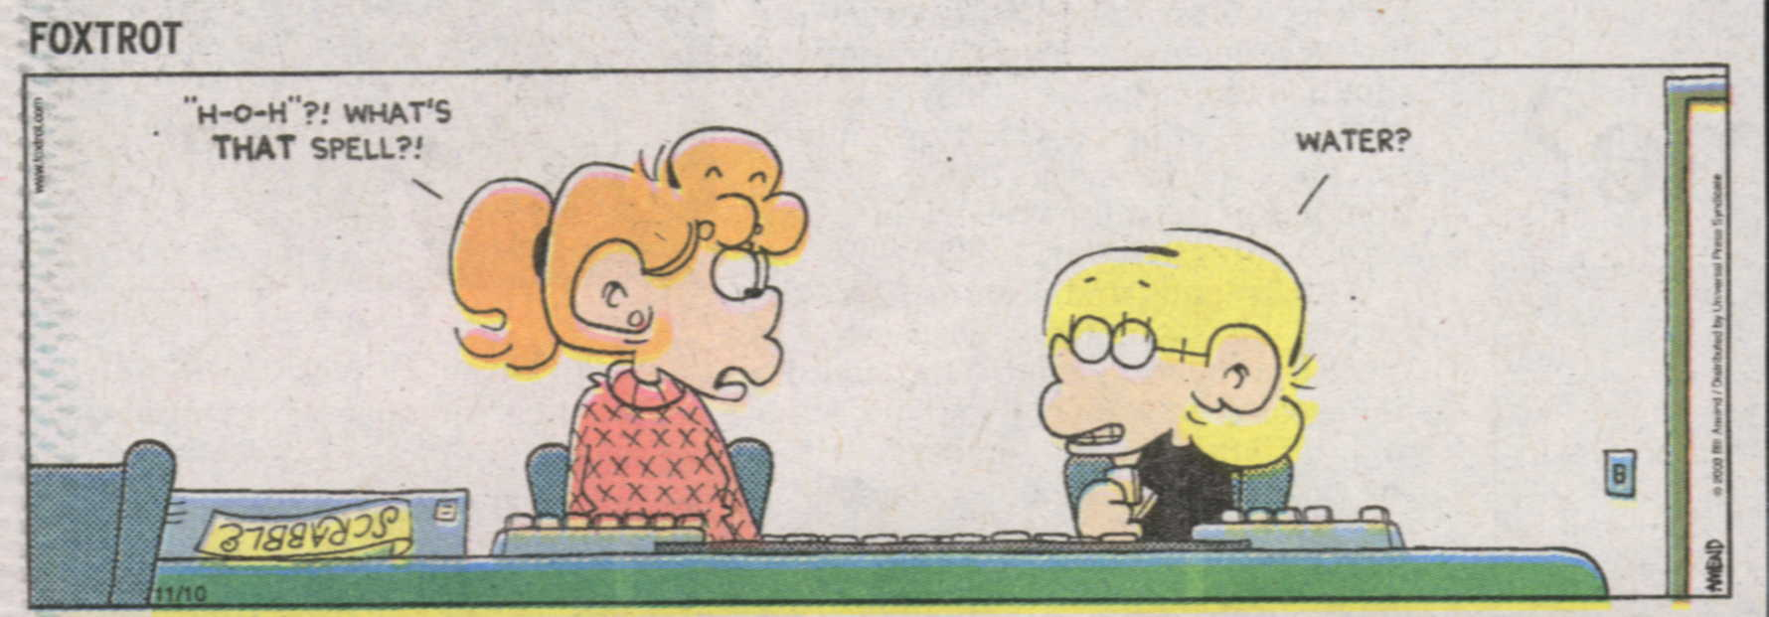
Teacher: What is the formula for water?
Student: H, I, J, K, L, M, N, O
Teacher: That’s not what I taught you.
Student: But you said the formula for water was…H to O.
mis
"H-O-H"?! WHAT'S
THAT SPELL?!
mis
WATER?
Website: Dihydrogen monoxide Information Campaign
“Little Johnny took a drink,
Now he shall drink no more.
For what he thought was H₂O,
Was H₂SO₄.”
Under aged Pb walks into a bar and the bartender turns to the gold
Bouncer and says, “Au, get the lead out!”
Notes:
A sign outside the chemistry hotel reads “Great Day Rates, Even Better NO₃⁻¹s”
What do you do with a dead chemist? Barium
FOXTROT cartoon from November 10, 2006 Pantagraph newspaper.

Slide 4
Table of Contents
‘Nomenclature’
Binary Compounds - Metal (fixed oxidation) + Nonmetal
Criss-Cross Rule
Binary Compounds - Metal (variable oxidation) + Nonmetal
Binary Compounds - Nonmetal + Nonmetal
Ternary Compounds
Binary Hydrogen Compounds
Meaning of Suffixes
Empirical Formulas
Subscripts, Superscripts, and Coefficients
Centrum Multivitamin
Polyatomic Ions
Notes:
Chemical Formula - Study Questions
1. What is an ion?
2. What is an atom?
3. What is an allotrope?
4. What is an isotope?
5. What is a polyatomic ion?
6. What is a diatomic molecule?
7. Which is more stable an element or a compound?
8. What has to happen for a compound to form?
9. What is the octet rule?
10. Why do some elements form ionic rather than covalent compounds?
11. What is the configuration of the ions in an ionic compound?
12. What holds the ions together in an ionic compound?
13. What is the general description of an ionic compound?
14. What are the general properties of an ionic compound? (3 required for a test)
15. Why do elements form covalent compounds?
16. How do atoms achieve a noble gas configuration in a covalent compound?
17. What is a molecule?
18. What are the general properties of a covalent compound?
19. What is the IUPAC rule from symbols of compounds with formal names?
20. How are the symbols for newly discovered elements derived?
21. What is the configuration for a symbol?
22. What is a chemical formula?
23. Which element is listed first in a chemical formula?
24. The formula of an ionic compound gives the simplest ratio. What does the ration in a molecular compound represent?
25. What is the oxidation number of an atom?
26. What can happen to the electrons in a compound?
27. Write the formula for a compound of Francium and Nitrogen.
28. Write the formula for a compound of Iron (II) and Carbon.
29. Write the formula for a compound of Ammonium and Dichromate.
30. What is the name of Al₂Te₃?
31. What is the name of H₂SO₄?
32. What is the name of Sn₃As₄?
33. Write the formula and name of a compound of Carbon and Arsenate.
34. Write the formula and name of a compound of Magnesium and Phosphorous.

Slide 5
Lecture Outline – Nomenclature
Lecture Outline – Nomenclature and Bonding
student notes outline
textbook questions
Lecture Outline – Nomenclature and Bonding
textbook questions
Keys
text
http://www.unit5.org/chemistry/Nomenclature.html
Notes:
ALL students should;
Know the apporoximate locations of metals, non-metals and metalloids on the periodic table
Understand the meaning of the terms Molecule and Ion
Learn the lists of common anions and cations (including polyatomic ions) studied in TOPIC 3
Know how to combine those anions and cations in the correct proportions to form ionic compounds with no net charge
Be able to name binary ionic compounds of a metal and a non-metal
Be able to name binary molecular compounds of two non-metals
Be able to name simple binary acids
Be able to name ionic compounds containing polyatomic anions
Be able to name oxoacids and compounds containing oxoanions
Be able to name hydrated salts

Slide 6
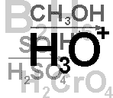
Four Types of Naming
Binary compounds
Ternary compounds
Coordination compounds
Organic compounds
Contain only two types of elements
Contain more than two types of elements
These will not be covered
We will cover these in a separate unit

Slide 7
Binary Compounds
Metals (fixed oxidation) + Nonmetals
Notes:
Objectives:
To predict the ionic charge on a cation in a binary ionic compound.
To write systematic names and formulas for binary ionic compounds.

Slide 8
Binary Compounds
1+
1
H
1
2+
3+
He
2
2
Li
3
Be
4
B
5
C
6
N
7
O
8
F
9
Ne
10
3
Na
11
Mg
12
1+
2+
Al
13
Si
14
P
15
S
16
Cl
17
Ar
18
4
K
19
Ca
20
Sc
21
Ti
22
V
23
Cr
24
Mn
25
Fe
26
Co
27
Ni
28
Cu
29
Zn
30
Ga
31
Ge
32
As
33
Se
34
Br
35
Kr
36
Binary compounds that contain a metal of fixed oxidation number
(group 1, group 2, Al, Zn, Ag, etc.), and a non-metal.
Rb
37
Sr
38
Y
39
Zr
40
Nb
41
Mo
42
Tc
43
Ru
44
Rh
45
Pd
46
Ag
47
Cd
48
In
49
Sn
50
Sb
51
Te
52
I
53
Xe
54
5
6
Cs
55
Ba
56
∗
Hf
72
Ta
73
W
74
Re
75
Os
76
Ir
77
Pt
78
Au
79
Hg
80
Tl
81
Pb
82
Bi
83
Po
84
At
85
Rn
86
7
Fr
87
Ra
88
Ω
Rf
104
Db
105
Sg
106
Bh
107
Hs
108
Mt
109
To name these compounds, give the name of metal followed by the
name of the non-metal, with the ending replaced by the suffix –ide.
Examples:
NaCl
sodium chlor
ine
ide
(Na¹⁺ Cl¹⁻)
CaS
calcium sulf
ide
ur
(Ca²⁺ S²⁻)
AlI₃
aluminum iod
ine
ide
(Al³⁺ I¹⁻)
3

Slide 9
Binary Compounds
Binary compounds that contain a metal of fixed oxidation number
(group 1, group 2, Al, Zn, Ag, etc.), and a non-metal.
To name these compounds, give the name of metal followed by the
name of the non-metal, with the ending replaced by the suffix –ide.
Examples:
NaCl
sodium chlor
ine
ide
(Na¹⁺ Cl¹⁻)
CaS
calcium sulf
ide
ur
(Ca²⁺ S²⁻)
AlI₃
aluminum iod
ine
ide
(Al³⁺ I¹⁻)
3

Slide 10
Cations and Anions
Common Simple Cations and Anions
Cation Name Anion Name*
H ¹⁺ hydrogen H ¹⁻ hydride
Li ¹⁺ lithium F ¹⁻ fluoride
Na ¹⁺ sodium Cl ¹⁻ chloride
K ¹⁺ potassium Br ¹⁻ bromide
Cs ¹⁺ cesium I ¹⁻ iodide
Be ²⁺ beryllium O ²⁻ oxide
Mg ²⁺ magnesium S ²⁻ sulfide
Al ³⁺ aluminum
Ag ¹⁺ silver
*The root is given in color.
Zumdahl, Zumdahl, DeCoste, World of Chemistry 2002, page 86

Slide 11
Ionic Binary Compounds:
Single-Charge Cations
Ionic Binary Compounds: Single-Charge Cations
Ionic Binary Compounds: Single-Charge Cations
Keys
http://www.unit5.org/chemistry/Nomenclature.html

Slide 12
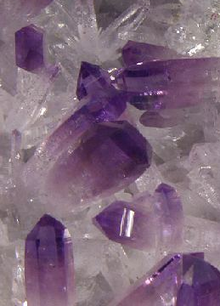
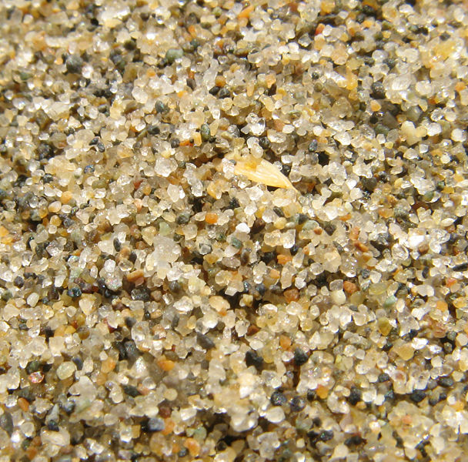

Molecular Compound
A compound containing atoms of two or more elements that are bonded together by sharing electrons.
Silicon dioxide, SiO₂, is a molecular compound. It is also a mineral called quartz (left).
Quartz is found in nearly every type of rock. Most sand grains (center) are bits of quartz.
Glass is made from sand.
Notes:
Quartz (silicon dioxide) is the most common mineral species in the earth's crust.
http://www.minvision.com/mvpics/0275331001148477692730993.jpg
http://ftp.gnome.org/pub/GNOME/teams/art.gnome.org/backgrounds/NATURE-QuartzSand_1024x768.jpg
http://en.wikipedia.org/wiki/Image:Third_beach_sand.jpg

Slide 13
Criss-Cross Rule

Slide 14

“Perhaps one of you gentlemen would mind telling me just
what is outside the window that you find so attractive..?”
Image courtesy NearingZero.net

Slide 15
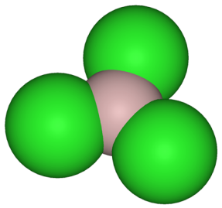
Example: Aluminum Chloride
Criss-Cross Rule
Aluminum Chloride
Step 1:
write out name with space
Al Cl
3+
1-
Step 2:
write symbols & charge of elements
Al Cl
Step 3:
1
3
criss-cross charges as subsrcipts
Step 4: AlCl
3
combine as formula unit
(“1” is never shown)
Notes:
http://upload.wikimedia.org/wikipedia/commons/4/42/Aluminium-trichloride-3D-structures.png

Slide 16
Example: Aluminum Chloride
Criss-Cross Rule
Step 1: Aluminum Chloride
Step 2: Al³⁺ Cl¹⁻
Step 3: Al Cl
1
3
Step 4: AlCl
3

Slide 17
Example: Aluminum Oxide
Criss-Cross Rule
Step 1: Aluminum Oxide
Step 2: Al³⁺ O²⁻
Step 3: Al O
2
3
Step 4: Al₂O₃

Slide 18
Example: Magnesium Oxide
Criss-Cross Rule
Step 1: Magnesium Oxide
Step 2: Mg²⁺ O²⁻
Step 3: Mg O
2
2
Step 4: Mg₂O₂
Step 5: MgO

Slide 19
Naming Binary Compounds
Formula Name
barium oxide
BaO ____________________
________________ sodium bromide
MgI₂ ____________________
KCl ____________________
________________ strontium fluoride
________________ cesium fluoride
NaBr
magnesium iodide
potassium chloride
SrF₂
CsF

Slide 20
Rules for Parentheses
Parentheses are used only when the following
two condition are met:
There is a radical (polyatomic ion) present and…
There are two or more of that radical in the formula.
Examples:
NaNO₃ NO₃¹⁻ is a radical, but there is only one of it.
Co(NO₃)₂ NO₃¹⁻ is a radical and there are two of them
(NH₄)₂SO₄ NH₄¹⁺ is a radical and there are two of them;
SO₄²⁻ is a radical but there is only one of it.
Co(OH)₂ OH¹⁻ is a radical and there are two of it.
Al₂(CO₃)₃ CO₃²⁻ is a radical and there are three of them.
NaOH OH¹⁻ is a radical but there is only one of it.

Slide 21
Ions in Chemical Formulas
Ions in Chemical Formulas
Ions in Chemical Compounds - Grid
Ions in Chemical Formulas
Ions in Chemical Compounds - Grid
Keys
http://www.unit5.org/chemistry/Nomenclature.html

Slide 22

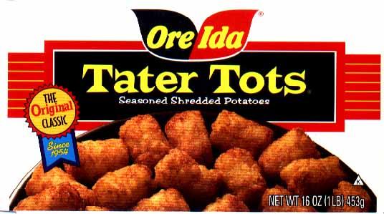
Hungry for Tater Tots?
Mr. C at 7 years old.
Notes:
Photograph is of me (Mr. Christopherson in 1973, age 7)
Story that goes along with this slide is told in class.

Slide 23
Ions in Chemical Compounds
Ions in Chemical Compounds - Grid
Ions in Chemical Compounds - Grid
Keys
http://www.unit5.org/chemistry/Nomenclature.html

Slide 24
Chemical Bonding
& Nomenclature
General Chemistry Notes

Slide 25
Chemical Bonding
Covalent Bonds
…atoms share electrons to get a full valence shell
2s² 2p²
C
1s²
(4 v.e–)
F
2s² 2p⁵
(7 v.e–)
1s²
both need 8 valence electrons for a full outer shell
(octet rule)

Slide 26
Covalent bonding
Fluorine has seven valence electrons
A second F atom also has seven
By sharing electrons
Both end with full orbitals (stable octets)
F
F
8 Valence electrons
8 Valence electrons

Slide 27
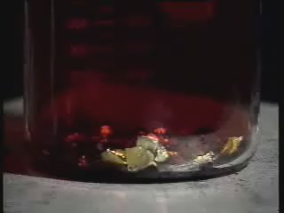
Chemical Bonding
Ionic Bonds:
    atoms give up or gain electrons and are attracted
    to each other by coulombic attraction
Na loses an e–
Cl gains an e–
Na → Na¹⁺ + e–
Cl + e– → Cl^{1–}
ionic compounds = salts
Na¹⁺ + Cl^{1–} → NaCl
K¹⁺ + NO₃^{1–} → KNO₃
where NO₃^{1–} is a polyatomic ion: a charged group of atoms
that stay together

Slide 28
Formation of Cation
sodium atom
Na
sodium ion
Na⁺
e⁻
e⁻
e⁻
e⁻
e⁻
e⁻
e⁻
e⁻
e⁻
loss of
one valence
electron
11p⁺
e⁻
11p⁺
e⁻
e⁻
e⁻
e⁻
e⁻
e⁻
e⁻
e⁻
e⁻
e⁻
e⁻
e⁻

Slide 29
Formation of Anion
chlorine atom
Cl
chloride ion
Cl¹⁻
gain of
one valence
electron
e⁻
e⁻
e⁻
e⁻
e⁻
e⁻
e⁻
e⁻
e⁻
e⁻
e⁻
e⁻
e⁻
e⁻
e⁻
17p⁺
e⁻
17p⁺
e⁻
e⁻
e⁻
e⁻
e⁻
e⁻
e⁻
e⁻
e⁻
e⁻
e⁻
e⁻
e⁻
e⁻
e⁻
e⁻
e⁻
e⁻
e⁻
e⁻

Slide 30
Formation of Ionic Bond
chloride ion
Cl¹⁻
sodium ion
Na⁺
e⁻
e⁻
e⁻
e⁻
e⁻
e⁻
e⁻
e⁻
e⁻
e⁻
e⁻
11p⁺
e⁻
e⁻
17p⁺
e⁻
e⁻
e⁻
e⁻
e⁻
e⁻
e⁻
e⁻
e⁻
e⁻
e⁻
e⁻
e⁻
e⁻
e⁻

Slide 31
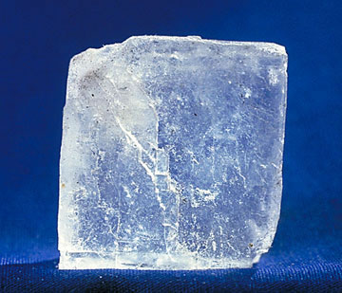
Ionic Bonding
NaCl
n = 3
n = 2
-
n = 3
-
-
-
-
-
-
-
-
-
-
-
-
-
-
-
+
-
-
-
-
-
-
-
-
-
-
-
-
-
-
-
-
Na
[Ne]3s¹
Cl
[Ne]3s²3p⁵
Na⁺
[Ne]
Cl⁻
[Ne]3s²3p⁶
Transfer of electrons to achieve a stable octet (8 electrons in valence shell).

Slide 32
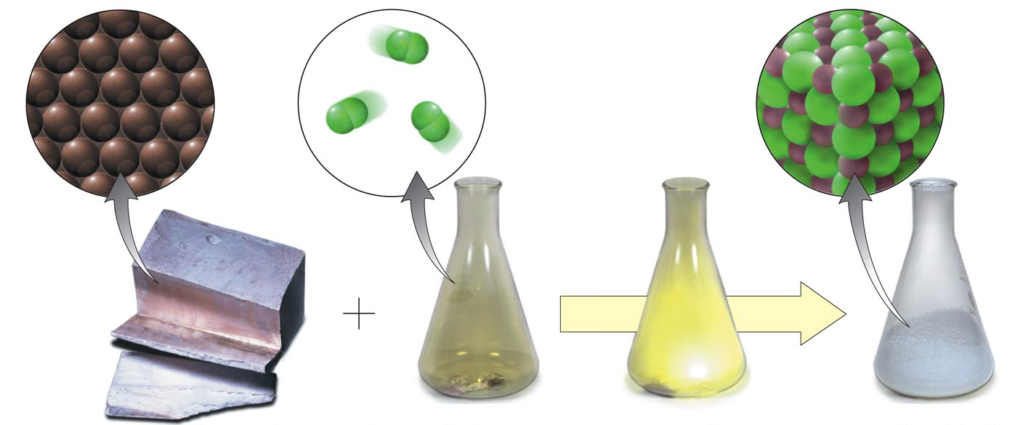
sodium metal and chlorine gas react to form sodium chloride
2
Na + Cl₂ NaCl
2
Copyright © 2007 Pearson Benjamin Cummings. All rights reserved.

Slide 33
Covalent Bonding
n = 2
-
-
n = 1
-
-
-
-
-
-
-
+
-
-
-
-
-
-
-
-
-
-
-
-
-
-
-
-
-
-
-
O
[He]2s²2p⁴
O
[He]2s²2p⁴
O₂
Sharing of electrons to achieve a stable octet (8 electrons in valence shell).

Slide 34
Properties of Salts
VERY HARD
each ion is bonded to several oppositely- charged ions
HIGH MELTING POINTS
many bonds must be broken
BRITTLE
with sufficient force, like atoms are brought next to each other and repel

Slide 35
Vocabulary
Chemical Bond
  attractive force between atoms or ions that binds them together as a unit
  bonds form in order to…
    decrease potential energy (PE)
    increase stability
Courtesy Christy Johannesson www.nisd.net/communicationsarts/pages/chem
Notes:
Atoms in all substances that contain more than one atom are held together by electrostatic interactions—interactions between electrically charged particles such as protons and electrons.

Slide 36
Vocabulary
CHEMICAL FORMULA
IONIC
COVALENT
formula
unit
molecular
formula
NaCl
CO₂
Courtesy Christy Johannesson www.nisd.net/communicationsarts/pages/chem

Slide 37
Vocabulary
COMPOUND
more than 2
elements
2 elements
binary
compound
ternary
compound
NaCl
NaNO₃
Courtesy Christy Johannesson www.nisd.net/communicationsarts/pages/chem

Slide 38
Vocabulary
ION
1 atom
2 or more atoms
monatomic
Ion
polyatomic
Ion
Na⁺
NO₃⁻
Courtesy Christy Johannesson www.nisd.net/communicationsarts/pages/chem

Slide 39
Types of Bonds
IONIC
COVALENT
Bond Formation
e⁻ are transferred from metal to nonmetal
e⁻ are shared between two nonmetals
Type of Structure
crystal lattice
true molecules
Physical
State
liquid or gas
solid
Melting
Point
high
low
Solubility in
Water
yes
usually not
Electrical Conductivity
yes (solution or liquid)
no
Other
Properties
odorous
Courtesy Christy Johannesson www.nisd.net/communicationsarts/pages/chem

Slide 40
Types of Bonds
METALLIC
bond formation
electrons are delocalized
among metal atoms
type of structure
“electron sea”
physical state
solid
melting point
very high
solubility in water
no
conductivity
yes (any form)
other properties
malleable, ductile, lustrous
Courtesy Christy Johannesson www.nisd.net/communicationsarts/pages/chem

Slide 41
Types of Bonds
Ionic Bonding - Crystal Lattice
Table salt

Slide 42
Types of Bonds
Ionic Bonding - Crystal Lattice
Table salt

Slide 43
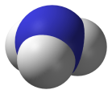

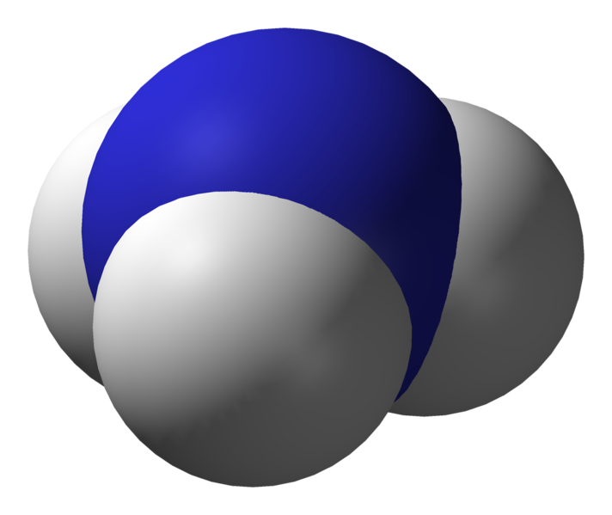
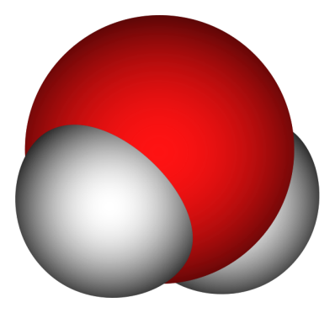



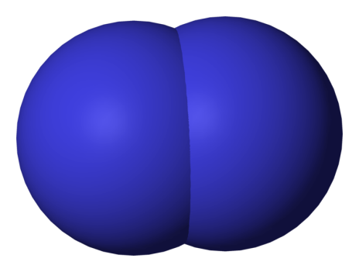




Types of Bonds
Covalent Bonding - True Molecules
Nitrogen
Water
Ammonia
Diatomic
Molecule

Slide 44
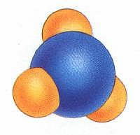
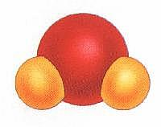
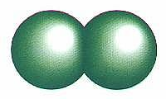
Types of Bonds
Covalent Bonding - True Molecules
Chlorine
Water
Ammonia
Diatomic
Molecule
Courtesy Christy Johannesson www.nisd.net/communicationsarts/pages/chem

Slide 45
Lewis Structure
Lewis structure:
a model of a covalent molecule that
shows all of the valence electrons
1. Two shared electrons make a single covalent bond,
four make a double bond, etc.
2. unshared pairs: pairs of un-bonded valence electrons
3. Each atom needs a full outer shell, i.e., 8 electrons.
Exception: H needs 2 electrons

Slide 46
Lewis Structure
carbon tetrafluoride (CF₄)
x
x
x
x
x
F
x
x
F
x
x
x
x
x
o
x
x
x
x
o
x
x
x
x
x
x
x
o
C
x
F
x
x
F
o
C
x
F
x
x
F
C
F
x
o
x
x
x
o
x
x
x
o
x
x
x
x
o
x
x
x
x
x
x
x
x
F
x
x
F
x
x
x
x
x
x
x
x
x
covalent compounds = molecular compounds
(have lower melting points than do ionic compounds)

Slide 47
Lewis Structure
methane (CH₄)
H
H
o
x
x
o
o
C
H
H
o
C
x
o
x
o
H
H
C
H
o
o
x
H
H
o
o
x
x
x
x
o
o
x
x
x
x
x
x
o
nitrogen triiodide (NI₃)
o
o
N
x
I
x
x
I
o
N
x
I
x
x
I
N
I
o
x
x
x
o
x
x
o
x
x
x
x
x
x
o
x
x
x
x
x
x
x
x
I
x
x
I
x
x
x
x
x
x
x
x
x
o
x
x
x
x
o
x
carbon dioxide (CO₂)
o
x
x x
x x
C
x
O
x
x
O
x
o
C
x
O
o
x
x
o
x
O = C = O
o
x
x
o
x
x
x x
x x

Slide 48
Properties of Metals
conduct heat and electricity; ductile; malleable
Other Types of Bonds
dipole-dipole forces
hydrogen bonds
London dispersion forces
ion-dipole forces (solutions)

Slide 49
Writing Formulas of Ionic Compounds
chemical formula:
has neutral charge;
shows types of atoms and how many of each
To write an ionic compound’s formula, we need:
1. the two types of ions
2. the charge on each ion
Na¹⁺ and F^{1–}
Ba²⁺ and O^{2–}
Na¹⁺ and O^{2–}
Ba²⁺ and F^{1–}
NaF
sodium fluoride
BaO
barium oxide
Na₂O
sodium oxide
BaF₂
barium fluoride

Slide 50
Ca²⁺ and P^{3–}
Ca₃P₂
calcium phosphide
Ca²⁺
Ca₃P₂
Ca²⁺
Ca²⁺
P³⁻
P³⁻
Ca²⁺
Ca²⁺
P ³⁻
Formula Unit
Ca²⁺
P³⁻

Slide 51

Criss-Cross Rule
criss-cross rule:
charge on cation / anion
“becomes” subscript of anion / cation
** Warning: Reduce to lowest terms.
Al³⁺ and O^{2–}
Ba²⁺ and S^{2–}
In³⁺ and Br^{1–}
Al₂ O₃
Ba₂ S₂
In₁ Br₃
Al₂O₃
BaS
InBr₃
aluminum oxide
barium sulfide
indium bromide

Slide 52
Writing Formulas ^{w}/Polyatomic Ions
Parentheses are required only when you need more
than one “bunch” of a particular polyatomic ion.
Ba²⁺ and SO₄^{2–}
BaSO₄
barium sulfate
Mg²⁺ and NO₂^{1–}
Mg(NO₂)₂
magnesium nitrite
NH₄¹⁺ and ClO₃^{1–}
NH₄ClO₃
ammonium chlorate
?
Sn⁴⁺ and SO₄^{2–}
Sn(SO₄)₂
tin (IV) sulfate
Fe³⁺ and Cr₂O₇^{2–}
Fe₂(Cr₂O₇)₃
iron (III) dichromate
NH₄¹⁺ and N^{3–}
(NH₄)₃N
ammonium nitride

Slide 53
Multiple Oxidation States
“tin fluoride”
Tin is either 2+ or 4+ oxidation state.
tin (II) fluoride
tin (IV) fluoride
Sn²⁺
F¹⁻
Sn⁴⁺
F¹⁻
SnF₂
SnF₄
tin (II) sulfide
tin (II) sulfate
tin (II) sulfite
tin (IV) sulfate
Sn²⁺
S²⁻
Sn²⁺
SO₄²⁻
Sn²⁺
SO₃²⁻
Sn⁴⁺
SO₄²⁻
Sn₂S₂
SnSO₄
SnSO₃
Sn₂(SO₄)₄
SnS
Sn(SO₄)₂

Slide 54
Compounds Containing Polyatomic Ions
Insert name of ion where it should go in the compound’s name.
Write formulas:
iron (III) nitrate
ammonium phosphide
ammonium chlorite
zinc phosphate
lead (II) permanganate
Fe³⁺
3
NO₃^{1–}
Fe(NO₃)₃
3
NH₄¹⁺
P^{3–}
(NH₄)₃P
NH₄¹⁺
ClO₂^{1–}
NH₄ClO₂
3
Zn²⁺
2
PO₄^{3–}
Zn₃(PO₄)₂
Pb²⁺
2
MnO₄^{1–}
Pb(MnO₄)₂

Slide 55
Writing Formulas of Ionic Compounds
Write names:
(NH₄)₂S₂O₃
AgBrO₃
(NH₄)₃N
U(CrO₄)₃
Cr₂(SO₃)₃
ammonium thiosulfate
silver bromate
ammonium nitride
U
6+
3
CrO₄^{2–}
uranium (VI) chromate
?
2
Cr
3+
3
SO₃^{2–}
chromium (III) sulfite
?

Slide 56
Writing Formulas of Covalent Molecules
Covalent Molecules
contain two types of nonmetals
Key: FORGET CHARGES
What to do:
Use Greek prefixes to indicate how many atoms
of each element, but don’t use “mono” on first element.
1 – mono 6 – hexa
2 – di 7 – hepta
3 – tri 8 – octa
4 – tetra 9 – nona
5 – penta 10 – deca

Slide 57
Writing Formulas of Covalent Molecules
EXAMPLES:
carbon dioxide
CO
dinitrogen trioxide
N₂O₅
carbon tetrachloride
NI₃
CO₂
carbon monoxide
N₂O₃
dinitrogen pentoxide
CCl₄
nitrogen triiodide

Slide 58
Multiple-Charge Cations with Elemental Anions
Pb²⁺/Pb⁴⁺,
Sn²⁺/Sn⁴⁺,
transition elements
(not Ag or Zn)
A. To name, given the formula:
1. Figure out charge on cation.
2. Write name of cation.
Stock System
of nomenclature
3. Write Roman numerals in ( )
to show cation’s charge.
4. Write name of anion.
FeO
Fe₂O₃
CuBr
CuBr₂
Fe O^{2–}
iron (II) oxide
?
²⁺
2 Fe 3 O^{2–}
iron (III) oxide
³⁺
?
Cu Br^{1–}
copper (I) bromide
?
¹⁺
Cu 2 Br^{1–}
copper (II) bromide
²⁺
?

Slide 59
B. To find the formula, given the name:
1. Write symbols for the two types of ions.
2. Balance charges to write formula.
cobalt (III) chloride Co³⁺ Cl^{1–} CoCl₃
tin (IV) oxide Sn⁴⁺ O^{2–} SnO₂
tin (II) oxide Sn²⁺ O^{2–} SnO

Slide 60
Traditional (OLD) System of Nomenclature
…used historically (and still some today) to name
compounds ^{w}/multiple-charge cations
To use:
1. Use Latin root of cation.
2. Use -ic ending for higher charge
“ -ous “ “ lower “
3. Then say name of anion, as usual.
; (“icky” food is good for you!)
; (“delicious” food is not good for you!)
Element Latin root -ic -ous
gold, Au aur- Au³⁺ Au¹⁺
lead, Pb plumb- Pb⁴⁺ Pb²⁺
tin, Sn stann- Sn⁴⁺ Sn²⁺
copper, Cu cupr- Cu²⁺ Cu¹⁺
iron, Fe ferr- Fe³⁺ Fe²⁺

Slide 61
Write formulas:
Write names:
cuprous sulfide
Pb₃P₄
3 Pb? 4 P^{3–}
Cu¹⁺
S^{2–}
Cu₂S
plumbic phosphide
copper (I) sulfide
lead (IV) phosphide
auric nitride
Pb₃P₂
3 Pb? 2 P^{3–}
Au³⁺
N^{3–}
AuN
plumbous phosphide
gold (III) nitride
lead (II) phosphide
ferrous fluoride
SnCl₄
Sn? 4 Cl^{1–}
F^{1–}
FeF₂
stannic chloride
Fe²⁺
iron (II) fluoride
tin (IV) chloride

Slide 62
Bonding Activity

Slide 63
K
Br
Br
K¹⁺
e⁻
e⁻
Br¹⁻
K
e⁻
potassium atom
bromine atom
potassium atom
bromine atom
K¹⁺
Br¹⁻
potassium ion
bromide ion
potassium ion
bromide ion
potassium bromide
KBr
Br¹⁻
K¹⁺
Mg²⁺
O²⁻
Br¹⁻
K¹⁺
magnesium bromide
potassium oxide
MgBr₂
K₂O

Slide 64
K¹⁺
Br¹⁻
Al³⁺
N³⁻
PO₄³⁻
K¹⁺
Pb⁴⁺
O²⁻
K¹⁺
?
Ca²⁺
S²⁻
Br¹⁻
OH¹⁻
Mg²⁺
Cu²⁺
Br¹⁻
NH₄¹⁺
NO₃¹⁻
OH¹⁻

Slide 65
Chemical Bonding Activity
Na¹⁺
OH¹⁻
N³⁻
Pb⁴⁺
Al³⁺
N³⁻
M¹⁺
N³⁻
(metal)
N³⁻
(metal)
Pb⁴⁺
M²⁺
N²⁻
M¹⁺
(metal)
(nonmetal)
Pb⁴⁺
(metal)
N³⁻
?
Ca²⁺
OH¹⁻
Pb⁴⁺ N³⁻
Mg²⁺
Pb₃N₄
Pb⁴⁺
OH¹⁻
N³⁻
lead (IV) nitride
or
plumbic nitride

Slide 66
Chemical Bonding Activity
Power
Point
Chemical Bonding Activity (pink/blue)
Chemical Bonding Activity Pieces
Chemical Bonding Activity (pink/blue)
Chemical Bonding Activity Pieces
Keys
http://www.unit5.org/chemistry/Nomenclature.html

Slide 67
Key
http://www.unit5.org/christjs/4bondingact.doc
4.
5.
1.
N³⁻
K¹⁺
Br¹⁻
Pb⁴⁺
Al³⁺
N³⁻
KBr
N³⁻
2.
K¹⁺
AlN
O²⁻
Pb⁴⁺
K¹⁺
6.
OH¹⁻
N³⁻
Cu²⁺
K₂O
OH¹⁻
3.
Br¹⁻
Pb⁴⁺
Cu(OH)₂
N³⁻
Mg²⁺
Br¹⁻
7.
NH₄¹⁺
NO₃¹⁻
Pb₃N₄
MgBr₂
NH₄NO₃

Slide 68
Key
8.
9.
NH₄¹⁺
10.
Ca²⁺
O²⁻
PO₄³⁻
NH₄¹⁺
PO₄³⁻
Al³⁺
NH₄¹⁺
Ca²⁺
O²⁻
(NH₄)₃PO₄
PO₄³⁻
11.
Al³⁺
Ca²⁺
O²⁻
Fe²⁺
O²⁻
Ca₃(PO₄)₂
Al₂O₃
FeO

Slide 69

Key
13.
14.
S²⁻
Pb²⁺
S²⁻
12.
Pb⁴⁺
O²⁻
PbS
Fe³⁺
S²⁻
15.
O²⁻
Cu²⁺
O²⁻
S²⁻
CuO
Fe³⁺
Pb⁴⁺
O²⁻
16.
Cu¹⁺
S²⁻
O²⁻
Fe₂O₃
Cu¹⁺
Pb₂S₄
Cu₂O
PbS₂
Pb₂S₃

Slide 70
Binary Compounds
Metals (variable oxidation) + Nonmetals

Slide 71
Binary Compounds
Containing a Metal of Variable Oxidation Number
To name these compounds, give the name of the metal (Type II
cations) followed by Roman numerals in parentheses to indicate
the oxidation number of the metal, followed by the name of the
nonmetal, with its ending replaced by the suffix –ide.
Examples Stock System
Traditional (OLD) System
(II)
FeCl₂
Iron chloride
Ferrous chloride
FeCl₃
Iron chloride
(III)
Ferric chloride
(II)
SnO Tin oxide
SnO₂ Tin oxide
Stannous oxide
(IV)
Stannic oxide
(“ic” ending = higher oxidation state;
“ous” is lower oxidation state)

Slide 72
Type II Cations
Common Type II Cations
Ion Stock System Traditional System
Fe ³⁺ iron (III) ferric
Fe ²⁺ iron (II) ferrous
Cu ²⁺ copper (II) cupric
Cu ¹⁺ copper (I) cuprous
Co ³⁺ cobalt (III) cobaltic
Co ²⁺ cobalt (II) cobaltous
Sn ⁴⁺ tin (IV) stannic
Sn ²⁺ tin (II) stannous
Pb ⁴⁺ lead (IV) plumbic
Pb ²⁺ lead (II) plumbous
Hg ²⁺ mercury (II) mercuric
Hg₂ ²⁺ mercury (I) mercurous
*Mercury (I) ions are always bound together in pairs to form Hg₂ ²⁺
Zumdahl, Zumdahl, DeCoste, World of Chemistry 2002, page 90

Slide 73
Naming Binary Compounds
Formula Name
mercury (I) oxide
Hg₂O ____________________
HgO ____________________
________________ copper (II) fluoride
________________ copper (I) sulfide
Cr₂O₃ ____________________
________________ lead (IV) oxide
mercury (II) oxide
CuF₂
Cu₂S
chromium (III) oxide
PbO₂

Slide 74
Periodic Table with charges
Single-charge cations
1+
Multiple-charge cations
H
1
He
2
H
1
Elemental anions
1
2+
3+
3-
2-
1-
2
Li
3
Be
4
B
5
C
6
N
7
O
8
F
9
Ne
10
3
Na
11
Mg
12
Al
13
Si
14
P
15
S
16
Cl
17
Ar
18
1+
2+
4
K
19
Ca
20
Sc
21
Ti
22
V
23
Cr
24
Mn
25
Fe
26
Co
27
Ni
28
Cu
29
Zn
30
Ga
31
Ge
32
As
33
Se
34
Br
35
Kr
36
5
Rb
37
Sr
38
Y
39
Zr
40
Nb
41
Mo
42
Tc
43
Ru
44
Rh
45
Pd
46
Ag
47
Cd
48
In
49
Sn
50
Sb
51
Te
52
I
53
Xe
54
6
Cs
55
Ba
56
∗
Hf
72
Ta
73
W
74
Re
75
Os
76
Ir
77
Pt
78
Au
79
Hg
80
Tl
81
Pb
82
Bi
83
Po
84
At
85
Rn
86
7
Fr
87
Ra
88
Ω
Rf
104
Db
105
Sg
106
Bh
107
Hs
108
Mt
109
La
57
Ce
58
Pr
59
Nd
60
Pm
61
Sm
62
Eu
63
Gd
64
Tb
65
Dy
66
Ho
67
Er
68
Tm
69
Yb
70
Lu
71
Ac
89
Th
90
Pa
91
U
92
Np
93
Pu
94
Am
95
Cm
96
Bk
97
Cf
98
Es
99
Fm
100
Md
101
No
102
Lr
103

Slide 75
Ionic Compounds:
Polyatomic Ions with Multiple-Charge Cations
Ionic Compounds: Polyatomic Ions with Multiple-Charge Cations
Ionic Compounds: Polyatomic Ions with Multiple-Charge Cations
Polyatomic Ions Grid to Memorize
Chart of the Ions and Polyatomic Ions
Keys
http://www.unit5.org/chemistry/Nomenclature.html

Slide 76
Ionic Formulas
(Binary, Polyatomic, Transition Metals)
Ionic Formula (Binary, Polyatomic, Transition Metals)
Formulas of Ionic Compounds
Ionic Formula (Binary, Polyatomic, Transition Metals)
Keys
http://www.unit5.org/chemistry/Nomenclature.html

Slide 77
Ionic Compounds:
Traditional System of Nomenclature
Ionic Compounds: Traditional System of Nomenclature
Ionic Compounds: Traditional System of Nomenclature
Keys
http://www.unit5.org/chemistry/Nomenclature.html

Slide 78
Binary Molecular Compounds
Nonmetal + Nonmetal
Notes:
Objectives:
To write systematic names and formulas for binary molecular compounds.

Slide 79
Binary Compounds
Containing Two Nonmetals
To name these compounds, give the name of the less electronegative
element first with the Greek prefix indicating the number of atoms of that
element present, followed by the name of the more electronegative non-
metal with the Greek prefix indicating the number of atoms of that element
present and with its ending replaced by the suffix –ide.
Prefixes you should know:
Mono Di Tri Tetra Penta Hexa Hepta Octa Nona Deca
1 2 3 4 5 6 7 8 9 10

Slide 80
Binary Compounds
Containing Two Nonmetals (Type III Compounds)
As₂S₃
________________ diarsenic trisulfide
________________ sulfur dioxide
P₂O₅ ____________________
________________ carbon dioxide
N₂O₅ ____________________
H₂O ____________________
SO₂
diphosphorus pentoxide
CO₂
dinitrogen pentoxide
dihydrogen monoxide

Slide 81
Prefixes – Binary Molecular Compounds
Greek Prefixes for Two Nonmetals
Number Indicated Prefixes
1 mono-
2 di-
3 tri-
4 tetra-
5 penta-
6 hexa-
7 hepta-
8 octa-
9 nona-
10 deca-

Slide 82
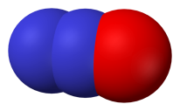
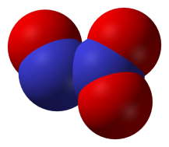
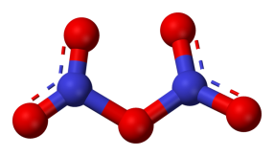
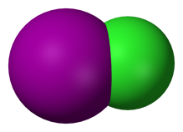
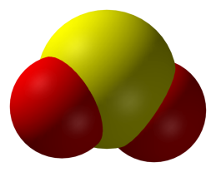
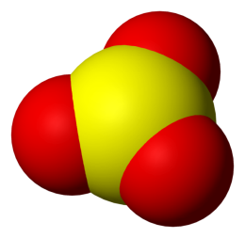
Binary Molecular Compounds
N₂O dinitrogen monoxide
N₂O₃ dinitrogen trioxide
N₂O₅ dinitrogen pentoxide
ICl iodine monochloride
ICl₃ iodine trichloride
SO₂ sulfur dioxide
SO₃ sulfur trioxide
Notes:
http://en.wikipedia.org/wiki/Image:Sulfur-dioxide-3D-vdW.png
http://en.wikipedia.org/wiki/Image:Sulfur-trioxide-3D-vdW.png
http://en.wikipedia.org/wiki/Image:Iodine-monochloride-3D-vdW.png
http://en.wikipedia.org/wiki/Image:Nitrous-oxide-3D-vdW.png
http://en.wikipedia.org/wiki/Image:Dinitrogen-trioxide-3D-vdW.png
http://en.wikipedia.org/wiki/Image:Dinitrogen-pentoxide-3D-balls.png
Technical Note: Iodine trichloride is actually a dimer with the formula I₂Cl₆

Slide 83
Naming Binary Compounds
Binary Compound?
Yes
Metal Present?
No
Yes
Type III
Use Greek
Prefixes
Does the metal form
more than one cation?
No
Yes
Type I
Use the element
name for the cation.
Type II
Determine the charge
of the cation; use a Roman
numeral after the cation
name.
Zumdahl, Zumdahl, DeCoste, World of Chemistry 2002, page 98

Slide 84
Covalent Binary Compounds:
Nonmetal-Nonmetal Combinations
Covalent Binary Compounds: Nonmetal-Nonmetal Combinations
Covalent Binary Compounds: Nonmetal-Nonmetal Combinations
Keys
http://www.unit5.org/chemistry/Nomenclature.html

Slide 85
Ternary Compounds
Notes:
Objectives:
To determine the ionic charge on a cation in a ternary ionic compound.
To write systematic names and formulas for ternary ionic compounds.

Slide 86
Ternary Compounds
Ternary compounds are those containing three different elements.
(NaNO₃, NH₄Cl, etc.). The naming of ternary compounds involves the
memorization of several positive and negative polyatomic ions, (two or
more atoms per ion), and adding these names to the element with which
they combine.
i.e., Sodium ion, Na¹⁺ added to the nitrate ion, NO₃¹⁻, to give the compound, NaNO₃, sodium nitrate.
Binary rules for indicating the oxidation number of metals and for indicating
the numbers of atoms present are followed. The polyatomic ions that should
be learned are listed in a separate handout.

Slide 87
Phosphate
(PO₄)³⁻
PO₄³⁻
?
☺
@ 3-
1 P
@ 5+
= 3-
= 5+
4 O
@ 2-
= 8-
11-
3-
Fluorine and oxygen are highly electronegative and will attract
electrons very strongly. Generally, phosphorus will be 3- oxidation
state: however, when combining with oxygen, phosphorus will lose
five electrons and take on a 5+ oxidation charge.

Slide 88
Polyatomic Ions - Memorize
Eight “-ATE’s”
PO₄^{3- ……………}
SO₄^{2- ……………}
CO₃^{2- …………..}
ClO₃^{1- …………..}
NO₃^{1- ………..….}
phosphate
sulfate
carbonate
chlorate
nitrate
phosphATE
sulfATE
carbonATE
chlorATE
nitrATE
Exceptions:
NH₄^{1+ ……………}
OH^{1- ……………}
CN^{1- …………..}
ammonium
hydroxide
cyanide

Slide 89
Pattern to Memorizing Nomenclature
XY
“-ide”
XYO₄
XYO₃
XYO₂
XYO
“per___-ate”
“-ate”
“-ite”
“hypo___-ite”
1 more oxygen
normal
1 less oxygen
2 less oxygen

Slide 90
Polyatomic Ion:
a group of atoms that stay together and have a single, overall charge.
BrO₄¹⁻ Perbromate ion | BrO₃¹⁻ Bromate ion | BrO₂¹⁻ Bromite ion | BrO¹⁻ Hypobromite ion
CO₄²⁻ | CO₃²⁻ Carbonate ion | CO₂²⁻ | CO²⁻
ClO₄¹⁻ | ClO₃¹⁻ Chlorate ion | ClO₂¹⁻ | ClO¹⁻
IO₄¹⁻ | IO₃¹⁻ Iodate ion | IO₂¹⁻ | IO¹⁻
NO₄¹⁻ | NO₃¹⁻ Nitrate ion | NO₂¹⁻ | NO¹⁻
PO₅³⁻ | PO₄³⁻ Phosphate ion | PO₃³⁻ | PO₂³⁻
SO₅²⁻ | SO₄²⁻ Sulfate ion | SO₃²⁻ | SO₂²⁻
1 more oxygen | “normal” | 1 less oxygen | 2 less oxygen

Slide 91
Polyatomic Ion:
a group of atoms that stay together and have a single, overall charge.
BrO₄¹⁻ Perbromate ion | BrO₃¹⁻ Bromate ion | BrO₂¹⁻ Bromite ion | BrO¹⁻ Hypobromite ion
CO₄²⁻ | CO₃²⁻ Carbonate ion | CO₂²⁻ | CO²⁻
ClO₄¹⁻ | ClO₃¹⁻ Chlorate ion | ClO₂¹⁻ | ClO¹⁻
IO₄¹⁻ | IO₃¹⁻ Iodate ion | IO₂¹⁻ | IO¹⁻
NO₄¹⁻ | NO₃¹⁻ Nitrate ion | NO₂¹⁻ | NO¹⁻
PO₅³⁻ | PO₄³⁻ Phosphate ion | PO₃³⁻ | PO₂³⁻
SO₅²⁻ | SO₄²⁻ Sulfate ion | SO₃²⁻ | SO₂²⁻
1 more oxygen | “normal” | 1 less oxygen | 2 less oxygen

Slide 92
Ternary Compounds
NaNO₂ sodium nitrite
KClO₃ potassium chlorate
Ca₃(PO₄)₂ calcium phosphate
Fe(OH)₃ iron (III) hydroxide
NaHCO₃ sodium bicarbonate
‘sodium hydrogen carbonate’

Slide 93
Calcium hydrox
ide
ide
Ca²⁺
OH¹⁻
H
CaOH₂
Ca - O
H
vs.
Ca(OH)₂
HO - Ca - OH
Notes:
Calcium hydroxide is also called slaked lime.

Slide 94
Common Polyatomic Ions
Names of Common Polyatomic Ions
Ion Name Ion Name
NH₄ ¹⁺ ammonium CO₃ ²⁻ carbonate
NO₂ ¹⁻ nitrite HCO₃ ¹⁻ hydrogen carbonate
NO₃ ¹⁻ nitrate (“bicarbonate” is a widely
SO₃ ²⁻ sulfite used common name)
SO₄ ²⁻ sulfate ClO ¹⁻ hypochlorite
HSO₄ ¹⁻ hydrogen sulfate ClO₂ ¹⁻ chlorite
(“bisulfate” is a widely ClO₃ ¹⁻ chlorate
used common name) ClO₄ ¹⁻ perchlorate
OH ¹⁻ hydroxide C₂H₃O₂ ²⁻ acetate
CN ¹⁻ cyanide MnO₄ ¹⁻ permanganate
PO₄ ³⁻ phosphate Cr₂O₇ ²⁻ dichromate
HPO₄ ²⁻ hydrogen phosphate CrO₄ ²⁻ chromate
H₂PO₄ ¹⁻ dihydrogen phosphate O₂ ²⁻ peroxide
Zumdahl, Zumdahl, DeCoste, World of Chemistry 2002, page 100
Print Version
Notes:
Groups of atoms that bear a net electrical charge
Atoms that make up a polyatomic atom are held together by the same covalent bonds that hold atoms together in molecules
Many more kinds of polyatomic ions than monatomic ions and polyatomic anions are more numerous than polyatomic cations
Method used to predict empirical formula for ionic compounds that contain monatomic ions can be used for compounds containing polyatomic ions. Overall charge on the cations must balance the overall charge on the anions in the formula unit.

Slide 95
Ternary Compounds
Ca₃(PO₄) ₂
________________ calcium phosphate
________________ ammonium carbonate
________________ aluminum sulfate
Na₂SO₄ ____________________
LiCN ____________________
Ba(ClO₃)₂ ____________________
________________ copper (II) hydroxide
(NH₄)₂CO₃
Al₂(SO₄)₃
sodium sulfate
lithium cyanide
barium chlorate
Cu(OH)₂

Slide 96
Magnesium Phosphate
Step 1: Magnesium Phosphate
Step 2: Mg²⁺ PO₄³⁻
Step 3: Mg (PO₄)
3
2
Step 4: Mg₃(PO₄)₂
Notes:
Often used as laxatives and antacids.

Slide 97
Ir
Ca
Ti
Pt
Ba
Sr
K
Zn
Mn
Au
Na
variable
fixed
variable
variable
fixed
fixed
fixed
fixed
variable
variable
fixed
₂(Cr₂O₇)₃
(OH)₂
(CrO₄)₂
(CH₃COO)₂
(BrO₃)₂
SO₄
CN
(NO₂)₂
(ClO₃)₄
PO₄
NO₃
F₃
S
S₂
Cl₂
Br₂
₃P₂
F
I₂
Cl₄
₂O₃
₃P
iridium (III)
calcium
titanium (IV)
platinum (II)
barium
strontium
potassium
zinc
manganese (IV)
gold (III)
sodium
fluoride
sulfide
sulfide
chloride
bromide
phosphide
fluoride
iodide
chloride
oxide
phosphide
dichromate
hydroxide
chromate
acetate
bromate
sulfate
cyanide
nitrite
chlorate
phosphate
nitrate
Ir^{2+,3+,4+,6+}
Ca²⁺
Ti^{3+,4+}
Pt^{2+,4+}
Ba²⁺
Sr²⁺
K¹⁺
Zn²⁺
Mn^{2,3,4,6,7+}
Au^{1+,3+}
Na¹⁺

Slide 98
Ir
Ca
Ti
Pt
Ba
Sr
K
Zn
Mn
Au
Na
variable
fixed
variable
variable
fixed
fixed
fixed
fixed
variable
variable
fixed
F₃
S
S₂
Cl₂
Br₂
₃P₂
F
I₂
Cl₄
₂O₃
₃P
iridium (III)
calcium
titanium (IV)
platinum (II)
barium
strontium
potassium
zinc
manganese (IV)
gold (III)
sodium
fluoride
sulfide
sulfide
chloride
bromide
phosphide
fluoride
iodide
chloride
oxide
phosphide
Ir^{2+,3+,4+,6+}
Ca²⁺
Ti^{3+,4+}
Pt^{2+,4+}
Ba²⁺
Sr²⁺
K¹⁺
Zn²⁺
Mn^{2,3,4,6,7+}
Au^{1+,3+}
Na¹⁺

Slide 99
Ir
Ca
Ti
Pt
Ba
Sr
K
Zn
Mn
Au
Na
variable
fixed
variable
variable
fixed
fixed
fixed
fixed
variable
variable
fixed
₂(Cr₂O₇)₃
(OH)₂
(CrO₄)₂
(CH₃COO)₂
(BrO₃)₂
₃SO₄
CN
(NO₂)₂
(ClO₃)₄
PO₄
NO₃
iridium (III)
calcium
titanium (IV)
platinum (II)
barium
strontium
potassium
zinc
manganese (IV)
gold (III)
sodium
dichromate
hydroxide
chromate
acetate
bromate
sulfate
cyanide
nitrite
chlorate
phosphate
nitrate
Ir^{2+,3+,4+,6+}
Ca²⁺
Ti^{3+,4+}
Pt^{2+,4+}
Ba²⁺
Sr²⁺
K¹⁺
Zn²⁺
Mn^{2,3,4,6,7+}
Au^{1+,3+}
Na¹⁺

Slide 100
Two nonmetals
Multiple-charge cation
Everything else
carbon tetrabromide
rubidium sulfate
sulfur dichloride
NH₄ClO₃
N₂O₅
NCl₃
barium oxide
vanadium (II) chromate
KI
niobium (V) perchlorate
Mn₂S₅
Pt(IO₃)₄
Greek prefixes
Roman numeral
for name only
Roman
numeral
Charge
Polyatomic ions
OK
Polyatomic ions OK
Criss-
Cross
Rule
Where would you file this?
VCrO₄
VCrO₄
dinitrogen pentoxide
dinitrogen pentoxide
BaO
BaO
platinum (IV) iodate
platinum (IV) iodate
CBr₄
CBr₄
ammonium chlorate
ammonium chlorate
Roman
numeral
Nb(ClO₄)₅
Nb(ClO₄)₅
potassium iodide
potassium iodide
SCl₂
SCl₂
nitrogen trichloride
nitrogen trichloride
Rb₂SO₄
Rb₂SO₄
manganese (V) sulfide
manganese (V) sulfide

Slide 101
Two nonmetals
Multiple-charge cation
Everything else
Greek prefixes
Roman numeral
for name only
Roman
numeral
Charge
Polyatomic ions
OK
Polyatomic ions
Criss-
Cross
Rule
Where would you file this?
VCrO₄
dinitrogen pentoxide
BaO
platinum (IV) iodate
CBr₄
ammonium chlorate
Roman
numeral
Nb(ClO₄)₅
potassium iodide
SCl₂
nitrogen trichloride
Rb₂SO₄
manganese (V) sulfide

Slide 102
Write the compound formed by the following ions:
1) Al³⁺ S²⁻
2) Mg²⁺ PO₄³⁻
When a formula is given…write the proper name.
When a name is given…write the proper formula.
3) BaO
4) lithium bromide
5) Ni₂S₃
    6) triphosphorus heptoxide
7) N₂O₅
8) molybdenum (VI) nitride
9) trinitrotoluene (TNT)… CH₃C₆H₂(NO₂)₃
10) phosphoric acid H₃PO₄
Write the total number of atoms that make up each compound.
Extra credit: What is the formula for plumbic iodide? (Hint: lead is Pb²⁺ or Pb⁴⁺)

Slide 103
POP
QUIZ
Write the compound formed by the following ions:
1) Al³⁺ S²⁻
2) Mg²⁺ PO₄³⁻
When a formula is given…write the proper name.
When a name is given…write the proper formula.
3) BaO
4) lithium bromide
5) Ni₂S₃
    6) triphosphorus heptoxide
7) N₂O₅
8) molybdenum (VI) nitride
9) trinitrotoluene (TNT)… CH₃C₆H₂(NO₂)₃
10) phosphoric acid H₃PO₄
Write the total number of atoms that make up each compound.
Extra credit: What is the formula for plumbic iodide? (Hint: lead is Pb²⁺ or Pb⁴⁺)

Slide 104
Answer Key
Write the compound formed by the following ions:
1) Al³⁺ S²⁻
2) Mg²⁺ PO₄³⁻
When a formula is given…write the proper name.
When a name is given…write the proper formula.
3) BaO
4) lithium bromide
5) Ni₂S₃
    6) triphosphorus heptoxide
7) N₂O₅
8) molybdenum (VI) nitride
9) trinitrotoluene (TNT)… CH₃C₆H₂(NO₂)₃
10) phosphoric acid H₃PO₄
aluminum sulfide
Al₂S₃
magnesium phosphate
Mg₃(PO₄)₂
barium oxide
LiBr
nickel (III) sulfide
P₃O₇
dinitrogen pentoxide
MoN₂
Write the total number of atoms that make up each compound.
21
8
Extra credit: What is the formula for plumbic iodide? (Hint: lead is Pb²⁺ or Pb⁴⁺)
PbI₄

Slide 105
Polyatomic Ions - Quiz
C₂O₄^{2- ……………}
CrO₄^{2- ……………}
Cr₂O₇^{2- …………..}
MnO₄^{1- …………..}
CH₃COO^{1- …….}
oxalate
chromate
dichromate
permanganate
acetate

Slide 106
Exceptions!
Two exceptions to the simple –ide ending are the diatomic oxide ions,
O₂²⁻ and O₂¹⁻.
O₂²⁻ is called peroxide
O₂¹⁻ is called superoxide.
Note the differences.
BaO
barium oxide __________
barium peroxide __________
Ba²⁺
BaO₂
Na₂O
sodium oxide __________
sodium peroxide __________
Na¹⁺
Na₂O₂
Do Not Reduce to lowest terms!
K₂O
potassium oxide __________
potassium superoxide __________
K¹⁺
KO₂

Slide 107
Ionic Compounds:
Polyatomic Ions
Ionic Compounds: Polyatomic Ions
Ionic Compounds: Polyatomic Ions
Polyatomic Ions Grid to Memorize
Chart of the Ions and Polyatomic Ions
Keys
http://www.unit5.org/chemistry/Nomenclature.html

Slide 108
Ionic Binary Compounds:
Multiple-Charge Cations
Ionic Binary Compounds: Multiple-Charge Cations
Ionic Binary Compounds: Multiple-Charge Cations
Keys
http://www.unit5.org/chemistry/Nomenclature.html
Notes:
An ionic compound that contains only two elements, one present as a cation and one as an anion, is called a binary ionic compound.
For such compounds, the subscripts in the empirical formula can also be obtained using the absolute value of the charge on one ion as the subscript for the other ion and then reduce the subscripts to their simplest ratio to write the empirical formula.

Slide 109
Naming Chemical Compounds
Binary Compound?
No
Yes
Polyatomic ions
present?
Use the strategy
summarized
earlier
No
Yes
This is a compound
for which naming
procedures have not yet
been considered.
Name the compound
using procedures similar
to those for naming
binary ionic compounds.
Zumdahl, Zumdahl, DeCoste, World of Chemistry 2002, page 102

Slide 110
Nomenclature Review Flow Chart

Slide 111
Formula → Name?
Metal + Nonmetal?
(Except: NH₄⁺)
Two Nonmetals?
Ionic
d,f-block
Pb,Sn
Columns 1, 2, 13
Ag⁺, Zn²⁺
Multiple
Single
Covalent
Steps 1 & 4 ONLY
Write name of cation (metal)
Determine the charge on the metal by balancing the (-) charge from the anion
Write the charge of the metal in Roman Numerals and put in parentheses
Write name of anion
(Individual anions need –ide ending!)
Use Prefixes!!!
*Mono* Hexa
Di Hepta
Tri Octa
Tetra Nona
Penta Deca

Slide 112
Name → Formula?
No Prefixes?
Prefixes?
Ionic
Covalent
Determine the ions present
and the charge on each (Roman Numeral = cation charge, otherwise use PT)
Balance formula (criss-cross)
Reduce subscripts (if needed)
FORGET CHARGES!!!
Use prefixes to determine subscripts
Do NOT reduce subscripts!

Slide 113
Oxidation Numbers and Ionic Compounds
Oxidation Numbers and Ionic Compounds
Oxidation Numbers and Ionic Compounds
Keys
http://www.unit5.org/chemistry/Nomenclature.html

Slide 114
Names and Formulas of Compounds
Names and Formulas of Compounds
Names and Formulas of Compounds
Keys
http://www.unit5.org/chemistry/Nomenclature.html

Slide 115
Binary Hydrogen Compounds
Oxysalts + H₂O → Oxyacids

Slide 116
Binary Hydrogen Compounds of Nonmetals When Dissolved in Water
(These compounds are commonly called acids.)
The prefix hydro- is used to represent hydrogen, followed by the name
of the nonmetal with its ending replaced by the suffix –ic and the word
acid added.
Examples:
*HCl
HBr
Hydrochloric acid
Hydrobromic acid
*The name of this compound would be hydrogen chloride if it was NOT dissolved in water.

Slide 117
Naming Simple Chemical Compounds
Ionic (metal and nonmetal)
Covalent (2 nonmetals)
Metal
Nonmetal
First
nonmetal
Second
nonmetal
Forms
only one
positive
ion
Forms
more than
one positive
ion
Single
Negative
Ion
Polyatomic
Ion
Use the
name of
element
Use element
name followed
by a Roman
numeral to
show the charge
Use the name
of the
element, but
end with ide
Use the
name of
polyatomic
ion (ate or
Ite)
Before
element name
use a prefix
to match
subscript
Use a prefix
before
element name
and end
with ide

Slide 118
Naming Ternary Compounds from Oxyacids
The following table lists the most common families of oxy acids.
one more
oxygen atom
HClO₄
perchloric acid
most
“common”
HClO₃
chloric acid
H₂SO₄
sulfuric acid
H₃PO₄
phosphoric acid
HNO₃
nitric acid
one less
oxygen
HClO₂
chlorous acid
H₂SO₃
sulfurous acid
H₃PO₃
phosphorous acid
HNO₂
nitrous acid
two less
oxygen
HClO
hypochlorous acid
H₃PO₂
hypophosphorous acid
(HNO)₂
hyponitrous acid

Slide 119
An acid with a
name ending in
A salt with a
name ending in
-ous
forms
-ite
-ic
-ate
forms
Hill, Petrucci, General Chemistry An Integrated Approach 1999, page 60

Slide 120
Oxyacids → Oxysalts
If you replace hydrogen with a metal, you have formed an oxysalt.
A salt is a compound consisting of a metal and a non-metal. If the
salt consists of a metal, a nonmetal, and oxygen it is called an
oxysalt. NaClO₄, sodium perchlorate, is an oxysalt.
OXYACID OXYSALT
HClO₄
perchloric acid
NaClO₄
sodium perchlorate
HClO₃
chloric acid
NaClO₃
sodium chlorate
HClO₂
chlorous acid
NaClO₂
sodium chlorite
HClO
hypochlorous acid
NaClO
sodium hypochlorite

Slide 121
ACID SALT
per stem ic changes to per stem ate
stem ic changes to stem ate
stem ous changes to stem ite
hyper stem ous changes to hypo stem ite
HClO₃ + Na¹⁺ NaClO₃ + H¹⁺
acid cation salt

Slide 122
Meaning of Suffixes

Slide 123
Suffixes have meaning
“-ide” binary compound
  sodium chloride (NaCl)
“-ite” or “-ate” polyatomic compound
  sulfite (SO₃²⁻)
  sulfate (SO₄²⁻) “-ate” means one more oxygen than “-ite”
“-ol” alcohol
  methyl alcohol (methanol)
“-ose” sugar
  sucrose
“-ase” enzyme
sucrase

Slide 124
Oxidation States in Formulas and Names
Traditional System Stock System
(Two non-metals)
+1 -2
dinitrogen monoxide N₂O nitrogen (I) oxide
dinitrogen trioxide N₂O₃ nitrogen (III) oxide
dinitrogen pentoxide N₂O₅ nitrogen (V) oxide
sulfur dioxide SO₂ sulfur (IV) oxide
sulfur trioxide SO₃ sulfur (VI) oxide
+3 -2
+5 -2
+4 -2
+6 -2
stock system is NOT preferred for two non-metals

Slide 125
Empirical Formula
% → g
g → mol
mol / mol
Notes:
Objectives:
To calculate the percent composition of a compound given its chemical formula.
To calculate the empirical formula of a compound given its mass composition.
To calculate the empirical formula of a compound given its percent composition.
To calculate the molecular formula for a compound given its empirical formula and molar mass.

Slide 126
Percentage Composition
(by mass...not atoms)
part
whole
24.305
35.453
24 g
95 g
% Mg = x 100
% = x 100
Mg
Cl
12
17
magnesium
chlorine
25.52% Mg
Mg²⁺ Cl¹⁻
74.48% Cl
MgCl₂
It is not 33% Mg and 66% Cl
1 Mg @ 24.305 amu = 24.305 amu
2 Cl @ 35.453 amu = 70.906 amu
95.211 amu
Notes:
Law of definite proportions states that a chemical compound always contains the same proportion of elements by mass
Percent composition — the percentage of each element present in a pure substance—is constant
Calculation of mass percentage
1. Use atomic masses to calculate the molar mass of the compound
2. Divide the mass of each element by the molar mass of the compound and then multiply by 100% to obtain percentages
3. To find the mass of an element contained in a given mass of the compound, multiply the mass of the compound by the mass percentage of that element expressed as a decimal

Slide 127
Empirical and Molecular Formulas
A pure compound always consists of the same elements combined in the same proportions by weight.
Therefore, we can express molecular composition as PERCENT BY WEIGHT.
Ethanol, C₂H₆O
52.13% C
13.15% H
34.72% O
Notes:
Empirical formula gives only the relative numbers of atoms in a substance in the smallest possible ratio
Molecular formula gives the actual number of atoms of each kind present per molecule

Slide 128
Empirical Formula
Quantitative analysis shows that a compound contains 32.38% sodium,
22.65% sulfur, and 44.99% oxygen.
Find the empirical formula of this compound.
sodium sulfate
32.38% Na
22.65% S
44.99% O
32.38 g Na
22.65 g S
44.99 g O
= 1.408 mol Na
/ 0.708 mol
= 2 Na
Na₂SO₄
= 0.708 mol S
/ 0.708 mol
= 1 S
Na₂SO₄
= 2.812 mol O
/ 0.708 mol
= 4 O
Step 1) % → g
Step 2) g → mol
Step 3) mol
mol

Slide 129
Empirical Formula
A sample weighing 250.0 g is analyzed and found to contain the following:
27.38% sodium
1.19% hydrogen
14.29% carbon
57.14% oxygen
27.38 g Na
1.19 g H
14.29 g C
57.14 g O
Assume sample is 100 g.
Determine the empirical formula of this compound.
Step 1) convert % → gram
Step 2) gram → moles
Step 3) mol / mol
/ 1.19 mol = 1 Na
/ 1.19 mol = 1 H
NaHCO₃
/ 1.19 mol = 1 C
/ 1.19 mol = 3 O

Slide 130
Empirical & Molecular Formula
(contains only hydrogen + carbon)
(~17% hydrogen)
A 175 g hydrocarbon sample is analyzed and found to contain ~83% carbon.
The molar mass of the sample is determined to be 58 g/mol.
Determine the empirical and molecular formula for this sample.
Determine the empirical formula of this compound.
Step 1) convert % → gram
Step 2) gram → moles
Step 3) mol / mol
2 C @ 12 g = 24 g
5 H @ 1 g = 5 g
29 g
Assume sample is 100 g.
Then, 83 g carbon and 17 g hydrogen.
MM_{empirical} = 29 g/mol
/ 6.917 mol = 1 C
CH_{2.5}
C₂H₅
/ 6.917 mol = 2.5 H
(2.4577 H)
MM_{molecular} = 58 g/mol
58/29 = 2
Therefore 2(C₂H₅) = C₄H₁₀
butane
Notes:
To determine the empirical formula from the mass percentages of the elements in a compound, the following procedure is used:
1. The mass percentages are converted to relative numbers of atoms,
2. A 100 g sample of the compound, is assumed
3. Each of these masses is divided by the molar mass of the element to determine how many moles of each element are present in
the 100 g sample
4. The results give ratios of the various elements in the sample—but whole numbers are needed for the empirical formula, which expresses the relative numbers of atoms in the smallest whole numbers possible
5. To obtain whole numbers, the number of moles of all the elements in the sample are divided by the number of moles of the element present in the lowest relative amount. Results will be the subscripts of the elements in the empirical formula

Slide 131
Common Mistakes when Calculating Empirical Formula
Given: Compound consists of 36.3 g Zn and 17.8 g S.
Find: empirical formula
36.3 g Zn
= 2 Zn
17.8
Zn₂S
Chemical formula
indicates MOLE ratio,
not GRAM ratio
17.8 g S
= 1 S
17.8
36.3 g Zn
1 mol Zn
1
Zn
= 0.555 mol Zn
65.4 g Zn
0.555 mol
ZnS
17.8 g S
1 mol S
1
S
= 0.555 mol S
zinc sulfide
32.1 g S
0.555 mol

Slide 132
Empirical Formula of a Hydrocarbon
x
1 mol CO₂
44.01 g
burn
in O₂
x
2 mol C
1 mol CO₂
g CO₂
mol CO₂
mol C
mol H
C_{x}H_{y}
Empirical
formula
g H₂O
mol H₂O
1 mol H₂O
18.02 g
x
2 mol H
1 mol H₂O
x
Kotz & Treichel, Chemistry & Chemical Reactivity, 3rd Edition , 1996, page 224
Notes:
Combustion analysis—common way to determine the elemental composition of an unknown hydrocarbon
1. Determine the mass of the sample
2. Burn the sample in oxygen
3. Measure combustion products
4. Use molar masses of combustion products and atomic masses of elements to calculate masses of C, H, N, and S in the original sample
5. Use masses of C, H, N, and S and the mass of the original sample to calculate element percentages in the original sample
6. Use element percentages to calculate moles of C, H, N, and S in 100 g sample
7. Divide moles of C, H, N, and S by moles of the element present in the smallest amount
8. Multiply nonintegral ratios to give small whole numbers

Slide 133
Empirical and Molecular Formulas
Empirical and Molecular Formulas
Empirical and Molecular Formulas
Empirical & Molecular Formula
Empirical and Molecular Formulas
Keys
http://www.unit5.org/chemistry/Nomenclature.html
Notes:
Empirical formula
– The relative numbers of atoms of the elements in the compound, reduced to the smallest whole numbers
– Based on experimental measurements of the numbers of atoms in a sample of the compound
– Shows only the ratios of the numbers of the elements present
– Empirical formulas are used to indicate the composition of ionic compounds since they do not contain discrete molecules
Formula unit
– Absolute grouping of atoms or ions represented by the empirical formula of a compound, either ionic or covalent

Slide 134
Errors in Chemical Formulas and Nomenclature
Errors in Chemical Formulas and Nomenclature
Airs n Knomenclayture
Errors in Chemical Formulas and Nomenclature
Keys
http://www.unit5.org/chemistry/Nomenclature.html

Slide 135
Find the molar mass and percentage composition of zinc acetate
Zn²⁺
CH₃COO¹⁻
acetate = CH₃COO¹⁻
Zn(CH₃COO)₂
1 Zn @ 65.4 g/mol = 65.4 g
/ 183.4 g x 100% = 35.6 % Zn
4 C @ 12 g/mol = 48 g
/ 183.4 g x 100% = 26.2 % C
6 H @ 1 g/mol = 6 g
/ 183.4 g x 100% = 3.3 % H
4 O @ 16 g/mol = 64 g
/ 183.4 g x 100% = 34.9 % O
Zn(CH₃COO)₂
183.4 g

Slide 136
A compound is found to be 45.5% Y and 54.5% Cl.
Its molar mass (molecular mass) is 590 g.
Assume a 100 g sample size
a) Find its empirical formula
45.5 g Y
1 mol Y
/ 0.5118 mol
= 0.5118 mol Y
= 1 Y
88.9 g Y
YCl₃
54.5 g Cl
1 mol Cl
= 1.535 mol Cl
/ 0.5118 mol
= 3 Cl
35.5 g Cl
1 Y @ 88.9 g/mol = 88.9g
b) Find its molecular formula
3 Cl @ 35.5 g/mol = 106.5 g
590 / 195.4
= 3
YCl₃
195.4 g
3 (YCl₃)
Y₃Cl₉

Slide 137

6.02x10²³
Molar Mass vs. Atomic Mass
2 g
H₂ = _____
H₂ = _______
2 amu
18 g
H₂O = _____
H₂O = ________
18 amu
120 g
MgSO₄ = _____
MgSO₄ = ________
120 amu
149 g
(NH₄)₃PO₄ = _____
(NH₄)₃PO₄ = ________
149 amu
Percentage Composition
(by mass)
Empirical Formula
% → g
g → mol
mol
mol
part
whole
% = x 100 %
Empirical vs. Molecular Formula
(lowest ratio)

Slide 138
Subscripts, Superscripts and Coefficients

Slide 139
Subscripts, Superscripts and Coefficients
superscripts
Al²⁺
SO₄³⁻
5
Al₃(SO₄ )₂
coefficient
subscripts
ALUMINUM SULFATE

Slide 140
Subscripts, Superscripts and Coefficients
Mg²⁺
SO₄²⁻
3
MgSO₄
MAGNESIUM SULFATE

Slide 141
Subscripts, Superscripts and Coefficients
Mg²⁺
NO₃¹⁻
4
MgNO₃
Mg(NO₃)₂
₂
subscript
MAGNESIUM NITRATE

Slide 142
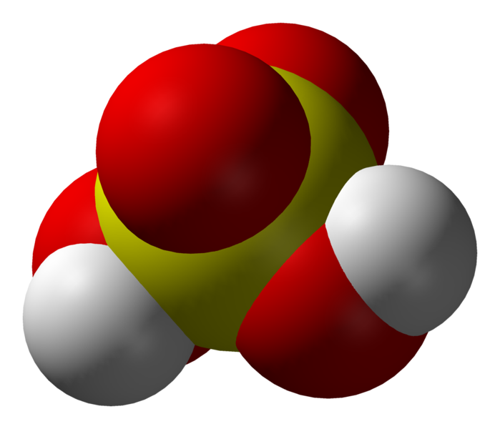
Interpretation of a Chemical Formula
O
O
O
H
S
H
O
Sulfuric Acid
H₂SO₄
Two atoms
of hydrogen
One atom
of sulfur
Four atoms
of oxygen
Notes:
http://en.wikipedia.org/wiki/Image:Sulfuric-acid-3D-vdW.png

Slide 143
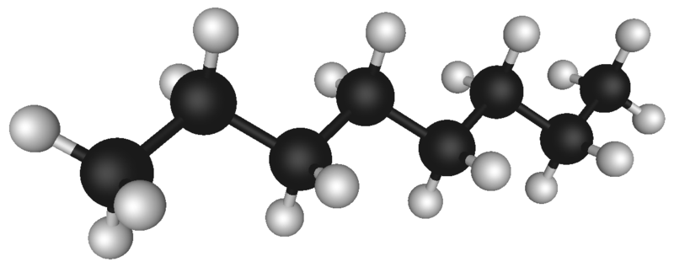
Chemical Formulas
C₈H₁₈
Subscript indicates that
there are 8 carbon atoms
in a molecule of octane.
Subscript indicates that
there are 18 hydrogen atoms
in a molecule of octane.
Davis, Metcalfe, Williams, Castka, Modern Chemistry, 1999, page 203
Notes:
Octane image: http://upload.wikimedia.org/wikipedia/commons/thumb/b/b8/Octane_molecule_3D_model.png/800px-Octane_molecule_3D_model.png

Slide 144
Stock System of Nomenclature
CuCl₂
Name of Roman
cation numeral
indicating
charge
Name of anion
+
copper (II)
chloride

Slide 145
Chemical Formulas
Al₂(SO₄)₃
Subscript 2
refers to
2 aluminum
atoms.
Subscript 4
refers to
4 oxygen
atoms in
sulfate ion.
Subscript 3 refers to
everything inside parentheses.
Here there are 3 sulfate ions,
with a total of 3 sulfur atoms
and 12 oxygen atoms.
Davis, Metcalfe, Williams, Castka, Modern Chemistry, 1999, page 204

Slide 146
Naming Binary Ionic Compounds
Al₂O₃
Name of cation Name of anion
aluminum oxide
Davis, Metcalfe, Williams, Castka, Modern Chemistry, 1999, page 207

Slide 147
The OLD System of Nomenclature
CuCl₂
Name of Name of anion
cation
-ic higher
oxidation #
-ous lower
oxidation #
+
Cupric chloride
Davis, Metcalfe, Williams, Castka, Modern Chemistry, 1999, page 208

Slide 148

Multi-vitamins
Notes:
http://www.vitaminsupplementanalyzer.com/pictures/vitamins.jpg

Slide 149
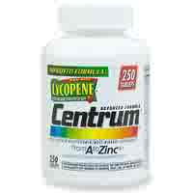
Centrum Multi-Vitamin
Ingredients: ascorbic acid, beta carotene, biotin, calcium pantothenate, calcium
phosphate, carnauba wax, chromium chloride, crospovidone, cupric sulfate,
cyanocobalamin, dl-alpha tocopheryl acetate, FD & C blue no. 2 aluminum lake,
hydroxypropyl cellulose, ferrous fumarate, hydroxypropyl methylcellulose, lactose,
Magnesium oxide, magnesium stearate, manganese sulfate, microcrystalline cellu-
lose,niacinamide, nickel sulfate, phytonandione, polyethylene glycol, potassium
chloride, potassium citrate, potassium iodide, povidone, pyridoxine hydrochloride,
riboflavin, silica gel, sodium borate, sodium metavanadate, sodium molybdate,
sodium selenate, stannous chloride, stearic acid, thiamin mononitrate, titanium
dioxide, triacetin, vitamin A acetate, vitamin D₃, zinc oxide. PC7563-46-00
Warning: Accidental overdose of iron-containing products is a leading cause of
fatal poisoning in children under 6. Keep this product out of reach of children.
In case of accidental overdose, call a doctor or poison control immediately.

Slide 150
Chromium (III) Chloride
RECALL: Chromium forms oxides in which metal exhibits oxidation
states of +3 and +2. STOCK system indicates oxidation
state of compound. Assume Cr³⁺ (chromium (III) chloride).
Step 1: Chromium (III) Chloride
Step 2: Cr³⁺ Cl¹⁻
Step 3: Cr Cl
1
3
Step 4: CrCl₃
Return to Centrum Bottle

Slide 151
Cupric Sulfate
RECALL: “ic” higher oxidation & “ous” lower oxidation
Cu²⁺ (higher) Cu¹⁺ (lower)
Step 1: Cupric Sulfate
Step 2: Cu²⁺ SO₄²⁻
Step 3: Cu (SO₄)
2
2
Step 4: Cu₂(SO₄)₂
Step 5: CuSO₄
Return to Centrum Bottle

Slide 152
Manganese (III) Sulfate
RECALL: Manganese forms oxides in which metal exhibits oxidation
states of +2, +3, +4, and +7. STOCK system indicates oxidation
state of compound. Assume Mn³⁺ (manganese (III) sulfate).
Step 1: Manganese (III) Sulfate
Step 2: Mn³⁺ SO₄²⁻
Step 3: Mn (SO₄)
2
3
Step 4: Mn₂(SO₄)₃
Return to Centrum Bottle

Slide 153
Stannous Chloride
RECALL: “ic” higher oxidation & “ous” lower oxidation
Sn⁴⁺ (higher) Sn²⁺ (lower)
Step 1: Stannous (tin) Chloride
Step 2: Sn²⁺ Cl¹⁻
Step 3: Sn Cl
1
2
Step 4: SnCl₂
Return to Centrum Bottle

Slide 154
Stannic Chloride
RECALL: “ic” higher oxidation & “ous” lower oxidation
Sn⁴⁺ (higher) Sn²⁺ (lower)
Step 1: Stannic (tin) Chloride
Step 2: Sn⁴⁺ Cl¹⁻
Step 3: Sn Cl
1
4
Step 4: SnCl₄
Return to Centrum Bottle

Slide 155
Chromium Chloride
RECALL: Chromium has multiple oxidation states.
Name with STOCK system.
Assume Chromiun (II).
Step 1: Chromium (II) Chloride
Step 2: Cr²⁺ Cl¹⁻
Step 3: Cr Cl
1
2
Step 4: Cr₁Cl₂
Step 5: CrCl₂
Return to Centrum Bottle

Slide 156
Calcium Phosphate
Step 1: Calcium Phosphate
Step 2: Ca²⁺ PO₄³⁻
Step 3: Ca (PO₄)
3
2
Step 4: Ca₃(PO₄)₂
Return to Centrum Bottle

Slide 157
Zinc Oxide
Step 1: Zinc Oxide
Step 2: Zn²⁺ O²⁻
Step 3: Zn O
2
2
Step 4: Zn₂O₂
Step 5: ZnO
Return to Centrum Bottle

Slide 158
Polyatomic Ions

Slide 159
Common Polyatomic Ions
Names of Common Polyatomic Ions
Ion
Name
Ion
Name
NH₄⁺
ammonium
CO₃²⁻
carbonate
NO₂⁻
nitrite
HCO₃⁻
hydrogen carbonate
(bicarbonate is a widely
used common name)
NO₃⁻
nitrate
SO₃²⁻
sulfite
SO₄²⁻
sulfate
ClO⁻
hypochlorite
HSO₄⁻
hydrogen sulfate
(bisulfate is a widely
used common name)
ClO₂⁻
chlorite
ClO₃⁻
chlorate
ClO₄⁻
perchlorate
OH⁻
hydroxide
C₂H₃O₂⁻
acetate
CN⁻
cyanide
MnO₄⁻
permanganate
PO₄³⁻
phosphate
Cr₂O₇²⁻
dichromate
HPO₄²⁻
hydrogen phosphate
CrO₄²⁻
chromate
H₂PO₄⁻
dihydrogen phosphate
O₂²⁻
peroxide

Slide 160
Vocabulary - Chemical Bonds
Vocabulary – Chemical Bonds
Vocabulary – Chemical Bonds
Keys
http://www.unit5.org/chemistry/Nomenclature.html

Slide 161
Electronegativities
1A
8A
1
H
2.1
1
2A
3A
4A
5A
6A
7A
2
Li
1.0
Be
1.5
B
2.0
C
2.5
N
3.0
O
3.5
F
4.0
2
3
Na
0.9
Mg
1.2
Al
1.5
Si
1.8
P
2.1
S
2.5
Cl
3.0
3
3B
4B
5B
6B
7B
8B
1B
2B
Period
4
K
0.8
Ca
1.0
Sc
1.3
Ti
1.5
V
1.6
Cr
1.6
Mn
1.5
Fe
1.8
Co
1.8
Ni
1.8
Cu
1.9
Zn
1.7
Ga
1.6
Ge
1.8
As
2.0
Se
2.4
Br
2.8
4
5
Rb
0.8
Sr
1.0
Y
1.2
Zr
1.4
Nb
1.6
Mo
1.8
Tc
1.9
Ru
2.2
Rh
2.2
Pd
2.2
Ag
1.9
Cd
1.7
In
1.7
Sn
1.8
Sb
1.9
Te
2.1
I
2.5
5
Cs
0.7
Ba
0.9
∗
6
La
1.1
Hf
1.3
Ta
1.5
W
1.7
Re
1.9
Os
2.2
Ir
2.2
Pt
2.2
Au
2.4
Hg
1.9
Tl
1.8
Pb
1.8
Bi
1.9
Po
2.0
At
2.2
6
Fr
0.7
Ra
0.9
ψ
Ac
1.1
∗
7
Lanthanides: 1.1 - 1.3
ψ
Actinides: 1.3 - 1.5
Below 1.0
2.0 - 2.4
1.0 - 1.4
2.5 - 2.9
1.5 - 1.9
3.0 - 4.0
Hill, Petrucci, General Chemistry An Integrated Approach 2nd Edition, page 373
Notes:
Linus Pauling (1901 - 1994) awarded Nobel Prize in chemistry in 1954 for his 1939 text, The Nature of the Chemical Bond,
and also won the Nobel Peace Prize in 1962 for his fight to control nuclear weapons.
The greater the electronegativity of an atom in a molecule, the more strongly it attracts the electrons in a covalent bond.

Slide 162
Review
TWO Elements
Metal (fixed) + Non-metal
Group 1, Group 2, Ag, Zn, Al
binary -ide
NaCl sodium chloride
Metal (variable) + Non-metal
Transition Elements
STOCK system (Roman Numeral)
CrCl₂ chromium (II) chloride
Cr²⁺ Cl¹⁻
Sn stannum
Pb plumbum
Cu cuprum
Au aurum
Fe ferrum
OLD system [-ic (higher) & -ous (lower)]
Cu¹⁺ or Cu²⁺
CuCl₂ cupric chloride
Three or more Elements
Ternary Compounds
Polyatomic Ions [-ate (one more O) & -ite (one less O)]
LiNO₃ lithium nitrate
LiNO₂ lithium nitrite
Li₃N lithium nitride
(binary compound)

Slide 163
Polyatomic Ions [-ate (one more O) & -ite (one less O)]
1 more oxygen
Memorize
1 less oxygen
2 less oxygen
per____ate NORMAL _____ite hypo_____ite
_____ate
perchlorate
pernitrate
percarbonate
persulfate
perphosphate
ClO₄¹⁻
NO₄¹⁻
CO₄²⁻
SO₅²⁻
PO₅³⁻
chlorate
nitrate
carbonate
sulfate
phosphate
ClO₃¹⁻
NO₃¹⁻
CO₃²⁻
SO₄²⁻
PO₄³⁻
chlorite
nitrite
carbonite
sulfite
phosphite
ClO₂¹⁻
NO₂¹⁻
CO₂²⁻
SO₃²⁻
PO₃³⁻
hypochlorite
hyponitrite
hypocarbonite
hyposulfite
hypophosphite
ClO¹⁻
NO¹⁻
CO²⁻
SO₂²⁻
PO₂³⁻
ammonium, cyanide, hydroxide
NH₄¹⁺
CN¹⁻
OH¹⁻
How many atoms are in a formula unit of ammonium hypophosphite?
18
3
NH₄¹⁺
PO₂³⁻
(NH₄)₃PO₂
Nonmetal & Nonmetal (Greek prefixes)……DO NOT REDUCE!
Mono Di Tri Tetra Penta Hexa Hepta Octa Nona Deca
1 2 3 4 5 6 7 8 9 10

Slide 164
Molecular Models Activity
Molecular Model's Activity
Molecular Model's Activity
Keys
http://www.unit5.org/chemistry/Nomenclature.html

Slide 165
Molecular Models Activity
carbon tetrachloride
methane
water
ethane
ethyne
dihydrogen monosulfide
carbon dioxide
ammonia
hydrogen monochloride
trichloromethane
urea
propane
butane
nitrogen triiodide (video)
supplies

Slide 166
Bonding and Shape of Molecules
Number
of Bonds
Number of
Unshared Pairs
Covalent
Structure
Shape
Examples
2
3
4
3
2
0
0
0
1
2
-Be-
Linear
Trigonal planar
Tetrahedral
Pyramidal
Bent
BeCl₂
BF₃
CH₄, SiCl₄
NH₃, PCl₃
H₂O, H₂S, SCl₂
B
C
:
N
:
:
O

Slide 167
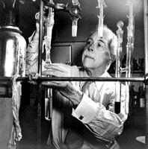
Lewis Structures
1) Count up total number of valence electrons
2) Connect all atoms with single bonds
- “multiple” atoms usually on outside
- “single” atoms usually in center;
C always in center,
H always on outside.
Gilbert Lewis
3) Complete octets on exterior atoms
(not H, though)
- no unpaired electrons (free radicals)
4) Check
- valence electrons match with Step 1
- all atoms (except H) have an octet;
if not, try multiple bonds
- any extra electrons?
Put on central atom
Notes:
Gilbert Lewis, a renowned chemist at U.C. Berkeley, isolated the first sample of essentially pure heavy water from ordinary water in 1933.
http://www.pbs.org/wgbh/nova/hydro/images/wate-gilbertlewis.jpg

Slide 168
Carbon tetrachloride
Cl
Cl
Cl
C
Cl
C
Cl
Cl
Cl
109.5º
Cl
CCl₄
Tetrahedral geometry
Carbon tetrachloride – “carbon tet” had been used as dry cleaning solvent
because of its extreme non-polarity.

Slide 169
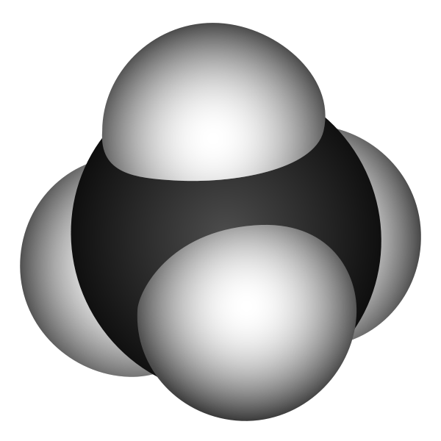
Methane
H
H
H
C
H
C
H
H
H
109.5º
H
Tetrahedral geometry
Methane –The first member of the paraffin (alkane) hydrocarbons series.
a.k.a. (marsh gas, CH₄).

Slide 170
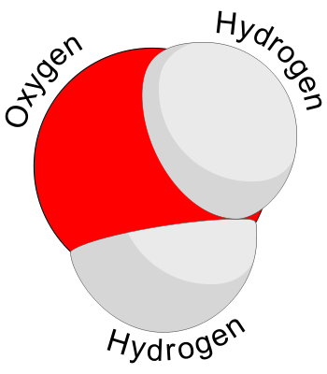
Water
δ(-)
..
..
SO₂
Bent
geometry
O
H
H
δ(+)
Polar molecule
Notes:
http://en.wikipedia.org/wiki/Image:Water_molecule.svg

Slide 171
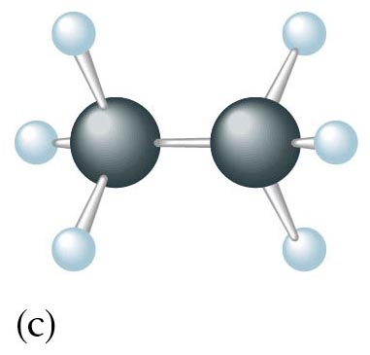
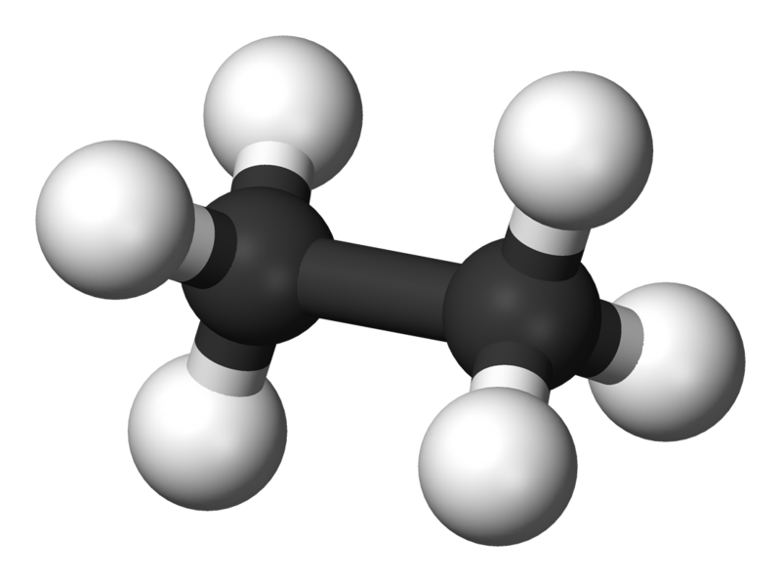
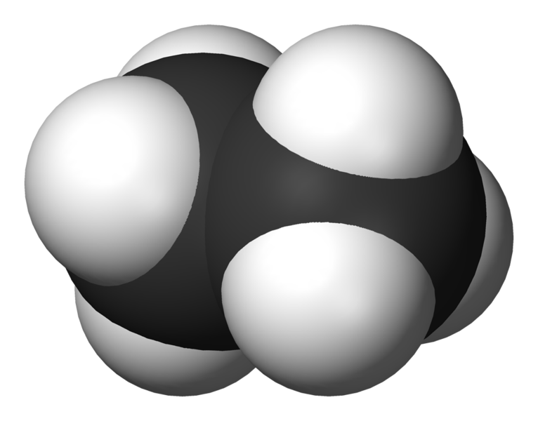
Ethane
C = 1s²2s²2p²
H
H
H
C
C
H
H
H
Lewis dot notation
ball-and-stick
C₂H₆
molecular formula
space-filling molecule
Notes:
http://en.wikipedia.org/wiki/Image:Ethane-3D-vdW.png
http://en.wikipedia.org/wiki/Image:Ethane-3D-balls.png

Slide 172
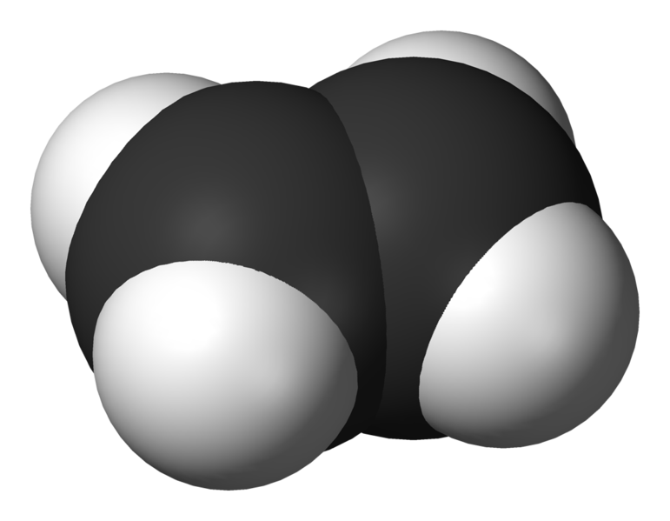
Ethene
H
H
H
C
C
H
H
H
Lewis dot notation
ball-and-stick
C₂H₄
molecular formula
space-filling molecule
Notes:
http://en.wikipedia.org/wiki/Image:Ethylene-3D-vdW.png

Slide 173
Ethyne
No octet
6 electrons = triple bond
each C “feels” 6 electrons
H
C
C
H
H
H
C
C
C
C
H
H
C₂H₂
Stable octet
H
C
C
H
each C “feels” 7 carbons
Ethyne – a.k.a. “acetylene”

Slide 174
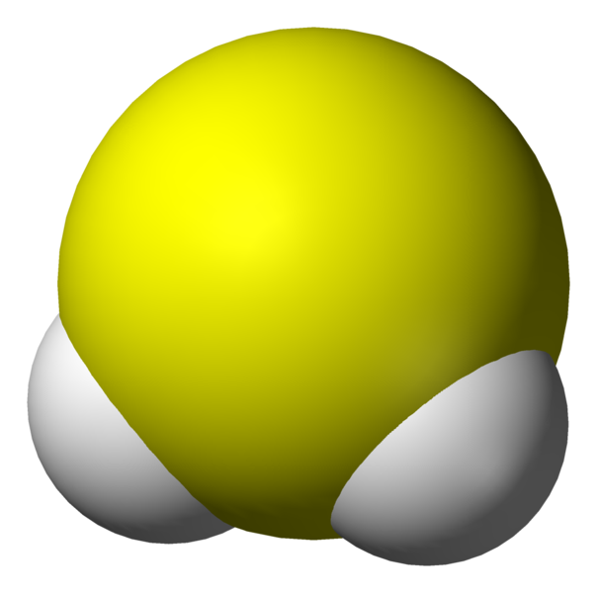
Dihydrogen monosulfide
..
..
SO₂
S
H
H
Bent
Notes:
http://en.wikipedia.org/wiki/Image:Hydrogen-sulfide-3D-vdW.png

Slide 175
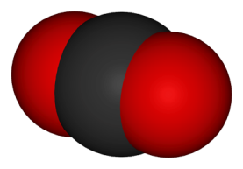
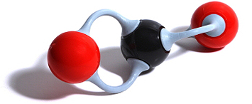
Carbon dioxide
O
C
O
C
O
C
O
O
O
Linear
geometry
CO₂
Notes:
http://www.wmnet.org.uk/resources/stern/stern/commonimages/co2.jpg
http://www.globalwarmingart.com/images/thumb/7/7d/Carbon_Dioxide_Molecule_VdW.png/250px-Carbon_Dioxide_Molecule_VdW.png

Slide 176

Ammonia
..
..
N
N
H
H
N
N
NH₃
H
H
H
H
H
H
H
H
H
Trigonal
Pyramidal
geometry
107º
H
Notes:
http://en.wikipedia.org/wiki/Image:Ammonia-3D-vdW.png

Slide 177
Amino Acids – Functional Groups
Amine
Base Pair
Carboxylic Acid
NH₂¹⁻
R- COOH
lose H⁺
H⁺
H⁺
NH₂¹⁻
NH₃
NH₄¹⁺
H
:
:
:
¹⁺
N
¹⁻
N
N
:
H
H
H
H
H
H
H
H
H
amine
+
ammonia
ammonium ion

Slide 178
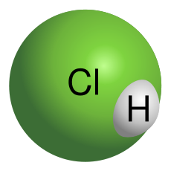
Hydrogen monochloride
H
H
H
Cl
Cl
Cl
HCl
δ(+)
δ(-)
HCl(g) + H₂O(l) → HCl(aq)
hydrogen
chloride
water
hydrochloric
acid
Polar molecule
Notes:
http://en.wikipedia.org/wiki/Image:HCl_molecule_model-VdW_surface.svg

Slide 179
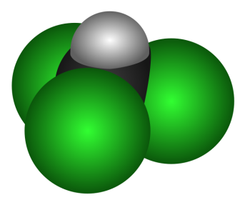
Trichloromethane
δ(+)
H
H
H
Cl
C
Cl
Cl
C
Cl
C
Cl
Cl
Cl
Cl
109.5º
Cl
CHCl₃
δ(-)
Tetrahedral geometry
Polar molecule
Notes:
http://en.wikipedia.org/wiki/Image:Chloroform_3D.svg

Slide 180
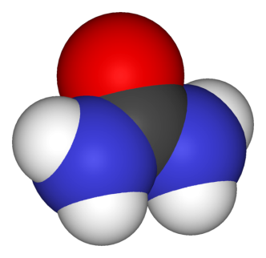
Urea
NOT “di-urea”
H
H
H
H
N
N
O
C
O
C
N
N
H
H
H
H
CO(NH₂)₂
Urea – The first organic compound to be synthesized (Wohler, 1828).
Notes:
http://en.wikipedia.org/wiki/Image:Urea-3D-vdW.png

Slide 181
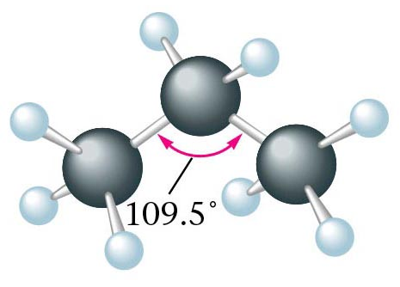
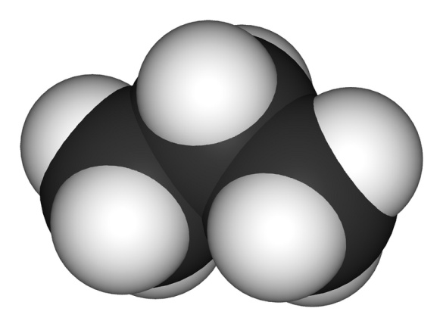
Propane
H
H
H
H
H
H
H
C
C
C
H
C
C
C
H
H
H
H
H
H
H
H
C₃H₈
Notes:
http://en.wikipedia.org/wiki/Image:Propane-3D-space-filling.png

Slide 182
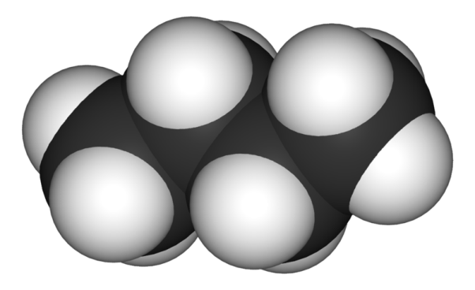
Butane
H
H
H
H
H H H H
H
C
C
C
C
H
H - C - C - C - C - H
H
H
H
H
H H H H
H
H
H
H
C₄H₁₀
H
C
C
C
C
H
H
H
H
H
Notes:
http://en.wikipedia.org/wiki/Image:Butane-3D-space-filling.png

Slide 183
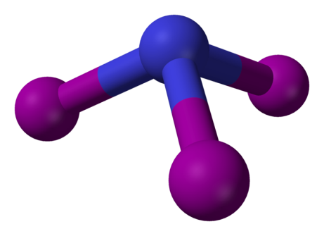
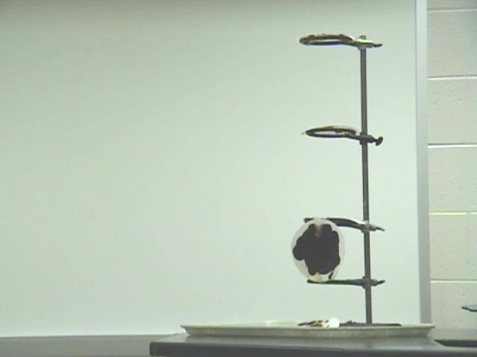

Nitrogen triiodide
..
N
I
I
N
I
I
I
107º
I
NI₃
Trigonal
Pyramidal
geometry
Video clip:
(slow motion)
detonation of NI₃
Notes:
http://en.wikipedia.org/wiki/Image:Nitrogen-triiodide-3D-balls.png

Slide 184
Supplies
15 black (carbon)
8 green (chlorine and iodine)
1 yellow (sulfur)
4 blue (oxygen)
4 red (nitrogen)
42 hydrogen (hydrogen)
67 bonds (bonds)

Slide 185
C
S
Cl
I
O
N
H
Cl
H
Cl
C
Cl
H
C
H
O
C
O
Cl
H
CO₂
CCl₄
CH₄
S
H
H
C
C
H
H
H
Cl
C
Cl
C₂H₂
SH₂
Cl
H
Cl
CHCl₃
HCl

Slide 186
H
H
H
H
H
H
H
H
C
C
C
C
H
H
C
C
C
H
H
H
H
H
H
H
H
N
N
H
H
I
I
H
I

Slide 187
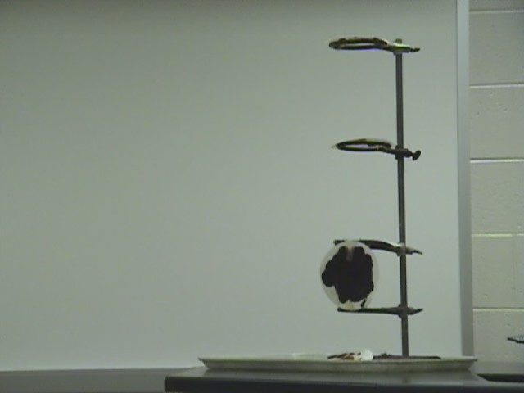
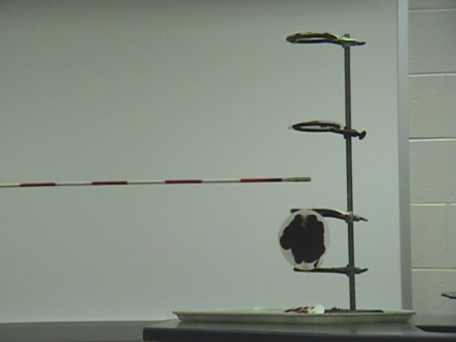
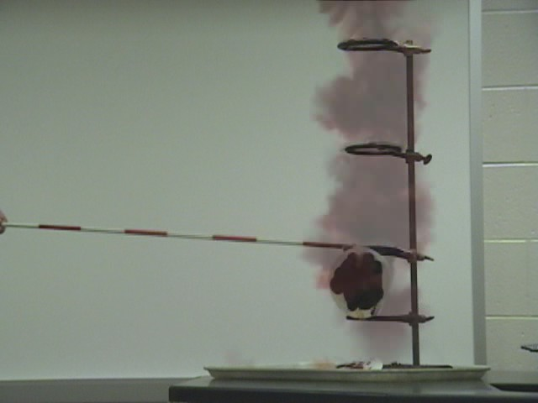
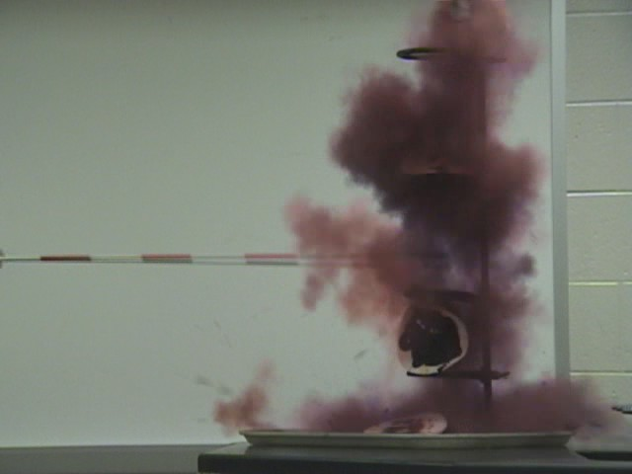
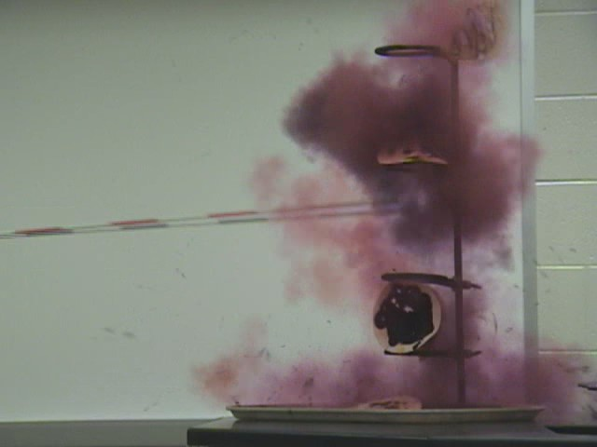
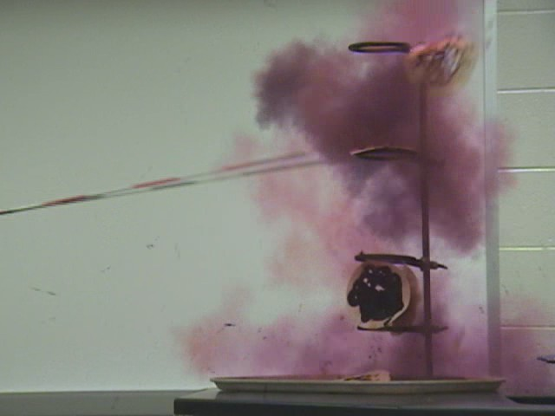
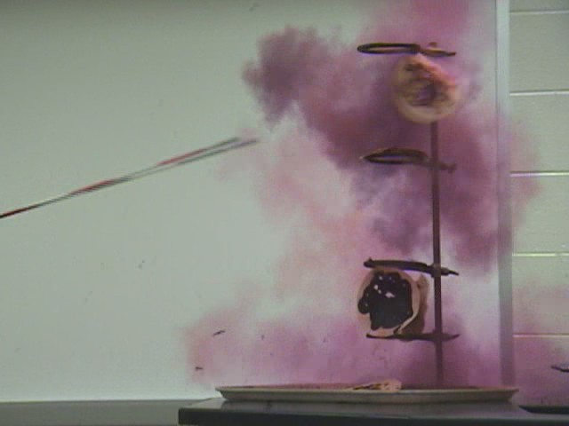





Decomposition of Nitrogen Triiodide

Slide 189
Decomposition of Nitrogen Triiodide
N₂
NI₃
I₂
2 NI₃(s) N₂(g) + 3 I₂(g)
Notes:
Molecules store energy (chemical potential energy) in the bonds that hold them together. When the bonds are broken, energy is released.

Slide 190
H
..
..
C
N
O
H
H
H
H
..
H
109.5º
107º
104.5º
H
H
H
CH₄, methane
NH₃, ammonia
H₂O, water
..
lone pair
electrons
O
O
O
O
O
O
O₃, ozone

Slide 191

The VSEPR Model
The Shapes of Some Simple AB_{n} Molecules
..
..
..
SO₂
O
S
N
C
F
O
O
O
O
S
F
F
O
O
Linear
Bent
Trigonal
planar
Trigonal
pyramidal
AB₆
F
F
F
F
F
F
F
F
Xe
P
F
S
F
Cl
F
F
F
F
F
F
T-shaped
Square
planar
F
F
Trigonal
bipyramidal
Octahedral
Brown, LeMay, Bursten, Chemistry The Central Science, 2000, page 305
Notes:
Students often confuse electron-domain geometry with molecular geometry.
You must stress that the molecular geometry is a consequence of the electron domain geometry.
The best arrangement of a given number of electron domains is the one that minimizes the repulsions among them.

Slide 192
KEYS - Nomenclature
Objectives
Worksheet - binary cmpds: single charge cation
Worksheet - binary compounds
Worksheet - ions in chemical formulas
Worksheet - ions in chemical compounds
Worksheet - ionic cmpds: polyatomic ions w multiple-charge cation
Worksheet - ionic formulas (binary, polyatomic, transition)
Worksheet - empirical and molecular
Worksheet – ionic cmpds: traditional system of nomenclature
Worksheet - vocab (bonding)
Worksheet - covalent binary cmpds: non-metal - non-metal
Worksheet - ionic cmpds: polyatomic ions
Activity – bonding PP
Worksheet - ionic binary cmpds: multiple charge cation
Activity - molecular models
Worksheet - errors in chemical formulas and nomenclature
activity - mole pattern
Worksheet - oxidation numbers and ionic cmpds
Textbook - questions
Worksheet - names and formulas of cmpds
Outline (general)

Slide 193
Resources - Nomenclature
Objectives
General Chemistry PP
Worksheet - binary cmpds: single charge cation
Worksheet - binary compounds
Worksheet - ions in chemical formulas
Worksheet - ions in chemical compounds
Worksheet - ionic cmpds: polyatomic ions w multiple-charge cation
Worksheet - ionic formulas (binary, polyatomic, transition)
Worksheet - empirical and molecular
Worksheet - traditional system of nomenclature
Worksheet - vocab (bonding)
Worksheet - covalent binary cmpds: non-metal - non-metal
Worksheet - ionic cmpds: polyatomic ions
Activity - bonding pieces
Worksheet - ionic binary cmpds: multiple charge cation
Activity - molecular models
Worksheet - errors in chemical formulas and nomenclature
Activity - mole pattern
Worksheet - oxidation numbers and ionic cmpds
Textbook - questions
Worksheet - names and formulas of cmpds
Outline (general)

