Slide 1
JEOPARDY
Chemistry Edition v1.0

Slide 2
Intro. to
Chemistry
Matter /
Energy
Symbols of
Elements
Nomen-
clature
Chemical
Equations
100
100
100
100
100
200
200
200
200
200
300
300
300
300
300
400
400
400
400
400
500
500
500
500
500

Slide 4
Intro. to Chemistry

Slide 5
What is the basic building block of all matter?
The ATOM
6
10
1
2
9
3
7
4
5
0
8

Slide 6
Most important piece of safety equipment in the lab?
Safety Glasses
6
10
1
2
9
3
7
4
5
0
8

Slide 7
Explanation of an event?
Theory
6
10
1
2
9
3
7
4
5
0
8

Slide 8
What is the basic building block of all matter?
The ATOM
6
10
1
2
9
3
7
4
5
0
8

Slide 10
Length of paperclip?
0
1
2
3
4
5
Centimeters
1.60 cm
6
10
1
2
9
3
7
4
5
0
8

Slide 11
How close a series of measurements are to each other.
Precision
6
10
1
2
9
3
7
4
5
0
8

Slide 12
Matter and Energy

Slide 13
What is the name of the element that is used as the standard to mass all other elements?
Carbon
6
10
1
2
9
3
7
4
5
0
8

Slide 14
What is the SI unit for measuring amount of substance?
Mole
6
10
1
2
9
3
7
4
5
0
8

Slide 15
Number of Joules in 100 calories
418.4 Joules
Recall: 1 Joule = 4.184 calories
6
10
1
2
9
3
7
4
5
0
8

Slide 16
Changing from a solid to a gas directly (without being a liquid)?
Sublimation
6
10
1
2
9
3
7
4
5
0
8

Slide 17
Symbols of Elements

Slide 18
Chlorine
Cl
6
10
1
2
9
3
7
4
5
0
8

Slide 20
Silver
Ag
6
10
1
2
9
3
7
4
5
0
8

Slide 22
Mercury
Hg
6
10
1
2
9
3
7
4
5
0
8

Slide 24
Tungsten
W
6
10
1
2
9
3
7
4
5
0
8

Slide 26
Antimony
Sb
6
10
1
2
9
3
7
4
5
0
8

Slide 28
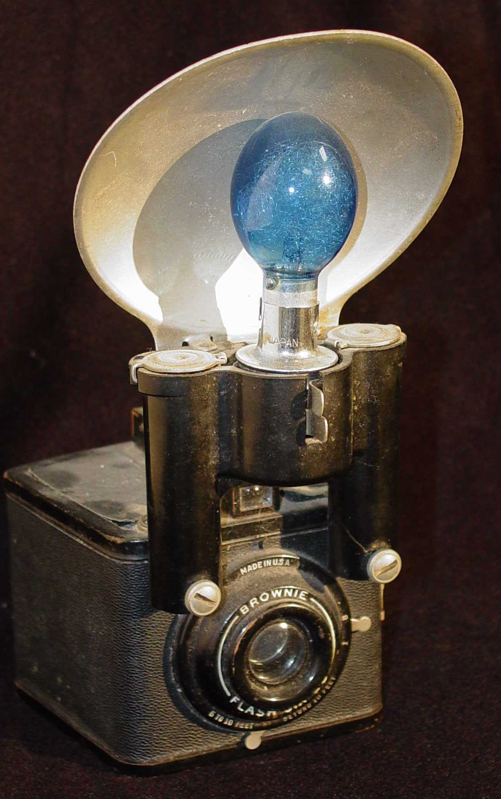
What is the name of the element that is in this flashbulb?
DAILY
DOUBLE
Magnesium

Slide 29
Atomic Structure

Slide 30
Where would a proton be located in an atom?
Nucleus
6
10
1
2
9
3
7
4
5
0
8

Slide 31
Each orbital can hold TWO electrons with opposite spins
Pauli Exclusion Principle
6
10
1
2
9
3
7
4
5
0
8

Slide 32
Which model(s) of the atom contained orbitals?
+
e
-
e
e
+
e
-
+
+
-
+
+
e
+
-
e
e
e
-
+
e
+
e
A
B
C
D
E
E
Model "D" is Bohr's planetary model of the atom
and had the electrons in orbit.
An orbital is a probable region in space where an electron
may be found designated s, p, d or f.
6
10
1
2
9
3
7
4
5
0
8

Slide 33
Electrons fill the lowest energy orbitals first
Aufbau Principle
6
10
1
2
9
3
7
4
5
0
8

Slide 34
Which series of emission lines is caused from an electron falling to the 1st energy level?
Lyman Series
6
10
1
2
9
3
7
4
5
0
8

Slide 35
Within a sublevel, place one electron per orbital before pairing them
Hund's Rule
6
10
1
2
9
3
7
4
5
0
8

Slide 36
How many electrons does an atom of bromine have?
80
Br
35
35
6
10
1
2
9
3
7
4
5
0
8

Slide 37
Calculate the molar mass of bromine to the nearest gram.
160 g
6
10
1
2
9
3
7
4
5
0
8

Slide 38
Approximately how much heavier is a neutron than an electron?
1837x
6
10
1
2
9
3
7
4
5
0
8

Slide 39
Nomenclature

Slide 40
Give the symbols of 5 of the 7 diatomic molecules.
H, O, Br, F, I, N, Cl
6
10
1
2
9
3
7
4
5
0
8

Slide 41
What is the chemical formula for ammonium cyanide?
NH₄CN
6
10
1
2
9
3
7
4
5
0
8

Slide 42
Name the following compound using the stock system: FeCl₃
Iron (III) chloride
6
10
1
2
9
3
7
4
5
0
8

Slide 43
How many ions will be produced when a single Ca₃(PO₄)₂ dissolves in water?
Five
3 Ca²⁺ cations and 2 PO₄³⁻ (phosphate anions)
6
10
1
2
9
3
7
4
5
0
8

Slide 44
Chemical Equations

Slide 45
Classify the following reaction: AB + C CB + A
Single replacement
6
10
1
2
9
3
7
4
5
0
8

Slide 46
Classify the following reaction: iron + oxygen ferrous oxide
Synthesis
6
10
1
2
9
3
7
4
5
0
8

Slide 47
Minimum amount of energy needed to start a chemical reaction?
Activation Energy
6
10
1
2
9
3
7
4
5
0
8

Slide 48
Periodic Table

Slide 49
What is the name of the element in period 4 and group 6?
Chromium
6
10
1
2
9
3
7
4
5
0
8

Slide 50
Who created the modern Periodic Table?
Henry Mosely
6
10
1
2
9
3
7
4
5
0
8

Slide 51
What is the name of the heaviest alkaline earth metal?
Radium
6
10
1
2
9
3
7
4
5
0
8

Slide 52
Method of separation of mixtures using differences in boiling point?
Distillation
6
10
1
2
9
3
7
4
5
0
8

Slide 53
What is the name of the element with the highest melting point?
Tungsten
6
10
1
2
9
3
7
4
5
0
8

Slide 54
Trivia

Slide 58
What is the empirical formula for gasoline (C₈H₁₈)?
C₄H₉
6
10
1
2
9
3
7
4
5
0
8

Slide 59
Amount of energy needed to remove the most loosely held valence electron for an atom in the gaseous state.
Ionization energy
6
10
1
2
9
3
7
4
5
0
8

Slide 60
When a system at equilibrium is disturbed, it shifts to a new equilibrium that counteracts the disturbance.
LeChatelier's Principle
6
10
1
2
9
3
7
4
5
0
8

Slide 61
Amount of energy needed to remove the most loosely held valence electron for an atom in the gaseous state.
Ionization energy
6
10
1
2
9
3
7
4
5
0
8

Slide 62
Amount of energy needed to remove the most loosely held valence electron for an atom in the gaseous state.
Ionization energy
6
10
1
2
9
3
7
4
5
0
8

Slide 63
Amount of energy needed to remove the most loosely held valence electron for an atom in the gaseous state.
Ionization energy
6
10
1
2
9
3
7
4
5
0
8

