Slide 1
Measurement
Scientific measurement

Slide 2
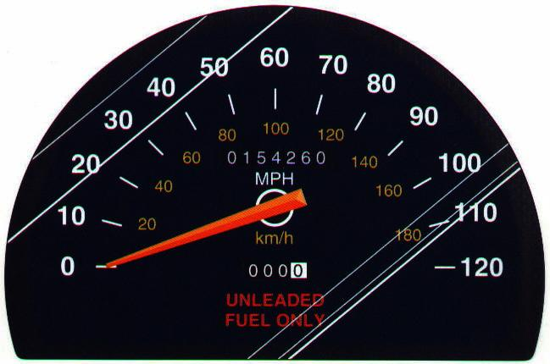
Number vs. Quantity
Quantity - number + unit
UNITS MATTER!!
Courtesy Christy Johannesson www.nisd.net/communicationsarts/pages/chem

Slide 3
Types of measurement
Quantitative- use numbers to describe
Qualitative- use description without numbers
4 feet
extra large
Hot
100ºF

Slide 4
Scientists prefer
Quantitative - easy to check
Easy to agree upon, no personal bias
The measuring instrument limits how good the measurement is.

Slide 5
How good are the measurements?
Scientists use two word to describe how good the measurements are
Accuracy- how close the measurement is to the actual value
Precision- how well can the measurement be repeated

Slide 6
Accuracy vs. Precision
Good accuracy
Good precision
Poor accuracy
Good precision
Poor accuracy
Poor precision
Systematic errors:
reduce accuracy
Random errors:
reduce precision
(instrument)
(person)
Notes:
Scientists repeat experiments many times to increase their accuracy.

Slide 7
Differences
Accuracy can be true of an individual measurement or the average of several
Precision requires several measurements before anything can be said about it
examples

Slide 8
Let’s use a golf anaolgy

Slide 9
Accurate?
No
Precise?
Yes
10

Slide 10
Accurate?
Yes
Precise?
Yes
12

Slide 11
Precise?
No
Accurate?
Maybe?
13

Slide 12
Accurate?
Yes
Precise?
We cant say!
18

Slide 13
Accurate?
Yes
Precise?
We cant say!
18

Slide 14
Accurate?
Yes
Precise?
We cant say!
18

Slide 15
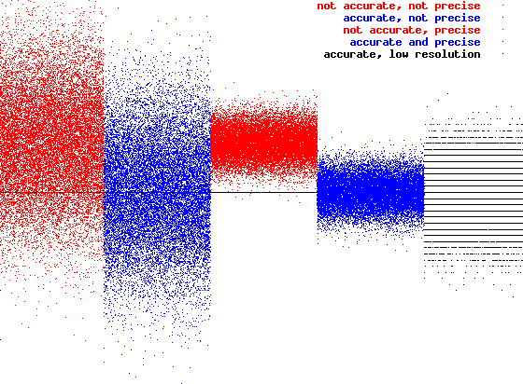
Accuracy Precision Resolution
not accurate, not precise
accurate, not precise
not accurate, precise
accurate and precise
accurate, low resolution
3
2
1
time offset [arbitrary units]
0
-1
-2
-3
subsequent samples

Slide 16
In terms of measurement
Three students measure the room to be 10.2 m, 10.3 m and 10.4 m across.
Were they precise?
Were they accurate?

Slide 17
Definitions: Precision
Precision – is a measure of the spread of data about a central value and may
be expressed as the range, the standard deviation, or the variance.
Repeatability – the precision for an analysis in which the only source of
variability is the analysis of replicate samples.
Reproducibility – the precision when comparing results for several samples,
for several analysts of several methods.
Indeterminate error – any random error that causes some measurements
or results to be too high while others are too low.
Human error – is a type of indeterminate error
David Harvery, Modern Analytical Chemistry, 2000, page 62

Slide 18
Definitions: Error & Uncertainty
Error – a measure of bias in a result or measurement.
Uncertainty – the range of possible values for a measurement.
David Harvery, Modern Analytical Chemistry, 2000, page 64

Slide 19
SI System for Measuring Length
Unit Symbol Meter Equivalent
kilometer km 1,000 m or 10³ m
meter m 1 m or 10⁰ m
decimeter dm 0.1 m or 10⁻¹ m
centimeter cm 0.01 m or 10⁻² m
millimeter mm 0.001 m or 10⁻³ m
micrometer mm 0.000001 m or 10⁻⁶ m
nanometer nm 0.000000001 m or 10⁻⁹ m

Slide 20
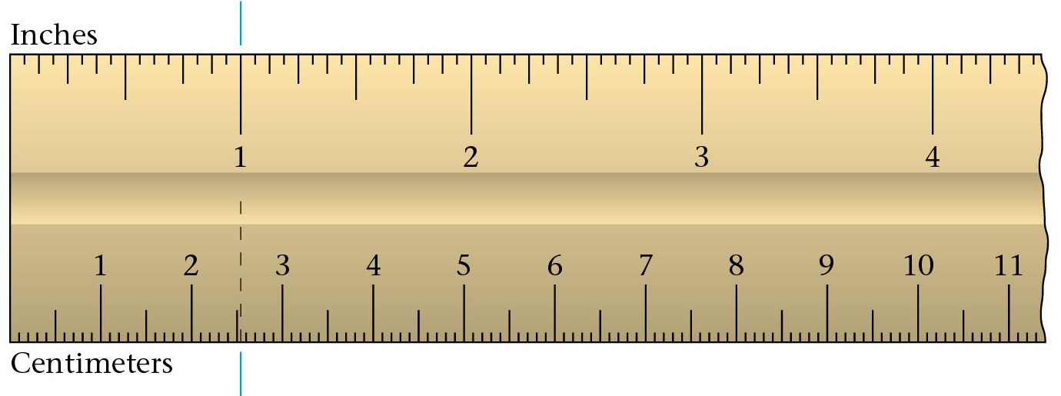
Comparison of English and SI Units
1 inch
2.54 cm
1 inch = 2.54 cm
Zumdahl, Zumdahl, DeCoste, World of Chemistry 2002, page 119

Slide 21
Reporting Measurements
Using significant figures
Report what is known with certainty
Add ONE digit of uncertainty (estimation)
Davis, Metcalfe, Williams, Castka, Modern Chemistry, 1999, page 46
Notes:
By adding additional numbers to a measurement – you do not make it more precise. The instrument determines how precise it can make a measurement. Remember, you can only add ONE digit of uncertainty to a measurement.

Slide 22
Practice Measuring
0
1
2
3
4
5
4.5 cm
cm
0
1
2
3
4
5
4.54 cm
cm
0
1
2
3
4
5
3.0 cm
cm
Timberlake, Chemistry 7th Edition, page 7
Notes:
PRACTICE MEASURING
Estimate one digit of uncertainty.
a) 4.5 cm
b) * 4.55 cm
c) 3.0 cm
*4.550 cm is INCORRECT while 4.52 cm or 4.58 cm are CORRECT (although the estimate is poor)
The better marks the better we can estimate.
Scientist always understand that the last number measured is actually an estimate

Slide 23
Reading a Vernier
A Vernier allows a precise reading of some value.
In the figure to the left, the Vernier moves up and
down to measure a position on the scale.
This could be part of a barometer which reads
atmospheric pressure.
The "pointer" is the line on the vernier labelled "0".
Thus the measured position is almost exactly 756
in whatever units the scale is calibrated in.
If you look closely you will see that the distance
between the divisions on the vernier are not the
same as the divisionson the scale. The 0 line on
the vernier lines up at 756 on the scale, but the
10 line on the vernier lines up at 765 on the scale.
Thus the distance between the divisions on the
vernier are 90% of the distance between the
divisions on the scale.
770
10
Vernier
760
5
Scale
756
0
750
Notes:
http://www.upscale.utoronto.ca/PVB/Harrison/Vernier/Vernier.html

Slide 24
If we do another reading with the vernier at a different position, the pointer, the line marked 0, may not line up exactly with one of the lines on the scale. Here the "pointer" lines up at approximately 746.5 on the scale.
If you look you will see that only one line on the vernier lines up exactly with one of the lines on the scale, the 5 line. This means that our first guess was correct: the reading is 746.5.
760
10
5
750
0
What is the reading now?
741.9
740
Notes:
http://www.upscale.utoronto.ca/PVB/Harrison/Vernier/Vernier.html

Slide 25
If we do another reading with the vernier at a different position, the pointer, the line marked 0, may not line up exactly with one of the lines on the scale. Here the "pointer" lines up at approximately 746.5 on the scale.
If you look you will see that only one line on the vernier lines up exactly with one of the lines on the scale, the 5 line. This means that our first guess was correct: the reading is 746.5.
760
10
5
750
0
What is the reading now?
756.0
740
Notes:
http://www.upscale.utoronto.ca/PVB/Harrison/Vernier/Vernier.html

Slide 26
Here is a final example, with the vernier at yet another position. The pointer points to a value that is obviously greater than 751.5 and also less than 752.0. Looking for divisions on the vernier that match a division on the scale, the 8 line matches fairly closely. So the reading is about 751.8.
In fact, the 8 line on the vernier appears to be a little bit above the corresponding line on the scale. The 8 line on the vernier is clearly somewhat below the corresponding line of the scale. So with sharp eyes one might report this reading as 751.82 ± 0.02.
This "reading error" of ± 0.02 is probably the correct error of precision to specify for all measurements done with this apparatus.
10
760
5
0
750
740
Notes:
http://www.upscale.utoronto.ca/PVB/Harrison/Vernier/Vernier.html

Slide 27
Accuracy vs. Precision
Accuracy - how close a measurement is to the accepted value
Precision - how close a series of measurements are to each other
ACCURATE = CORRECT
PRECISE = CONSISTENT
Courtesy Christy Johannesson www.nisd.net/communicationsarts/pages/chem

Slide 28
Percent Error
Indicates accuracy of a measurement
your value
accepted value
Courtesy Christy Johannesson www.nisd.net/communicationsarts/pages/chem

Slide 29
Percent Error
A student determines the density of a substance to be 1.40 g/mL. Find the % error if the accepted value of the density is 1.36 g/mL.
% error = 2.9 %
Courtesy Christy Johannesson www.nisd.net/communicationsarts/pages/chem

Slide 30
Significant Figures
Indicate precision of a measurement.
Recording Sig. Figs.
Sig. figs. in a measurement include the known digits plus a final estimated digit
1.19 cm
0
1
2
3
4
5
Centimeters
Courtesy Christy Johannesson www.nisd.net/communicationsarts/pages/chem

Slide 31
Significant Figures
Counting Sig Figs
Count all numbers EXCEPT:
Leading zeros -- 0.0025
Trailing zeros without a decimal point -- 2,500
Courtesy Christy Johannesson www.nisd.net/communicationsarts/pages/chem

Slide 32
Significant Figures
Counting Sig. Figs. Examples
1. 23.50
1. 23.50
4 sig figs
2. 402
3 sig figs
2. 402
3. 5,280
3. 5,280
3 sig figs
4. 0.080
2 sig figs
4. 0.080
Courtesy Christy Johannesson www.nisd.net/communicationsarts/pages/chem

Slide 33
Significant Figures
Calculating with Sig Figs
Multiply/Divide - The # with the fewest sig figs determines the # of sig figs in the answer.
(13.91g/cm³)(23.3cm³) = 324.103g
4 SF
3 SF
3 SF
324 g
Courtesy Christy Johannesson www.nisd.net/communicationsarts/pages/chem

Slide 34
Significant Figures
Calculating with Sig Figs (con’t)
Add/Subtract - The # with the lowest decimal value determines the place of the last sig fig in the answer.
224 g
+ 130 g
354 g
3.75 mL
+ 4.1 mL
7.85 mL
224 g
+ 130 g
354 g
3.75 mL
+ 4.1 mL
7.85 mL
→ 7.9 mL
→ 350 g
Courtesy Christy Johannesson www.nisd.net/communicationsarts/pages/chem

Slide 35
Significant Figures
Calculating with Sig Figs (con’t)
Exact Numbers do not limit the # of sig figs in the answer.
Counting numbers: 12 students
Exact conversions: 1 m = 100 cm
“1” in any conversion: 1 in = 2.54 cm
Courtesy Christy Johannesson www.nisd.net/communicationsarts/pages/chem

Slide 36
Significant Figures
Practice Problems
5. (15.30 g) ÷ (6.4 mL)
4 SF
2 SF
= 2.390625 g/mL
→ 2.4 g/mL
6. 18.9 g
- 0.84 g
2 SF
→ 18.1 g
18.06 g
Courtesy Christy Johannesson www.nisd.net/communicationsarts/pages/chem

Slide 37
Scientific Notation
65,000 kg → 6.5 × 10⁴ kg
Converting into Scientific Notation:
Move decimal until there’s 1 digit to its left. Places moved = exponent.
Large # (>1) ⇒ positive exponent Small # (<1) ⇒ negative exponent
Only include sig figs.
Courtesy Christy Johannesson www.nisd.net/communicationsarts/pages/chem

Slide 38
D. Scientific Notation
Practice Problems
7. 2,400,000 μg
8. 0.00256 kg
9. 7 × 10⁻⁵ km
10. 6.2 × 10⁴ mm
2.4 × 10⁶ μg
2.56 × 10⁻³ kg
0.00007 km
62,000 mm
Courtesy Christy Johannesson www.nisd.net/communicationsarts/pages/chem

Slide 39
Scientific Notation
Calculating with Scientific Notation
(5.44 × 10⁷ g) ÷ (8.1 × 10⁴ mol) =
Type on your calculator:
EXP
EXP
EXE
5.44
7
÷
8.1
4
EE
EE
ENTER
= 671.6049383
= 670 g/mol
= 6.7 × 10² g/mol
Courtesy Christy Johannesson www.nisd.net/communicationsarts/pages/chem

Slide 40
Proportions
Direct Proportion
y
x
Inverse Proportion
y
x
Courtesy Christy Johannesson www.nisd.net/communicationsarts/pages/chem

Slide 41
Significant Figures
What is the smallest mark on the ruler that measures 142.15 cm?
142 cm?
140 cm?
Here there’s a problem does the zero count or not?
They needed a set of rules to decide which zeros count.
All other numbers do count

Slide 42
Which zeros count?
Those at the end of a number before the decimal point don’t count
12400
If the number is smaller than one, zeros before the first number don’t count
0.045

Slide 43
Which zeros count?
Zeros between other sig figs do.
1002
zeroes at the end of a number after the decimal point do count
45.8300
If they are holding places, they don’t.
If they are measured (or estimated) they do

Slide 44
Sig Figs
Only measurements have sig figs.
Counted numbers are exact
A dozen is exactly 12
A a piece of paper is measured 11 inches tall.
Being able to locate, and count significant figures is an important skill.

Slide 45
Sig figs.
How many sig figs in the following measurements?
458 g
4085 g
4850 g
0.0485 g
0.004085 g
40.004085 g

Slide 46
Sig Figs.
405.0 g
4050 g
0.450 g
4050.05 g
0.0500060 g
Next we learn the rules for calculations

Slide 47
More Sig Figs
How to Round

Slide 48
Problems
50 is only 1 significant figure
if it really has two, how can I write it?
A zero at the end only counts after the decimal place
Scientific notation
5.0 x 10¹
now the zero counts.

Slide 49
Adding and subtracting with sig figs
The last sig fig in a measurement is an estimate.
Your answer when you add or subtract can not be better than your worst estimate.
have to round it to the least place of the measurement in the problem

Slide 50
For example
27.93
+
6.4
First line up the decimal places
27.93
27.93
Then do the adding
+
6.4
6.4
Find the estimated numbers in the problem
34.33
This answer must be rounded to the tenths place

Slide 51
Rounding rules
look at the number behind the one you’re rounding.
If it is 0 to 4 don’t change it
If it is 5 to 9 make it one bigger
round 45.462 to four sig figs
to three sig figs
to two sig figs
to one sig fig

Slide 52
Practice
4.8 + 6.8765
520 + 94.98
0.0045 + 2.113
6.0 x 10² - 3.8 x 10³
5.4 - 3.28
6.7 - .542
500 -126
6.0 x 10⁻² - 3.8 x 10⁻³

Slide 53
Multiplication and Division
Rule is simpler
Same number of sig figs in the answer as the least in the question
3.6 x 653
2350.8
3.6 has 2 s.f. 653 has 3 s.f.
answer can only have 2 s.f.
2400

Slide 54
Multiplication and Division
Same rules for division
practice
4.5 / 6.245
4.5 x 6.245
9.8764 x .043
3.876 / 1983
16547 / 714

Slide 55
The Metric System
An easy way to measure

Slide 56
SI System
The International System of Units
Derived Units Commonly Used in Chemistry
Area and Volume: Derived Units
Prefixes in the SI System

Slide 57
Measuring
The numbers are only half of a measurement
Measurement = number + unit
It is 10 long
10 what.
Numbers without units are meaningless.
How many feet in a yard
A mile
A rod

Slide 58
The Metric System
Easier to use because it is a decimal system
Every conversion is by some power of 10.
A metric unit has two parts
A prefix and a base unit.
prefix tells you how many times to divide or multiply by 10.

Slide 59
B. SI Units
Quantity
Symbol
Base Unit
Abbrev.
Length
l
meter
m
Mass
m
kilogram
kg
Time
t
second
s
Temp
T
Kelvin
K
Amount
n
mole
mol
Courtesy Christy Johannesson www.nisd.net/communicationsarts/pages/chem

Slide 60
Base Units
Length - meter more than a yard - m
Mass - grams - a bout a raisin - g
Time - second - s
Temperature - Kelvin or ºCelsius K or C
Energy - Joules- J
Volume - Liter - half f a two liter bottle- L
Amount of substance - mole - mol

Slide 61
The International System of Units
Quantity Name Symbol
Length meter m
Mass kilogram kg
Time second s
Amount of substance mole mol
Thermodynamic temperature Kelvin K
Electric current amperes amps
Luminous intensity candela cd
Dorin, Demmin, Gabel, Chemistry The Study of Matter , 3rd Edition, 1990, page 16
Notes:
Internet Access to the National Institute of Standards and Technology
“To be or not to be”: the English or the Metric system
The English system of measurement used today in the United States originated in the decrees of English monarchs. The French Revolution produced the overthrow of the French monarchy and in 1799 it also led to the creation of the set of weights and measures we call the metric system. The metric system was legalized for use in the United States in 1866 along with the traditional English system. Today the only countries in the world that do not use the metric system are the United States of America, Liberia and Myanamar.
United States government policy toward the Metric System
This part is to access the following URLs for the National Institute of Standards and Technology, NIST, and review the evolution of the relationship between the United States and the Metric System. You can answer the first question after reviewing this NIST page.
http://ts.nist.gov/ts/htdocs/200/202/ic1136a.htm
What was the year when the United States signed the “Treaty of the Meter”?
Access this FDA page to answer the following question.
http://www.fds.goc/ora/inspect_ref/itg30.html
What does the term “Both timeless and toothless” have to do with the Metric Conversions Act of 1975? In your opinion does this influence the pace of metrification in the United States?
Name ____________________ Hr ____
Internet Access to the National Institute of Standards and Technology
“To be or not to be”: the English or the Metric system
Another part of your assignment is to write a brief argument on the back of this page for adopting the metric system and replacing the English system. Lastly you are to write an argument for continuing the current pattern of using two systems.
Argument for adopting the Metric system and dropping the English system.
Argument for retaining both the English system and the Metric system

Slide 62
Prefixes
kilo k 1000 times
deci d 1/10
centi c 1/100
milli m 1/1000
kilometer - about 0.6 miles
centimeter - less than half an inch
millimeter - the width of a paper clip wire

Slide 63
Prefixes in the SI System
The Commonly Used Prefixes in the SI System
Power of 10 for
Prefix Symbol Meaning Scientific Notation
_______________________________________________________________________
mega- M 1,000,000 10⁶
kilo- k 1,000 10³
deci- d 0.1 10⁻¹
centi- c 0.01 10⁻²
milli- m 0.001 10⁻³
micro- μ 0.000001 10⁻⁶
nano- n 0.000000001 10⁻⁹
Zumdahl, Zumdahl, DeCoste, World of Chemistry 2002, page 118

Slide 64
B. SI Units
Prefix
Symbol
Factor
mega-
M
10⁶
kilo-
k
10³
BASE UNIT
---
10⁰
deci-
d
10⁻¹
centi-
c
10⁻²
milli-
m
10⁻³
micro-
μ
10⁻⁶
nano-
n
10⁻⁹
pico-
p
10⁻¹²
Courtesy Christy Johannesson www.nisd.net/communicationsarts/pages/chem

Slide 65
The Original Metric Reference
H₂O
1 kg
= 1 liter
1/10,000,000
Earth
Volume
= 1 meter
Length
H₂O
1/10 m
= 1 kilogram
1/10 m
1/10 m
Mass

Slide 66
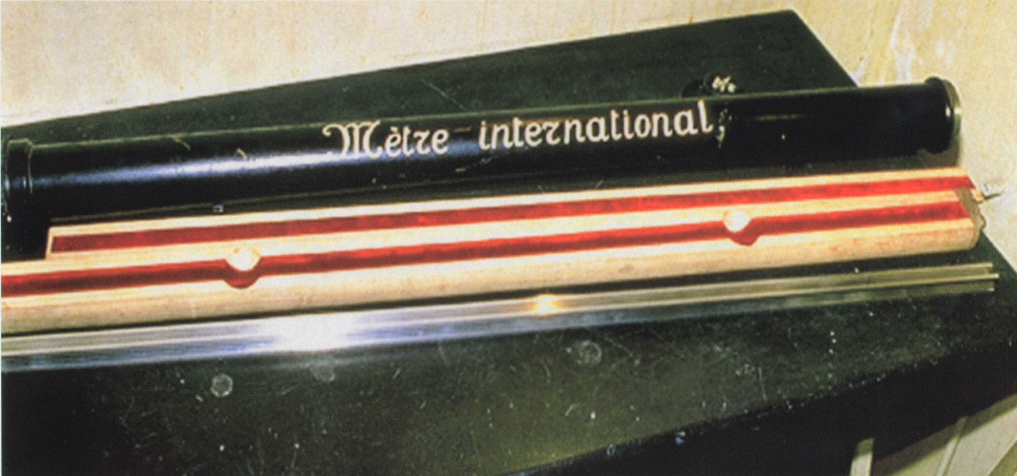
The Official Standard Meter

Slide 67
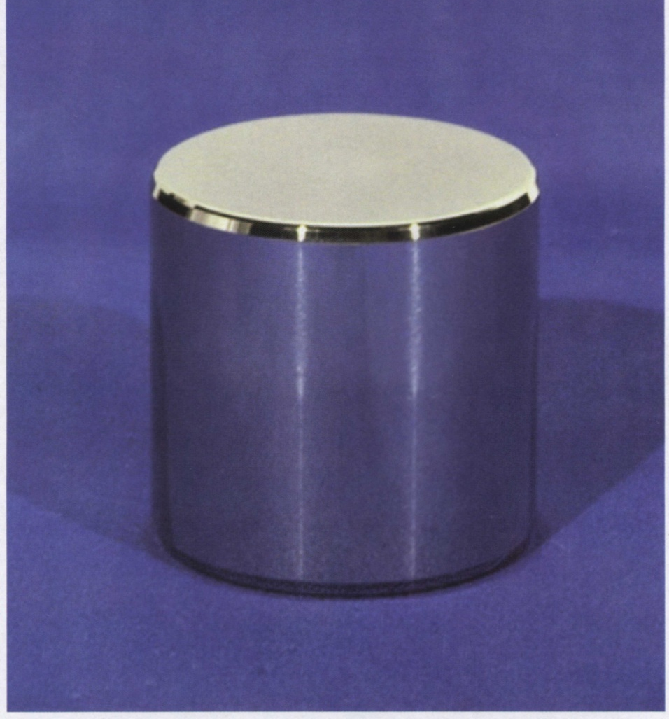
The Official Standard Kilogram

Slide 68
Derived Units Commonly Used in Chemistry
Quantity Name Symbol
Area square meter m²
Volume cubic meter m³
Force newton N
Pressure pascal Pa
Energy joule J
Power watt W
Voltage volt V
Frequency hertz Hz
Electric charge coulomb C

Slide 69
Area and Volume: Derived Units
Area = length x width
= 5.0 m x 3.0 m
= 15 ( m x m)
= 15 m²
Volume = length x width x height
= 5.0 m x 3.0 m x 4.0 m
= 60 ( m x m x m)
= 60 m³

Slide 70
Measurement
100 mL Graduated Cylinder
Units of Measuring Volume
Reading a Meniscus
Units for Measuring Mass
Quantities of Mass
SI-English Conversion Factors
Accuracy vs. Precision
Accuracy Precision Resolution
SI units for Measuring Length
Comparison of English and SI Units
Reporting Measurements
Measuring a Pin
Practice Measuring

Slide 71
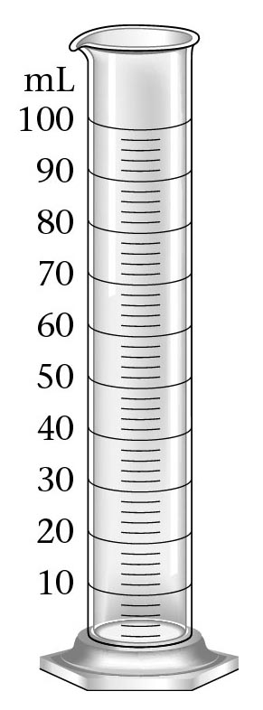
100 mL Graduated Cylinder
Zumdahl, Zumdahl, DeCoste, World of Chemistry 2002, page 119

Slide 72
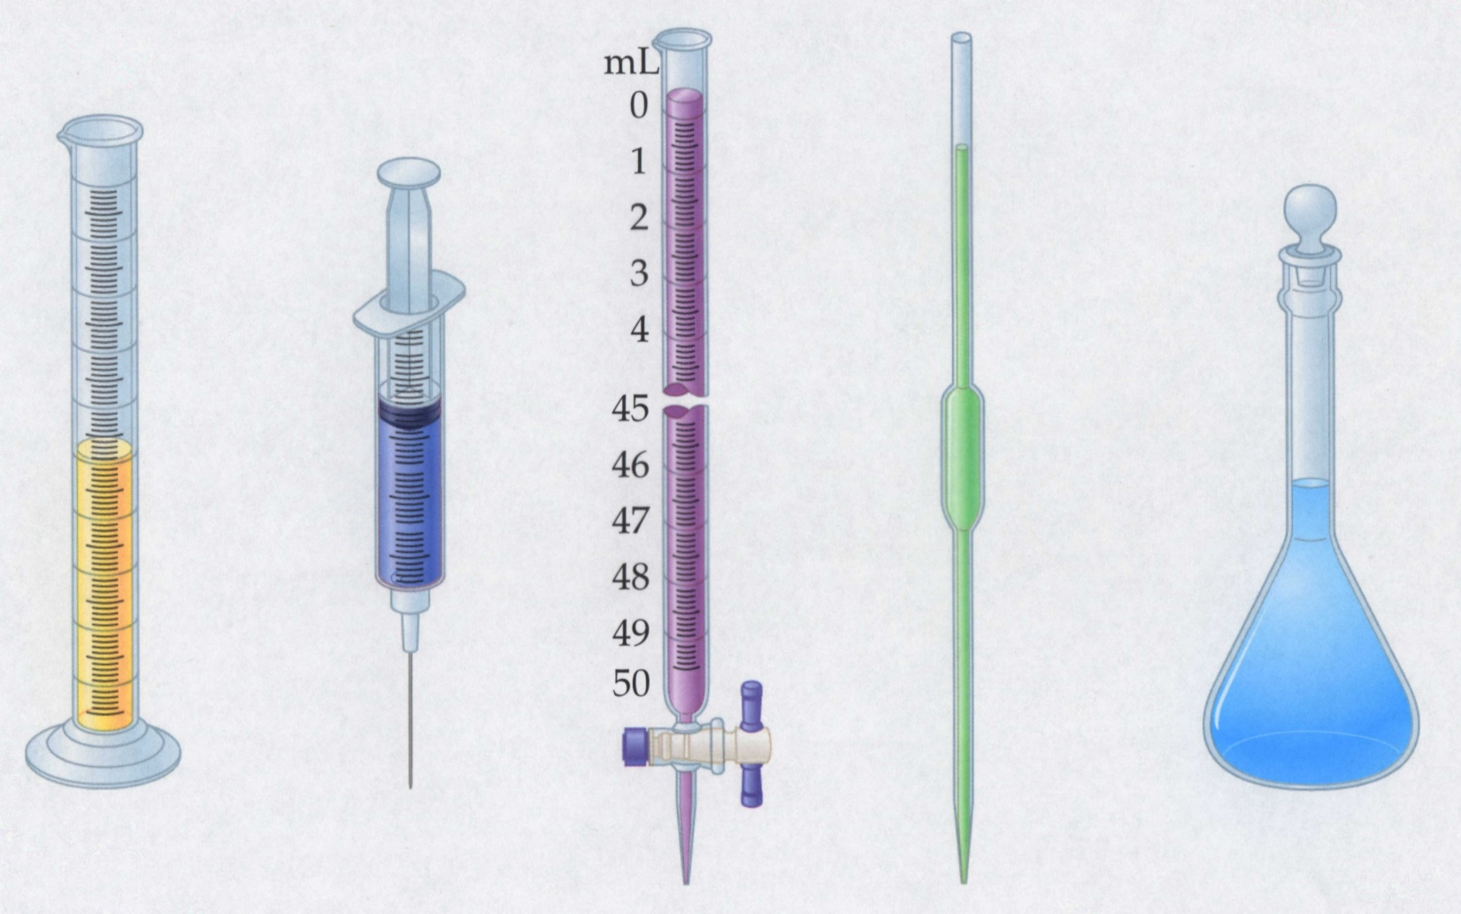
Instruments for Measuring Volume
Graduated
cylinder
Volumetric
flask
Syringe
Buret
Pipet

Slide 73
Units of Measuring Volume
1 L = 1000 mL
1 qt = 946 mL
Timberlake, Chemistry 7th Edition, page 3
Notes:
UNITS OF MEASURING VOLUME
A measurement has two parts: a number and a unit.
Note: NO NAKED NUMBERS

Slide 74
Reading a Meniscus
10 mL
10
line of sight too high
reading too high
8
proper line of sight
reading correct
line of sight too low
6
reading too low
graduated
cylinder

Slide 75
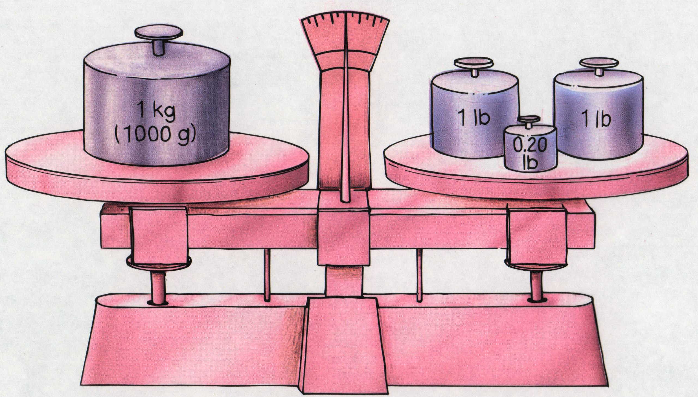
Units for Measuring Mass
1 kg = 2.20 lb
Timberlake, Chemistry 7th Edition, page 3
Notes:
UNITS FOR MEASURING MASS
Mass – amount of substance present. Does not change when going to the moon.
Mass is measured on a pan balance.
Weight – related to gravity. Your weight is about 1/3 on the moon and 3X on Jupiter.
As gravity increases your weight increases.
Pull of gravity on jet fighter planes – make your arms and legs very heavy and g-forces increase.
Weight is measured on a scale.

Slide 76
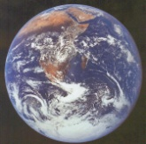
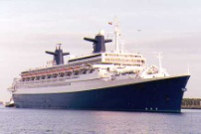
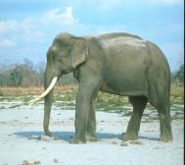
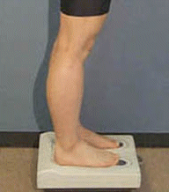
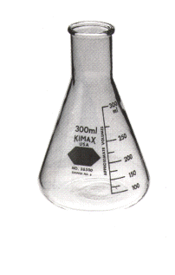
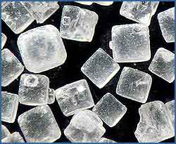
Quantities of Mass
10²⁴ g
10²¹ g
Earth’s atmosphere
to 2500 km
10¹⁸ g
10¹⁵ g
10¹² g
Ocean liner
Giga-
10⁹ g
Mega-
10⁶ g
Indian elephant
Average human
Kilo-
10³ g
1.0 liter of water
base
10⁰ g
milli-
10⁻³ g
micro-
10⁻⁶ g
nano-
Grain of table salt
10⁻⁹ g
pico-
10⁻¹² g
femto-
10⁻¹⁵ g
atomo-
10⁻¹⁸ g
Typical protein
10⁻²¹ g
Uranium atom
10⁻²⁴ g
Water molecule
Kelter, Carr, Scott, Chemistry A Wolrd of Choices 1999, page 25

Slide 77
SI-US Conversion Factors
Relationship Conversion Factors
Length
2.54 cm
1 in
1 in
2.54 cm
2.54 cm = 1 in.
and
39.4 in
1 m
1 m
39.4 in.
1 m = 39.4 in.
and
Volume
946 mL = 1 qt
946 mL
1 qt
1 qt
946 mL
and
1 L = 1.06 qt
1.06 qt
1 L
and
1 L
1.06 qt
Mass
454 g
1 lb
1 lb
454 g
454 g = 1 lb
and
1 kg = 2.20 lb
2.20 lb
1 kg
and
1 kg
2.20 lb
Notes:
Dominoes Activity

Slide 78
Accuracy vs. Precision
Good accuracy
Good precision
Poor accuracy
Good precision
Poor accuracy
Poor precision
Random errors:
reduce precision
Systematic errors:
reduce accuracy
Notes:
Scientists repeat experiments many times to increase their accuracy.

Slide 79
Accuracy Precision Resolution
not accurate, not precise
accurate, not precise
not accurate, precise
accurate and precise
accurate, low resolution
3
2
1
time offset [arbitrary units]
0
-1
-2
-3
subsequent samples

Slide 80
SI System for Measuring Length
The SI Units for Measuring Length
Unit Symbol Meter Equivalent _______________________________________________________________________
kilometer km 1,000 m or 10³ m
meter m 1 m or 10⁰ m
decimeter dm 0.1 m or 10⁻¹ m
centimeter cm 0.01 m or 10⁻² m
millimeter mm 0.001 m or 10⁻³ m
micrometer μm 0.000001 m or 10⁻⁶ m
nanometer nm 0.000000001 m or 10⁻⁹ m
Zumdahl, Zumdahl, DeCoste, World of Chemistry 2002, page 118

Slide 81
Volume
calculated by multiplying L x W x H
Liter the volume of a cube 1 dm (10 cm) on a side
so 1 L = 10 cm x 10 cm x 10 cm
1 L = 1000 cm³
1/1000 L = 1 cm³
1 mL = 1 cm³

Slide 82
Volume
1 L about 1/4 of a gallon - a quart
1 mL is about 20 drops of water or 1 sugar cube

Slide 83
Mass
weight is a force, is the amount of matter.
1gram is defined as the mass of 1 cm³ of water at 4 ºC.
1000 g = 1000 cm³ of water
1 kg = 1 L of water

Slide 84
Mass
1 kg = 2.5 lbs
1 g = 1 paper clip
1 mg = 10 grains of salt or 2 drops of water.

Slide 85
Converting
k
h
D
d
c
m
how far you have to move on this chart, tells you how far, and which direction to move the decimal place.
The box is the base unit, meters, Liters, grams, etc.

Slide 86
Conversions
k
h
D
d
c
m
Change 5.6 m to millimeters
starts at the base unit and move three to the right.
move the decimal point three to the right
5
6
0
0

Slide 87
Conversions
k
h
D
d
c
m
convert 25 mg to grams
convert 0.45 km to mm
convert 35 mL to liters
It works because the math works, we are dividing or multiplying by 10 the correct number of times

Slide 88
Conversions
k
h
D
d
c
m
Change 5.6 km to millimeters

Slide 89
Which is heavier?
it depends

Slide 90
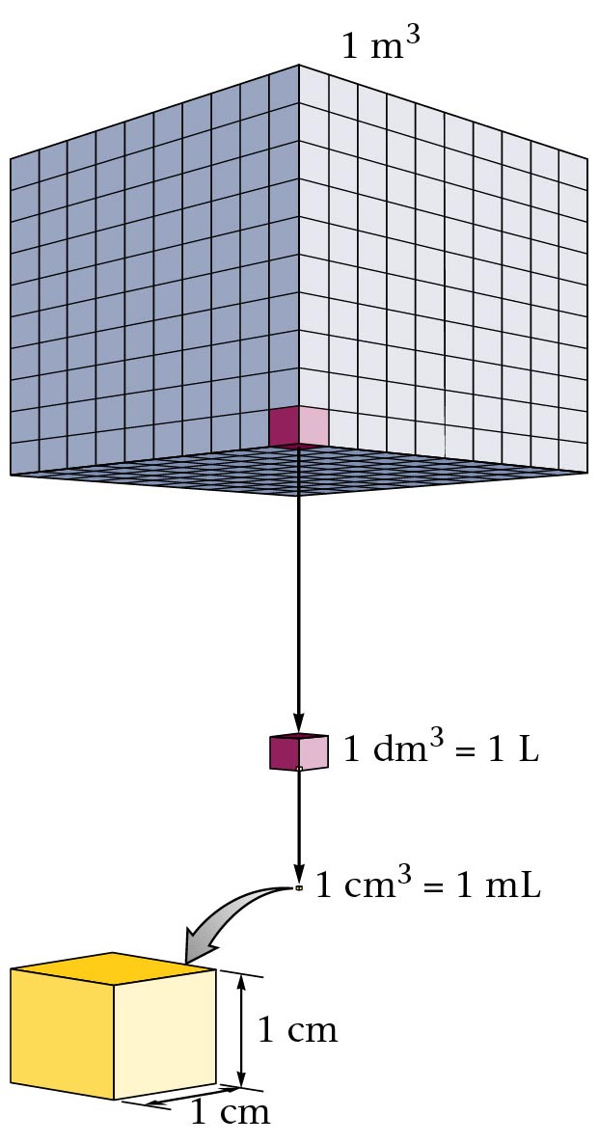
Cube Representations
1 m³ = 1 000 000 cm³
Zumdahl, Zumdahl, DeCoste, World of Chemistry 2002, page 119

Slide 91
Volume and Density
Relationship Between Volume and Density for Identical Masses of Common Substances
Cube of substance Mass Volume Density
Substance (face shown actual size) (g) (cm³) (g.cm³)
Lithium
Water
Aluminum
Lead
10 19 0.53
10 10 1.0
10 3.7 2.7
10 0.58 11.4
Notes:
Density is a derived unit.
Mathematically: Density = ^{mass} / _{volume}
Density is an intensive property of matter.

Slide 92
Density
D =
M
V
M
M = D x V
ass
D
V
V =
M
D
ensity
olume

Slide 93
Density of Some Common Substances
Substance Density
(g / cm3)
Air 0.0013*
Lithium 0.53
Ice 0.917
Water 1.00
Aluminum 2.70
Iron 7.86
Lead 11.4
Gold 19.3
*at 0ºC and 1 atm pressure

Slide 94
Consider Equal Volumes
Mass
Density =
Volume
Equal volumes…
…but unequal masses
The more massive object
(the gold cube) has the
_________ density.
GREATER
aluminum
gold
Dorin, Demmin, Gabel, Chemistry The Study of Matter , 3rd Edition, 1990, page 71
Notes:
Question: Which weighs more a ton of feathers or a ton of bricks?
(They weigh the same)
Question: Which occupies a larger volume; a ton of feathers or a ton of bricks?
(the feathers will occupy a larger volume)

Slide 95
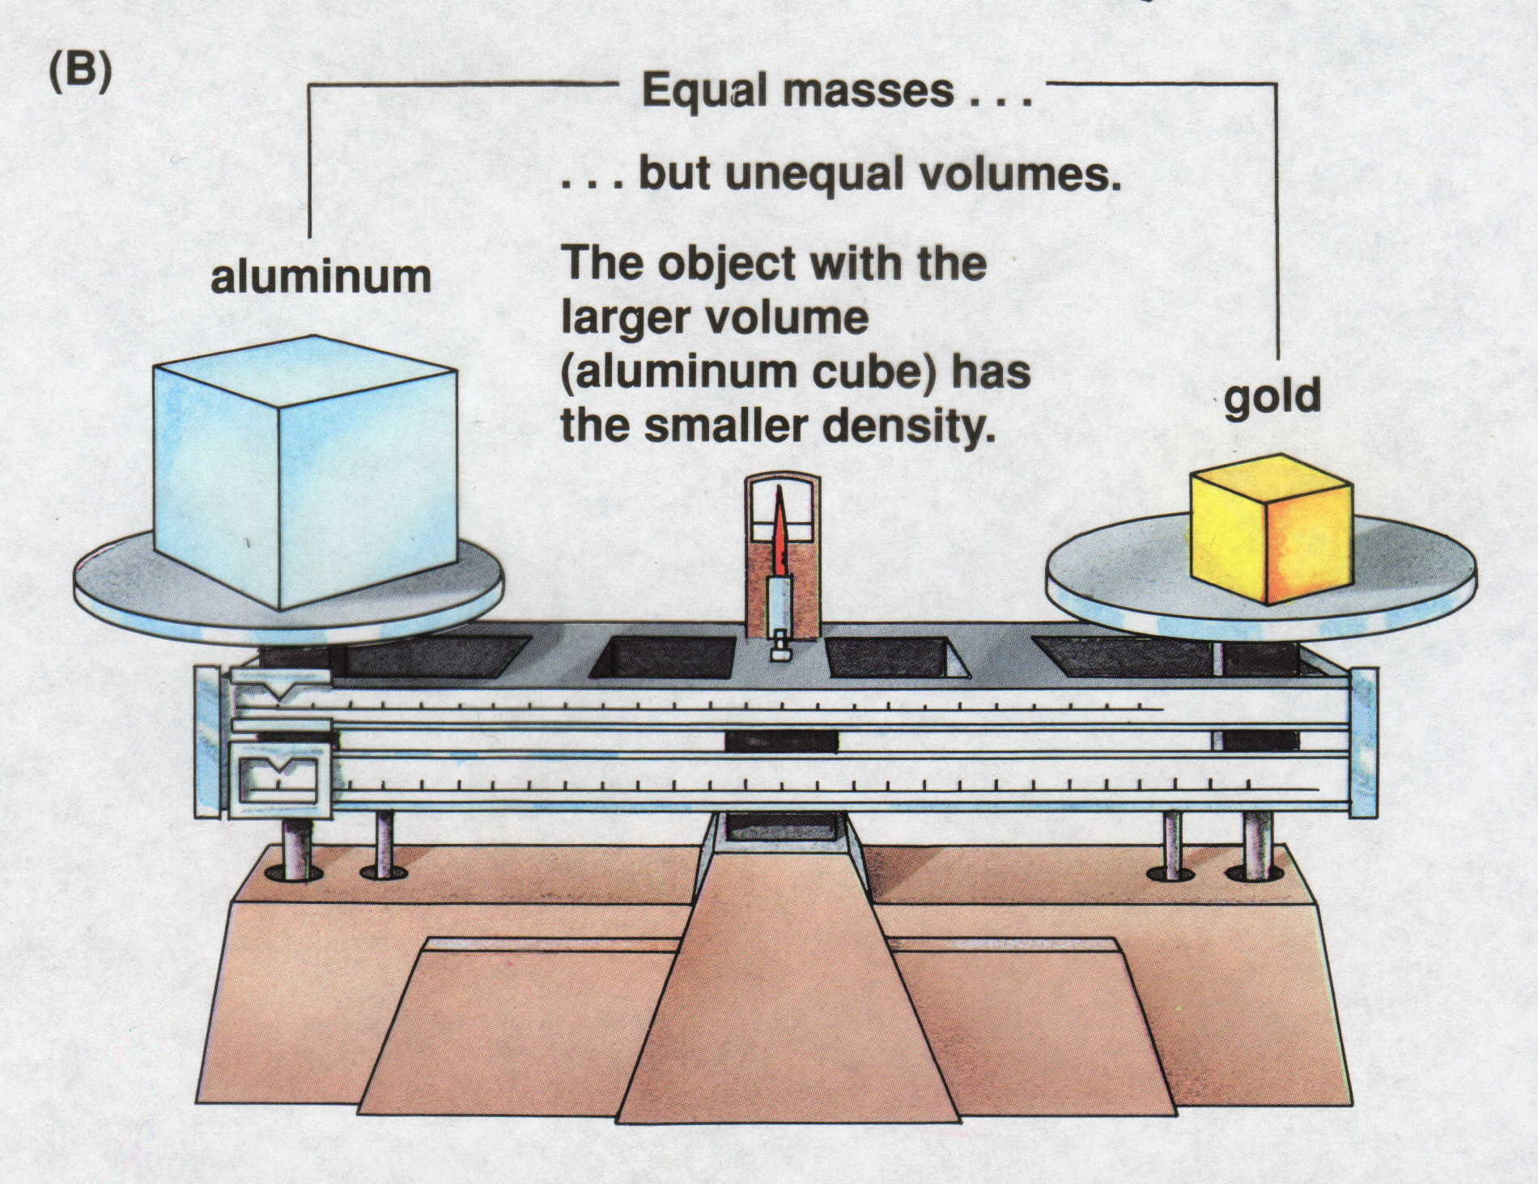
Consider Equal Masses
Equal masses…
…but unequal volumes.
The object with the
larger volume
(aluminum cube) has
the smaller density.
gold
aluminum
Dorin, Demmin, Gabel, Chemistry The Study of Matter , 3rd Edition, 1990, page 71

Slide 96
Two ways of viewing density
Dorin, Demmin, Gabel, Chemistry The Study of Matter , 3rd Edition, 1990, page 71
Notes:
“Two Ways of Viewing Density”
Description
This slide illustrates (density) = ^{mass} / _{volume} relationships for gold and aluminum.
Basic Concepts
Density is an intensive property, that it, it does not depend on the size of the sample.
The density of an object can be calculated using the following formula: density = ^{mass} / _{volume}.
The density of a substance changes with changes in temperature.
Teaching Suggestions
Use this slide to review the definition of density. Remind students that density is an intensive property. Review the equation for calculating the density of a sample.
Point out that density describes the relationship between the mass and the volume of a sample.
To make this concept more concrete, use numbers with the concept of density. In the case of aluminum and gold, there is less mass in 1 cm³ of aluminum (2.7 grams) than in 1 cm³ of gold (19.3 grams). Put another way, 1 gram of aluminum occupies a larger volume (0.37 cm³) than 1 gram of gold (0.05 cm³).
Questions
1. What does diagram (A) show about density?
2. What does diagram (B) show about density?
3. Would a knowledge of density be useful in
a. Choosing a material with which to construct a 10-kilogram barbell?
b. Selecting a head of lettuce that will give you the most lettuce for your money if lettuce sells for 99 cents a head?
c. Predicting whether an object would float or sink in water?
For each, explain why or why not.
4. Suppose a 20-gram cube of aluminum were cut into four equal parts. How would the density of one part be related to the density of the whole cube?
5. Metals expand when heated. If gold is heated, what will happen to its density? Explain.
6. The density of ice is 0.9 g/cm³, and the density of water is 1.0 g/cm³. Suppose a glass containing ice is filled with water so the ice is even with the rim of the glass. As the ice melts, would you expect any water to spill out of the glass? Why or why not?

Slide 97
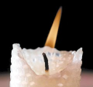
Density of Carbon Dioxide
Carbon
Dioxide
CO₂
Density Air = 1.29 g/L
Density CO₂ = 1.96 g/L
Carbon
Dioxide
CO₂

Slide 98
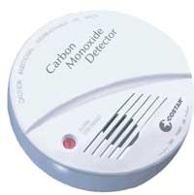
Carbon Dioxide Detector
Where is the best location to place a CO₂ detector in your home?
Recall: Density Air = 1.29 g/L
Density CO₂ = 1.96 g/L
Top floor of home
B. Basement (near ceiling)
Basement (near floor)
It doesn’t matter, if your batteries are dead in the detector
Basement (near floor) Carbon dioxide is denser than air and sinks.

Slide 99
Symptoms of CO Poisoning
Concentration of CO in air (ppm)* | Hemoglobin molecules as HbCO | Visible effects
100 for 1 hour or less | 10% or less | no visible symptoms
500 for 1 hour or less | 20% | mild to throbbing headache, some dizziness, impaired perception
500 for an extended period of time | 30 - 50% | headache, confusion, nausea, dizziness, muscular weakness, fainting
1000 for 1 hour or less | 50 - 80% | coma, convulsions, respiratory failure, death
*ppm is parts per million
Davis, Metcalfe, Williams, Castka, Modern Chemistry, 1999, page 760

Slide 100
Carbon Monoxide Poisoning ‘The Silent Killer’
Hemoglobin (Hb) binds with carbon monoxide (CO) in the capillaries of the lungs.
Poisoning: Hb + CO → HbCO
If caught in time, giving pure oxygen (O₂) revives victim of CO poisoning.
Treatment causes carboxyhemoglobin (HbCO) to be converted slowly to
oxyhemoglobin (HbO₂).
Treatment: O₂ + HbCO → CO + HbO₂
Carbon monoxide, CO, has almost 200 times the affinity to bind
with hemoglobin, Hb, in the blood as does oxygen, O₂.
Davis, Metcalfe, Williams, Castka, Modern Chemistry, 1999, page 760
Notes:
Look for web site to link for more information:
carbon monoxide detectors
number of deaths/year in US
medical treatment

Slide 101
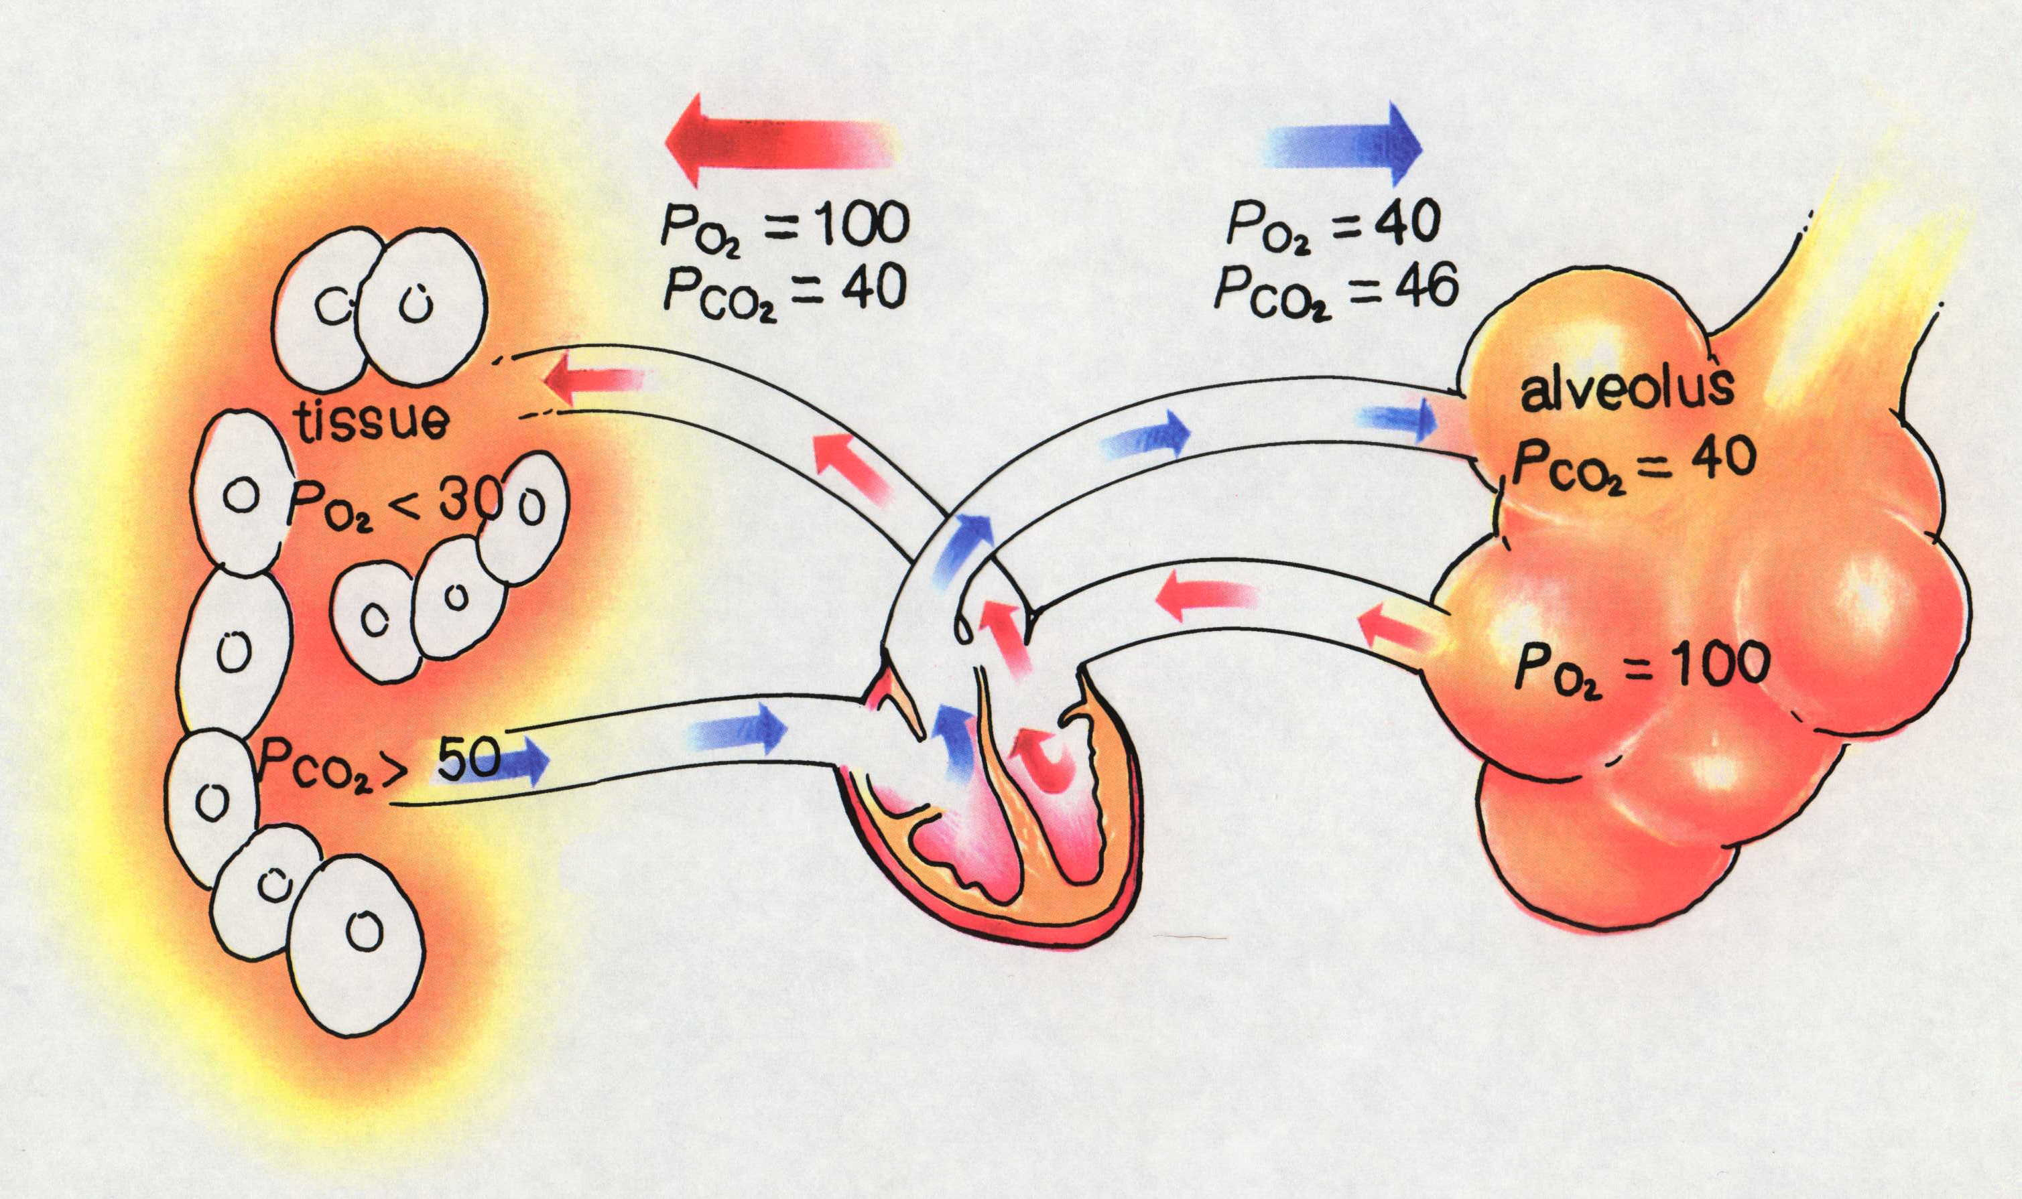
Exchange of Blood Gases
Notes:
The diffusion of oxygen and carbon dioxide across the membranes of the alveoli and tissues during the exchange of blood gases.

Slide 102
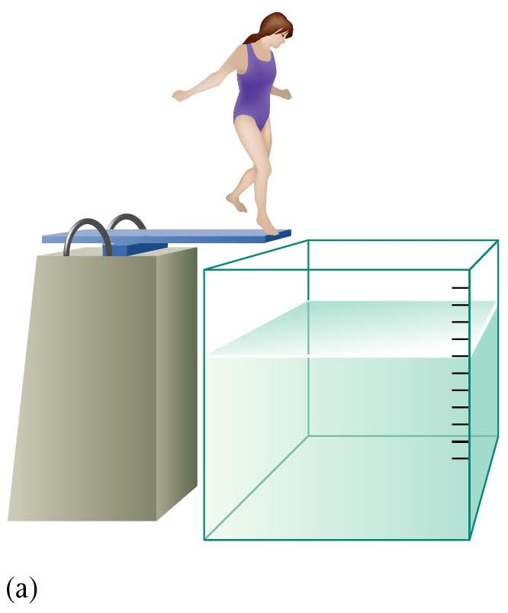
Tank of Water
Zumdahl, Zumdahl, DeCoste, World of Chemistry 2002, page 143

Slide 103
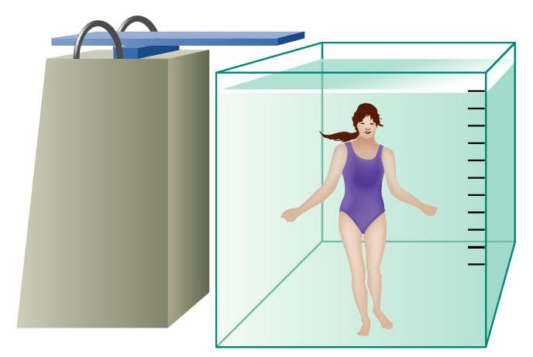
Person Submerged in Water
Zumdahl, Zumdahl, DeCoste, World of Chemistry 2002, page 143
Notes:
Archimedes Principle: water displacement method to find the volume of an irregularly shaped object.
The volume the water level increased is equal to the volume of the submerged object.

Slide 104
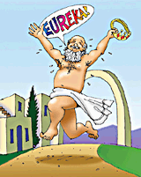
Archimedes Principle
Thread
V_{final} = 88.5 cm³
- V_{initial} = 44.5 cm³
V_{fishing} _{sinker} = 44.0 cm³
88.5 cm³
44.5 cm³
Fishing sinker
Water
Before immersion
After immersion

Slide 105
Galilean Thermometer
Density = Mass / Volume
Mass is constant
Volume changes with temperature
Increase temperature → larger volume
In the Galilean thermometer, the small glass bulbs are partly filled with a different (colored) liquid. Each is filled with a slightly different amount, ranging from lightest at the uppermost bulb to heaviest at the lowermost bulb. The clear liquid in which the bulbs are submerged is not water, but some inert hydrocarbon (probably chosen because its density varies with temperature more than that of water does).
Temp = 68 ºC

Slide 106
Galilean Thermometer
In the Galilean thermometer, the small glass bulbs are partly filled with a different (colored) liquid. Each is filled with a slightly different amount, ranging from lightest at the uppermost bulb to heaviest at the lowermost bulb. The clear liquid in which the bulbs are submerged is not water, but some inert hydrocarbon (probably chosen because its density varies with temperature more than that of water does).
The correct temperature is the lowest floating bulb. As temperature increases, density of the clear medium decreases (and bulbs sink).
RECALL: Density equals mass / volume.
76ºF 68 ºF
80º
80º
76º
76º
72º
72º
68º
68º
64º
64º

Slide 107
Density
how heavy something is for its size
the ratio of mass to volume for a substance
D = M / V
Independent of how much of it you have
gold - high density
air low density.

Slide 108
Derived Units
Combination of base units.
Volume (m³ or cm³)
length × length × length
1 cm³ = 1 mL
1 dm³ = 1 L
M
V
Density (kg/m³ or g/cm³)
mass per volume
D =
Courtesy Christy Johannesson www.nisd.net/communicationsarts/pages/chem

Slide 109
Calculating
The formula tells you how
units will be g/mL or g/cm³
A piece of wood has a mass of 11.2 g and a volume of 23 mL what is the density?
A piece of wood has a density of 0.93 g/mL and a volume of 23 mL what is the mass?

Slide 110
Calculating
A piece of wood has a density of 0.93 g/mL and a mass of 23 g what is the volume?
The units must always work out.
Algebra 1
Get the thing you want by itself, on the top.
What ever you do to onside, do to the other

Slide 111
Floating
Lower density floats on higher density.
Ice is less dense than water.
Most wood is less dense than water
Helium is less dense than air.
A ship is less dense than water

Slide 112
Density of water
1 g of water is 1 mL of water.
density of water is 1 g/mL
at 4ºC
otherwise it is less

Slide 113
D. Density
Mass (g)
Volume (cm³)
Courtesy Christy Johannesson www.nisd.net/communicationsarts/pages/chem

Slide 114
Problem-Solving Steps
1. Analyze
2. Plan
3. Compute
4. Evaluate
Courtesy Christy Johannesson www.nisd.net/communicationsarts/pages/chem

Slide 115
D. Density
An object has a volume of 825 cm³ and a density of 13.6 g/cm³. Find its mass.
GIVEN:
V = 825 cm³
D = 13.6 g/cm³
M = ?
WORK:
M = DV
M = (13.6 g/cm³)(825cm³)
M = 11,200 g
Courtesy Christy Johannesson www.nisd.net/communicationsarts/pages/chem

Slide 116
Density
A liquid has a density of 0.87 g/mL. What volume is occupied by 25 g of the liquid?
GIVEN:
D = 0.87 g/mL
V = ?
M = 25 g
WORK:
V = M
D
V = 25 g
0.87 g/mL
V = 29 mL
Courtesy Christy Johannesson www.nisd.net/communicationsarts/pages/chem

Slide 117
Measuring Temperature
0ºC
Celsius scale.
water freezes at 0ºC
water boils at 100ºC
body temperature 37ºC
room temperature 20 - 25ºC

Slide 118
Measuring Temperature
273 K
Kelvin starts at absolute zero (-273 º C)
degrees are the same size
C = K -273
K = C + 273
Kelvin is always bigger.
Kelvin can never be negative.

Slide 119
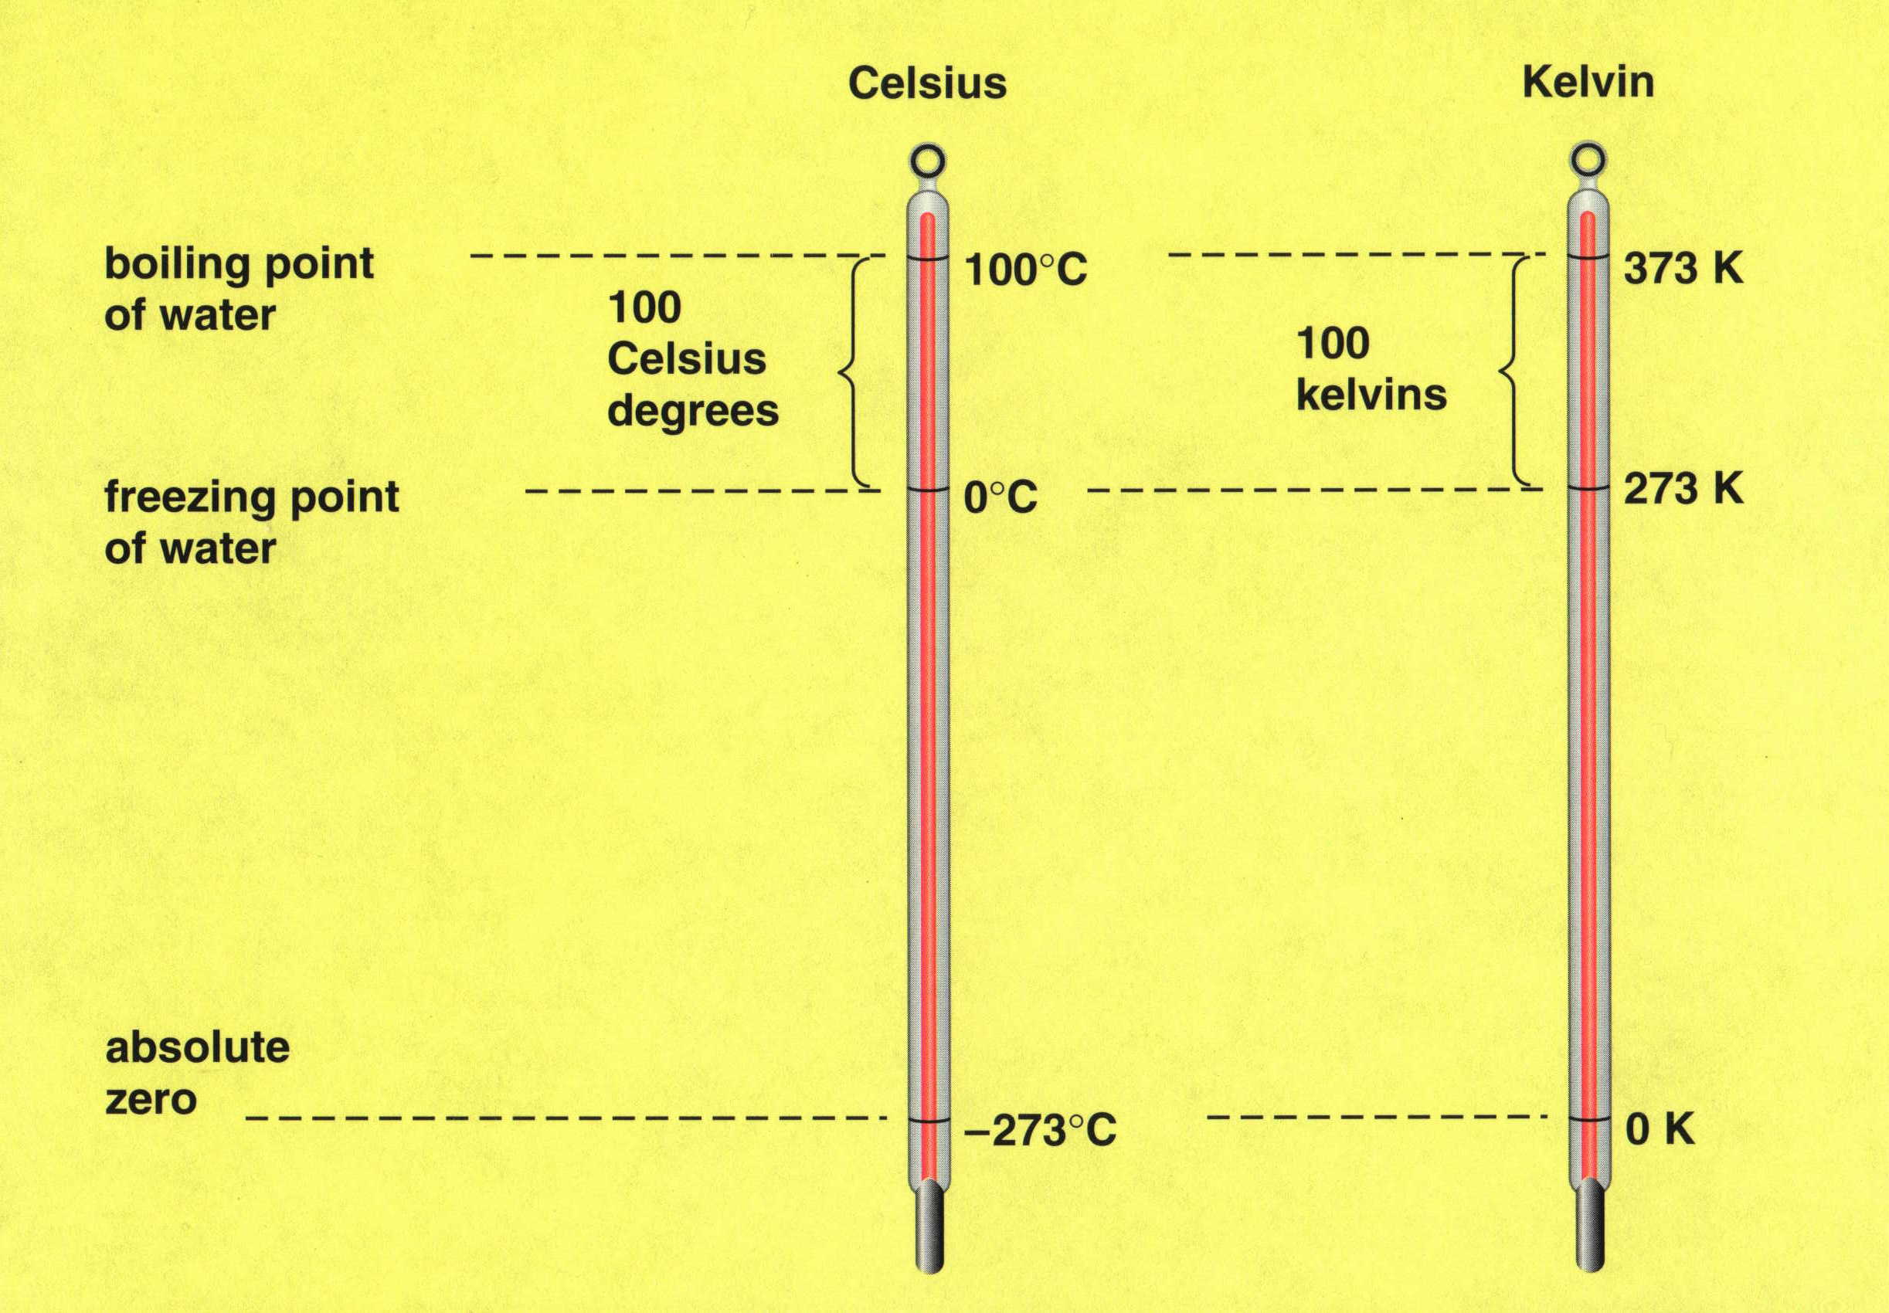
Celcius & Kelvin Temperature Scales

Slide 120
Temperature is Average Kinetic Energy
“HOT” “COLD”
Fast Slow
Kinetic Energy (KE) = ½ m v²
*Vector = gives direction and magnitude
Notes:
Average Kinetic Energy is temperature. Mathematically, kinetic energy (avg) = ½ mv².
Total kinetic energy is what we call heat.
Heat is measured with an instrument called a calorimeter.
Temperature is measured with an instrument called a thermometer.

Slide 121
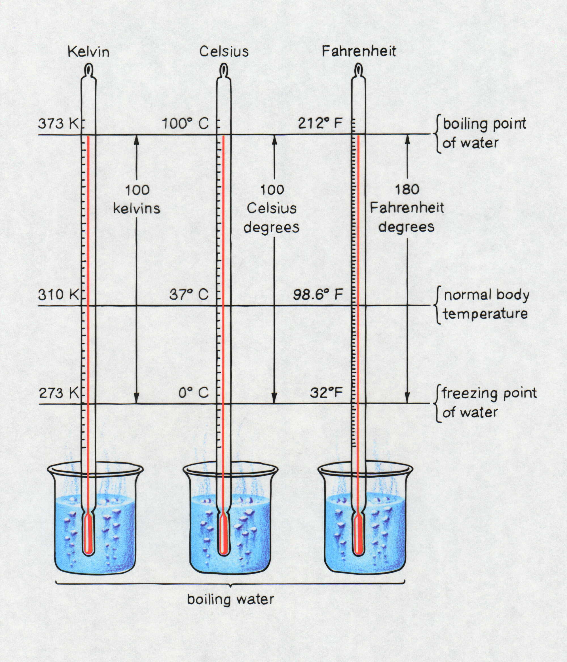
A Comparison of Scales
Timberlake, Chemistry 7th Edition, page 205

Slide 122
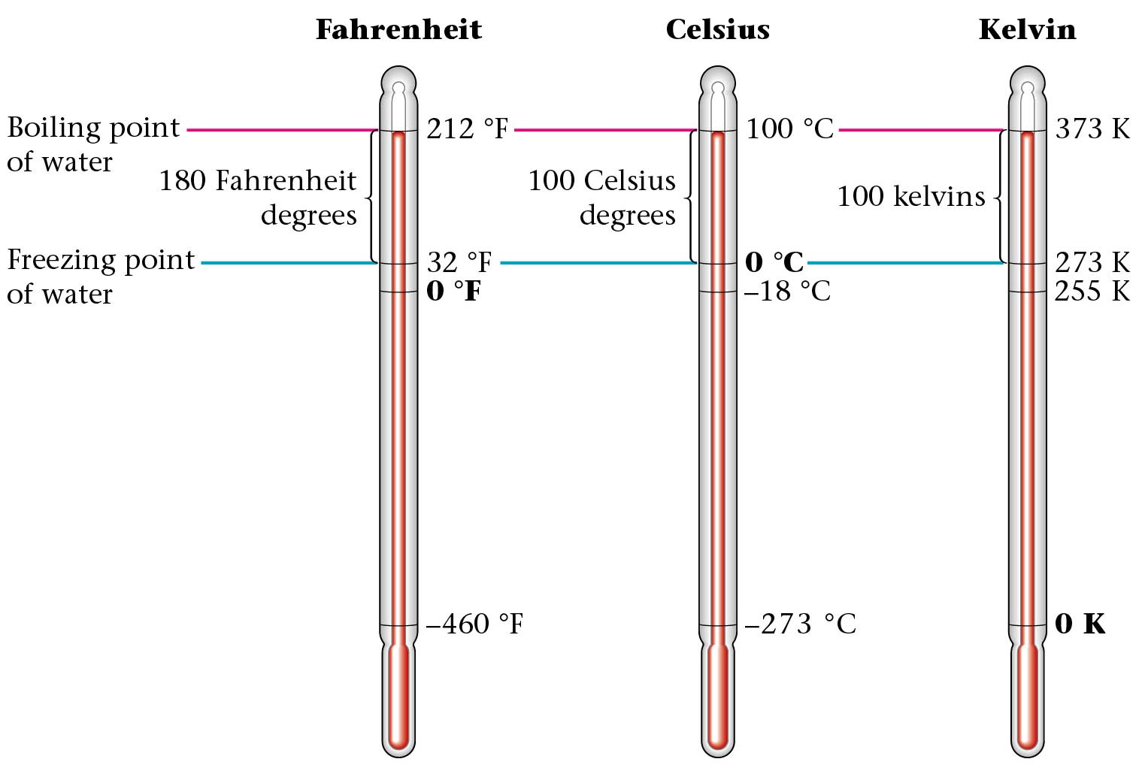
Temperature Scales
Zumdahl, Zumdahl, DeCoste, World of Chemistry 2002, page 136
Notes:
An absolute English scale exists called the Rankin scale.
On the Kelvin scale it is NOT possible to have a negative temperature.

Slide 123
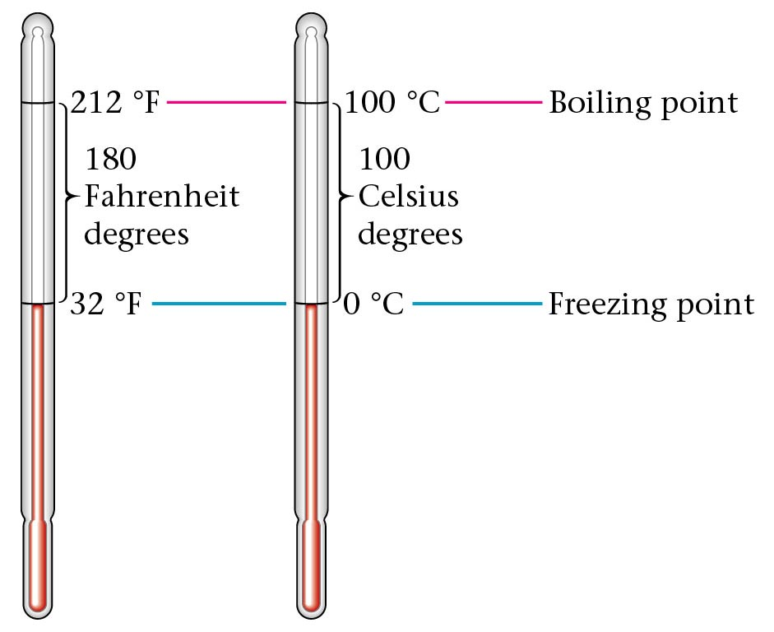
Compare Celcius to Fahrenheit
ºF – 32 = 1.8 ºC
Zumdahl, Zumdahl, DeCoste, World of Chemistry 2002, page 139

Slide 124
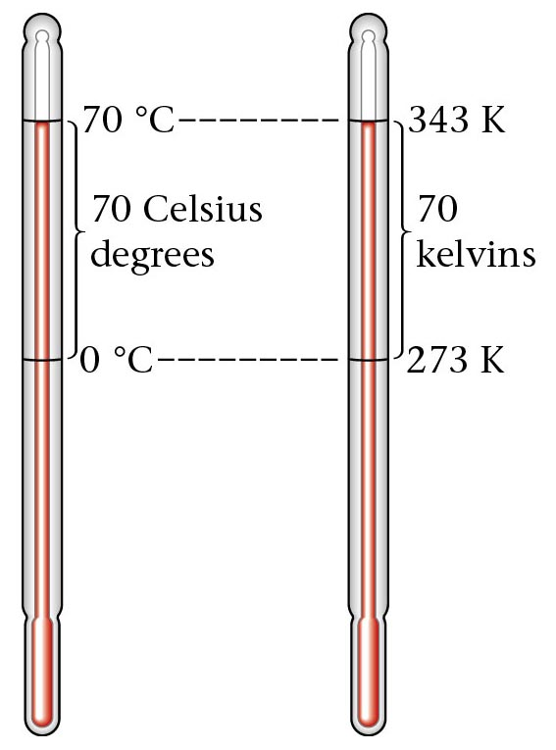
Converting 70º C to Kelvin units
ºC + 273 = K
Zumdahl, Zumdahl, DeCoste, World of Chemistry 2002, page 137

Slide 125
Temperature Scales
Temperature can be subjective and so fixed scales had to be introduced.
The boiling point and freezing point of water are two such points.
Celcius scale (ºC)
The Celcius scale divides the range from freezing to boiling into 100 divisions.
Original scale had freezing as 100 and boiling as 0.
Today freezing is 0 ºC and boiling is 100 ºC.
Fahrenheit scale (ºF)
Mercury and alcohol thermometers rely on thermal expansion

Slide 126
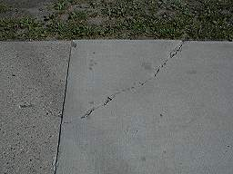
Thermal Expansion
Most objects e-x-p-a-n-d when heated
Large structures such as bridges must be built to leave room for thermal expansion
All features expand together
Cracks in sidewalk.
COLD
HOT

Slide 127
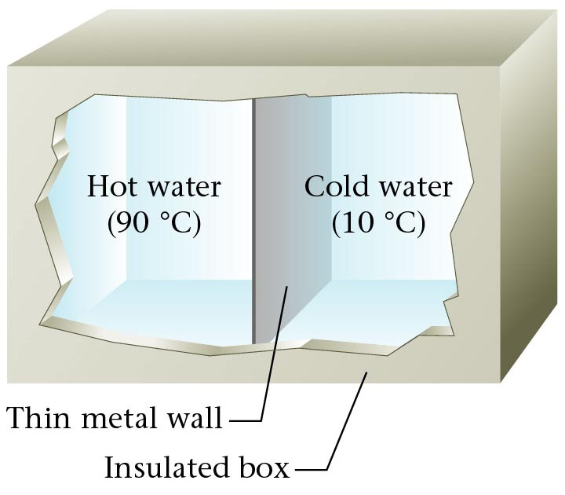
Equal Masses of Hot and Cold Water
Thin metal wall
Insulated box
Zumdahl, Zumdahl, DeCoste, World of Chemistry 2002, page 291

Slide 128
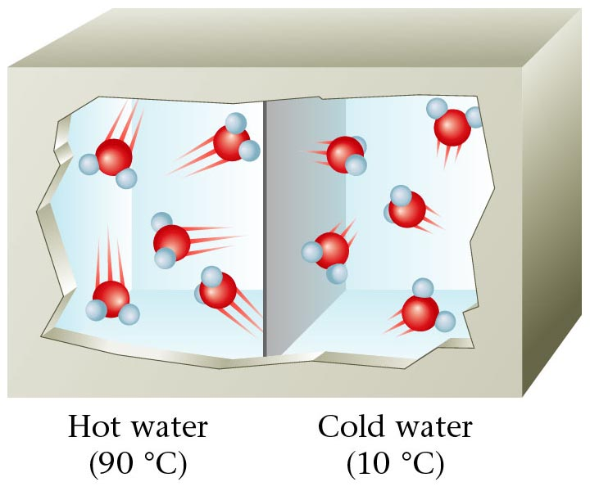
Water Molecules in Hot and Cold Water
Hot water Cold Water
90 ºC 10 ºC
Zumdahl, Zumdahl, DeCoste, World of Chemistry 2002, page 291

Slide 129
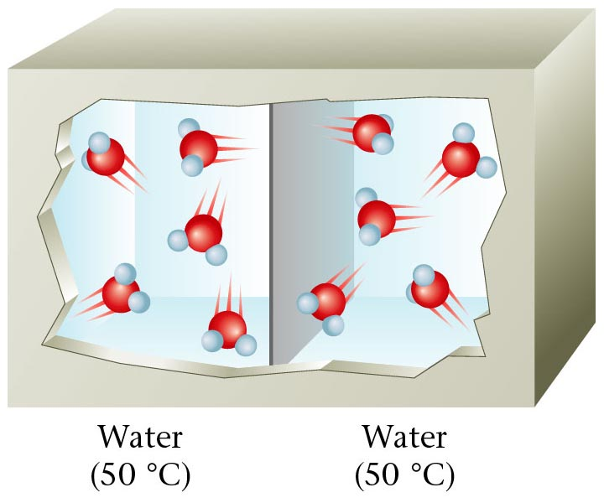
Water Molecules in the same temperature water
Water
(50 ºC)
Water
(50 ºC)
Zumdahl, Zumdahl, DeCoste, World of Chemistry 2002, page 291

Slide 130
Heat
a form of energy

Slide 131
Temperature is different
than heat.
Temperature is which way heat will flow (from hot to cold)
Heat is energy, ability to do work.
A drop of boiling water hurts,
kilogram of boiling water kills

Slide 132
Units of heat are
calories or Joules
1 calorie is the amount of heat needed to raise the temperature of 1 gram of water by 1ºC
a food Calorie is really a kilocalorie
How much energy is absorbed to heat 15 grams of water by 25ºC
1 calorie = 4.18 J

Slide 133
Some things heat up easily
some take a great deal of energy to change their temperature.
The Specific Heat Capacity amount of heat to change the temperature of 1 g of a substance by 1ºC
specific heat SH
S.H. = heat (cal) mass(g) x change in temp(ºC)

Slide 134
Specific Heat
table page 42
Water has a high specific heat
1 cal/gºC
units will always be cal/gºC
or J/gºC
the amount of heat it takes to heat something is the same as the amount of heat it gives off when it cools because...

Slide 135
Problems
It takes 24.3 calories to heat 15.4 g of a metal from 22 ºC to 33ºC. What is the specific heat of the metal?
Iron has a specific heat of 0.11 cal/gºC. How much heat will it take to change the temperature of 48.3 g of iron by 32.4ºC?

Slide 136
Resources - Measurement
Objectives

