Slide 1
Research Project
for
Mr. Christopherson’s
Advanced Chemistry
March 2002

Slide 2
Table of Contents
How to Choose a Topic
How Do I Get Started
Scientific Method
Professional Presentation
Presentation
What is Needed
Time Line
Bonus Points
Penalties

Slide 3
How to Choose a Topic
Related to Chemistry
Can perform an experiment and research background on subject
Availability of materials (chemicals, equipment).
Question to research
(What do you want to find out?)

Slide 4
How Do I Get Started?
Choose a Lab Partner
Pick a topic that interests you.
Look at ChemMatters, internet, or textbook for ideas
Apply the scientific method
Cost may not exceed $15 / group
Must give me a materials list before beginning

Slide 5
Scientific Method
Gather information – background
Propose a hypothesis
Set up a controlled experiment
Repeat experiment and process quantitative data (is it statistically meaningful?)

Slide 6
Scientific Method (cont’d)
Reformulate your hypothesis
Ask another question and redesign your experimental design with ‘new’ information you’ve learned
Synthesize your data and draw valid conclusions

Slide 7
Professional Presentation
Present your research in a professional manner (PowerPoint)
Include references and appropriate Internet sites (embedded in presentation)
Include data table of materials cost
Include digital photos of lab apparatus
Include graphs when appropriate

Slide 8
Presentation
Introduction – overview of what you’ll present
Background – include definitions
Experimental Design – variables you examined
Materials and Methods – experimental protocol
Data – what you measured and observed
Data Interpretation
Analysis
Links
References

Slide 9
What is Needed
Daily log book – typed copy AND handwritten copy
Handout of PowerPoint and presentation on disk
Questions or worksheet for class
Limitations
Future directions of research if time permits
Step-by-step directions for someone to follow your research
Everything must be typed

Slide 10
Timeline
Five Weeks (work on PowerPoint throughout time)
Week One – Background research
Week Two – Experiment in lab
Week Three – Modify experiment
Week Four – Process Data
Week Five – PowerPoint presentation

Slide 11
BONUS POINTS
Questions that must be answered by linking to your PowerPoint hyperlinks
Demonstrations that involve classmates during presentation
Collaborative research with another group
Flow chart of experimental design

Slide 12
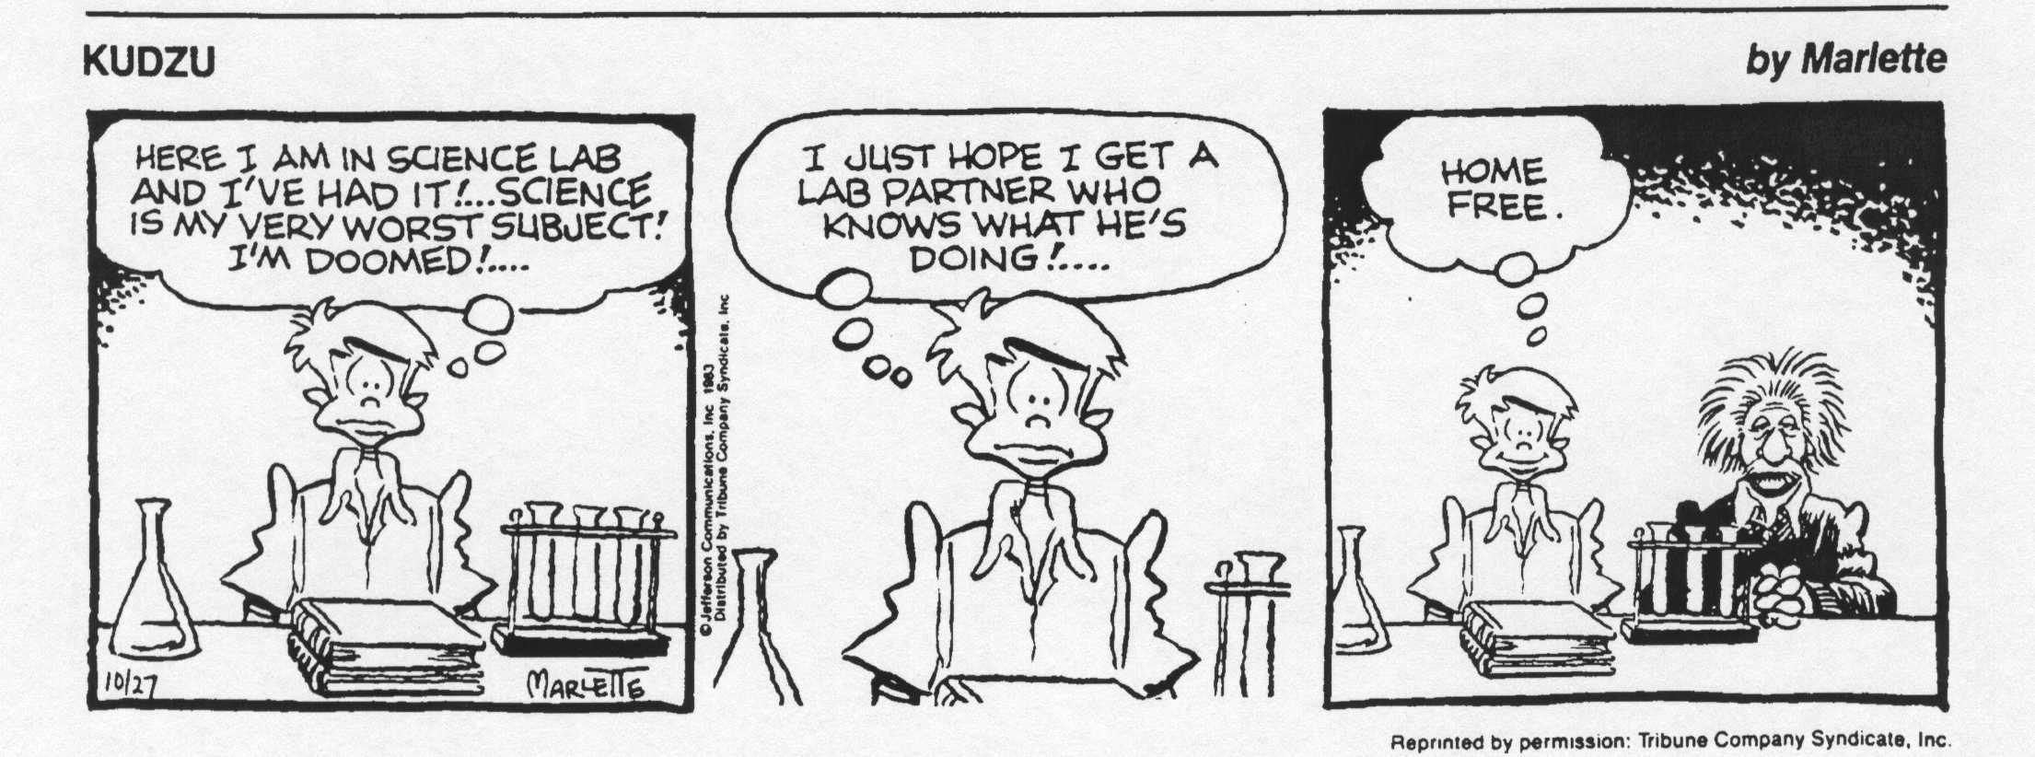
How to pick a lab partner
?
Groups may consist of two or three students ONLY!

Slide 13
Penalties
Absence from class (5 points / day)
Not cleaning up and putting away materials
(1 – 5 points / episode)
Off task / inappropriate behavior
Not prepared for Friday group meetings
Paperwork and /or research not completed in timely manner
Professional delivery of research to class

Slide 14
Possible Topics
Mortuary science
Nuclear Weapons
Chemistry of Warfare
Nuclear Power
Nuclear Waste Disposal
Rechargeable batteries
Pesticides and Herbicides
Yogurt
Greenhouse effect
Nylon Production
Alcohol Manufacturing
Thalidomide
Tokamak – Fusion
Nuclear Fission
Synthetic Products
Biodegradable materials
Forensic science
Poison ivy (histamines)
Aluminum recycling
Photography
Food Flavoring

Slide 15
Topics (cont’d)
Mining and Ore extraction
Oil spill clean-up
Insect pheromones
Catalytic Converters
Perfumes
Wastewater treatment
Dyeing clothes
Polymers
Enzymes (biological systems)
Western vs. Eastern medicine (herbs vs. pills)
Ab initio calculations
Food preservatives
Ozone depletion
Immunology

