Slide 1
Benzene
C₆H₆
Uses: styrene; phenol; synthetic detergents; cyclohexane for nylon; DDT; insecticides; fumigants; solvent; paint removers; rubber cement; antiknock gasoline

Slide 2
Phenol, (carbolic acid)
C₆H₅OH
Uses: solvent for refining lubricating oils; salicylic acid; phenoltpthalein; germicidal paints; pharmaceuticals; laboratory reagent; slimicide
Notes:
Derivative: ~75% of the phenol produced in the United States is made by the oxidation of cumene, yielding acetone as a by-product.

Slide 3
2,4,6 -Trinitrotoluene
CH₃C₆H₂(NO₂) ₃
Uses: Explosives; intermediate in dyestuffs and photographic chemicals
Will detonate only if vigorously shocked or heated to 450ºF

Slide 4
Buckeyball

Slide 5
Butane
C₄H₁₀
Uses: organic synthesis; raw material for synthetic rubber and high-octane liquid fuels; propellant in aerosols
Extremely stable; has no corrosive action on metal; does not react with moisture

Slide 6
Mg Flashbulb - Camera

Slide 7
Mg Flashbulb, Camera

Slide 8
Tongs

Slide 9
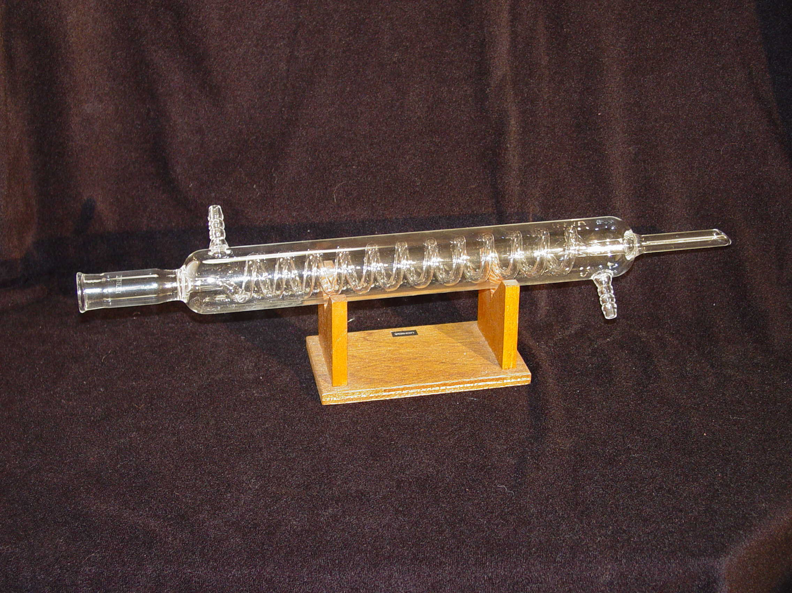
Condensor

Slide 10
Gas Cylinder - Manometer

Slide 11
Carbon Dioxide

Slide 12
Methane

Slide 13
Propane

Slide 14
Methyl Propane

Slide 15
Methyl Propane

Slide 16
Ice Crystals

Slide 17
Burners

Slide 18
pH Measuring

Slide 19
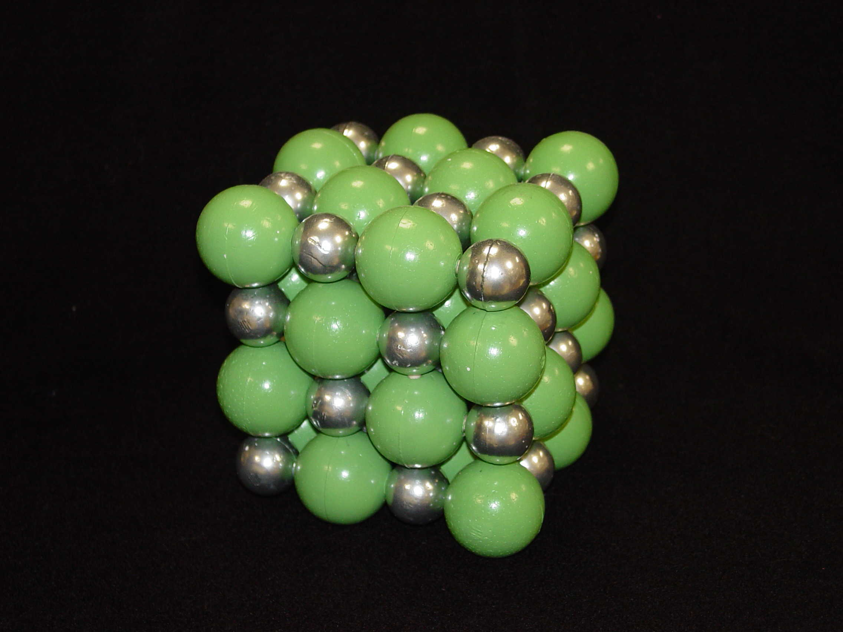
Salt, NaCl

Slide 20
Ground Glass Bottles

Slide 21
Funnels

Slide 22
Buchner Funnel

Slide 23
Dessicator

Slide 24
Chemical Storage Bottles
Lid Color = SAFETY
Green – NH₄OH
Blue – HCl
Yellow – H₂SO₄

Slide 25
Odd Equipment

Slide 26
Bent

Slide 27
Octahedron

Slide 28
Alcohol, R-OH

Slide 29
Aldehyde
Aldehydes end
with –al.
e.g., Ethanal
CH₃COH

Slide 30
Carboxylic Acid
Carboxylic acid
ends –ic acid.
e.g., Ethanoic acid
CH₃COOH

Slide 31
Ester
Ester ends with -oate
Name R’ first
e.g., methyl ethanoate
CH₃COOCH₃

Slide 32
Amine

Slide 33
Clay Triangle

Slide 34
Mortar and Pestal

Slide 35
Cermaic Dishes
Evaporating Dish
Crucible with lid

Slide 36
Microwell Plates

Slide 37
Beakers

Slide 38
Erlenmeyer Flask

Slide 39
Florence Flask

Slide 40
Graduated Cylinder

Slide 41
Graphite

Slide 42
Thermite – Iron Frypan

Slide 43
Molasses

Slide 44
The Mole

Slide 45
Benzene
C₆H₆
Uses: styrene; phenol; synthetic detergents; cyclohexane for nylon; DDT; insecticides; fumigants; solvent; paint removers; rubber cement; antiknock gasoline

Slide 46
Phenol, (carbolic acid)
C₆H₅OH
Uses: solvent for refining lubricating oils; salicylic acid; phenoltpthalein; germicidal paints; pharmaceuticals; laboratory reagent; slimicide
Notes:
Derivative: ~75% of the phenol produced in the United States is made by the oxidation of cumene, yielding acetone as a by-product.

Slide 47
2,4,6 -Trinitrotoluene
CH₃C₆H₂(NO₂) ₃
Uses: Explosives; intermediate in dyestuffs and photographic chemicals
Will detonate only if vigorously shocked or heated to 450ºF

Slide 48
Butane
C₄H₁₀
Uses: organic synthesis; raw material for synthetic rubber and high-octane liquid fuels; propellant in aerosols
Extremely stable; has no corrosive action on metal; does not react with moisture

Slide 49
Propane

Slide 50
Methyl Propane

Slide 51
Aldehyde
Aldehydes end
with –al.
e.g., Ethanal
CH₃COH

Slide 52
Carboxylic Acid
Carboxylic acid
ends –ic acid.
e.g., Ethanoic acid
CH₃COOH

Slide 53
Ester
Ester ends with -oate
Name R’ first
e.g., methyl ethanoate
CH₃COOCH₃

