Slide 1
Covalent Bonding
…electrons are shared

Slide 2
World of Chemistry The Annenberg Film Series
VIDEO ON DEMAND
Episode 8 – Chemical Bonds
Elements bond to form compounds by giving, taking, or sharing electrons. The differences between ionic and covalent bonds are
explained by the use of scientific models and examples from nature.
VIDEO ON DEMAND
Episode 9 – Molecular Architecture
The shape and physical properties of a molecule are determined by the electronic structure of its elements and their bonds.
How living organisms distinguish between similar molecules (isomers) is revealed.
Notes:
Video 08: Chemical Bonds The differences between ionic and covalent bonds are explained by the use of scientific models and examples from nature. (added 2006/10/08) World of Chemistry > http://www.learner.org/vod/vod_window.html?pid=800
Video 09: Molecular Architecture The program examines isomers and how the electronic structure of a molecule's elements and bonds affects its shape and physical properties. (added 2006/10/08) World of Chemistry > http://www.learner.org/vod/vod_window.html?pid=801
Journey through the exciting world of chemistry with Nobel laureate Roald Hoffman as your guide.
The foundations of chemical structures and their behavior are explored through computer animation,
demonstrations, and on-site footage at working industrial and research labs. Distinguished scientists
discuss yesterday’s breakthroughs and today’s challenged.
Produced by the University of Maryland and the Educational Film Center.
Released on cassette: Fall 1989 The Annenberg/ / CPB Collection 1-800-LEARNER

Slide 3
Guiding Questions?
Why are some thing liquids at room temperature
and other things gases or solids?
How are shapes of molecules determined?
How do Splenda and other artificial sweeteners
work?
How do bees tell the difference between a worker
and the queen?
How do intermolecular forces affect the structure
of proteins and DNA?
Notes:
The shape of a molecule can be used to predict the properties of that molecule.
The shape of a molecule is determined by the electron arrangement of the atoms that make up the molecule
More Specifically...:
Bonding Model
Define covalent bonding as a bond in which electrons are shared
Use electronegitivity difference to distinguish between polar and non-polar bonds
Contrast the intermolecular forces exhibited by ionic, polar, and non-polar bonds
a. ion-dipole interactions,
b. dipole-dipole interactions,
c. Hydrogen bonds and
d. London dispersion forces
Draw Lewis structures for covalent compounds including resonance structures
State that bonds form when orbitals overlap
Briefly describe hybridization of orbitals in methane
Use the VSEPR (Valence Shell Electron Pair Repulsion) model to predict the geometric shape of simple molecules and polyatomic ions
a. bent, linear, trigonal planar, tetrahedral, and trigonal pyramidal
Construct models of molecules and polyatomic ions to illustrate their predicted geometric shapes
Predict the polarity of molecules by using the VSEPR model for molecules containing polar covalent bonds
Nomenclature and formulas
Distinguish between empirical, molecular, and structural formulas
Name covalent compounds using the greek prefix system of mono, di, tri etc.
Write chemical formulas given the name of a compound
Choose the appropriate naming rules for a given chemical formula
Write the chemical formulas for certain common substances, such as ammonia, water, carbon monoxide, carbon dioxide, sulfur dioxide, and carbon tetraflouride.
Math
Calculate percent composition
Determine empirical and molecular formulas from experimental data

Slide 4
How does H₂ form?
The nuclei repel
But they are attracted to electrons
They share the electrons
+
+

Slide 5
Covalent bonds
Nonmetals hold onto their valence electrons.
They can’t give away electrons to bond.
Still want noble gas configuration.
Get it by sharing valence electrons with each other.
By sharing both atoms get to count the electrons toward noble gas configuration.
1s²2s²2p⁶3s²3p⁶…eight valence electrons (stable octet)

Slide 6
Covalent bonding
Fluorine has seven valence electrons
A second atom also has seven
By sharing electrons
…both end with full orbitals
8 Valence
electrons
8 Valence
electrons
F
F

Slide 7
Single Covalent Bond
A sharing of two valence electrons.
Only nonmetals and Hydrogen.
Different from an ionic bond because they actually form molecules.
Two specific atoms are joined.
In an ionic solid you can’t tell which atom the electrons moved from or to.

Slide 8
How to show how they formed
It’s like a jigsaw puzzle.
I have to tell you what the final formula is.
You put the pieces together to end up with the right formula.
For example- show how water is formed with covalent bonds.

Slide 9
Water
Each hydrogen has 1 valence electron
Each hydrogen wants 1 more
The oxygen has 6 valence electrons
The oxygen wants 2 more
They share to make each other happy
H
O

Slide 10
Water
Put the pieces together
The first hydrogen is happy
The oxygen still wants one more
H
O

Slide 11
Water
The second hydrogen attaches
Every atom has full energy levels
A pair of electrons is a single bond
H
O
H
O
H
H

Slide 12
Lewis Structures
1) Count up total number of valence electrons
2) Connect all atoms with single bonds
- “multiple” atoms usually on outside
- “single” atoms usually in center;
C always in center,
H always on outside.
3) Complete octets on exterior atoms
(not H, though)
4) Check
- valence electrons math with Step 1
- all atoms (except H) have an octet;
if not, try multiple bonds
- any extra electrons?
Put on central atom

Slide 13
Multiple Bonds
Sometimes atoms share more than one pair of valence electrons.
A double bond is when atoms share two pair (4) of electrons.
A triple bond is when atoms share three pair (6) of electrons.

Slide 14
Carbon dioxide
CO₂ - Carbon is central atom ( I have to tell you)
Carbon has 4 valence electrons
Wants 4 more
Oxygen has 6 valence electrons
Wants 2 more
C
O

Slide 15
Carbon dioxide
Attaching 1 oxygen leaves the oxygen 1 short and the carbon 3 short
C
O

Slide 16
Carbon dioxide
Attaching the second oxygen leaves both oxygen 1 short and the carbon 2 short
O
C
O

Slide 17
Carbon dioxide
The only solution is to share more
Requires two double bonds
Each atom gets to count all the atoms in the bond
8 valence electrons
8 valence electrons
8 valence electrons
O
C
O

Slide 18
How to draw them
Add up all the valence electrons.
Count up the total number of electrons to make all atoms happy.
Subtract.
Divide by 2
Tells you how many bonds - draw them.
Fill in the rest of the valence electrons to fill atoms up.

Slide 19
Examples
N
NH₃
N - has 5 valence electrons wants 8
H - has 1 valence electrons wants 2
NH₃ has 5+3(1) = 8
NH₃ wants 8+3(2) = 14
(14-8)/2= 3 bonds
4 atoms with 3 bonds
H

Slide 20
Examples
Draw in the bonds
All 8 electrons are accounted for
Everything is full
H
H
N
H

Slide 21
Examples
HCN C is central atom
N - has 5 valence electrons wants 8
C - has 4 valence electrons wants 8
H - has 1 valence electrons wants 2
HCN has 5+4+1 = 10
HCN wants 8+8+2 = 18
(18-10)/2= 4 bonds
3 atoms with 4 bonds -will require multiple bonds - not to H

Slide 22
HCN
Put in single bonds
Need 2 more bonds
Must go between C and N
H
C
N

Slide 23
HCN
Put in single bonds
Need 2 more bonds
Must go between C and N
Uses 8 electrons - 2 more to add
H
C
N

Slide 24
HCN
Put in single bonds
Need 2 more bonds
Must go between C and N
Uses 8 electrons - 2 more to add
Must go on N to fill octet
H
C
N

Slide 25
Another way of indicating bonds
Often use a line to indicate a bond
Called a structural formula
Each line is 2 valence electrons
H
O
H
H
O
H
=

Slide 26
Structural Examples
C has 8 electrons because each line is 2 electrons
Ditto for N
Ditto for C here
Ditto for O
H C N
H
C O
H

Slide 27
Coordinate Covalent Bond
When one atom donates both electrons in a covalent bond.
Carbon monoxide
CO
C
O

Slide 28
Coordinate Covalent Bond
When one atom donates both electrons in a covalent bond.
Carbon monoxide
CO
C
O

Slide 29
Coordinate Covalent Bond
When one atom donates both electrons in a covalent bond.
Carbon monoxide
CO
C
O

Slide 30
How do we know if
Have to draw the diagram and see what happens.
Often happens with polyatomic ions and acids.

Slide 31
Bond Energy
Multiple Bonds, Average Energy (KJ/mole)
C C | 614 | N O | 607
C C | 839 | N N | 418
O O | 495 | N N | 941
C O | 745 | C N | 891
C O | 1072 | C N | 615
It is the energy required to break a bond.
It gives us information about the strength of a bonding interaction.
Notes:
http://www.sciencegeek.net/Chemistry/Powerpoints.shtml

Slide 32
Resonance
When more than one dot diagram with the same connections are possible.
NO₂⁻
Which one is it?
Does it go back and forth.
It is a mixture of both, like a mule.
NO₃⁻

Slide 33
VSEPR
Valence Shell Electron Pair Repulsion.
Predicts three dimensional geometry of molecules.
Name tells you the theory.
Valence shell - outside electrons.
Electron Pair repulsion - electron pairs try to get as far away as possible.
Can determine the angles of bonds.

Slide 34
VSEPR
Based on the number of pairs of valence electrons both bonded and unbonded.
Unbonded pair are called lone pair.
CH₄ - draw the structural formula
Has 4 + 4(1) = 8
wants 8 + 4(2) = 16
(16-8)/2 = 4 bonds

Slide 35
VSEPR
Single bonds fill all atoms.
There are 4 pairs of electrons pushing away.
The furthest they can get away is 109.5º.
H
H
C
H
H

Slide 36
4 atoms bonded
Basic shape is tetrahedral.
A pyramid with a triangular base.
Same shape for everything with 4 pairs.
H
109.5º
C
H
H
H

Slide 37
3 bonded - 1 lone pair
Still basic tetrahedral but you can’t see the electron pair.
Shape is called trigonal pyramidal.
H
N
H
N
H
H
H
H
<109.5º

Slide 38
2 bonded - 2 lone pair
Still basic tetrahedral but you can’t see the 2 lone pair.
Shape is called bent.
H
O
O
H
H
H
<109.5º

Slide 39
3 atoms no lone pair
The farthest you can the electron pair apart is 120º
H
C
O
H

Slide 40
3 atoms no lone pair
The farthest you can the electron pair apart is 120º.
Shape is flat and called trigonal planar.
H
120º
H
C
C
O
H
O
H

Slide 41
2 atoms no lone pair
With three atoms the farthest they can get apart is 180º.
Shape called linear.
180º
O
C
O

Slide 42
Hybrid Orbitals
Combines bonding with geometry

Slide 43
Hybridization
The mixing of several atomic orbitals to form the same number of hybrid orbitals.
All the hybrid orbitals that form are the same.
sp³ -1 s and 3 p orbitals mix to form 4 sp³ orbitals.
sp² -1 s and 2 p orbitals mix to form 3 sp² orbitals leaving 1 p orbital.
sp -1 s and 1 p orbitals mix to form 4 sp orbitals leaving 2 p orbitals.

Slide 44
Hybridization
We blend the s and p orbitals of the valence electrons and end up with the tetrahedral geometry.We combine one s orbital and 3 p orbitals. sp³ hybridization has tetrahedral geometry.

Slide 45
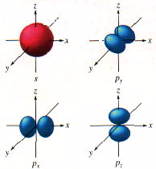
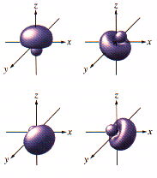

Slide 46
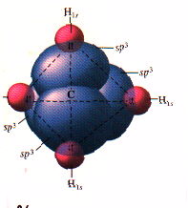

Slide 47
sp³ geometry
This leads to tetrahedral shape.
Every molecule with a total of 4 atoms and lone pair is sp³ hybridized.
Gives us trigonal pyramidal and bent shapes also.
109.5º

Slide 48
How we get to hybridization
We know the geometry from experiment.
We know the orbitals of the atom hybridizing atomic orbitals can explain the geometry. So if the geometry requires a tetrahedral shape, it is sp³ hybridized. This includes bent and trigonal pyramidal molecules because one of the sp³ lobes holds the lone pair.

Slide 49
sp² hybridization
C₂H₄
double bond acts as one pair
trigonal planar
Have to end up with three blended orbitals use one s and two p orbitals to make sp² orbitals.
leaves one p orbital perpendicular

Slide 50
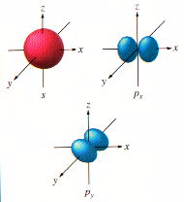
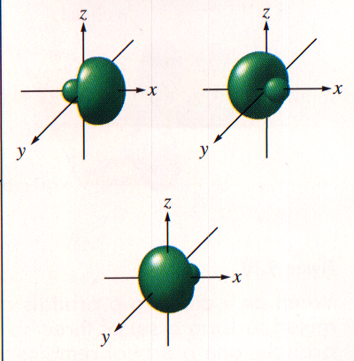

Slide 51
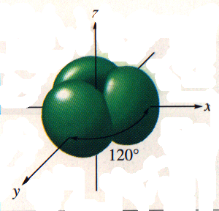

Slide 52
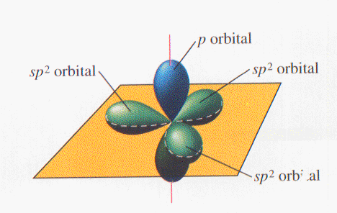
Where is the p orbital?
Perpendicular
The overlap of orbitals makes a sigma bond (σ bond)

Slide 53
Two types of Bonds
Sigma bonds from overlap of orbitals
between the atoms
Pi bond (π bond) above and below atoms
Between adjacent p orbitals.
The two bonds of a double bond

Slide 54
H
H
C
C
H
H

Slide 55
sp² hybridization
when three things come off atom
trigonal planar
120º
one π bond

Slide 56
What about two
when two things come off
one s and one p hybridize
linear

Slide 57
sp hybridization
end up with two lobes 180º apart.
p orbitals are at right angles makes room for two π bonds and two sigma bonds.
a triple bond or two double bonds

Slide 58
CO₂
C can make two σ and two π
O can make one σ and one π
O
C
O

Slide 59
N₂

Slide 60
N₂

Slide 61
Polar Bonds
When the atoms in a bond are the same, the electrons are shared equally.
This is a nonpolar covalent bond.
When two different atoms are connected, the atoms may not be shared equally.
This is a polar covalent bond.
How do we measure how strong the atoms pull on electrons?

Slide 62
Electronegativity
A measure of how strongly the atoms attract electrons in a bond.
The bigger the electronegativity difference the more polar the bond.
0.0 - 0.5 Covalent nonpolar
0.5 - 1.0 Covalent moderately polar
1.0 - 2.0 Covalent polar
> 2.0 Ionic

Slide 63
How to show a bond is polar
Isn’t a whole charge just a partial charge
δ+ means a partially positive
δ− means a partially negative
The Cl pulls harder on the electrons
The electrons spend more time near the Cl
δ+
δ−
H
Cl

Slide 64
Polar Molecules
Molecules with ends

Slide 65
Polar Molecules
Molecules with a positive and a negative end
Requires two things to be true
The molecule must contain polar bonds
This can be determined from differences in electronegativity.
Symmetry can not cancel out the effects of the polar bonds.
Must determine geometry first.

Slide 66
Is it polar?
HF
H₂O
NH₃
CCl₄
CO₂

Slide 67
Bond Dissociation Energy
The energy required to break a bond
C - H + 393 kJ C + H
We get the Bond dissociation energy back when the atoms are put back together
If we add up the BDE of the reactants and subtract the BDE of the products we can determine the energy of the reaction (ΔH)

Slide 68
Find the energy change for the reaction
CH₄ + 2O₂ CO₂ + 2H₂O
For the reactants we need to break 4 C-H bonds at 393 kJ/mol and 2 O=O bonds at 495 kJ/mol= 2562 kJ/mol
For the products we form 2 C=O at 736 kJ/mol and 4 O-H bonds at 464 kJ/mol
= 3328 kJ/mol
reactants - products = 2562-3328 = -766kJ

Slide 69
Intermolecular Forces
What holds molecules to each other

Slide 70
Intermolecular Forces
They are what make solid and liquid molecular compounds possible.
The weakest are called van derWaal’s forces - there are two kinds
Dispersion forces
Dipole Interactions
depend on the number of electrons
more electrons stronger forces
Bigger molecules

Slide 71
Dipole interactions
Depend on the number of electrons
More electrons stronger forces
Bigger molecules more electrons
Fluorine is a gas
Bromine is a liquid
Iodine is a solid

Slide 72
Dipole interactions
Occur when polar molecules are attracted to each other.
Slightly stronger than dispersion forces.
Opposites attract but not completely hooked like in ionic solids.

Slide 73
Dipole interactions
Occur when polar molecules are attracted to each other.
Slightly stronger than dispersion forces.
Opposites attract but not completely hooked like in ionic solids.
δ⁺ δ⁻
δ⁺ δ⁻
H F
H F

Slide 74
Dipole Interactions
δ⁺ δ⁻
δ⁺ δ⁻
δ⁺ δ⁻
δ⁺ δ⁻
δ⁺ δ⁻
δ⁺ δ⁻
δ⁺ δ⁻
δ⁺ δ⁻

Slide 75
Hydrogen bonding
Are the attractive force caused by hydrogen bonded to F, O, or N.
F, O, and N are very electronegative so it is a very strong dipole.
The hydrogen partially share with the lone pair in the molecule next to it.
The strongest of the intermolecular forces.

Slide 76
Hydrogen Bonding
δ⁻
δ⁺
O
H
δ⁺
δ⁺
δ⁻
H
H
O
H
δ⁺

Slide 77
Hydrogen bonding
H
O
O
H
H
O
H
H
H
H
O
H
H
H
O
H
O
O
H
H
H

