Slide 1

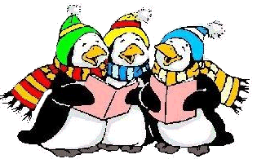

A Visit from Father Christmas
The Chemistry Teacher is Coming to Town
Test Tubes Bubbling

Slide 2

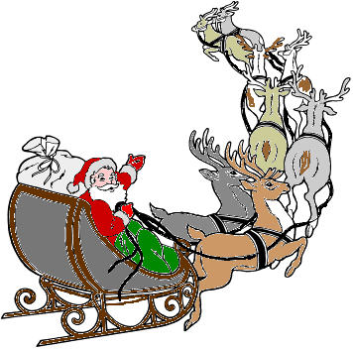
A Visit from Father Christmas
(A Christmas Fable)
The students were sleeping
So sound in their dorms,
All dreaming of fluids
And Crystalline forms.
Lab-Aides in their aprons
And I in my smock
Were sitting, recov'ring
From semester-end shock.
The flood-lights shone out
And I in my smock
Were sitting, recov'ring
From semester-end shock.
The flood-lights shone out
O'er the campus so bright
It looked like old Stockholm
On Nobel Prize Night.
My fume-blinded eyes,
Then viewed (dare I say?)
Eight anions pulling
A water-trough sleigh.
And holding the bonds
Tied to each one of them
Was a figure I knew
As our own Papa Chem.
With speeds in excess
Of most X-rays they came.
As they Dopplered along
He called each one by name.
"Now Nitrite, Now Phosphate,
Now Borate, now Chloride,
On Citrate, on Bromate,
On Sulfite and Oxide.
Forget what you know
Of that randomness stuff,
Let's go straight to that roof,
If you've quanta enough."
As fluids Bernoullian
Behave in a pinch
Those ions said "Alchemists,
This is a cinch,"
So up to the lab-roof
Those "chargers" they sped
With Pop Chemistry safe
In his water-trough sled.

Slide 3
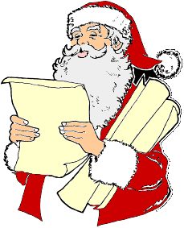
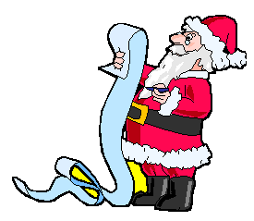
The Chemistry Teacher is Coming to Town
You better not weigh
You better not heat
You better not react
I’m telling you now
The Chemistry Teacher’s coming to town.
He’s collecting data
He’s checking it twice
He’s goin find out the heat of melting ice
The Chemistry Teacher’s coming to town.
He sees you when you’re decanting
He knows when you titrate
He knows when you are safe or not
So wear goggles for goodness sakes.
Oh, you better not filter and drink your filtrate.
You better not be careless and spill your precipitate.
The Chemistry Teacher’s coming to town.

Slide 4

Test Tubes Bubbling
(The Christmas Song – ‘Chestnuts roasting on an open fire’)
Test tubes bubbling in a water bath
strong smells nipping at your nose
Tiny molecules with their atoms all aglow
will find it hard to be inert tonight.
They know that Chlorine’s on its way
he’s loaded lots of little electrons on his sleigh.
And every students’ slide rule is on the sly
To see if the teacher can really multiply.
And so I offer you this simple phrase
To chemistry students in this room
Although it’s been said many times many ways
Merry Molecules to you.

Slide 5
The Twelve Days of Chemistry
On the first day of chemistry
My teacher gave to me
A candle from Chem Study
(Second day) Two asbestos pads
(Third day) Three little beakers
(Fourth day) Four worksheets
(Fifth day) Five golden moles
(Sixth day) Six flaming test tubes
(Seventh day) Seven unknown samples
(Eighth day) Eight homework problems
(Ninth day) Nine grams of salt
(Tenth day) A ten page test
(Eleventh day) Eleven molecules
(Twelfth day) A twelve point quiz

Slide 6
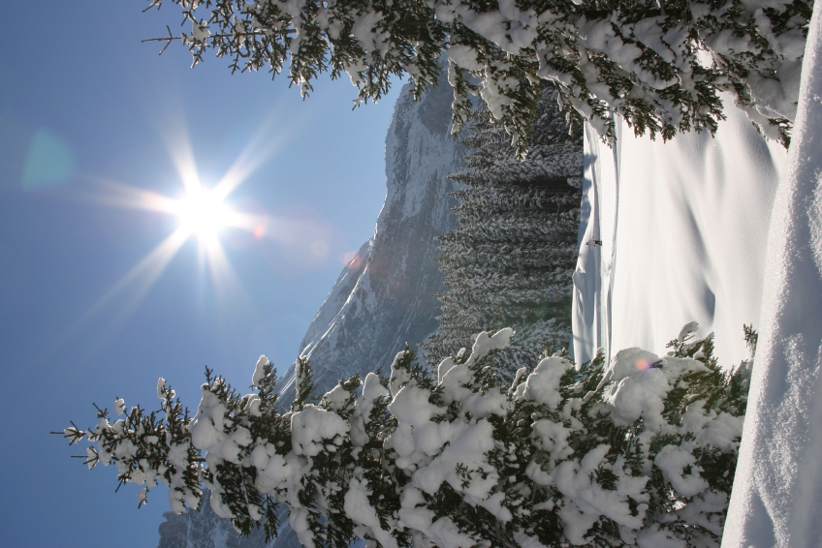
I'm Dreaming of a White Precipitate
I'm dreaming of a white precipitate
just like the ones I used to make
Where the colors are vivid
and the chemist is livid
to see impurities in the snow.
I'm dreaming of a white precipitate
with every chemistry test I write
may your equations be balanced and right
and may all your reactions be bright

Slide 7
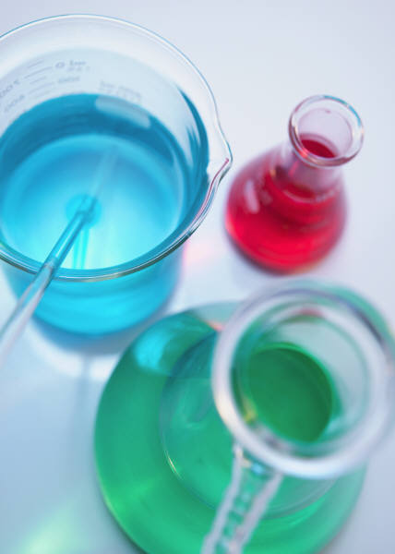
Silent Labs
Silent labs, difficult labs
All with math, all with graphs
Observations of colors and smells
Calculations and graph curves like bells
Memories of tests that have past
Oh--how long will chemistry last?
Silent labs, difficult labs
All with math, all with graphs
Lots of equations that need balancing
Gas pressure problems that make my head ring
Santa Chlorine's on his way
Oh--Please Santa bring me an 'A'.

Slide 8
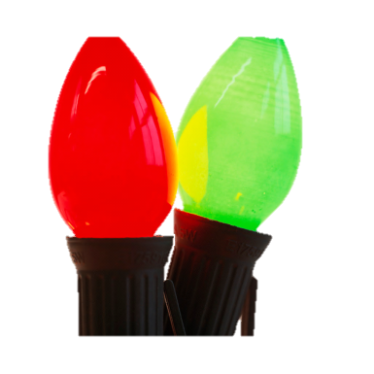
Deck the Labs
Deck the labs with rubber tubing, Fa la la la la, la la la la.
Use your funnel and your filter, Fa la la la la, la la la la.
Don we now our goggles and aprons,
Fa la la la la, la la la la.
Before we go to our lab stations, Fa la la la la, la la la la.
Fill the beakers with solutions, Fa la la la la, la la la la.
Mix solutions for reactions, Fa la la la la, la la la la.
Watch we now for observations, Fa la la la la, la la la la.
So we can collect our data, Fa la la la la, la la la la.

Slide 9
We Wish You a Happy Halogen
We wish you a happy halogen
We wish you a happy halogen
We wish you a happy halogen
To react with a metal.
Good acid we bring
to you and your base.
We wish you a merry molecule
and a happy halogen.

Slide 10

Chemistry Wonderland
Gases explode, are you listenin'
In your rest tube, silver glistens
A beautiful sight, we're happy tonight
Walking in a chemistry wonderland.
Gone away, is the buoyancy
Here to stay, is the density
A beautiful sight, we're happy tonight
Walking in a chemistry wonderland.
In the beaker we will make lead carbonate
and decide if what's left is nitrate
My partner asks "Do we measure it in moles or grams?"
and I'll say, "Does it matter in the end?"
Later on, as we calculate
the amount, of our nitrate
We'll face unafraid, the precipitates that we made
walking in a chemistry wonderland.

Slide 11

O Come all ye Gases
O Come all yea gases
diatomic wonders
O come yea, o come yea
calls Avogadro.
O come yea in moles
6 x 10 to the 23rd
O molar mass and molecules
O volume, pressure and temperature
O molar volume of gases at S.T.P.

Slide 12
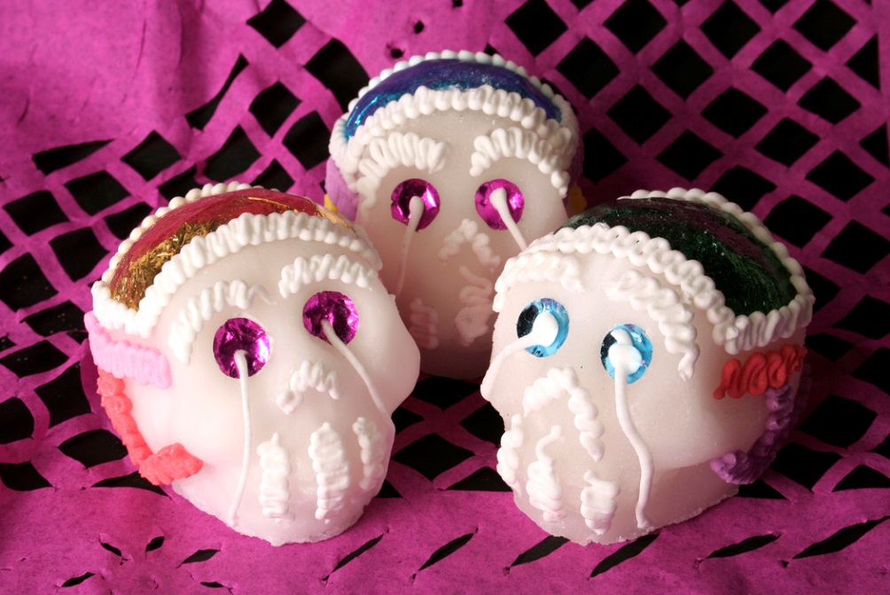
We Three Students of Chemistry Are
We three students of chemistry are
taking tests that we think are hard
Stoichiometry, volumes and densities
worrying all the time.
O room of wonder
room of fright
Room of thermites
blinding light:
With your energies
please don't burn us
Help us get our labs all right.

Slide 13
Iron the Red Atom Molecule
(to the tune of Rudolph the Red-Nosed Reindeer)
There was Cobalt and Argon and Carbon and Fluorine
Silver and Boron and Neon and Bromine
But do you recall
the most famous element of all?
Iron the red atom molecules, had a very shiny orbital
And if you ever saw him, You'd enjoy his magnetic glow
All of the other molecules, used to laugh and call him Ferrum
They never let poor Iron, join in any reaction games.
Then one inert Chemistry eve, Santa came to say
Iron with your orbital so bright, won't you catalyze the reaction tonight?
Then how the atoms reacted, and combined in twos and threes
Iron the red atom molecule, you'll go down in Chemistry!

Slide 14
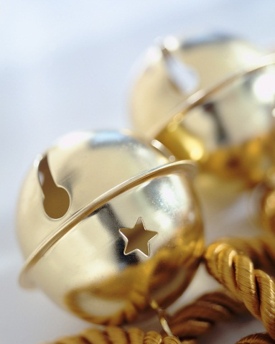
Lab Reports
(to the tune of Jingle Bells)
Dashing through the lab, with a ten page lab report.
Taking all those tests, and laughing at them all
Bells for fire drills ring, making spirits bright
What fun it is to laugh and sing a chemistry song tonight.
Oh, lab report, lab reports, reacting all the way.
Oh what fun it is to study for a chemistry test today, Hey!
Chemistry test, chemistry test, isn't it a blast
Oh what fun it is to take a chemistry test and pass.

Slide 15
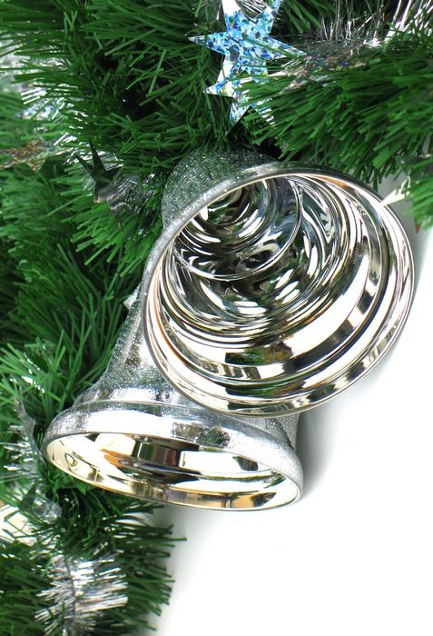
Silver Nitrate
(to the tune of Silver Bells)
Silver nitrate, silver nitrate
it's chemistry time in the lab
Ding-a-ling, with a copper ring
soon it will be chemistry day.
Take your nitrate, in solution
Add your copper with style
In the beaker there's a feeling of reactions
silver forming, blue solution
Bringing ooh's ah's and wows
now the data processing begins.
Get the mass, change to moles
what is the ratio with copper?
Write an equation, balance it
we're glad it's Chemistry Day.

