Slide 1
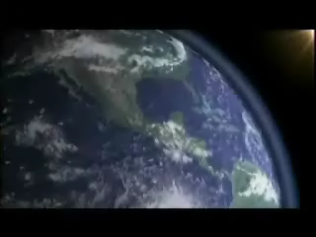
The Greenhouse Effect
HIGH ENERGY, SHORT λ LIGHT PASSES
EASILY THROUGH ATMOSPHERE
CO₂ MOLECULES
ENERGY RELEASED
AS HEAT
LOWER ENERGY, LONGER λ
LIGHT IS BLOCKED BY CO₂ AND CH₄; ENERGY DOESN’T
ESCAPE INTO SPACE;
ATMOSPHERE HEATS UP
Notes:
The atmospheric greenhouse effect
– CO₂ is a greenhouse gas that absorbs heat before it can be radiated from the earth into space
– CO₂ in the atmosphere can result in increased surface temperatures (the greenhouse effect)
– Temperature increases caused by increased CO₂ levels are superimposed upon much larger variations in the earth’s temperature

Slide 2
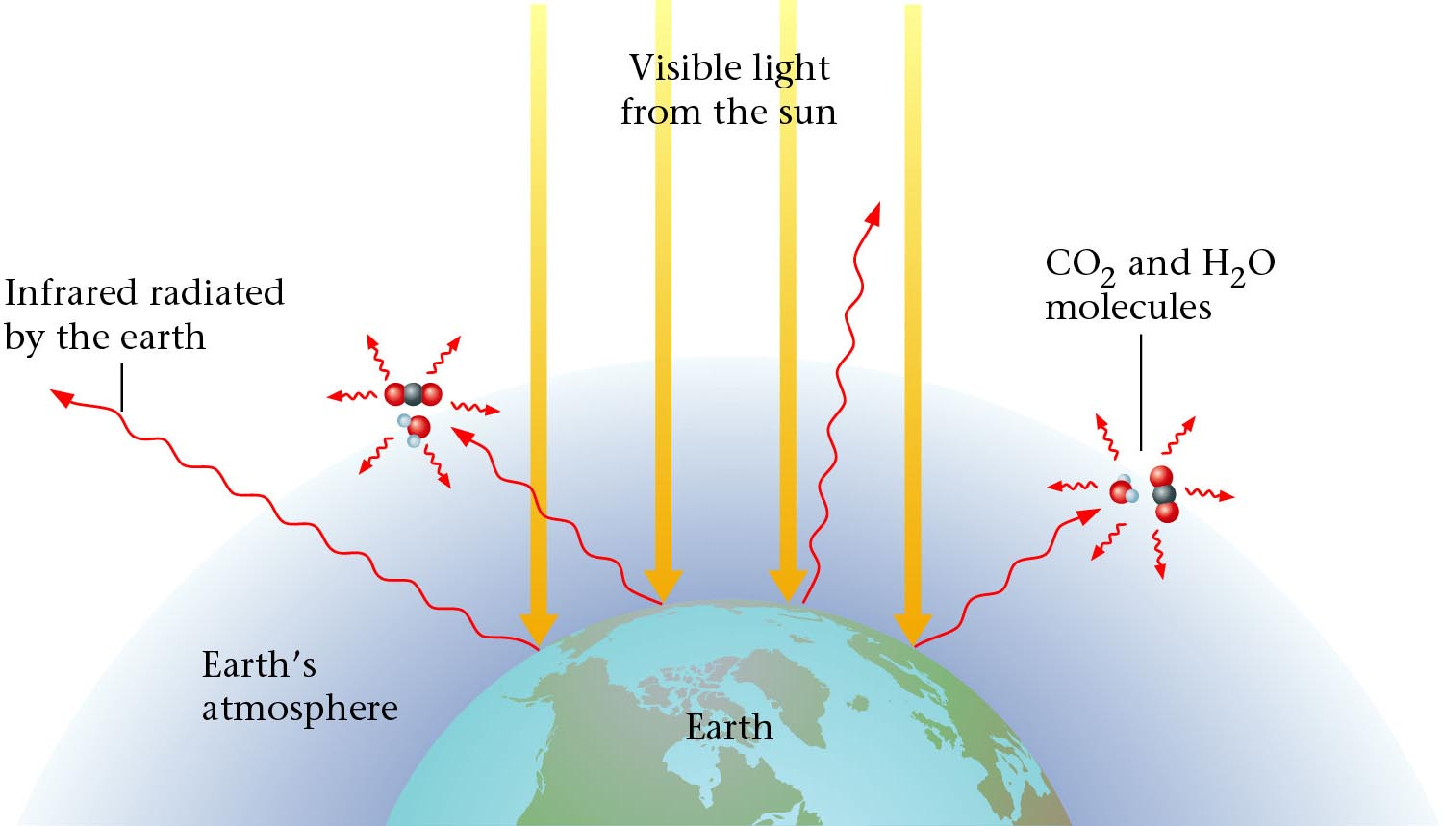

The Earths Atmosphere
Ozone
Zumdahl, Zumdahl, DeCoste, World of Chemistry 2002, page 309
Notes:
Earth’s atmosphere at sea level is an approximately 80:20 solution of nitrogen and oxygen gases with small amounts of carbon dioxide, water vapor, the noble gases, and trace amounts of a variety of other compounds.
Composition, temperature, and pressure of the atmosphere vary dramatically with altitude, so it is divided into layers that interact differently with the continuous flux of solar radiation from the top and the land and ocean masses at the bottom.
Layers do not mix readily with one another, and each layer has its own distinctive chemistry.

Slide 3
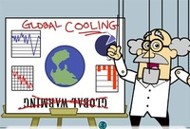
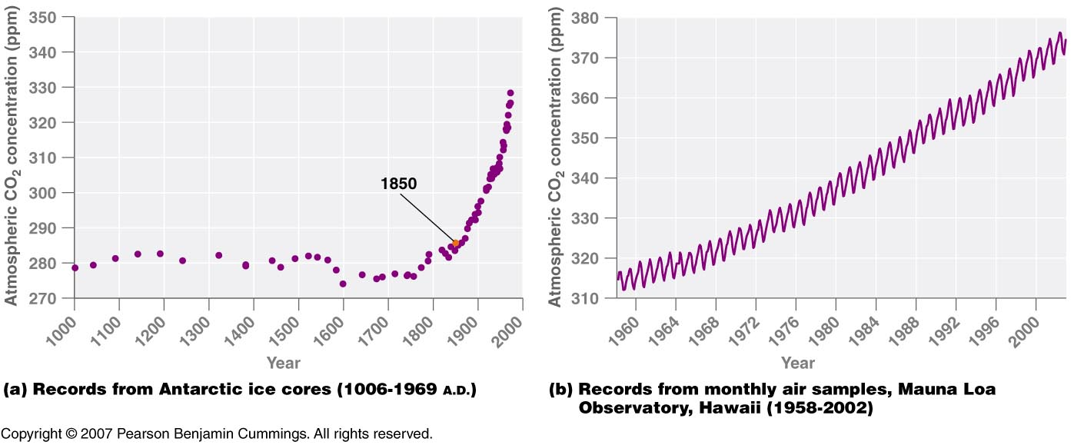
(a) Records from Antarctic ice cores (1006-1969 A.D.)
(b) Records from monthly air samples, Mauna Loa
Observatory, Hawaii (1958-2002)
Copyright © 2007 Pearson Benjamin Cummings. All rights reserved.
Notes:
http://blog.wired.com/wiredscience/images/2007/08/07/exxonscientist.jpg

Slide 4
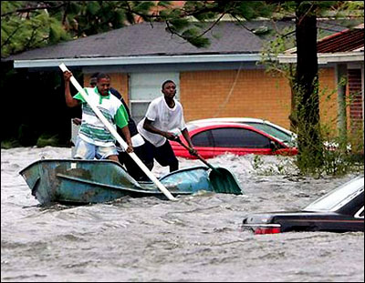
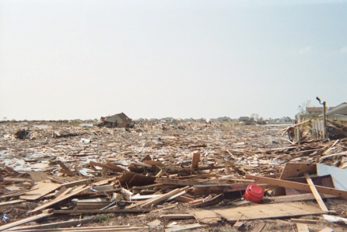
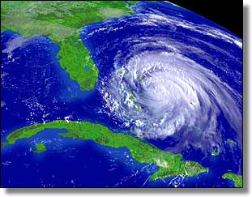
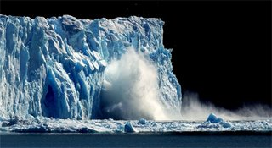
Greenhouse Effect
350
Atmospheric
CO₂ (ppm)
300
250
1000
1500
2000
Year
FACT: 15% increase in [CO₂] in last 100 years
Cause:
  Change from agricultural to industrial lifestyle
  Burning of fossil fuels (petroleum, coal)
  Increase CO₂ emissions (cars, factories etc…)
  Deforestation
Effects:
  Global warming
  Melt polar ice caps → flooding at sea level
  Warming oceans → more powerful storms
Notes:
Some teachers choose to show the movie Day After Tomorrow
http://www.lisamoscatiello.com/blogtest/uploaded_images/meltingglaciers-786472.jpg
http://images.google.com/imgres?imgurl=http://sitemaker.umich.edu/section2group4/files/hurricane-katrina_damage.jpg&imgrefurl=http://sitemaker.umich.edu/section2group4/indroduction_and_hypothesis__why_tropical_storms_&h=311&w=400&sz=47&hl=en&start=19&tbnid=BZz_iqNfb803hM:&tbnh=96&tbnw=124&prev=/images%3Fq%3Dtropical%2Bstorms%26gbv%3D2%26hl%3Den

Slide 5

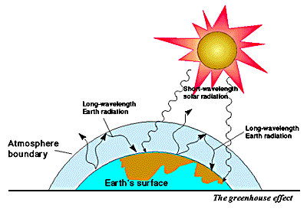
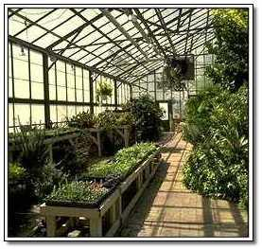
Greenhouse Effect
Children and pets left unattended in vehicles with windows
rolled up can die from high temperature in vehicle.
Carbon dioxide in atmosphere traps heat and acts like a
glass cover holding in the heat on planet Earth.

Slide 6
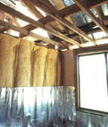
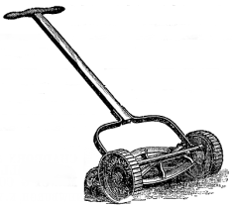
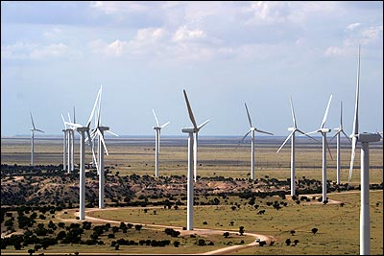
What can we do?
1. Reduce consumption of fossil fuels.
insulate home; run dishwasher full;
avoid temp. extremes (A/C & furnace);
wash clothes on “warm,” not “hot”
mow lawn less often (small engines)
At home:
On the road:
bike instead of drive; carpool;
energy-efficient vehicles
2. Support environmental organizations.
3. Rely on alternate energy sources.
solar, wind energy, hydroelectric power

Slide 7

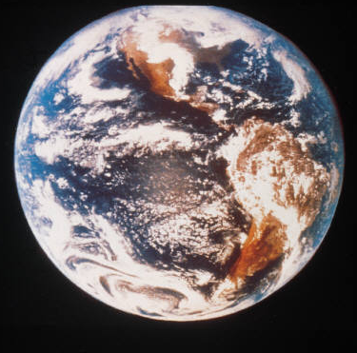



Ozone Depletion
Ozone (O₃)
  Absorbs harmful UV radiation from sun
ozone is produced during lightning storms
Chlorofluorocarbons (CFC’s) destroy ozone
  CFC’s production was banned in 1977
  CFC’s “live” for hundreds of years
Notes:
OZONE DEPLETION
Ozone is an allotropic form of oxygen. Ozone is made naturally during lightning storms. Ozone protects us from ultra violet radiation from the sun. The ozone layer is being depleted by chlorofluorocarbons (CFC’s).
“THE OZONE LAYER
Ozone is a reactive gas that contributes to pollution when it builds up in the atmosphere over cities. However, ozone in the stratosphere does the useful task of absorbing damaging ultraviolet (UV) light from the Sun, screening it from the Earth. Some synthetic chemicals, especially, chlorofluorocarbons (CFCs), react with ozone, creating holes in the ozone layer. These holes allow more UV light through, tending to cause an increase in skin cancer.”
Eyewitness Science “Chemistry” , Dr. Ann Newmark, DK Publishing, Inc., 1993, pg 34

Slide 8
Depletion of the Ozone Layer
Ozone (O₃) in upper atmosphere blocks ultraviolet (UV) light from Sun.
UV causes skin cancer and cataracts.
O₃ depletion is caused by chlorofluorocarbons (CFCs).
Uses for CFCs:
refrigerants
aerosol propellants
CFCs
banned in U.S. in 1996
O₃ is replenished with each strike of lightning.

Slide 9

Mechanism of Ozone Depletion
“free radical”
Solar radiation
Initiation CCl₂F₂ Cl + CF₂Cl
Propagation Cl + O₃ ClO + O₂
ClO + O Cl + O₂
Termination
.
.
.
.
.
.
.
A single chlorine molecule can destroy thousands of ozone molecules.

Slide 10
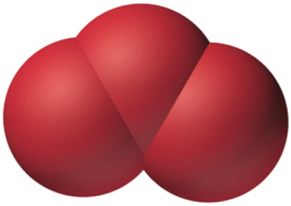
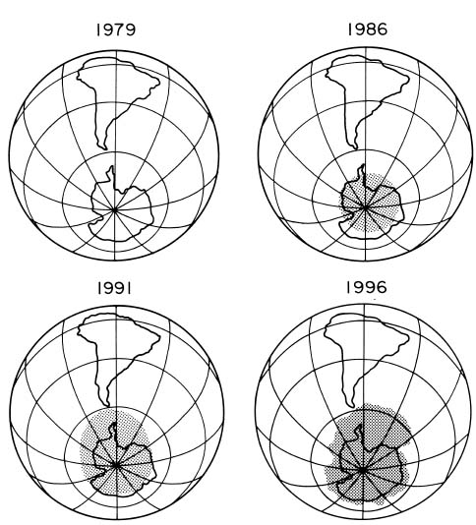
Ozone Hole Grows Larger
Ozone, O₃
Ozone hole has increased 50% from 1975 - 1985

Slide 11
Greenhouse Effect vs. Ozone Hole
Different
Alike
Different
Environmental
Issues
Global Warming
by trapping heat
on Earth
Depletion of O₃
(ozone layer)...
causes skin cancer
and cataracts
Topic
Topic
Caused by
buildup of CO₂
carbon dioxide
Related to
Earth's
Atmosphere
Caused by CFC's
(chlorofluorocarbons)
destroying ozone
layer
Greenhouse
Effect
Ozone
Hole
Plant trees to
slow down and burn
less fossil fuels
that produce CO₂
Man-made
problem
Replace CFC's in
AC & refrigerators
Notes:
The environmental issues of global warming, caused from buildup of carbon dioxide in Earth's atmosphere, is a separate issue from ozone depletion.
The greenhouse effect has had no major improvements and has failed international negotiations.
The ozone hole has largely been resolved by international cooperation. Improvement in ozone concentration is occurring.

Slide 12
Kinetic Molecular Theory
Postulates
Evidence
1. Gases are tiny molecules in mostly empty space. | The compressibility of gases.
2. There are no attractive forces between molecules. | Gases do not clump.
3. The molecules move in constant, rapid, random, straight-line motion. | Gases mix rapidly.
4. The molecules collide classically with container walls and one another. | Gases exert pressure that does not diminish over time.
5. The average kinetic energy of the molecules is proportional to the Kelvin temperature of the sample. | Charles’ Law
Notes:
The kinetic molecular theory of gases explains the laws that describe the behavior of gases and it was developed during the nineteenth century by Boltzmann, Clausius, and Maxwell
Kinetic molecular theory of gases provides a molecular explanation for the observations that led to the development of the ideal gas law
The kinetic molecular theory of gases is based on the following postulates:
1. A gas is composed of a large number of particles called molecules (whether monatomic or polyatomic) that are in constant random motion.
2. Because the distance between gas molecules is much greater than the size of the molecules, the volume of the molecules is negligible.
3. Intermolecular interactions, whether repulsive or attractive, are so weak that they are also negligible.
4. Gas molecules collide with one another and with the walls of the container, but collisions are perfectly elastic; they do not change the average kinetic energy of the molecules.
5. The average kinetic energy of the molecules of any gas depends on only the temperature, and at a given temperature, all gaseous molecules have exactly the same average kinetic energy.
Postulates 1 and 4 state that molecules are in constant motion and collide frequently with the walls of their container and are an explanation for pressure
1. Anything that increases the frequency with which the molecules strike the walls or increases the momentum of the gas molecules increases the pressure.
2. Anything that decreases that frequency or the momentum of the molecules decreases the pressure.
• Postulates 2 and 3 state that all gaseous particles behave identically, regardless of the chemical nature of their component molecules — this is the essence of the ideal gas law.
• Postulate 2 explains how to compress a gas — simply decrease the distance between the gas molecules.

Slide 13
Kinetic Molecular Theory (KMT)
explains why gases behave as they do
deals ^{w}/“ideal” gas particles…
1. …are so small that they are assumed to have zero volume
…are in constant, straight-line motion
…experience elastic collisions in which no energy is lost
…have no attractive or repulsive forces toward each other
…have an average kinetic energy (KE) that is proportional
to the absolute temp. of gas (i.e., Kelvin temp.)
AS TEMP. , KE

Slide 14
Properties of Gases
Gas properties can be modeled using math.
Model depends on:
V = volume of the gas (liters, L)
T = temperature (Kelvin, K)
P = pressure (atmospheres, atm)
n = amount (moles, mol)

Slide 15
Pressure - Temperature - Volume Relationship
P T V
P T V
P T V
1
V
Boyle’s P
α
___
α
Charles V T
α
Gay-Lussac’s P T
Notes:
Pressure versus volume
– At constant temperature, the kinetic energy of the molecules of a gas and the root mean square speed remain unchanged.
– If a given gas sample is allowed to occupy a larger volume, the speed of the molecules doesn’t change, but the density of the gas decreases and the average distance between the molecules increases: they collide with one another and with the walls of the container less often, leading to a decrease in pressure.
– Increasing the pressure forces the molecules closer together and increases the density, until the collective impact of the collisions of the molecules with the walls of the container balances the applied pressure.
Volume versus temperature
– Raising the temperature of a gas increases the average kinetic energy and the root mean square speed (and the average speed) of the gas molecules.
– As the temperature increases, the molecules collide with the walls of the container more frequently and with greater force, thereby increasing the pressure unless the volume increases to reduce the pressure
– An increase in temperature must be offset by an increase in volume for the net impact (pressure) of the gas molecules on the container walls to remain unchanged.
Pressure of gas mixtures
– If gaseous molecules do not interact, then the presence of one gas in a gas mixture will have no effect on the pressure exerted by another, and Dalton’s law of partial pressures holds.

Slide 16
Pressure - Temperature - Volume Relationship
P T V
P n V
1
V
Boyle’s P
α
___
α
Charles V T
α
Gay-Lussac’s P T

Slide 17
Kinetic Theory and the Gas Laws
10
10
10
10
(a)
(b)
(c)
original temperature
original pressure
original volume
increased temperature
increased pressure
original volume
increased temperature
original pressure
increased volume
Dorin, Demmin, Gabel, Chemistry The Study of Matter , 3rd Edition, 1990, page 323 (newer book)
Notes:
“Kinetic Theory and the Gas Laws”
Description: This slide shows three cylinders filled with equal masses of the same gas under different conditions. In cylinder (b), the pressure and temperature both have doubled from their values in cylinder (a). In cylinder (c), only the temperature has been doubled. The velocities of the gas particles are represented graphically to help students interpret the macroscopic changes in terms of the kinetic theory.
Basic Concepts
The kinetic theory can explain the combined gas law relationships of an ideal gas.
The pressure of a confined gas increases when the particles of the gas collide with the container walls more frequently or with greater force.
Teaching Suggestions
Use this slide to review the kinetic theory as it applies to the temperature, volume, and pressure of gases. Ask students whether the velocities of the gas particles would be the same for all gases at the same temperature. Point out that the average kinetic energy would be the same for all gases, but more massive gas particles would have slower velocities because mass and velocity are inversely proportional in the formula for kinetic energy: ½ mv².
Questions
The three cylinders in the diagram contain equal masses of the same gas under different conditions. Compare and contrast the conditions of the gas in each of the cylinders with respect to the pressure, volume, and temperature of the gas.
Cylinder (b) illustrates what happens when the gas in cylinder (a) is heated at constant volume. What happens to the average kinetic energy of the gas particles? How does this affect the velocity of the particles?
Use the kinetic theory to explain why the internal gas pressure in cylinder (b) is greater than the internal gas pressure in cylinder (a). What has been done to cylinder (b) to keep the gas volume the same as in cylinder (a)? Explain in terms of the equilibrium between internal and external pressure.
Suppose you are given the information that the temperature in both cylinder (b) and cylinder c) is double the temperature in cylinder (a). Compared with cylinder (a), how much greater is the volume in cylinder (c)? Explain how your answers illustrate the combined gas law (PV/T = constant).
Predict what would happen if you doubled the mass on top of the piston in cylinder (a), with the temperature constant. Use the kinetic theory to describe how this change would affect each of the following: volume, density, temperature, average velocity of the particles, rate of collision of the particles with the container wall, energy of these collisions, and internal pressure.
Suppose you take a basketball outside on a cold winter day. At first the basketball bounces normally, but then you notice that it starts to lose some of its bounce. Use the kinetic theory of gases to explain what is happening. Think of a few explanations. How could you determine which explanation is the best one?

Slide 18
Molar Volume
1 mol of a gas @ STP has a volume of 22.4 L
P = 1 atm
P = 1 atm
P = 1 atm
n_{O} = 1 mole
(32.0 g)
n_{He} = 1 mole
(4.0 g)
n_{N} = 1 mole
(28.0 g)
2
2
2
V_{O} = 22.4 L
V_{He} = 22.4 L
V_{N} = 22.4 L
2
273 K
2
273 K
2
273 K
Timberlake, Chemistry 7th Edition, page 268
Notes:
MOLAR VOLUME
One mole of any gas occupies 22.4 liters at standard temperature and pressure (STP).

Slide 19
Volume and Number of Moles
n = 3
n = 2
n = 1
V
2 V
3 V
Zumdahl, Zumdahl, DeCoste, World of Chemistry 2002, page 413

Slide 20
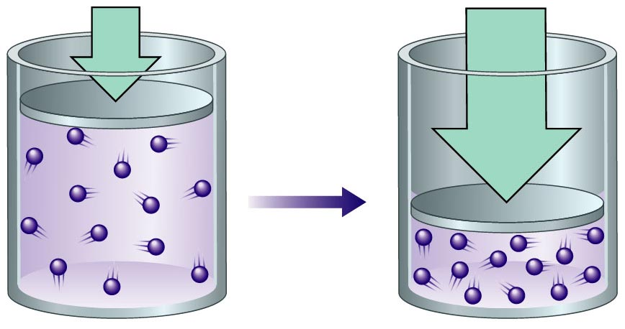
A Gas Sample is Compressed
Zumdahl, Zumdahl, DeCoste, World of Chemistry 2002, page 429

Slide 21





Avogadro’s Hypothesis
N₂
H₂
Ar
CH₄
At the same temperature and pressure, equal volumes of
different gases contain the same number of molecules.
Each balloon holds 1.0 L of gas at 20ºC and 1 atm pressure.
Each contains 0.045 mol or 2.69 x 10²² molecules of gas.

Slide 22
Volume vs. Quantity of Gas
26
24
22
20
1 mole = 22.4 L @ STP
18
16
Volume (L)
14
12
10
The graph shows there is a direct
relationship between the volume
and quantity of gas.
Whenever the quantity of gas is
increased, the volume will increase.
8
6
4
2
0 0.2 0.4 0.6 0.8 1.0
Number of moles
Notes:
The pressure for this data was NOT at 1 atm.
Practice with this data: (where Pressure = 1 atmosphere)
Volume Temp (ºC) (K) V/T
63.4 L 500 773 0.0821
55.2 400 673 0.0821
47.0 300 573 0.0821
38.8 200 473 0.0821
Avogadro postulated that, at the same temperature and pressure, equal volumes of gases contain the same number of gaseous particles.
Avogadro’s law describes the relationship between volume and amount of gas: At constant temperature and pressure, the volume of a sample of gas is directly proportional to the number of moles of gas in the sample.
Stated mathematically:
V = (constant) (n) or V ∝ n (at constant T and P) The relationships between the volume of a gas and its pressure, temperature, and amount are summarized in the figure below.
• The volume increases with increasing temperature or amount but decreases with increasing pressure.

Slide 23
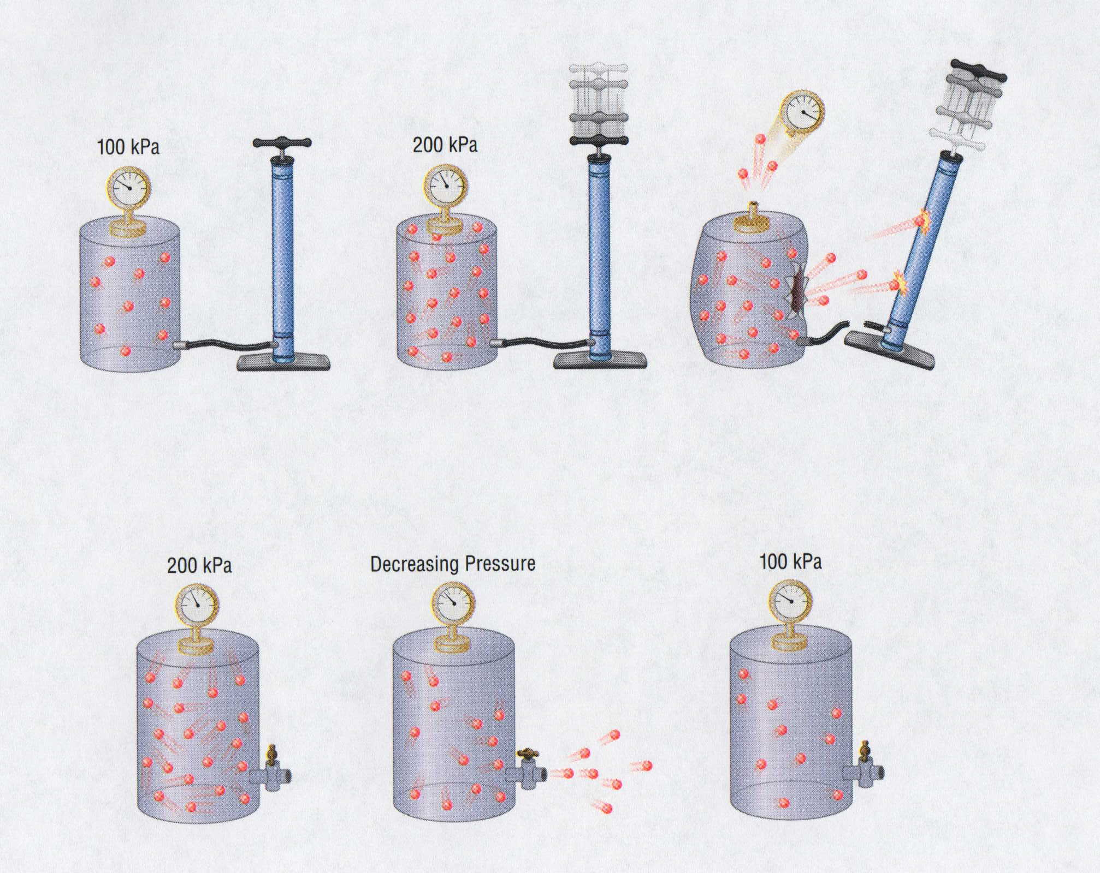
Adding and Removing Gases
100 kPa
200 kPa
200 kPa
Decreasing Pressure
100 kPa

Slide 24
Temperature
Always use absolute temperature (Kelvin) when working with gases.
ºF
-459
32
212
ºC
-273
0
100
K
0
273
373
K = ºC + 273
Courtesy Christy Johannesson www.nisd.net/communicationsarts/pages/chem
Notes:
Fahrenheit
Developed by the German physicist Gabriel Daniel Fahrenheit in 1724, the Fahrenheit scale sets zero as the temperature of a mixture of equal amounts of water, salt, and ice. On this scale, the freezing point of water is 32 degrees, and he named the boiling point of water at 212 degrees. (Fahrenheit also invented the mercury thermometer in 1714.) The Fahrenheit scale is the scale most commonly used in the U.S.
Celsius
The Celsius scale is named after the Swedish astronomer Anders Celsius who developed an early version of the scale -- originally called the centigrade scale ("centi" because the scale was divided into 100 degrees). The Celsius scale names the freezing point of water as 0 and the boiling point of water as 100. The Celsius scale is the scale most commonly used everywhere in the world except in the U.S..
Kelvin
The Kelvin scale was invented by Lord Kelvin, a Scottish physicist, in 1848. He set as zero on his scale the coldest any material could possibly get, a point now known as absolute zero. Nothing can ever be colder than absolute zero -- the temperature can only go up from there. That zero point corresponds to -273.15 ºC and -459.67 ºF. The Kelvin scale is the one most often used by scientists who study extremely cold temperatures.

Slide 25
STP
STP
Standard Temperature & Pressure
0°C
1 atm
273 K
- OR -
101.325 kPa
760 mm Hg
Courtesy Christy Johannesson www.nisd.net/communicationsarts/pages/chem

Slide 26

Pressure
KEY UNITS AT SEA LEVEL
  101.325 kPa (kilopascal)
  1 atm
  760 mm Hg
  760 torr
  14.7 psi
Sea level
Courtesy Christy Johannesson www.nisd.net/communicationsarts/pages/chem
Notes:
Any object exerts a force on any surface with which it comes in contact.
• Pressure is dependent on both the force exerted and the size of the area to which the force is applied:
P = F
A
• Units of pressure are derived from the units used to measure force and area
1. In the English system, the units of force are pounds and the units of area are square inches, so pressure is expressed in pounds per square inch, lb/in² (or psi).
2. For scientific measurements, the SΙ unit for pressure, derived from the SΙ units for force (newtons) and area (square meters), is the newton per square meter, N/m², called the paschal (Pa):
1 pascal (Pa) = 1 newton/meter² (N/m²)

Slide 27
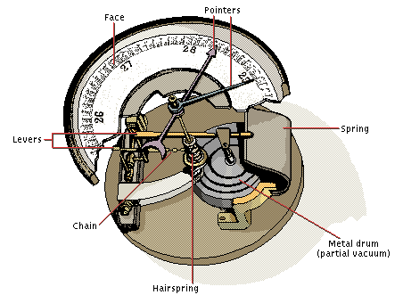
How to Measure Pressure
Barometer
  measures atmospheric pressure
Face
Pointers
vacuum
Levers
Spring
P_{atm}
P_{Hg}
Chain
Metal drum
(partial vacuum)
Hairspring
Aneroid Barometer
Courtesy Christy Johannesson www.nisd.net/communicationsarts/pages/chem

Slide 28
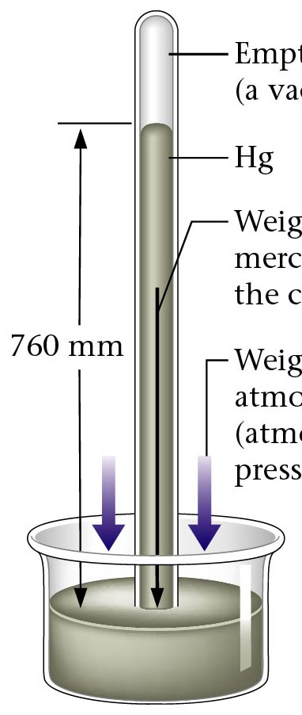
Barometer
Empty space
(a vacuum)
Hg
Weight of the
mercury in
the column
Weight of the
atmosphere
(atmospheric
pressure)
Zumdahl, Zumdahl, DeCoste, World of Chemistry 2002, page 401

Slide 29

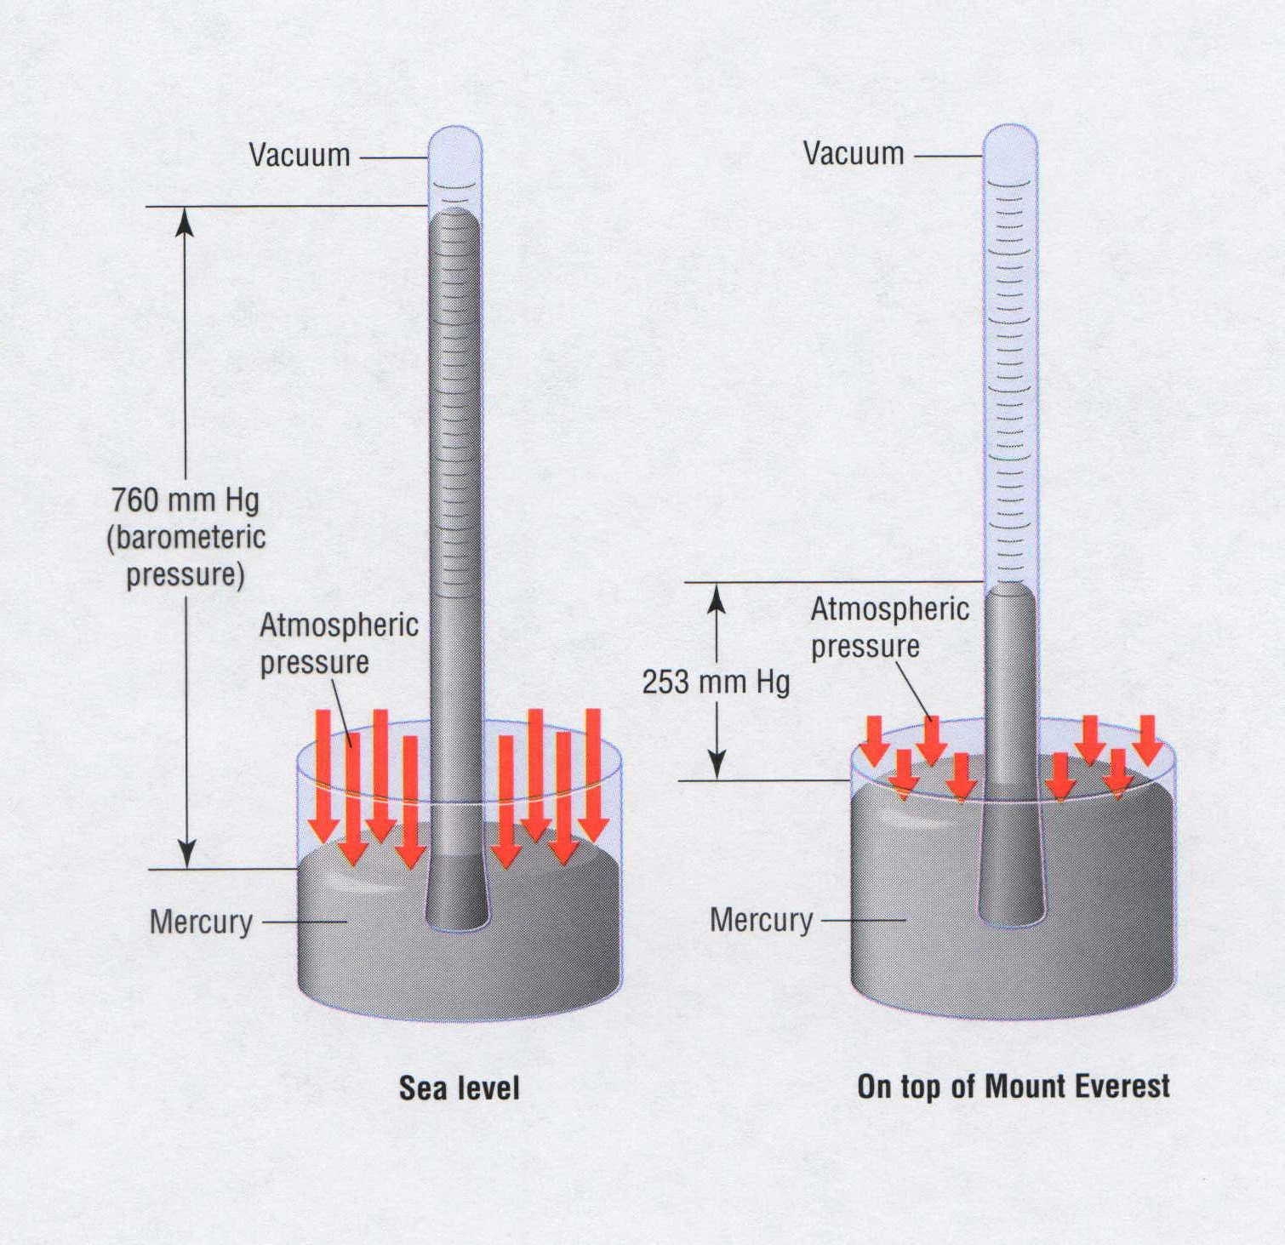
Barometers
fraction of 1 atm | average altitude
 | (m) | (ft)
1 | 0 | 0
1/2 | 5,486 | 18,000
1/3 | 8,376 | 27,480
1/10 | 16,132 | 52,926
1/100 | 30,901 | 101,381
1/1000 | 48,467 | 159,013
1/10000 | 69,464 | 227,899
1/100000 | 96,282 | 283,076
Mount Everest
Sea level
Sea level On top of Mount Everest
Notes:
Every point on Earth’s surface experiences a net pressure called atmospheric pressure.
• Pressure exerted by the atmosphere is considerable.
• A 1.0-m² column, measured from sea level to the top of the atmosphere, has a mass of about 10,000 kg, which gives a pressure of 100 kPa:
pressure = (1.0 x 10⁴kg) (9.807 m/s²) = 1.0 x10⁵ Pa = 100 kPa
1.0 m²
• In English units, this is 15 lb/in^{2.}
Atmospheric pressure can be measured using a barometer, a closed, inverted tube filled with mercury.
• The height of the mercury column is proportional to the atmospheric pressure, which is reported in units of millimeters of mercury (mmHg), also called torr.
Standard atmospheric pressure is the atmospheric pressure required to support a column of mercury exactly 760 mm tall; this pressure is also referred to as 1 atmosphere (atm).
• A pressure of 1 atm equals 760 mmHg exactly and is approximately equal to 100 kPa:
1 atm = 760 mmHg = 760 torr = 1.01325 x 10⁵Pa = 101.325 kPa
Pressure varies smoothly from the earth's surface to the top of the mesosphere. Although the pressure changes with the weather, NASA has averaged the conditions for all parts of the earth year-round. The following is a list of air pressures (as a fraction of one atmosphere) with the corresponding average altitudes. The table gives a rough idea of air pressure at various altitudes.

Slide 30
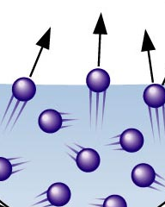
Boiling vs. Evaporation
Boiling point: atmospheric pressure = vapor pressure
AIR
PRESSURE
15psi
Revolutionary process - fast
VAPOR
PRESSURE
15 psi
Lyophilization – freeze drying
Evaporation: molecules go from liquid to gas phase
gas
Evolutionary process - slow
liquid

Slide 31
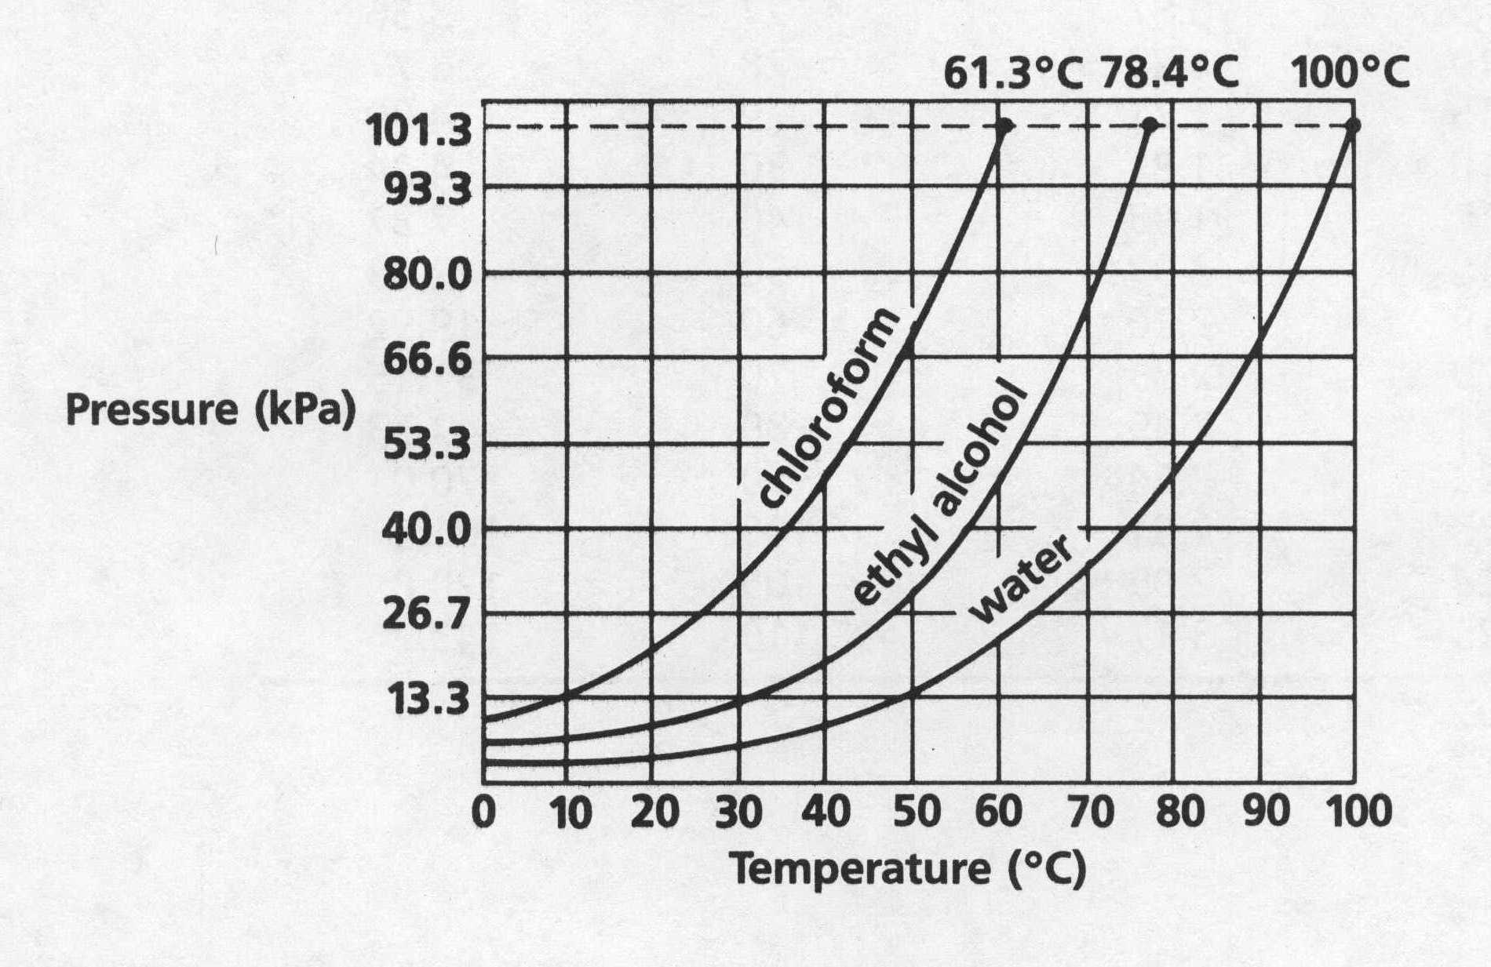
Boiling Point on Mt. Everest
Water exerts a vapor pressure of 101.3 kPa at
a temperature of 100 ºC. This is defined as its
normal boiling point:
‘vapor pressure = atmospheric pressure’
x kPa = 253 mm Hg (101.3 kPa) = 33.7 kPa
(760 mm Hg)

Slide 32
Boiling Point on Mt. Everest
Water exerts a vapor pressure of 101.3 kPa at
a temperature of 100 ºC. This is defined as its
normal boiling point:
‘vapor pressure = atmospheric pressure’
101.3
61.3ºC
78.4ºC
100ºC
93.3
80.0
66.6
chloroform
ethyl alcohol
53.3
Pressure (KPa)
40.0
water
26.7
13.3
0
10
20
30
40
50
60
70
80
90
100
On top of Mt. Everest
Temperature (ºC)
101.3 kPa
x kPa = 253 mm Hg
=
33.7 kPa
760 mm Hg

Slide 33
Boiling Point on Mt. Everest
Water exerts a vapor pressure of 101.3 kPa at
a temperature of 100 ºC. This is defined as its
normal boiling point:
‘vapor pressure = atmospheric pressure’
101.3
61.3ºC
78.4ºC
100ºC
93.3
80.0
66.6
chloroform
ethyl alcohol
Pressure (KPa)
53.3
40.0
water
26.7
13.3
0
10
20
30
40
50
60
70
80
90
100
Temperature (ºC)
x kPa = 253 mm Hg
101.3 kPa
=
33.7 kPa
760 mm Hg

Slide 34
Manometer
P_{a}
higher
pressure
height
750 mm Hg
P_{a} =
+
h =
130 mm
higher
pressure
880 mm Hg

Slide 35
“Mystery” U-tube
AIR
PRESSURE
15psi
AIR
PRESSURE
15psi
AIR
PRESSURE
15psi
4 psi
2
HIGH Vapor Pressure
LOW Vapor Pressure
Evaporates Easily
VOLATILE
Evaporates Slowly
ALCOHOL WATER

Slide 36
‘Net’ Pressure
AIR
PRESSURE
15psi
AIR
PRESSURE
15psi
11 psi N E T P R E S S U R E 13 psi
4 psi
11
psi
13
psi
2
ALCOHOL WATER

Slide 37
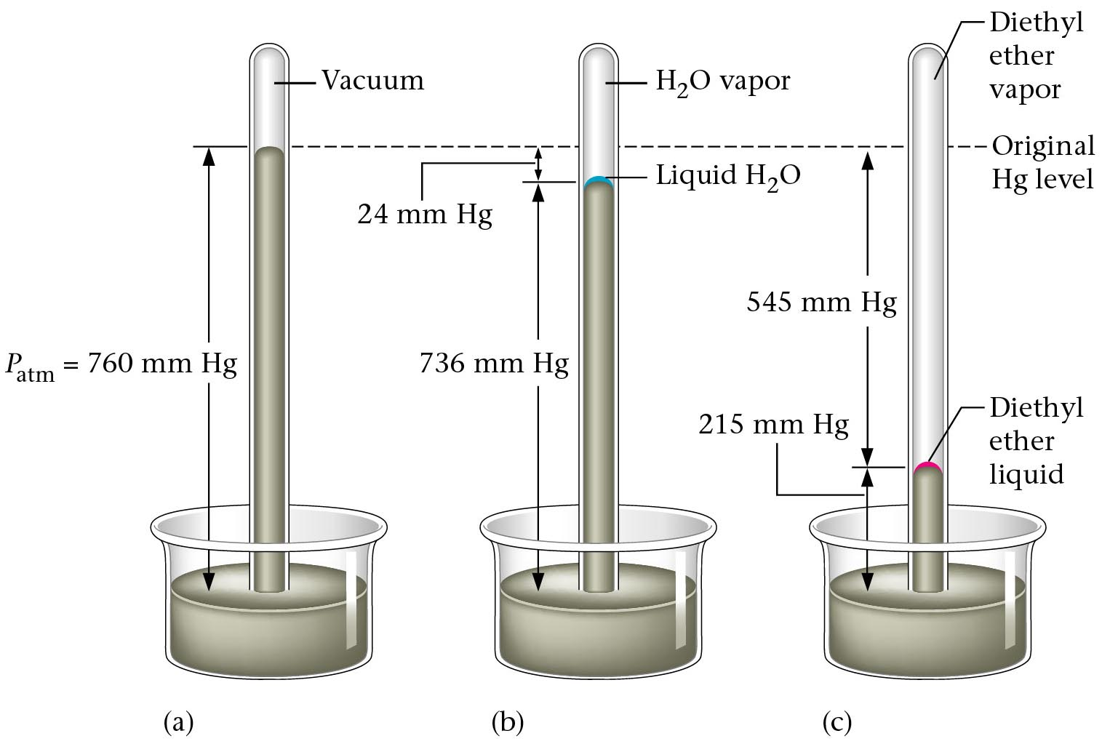
Barometer
(a)
(b)
(c)
Zumdahl, Zumdahl, DeCoste, World of Chemistry 2002, page 451

Slide 38
More massive gas particles are slower than less massive gas particles (on average).
Particle-Velocity Distribution
(various gases, same T and P)
CO₂
# of
particles
N₂
H₂
(SLOW)
Velocity of particles (m/s)
(FAST)

Slide 39
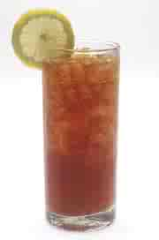

Hot vs. Cold Tea
Low temperature
(iced tea)
Many molecules have an
intermediate kinetic energy
High temperature
(hot tea)
Few molecules have a
very high kinetic energy
Percent of molecules
~
~
~
Kinetic energy

Slide 40
BIG
BIG = small + height
112.8 kPa
760 mm Hg
height = BIG - small
=
846 mm Hg
101.3 kPa
X mm Hg
=
846 mm Hg
-
593 mm Hg
X mm Hg
=
253 mm Hg
253 mm Hg
STEP 1) Decide which pressure is BIGGER
STEP 2) Convert ALL numbers to the unit
of unknown
small
STEP 3) Use formula Big = small + height
0.78 atm
height
X mm Hg
0.78 atm
760 mm Hg
=
593 mm Hg
1 atm

Slide 41
KEY
X atm
Because no difference in height is shown in barometer,
You only need to convert “kPa” into “atm”.
1.
125.6 kPa
0 mm Hg
112.8 kPa
760 mm Hg
= 846 mm Hg
125.6 kPa
1 atm
= 1.24 atm
101.3 kPa
101.3 kPa
2.
Convert all units into “mm Hg”
Use the formula Big = small + height
Height = Big - small
X mm Hg = 846 mm Hg - 593 mm Hg
X = 253 mm Hg
0.78 atm
X mm Hg
0.78 atm
760 mm Hg
= 593 mm Hg
1 atm

Slide 42
KEY
0.58 atm
760 mm Hg
= 441 mm Hg
1 atm
3.
Height = Big - small
X mm Hg = 738 mm Hg - 441 mm Hg
X = 297 mm Hg
98.4 kPa
X mm Hg
98.4 kPa
760 mm Hg
= 738 mm Hg
X atm
101.3 kPa
4.
135.5 kPa
208 mm Hg
1 atm
= 0.28 atm
760 mm Hg
small = Big - height
X atm = 1.34 atm - 0.28 atm
X = 1.06 atm
135.5 kPa
1 atm
= 1.34 atm
101.3 kPa

Slide 43
Evaporation
H₂O(g)
molecules
(water vapor)
H₂O(l)
molecules

Slide 44
How Vapor Pressure is Measured
atmospheric
pressure
760 mm + 120 mm = 880 mm Hg
1 atm = 760 mm Hg
dropper
containing
a liquid
atm. pressure
120 mm
vapor from
the liquid
mercury
Animation by Raymond Chang
All rights reserved

Slide 45
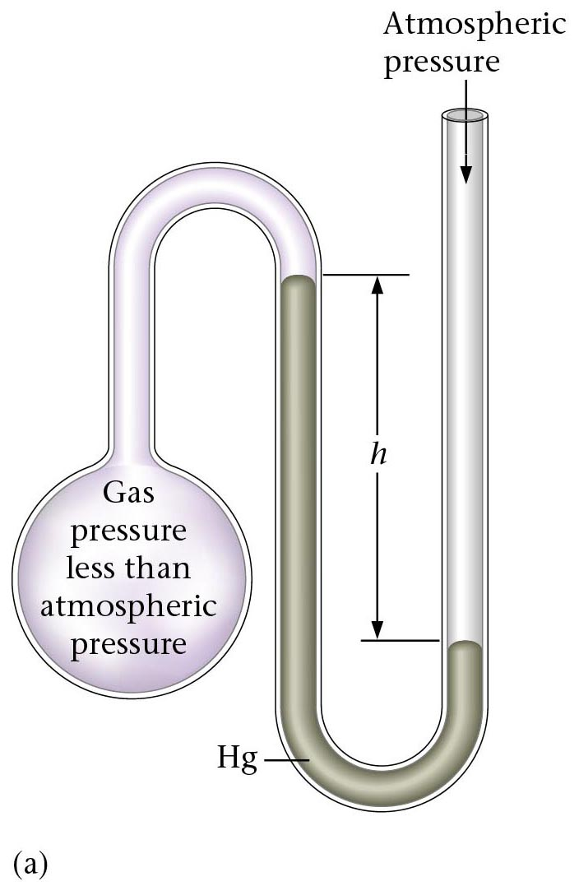
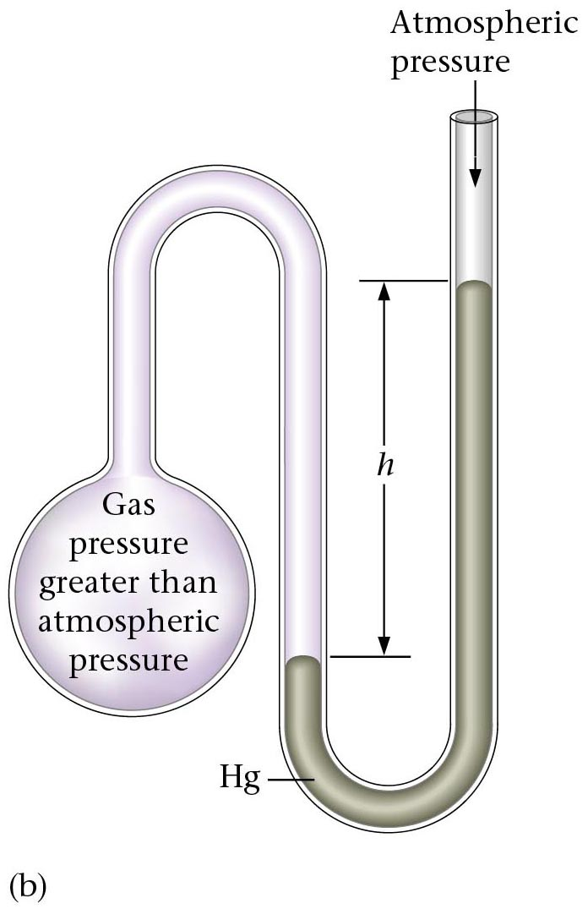
Manometer
Atmospheric Pressure
Zumdahl, Zumdahl, DeCoste, World of Chemistry 2002, page 401

Slide 46
Manometer A
760 mm Hg
BIG = small + height
760 mm 120 mm
________ = small + __________
Small = 640 mm Hg
h = 120 mm
?
Zumdahl, Zumdahl, DeCoste, World of Chemistry 2002, page 401

Slide 47
Manometer B
760 mm Hg
BIG = small + height
760 mm 120 mm
BIG = ________ + _________
BIG = 880 mm Hg
h = 120 mm
?
Zumdahl, Zumdahl, DeCoste, World of Chemistry 2002, page 401

Slide 48
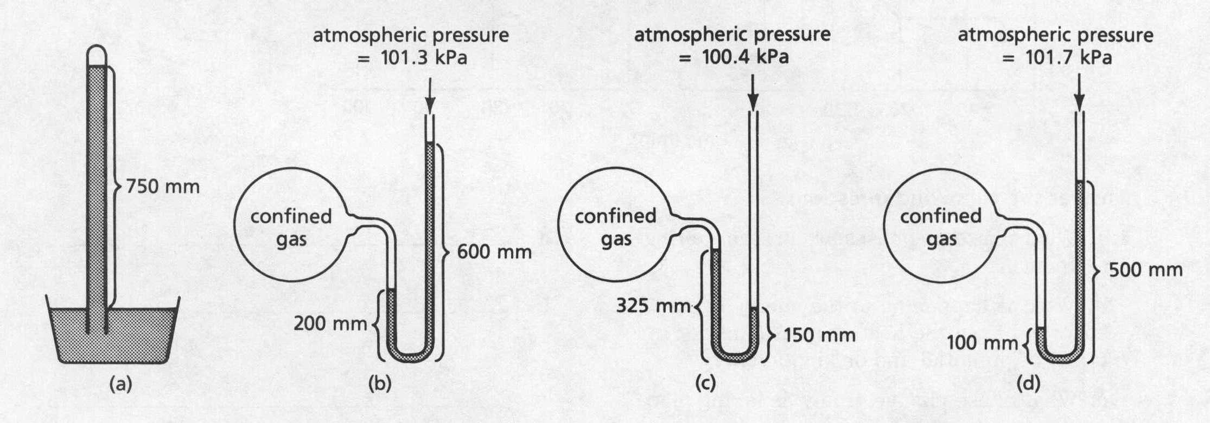
Barometer & Manometer
atmospheric pressure
= 101.3 kPa
atmospheric pressure
= 100.4 kPa
atmospheric pressure
= 101.7 kPa
750 mm
confined
gas
confined
gas
confined
gas
600 mm
500 mm
200 mm
325 mm
150 mm
100 mm
(a)
(b)
(c)
(d)

Slide 49
Pressure and Temperature
STP
(Standard Temperature and Pressure)
standard temperature
standard pressure
0ºC
1 atm
273 K
101.3 kPa
760 mm Hg
Equations / Conversion Factors:
K = ºC + 273
ºC = K – 273
1 atm = 101.3 kPa = 760 mm Hg

Slide 50
Convert 25ºC to Kelvin.
K = ºC + 273
25ºC + 273
=
298 K
How many kPa is 1.37 atm?
101.3 kPa
X kPa = 1.37 atm
= 138.8 kPa
1 atm
How many mm Hg is 231.5 kPa?
760 mm Hg
X mm Hg = 231.5 kPa
= 1737 mm Hg
101.3 kPa

Slide 51
AIR
PRESSURE
higher
pressure
CONFINED
GAS
P_{a}
Hg HEIGHT
DIFFERENCE
manometer: measures the
pressure of a confined gas

Slide 52
manometer: measures the
pressure of a confined gas
AIR
PRESSURE
CONFINED
GAS
Hg HEIGHT
DIFFERENCE

Slide 53
small
Atmospheric pressure is 96.5 kPa;
96.5 kPa
mercury height difference is 233 mm.
Find confined gas pressure, in atm.
BIG
1.26 atm
X atm
SMALL + HEIGHT = BIG
233 mm Hg
96.5 kPa + 233 mm Hg = X atm
1 atm
1 atm
96.5 kPa
+ 233 mm Hg
= X atm
101.3 kPa
760 mm Hg
0.953 atm + 0.307 atm = X atm
X = 1.26 atm

Slide 54
100
80
CHLOROFORM
PRESSURE
(kPa)
60
ETHANOL
b.p. = 78ºC
40
20
WATER
b.p. = 100ºC
0
0
20
40
60
80
100
TEMPERATURE (ºC)
Volatile substances evaporate easily (have high v.p.’s).
BOILING → when vapor pressure = confining pressure
(usually from atmosphere)
atmospheric pressure is 101.3 kPa

Slide 55
Vapor Pressure
61.3ºC
78.4ºC
100ºC
101.3
93.3
80.0
66.6
chloroform
Pressure (KPa)
ethyl alcohol
53.3
40.0
water
26.7
13.3
0
10
20
30
40
50
60
70
80
90
100
Temperature (ºC)

Slide 56
Gas Law Calculations
Boyle’s Law
PV = k
Charles’ Law
V
T
= k
P and V
change
n, R, T are
constant
Ideal
Gas Law
PV = nRT
T and V
change
P, n, R are
constant
P, V, and T change
n and R are constant
Combined
Gas Law
PV
T
= k

Slide 57
Gas Law Calculations
Boyle’s Law
Bernoulli’s
Principle
Avogadro’s Law
P₁V₁ = P₂V₂
Fast moving fluids…
create low pressure
Add or remove gas
Manometer
Charles’ Law
Combined
Ideal
Gas Law
PV = nRT
V₁ = V₂
T₁ = T₂
P₁V₁ = P₂V₂
Big = small + height
T₁ = T₂
Gay-Lussac
Graham’s Law
P₁ = P₂
Density
T₁ = T₂
P₁ = P₂
diffusion vs. effusion
T₁D₁ = T₂D₂
Dalton’s Law
Partial Pressures
P_{T} = P_{A} + P_{B}
1 atm = 760 mm Hg = 101.3 kPa
R = 0.0821 L atm / mol K
Notes:
Any set of relationships between a single quantity (such as V) and several other variables (P, T, n) can be combined into a single expression that describes all the relationships simultaneously.
The following three expressions
V ∝ 1/P (at constant n, T)
V ∝ T ( at constant n, P)
V ∝ n (at constant T, P)
can be combined to give
V ∝ nT or V = constant (nT/P)
• The proportionality constant is called the gas constant, represented by the letter R.
• Inserting R into an equation gives V = RnT = nRT
P P
Multiplying both sides by P gives the following equation, which is known as the ideal gas law:
PV = nRT
• An ideal gas is defined as a hypothetical gaseous substance whose behavior is independent of attractive and repulsive forces and can be completely described by the ideal gas law.
• The form of the gas constant depends on the units used for the other quantities in the expression — if V is expressed in liters (L), P in atmospheres (atm), T in kelvins (K), and n in moles (mol), then
R = 0.082057 (L•atm)/(K•mol).
• R can also have units of J/(K•mol) or cal/(K•mol).
A particular set of conditions were chosen to use as a reference; 0ºC (273.15 K) and 1 atm pressure are referred to as standard temperature and pressure (STP).
The volume of 1 mol of an ideal gas under standard conditions can be calculated using the variant of the ideal gas law:
V = nRT = (1 mol) [0.082057 (L•atm)/(K•mol)] (273.15 K) = 22.41 L
P 1 atm
• The volume of 1 mol of an ideal gas at 0ºC and 1 atm pressure is 22.41 L, called the standard molar volume of an ideal gas.
• The relationships described as Boyle’s, Charles’s, and Avogadro’s laws are simply special cases of the ideal gas law in which two of the four parameters (P, V, T, n) are held fixed.

Slide 58
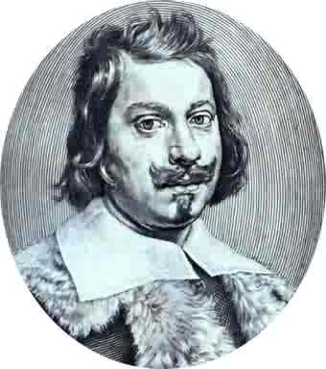
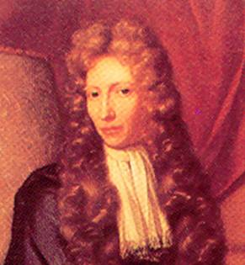
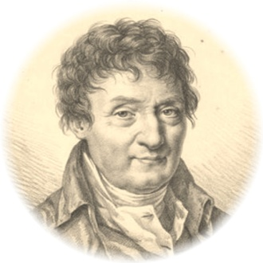
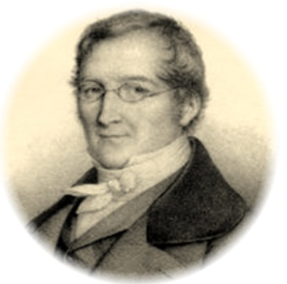
Scientists
Evangelista Torricelli (1608-1647)
  Published first scientific explanation of a vacuum.
  Invented mercury barometer.
Robert Boyle (1627- 1691)
  Volume inversely related to pressure (temperature remains constant)
Jacques Charles (1746 -1823)
  Volume directly related to temperature (pressure remains constant)
Joseph Gay-Lussac (1778-1850)
  Pressure directly related to temperature (volume remains constant)

Slide 59
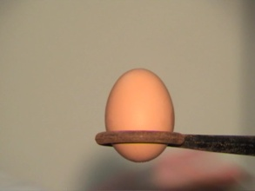




Gas Demonstrations
Eggsplosion
Gas: Demonstrations
Effect of Temperature
on Volume
of a Gas VIDEO
Effect of Temperature on Volume
of a Gas VIDEO
Air Pressure
Crushes a Popcan
VIDEO
Air Pressure Crushes a Popcan
VIDEO
Gas: Demonstrations
Air Pressure
Inside a Balloon
(Needle through
a balloon)
VIDEO
Air Pressure Inside a Balloon
(Needle through a balloon)
VIDEO
Effect of Pressure
on Volume
(Shaving Creme
in a Belljar)
VIDEO
Effect of Pressure on Volume
(Shaving Creme in a Belljar)
VIDEO
http://www.unit5.org/chemistry/GasLaws.html

Slide 60
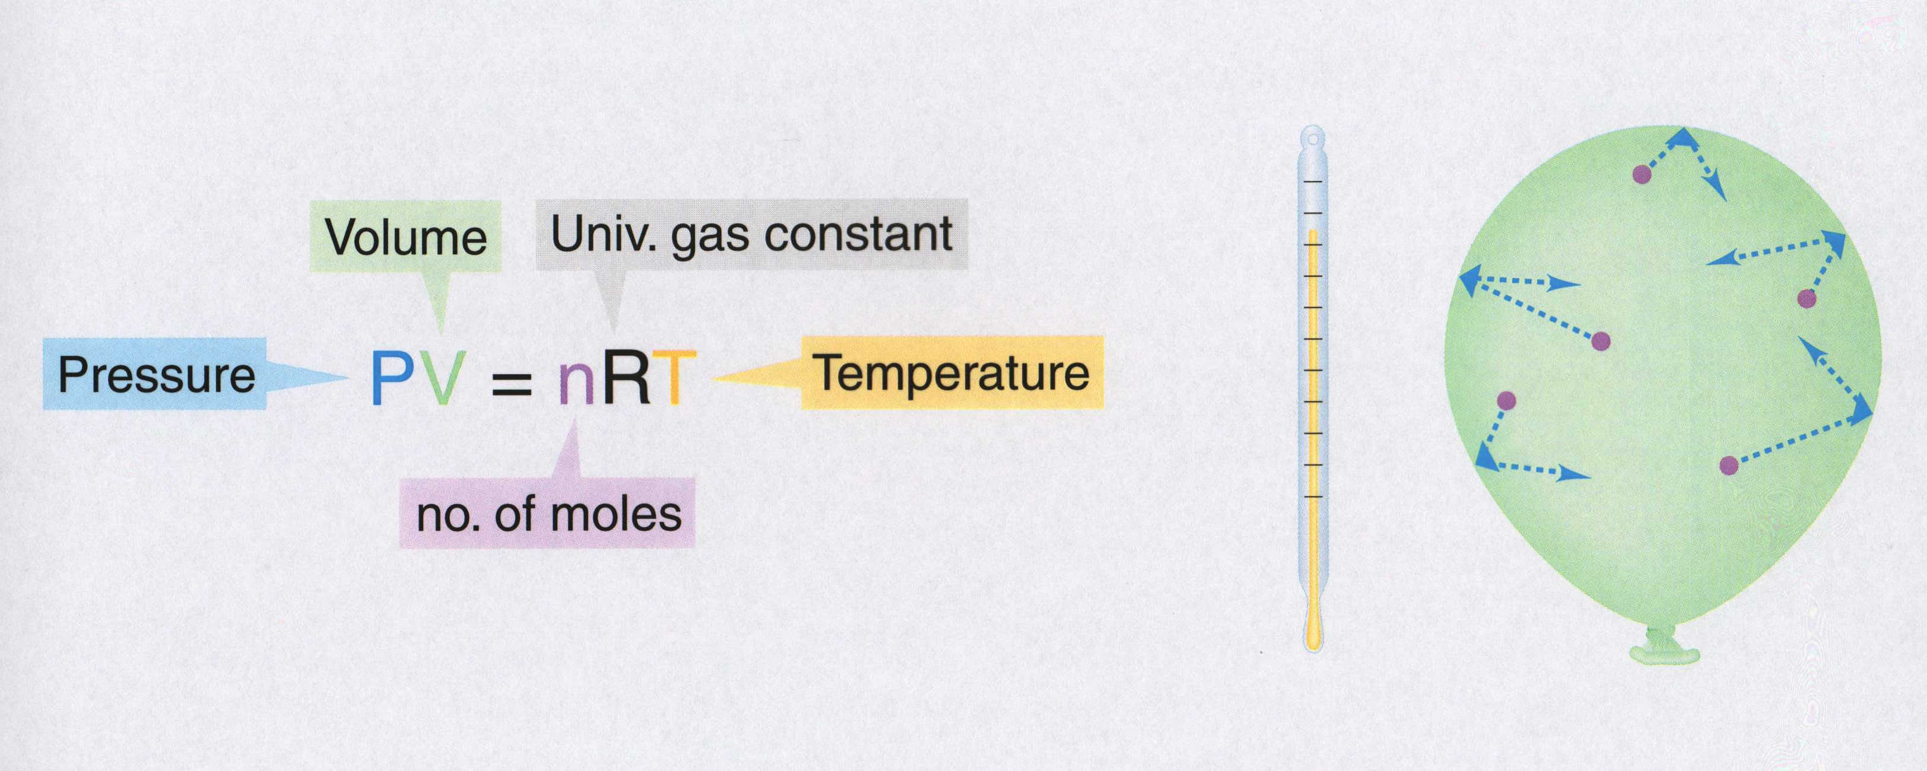
Ideal Gas Equation
Volume
Universal Gas Constant
Pressure
P V = n R T
Temperature
No. of moles
R = 0.0821 atm L / mol K
R = 8.314 kPa L / mol K
Kelter, Carr, Scott, Chemistry A Wolrd of Choices 1999, page 366
Notes:
The ideal gas law allows the calculation of the fourth variable for a gaseous sample if the values of any three of the four variables (P, V, T, n) are known.
• The ideal gas law predicts the final state of a sample of a gas (that is, its final temperature, pressure, volume, and quantity) following any changes in conditions if the parameters (P, V, T, n) are specified for an initial state.
• In cases where two of the variables P, V, and T are allowed to vary for a given sample of gas (n is constant) and the change in the value of the third variable under the new conditions needs to be calculated, the ideal gas needs to be arranged. The ideal gas law is rearranged so that P, V, and T, the quantities that change, are on one side and the constant terms (R and n for a given sample of gas) are on the other:
PV = nR = constant
T
• The quantity PV/T is constant if the total amount of gas is constant.
• The relationship between any two sets of parameters for a sample of gas can be written as
P₁V₁ = P₂V_{2.}
T₁ T₂
• An equation can be solved for any of the quantities P₂, V₂, or T₂ if the initial conditions are known.

Slide 61

PV = nRT
Standard Temperature and Pressure (STP)
T = 0 ºC or 273 K
P = 1 atm = 101.3 kPa = 760 mm Hg
P = pressure
V = volume
T = temperature (Kelvin)
n = number of moles
R = gas constant
Solve for constant (R)
PV
nT
1 mol = 22.4 L @ STP
Recall: 1 atm = 101.3 kPa
Substitute values:
(1 atm) (22.4 L)
(1 mole)(273 K)
= R
R = 0.0821 atm L
mol K
(101.3 kPa)
= 8.31 kPa L
mol K
( 1 atm)
R = 0.0821 atm L / mol K or R = 8.31 kPa L / mol K
Notes:
Any set of relationships between a single quantity (such as V) and several other variables (P, T, n) can be combined into a single expression that describes all the relationships simultaneously.
The following three expressions
V ∝ 1/P (at constant n, T)
V ∝ T ( at constant n, P)
V ∝ n (at constant T, P)
can be combined to give
V ∝ nT or V = constant (nT/P)
• The proportionality constant is called the gas constant, represented by the letter R.
• Inserting R into an equation gives V = RnT = nRT
P P
Multiplying both sides by P gives the following equation, which is known as the ideal gas law:
PV = nRT
• An ideal gas is defined as a hypothetical gaseous substance whose behavior is independent of attractive and repulsive forces and can be completely described by the ideal gas law.
• The form of the gas constant depends on the units used for the other quantities in the expression — if V is expressed in liters (L), P in atmospheres (atm), T in kelvins (K), and n in moles (mol), then
R = 0.082057 (L•atm)/(K•mol).
• R can also have units of J/(K•mol) or cal/(K•mol).
A particular set of conditions were chosen to use as a reference; 0ºC (273.15 K) and 1 atm pressure are referred to as standard temperature and pressure (STP).
The volume of 1 mol of an ideal gas under standard conditions can be calculated using the variant of the ideal gas law:
V = nRT = (1 mol) [0.082057 (L•atm)/(K•mol)] (273.15 K) = 22.41 L
P 1 atm
• The volume of 1 mol of an ideal gas at 0ºC and 1 atm pressure is 22.41 L, called the standard molar volume of an ideal gas.
• The relationships described as Boyle’s, Charles’s, and Avogadro’s laws are simply special cases of the ideal gas law in which two of the four parameters (P, V, T, n) are held fixed.

Slide 62

Ideal Gas Law
What is the volume that 500 g of iodine will occupy under the conditions:
Temp = 300ºC and Pressure = 740 mm Hg?
Step 1) Write down given information.
mass = 500 g iodine
T = 300ºC
P = 740 mm Hg
R = 0.0821 atm . L / mol . K
Step 2) Equation:
PV = nRT
Step 3) Solve for variable
V
=
nRT
P
Step 4) Substitute in numbers and solve
(500 g)(0.0821 atm . L / mol . K)(300ºC)
V
=
740 mm Hg
V =
What MISTAKES did we make in this problem?

Slide 63
What mistakes did we make in this problem?
What is the volume that 500 g of iodine will occupy under the conditions:
Temp = 300ºC and Pressure = 740 mm Hg?
Step 1) Write down given information.
mass = 500 g iodine → Convert mass to gram;
recall iodine is diatomic (I₂)
x mol I₂ = 500 g I₂(1mol I₂ / 254 g I₂)
n = 1.9685 mol I₂
T = 300ºC →Temperature must be converted to Kelvin
T = 300ºC + 273
T = 573 K
P = 740 mm Hg →Pressure needs to have same unit as R;
therefore, convert pressure from mm Hg to atm.
x atm = 740 mm Hg (1 atm / 760 mm Hg)
P = 0.8 atm
R = 0.0821 atm . L / mol . K

Slide 64
Ideal Gas Law
What is the volume that 500 g of iodine will occupy under the conditions:
Temp = 300ºC and Pressure = 740 mm Hg?
Step 1) Write down given information.
mass = 500 g iodine
n = 1.9685 mol I₂
T = 573 K (300ºC)
P = 0.9737 atm (740 mm Hg)
R = 0.0821 atm . L / mol . K
V = ? L
Step 2) Equation: PV = nRT
Step 3) Solve for variable
V
=
nRT
P
Step 4) Substitute in numbers and solve
(1.9685 mol)(0.0821 atm . L / mol . K)(573 K)
V
=
0.9737 atm
V = 95.1 L I₂

Slide 65
Ideal Gas Law
What is the volume that 500 g of iodine will occupy under the conditions:
Temp = 300ºC and Pressure = 740 mm Hg?
Step 1) Write down given information.
mass = 500 g iodine
T = 300ºC
P = 740 mm Hg
R = 0.0821 atm . L / mol . K
Step 2) Equation:
PV = nRT
Step 3) Solve for variable
V
=
nRT
P
Step 4) Substitute in numbers and solve
(500 g)(0.0821 atm . L / mol . K)(300ºC)
V
=
740 mm Hg
V =
What MISTAKES did we make in this problem?

Slide 66
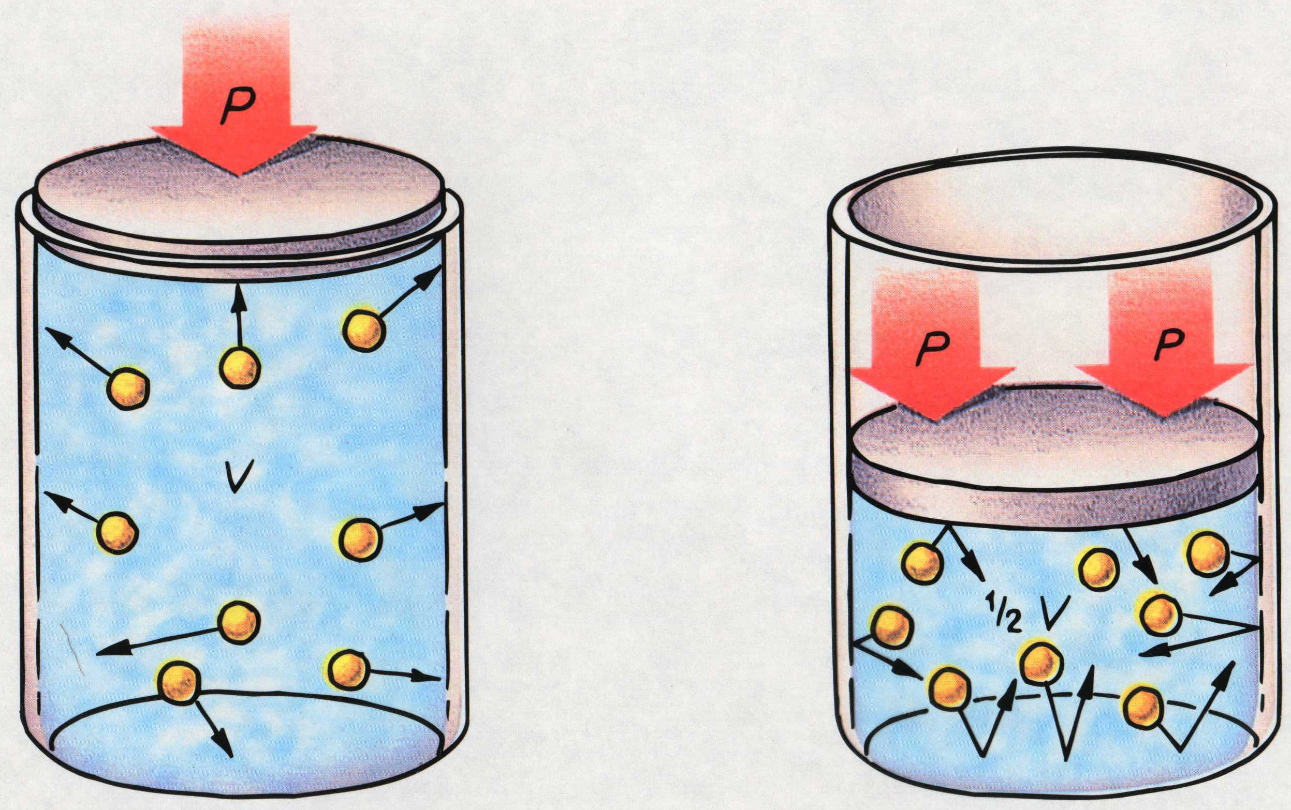
Boyle’s Law
P₁V₁ = P₂V₂
(Temperature is held constant)
Timberlake, Chemistry 7th Edition, page 253
Notes:
When the volume of a gas decreases, its pressure increases as long as there is no change in the temperature or the amount of the gas.

Slide 67
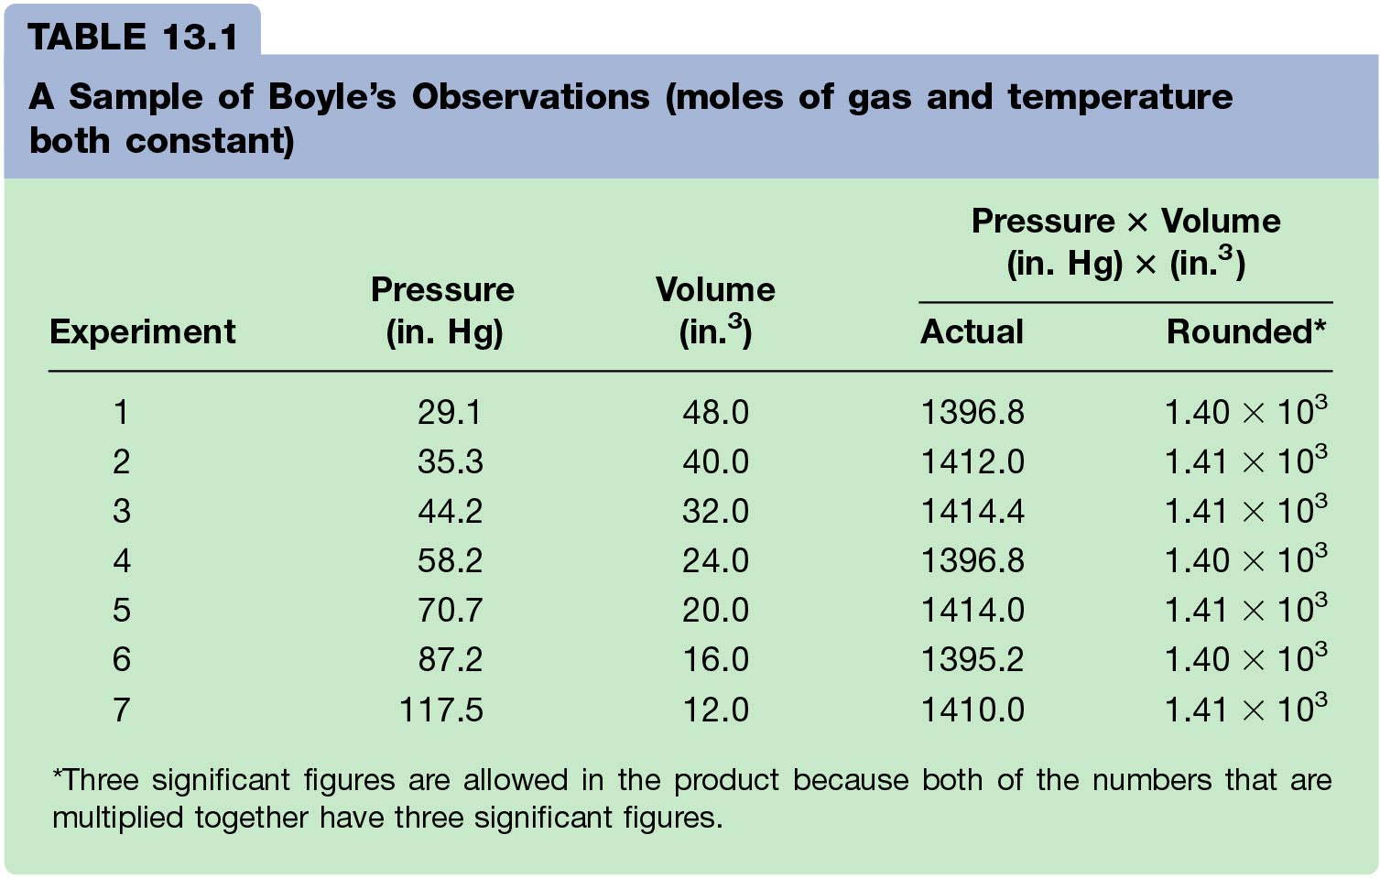
Boyle’s Law Data
Notes:
As the pressure on a gas increases, the volume of the gas decreases because the gas particles are forced closer together.
As the pressure on a gas decreases, the gas volume increases because the gas particles can now move farther apart.
Boyle carried out some experiments that determined the quantitative relationship between the pressure and volume of a gas.
Plots of Boyle’s data showed that a simple plot of V versus P is a hyperbola and reveals an inverse relationship between pressure and volume; as the pressure is doubled, the volume decreases by a factor of two.
Relationship between the two quantities is described by the equation PV = constant.
Dividing both sides by P gives an equation that illustrates the inverse relationship between P and V:
V = constant = constant(1/P) or V ∝ 1/P
P
• A plot of V versus 1/P is a straight line whose slope is equal to the constant.
• Numerical value of the constant depends on the amount of gas used in the experiment and on the temperature at which the experiments are carried out.
• This relationship between pressure and volume is known as Boyle’s law which states that at constant temperature, the volume of a fixed amount of a gas is inversely proportional to its pressure.

Slide 68
Pressure vs. Volume for a Fixed Amount of Gas
(Constant Temperature)
600
Pressure Volume PV
(Kpa) (mL)
100 500 50,000
150 333 49,950
200 250 50,000
250 200 50,000
300 166 49,800
350 143 50,500
400 125 50,000
450 110 49,500
500
400
300
Volume (mL)
200
100
0 100 200 300 400 500
Pressure (KPa)
Notes:
The pressure for this data was NOT at 1 atm.
Practice with this data: (where Pressure = 1 atmosphere)
Volume Temp (ºC) (K) V/T
63.4 L 500 773 0.0821
55.2 400 673 0.0821
47.0 300 573 0.0821
38.8 200 473 0.0821
As the pressure on a gas increases, the volume of the gas decreases because the gas particles are forced closer together.
As the pressure on a gas decreases, the gas volume increases because the gas particles can now move farther apart.
Boyle carried out some experiments that determined the quantitative relationship between the pressure and volume of a gas.
Plots of Boyle’s data showed that a simple plot of V versus P is a hyperbola and reveals an inverse relationship between pressure and volume; as the pressure is doubled, the volume decreases by a factor of two.
Relationship between the two quantities is described by the equation PV = constant.
Dividing both sides by P gives an equation that illustrates the inverse relationship between P and V:
V = constant = constant(1/P) or V ∝ 1/P
P
• A plot of V versus 1/P is a straight line whose slope is equal to the constant.
• Numerical value of the constant depends on the amount of gas used in the experiment and on the temperature at which the experiments are carried out.
• This relationship between pressure and volume is known as Boyle’s law which states that at constant temperature, the volume of a fixed amount of a gas is inversely proportional to its pressure.

Slide 69
Pressure vs. Reciprocal of Volume for a Fixed Amount of Gas
(Constant Temperature)
0.010
0.008
Pressure Volume 1/V
(Kpa) (mL)
100 500 0.002
150 333 0.003
200 250 0.004
250 200 0.005
300 166 0.006
350 143 0.007
400 125 0.008
450 110 0.009
0.006
1 / Volume (1/L)
0.004
0.002
0 100 200 300 400 500
Pressure (KPa)
Notes:
The pressure for this data was NOT at 1 atm.
Practice with this data: (where Pressure = 1 atmosphere)
Volume Temp (ºC) (K) V/T
63.4 L 500 773 0.0821
55.2 400 673 0.0821
47.0 300 573 0.0821
38.8 200 473 0.0821
As the pressure on a gas increases, the volume of the gas decreases because the gas particles are forced closer together.
As the pressure on a gas decreases, the gas volume increases because the gas particles can now move farther apart.
Boyle carried out some experiments that determined the quantitative relationship between the pressure and volume of a gas.
Plots of Boyle’s data showed that a simple plot of V versus P is a hyperbola and reveals an inverse relationship between pressure and volume; as the pressure is doubled, the volume decreases by a factor of two.
Relationship between the two quantities is described by the equation PV = constant.
Dividing both sides by P gives an equation that illustrates the inverse relationship between P and V:
V = constant = constant(1/P) or V ∝ 1/P
P
• A plot of V versus 1/P is a straight line whose slope is equal to the constant.
• Numerical value of the constant depends on the amount of gas used in the experiment and on the temperature at which the experiments are carried out.
• This relationship between pressure and volume is known as Boyle’s law which states that at constant temperature, the volume of a fixed amount of a gas is inversely proportional to its pressure.

Slide 70
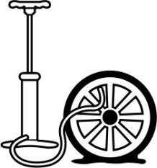
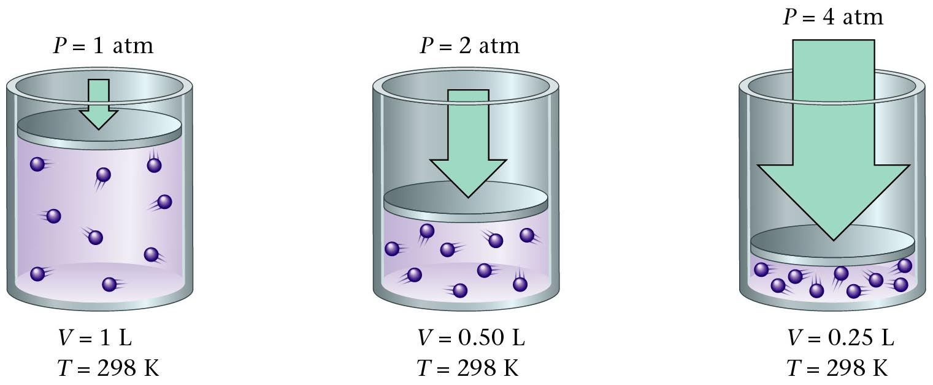
Boyle’s Law Illustrated
Zumdahl, Zumdahl, DeCoste, World of Chemistry 2002, page 404
Notes:
http://images.jupiterimages.com/common/detail/56/84/23298456.jpg

Slide 71
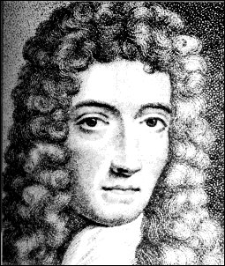
Boyle’s Law
Volume (mL) | Pressure (torr) | P.V (mL.torr)
10.0 20.0 30.0 40.0 | 760.0 379.6 253.2 191.0 | 7.60 x 10³ 7.59 x 10³ 7.60 x 10³ 7.64 x 10³
The pressure and volume of a gas are inversely related
  at constant mass & temp
PV = k
P
V
Courtesy Christy Johannesson www.nisd.net/communicationsarts/pages/chem
Notes:
As the pressure on a gas increases, the volume of the gas decreases because the gas particles are forced closer together.
As the pressure on a gas decreases, the gas volume increases because the gas particles can now move farther apart.
Boyle carried out some experiments that determined the quantitative relationship between the pressure and volume of a gas.
Plots of Boyle’s data showed that a simple plot of V versus P is a hyperbola and reveals an inverse relationship between pressure and volume; as the pressure is doubled, the volume decreases by a factor of two.
Relationship between the two quantities is described by the equation PV = constant.
Dividing both sides by P gives an equation that illustrates the inverse relationship between P and V:
V = constant = constant(1/P) or V ∝ 1/P
P
• A plot of V versus 1/P is a straight line whose slope is equal to the constant.
• Numerical value of the constant depends on the amount of gas used in the experiment and on the temperature at which the experiments are carried out.
• This relationship between pressure and volume is known as Boyle’s law which states that at constant temperature, the volume of a fixed amount of a gas is inversely proportional to its pressure.

Slide 72
Pressure and Volume of a Gas
Boyle’s Law
A quantity of gas under a pressure of 106.6 kPa has a volume
of 380 dm³. What is the volume of the gas at standard
pressure, if the temperature is held constant?
P₁ x V₁ = P₂ x V₂
(106.6 kPa) x (380 dm³) = (103.3 kPa) x (V₂)
V₂ = 392 dm³
V₂ = 400 dm³

Slide 73
PV Calculation (Boyle’s Law)
A quantity of gas has a volume of 120 dm³ when confined
under a pressure of 93.3 kPa at a temperature of 20 ºC.
At what pressure will the volume of the gas be 30 dm³ at
20 ºC?
P₁ x V₁ = P₂ x V₂
(93.3 kPa) x (120 dm³) = (P₂) x (30 dm³)
P₂ = 373.2 kPa

Slide 74
Solubility of Carbon Dioxide in Water
Temperature Pressure Solubility of CO₂
Temperature Effect
0ºC 1.00 atm 0.348 g / 100 mL H₂O
20ºC 1.00 atm 0.176 g / 100 mL H₂O
40ºC 1.00 atm 0.097 g / 100 mL H₂O
60ºC 1.00 atm 0.058 g / 100 mL H₂O
Pressure Effect
0ºC 1.00 atm 0.348 g / 100 mL H₂O
0ºC 2.00 atm 0.696 g / 100 mL H₂O
0ºC 3.00 atm 1.044 g / 100 mL H₂O
Notice that higher temperatures decrease the solubility and that higher pressures increase the solubility.
Corwin, Introductory Chemistry 4th Edition, 2005, page 370

Slide 75
Vapor Pressure of Water
Temp. Vapor Temp. Vapor Temp. Vapor
(ºC) Pressure (ºC) Pressure (ºC) Pressure
(mm Hg) (mm Hg) (mm Hg)
0 4.6 21 18.7 35 41.2
6.5 22 19.8 40 55.3
10 9.2 23 21.1 50 71.9
10.5 24 22.4 55 92.5
14 12.0 25 23.8 35 118.0
13.6 26 25.2 40 149.4
14.5 27 26.7 40 233.7
18 15.5 28 28.4 55 355.1
19 16.5 29 30.0 35 525.8
20 17.5 30 31.8 40 760.0
Corwin, Introductory Chemistry 4th Edition, 2005, page 584

Slide 76

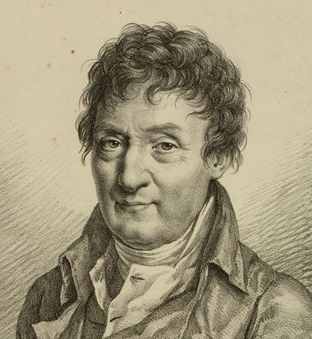
Charles' Law
If n and P are constant, then
V = (nR/P) = kT
This means, for example, that
Temperature goes up as Pressure goes up.
V and T are directly related.
A hot air balloon is a good example of Charles's law.
V₁ V₂
Jacques Charles
(1746 - 1823)
Isolated boron and studied gases.
Balloonist.
=
T₁ T₂
(Pressure is held constant)
Notes:
http://www.balloon-rides-ny.com/DylanBalloon.jpg

Slide 77
Temperature
Raising the temperature of a gas increases the pressure if the volume is held constant.
The molecules hit the walls harder.
The only way to increase the temperature at constant pressure is to increase the volume.

Slide 78
300 K
If you start with 1 liter of gas at 1 atm pressure and 300 K
and heat it to 600 K one of 2 things happen

Slide 79
600 K
300 K
Either the volume will increase to 2 liters at 1 atm.

Slide 80
300 K
600 K
the pressure will increase to 2 atm.

Slide 81
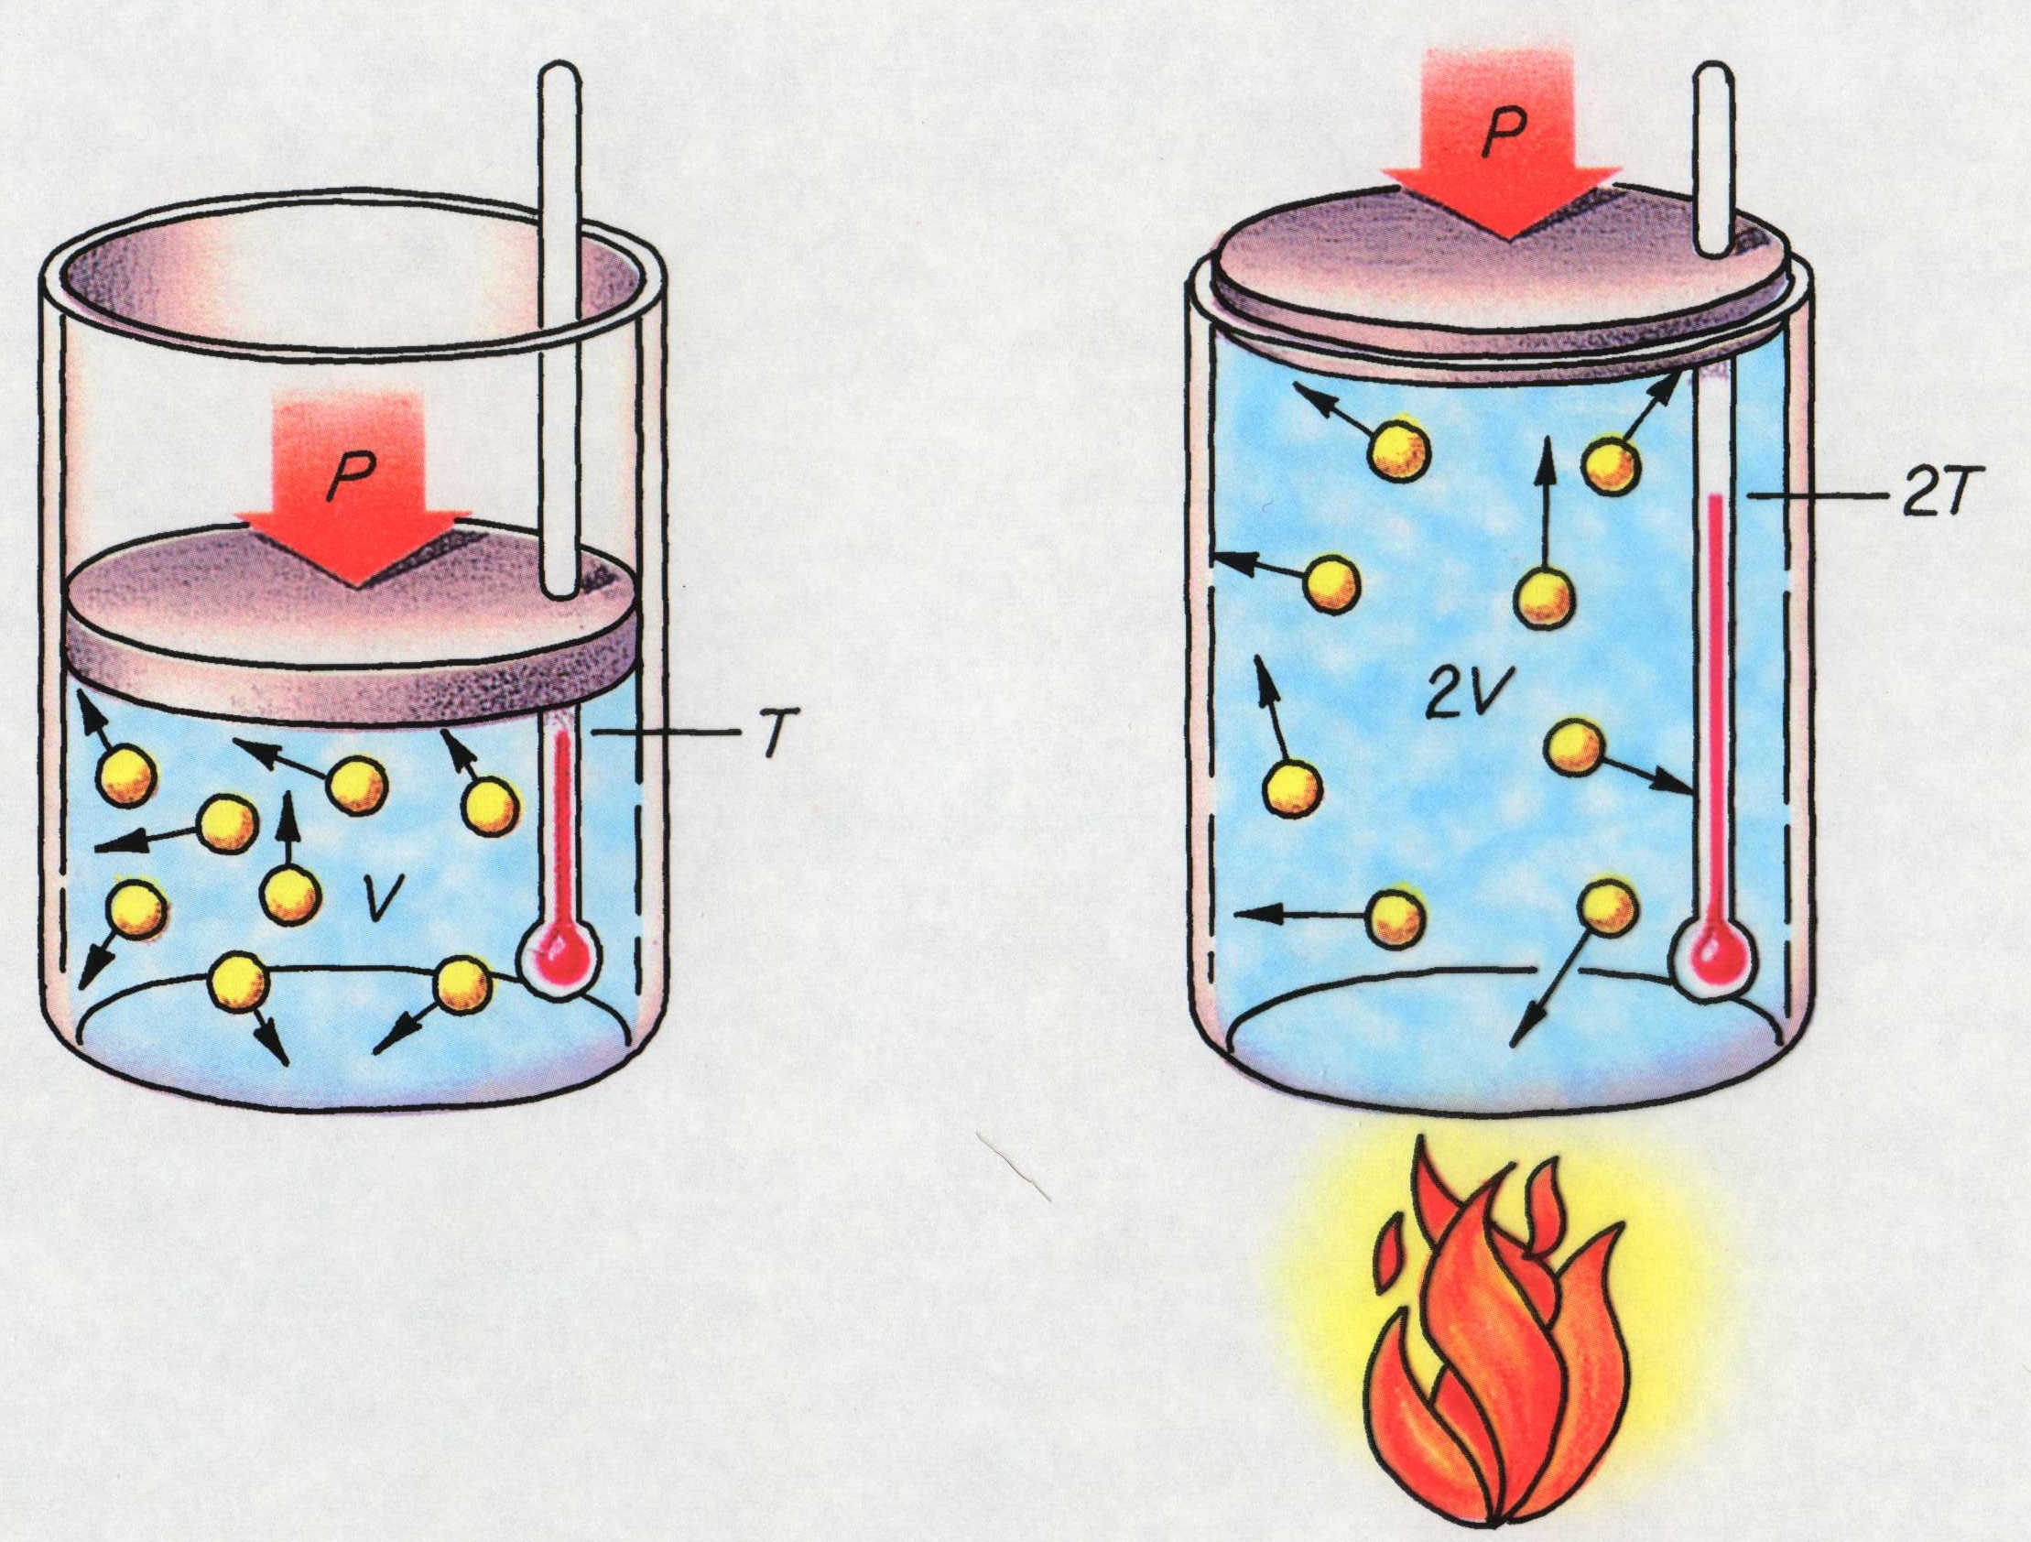
Charles’ Law
V₁ V₂
=
T₁ T₂
(Pressure is held constant)
Timberlake, Chemistry 7th Edition, page 259
Notes:
The Kelvin temperature of a gas is directly related to the volume of the gas when there is no change in pressure or amount.

Slide 82
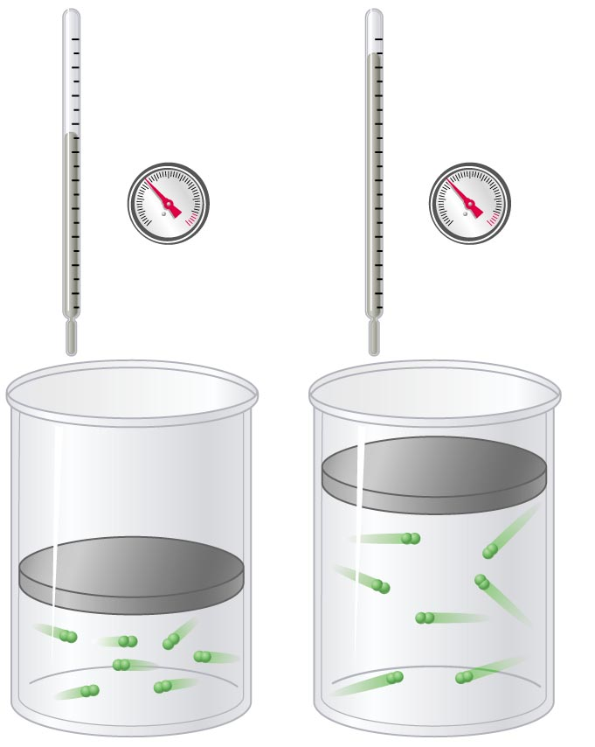
V vs. T (Charles’ law)
At constant pressure and
amount of gas, volume
increases as temperature increases
(and vice versa).
V₁ V₂
=
T₁ T₂
(Pressure is held constant)
Copyright © 2007 Pearson Benjamin Cummings. All rights reserved.

Slide 83
Volume vs. Kelvin Temperature of a Gas at Constant Pressure
Trial Temperature (T) Volume (V)
ºC K mL
10.0 283 100
50.0 323 114
100.0 373 132
200.0 473 167
180
160
140
120
100
80
60
40
20
0
Volume (mL)
Trial Ratio: V / T
  0.35 mL / K
  0.35 mL / K
  0.35 mL / K
  0.35 mL / K
origin
(0,0 point)
0 100 200 300 400 500 Temperature (K)
-273 -200 100 0 100 200 Temperature (ºC)
Notes:
The pressure for this data was NOT at 1 atm.
Practice with this data: (where Pressure = 1 atmosphere)
Volume Temp (ºC) (K) V/T
63.4 L 500 773 0.0821
55.2 400 673 0.0821
47.0 300 573 0.0821
38.8 200 473 0.0821
Hot air rises and gases expand when heated.
Charles carried out experiments to quantify the relationship between the temperature and volume of a gas and showed that a plot of the volume of a given sample of gas versus temperature (in ºC) at constant pressure is a straight line.
Gay-Lussac showed that a plot of V versus T was a straight line that could be extrapolated to –273.15ºC at zero volume, a theoretical state.
The slope of the plot of V versus T varies for the same gas at different pressures, but the intercept remains constant at –273.15ºC.
Plots of V versus T for different amounts of varied gases are straight lines with different slopes but the same intercept on the T axis.
Significance of the invariant T intercept in plots of V versus T was recognized by Thomson (Lord Kelvin), who postulated that –273.15ºC was the lowest possible temperature that could theoretically be achieved, and he called it absolute zero (0 K).
Charles’s and Gay-Lussac’s findings can be stated as: At constant pressure, the volume of a fixed amount of a gas is directly proportional to its absolute temperature
(in K).
This relationship is referred to as Charles’s law and is stated mathematically as
V = (constant) [T (in K)] or V ∝ T (in K, at constant P).

Slide 84
Volume vs. Kelvin Temperature of a Gas at Constant Pressure
Trial Temperature (T) Volume (V)
ºC K mL
10.0 283 100
50.0 323 114
100.0 373 132
200.0 473 167
180
160
140
120
100
80
60
40
20
0
180
160
140
120
100
80
60
40
20
0
Volume (mL)
Trial Ratio: V / T
  0.35 mL / K
  0.35 mL / K
  0.35 mL / K
  0.35 mL / K
origin
(0,0 point)
0 100 200 300 400 500 Temperature (K)
-273 -200 100 0 100 200 Temperature (ºC)
Notes:
The pressure for this data was NOT at 1 atm.
Practice with this data: (where Pressure = 1 atmosphere)
Volume Temp (ºC) (K) V/T
63.4 L 500 773 0.0821
55.2 400 673 0.0821
47.0 300 573 0.0821
38.8 200 473 0.0821
Hot air rises and gases expand when heated.
Charles carried out experiments to quantify the relationship between the temperature and volume of a gas and showed that a plot of the volume of a given sample of gas versus temperature (in ºC) at constant pressure is a straight line.
Gay-Lussac showed that a plot of V versus T was a straight line that could be extrapolated to –273.15ºC at zero volume, a theoretical state.
The slope of the plot of V versus T varies for the same gas at different pressures, but the intercept remains constant at –273.15ºC.
Plots of V versus T for different amounts of varied gases are straight lines with different slopes but the same intercept on the T axis.
Significance of the invariant T intercept in plots of V versus T was recognized by Thomson (Lord Kelvin), who postulated that –273.15ºC was the lowest possible temperature that could theoretically be achieved, and he called it absolute zero (0 K).
Charles’s and Gay-Lussac’s findings can be stated as: At constant pressure, the volume of a fixed amount of a gas is directly proportional to its absolute temperature
(in K).
This relationship is referred to as Charles’s law and is stated mathematically as
V = (constant) [T (in K)] or V ∝ T (in K, at constant P).

Slide 85
Volume vs. Kelvin Temperature of a Gas at Constant Pressure
Trial Temperature (T) Volume (V)
ºC K mL
10.0 283 100
50.0 323 114
100.0 373 132
200.0 473 167
160
160
140
140
120
120
100
100
80
80
Volume (mL)
Trial Ratio: V / T
1 0.35 mL / K
2 0.35 mL / K
3 0.35 mL / K
4 0.35 mL / K
60
60
40
40
20
20
origin
(0,0 point)
0 100 200 300 400 500 Temperature (K)
-273 -200 100 0 100 200 Temperature (ºC)
absolute zero
Notes:
The pressure for this data was NOT at 1 atm.
Practice with this data: (where Pressure = 1 atmosphere and n = 1 mole)
Volume Temp (ºC) (K) V/T
63.4 L 500 773 0.0821
55.2 400 673 0.0821
47.0 300 573 0.0821
38.8 200 473 0.0821
Data Set 2: Volume-Temperature Data for a Gas at a Constant Pressure
Volume Temp (ºC) (K) V/T
1094 L 273 546 2.00
747 100 373 2.01
568 10 283 2.01
545 1 274 1.99
545 0 273 2.00
546 -1 272 2.01
403 -73 200 2.02
199 -173 100 1.99
100 -223 50 2.00
Hot air rises and gases expand when heated.
Charles carried out experiments to quantify the relationship between the temperature and volume of a gas and showed that a plot of the volume of a given sample of gas versus temperature (in ºC) at constant pressure is a straight line.
Gay-Lussac showed that a plot of V versus T was a straight line that could be extrapolated to –273.15ºC at zero volume, a theoretical state.
The slope of the plot of V versus T varies for the same gas at different pressures, but the intercept remains constant at –273.15ºC.
Plots of V versus T for different amounts of varied gases are straight lines with different slopes but the same intercept on the T axis.
Significance of the invariant T intercept in plots of V versus T was recognized by Thomson (Lord Kelvin), who postulated that –273.15ºC was the lowest possible temperature that could theoretically be achieved, and he called it absolute zero (0 K).
Charles’s and Gay-Lussac’s findings can be stated as: At constant pressure, the volume of a fixed amount of a gas is directly proportional to its absolute temperature
(in K).
This relationship is referred to as Charles’s law and is stated mathematically as
V = (constant) [T (in K)] or V ∝ T (in K, at constant P).

Slide 86
Plot of V vs. T (Different Gases)
High temperature
Large volume
He
6
5
Low temperature
Small volume
CH₄
4
V (L)
3
H₂O
2
H₂
1
N₂O
-200
-100
0
100
200
300
-273 ºC
T (ºC)
Zumdahl, Zumdahl, DeCoste, World of Chemistry 2002, page 408

Slide 87
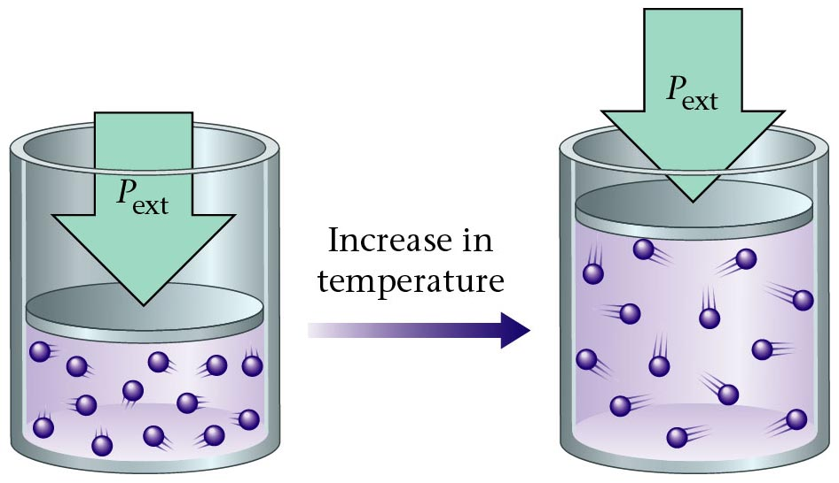
Charles' Law
Zumdahl, Zumdahl, DeCoste, World of Chemistry 2002, page 428

Slide 88
Temperature and Volume of a Gas
Charles’ Law
At constant pressure, by what fraction of its volume will a
quantity of gas change if the temperature changes from
0 ºC to 50 ºC?
1
273 K
X
323 K
T₁ = 0 ºC + 273 = 273 K
T₂ = 50 ºC + 273 = 323 K
V₁ = 1
V₂ = X
=
X = 323 / 273
V₁ = V₂
or 1.18 x larger
T₁ T₂

Slide 89
VT Calculation (Charles’ Law)
At constant pressure, the volume of a gas is increased from
150 dm³ to 300 dm³ by heating it. If the original temperature
of the gas was 20 ºC, what will its final temperature be (ºC)?
150 dm³
293 K
300 dm³
T₂
T₁ = 20 ºC + 273 = 293 K
T₂ = X K
V₁ = 150 dm³
V₂ = 300 dm³
=
T₂ = 586 K
ºC = 586 K - 273
T₂ = 313 ºC

Slide 90

Temperature and the Pressure of a Gas
High in mountains, Richard checked the pressure of his car tires and
observed that they has 202.5 kPa of pressure. That morning, the
temperature was -19 ºC. Richard then drove all day, traveling through the
desert in the afternoon. The temperature of the tires increased to 75 ºC
because of the hot roads. What was the new tire pressure? Assume the
volume remained constant. What is the percent increase in pressure?
P₁ = 202.5 kPa
P₂ = X kPa
T₁ = -19 ºC + 273 = 254 K
T₂ = 75 ºC + 273 = 348 K
202.5 kPa
254 K
P₂
348 K
=
P₂ = 277 kPa
% increase = 277 kPa - 202.5 kPa x 100 %
202.5 kPa
or 37% increase
Notes:
Image of tire: http://media.canada.com/6c8714d8-471c-4ede-8876-90dda09eae8f/increasepressuretrips.jpg Photograph by : CanWest News Service
Density of nitrogen gas = 1.251 g/L
Air’s density = 1.2 g/L

Slide 91
The Combined Gas Law
When measured at STP, a quantity of gas has a volume of 500 dm³. What volume will it occupy at 0 ºC and 93.3 kPa?
(101.3 kPa) x (500 dm³) = (93.3 kPa) x (V₂)
273 K
273 K
(101.3) x (500) = (93.3) x (V₂)
P₁ = 101.3 kPa
T₁ = 273 K
V₁ = 500 dm³
P₂ = 93.3 kPa
T₂ = 0 ºC + 273 = 273 K
V₂ = X dm³
V₂ = 542.9 dm³

Slide 92
The Combined Gas Law
When measured at STP, a quantity of gas has a volume of 500 dm³. What volume will it occupy at 0 ºC and 93.3 kPa?
P₁ x V₁
T₁
P₂ x V₂
T₂
(101.3 kPa) x (500 dm³) = (93.3 kPa) x (V₂)
=
273 K
273 K
P₁ = 101.3 kPa
T₁ = 273 K
V₁ = 500 dm³
P₂ = 93.3 kPa
T₂ = 0 ºC + 273 = 273 K
V₂ = X dm³
V₂ = 542.9 dm³

Slide 93
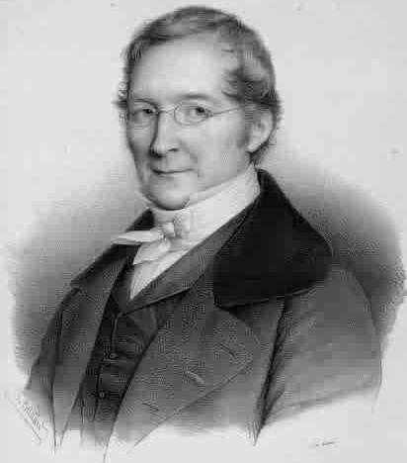
Gay-Lussac’s Law
Temperature (K) | Pressure (torr) | P/T (torr/K)
248 | 691.6 | 2.79
273 | 760.0 | 2.78
298 | 828.4 | 2.78
373 | 1,041.2 | 2.79
The pressure and absolute temperature (K) of a gas are directly related
  at constant mass & volume
P
T
Courtesy Christy Johannesson www.nisd.net/communicationsarts/pages/chem
Notes:
Joseph Louis Gay-Lussac (1788-1850, France) His experiments led him to propose in 1808 the Law of Combining Volumes, which states that the volume of gases involved in a chemical reaction are in a small whole number ratio.

Slide 94
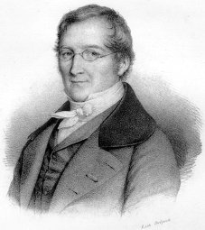
Gay-Lussac’s Law
The pressure and absolute temperature (K) of a gas are directly related
  at constant mass & volume
P
T
Courtesy Christy Johannesson www.nisd.net/communicationsarts/pages/chem

Slide 95
Gas Law Calculations
Boyle’s Law
PV = k
Charles’ Law
V
T
= k
P and V
change
n, R, T are
constant
Ideal
Gas Law
PV = nRT
T and V
change
P, n, R are
constant
P, V, and T change
n and R are constant
Combined
Gas Law
PV
T
= k

Slide 96
Real Gases Do Not Behave Ideally
CH₄
N₂
2.0
H₂
PV
nRT
CO₂
1.0
Ideal
gas
0
0
200
400
600
800
1000
P (atm)
Notes:
Postulates of the kinetic molecular theory of gases ignore both the volume occupied by the molecules of a gas and all interactions between molecules, whether attractive or repulsive.
• In reality, all gases have nonzero molecular volumes and the molecules of real gases interact with one another in ways that depend on the structure of the molecules and differ for each gaseous substance.
For an ideal gas, a plot of PV/nRT versus P gives a horizontal line with an intercept of 1 on the PV/nRT axis.
• Real gases show significant deviations from the behavior expected for an ideal gas, particularly at high pressures, but at low pressures (less than 1 atm) and at higher temperatures, real gases approximate ideal gas behavior.
Real gases behave differently from ideal gases at high pressures and low temperatures because the basic assumptions behind the ideal gas law — that gas molecules have negative volume and that intermolecular interactions are negligible — are no longer valid.
• Molecules of an ideal gas are assumed to have zero volume; volume available to them for motion is the same as the volume of the container.
Molecules of a real gas have small but measurable volumes.
– At low pressures, gaseous molecules are far apart.
– As pressure increases, intermolecular distances become smaller and smaller and the volume occupied by the molecules becomes significant compared with the volume of the container.
– Total volume occupied by gas is greater than the volume predicted by the ideal gas law, and at very high pressures, the experimentally measured value of PV/nRT is greater than the value predicted by the ideal gas law.
Molecules are attracted to one another by a combination of forces that are important for gases at low temperatures and high pressures where intermolecular distances are shorter.
– As the intermolecular distances decrease, the pressure exerted by the gas on the container wall decreases and the observed pressure is less than expected.
– At low temperatures, the ratio of PV/nRT is lower than predicted for an ideal gas.
– At high pressures, the effect of nonzero molecular volume predominates.
– At high temperatures, molecules have sufficient kinetic energy to overcome intermolecular attractive forces and the effects of nonzero molecular volume predominates.

Slide 97
Equation of State of an Ideal Gas
Robert Boyle (1662) found that at fixed temperature
  Pressure and volume of a gas is inversely proportional
    PV = constant Boyle’s Law
J. Charles and Gay-Lussac (circa 1800) found that
at fixed pressure
  Volume of gas is proportional to change in temperature
Volume
He
CH₄
H₂O
H₂
-273.15 ºC
Temp
All gases extrapolate to zero volume at a temperature
corresponding to –273.15 ºC (absolute zero).

Slide 98
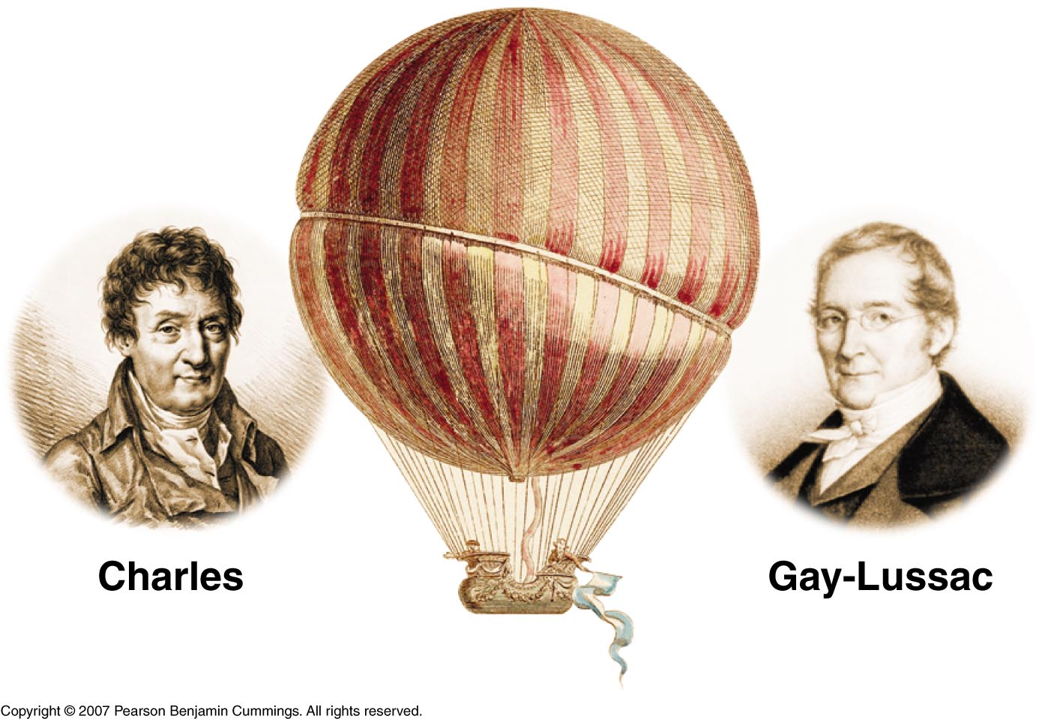
V₁ V₂
P₁ P₂
=
=
T₁ T₂
T₁ T₂
(Pressure is held constant)
(Volume is held constant)
Copyright © 2007 Pearson Benjamin Cummings. All rights reserved.
Notes:
GAY-LUSSAC -- SCIENTIST
Joseph Louis Gay-Lussac, by virtue of his skill and diligence as an experimentalist, and by his demonstration of the power of the scientific method, deserves recognition as a great scientist. Born on December 6, 1778, Joseph was the eldest of five children. His father, Antoine Gay, was a lawyer who, to distinguish himself from other people in the Limoges region with the last name of Gay, used the surname Gay-Lussac from the name of some family property near St Leonard(4) The French Revolution affected many of what were to become the French scientific elite. Gay-Lussac was sent to Paris at the age of fourteen when his father was arrested. After having had private lessons and attending a boarding school, the Ecole Polytechnique and the civil engineering school, Gay-Lussac became an assistant to Berthollet who was himself a co-worker of Lavoisier. Gay-Lussac thus got the chance to become part of the group of famous men who spent time at Berthollet's country house near Arcueil. Here among the Arcueil Society he received his training in chemical research(4).
With the encouragement of Berthollet and LaPlace, Gay-Lussac at the age of 24 conducted his first major research in the winter of 1801-1802. He settled some conflicting evidence about the expansion properties of different gases. By excluding water vapor from the apparatus and by making sure that the gases themselves were free of moisture, he obtained results that were more accurate than had been obtained previously by others. He concluded that equal volumes of all gases expand equally with the same increase in temperature. While Jacques Charles discovered this volume-temperature relationship fifteen years earlier, he had not published it. Unlike Gay-Lussac, Charles did not measure the coefficient of expansion. Also, because of the presence of water in the apparatus and the gases themselves, Charles obtained results that indicated unequal expansion for the gases that were water soluble(16,19).
Gay-Lussac, like his mentor Berthollet, was interested in how chemical reactions take place. Working with the mathematical physicist, LaPlace, Gay-Lussac made quantitative measurements on capillary action. The goal was to support LaPlace 's belief in his Newtonian theory of chemical affinity. In 1814 this theoretical bent continued as Gay-Lussac and LaPlace sought to determine if chemistry could be reduced to applied mathematics. The approach was to ask whether the conditions of chemical reactions could be reduced simply to, as LaPlace had suggested, considerations of heat(4).
As with his mentor before him, Gay-Lussac was consulted by industry and supported by the government. "Napoleonic science sharpened the appetites of young men by holding up the prospects of recognition and reward"(5). Gay-Lussac and Thenard, the laboratory boy turned professor, isolated the element boron nine days before Davy's group did (but Davy was the first to publish(1).) Gay-Lussac led his group into the isolation of plant alkaloids for potential medical use (8) and he was instrumental in developing the industrial production of oxalic acid from the fusion of sawdust with alkali.(17) His most important contribution to industry was, in 1827, the refinement of the lead chamber process for the production of sulfuric acid, the industrial chemical produced in largest volume in the world. The tall absorbtion towers were known as Gay-Lussac Towers. The process is:
SO2 (g) + NO2 (g) -------> SO3 (g) + NO (g) This reaction was carried out in a lead-lined chamber in which the sulfur trioxide was then dissolved in water to produce sulfuric acid. Gay-Lussac's contribution was a process for recycling the nitrogen monoxide after oxidizing it to NO2. Sulfuric acid was produced this way well into the twentieth century, when it was replaced by catalytic oxidation of SO2 in the "Contact Process".(13) While Gay-Lussac was a great theoretical scientist, he was also respected by his colleagues for his careful, elegant, experimental work. Wanting to know why and how something happened was important to Gay-Lussac, but he preferred knowing much about a limited subject rather than proposing broad new theories which might be wrong . He devised many new types of apparatus such as the portable barometer, an improved pipette and burette and, when working at the Mint, a new apparatus for quickly and accurately estimating the purity of silver which was the only legal measure in France until 1881(5). His work on iodine is considered a model of chemical research(16). His precise measurement of the thermal expansion of gases mentioned above was used by Lord Kelvin in the development of the absolute temperature scale and Third Law of Thermodynamics and by Clausius in the development of the Second Law(9). He and Thenard improved existing methods of elemental analysis and developed volumetric procedures for measuring acids and alkalis(16). His quantification of the effect of light on the reaction of chlorine with hydrogen elevated photochemistry from mere artifice into a theoretical science which culminated, fifty years after his death, in the quantum theory(10). An example of his dedication to meticulous experimenting is his decision to undertake a balloon flight to a record setting height of 23,000 feet to test an hypotheses on earth's magnetic field and the composition of the air(20).
The work for which Gay-Lussac is most remembered in high school and university courses of general chemistry is his Law of Combining Volumes: "The compounds of gaseous substances with each other are always formed in very simple ratios by volume"(11). If we follow the development of this law we can see the scientific method at work, in all its beauty and nobility, and with its pitfalls, resting as it does on the frailty of human nature.
Gay-Lussac began with a statement of intent: "I hope by this means to give proof of an idea advanced by several distinguished chemists--that we are perhaps not far removed from the time when we shall be able to submit the bulk of chemical formula to calculation"(11).
The events that culminated in the presentation of his memoir at Arcueil began with his balloon flight and measurements of the composition of the air. These studies led him to criticize a man ten years his elder--the scientist-explorer Alexander von Humbolt, who had also published measurements on the composition of the air. But in an illustration of the nobility of science, Humbolt, far from becoming angry with Gay-Lussac, saw that he had something to learn about precision in scientific research. The two became collaborators and friends and, in fact, eventually traveled together throughout Europe for a year in 1805, going to Rome, Switzerland and Berlin(3). Before that trip they worked on finding the ratio in which hydrogen and oxygen combine to form water. They needed this fact in order to find the percent of oxygen in the air. They came up with the remarkably accurate results of a volume ratio of 100 of oxygen to 200 of hydrogen.
What is surprising is that four years passed before Gay-Lussac published his now famous results. In the interim, during their trip together, he worked with Humbolt on measuring the earth's magnetic intensity. In 1807 he worked on a series of experiments to find out if there is a general relationship between the specific heats of gases and their densities(3).
Gay-Lussac looked at some previous data collected by Davy. This consisted of analysis of the proportions by weight of elements in three different oxides of nitrogen, as follows:
Proportions by WeightNitrogenOxygenNitrous oxide63.3036.70Nitrous gas44.0555.95Nitric Acid29.5070.50
Next Gay-Lussac "reduces these proportions to volumes", using the specific gravities of the gases relative to hydrogen:
Proportions by VolumeNitrogenOxygenNitrous oxide10049.5Nitrous gas100108.9Nitric acid100204.7
Now he can accept (by what today we call the 5% rule) that "the first and last of these proportions differ only slightly from 100:50 and 100:200" (11), but he recognizes that the second is significantly different from 100:100. He also knew that Berthollet had obtained the proportions by volume of H and N in ammonia, while Gay-Lussac, himself, had obtained those of sulfurous gas and oxygen in sulfuric acid and that these are indeed simple whole numbers. So he does an analytical experiment. He reacts 100 volumes of nitrous gas with "the new combustible substance from potash"(11) (presumably potassium) and he finds that the volume of the gas decreases by 50% and the remnant is all nitrogen. The reaction presumably is:
4K (s) + 2NO (g) -------> 2K2O + N2 He can now write: Proportions by VolumeNitrogenOxygenNitrous oxide10050Nitrous gas100100Nitric acid100200
In modern terms these three compounds are N2O, NO, and NO2. So Gay-Lussac has used the scientific method: Question, Hypothesis, Experiment (including careful measurement, reproducibility, independent observations in other laboratories) to devise an explanation of how gases combine--the resulting Law of Combining Volumes was announced at a meeting of the Societe Philomatique in Paris on December 31, 1808. As Crosland writes in his article in the Dictionary of Scientific Biography, "For Gay-Lussac, himself, the law provided a vindication of his belief in regularities in the physical world, which it was the business of the scientist to discover". Crosland adds that "These neat ratios do not, however, correspond exactly to his experimental results. He deduced his law from a few fairly clear cases... and glossed over discrepancies in some of the others. The simple reaction between hydrogen and chlorine, which is often used today as an elementary illustration of the law, was not discovered until 1809 and was included only as a footnote when this memoir was printed". Now comes the pitfall; not Gay-Lussac's at first but John Dalton's. In the second part of his "New System of Chemical Philosophy" Dalton criticized the accuracy of Gay-Lussac's measurements, experiments and generalizations. This was ironic since Dalton was more speculator than experimentalist, sometimes accepting large standard deviations, as in the case of the atomic weight of sulfur, for which he accepted values ranging from 12 to 22 based on his own experiments. Nevertheless, he had the gall to claim that the ratio of volumes of H and O in water was 1:1.97 which, he said, was not a simple whole number ratio, thereby invalidating Gay-Lussac's Law. Thus he was unable to "admit the French doctrine" as he called it(7).
It is instructive to trace Dalton's thought processes. In a paper read before the Literary and Philosophical Society in Manchester in 1802 (before the Law of Combining Volumes) Dalton stated that: "The particles of one gas are not elastic or repulsive to the particles of another gas but only to the particles of their own kind." In his New System of Chemical Philosophy, Part I (in 1808 after Gay-Lussac's Law), he set out a number of rules for combinations of atoms: "When only one combination of two bodies can be obtained, it must be presumed to be a binary one, unless some cause appear to the contrary" (6). Consequently, hydrogen peroxide not yet having been discovered (it was isolated by Thenard in 1818(16)), Dalton was forced to conclude that the formula of water was HO. Although others of his contemporaries, including Berzelius and Avogadro were quite comfortable with Gay-Lussac's Law and used it to their advantage, Dalton stubbornly rejected it. Like atoms could not stick together. They would repel each other as like charges do. Furthermore, atoms combined in simple proportions by weight according to Dalton's Law of Multiple Proportions, and Dalton could not see how the same proportions could apply to combining volumes(12). Avogadro had the answer: equal volumes of gases at the same temperature and pressure contain the same number of particles. To the latter, who had used electricity extensively in his studies of the halogens, it must have seemed preposterous to believe that gases such as oxygen, hydrogen and chlorine could be diatomic in nature. Two like atoms and two like charges were bound to repel each other; even though a cornerstone of Avogadro's work was the production of two volumes of HCl from one each of hydrogen and chlorine. So Avogadro's work was consigned to obscurity for fifty years, until his compatriot, Cannizzaro brought it to light in a pamphlet distributed at the end of the Karlsruhe Conference in December 1860(7) after Gay-Lussac, Berzelius and Dalton were dead.
In the end Dalton did bow under the weight of the evidence and accept the Law of Combining Volumes. But neither he nor Gay-Lussac nor Berzelius ever accepted Avogadro's Law; not even when Gaudin in 1833 clearly showed how it could be applied to explain the formation of water(15), not even with the background of Cavendish eudiometer experiments(14).
The stubborn blindness of Dalton and Berzelius and Gay-Lussac is a clear example of a common pitfall in the practice of science. Roger Bacon might have recognized it as the third "Cause of Error": popular prejudice(2), but it also has elements of Bacon's first cause of error, namely, submission to faulty and unworthy authority. We see that science has the pitfalls of human frailty as well as beauty and nobility.
References
1. Asimov, I., The Search for the Elements, Fawcett World Library, N.Y. 1962, pp.64 -- 65. 2. Bacon, R., Opus Majus, 1266, trans. Burke, R.B., Univ. Pennsylvania Press, Philadelphia, PA , 1928, p.4.
3. Crosland, M.P., Gay-Lussac, Gillispie, C.C., ed., Dictionary of Scientific Biography, Scribner, N.Y.,N.Y., 1972, p. 319.
4. Crosland, M. P. , Gay - Lussac: Scientist and Bourgeois. Cambridge University Press, Cambridge, England, 1978, p. 48 -- 50.
5. Ibid... p. 258 -- 260.
6. Dalton, John., A New System of Chemical Philosophy, Part 1, Bickerstaff, London, England, excerpted in ref.18 , pp. 768 -- 780.
7. Farber, E., The Evolution of Chemistry, Ronald Press, N.Y. 1952, pp. 130 -- 133.
8. Ibid ... p.162.
9. Ibid ... p. 206 & p. 222.
10. Ibid ... p. 227.
11. Gay Lussac, J.L., Mem. de la Soc. d'Arcuel, 1809, translation reprinted in ref. 19, pp. 804 -- 818.
12. Mason, S.F., A Short History of the Sciences, Macmillan, N.Y., N.Y., 1956, pp. 453 -- 454.
13. Oxtoby, D.W. and Nachtrieb, N.H., Principles of Modern Chemistry, Saunders, N.Y., 1986, p. 697.
14. Partington, J.R., A Short History of Chemistry, Dover, N.Y., N.Y., 1989,. pp. 138 -- 139.
15. Ibid... p. 210.
16. Ibid ... p. 223.
17. Ibid ... 226.
18. Schwartz, G. and Bishop, P.W., (ed.) The Development of Modern Science, Vol. 1, Basic Books, N.Y., N.Y., 1958.
19. Schwartz, G. and Bishop, P.W., (ed.) The Development of Modern Science, Vol. 2, Basic Books, N.Y., N.Y., 1958.
20. Ibid ... p. 22.
http://www.woodrow.org/teachers/chemistry/institutes/1992/Gay-Lussac.html

Slide 99
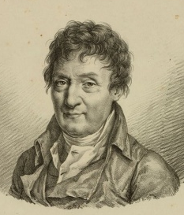
Kelvin Temperature Scale
Kelvin temperature (K) is given by
K = ºC + 273.15
where K is the temperature in Kelvin, ºC is temperature in Celcius
Using the ABSOLUTE scale, it is now possible to write Charles’ Law as
V / T = constant Charles’ Law
Gay-Lussac also showed that at fixed volume
P / T = constant
Combining Boyle’s law, Charles’ law, and Gay-Lussac’s law, we have
P V / T = constant
Charles
Gay-Lussac

Slide 100
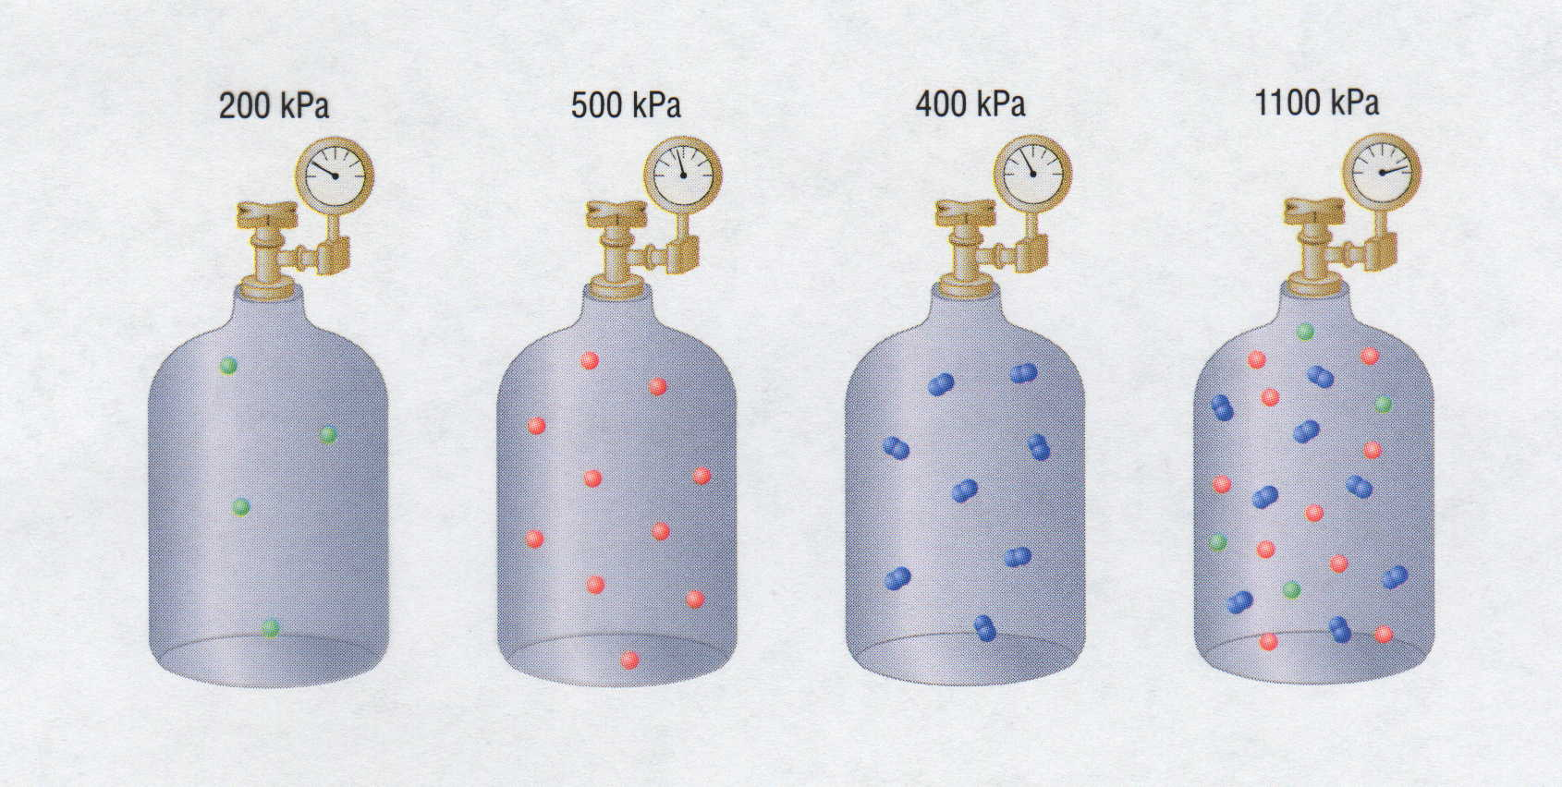
Partial Pressures
200 kPa
500 kPa
400 kPa
? kPa
+
+
=
1100 kPa
Notes:
PARTIAL PRESSURES
Dalton’s law of partial pressures states that the sum of the partial pressures of gases sum to the total pressure of the gases when combined.
The ideal gas law assumes that all gases behave identically and that their behavior is independent of attractive and repulsive forces.
If the volume and temperature are held constant, the ideal gas equation can be arranged to show that the pressure of a sample of gas is directly proportional to the number of moles of gas present:
P = n(RT/V) = n(constant)
Nothing in the equation depends on the nature of the gas, only on the quantity.
The total pressure exerted by a mixture of gases at a given temperature and volume is the sum of the pressures exerted by each of the gases alone.
If the volume, temperature, and number of moles of each gas in a mixture is known, then the pressure exerted by each gas individually, which is its partial pressure, can be calculated.
Partial pressure is the pressure the gas would exert if it were the only one present (at the same temperature and volume).
The total pressure exerted by a mixture of gases is the sum of the partial pressures of component gases.
This law is known as Dalton’s law of partial pressures and can be written mathematically as
P_{t} = P₁ + P₂ + P₃ - - - + P_{i}
where P_{t} is the total pressure and the other terms are the partial pressures of the individual gases.
For a mixture of two ideal gases, A and B, the expression for the total pressure can be written as
P_{t} = P_{A} + P_{B} = n_{A}(RT/V) + n_{B}(RT/V) = (n_{A} + n_{B}) (RT/V).
• More generally, for a mixture of i components, the total pressure is given by
P_{t} = (n₁ + n₂ + n₃ + - - - +n_{i}) (RT/V).
• The above equation makes it clear that, at constant temperature and volume, the pressure exerted by a gas depends on only the total number of moles of gas present, whether the gas is a single chemical species or a mixture of gaseous species.

Slide 101


Dalton’s Law of Partial Pressures
& Air Pressure
8 mm Hg
P
590 mm Hg
Ar
P
P
P
P
P
P
N₂
Total
= + + +
O₂
N₂
CO₂
Ar
149 mm Hg
P
P
149 590 3 8 mm Hg
O₂
Total
= + + +
3 mm Hg
P
P_{Total} = 750 mm Hg
CO₂
EARTH

Slide 102
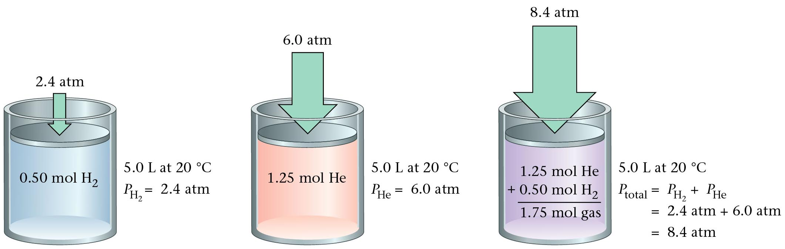
Dalton’s Partial Pressures
Zumdahl, Zumdahl, DeCoste, World of Chemistry 2002, page 421

Slide 103
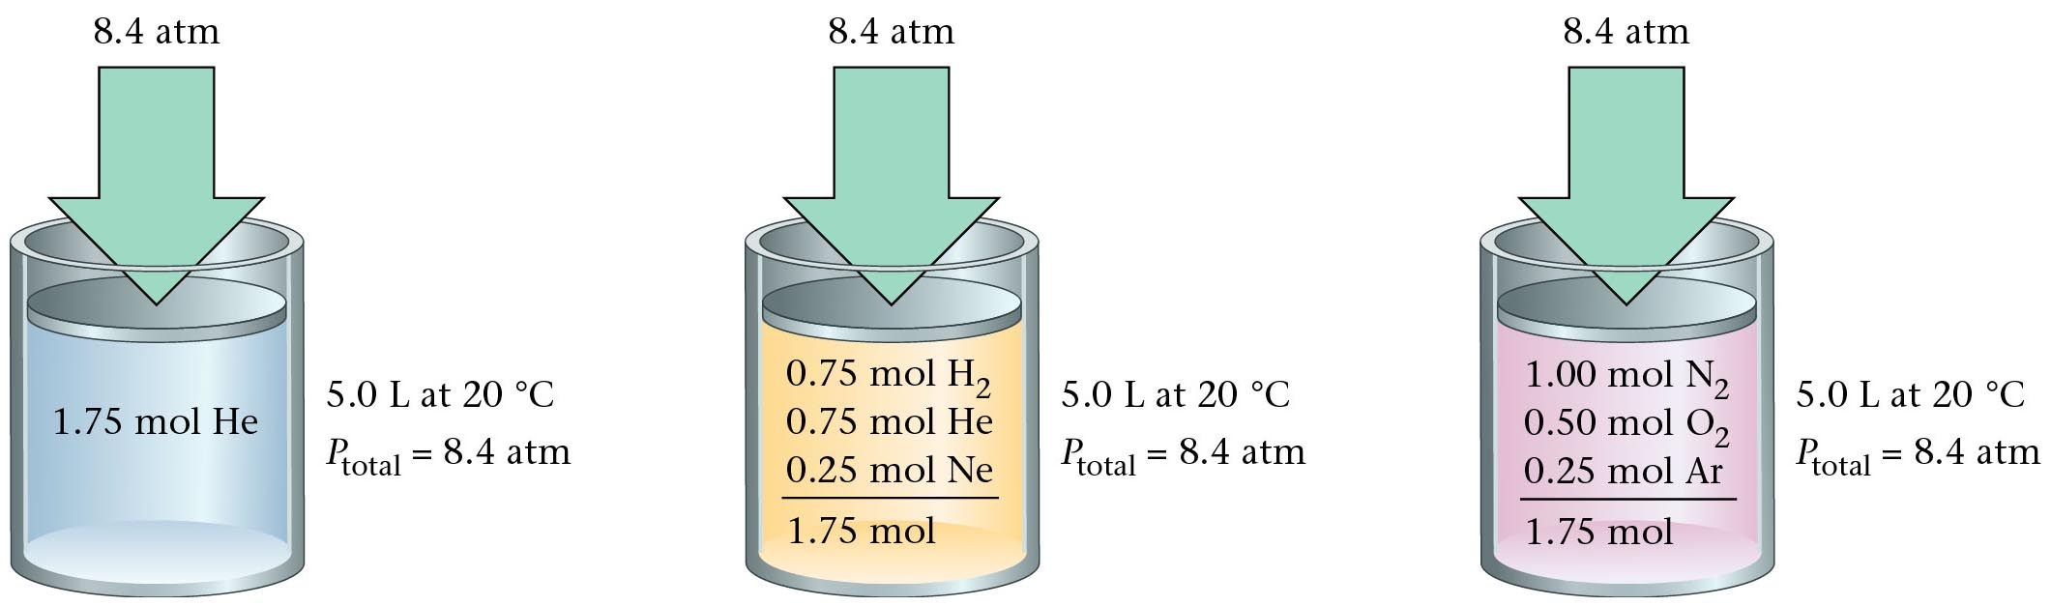
Dalton’s Law
Zumdahl, Zumdahl, DeCoste, World of Chemistry 2002, page 422

Slide 104
Dalton’s Law Applied
Suppose you are given four containers – three filled with noble gases.
The first 1 L container is filled with argon and exerts a pressure of 2 atm.
The second 3 liter container is filled with krypton and has a pressure of
380 mm Hg. The third 0.5 L container is filled with xenon and has a
pressure of 607.8 kPa. If all these gases were transferred into an empty
2 L container…what would be the pressure in the “new” container?
What would the pressure of argon be if transferred to 2 L container?
P_{T} = P_{Ar} + P_{Kr} + P_{Xe}
P₁ x V₁ = P₂ x V₂
P_{T} = P_{Ar} + P_{Kr} + P_{Xe}
P_{T} = 2 + 0.5 + 6
(2 atm) (1L) = (X atm) (2L)
P_{T} = 2 + 380 + 607.8
P_{T} = 8.5 atm
P_{Ar} = 1 atm
P_{T} = 989.8
P_{total} = ?
P_{Ar} = 2 atm
P_{Kr} = 380 mm Hg
P_{Kr} = 0.5 atm
P_{xe}
6 atm
P_{xe}
607.8 kPa
V = 1 liter V = 2 liters
V = 3 liters V = 0.5 liter

Slide 105
…just add them up
P_{total} = ?
P_{Ar} = 2 atm
P_{Kr} = 380 mm Hg
P_{Kr} = 0.5 atm
P_{xe}
6 atm
P_{xe}
607.8 kPa
V = 1 liter V = 3 liters V = 0.5 liter V = 2 liters
Dalton’s Law of Partial Pressures
“Total Pressure = Sum of the Partial Pressures”
P_{T} = P_{Ar} + P_{Kr} + P_{Xe} + …
P₁ x V₁ = P₂ x V₂
P₁ x V₁ = P₂ x V₂
(0.5 atm) (3L) = (X atm) (2L)
(6 atm) (0.5 L) = (X atm) (2L)
P_{Kr} = 0.75 atm
P_{xe} = 1.5 atm
P_{T} = 1 atm + 0.75 atm + 1.5 atm
P_{T} = 3.25 atm

Slide 106
Dalton’s Law of Partial Pressures
In a gaseous mixture, a gas’s partial pressure is the one the gas would exert
if it were by itself in the container.
The mole ratio in a mixture of gases determines each gas’s partial pressure.
Total pressure of mixture (3.0 mol He and 4.0 mol Ne) is 97.4 kPa.
Find partial pressure of each gas
3 mol He
7 mol gas
P_{He} =
?
(97.4 kPa)
=
41.7 kPa
4 mol Ne
7 mol gas
P_{Ne} =
?
(97.4 kPa)
=
55.7 kPa

Slide 107
80.0 g each of He, Ne, and Ar are in a container.
The total pressure is 780 mm Hg.
Find each gas’s partial pressure.
P_{He} = ²⁰/₂₆
of total
Total:
26 mol gas
P_{Ne} = ⁴/₂₆
of total
P_{Ar} = ²/₂₆
of total

Slide 108
Dalton’s Law: P_{Z} = P_{A,Z} + P_{B,Z} + …
Two 1.0 L containers, A and B, contain gases under 2.0 and 4.0 atm, respectively.
Both gases are forced into Container B. Find total pres. of mixture in B.
A
B
 | P_{X} | V_{X} | V_{Z} | P_{X,Z}
A | 2.0 atm | 1.0 L |  | 2.0 atm
B | 4.0 atm | 1.0 L |  | 4.0 atm
1.0 L
Total = 6.0 atm

Slide 109
Two 1.0 L containers, A and B, contain gases under 2.0 and 4.0 atm, respectively.
Both gases are forced into Container Z (^{w}/vol. 2.0 L). Find total pres. of mixture in Z.
A
B
Z
 | P_{X} | V_{X} | V_{Z} | P_{X,Z}
A
B
P_{A}V_{A} = P_{Z}V_{Z}
2.0 atm
1.0 L
1.0 atm
2.0 atm (1.0 L) = X atm (2.0 L)
2.0 L
X = 1.0 atm
4.0 atm
1.0 L
2.0 atm
P_{B}V_{B} = P_{Z}V_{Z}
4.0 atm (1.0 L) = X atm (2.0 L)
Total = 3.0 atm

Slide 110
Find total pressure of mixture in Container Z.
A
B
C
Z
1.3 L 2.6 L 3.8 L 2.3 L
3.2 atm 1.4 atm 2.7 atm X atm
 | P_{X} | V_{X} | V_{Z} | P_{X,Z}
A
B
C
P_{A}V_{A} = P_{Z}V_{Z}
3.2 atm (1.3 L) = X atm (2.3 L)
3.2 atm
1.3 L
1.8 atm
X = 1.8 atm
P_{B}V_{B} = P_{Z}V_{Z}
1.4 atm
2.6 L
2.3 L
1.6 atm
1.4 atm (2.6 L) = X atm (2.3 L)
2.7 atm
3.8 L
4.5 atm
P_{C}V_{C} = P_{Z}V_{Z}
2.7 atm (3.8 L) = X atm (2.3 L)
Total = 7.9 atm
Notes:
Example of Dalton’s law of partial pressures. Must use Boyle’s law to account for new volume each gas is contained in.

Slide 111
Dalton’s Law
Hydrogen gas is collected over water at 22.5°C. Find the pressure of the dry gas if the atmospheric pressure is 94.4 kPa.
The total pressure in the collection bottle is equal to atmospheric pressure and is a mixture of H₂ and water vapor.
GIVEN:
P_{H2} = ?
P_{total} = 94.4 kPa
P_{H2O} = 2.72 kPa
WORK:
P_{total} = P_{H2} + P_{H2O}
94.4 kPa = P_{H2} + 2.72 kPa
P_{H2} = 91.7 kPa
Look up water-vapor pressure on p.899 for 22.5°C.
Sig Figs: Round to least number of decimal places.
Courtesy Christy Johannesson www.nisd.net/communicationsarts/pages/chem

Slide 112
Dalton’s Law
A gas is collected over water at a temp of 35.0°C when the barometric pressure is 742.0 torr. What is the partial pressure of the dry gas?
The total pressure in the collection bottle is equal to barometric pressure and is a mixture of the “gas” and water vapor.
GIVEN:
P_{gas} = ?
P_{total} = 742.0 torr
P_{H2O} = 42.2 torr
WORK:
P_{total} = P_{gas} + P_{H2O}
742.0 torr = P_{H2} + 42.2 torr
P_{gas} = 699.8 torr
Look up water-vapor pressure on p.899 for 35.0°C.
Sig Figs: Round to least number of decimal places.
Courtesy Christy Johannesson www.nisd.net/communicationsarts/pages/chem

Slide 113
Dalton’s Law of Partial Pressures
Container A (with volume 1.23 dm³) contains a gas under 3.24 atm of pressure. Container B (with volume 0.93 dm³) contains a gas under 2.82 atm of pressure. Container C (with volume 1.42 dm³) contains a gas under 1.21 atm of pressure. If all of these gases are put into Container D (with volume 1.51 dm³), what is the pressure in Container D?
P_{x}
V_{x}
P_{D}
V_{D}
1.51 dm³
A
3.24 atm
1.23 dm³
2.64 atm
1.51 dm³
B
2.82 atm
0.93 dm³
1.74 atm
1.51 dm³
C
1.21 atm
1.42 dm³
1.14 atm
1.51 dm³
P_{T} = P_{A} + P_{B} + P_{C}
TOTAL
5.52 atm
(P_{A})(V_{A}) = (P_{D})(V_{D})
(P_{B})(V_{B}) = (P_{D})(V_{D})
(P_{C})(V_{A}) = (P_{D})(V_{D})
(3.24 atm)(1.23 dm³) = (x atm)(1.51 dm³)
(2.82 atm)(0.93 dm³) = (x atm)(1.51 dm³)
(1.21 atm)(1.42 dm³) = (x atm)(1.51 dm³)
(P_{A}) = 2.64 atm
(P_{B}) = 1.74 atm
(P_{C}) = 1.14 atm

Slide 114
Dalton’s Law of Partial Pressures
Container A (with volume 150 mL) contains a gas under an unknown pressure. Container B (with volume 250 mL) contains a gas under 628 mm Hg of pressure. Container C (with volume 350 mL) contains a gas under 437 mm Hg of pressure. If all of these gases are put into Container D (with volume 300 mL), giving it 1439 mm Hg of pressure, find the original pressure of the gas in Container A.
P_{x}
V_{x}
P_{D}
V_{D}
STEP 4)
STEP 3)
300 mL
A
P_{A}
150 mL
406 mm Hg
300 mL
STEP 2)
B
628 mm Hg
250 mL
523 mm Hg
300 mL
STEP 1)
C
437 mm Hg
350 mL
510 mm Hg
300 mL
TOTAL
P_{T} = P_{A} + P_{B} + P_{C}
1439 mm Hg
STEP 1)
(P_{C})(V_{C}) = (P_{D})(V_{D})
STEP 2)
(P_{B})(V_{B}) = (P_{D})(V_{D})
STEP 3)
1439
-510
-523
406 mm Hg
STEP 4)
(P_{A})(V_{A}) = (P_{D})(V_{D})
(437)(350) = (x)(300)
(628)(250) = (x)(300)
(P_{A})(150 mL) = (406 mm Hg)(300 mL)
(P_{C}) = 510 mm Hg
(P_{B}) = 523 mm Hg
812 mm Hg
(P_{A}) = 812 mm Hg

Slide 115
Table of Partial Pressures of Water
Vapor Pressure of Water
Temperature Pressure
Temperature Pressure
Temperature Pressure
(ºC) (kPa)
0 0.6
5 0.9
8 1.1
10 1.2
12 1.4
14 1.6
16 1.8
18 2.1
20 2.3
(ºC) (kPa)
21 2.5
22 2.6
23 2.8
24 3.0
25 3.2
26 3.4
27 3.6
28 3.8
29 4.0
(ºC) (kPa)
30 4.2
35 5.6
40 7.4
50 12.3
60 19.9
70 31.2
80 47.3
90 70.1
100 101.3

Slide 116
Mole Fraction
χ
The ratio of the number of moles of a given component in a mixture to the total number of moles in the mixture.

Slide 117
The partial pressure of oxygen was observed to be 156 torr in air with total atmospheric pressure of 743 torr. Calculate the mole fraction of O₂ present.

Slide 118
The mole fraction of nitrogen in the air is 0.7808. Calculate the partial pressure of N₂ in air when the atmospheric pressure is 760. torr.
0.7808 X 760. torr = 593 torr

Slide 119
Gas Law Calculations
Boyle’s Law
Bernoulli’s
Principle
Avogadro’s Law
P₁V₁ = P₂V₂
Fast moving fluids…
create low pressure
Add or remove gas
Manometer
Charles’ Law
Combined
Ideal
Gas Law
PV = nRT
V₁ = V₂
T₁ = T₂
P₁V₁ = P₂V₂
Big = small + height
T₁ = T₂
Gay-Lussac
Graham’s Law
P₁ = P₂
Density
T₁ = T₂
P₁ = P₂
diffusion vs. effusion
T₁D₁ = T₂D₂
Dalton’s Law
Partial Pressures
P_{T} = P_{A} + P_{B}
1 atm = 760 mm Hg = 101.3 kPa
R = 0.0821 L atm / mol K
Notes:
Any set of relationships between a single quantity (such as V) and several other variables (P, T, n) can be combined into a single expression that describes all the relationships simultaneously.
The following three expressions
V ∝ 1/P (at constant n, T)
V ∝ T ( at constant n, P)
V ∝ n (at constant T, P)
can be combined to give
V ∝ nT or V = constant (nT/P)
• The proportionality constant is called the gas constant, represented by the letter R.
• Inserting R into an equation gives V = RnT = nRT
P P
Multiplying both sides by P gives the following equation, which is known as the ideal gas law:
PV = nRT
• An ideal gas is defined as a hypothetical gaseous substance whose behavior is independent of attractive and repulsive forces and can be completely described by the ideal gas law.
• The form of the gas constant depends on the units used for the other quantities in the expression — if V is expressed in liters (L), P in atmospheres (atm), T in kelvins (K), and n in moles (mol), then
R = 0.082057 (L•atm)/(K•mol).
• R can also have units of J/(K•mol) or cal/(K•mol).
A particular set of conditions were chosen to use as a reference; 0ºC (273.15 K) and 1 atm pressure are referred to as standard temperature and pressure (STP).
The volume of 1 mol of an ideal gas under standard conditions can be calculated using the variant of the ideal gas law:
V = nRT = (1 mol) [0.082057 (L•atm)/(K•mol)] (273.15 K) = 22.41 L
P 1 atm
• The volume of 1 mol of an ideal gas at 0ºC and 1 atm pressure is 22.41 L, called the standard molar volume of an ideal gas.
• The relationships described as Boyle’s, Charles’s, and Avogadro’s laws are simply special cases of the ideal gas law in which two of the four parameters (P, V, T, n) are held fixed.

Slide 120
Scientists
Evangelista Torricelli (1608-1647)
  Published first scientific explanation of a vacuum.
  Invented mercury barometer.
Robert Boyle (1627- 1691)
  Volume inversely related to pressure (temperature remains constant)
Jacques Charles (1746 -1823)
  Volume directly related to temperature (pressure remains constant)
Joseph Gay-Lussac (1778-1850)
  Pressure directly related to temperature (volume remains constant)

Slide 121
Apply the Gas Law
The pressure shown on a tire gauge doubles as twice the volume of air is added at the same temperature.
A balloon over the mouth of a bottle containing air begins to inflate as it stands in the sunlight.
An automobile piston compresses gases.
An inflated raft gets softer when some of the gas is allowed to escape.
A balloon placed in the freezer decreases in size.
A hot air balloon takes off when burners heat the air under its open end.
When you squeeze an inflated balloon, it seems to push back harder.
A tank of helium gas will fill hundreds of balloons.
Model: When red, blue, and white ping-pong balls are shaken in a box, the effect is the same as if an equal number of red balls were in the box.
Avogadro’s principle
Charles’ law
Boyle’s law
Avogadro’s principle
Charles’ law
Charles’ law
Boyle’s law
Boyle’s law
Dalton’s law

Slide 122
Gas Law Problems
A gas occupies 473 cm³ at 36°C. Find its volume at 94°C.
CHARLES’ LAW
GIVEN:
V₁ = 473 cm³
T₁ = 36°C = 309 K
V₂ = ?
T₂ = 94°C = 367 K
T↑
V↑
WORK:
P₁V₁T₂ = P₂V₂T₁
(473 cm³)(367 K)=V₂(309 K)
V₂ = 562 cm³
Courtesy Christy Johannesson www.nisd.net/communicationsarts/pages/chem

Slide 123
Gas Law Problems
A gas occupies 100. mL at 150. kPa. Find its volume at 200. kPa.
BOYLE’S LAW
GIVEN:
V₁ = 100. mL
P₁ = 150. kPa
V₂ = ?
P₂ = 200. kPa
P↑
V↓
WORK:
P₁V₁T₂ = P₂V₂T₁
(150.kPa)(100.mL)=(200.kPa)V₂
V₂ = 75.0 mL
Courtesy Christy Johannesson www.nisd.net/communicationsarts/pages/chem

Slide 124
Gas Law Problems
A gas occupies 7.84 cm³ at 71.8 kPa & 25°C. Find its volume at STP.
COMBINED GAS LAW
P↑ T↓
V↓
GIVEN:
V₁ = 7.84 cm³
P₁ = 71.8 kPa
T₁ = 25°C = 298 K
V₂ = ?
P₂ = 101.325 kPa
T₂ = 273 K
WORK:
P₁V₁T₂ = P₂V₂T₁
(71.8 kPa)(7.84 cm³)(273 K)
=(101.325 kPa) V₂ (298 K)
V₂ = 5.09 cm³
Courtesy Christy Johannesson www.nisd.net/communicationsarts/pages/chem

Slide 125
Gas Law Problems
A gas’ pressure is 765 torr at 23°C. At what temperature will the pressure be 560. torr?
GAY-LUSSAC’S LAW
GIVEN:
P₁ = 765 torr
T₁ = 23°C = 296K
P₂ = 560. torr
T₂ = ?
P↓
T↓
WORK:
P₁V₁T₂ = P₂V₂T₁
(765 torr)T₂ = (560. torr)(309K)
T₂ = 226 K = -47°C
Courtesy Christy Johannesson www.nisd.net/communicationsarts/pages/chem

Slide 126
The Combined Gas Law
(This “gas law” comes from “combining” Boyle’s, Charles’, and Gay-Lussac’s law)
P = pressure (any unit will work)
V = volume (any unit will work)
T = temperature (must be in Kelvin)
1 = initial conditions
2 = final conditions

Slide 127
A gas has volume of 4.2 L at 110 kPa.
If temperature is constant, find pressure of gas when
the volume changes to 11.3 L.
P₁V₁ P₂V₂
P₁V₁ P₂V₂
=
=
(temperature is constant)
T₁ T₂
110 kPa (4.2 L) = P₂ (11.3 L)
(substitute into equation)
P₂ = 40.9 kPa

Slide 128
Original temp. and vol. of gas are 150ºC and 300 dm³. Final vol. is 100 dm³.
Find final temp. in ºC, assuming constant pressure.
T₁ = 150ºC
+ 273 = 423 K
P₁V₁ P₂V₂
V₁ V₂
300 dm³ 100 dm³
=
=
=
T₁ T₂
T₁ T₂
423 K T₂
Cross-multiply and divide
300 dm³ (T₂) = 423 K (100 dm³)
T₂ = 141 K
- 132ºC
K - 273 = ºC

Slide 129
A sample of methane occupies 126 cm³ at -75ºC and 985 mm Hg.
Find its volume at STP.
T₁ = -75ºC
+ 273 = 198 K
P₁V₁ P₂V₂
985 mm Hg (126 cm³) 760 mm Hg (V₂)
=
=
T₁ T₂
198 K 273 K
Cross-multiply and divide:
985 (126) (273) = 198 (760) V₂
V₂ = 225 cm³

Slide 130
Density of Gases
Density formula for any substance:
For a sample of gas, mass is constant, but pres. and/or temp.
changes cause gas’s vol. to change. Thus, its density will change, too.
ORIG. VOL.
NEW VOL.
ORIG. VOL.
NEW VOL.
If V (due to P or T ), then… D
If V (due to P or T ), then… D
Density of Gases Equation:
** As always, T’s must be in K.
Notes:
The ideal gas law can be used to calculate molar masses of gases from experimentally measured gas densities.
Rearrange the ideal gas law to obtain
n = P
V RT
The left side has the units of moles per unit volume, mol/L.
The number of moles of a substance equals its mass (in grams) divided by its molar mass (M, in grams per mole):
n (in moles) = m (in grams)
M (in grams/mole)
Substituting this expression for n in the preceding equation gives
m = P
MV RT
Because m/V is the density d of a substance, m/V can be replaced by d and the equation rearranged to give
d = PM
RT
The distance between molecules in gases is large compared to the size of the molecules, so their densities are much lower than the densities of liquids and solids.
Gas density is usually measured in grams per liter (g/L) rather than grams per milliliter (g/mL).

Slide 131
Density of Gases
Density formula for any substance:
For a sample of gas, mass is constant, but pres. and/or temp.
changes cause gas’s vol. to change. Thus, its density will change, too.
Because mass is constant, any
value can be put into the equation:
lets use 1 g for mass.
For gas #1:
Take reciprocal of both sides:
Substitute into equation
“new” values for V₁ and V₂
For gas #2:

Slide 132
A sample of gas has density 0.0021 g/cm³ at –18ºC and 812 mm Hg.
Find density at 113ºC and 548 mm Hg.
T₁ = –18ºC
+ 273 = 255 K
T₂ = 113ºC
+ 273 = 386 K
P₁ P₂
812 mm Hg 548 mm Hg
=
=
T₁D₁ T₂D₂
255 K (0.0021 g/cm³) 386 K (D₂)
Cross multiply and divide (drop units)
812 (386)(D₂) = 255 (0.0021)(548)
D₂ = 9.4 x 10^{–4} g/cm³

Slide 133
A gas has density 0.87 g/L at 30ºC and 131.2 kPa.
Find density at STP.
T₁ = 30ºC
+ 273 = 303 K
P₁ P₂
131.2 kPa 101.3 kPa
=
=
T₁D₁ T₂D₂
303 K (0.87 g/L) 273 K (D₂)
Cross multiply and divide (drop units)
131.2 (273)(D₂) = 303 (0.87)(101.3)
D₂ = 0.75 g/L

Slide 134
Find density of argon at STP.
m
V
39.9 g
22.4 L
D =
=
1.78 ^{g}/_{L}
1 mole of Ar = 39.9 g Ar = 6.02 x 10²³ atoms Ar = 22.4 L @ STP

Slide 135
Find density of nitrogen dioxide at 75ºC and 0.805 atm.
D of NO₂ @ STP…
T₂ = 75ºC + 273 = 348 K
1 (348) (D₂) = 273 (2.05) (0.805) → D₂ = 1.29 g/L

Slide 136
A gas has mass 154 g and density 1.25 g/L at 53ºC and 0.85 atm.
What vol. does sample occupy at STP?
Find D at STP.
T₁ = 53ºC + 273 = 326 K
0.85 (273) (D₂) = 326 (1.25) (1) → D₂ = 1.756 g/L
Find vol. when gas has that density.

Slide 137


Diffusion vs. Effusion
Diffusion - The tendency of the molecules of a given substance to move from regions of higher concentration to regions of lower concentration
Examples: A scent spreading throughout a room
or people entering a theme park
Effusion - The process by which gas particles under pressure pass through a tiny hole
Examples: Air slowly leaking out of a tire or
helium leaking out of a balloon
Notes:
Diffusion is the gradual mixing of gases due to the motion of their component particles even in the absence of mechanical agitation such as stirring.
Result is a gas mixture with uniform composition
The rate of diffusion of a gaseous substance is inversely proportional to the square root of its molar mass (rate ∝ 1/ √M) and is referred to as Graham’s law.
• The ratio of the diffusion rates of two gases is the square root of the inverse ratio of their molar masses.
If r is the diffusion rate and M is the molar mass, then
r₁/r₂ = √ M₂/M₁
• If M₁ < M₂, then gas #1 will diffuse more rapidly than gas #2.
Effusion is the escape of a gas through a small (usually microscopic) opening into an evacuated space.
• Rates of effusion of gases are inversely proportional to the square root of their molar masses.
• Heavy molecules effuse through a porous material more slowly than light molecules.

Slide 138
Graham’s Law
Diffusion
  Spreading of gas molecules throughout a container until evenly distributed.
    e.g. perfume bottle spills
Effusion
  Passing of gas molecules through a tiny opening in a container
    e.g. helium gas leaks out of a balloon
Courtesy Christy Johannesson www.nisd.net/communicationsarts/pages/chem

Slide 139

Effusion
Particles in regions of high concentration
spread out into regions of low concentration,
filling the space available to them.

Slide 140

To use Graham’s Law, both gases must be at same temperature.
diffusion: particle movement from
high to low concentration
NET MOVEMENT
effusion: diffusion of gas particles
through an opening
For gases, rates of diffusion & effusion obey Graham’s law:
more massive = slow; less massive = fast
Notes:
http://images.google.com/imgres?imgurl=http://www.indiana.edu/~phys215/lecture/lecnotes/lecgraphics/diffusion2.gif&imgrefurl=http://www.indiana.edu/~phys215/lecture/lecnotes/diff.html&h=480&w=640&sz=622&hl=en&start=1&tbnid=-d6cgg2umyDy0M:&tbnh=103&tbnw=137&prev=/images%3Fq%3Ddiffusion%26gbv%3D2%26hl%3Den

Slide 141
Derivation of Graham’s Law
The average kinetic energy of gas molecules depends on the temperature:
where m is the mass and v is the speed
Consider two gases:

Slide 142
Graham’s Law
Consider two gases at same temp.
Gas 1: KE₁ = ½ m₁ v₁²
Gas 2: KE₂ = ½ m₂ v₂²
Since temp. is same, then… KE₁ = KE₂
½ m₁ v₁² = ½ m₂ v₂²
m₁ v₁² = m₂ v₂²
Divide both sides by m₁ v₂²…
Take square root of both sides to get Graham’s Law:

Slide 143
On average, carbon dioxide travels at 410 m/s at 25ºC.
Find the average speed of chlorine at 25ºC.
**Hint: Put whatever you’re looking for in the numerator.

Slide 144
At a certain temperature fluorine gas travels at 582 m/s
and a noble gas travels at 394 m/s.
What is the noble gas?

Slide 145
CH₄ moves 1.58 times faster than which noble gas?
Governing relation:

Slide 146
HCl and NH₃ are released at same time from opposite ends
of 1.20 m horizontal tube. Where do gases meet?
HCl
NH₃
1.20 m
Velocities are relative; pick easy #s:
DISTANCE = RATE x TIME
So HCl dist. = 1.000 m/s (0.487 s) = 0.487 m

Slide 147

Graham’s Law
Consider two gases at same temp.
Gas 1: KE₁ = ½ m₁ v₁²
Gas 2: KE₂ = ½ m₂ v₂²
Since temp. is same, then… KE₁ = KE₂
½ m₁ v₁² = ½ m₂ v₂²
m₁ v₁² = m₂ v₂²
Divide both sides by m₁ v₂²…
“mouse in the house”
Take square root of both sides to get Graham’s Law:

Slide 148

Gas Diffusion and Effusion
Graham's law
governs effusion and
diffusion of gas molecules.
Rate of effusion is inversely
proportional to its molar mass.
Thomas Graham
(1805 - 1869)
Notes:
THOMAS GRAHAM
Thomas Graham was born in Glasgow, Scotland, on December 21, 1805. His father was a prosperous manufacturer who wanted his son to become a minister of the Church of Scotland. Graham entered the University of Glasgow in 1819 at the age of 14. While there, he was strongly influenced by the chemistry lectures of Thomas Thomson to enter the field. After receiving his M.A. at Glasgow in 1826, he worked for two years with Thomas Charles Hope at the University of Edinburgh. He then returned to Glasgow, where he privately taught mathematics and chemistry for one year. In 1829, he became an assistant at a school to teach workingmen science and then in 1830 he became a professor of chemistry at Anderson's College (later the Royal College of Science and Technology) in Glasgow.
In 1834 Graham became a fellow of the Royal Society and three years later moved to London to become professor of chemistry at the recently founded University College (now a part the University of London). In 1841 he helped to found the Chemical Society of London, which was the first national chemistry society setting an example for the formation of similar societies in France (1857), Germany (1867), and the United States (1876). Graham became the first president of the Chemical Society of London. In 1844 with the death of Dalton, Graham was generally acnowledged to be the leading chemist in England. He remained at the University College for 20 years until 1854, when he was appointed master of the mint (a post that Newton had occupied and that ceased to exist at Graham's death.) He remained there until his death on September 16, 1869.
Graham never really overcame a certain nervousness and hesitancy. However, this did not seem to affect his ability as a teacher since he made up for these deficiencies by being conscientious, organized, logical, and accurate. When he became master of the mint, it was generally expected that he would treat the position as a sinecure, but Graham took the position so seriously that he stopped all his research for several years while he organized the operation of the mint. For his work Graham received several awards including the Royal Medal of the Royal Society twice (1837 and 1863), the Copley Medal of the Royal Society (1862), and the Prix Jecker of the Paris Academy of Sciences (1862). In addition his textbook, Elements of Chemistry, was widely used in both England and in Europe.
Scientific Work
Graham's work mainly can be described now as being physical chemistry. However, his interests were extremely varied and included the following:
diffusion of gases (Graham's law)
the absorption of gases by charcoal
solubility of gases
colloids and emulsions
phosphorus compounds including phosphine and inorganic phosphates
the aurora borealis
the absorption of hydrogen gas by palladium metal
the determination of the formulas of the three phosphoric acids
the adulteration of coffee (in an article in the Journal of the Chemical Society of London in 1857 titled " Report on the Mode of Detecting Vegetable Substances mixed with coffee for the Purpose of Adulteration"
the production of alcohol during bread-making (enough for Graham to burn and ignite gunpowder.)
His three major areas of contribution are in the diffusion of gases, colloid chemistry (Graham is often considered the father of colloid chemistry), and the determination of the formulas of the PxOy polyatomic ions. In addition, Graham's work with the absorption of hydrogen gas by palladium metal has taken on more significance in light of the cold fusion controversy.
Graham's interest in gases developed at a very early age and continued throughout his life. As a university student of fourteen, he once asked his professor Thomas Thomson, " Don't you think, Doctor, that when liquids absorb gases the gases themselves become liquids?" It was suggested by colleagues of Graham that this remark so impressed the usually irascible Thomson that he was very solicitous of Graham for the rest of his life.
Graham's first experiment with gases dealt with the diffusion of different gases into the atmosphere. Gases were arranged separately in a cylindrical container with a tube opening to the atmosphere. The tube was bent in a right angle, with the tip pointing up or down depending on whether the gas was more or less dense than air. After several hours to allow for diffusion, the cylinder was placed in a pneumatic trough and water was allowed to enter to replace the gas that had diffused out. In this way Graham could measure how much of a particular gas diffused out of the tube in a given amount of time by how much water replaced the gas. In 1833 Graham published an article, " On the Law of the Diffusion of Gases," in which he explicitly stated what we now call Graham's Law:
The diffusion or spontaneous intermixture of two gases in contact is effected by an interchange in position of indefinitely minute volumes of the gases, which volumes are not necessarily of equal magnitude, being, in the case of each gas, inversely proportional to the square root of the density of that gas. Graham also worked on the diffusion of gases into gases other than air. In addition, he replaced the tube opening with a porous plate made of graphite or unglazed porcelain. Prior to 1833 when Graham published his work on phosphate compounds, it was thought that there were two forms of phosphoric acid which produced a variety of salts. The common form, what we now know is Na2HPO4, (for clarity, the modern formula of the salt will be given in parentheses) gave a yellow precipitate with silver nitrate and left the solution acidic. The second form resulted from heating the phosphate salt (Na2HPO4) above 350 degrees C. This form gave a white precipitate with silver nitrate and a neutral solution. Unfortunately, at the time the dualistic formalism for writing salts tended to confuse the understanding of these and other phosphorus compounds. For example, potassium sulfate was written as KO*SO3 and the potassium acid sulfate compound (which we know as KHSO4) was written as KO*2SO3 and the hydrogen was believed to be similar to the water of hydration. Similarly the formula for potassium carbonate was written KO*2CO2 and potassium bichromate was thought to be KO*2CrO3. The phosphate compounds were more complicated because pyrophosphate (Na4P2O7) and the neutral phosphate (Na2HPO4) both appeared to be 2NaO*P2O5. However, Graham found that when crystals of the neutral phosphate were heated, all but one of the water molecules in the crystal were readily lost (these were the water of hydration) and the last unit of water was not lost until the temperature was much higher. The salt that was formed from the pyrophosphate gave the white precipitate with silver nitrate. The difference between the two phosphate salts was the one water molecule. Graham then concluded that the water might play the role of a base in a salt. Continuing in this way Graham determined that there were really three phosphate salts of sodium (Na3PO4, Na2HPO4, NaH2PO4) as well as sodium pyrophosphate (Na4P2O7) and sodium metaphosphate (NaPO3).
Graham's work on colloids was largely overlooked when it was first published mainly because he introduced a vocabulary that was different from his colleagues. Colloids are solutions in which the dispersed particles are between 10-7 and 10-4 cm in diameter and cannot be separated by filtration or gravity alone. (Graham was the first to use terms gel, sol, and colloid). He also used a "dialyzer" which he developed to separate colloids (which dialyzed slowly) from crystalloids (which dialyzed rapidly). He prepared colloids of silicic acid, ferric oxide, and other hydrous metal oxides. He stated that colloids and crystalloids "appear like different worlds of matter". However, he also he recognized that "in nature there are no abrupt transitions, and the distinctions of class are never absolute."
Graham was also the first to observe that palladium metal is able to absorb large amounts of hydrogen gas, especially at lower temperatures. In addition he observed that when the palladium with hydrogen dissolved in it is exposed to the atmosphere, then the metal is likely to become hot and suddenly discharge the gas. This mechanism was offered as a possible explanation for the energy released during the "cold fusion" controversy several years ago.
Bibliography
R.A.Gortner, Colloids in Chemistry, Journal of Chemical Education, 1934, 29, 279-283.
A. Ruckstuhl, Thomas Graham's Study of the Diffusion of Gases, 1951, 34, 594-596.
T. Graham, On the Molecular Mobility of Gases, Journal of the Chemical Society of London, 1864, 17, 334-339.
T. Graham, Chemical Report on the Mode of Detecting Vegetable Substances Mixed with Coffee for the Purpose of Adulteration, Journal of the Chemical Society of London, 1857, 9, 33-51.
T. Graham, On the Properties of Silicic Acid and Other Analogous Colloidal Substances, Journal of the Chemical Society of London, 1864, 17, 318-323.
G. Kauffman in C.C.Gillispie, Dictionary of Scientific Biography, Charles Scribner's Sons (1972), 492-494.
T.E.Thorpe, Essays in Historical Chemistry, MacMillan, 1894, 206-293.
A. Ihde, The Development of Modern Chemistry, 2nd Edition, Dover Publications, 1964, 199-200.
http://www.woodrow.org/teachers/chemistry/institutes/1992/Graham.html

Slide 149
Graham’s Law
Graham’s Law
  Rate of diffusion of a gas is inversely related to the square root of its molar mass.
  The equation shows the ratio of Gas A’s speed to Gas B’s speed.
Courtesy Christy Johannesson www.nisd.net/communicationsarts/pages/chem

Slide 150

Graham’s Law
The rate of diffusion/effusion is proportional to the mass of the molecules
  The rate is inversely proportional to the square root of the molar mass of the gas
80 g
250 g
S T A R T
F I N I S H
Large molecules move slower than small molecules

Slide 151
2
17
He
Cl
4.0026
35.453
Find the relative rate of diffusion of helium
and chlorine gas
Step 1) Write given information
GAS 1 = helium
He
GAS 2 = chlorine
Cl₂
M₁ = 4.0 g
M₂ = 71.0 g
v₁ = x
v₂ = x
Step 2) Equation
Step 3) Substitute into equation and solve
v₁
71.0 g
4.21
=
v₂
4.0 g
1
He diffuses 4.21 times faster than Cl₂

Slide 152
9
10
F
Ne
18.9984
20.1797
If fluorine gas diffuses at a rate of 363 m/s at a certain temperature, what is the rate of diffusion of neon gas at the same temperature?
Step 1) Write given information
GAS 1 = fluorine
F₂
GAS 2 = Neon
Ne
M₁ = 38.0 g
M₂ = 20.18 g
v₁ = 363 m/s
v₂ = x
Step 2) Equation
Step 3) Substitute into equation and solve
363 m/s
20.18 g
=
498 m/s
v₂
38.0 g
Rate of diffusion of Ne = 498 m/s

Slide 153
18
Ar
39.948
Find the molar mass of a gas that diffuses about 4.45 times faster than argon gas.
What gas is this?
Hydrogen gas: H₂
Step 1) Write given information
GAS 1 = unknown
?
GAS 2 = Argon
Ar
M₁ = x g
M₂ = 39.95 g
v₁ = 4.45
v₂ = 1
Step 2) Equation
Step 3) Substitute into equation and solve
4.45
39.95 g
=
2.02 g/mol
1
x g
1
H
1.00794

Slide 154


Where should the NH₃ and the HCl meet in the tube if it is approximately 70 cm long?
41.6 cm from NH₃
28.4 cm from HCl
Stopper
Clamps
1 cm diameter
Stopper
Cotton plug
70-cm glass tube
Cotton plug
Ammonium hydroxide (NH₄OH) is ammonia (NH₃) dissolved in water (H₂O)
NH₃(g) + H₂O(l) NH₄OH(aq)
Notes:
Image (upper right) Copyright © 2007 Pearson Benjamin Cummings. All rights reserved

Slide 155
Graham’s Law of Diffusion
NH₄Cl(s)
HCl NH₃
100 cm
100 cm
Choice 1: Both gases move at the same speed and meet
in the middle.

Slide 156
Diffusion
NH₄Cl(s)
HCl NH₃
81.1 cm
118.9 cm
Choice 2: Lighter gas moves faster; meet closer to
heavier gas.

Slide 157
Calculation of Diffusion Rate
NH₃
V₁ = X
M₁ = 17 amu
HCl
V₂ = X
M₂ = 36.5 amu
Substitute values into equation
V₁ moves 1.465x for each 1x move of V₂
NH₃ HCl
1.465 x + 1x = 2.465
200 cm / 2.465 = 81.1 cm for x

Slide 158
Calculation of Diffusion Rate
V₁ m₂
V₂ m₁
NH₃
V₁ = X
M₁ = 17 amu
HCl
V₂ = X
M₂ = 36.5 amu
=
Substitute values into equation
V₁ 36.5
V₂ 17
V₁ moves 1.465x for each 1x move of v₂
=
NH₃ HCl
V₁
V₂
1.465
=
1.465 x + 1x = 2.465
200 cm / 2.465 = 81.1 cm for x

Slide 159

Copyright © 2007 Pearson Benjamin Cummings. All rights reserved.

Slide 160
Graham’s Law
35
36
Br
Kr
79.904
83.80
Determine the relative rate of diffusion for krypton and bromine.
The first gas is “Gas A” and the second gas is “Gas B”.
Relative rate mean find the ratio “v_{A}/v_{B}”.
Kr diffuses 1.381 times faster than Br₂.
Courtesy Christy Johannesson www.nisd.net/communicationsarts/pages/chem

Slide 161
Graham’s Law
1
8
H
O
1.00794
15.9994
A molecule of oxygen gas has an average speed of 12.3 m/s at a given temp and pressure. What is the average speed of hydrogen molecules at the same conditions?
Put the gas with the unknown speed as
“Gas A”.
Courtesy Christy Johannesson www.nisd.net/communicationsarts/pages/chem

Slide 162
Graham’s Law
1
8
H
H₂ = 2 g/mol
O
1.0
15.9994
An unknown gas diffuses 4.0 times faster than O₂. Find its molar mass.
The first gas is “Gas A” and the second gas is “Gas B”.
The ratio “v_{A}/v_{B}” is 4.0.
Square both sides to get rid of the square root sign.
Courtesy Christy Johannesson www.nisd.net/communicationsarts/pages/chem

Slide 163
Gas Laws Practice Problems
P₁V₁T₂ = P₂V₂T₁
1) Work out each problem on scratch paper.
2) Click ANSWER to check your answer.
3) Click NEXT to go on to the next problem.
CLICK TO START
Courtesy Christy Johannesson www.nisd.net/communicationsarts/pages/chem

Slide 164
QUESTION #1
Ammonia gas occupies a volume of 450. mL
at 720. mm Hg. What volume will it occupy at
standard pressure?
ANSWER
Courtesy Christy Johannesson www.nisd.net/communicationsarts/pages/chem

Slide 165
ANSWER #1
BOYLE’S LAW
V₂ = 426 mL
V₁ = 450. mL
P₁ = 720. mm Hg
V₂ = ?
P₂ = 760. mm Hg
P₁V₁ = P₂V₂
T₁
T₂
BACK TO PROBLEM
NEXT
Courtesy Christy Johannesson www.nisd.net/communicationsarts/pages/chem

Slide 166
QUESTION #2
A gas at STP is cooled to -185°C.
What pressure in atmospheres will it have at this temperature (volume remains constant)?
ANSWER
Courtesy Christy Johannesson www.nisd.net/communicationsarts/pages/chem

Slide 167
ANSWER #2
GAY-LUSSAC’S LAW
P₂ = 0.32 atm
P₁ = 1 atm
T₁ = 273 K
P₂ = ?
T₂ = -185°C
= 88 K
V₁
V₂
P₁ = P₂
T₁
T₂
BACK TO PROBLEM
NEXT
Courtesy Christy Johannesson www.nisd.net/communicationsarts/pages/chem

Slide 168
QUESTION #3
Helium occupies 3.8 L at -45°C.
What volume will it occupy at 45°C?
ANSWER
Courtesy Christy Johannesson www.nisd.net/communicationsarts/pages/chem

Slide 169
ANSWER #3
CHARLES’ LAW
P₁V₁T₂ = P₂V₂T₁
V₂ = 5.3 L
V₁ = 3.8 L
T₁ = -45°C (228 K)
V₂ = ?
T₂ = 45°C (318 K)
BACK TO PROBLEM
NEXT
Courtesy Christy Johannesson www.nisd.net/communicationsarts/pages/chem

Slide 170
QUESTION #4
Chlorine gas has a pressure of 1.05 atm at 25°C.
What pressure will it exert at 75°C?
ANSWER
Courtesy Christy Johannesson www.nisd.net/communicationsarts/pages/chem

Slide 171
ANSWER #4
GAY-LUSSAC’S
LAW
P₂ = 1.23 atm
P₁ = 1.05 atm
T₁ = 25°C = 298 K
P₂ = ?
T₂ = 75°C = 348 K
V₁
V₂
P₁ = P₂
T₁
T₂
BACK TO PROBLEM
NEXT
Courtesy Christy Johannesson www.nisd.net/communicationsarts/pages/chem

Slide 172
QUESTION #5
A gas occupies 256 mL at 720 torr and 25°C.
What will its volume be at STP?
ANSWER
Courtesy Christy Johannesson www.nisd.net/communicationsarts/pages/chem

Slide 173
ANSWER #5
V₁ = 256 mL
P₁ = 720 torr
T₁ = 25°C = 298 K
V₂ = ?
P₂ = 760. torr
T₂ = 273 K
COMBINED
GAS LAW
V₂ = 220 mL
P₁V₁ = P₂V₂
T₁
T₂
BACK TO PROBLEM
NEXT
Courtesy Christy Johannesson www.nisd.net/communicationsarts/pages/chem

Slide 174
QUESTION #6
A gas occupies 1.5 L at 850 mm Hg and 15°C.
At what pressure will this gas occupy 2.5 L at
30.0°C?
ANSWER
Courtesy Christy Johannesson www.nisd.net/communicationsarts/pages/chem

Slide 175
ANSWER #6
COMBINED
GAS LAW
P₂ = 540 mm Hg
V₁ = 1.5 L
P₁ = 850 mm Hg
T₁ = 15°C = 288 K
P₂ = ?
V₂ = 2.5 L
T₂ = 30.0°C = 303 K
P₁V₁ = P₂V₂
T₁
T₂
BACK TO PROBLEM
NEXT
Courtesy Christy Johannesson www.nisd.net/communicationsarts/pages/chem

Slide 176
QUESTION #7
At 27°C, fluorine occupies a volume of 0.500 dm³.
To what temperature in degrees Celsius should
it be lowered to bring the volume to 200. mL?
ANSWER
Courtesy Christy Johannesson www.nisd.net/communicationsarts/pages/chem

Slide 177
ANSWER #7
CHARLES’ LAW
P₁V₁T₂ = P₂V₂T₁
T₂ = -153°C
(120 K)
T₁ = 27ºC = 300. K
V₁ = 0.500 dm³
T₂ = ?°C
V₂ = 200. mL = 0.200 dm³
BACK TO PROBLEM
NEXT
Courtesy Christy Johannesson www.nisd.net/communicationsarts/pages/chem

Slide 178
QUESTION #8
A gas occupies 125 mL at 125 kPa. After being
heated to 75°C and depressurized to 100.0 kPa,
it occupies 0.100 L. What was the original
temperature of the gas?
ANSWER
Courtesy Christy Johannesson www.nisd.net/communicationsarts/pages/chem

Slide 179
ANSWER #8
COMBINED
GAS LAW
P₁V₁T₂ = P₂V₂T₁
T₁ = 544 K
(271°C)
V₁ = 125 mL
P₁ = 125 kPa
T₂ = 75°C = 348 K
P₂ = 100.0 kPa
V₂ = 0.100 L = 100. mL
T₁ = ?
BACK TO PROBLEM
NEXT
Courtesy Christy Johannesson www.nisd.net/communicationsarts/pages/chem

Slide 180
QUESTION #9
A 3.2-L sample of gas has a pressure of 102 kPa.
If the volume is reduced to 0.65 L, what pressure
will the gas exert?
ANSWER
Courtesy Christy Johannesson www.nisd.net/communicationsarts/pages/chem

Slide 181
ANSWER #9
BOYLE’S LAW
P₂ = 502 kPa
V₁ = 3.2 L
P₁ = 102 kPa
V₂ = 0.65 L
P₂ = ?
P₁V₁ = P₂V₂
T₁
T₂
BACK TO PROBLEM
NEXT
Courtesy Christy Johannesson www.nisd.net/communicationsarts/pages/chem

Slide 182
QUESTION #10
A gas at 2.5 atm and 25°C expands to 750 mL after being cooled to 0.0°C and depressurized to 122 kPa. What was the original volume of the gas?
ANSWER
Courtesy Christy Johannesson www.nisd.net/communicationsarts/pages/chem

Slide 183
ANSWER #10
COMBINED
GAS LAW
V₁ = 390 mL
P₁ = 2.5 atm
T₁ = 25°C = 298 K
V₂ = 750 mL
T₂ = 0.0°C = 273 K
P₂ = 122 kPa = 1.20 atm
V₁ = ?
P₁V₁ = P₂V₂
T₁
T₂
BACK TO PROBLEM
EXIT
Courtesy Christy Johannesson www.nisd.net/communicationsarts/pages/chem

Slide 184
Gas Review Problems
1) A quantity of gas has a volume of 200 dm³ at 17ºC and 106.6 kPa.
To what temperature (ºC) must the gas be cooled for its volume to be
reduced to 150 dm³ at a pressure of 98.6 kPa?
Answer
6) Iron (II) sulfide reacts with hydrochloric acid as follows:
FeS(s) + 2 HCl(aq) --> FeCl₂(aq) + H₂S(g)
What volume of H₂S, measured at 30ºC and 95.1 kPa, will
be produced when 132 g of FeS reacts?
Answer
2) A quantity of gas exerts a pressure of 98.6 kPa at a temperature of
22ºC. If the volume remains unchanged, what pressure will it exert at -8ºC?
Answer
7) What is the density of nitrogen gas at STP
(in g/dm³ and kg/m³)?
Answer
3) A quantity of gas has a volume of 120 dm³ when confined under a
pressure of 93.3 kPa at a temperature of 20ºC. At what pressure will
the volume of the gas be 30 dm³ at 20ºC?
Answer
8) A sample of gas at STP has a density of 3.12 x 10⁻³ g/cm³.
What will the density of the gas be at room temperature (21ºC)
and 100.5 kPa?
Answer
4) What is the mass of 3.34 dm³ sample of chlorine gas if the volume
was determined at 37ºC and 98.7 kPa?
The density of chlorine gas at STP is 3.17 g/dm³.
Answer
9) Suppose you have a 1.00 dm³ container of oxygen gas at
202.6 kPa and a 2.00 dm³ container of nitrogen gas at 101.3 kPa.
If you transfer the oxygen to the container holding the nitrogen,
a) what pressure would the nitrogen exert?
b) what would be the total pressure exerted by the mixture?
Answer
5) In an airplane flying from San Diego to Boston, the temperature and
pressure inside the 5.544-m³ cockpit are 25ºC and 94.2 kPa, respectively.
How many moles of air molecules are present?
Answer
10) Given the following information:
The velocity of He = 528 m/s.
The velocity of an UNKNOWN gas = 236 m/s
What is the unknown gas?
Answer

Slide 185
Gas Review Problem #1
1) A quantity of gas has a volume of 200 dm³ at 17ºC and 106.6 kPa.
To what temperature (ºC) must the gas be cooled for its volume to be
reduced to 150 dm³ at a pressure of 98.6 kPa?
Write given information:
V₁ = V₂ =
T₁ = T₂ =
P₁ = P₂ =
200 dm³
150 dm³
17 ºC
+ 273 = 290 K
_______
106.6 kPa
98.6 kPa
Write equation:
Substitute into equation:
Solve for T₂:
Recall: ºC + 273 = K
Therefore: Temperature = -71ºC
P₁xV₁ P₂xV₂
T₁ T₂
=
(101.6 kPa)x(200 dm³) (98.6 kPa)x(150 dm³)
290 K T₂
=
T₂ = 201 K

Slide 186
Gas Review Problem #2
2) A quantity of gas exerts a pressure of 98.6 kPa at a temperature of 22ºC.
If the volume remains unchanged, what pressure will it exert at -8ºC?
Write given information:
V₁ = V₂ =
T₁ = T₂ =
P₁ = P₂ =
constant
constant
22 ºC
+ 273 = 295 K
-8 ºC
+ 273 = 265 K
98.6 kPa
_________
P₁xV₁ P₂xV₂
T₁ T₂
Write equation:
Volume is constant...cancel it out from equation:
Substitute into equation:
Solve for P₂:
=
P₁ P₂
T₁ T₂
=
98.6 kPa P₂
295 K 265 K
To solve, cross multiply and divide:
=
(P₂)(295 K)
=
(98.6 kPa)(265 K)
(295 K)
(295 K)
P₂ = 88.6 kPa
(98.6 kPa)(265)
(295)
P₂ =

Slide 187
Gas Review Problem #4
What is the mass of 3.34 dm³ sample of chlorine gas if the volume
was determined at 37ºC and 98.7 kPa?
The density of chlorine gas at STP is 3.17 g/dm³.
Write given information:
V₁ = V₂ =
T₁ = T₂ =
P₁ = P₂ =
R = Density =
n =
Cl₂ =
Two approaches to solve this problem.
METHOD 1: Combined Gas Law & Density
Write equation:
Substitute into equation:
Solve for V₂:
Density = 3.17 g/dm³ @ STP
Recall:
Substitute into equation:
Solve for mass:
3.34 L
__________
37 ºC
+ 273 = 310 K
273 K
98.7 kPa
101.3 kPa
8.314 kPa L / mol K
3.17 g/dm³
___________
71 g/mol
P₁xV₁ P₂xV₂
=
T₁ T₂
(98.7 kPa)x(3.34 L) (101.3 kPa)x(V₂)
=
310 K 273K
2.85 L
V₂ = 2.85 L @ STP
Density =
mass
volume
PV = nRT
n
=
PV
RT
(98.7 kPa)(3.34 dm³)
n
=
[8.314 (kPa)(dm³)/(mol)(K)](310 K)
mass = 9.1 g chlorine gas
3.17 g/cm³ =
mass
2.85 L

Slide 188

METHOD 2: Ideal Gas Law
Write equation:
Solve for moles:
Substitute into equation:
Solve for mole: n = 0.128 mol Cl₂
Recall molar mass of diatomic chlorine is 71 g/mol
Calculate mass of chlorine: x g Cl₂ = 0.128 mol Cl₂ = 9.1 g Cl₂

Slide 189



Gas Review Problem #5
5) In an airplane flying from San Diego to Boston, the temperature and
pressure inside the 5.544-m³ cockpit are 25ºC and 94.2 kPa, respectively.
Convert m³ to dm³:
x dm³ = 5.544 m³ ⁼ 5544 dm³
^{Write given information:}
^{V = 5.544 m3} = 5544 dm³
^{T = 25 o}C + 273 = 298 K
^{P = 94.2 kPa}
^{R = 8.314 kPa L / mol K}
^{n = ___________}
^{Write equation:}
^{Solve for moles:}
^{Substitute into equation:}
Solve for mole: n = 211 mol air
How many moles of air molecules are present?
PV = nRT
n
=
PV
RT

Slide 190
Gas Review Problem #6
Iron (II) sulfide reacts with hydrochloric acid as follows:
FeS(s) + 2 HCl(aq) FeCl₂(aq) + H₂S(g)
What volume of H₂S, measured at 30ºC and 95.1 kPa, will be produced
when 132 g of FeS reacts?
Calculate number of moles of H₂S...
x mole H₂S = 132 g FeS
Write given information:
P =
n =
R =
T =
Equation:
Substitute into Equation:
Solve equation for Volume:
132 g
X L
1 mol FeS 1 mol H₂S
879 g FeS 1 mol FeS
= 1.50 mol H₂S
95.1 kPa
1.5 mole H₂S
8.314 L kPa/mol K
30ºC
+ 273 = 303 K
PV = nRT
(L)(Kpa)
(mol)(K)
(95.1 kPa)(V) = 1.5 mol H₂S 8.314 (303 K)
V = 39.7 L

Slide 191



Gas Review Problem #7
7) What is the density of nitrogen gas at STP (in g/dm³ and kg/m³)?
Write given information:
1 mole N₂ = 28 g N₂ = 22.4 dm³ @ STP
Write equation:
Substitute into equation:
Solve for Density: Density = 1.35 g/dm³
Recall: 1000 g = 1 kg & 1 m³ = 1000 dm³
Convert m³ to dm³:
x dm³ = 1 m³ ⁼ 1000 dm³
Convert:
Solve: 1.35 kg/m³

Slide 192




Gas Review Problem #8
A sample of gas at STP has a density of 3.12 x 10⁻³ g/cm³.
What will the density of the gas be at room temperature (21ºC) and 100.5 kPa?
Write given information:
*V₁ = 1.0 cm³ V₂ = __________
T₁ = 273 K T₂ = 21ºC + 273 = 294 K
P₁ = 101.3 kPa P₂ = 100.5 kPa
Density = 3.17 g/dm³
*Density is an INTENSIVE PROPERTY
Assume you have a mass = 3.12 x 10⁻³ g
THEN: V₁ = 1.0 cm³ [Recall Density = 3.12 x 10⁻³ g/cm³ ]
Write equation:
Substitute into equation:
Solve for V₂: V₂ = 1.0855 cm³
Recall:
Substitute into equation:
Solve for D₂: D₂ = 2.87 x 10⁻³ g/cm³

Slide 193
Gas Review Problem #9
Suppose you have a 1.00 dm³ container of oxygen gas at 202.6 kPa and a
2.00 dm³ container of nitrogen gas at 101.3 kPa. If you transfer the oxygen
to the container holding the nitrogen,
a) what pressure would the nitrogen exert?
b) what would be the total pressure exerted by the mixture?
Write given information:
 | P_{x} | V_{x} | V_{z} | P_{x,z}
O₂ | 202.6 kPa | 1 dm³ | 2 dm³ | 101.3 kPa
N₂ | 101.3 kPa | 2 dm³ | 2 dm³ | 101.3 kPa
O₂ + N₂ |  |  | 2 dm³ | 202.6 kPa

Slide 194
Part A: The nitrogen gas would exert the same pressure (its partial pressure)
independently of other gases present
Write equation:
Pressure exerted by the nitrogen gas = 101.3 kPa
Part B: Use Dalton's Law of Partial Pressures to solve for the pressure exerted
by the mixture.
Write equation:
Substitute into equation:
Solve for P_{Total} = 202.6 kPa

Slide 195
Gas Stoichiometry
Moles ↔ Liters of a Gas:
  STP - use 22.4 L/mol
  Non-STP - use ideal gas law
Non-STP
  Given liters of gas?
    start with ideal gas law
  Looking for liters of gas?
    start with stoichiometry conversion
Courtesy Christy Johannesson www.nisd.net/communicationsarts/pages/chem

Slide 196
Gas Stoichiometry Problem
What volume of CO₂ forms from 5.25 g of CaCO₃ at 103 kPa & 25ºC?
CaCO₃ → CaO + CO₂
5.25 g
? L
non-STP
Looking for liters: Start with stoich and calculate moles of CO₂.
5.25 g
CaCO₃
1 mol
CaCO₃
100.09g
CaCO₃
1 mol
CO₂
1 mol
CaCO₃
= 1.26 mol CO₂
Plug this into the Ideal Gas Law to find liters.
Courtesy Christy Johannesson www.nisd.net/communicationsarts/pages/chem

Slide 197
Gas Stoichiometry Problem
What volume of CO₂ forms from 5.25 g of CaCO₃ at 103 kPa & 25ºC?
GIVEN:
P = 103 kPa
V = ?
n = 1.26 mol
T = 25°C = 298 K
R = 8.315 dm³⋅kPa/mol⋅K
WORK:
PV = nRT
(103 kPa)V
=(1mol)(8.315dm³⋅kPa/mol⋅K)(298K)
V = 1.26 dm³ CO₂
Courtesy Christy Johannesson www.nisd.net/communicationsarts/pages/chem

Slide 198
Gas Stoichiometry Problem
How many grams of Al₂O₃ are formed from 15.0 L of O₂ at 97.3 kPa & 21°C?
4 Al + 3 O₂ → 2 Al₂O₃
15.0 L
non-STP
? g
GIVEN:
P = 97.3 kPa
V = 15.0 L
n = ?
T = 21°C = 294 K
R = 8.315 dm³⋅kPa/mol⋅K
WORK:
PV = nRT
(97.3 kPa) (15.0 L)
= n (8.315dm³⋅kPa/mol⋅K) (294K)
n = 0.597 mol O₂
Given liters: Start with Ideal Gas Law and calculate moles of O₂.
NEXT →
Courtesy Christy Johannesson www.nisd.net/communicationsarts/pages/chem

Slide 199
Gas Stoichiometry Problem
How many grams of Al₂O₃ are formed from 15.0 L of O₂ at 97.3 kPa & 21°C?
4 Al + 3 O₂ → 2 Al₂O₃
15.0L
non-STP
? g
Use stoich to convert moles of O₂ to grams Al₂O₃.
0.597
mol O₂
2 mol Al₂O₃
3 mol O₂
101.96 g Al₂O₃
1 mol
Al₂O₃
= 40.6 g Al₂O₃
Courtesy Christy Johannesson www.nisd.net/communicationsarts/pages/chem

Slide 200
Gas Stoichiometry
Find vol. hydrogen gas made when 38.2 g zinc react ^{w}/excess hydrochloric acid.
Pres. = 107.3 kPa; temp.= 88ºC.
Zn (s) + 2 HCl (aq) ZnCl₂(aq) + H₂(g)
38.2 g
excess
X L
(13.1 L)
P = 107.3 kPa
T = 88ºC
x L H₂ = 38.2 g Zn
1 mol Zn
1 mol H₂
22.4 L H₂
65.4 g Zn
1 mol Zn
1 mol H₂
= 13.1 L H₂
Zn
H₂
Combined
Gas Law
At STP, we’d use 22.4 L per 1 mol, but we aren’t at STP.
x mol H₂ = 38.2 g Zn
1 mol Zn
1 mol H₂
65.4 g Zn
1 mol Zn
= 0.584 mol H₂
88ºC + 273 = 361 K
P V = n R T
V =
n R T
=
0.584 mol (8.314 L.kPa/mol.K)(361 K)
=
16.3 L
P
107.3 kPa
Notes:
The relationship between the amounts of gases (in moles) and their volumes (in liters) in the ideal gas law is used to calculate the stoichiometry of reactions involving gases, if the pressure and temperature are known.
• Relationship between the amounts of products and reactants in a chemical reaction can be expressed in units of moles or masses of pure substances, of volumes of solutions, or of volumes of gaseous substances.
• The ideal gas law can be used to calculate the volume of gaseous products or reactants as needed.
• In the lab, gases produced in a reaction are collected by the displacement of water from filled vessels — the amount of gas can be calculated from the volume of water displaced and the atmospheric pressure.

Slide 201
Gas Stoichiometry
Find vol. hydrogen gas made when 38.2 g zinc react ^{w}/excess hydrochloric acid.
Pres. = 107.3 kPa; temp.= 88ºC.
Zn (s) + 2 HCl (aq) ZnCl₂(aq) + H₂(g)
38.2 g
excess
X L
(13.1 L)
P = 107.3 kPa
T = 88ºC
x L H₂ = 38.2 g Zn
1 mol Zn
1 mol H₂
22.4 L H₂
65.4 g Zn
1 mol Zn
1 mol H₂
= 13.1 L H₂
Zn
H₂
Combined
Gas Law
At STP, we’d use 22.4 L per 1 mol, but we aren’t at STP.
P₁ =
T₁ =
V₁ =
P₂ =
T₂ =
V₂ =
101.3 kPa
P₁ x V₁
T₁
P₂ x V₂
T₂
(101.3 kPa) x (13.1 L) = (107.3 kPa) x (V₂)
273 K
=
13.1 L
273 K
361 K
107.3 kPa
88 ºC
+ 273
= 361 K
V₂
=
16.3 L
X L
Notes:
The relationship between the amounts of gases (in moles) and their volumes (in liters) in the ideal gas law is used to calculate the stoichiometry of reactions involving gases, if the pressure and temperature are known.
• Relationship between the amounts of products and reactants in a chemical reaction can be expressed in units of moles or masses of pure substances, of volumes of solutions, or of volumes of gaseous substances.
• The ideal gas law can be used to calculate the volume of gaseous products or reactants as needed.
• In the lab, gases produced in a reaction are collected by the displacement of water from filled vessels — the amount of gas can be calculated from the volume of water displaced and the atmospheric pressure.

Slide 202
What mass solid magnesium is required to react ^{w}/250 mL carbon dioxide
at 1.5 atm and 77ºC to produce solid magnesium oxide and solid carbon?
2
Mg (s)
+ CO₂ (g)
2
MgO (s)
+ C (s)
250 mL
X g Mg
0.25 L
V = 250 mL
0.25 L
T = 77ºC
oC + 273 = K
350 K
P = 1.5 atm
151.95 kPa
151.95 kPa
(0.250 L)
P V
1.5 atm
P V = n R T
n =
n =
= 0.013 mol CO₂
0.0821 L.atm / mol.K
(350 K)
R T
8.314 L.kPa / mol.K
x g Mg = 0.013 mol CO₂
2 mol Mg
24.3 g Mg
1 mol CO₂
1 mol Mg
= 0.63 g Mg
CO₂
Mg

Slide 203
Gas Stoichiometry
How many liters of chlorine gas are needed to react with excess sodium metal
to yield 5.0 g of sodium chloride when T = 25ºC and P = 0.95 atm?
2
2
Na + Cl₂ NaCl
excess
X L
5 g
1 mol NaCl
1 mol Cl₂
22.4 L Cl₂
x g Cl₂ = 5 g NaCl
= 0.957 L Cl₂
58.5 g NaCl
2 mol NaCl
1 mol Cl₂
P₁ x V₁
T₁
P₂ x V₂
T₂
Ideal Gas
Method
=
P₁ = 1 atm
T₁ = 273 K
V₁ = 0.957 L
P₂ = 0.95 atm
T₂ = 25 ºC + 273 = 298 K
V₂ = X L
(1 atm) x (0.957 L) (0.95 atm) x (V₂)
=
273 K
298 K
V₂ = 1.04 L

Slide 204
Gas Stoichiometry
How many liters of chlorine gas are needed to react with excess sodium metal
to yield 5.0 g of sodium chloride when T = 25ºC and P = 0.95 atm?
2
2
Na + Cl₂ NaCl
excess
X L
5 g
1 mol NaCl
1 mol Cl₂
x g Cl₂ = 5 g NaCl
= 0.0427 mol Cl₂
58.5 g NaCl
2 mol NaCl
n R T
Ideal Gas
Method
P V = n R T
V =
P = 0.95 atm
T = 25 ºC + 273 = 298 K
V = X L
R = 0.0821 L.atm / mol.K
n = 0.0427 mol
P
0.0427 mol (0.0821 L.atm / mol.K) (298 K)
X L =
0.95 atm
V = 1.04 L

Slide 205
Bernoulli’s Principle
For a fluid traveling // to a surface:
…FAST-moving fluids exert LOW pressure
…SLOW- “ “ “ HIGH “
LIQUID
OR GAS
roof in hurricane
FAST
LOW P
SLOW
HIGH P
FAST
LOW P
SLOW
HIGH P

Slide 206
Bernoulli’s Principle
Fast moving fluid exerts low pressure. Slow moving fluid exerts high pressure.
Fluids move from concentrations of high to low concentration.
LIFT
AIR FOIL (WING)
Pressure exerted by slower moving air

