Slide 1
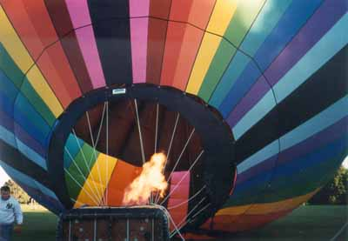

The Gas Laws
The density of a gas decreases as its temperature increases.
Notes:
There are fewer air particles per unit of volume inside the balloon, but because those particles are moving faster, the inside and outside air pressure are the same.
So, to lower air density in a balloon without losing air pressure, you simply need to increase the speed of the air particles. You can do this very easily by heating the air. The air particles absorb the heat energy and become more excited. This makes them move faster, which means they collide with a surface more often, and with greater force.
For this reason, hot air exerts greater air pressure per particle than cold air, so you don't need as many air particles to build to the same pressure level. So a hot air balloon rises because it is filled with hot, less dense air and is surrounded by colder, more dense air.

Slide 2
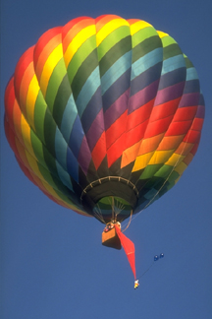
Table of Contents
‘Gas Laws’
Part 2
The Gas Laws
C L I C K T O P A R T 2
Greenhouse Effect
Ozone
Kinetic Molecular Theory
Boyle’s Law
Breathing
Graham’s Law of Diffusion
Charle’s Law
Combined Gas Law
Bernoulli’s Principle
Space Shuttle
Partial Pressures
Ideal vs. Real Gases
Air Pressure
Barometer
Diffusion
Manometer
Vapor Pressure
Self-Cooling Can
Liquid Nitrogen

Slide 3
Gases
You should be able to
  Perform calculations with gas law: Boyle’s, Charles’, Avogadro’s,
    Combined, and Ideal.
  Perform calculations with the ideal gas law to find the density or
  molar mass of the gas.
  Interpret or draw graphical relationships between gas variables.
  Perform stoichiometric calculations for reactions which produce gases.
  Perform calculations with molar volume.
  Perform calculations with Dalton’s Law for a mixture of gases.
  Perform calculations for gases collected over water.
  Perform calculations with rates of effusion to find the molar mass.
  Compare real gases to ideal gases.
Notes:
Fast Track to a 5 (page 61)
OBJECTIVES
To be able to describe the characteristics of a gas
To understand the relationships between the pressure, temperature, amount, and volume of a gas
To be able to use the ideal gas law to describe the behavior of a gas
To know how to determine the contribution of each component gas to the total pressure of a gaseous mixture
To understand the significance of the kinetic molecular theory of gases
To recognize the differences between the behaviors of an ideal gas and a real gas

Slide 4
Lecture Outline – The Gas Laws
Lecture Outline – The Gas Laws
student notes outline
textbook questions
Lecture Outline – The Gas Laws
textbook questions
Keys
text
http://www.unit5.org/chemistry/GasLaws.html
Notes:
ALL students should;
Understand the Kinetic Molecular Theory as applied to gases
Be able to convert between different units of pressure
Recall and be able to use Boyle's law in calculations
Recall and be able to use Charles's law in calculations
Recall and be able to use Avogadro's law in calculations
Recall and be able to use the Ideal gas law in calculations
Recall and be able to use the Combined gas law and the General gas law in calculations
Recall and be able to use Dalton's law of partial pressures in calculations
Recall the conditions that are used as standard in calculations
Be able to use molar gas volume in calculations
Understand the concept of, and be able to perform calculations involving, the root-mean-square-speed of molecules

Slide 5
Vocabulary - Gas Laws
Vocabulary - The Gas Laws
Vocabulary - The Gas Laws
Keys
http://www.unit5.org/chemistry/GasLaws.html

Slide 6
World of Chemistry
The Annenberg Film Series
VIDEO ON DEMAND
Episode 17 – The Precious Envelope
Journey through the exciting world of chemistry with Nobel laureate Roald Hoffman as your guide.
The foundations of chemical structures and their behavior are explored through computer animation,
demonstrations, and on-site footage at working industrial and research labs. Distinguished scientists
discuss yesterday’s breakthroughs and today’s challenged.
Notes:
Video 17: Precious Envelope
The earth's atmosphere is examined through theories of chemical evolution; ozone depletion and the greenhouse effect are explained. (added 2006/10/08)
World of Chemistry > http://www.learner.org/vod/vod_window.html?pid=809
Journey through the exciting world of chemistry with Nobel laureate Roald Hoffman as your guide.
The foundations of chemical structures and their behavior are explored through computer animation,
demonstrations, and on-site footage at working industrial and research labs. Distinguished scientists
discuss yesterday’s breakthroughs and today’s challenged.
Produced by the University of Maryland and the Educational Film Center.
Released on cassette: Fall 1989 The Annenberg/ / CPB Collection 1-800-LEARNER

Slide 7
Greenhouse Effect
CO₂

Slide 8
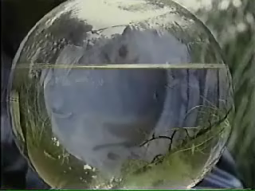
Earth as a Closed System

Slide 9
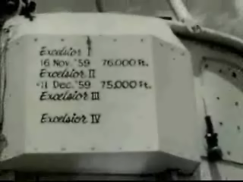
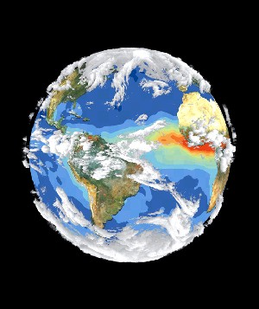
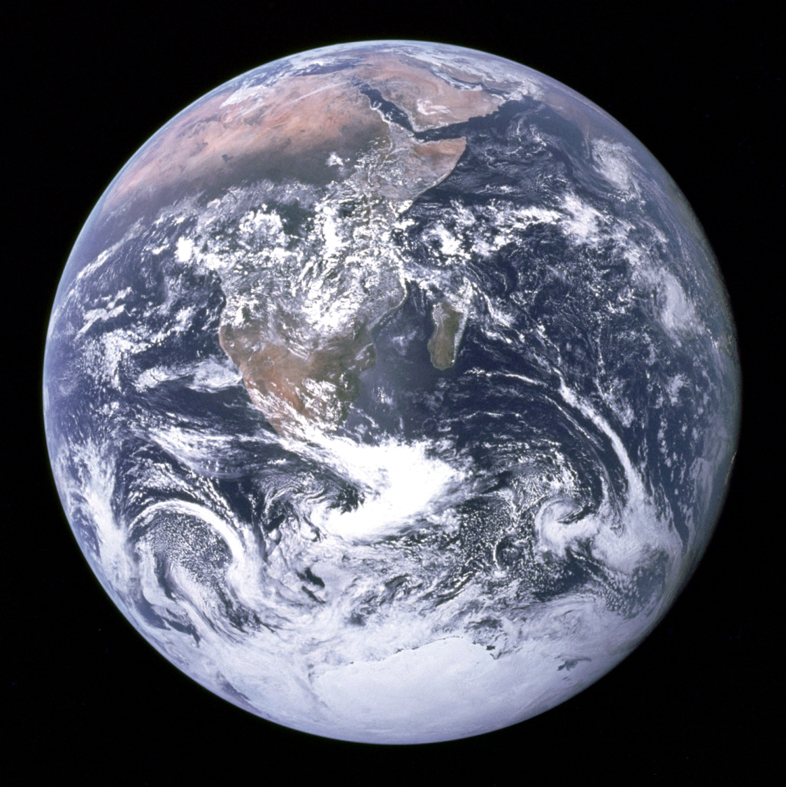

The Earth’s Atmosphere
‘The Precious Envelope’
78% Nitrogen
20% Oxygen
1% Argon
0.03% CO₂
Trace Elements
Nitrogen
Helium
Oxygen
Air
Neon
Water
vapor
Carbon
dioxide
Argon
Notes:
WHAT IS IN AIR?
The air we breathe is mostly nitrogen, an unreactive gas, with oxygen, which is essential for life, making up about a fifth. Traces of noble gases, pollution, and carbon dioxide, which animals breathe out and plants use to grow, make up the rest.

Slide 10
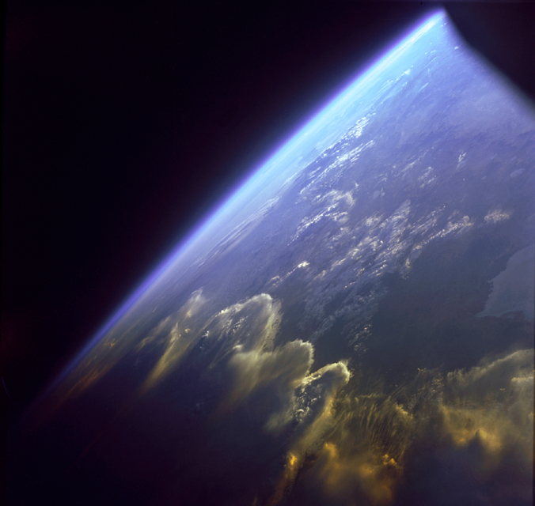
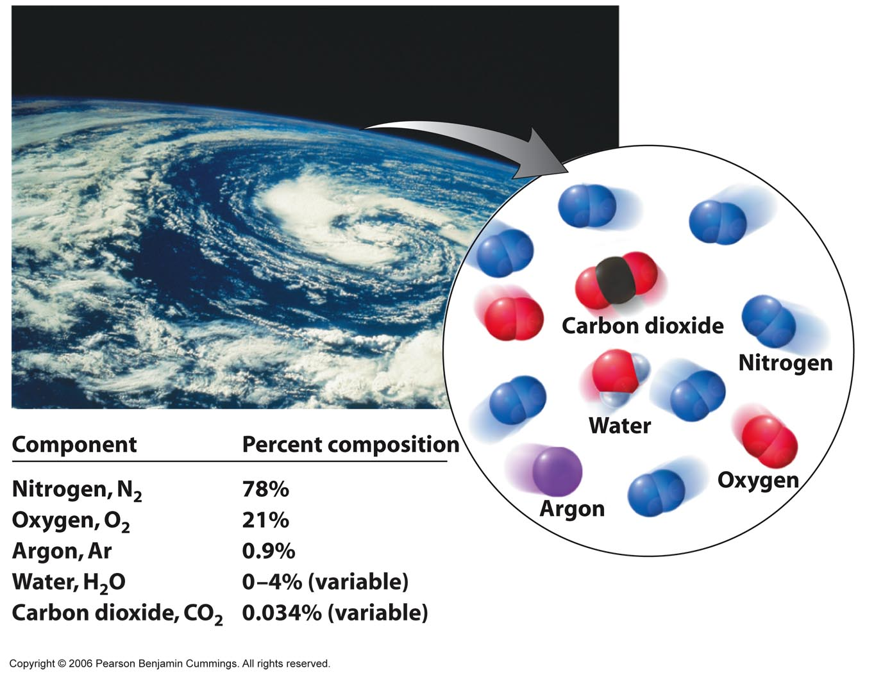
The Earth’s Atmosphere
From Space
Component Percent composition
Nitrogen, N₂ 78%
Oxygen, O₂ 21%
Argon, Ar 0.9%
Water, H₂O 0 – 4% (variable)
Carbon dioxide, CO₂ 0.034% (variable)
Copyright © 2007 Pearson Benjamin Cummings. All rights reserved.

Slide 11
Video - Crisis in the Atmosphere
Video - Crisis in the Atmosphere
Video - Crisis in the Atmosphere
Keys
http://www.unit5.org/chemistry/GasLaws.html

Slide 12
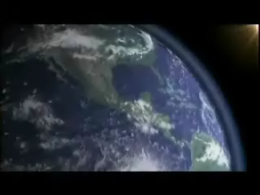
Global Warming
Reflected heat lost to
outer space
Light from
the sun
Reflected heat
absorbed by
atmosphere
Kelter, Carr, Scott, Chemistry A Wolrd of Choices 1999, page 392
Notes:
GLOBAL WARMING
Radiant energy from the sun enters the Earth’s atmosphere and is reflected off the surface of Earth back to outer space. The carbon dioxide and other gases in the atmosphere trap the radiant heat from leaving. This is like a greenhouse – where the glass allows the light energy in but traps the heat from escaping. Recall, when you go to your car in the winter on a sunny day. The interior of the car is warm. On a summer day the car is too hot inside if you don’t leave a window rolled down slightly to allow the heat to escape (heat rises).

Slide 13
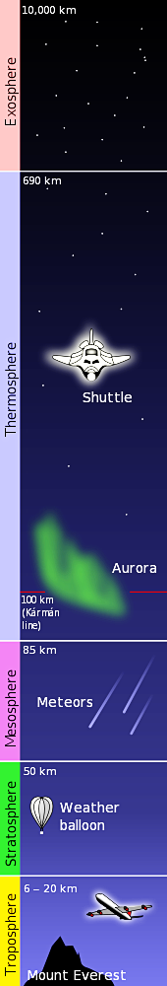
Global Warming
Reflected heat lost to
outer space
Light from
the sun
Reflected heat
absorbed by
atmosphere
Kelter, Carr, Scott, Chemistry A Wolrd of Choices 1999, page 392
Notes:
GLOBAL WARMING
Radiant energy from the sun enters the Earth’s atmosphere and is reflected off the surface of Earth back to outer space. The carbon dioxide and other gases in the atmosphere trap the radiant heat from leaving. This is like a greenhouse – where the glass allows the light energy in but traps the heat from escaping. Recall, when you go to your car in the winter on a sunny day. The interior of the car is warm. On a summer day the car is too hot inside if you don’t leave a window rolled down slightly to allow the heat to escape (heat rises).

Slide 14
The Greenhouse Effect
HIGH ENERGY, SHORT λ LIGHT PASSES
EASILY THROUGH ATMOSPHERE
CO₂ MOLECULES
ENERGY RELEASED
AS HEAT
LOWER ENERGY, LONGER λ
LIGHT IS BLOCKED BY CO₂ AND CH₄; ENERGY DOESN’T
ESCAPE INTO SPACE;
ATMOSPHERE HEATS UP
Notes:
The atmospheric greenhouse effect
– CO₂ is a greenhouse gas that absorbs heat before it can be radiated from the earth into space
– CO₂ in the atmosphere can result in increased surface temperatures (the greenhouse effect)
– Temperature increases caused by increased CO₂ levels are superimposed upon much larger variations in the earth’s temperature

Slide 15
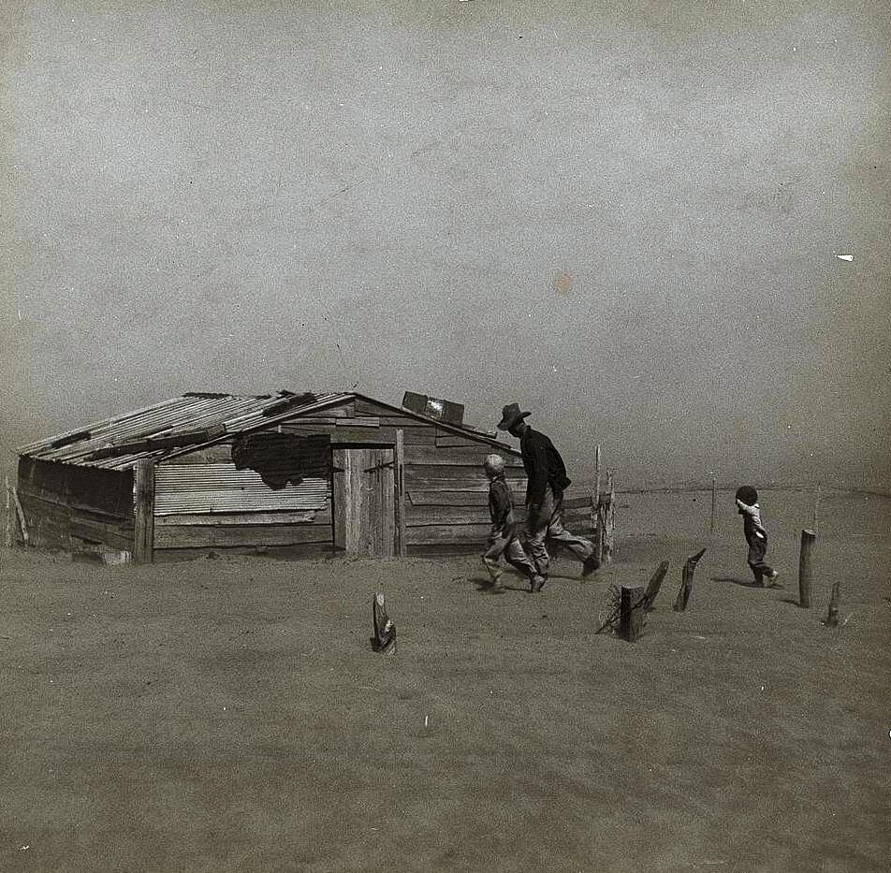
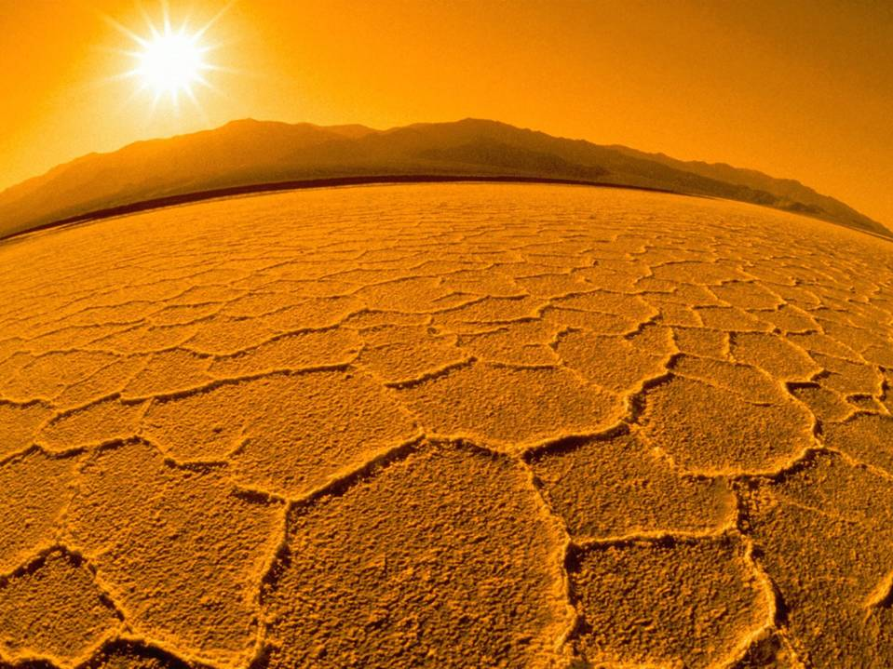
Global Warming

Slide 16
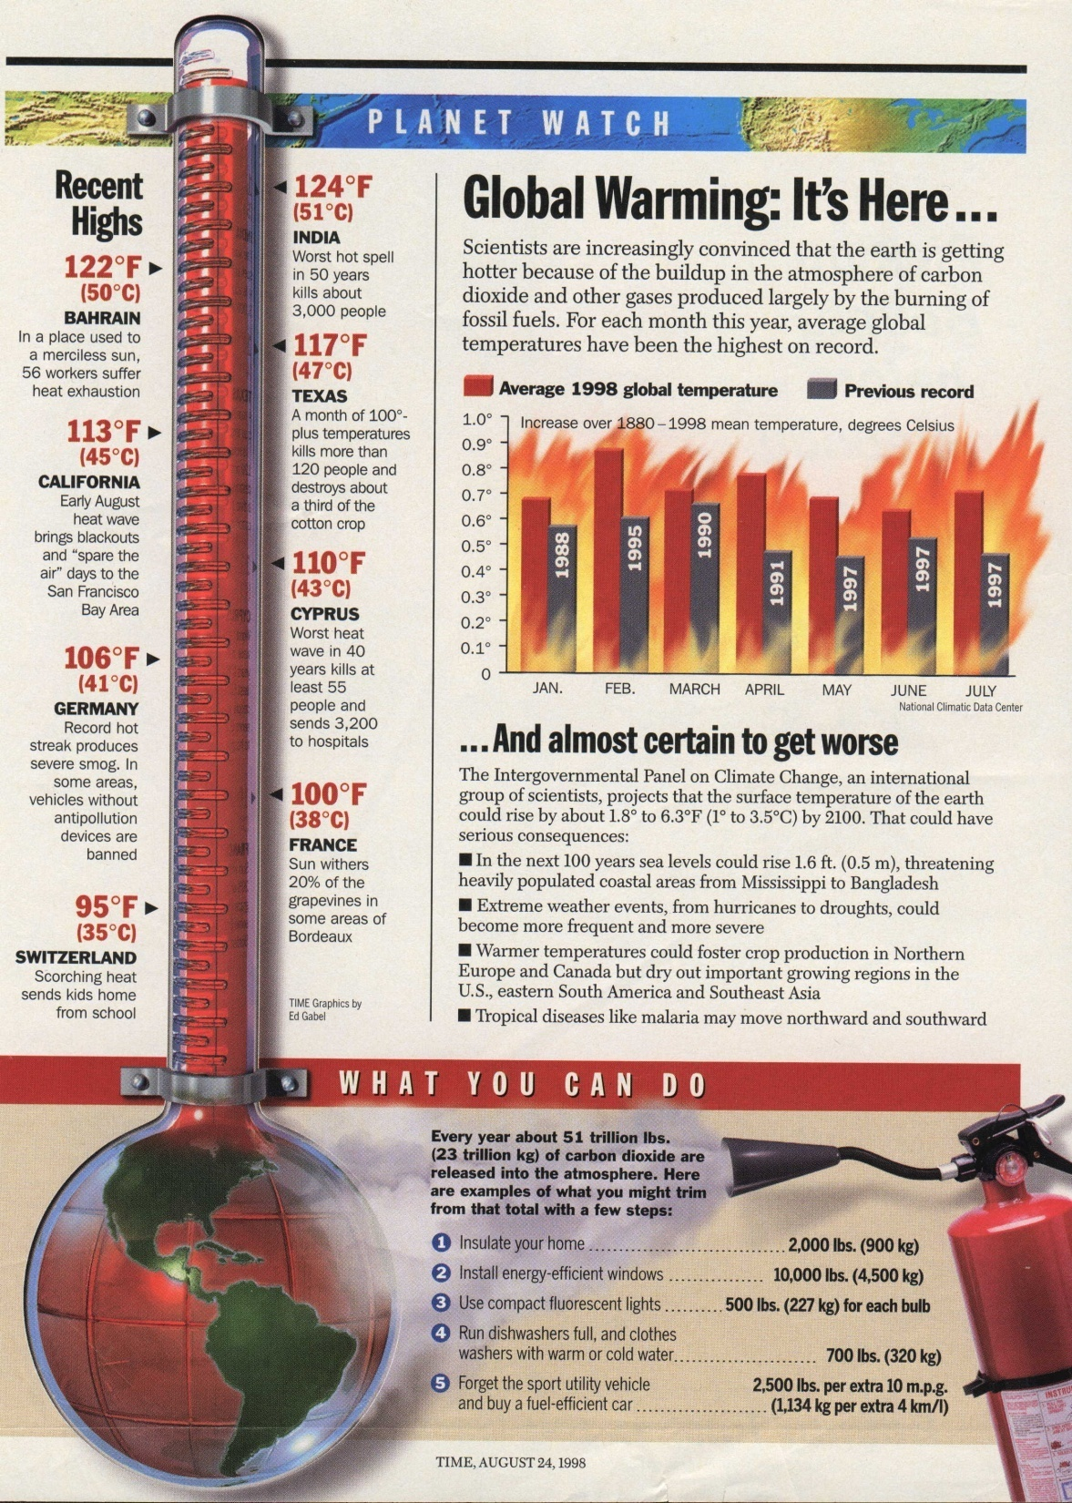
Greenhouse Gases
Notes:
GREENHOUSE GASES
Carbon dioxide is responsible for trapping heat on planet earth. Trees and plants naturally absorb excess carbon dioxide from the atmosphere.
In the last 100 years we have removed many forest and the level of global carbon dioxide is increasing.
The net effect is global warming…El Nino and La Nina, floods, drought and extreme weather patterns.

Slide 17
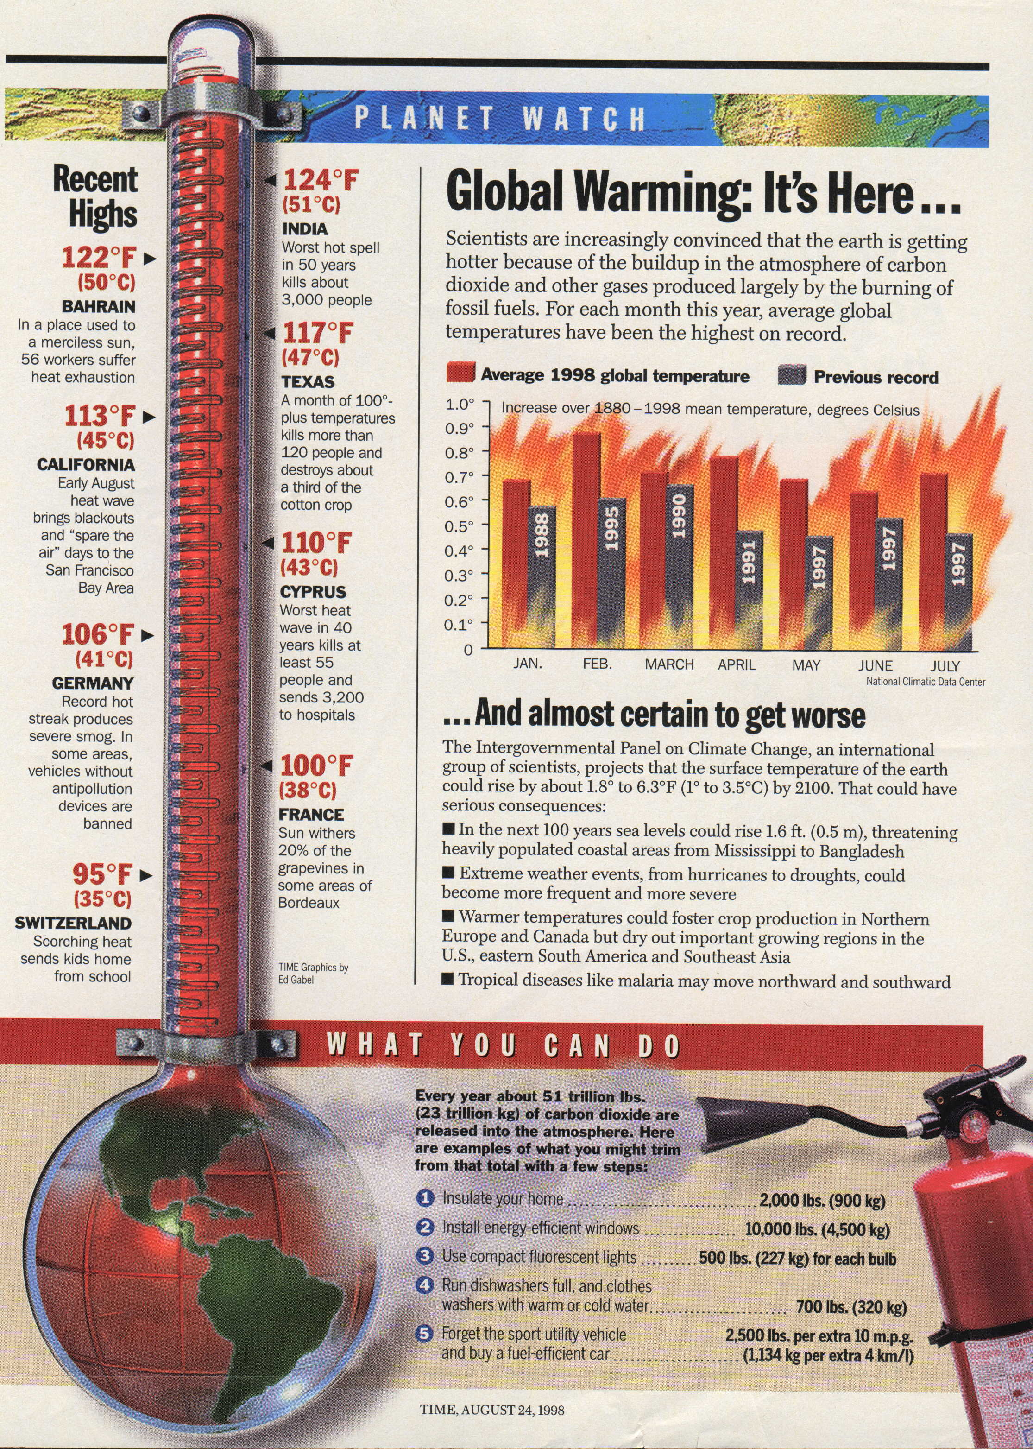
Global Warming: It’s Here…
Scientists are increasingly convinced that the earth is getting
hotter because of the buildup in the atmosphere of carbon
dioxide and other gases produced largely by the burning of
fossil fuels. For each month this year, average global
temperatures have been in the highest on record.

Slide 18
…And almost certain to get worse
The Intergovernmental Panel on Climate Change, an international
group of scientists, projects that the surface temperature of the earth
could rise by about 1.8º to 6.3ºF (1º to 3.5ºC) by 2010. That could have
serious consequences:
In the next 100 years sea levels could rise 1.6 ft. (0.5 m), threatening
heavily populated coastal areas from Mississippi to Bangladesh.
Extreme weather events, from hurricanes to droughts, could
become more frequent and more severe.
Warmer temperatures could foster crop production in Northern
Europe and Canada but dry out important growing regions in the
U.S., eastern South America and Southeast Asia.
Tropical diseases like malaria may move northward and southward.

Slide 20
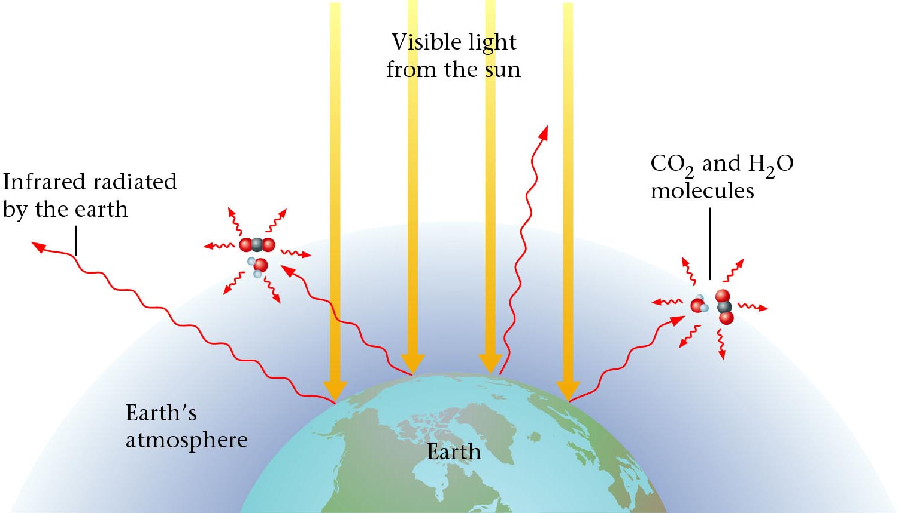
The Earths Atmosphere
Ozone
Zumdahl, Zumdahl, DeCoste, World of Chemistry 2002, page 309
Notes:
Earth’s atmosphere at sea level is an approximately 80:20 solution of nitrogen and oxygen gases with small amounts of carbon dioxide, water vapor, the noble gases, and trace amounts of a variety of other compounds.
Composition, temperature, and pressure of the atmosphere vary dramatically with altitude, so it is divided into layers that interact differently with the continuous flux of solar radiation from the top and the land and ocean masses at the bottom.
Layers do not mix readily with one another, and each layer has its own distinctive chemistry.

Slide 21
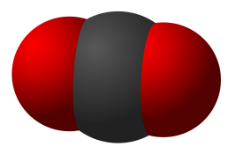
Carbon Dioxide Levels
350
Atmospheric
CO₂ (ppm)
300
250
1000
1500
2000
Year
Zumdahl, Zumdahl, DeCoste, World of Chemistry 2002, page 310
Notes:
The global carbon cycle
– The distribution and flow of carbon throughout the planet
– Atmospheric CO₂ either dissolves in the oceans and eventually precipitates as carbonate rocks or is taken up by plants
– Combustion of fossil fuels releases large amounts of CO₂ that upset the balance of the carbon cycle and result in a steady increase in atmospheric CO₂ levels.
http://en.wikipedia.org/wiki/Image:Carbon-dioxide-3D-vdW.svg

Slide 22
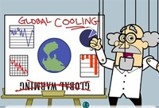
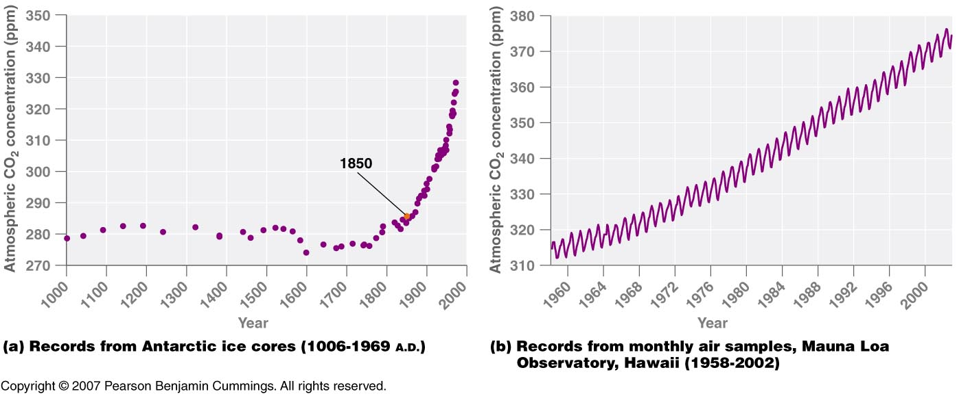
(a) Records from Antarctic ice cores (1006-1969 A.D.)
(b) Records from monthly air samples, Mauna Loa
Observatory, Hawaii (1958-2002)
Copyright © 2007 Pearson Benjamin Cummings. All rights reserved.
Notes:
http://blog.wired.com/wiredscience/images/2007/08/07/exxonscientist.jpg

Slide 23
Why more CO₂ in atmosphere now than 500 years ago?
burning of fossil fuels
deforestation
-- coal
-- petroleum
-- natural gas
-- wood
-- urban sprawl
-- rain forests
-- wildlife areas
* The burning of ethanol won’t slow greenhouse effect.
C₂H₅OH + O₂ → CO₂ + H₂O
Notes:
Burning of carbon-based fuels is done on a vast scale and produces large amounts of CO₂.
The amounts of CO₂ are overwhelming the natural ability of the planet to remove CO₂ from the atmosphere, and the elevated levels of CO₂ are affecting the temperature of the planet through the “greenhouse effect.”

Slide 24
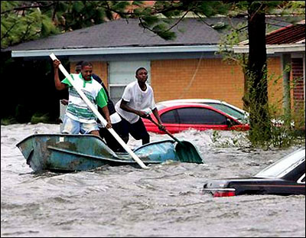
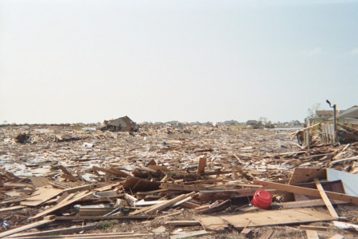
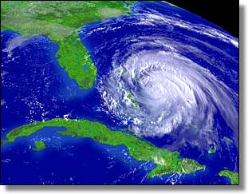
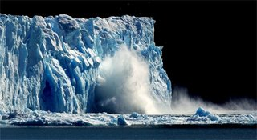
Greenhouse Effect
350
Atmospheric
CO₂ (ppm)
300
250
1000
1500
2000
Year
FACT: 15% increase in [CO₂] in last 100 years
Cause:
  Change from agricultural to industrial lifestyle
  Burning of fossil fuels (petroleum, coal)
  Increase CO₂ emissions (cars, factories etc…)
  Deforestation
Effects:
  Global warming
  Melt polar ice caps → flooding at sea level
  Warming oceans → more powerful storms
Notes:
Some teachers choose to show the movie Day After Tomorrow
http://www.lisamoscatiello.com/blogtest/uploaded_images/meltingglaciers-786472.jpg
http://images.google.com/imgres?imgurl=http://sitemaker.umich.edu/section2group4/files/hurricane-katrina_damage.jpg&imgrefurl=http://sitemaker.umich.edu/section2group4/indroduction_and_hypothesis__why_tropical_storms_&h=311&w=400&sz=47&hl=en&start=19&tbnid=BZz_iqNfb803hM:&tbnh=96&tbnw=124&prev=/images%3Fq%3Dtropical%2Bstorms%26gbv%3D2%26hl%3Den

Slide 25

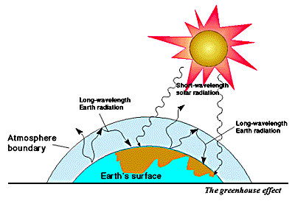
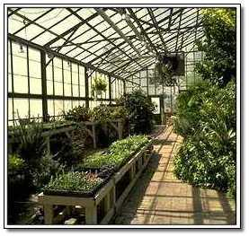
Greenhouse Effect
Children and pets left unattended in vehicles with windows
rolled up can die from high temperature in vehicle.
Carbon dioxide in atmosphere traps heat and acts like a
glass cover holding in the heat on planet Earth.

Slide 26
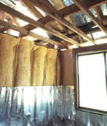
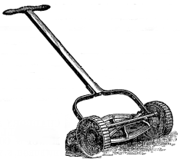
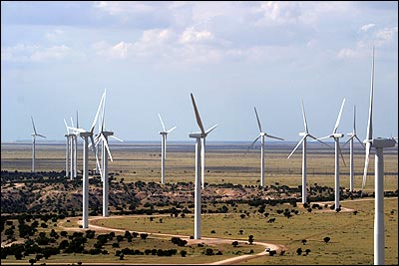
What can we do?
1. Reduce consumption of fossil fuels.
insulate home; run dishwasher full;
avoid temp. extremes (A/C & furnace);
wash clothes on “warm,” not “hot”
mow lawn less often (small engines)
At home:
On the road:
bike instead of drive; carpool;
energy-efficient vehicles
2. Support environmental organizations.
3. Rely on alternate energy sources.
solar, wind energy, hydroelectric power

Slide 27
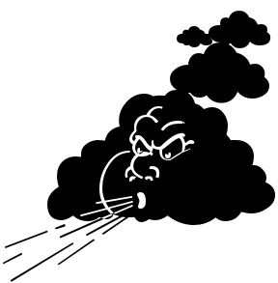


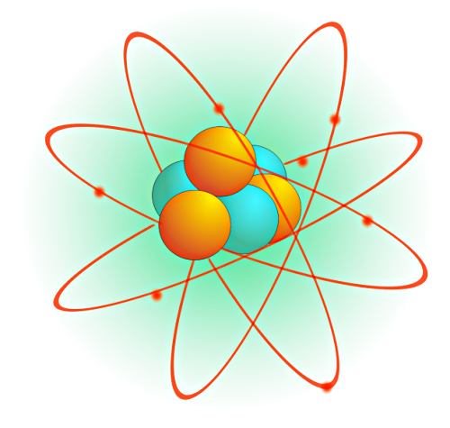
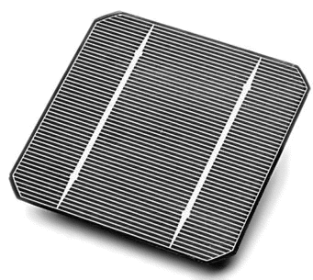


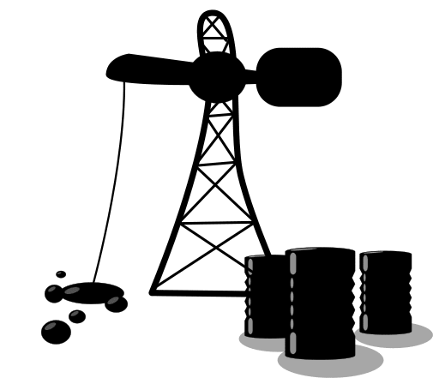


Sources of Energy
Notes:
http://www.wpclipart.com/browse.html

Slide 28
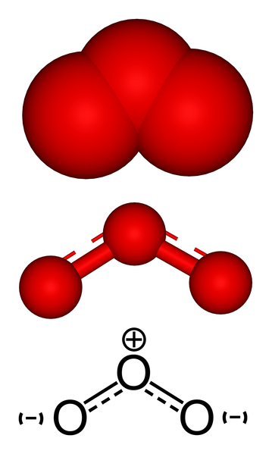
Ozone
O₃
Notes:
http://en.wikipedia.org/wiki/Image:Ozone-montage.png

Slide 29

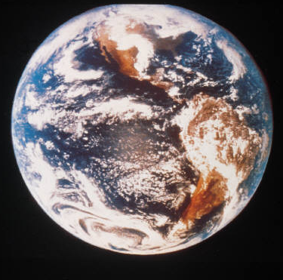
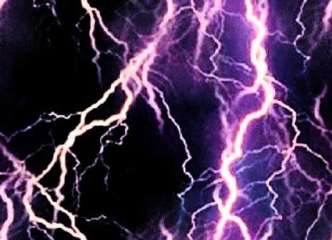

Ozone Depletion
Ozone (O₃)
  Absorbs harmful UV radiation from sun
ozone is produced during lightning storms
Chlorofluorocarbons (CFC’s) destroy ozone
  CFC’s production was banned in 1977
  CFC’s “live” for hundreds of years
Notes:
OZONE DEPLETION
Ozone is an allotropic form of oxygen. Ozone is made naturally during lightning storms. Ozone protects us from ultra violet radiation from the sun. The ozone layer is being depleted by chlorofluorocarbons (CFC’s).
“THE OZONE LAYER
Ozone is a reactive gas that contributes to pollution when it builds up in the atmosphere over cities. However, ozone in the stratosphere does the useful task of absorbing damaging ultraviolet (UV) light from the Sun, screening it from the Earth. Some synthetic chemicals, especially, chlorofluorocarbons (CFCs), react with ozone, creating holes in the ozone layer. These holes allow more UV light through, tending to cause an increase in skin cancer.”
Eyewitness Science “Chemistry” , Dr. Ann Newmark, DK Publishing, Inc., 1993, pg 34

Slide 30
Depletion of the Ozone Layer
Ozone (O₃) in upper atmosphere blocks ultraviolet (UV) light from Sun.
UV causes skin cancer and cataracts.
O₃ depletion is caused by chlorofluorocarbons (CFCs).
Uses for CFCs:
refrigerants
aerosol propellants
CFCs
banned in U.S. in 1996
O₃ is replenished with each strike of lightning.

Slide 31


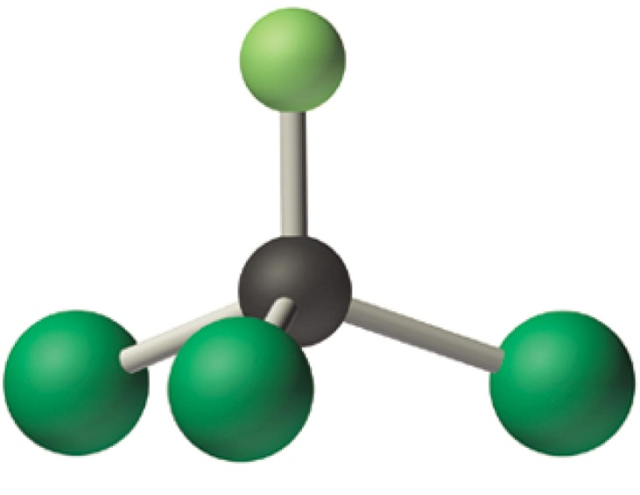
Freon (CFC’s)
chlorofluorocarbons
F
Cl
Cl
C
Cl
Cl
C
F
Cl
F
Trichlorofluoromethane
(Freon-11)
Dichlorodifluoromethane
(Freon-12)
CFC-11 and CFC-12 are odorless, nontoxic, nonflammable, and very stable.

Slide 32

Mechanism of Ozone Depletion
“free radical”
Solar radiation
Initiation CCl₂F₂ Cl + CF₂Cl
Propagation Cl + O₃ ClO + O₂
ClO + O Cl + O₂
Termination
.
.
.
.
.
.
.
A single chlorine molecule can destroy thousands of ozone molecules.

Slide 33
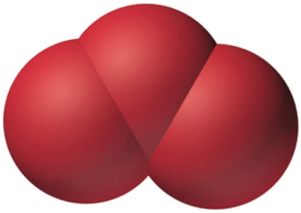
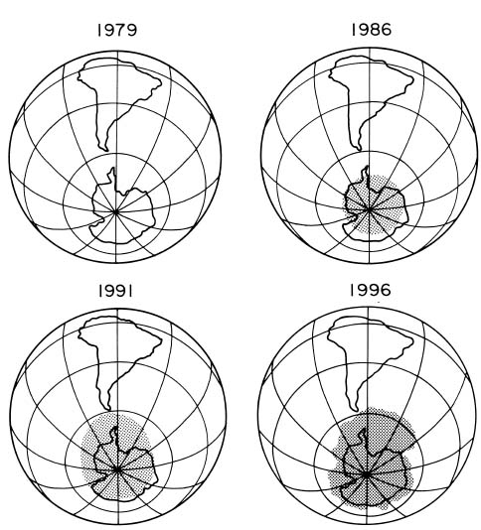
Ozone Hole Grows Larger
Ozone, O₃
Ozone hole has increased 50% from 1975 - 1985

Slide 34
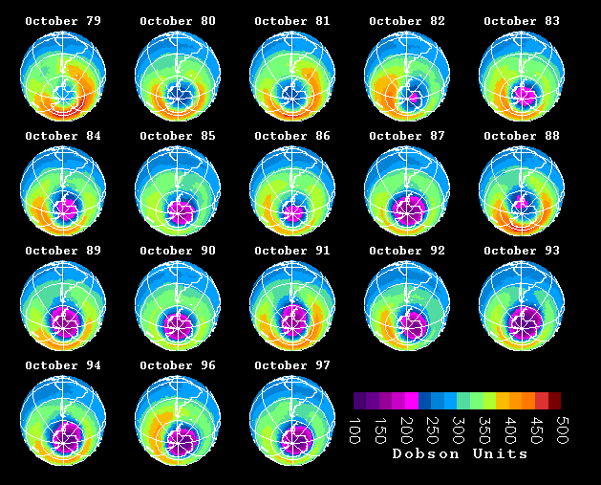
Monthly Change in Ozone
TOMS Total Ozone Monthly Averages

Slide 35
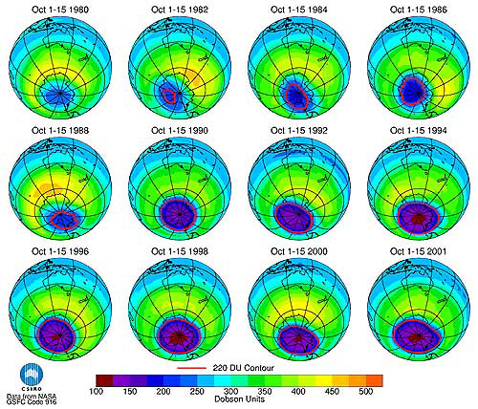

Slide 36
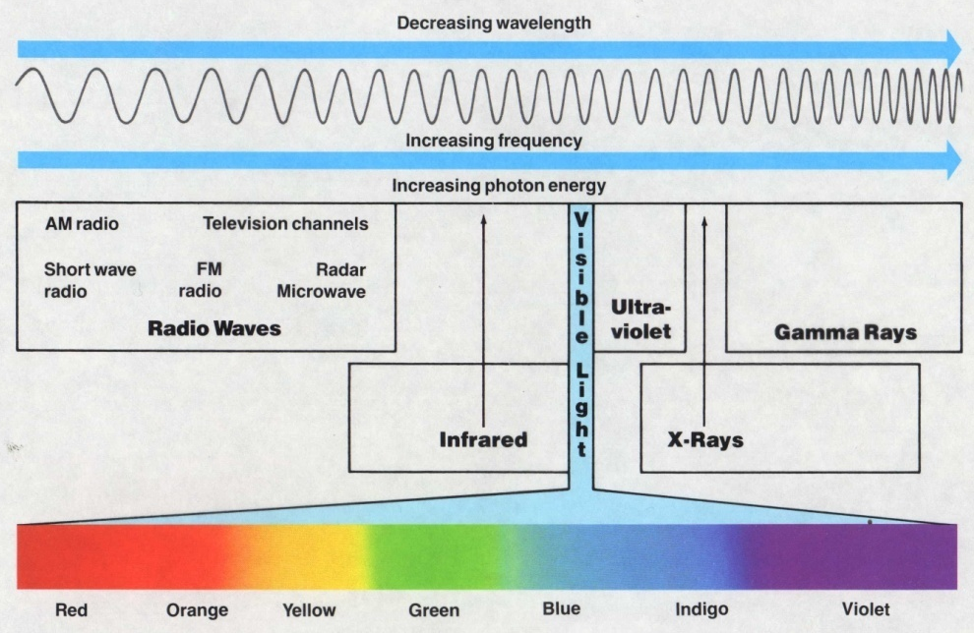

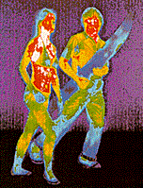
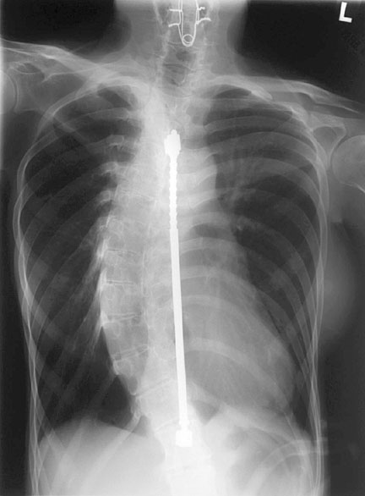

Ultraviolet Radiation
Skin cancer
Cataracts
Sun-glasses
  UVA & UVB protection

Slide 37
Greenhouse Effect vs. Ozone Hole
Different
Alike
Different
Environmental
Issues
Global Warming
by trapping heat
on Earth
Depletion of O₃
(ozone layer)...
causes skin cancer
and cataracts
Topic
Topic
Caused by
buildup of CO₂
carbon dioxide
Related to
Earth's
Atmosphere
Caused by CFC's
(chlorofluorocarbons)
destroying ozone
layer
Greenhouse
Effect
Ozone
Hole
Plant trees to
slow down and burn
less fossil fuels
that produce CO₂
Man-made
problem
Replace CFC's in
AC & refrigerators
Notes:
The environmental issues of global warming, caused from buildup of carbon dioxide in Earth's atmosphere, is a separate issue from ozone depletion.
The greenhouse effect has had no major improvements and has failed international negotiations.
The ozone hole has largely been resolved by international cooperation. Improvement in ozone concentration is occurring.

Slide 38
Kinetic Molecular Theory

Slide 39
Collisions of Gas Particles

Slide 40
Collisions of Gas Particles

Slide 41
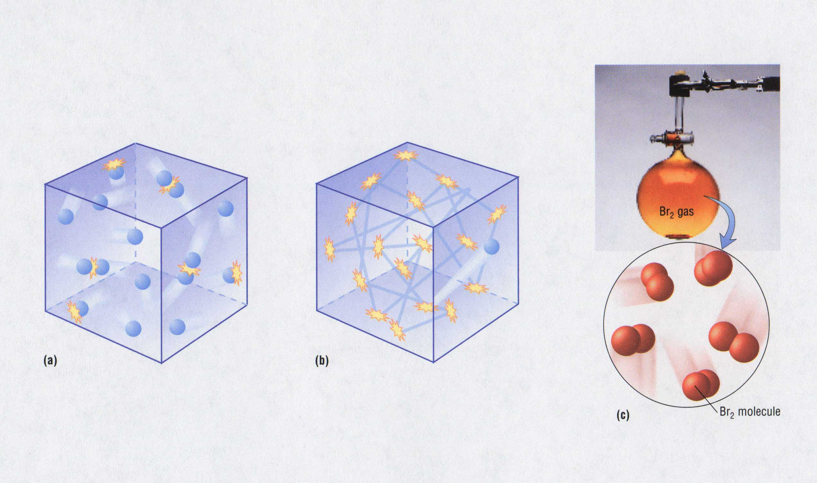
Kinetic Theory

Slide 42
Kinetic Molecular Theory
Postulates of the Kinetic Molecular Theory of Gases
Gases consist of tiny particles (atoms or molecules)
These particles are so small, compared with the distances between
them, that the volume (size) of the individual particles can be assumed
to be negligible (zero).
3. The particles are in constant random motion, colliding with the walls of
the container. These collisions with the walls cause the pressure exerted
by the gas.
4. The particles are assumed not to attract or to repel each other.
5. The average kinetic energy of the gas particles is directly proportional
to the Kelvin temperature of the gas
Notes:
The kinetic molecular theory of gases explains the laws that describe the behavior of gases and it was developed during the nineteenth century by Boltzmann, Clausius, and Maxwell
Kinetic molecular theory of gases provides a molecular explanation for the observations that led to the development of the ideal gas law
The kinetic molecular theory of gases is based on the following postulates:
1. A gas is composed of a large number of particles called molecules (whether monatomic or polyatomic) that are in constant random motion.
2. Because the distance between gas molecules is much greater than the size of the molecules, the volume of the molecules is negligible.
3. Intermolecular interactions, whether repulsive or attractive, are so weak that they are also negligible.
4. Gas molecules collide with one another and with the walls of the container, but collisions are perfectly elastic; they do not change the average kinetic energy of the molecules.
5. The average kinetic energy of the molecules of any gas depends on only the temperature, and at a given temperature, all gaseous molecules have exactly the same average kinetic energy.
Postulates 1 and 4 state that molecules are in constant motion and collide frequently with the walls of their container and are an explanation for pressure
1. Anything that increases the frequency with which the molecules strike the walls or increases the momentum of the gas molecules increases the pressure.
2. Anything that decreases that frequency or the momentum of the molecules decreases the pressure.
• Postulates 2 and 3 state that all gaseous particles behave identically, regardless of the chemical nature of their component molecules — this is the essence of the ideal gas law.
• Postulate 2 explains how to compress a gas — simply decrease the distance between the gas molecules.

Slide 43
Kinetic Molecular Theory
Postulates
Evidence
1. Gases are tiny molecules in mostly empty space. | The compressibility of gases.
2. There are no attractive forces between molecules. | Gases do not clump.
3. The molecules move in constant, rapid, random, straight-line motion. | Gases mix rapidly.
4. The molecules collide classically with container walls and one another. | Gases exert pressure that does not diminish over time.
5. The average kinetic energy of the molecules is proportional to the Kelvin temperature of the sample. | Charles’ Law
Notes:
The kinetic molecular theory of gases explains the laws that describe the behavior of gases and it was developed during the nineteenth century by Boltzmann, Clausius, and Maxwell
Kinetic molecular theory of gases provides a molecular explanation for the observations that led to the development of the ideal gas law
The kinetic molecular theory of gases is based on the following postulates:
1. A gas is composed of a large number of particles called molecules (whether monatomic or polyatomic) that are in constant random motion.
2. Because the distance between gas molecules is much greater than the size of the molecules, the volume of the molecules is negligible.
3. Intermolecular interactions, whether repulsive or attractive, are so weak that they are also negligible.
4. Gas molecules collide with one another and with the walls of the container, but collisions are perfectly elastic; they do not change the average kinetic energy of the molecules.
5. The average kinetic energy of the molecules of any gas depends on only the temperature, and at a given temperature, all gaseous molecules have exactly the same average kinetic energy.
Postulates 1 and 4 state that molecules are in constant motion and collide frequently with the walls of their container and are an explanation for pressure
1. Anything that increases the frequency with which the molecules strike the walls or increases the momentum of the gas molecules increases the pressure.
2. Anything that decreases that frequency or the momentum of the molecules decreases the pressure.
• Postulates 2 and 3 state that all gaseous particles behave identically, regardless of the chemical nature of their component molecules — this is the essence of the ideal gas law.
• Postulate 2 explains how to compress a gas — simply decrease the distance between the gas molecules.

Slide 44
Kinetic Molecular Theory (KMT)
explains why gases behave as they do
deals ^{w}/“ideal” gas particles…
1. …are so small that they are assumed to have zero volume
…are in constant, straight-line motion
…experience elastic collisions in which no energy is lost
…have no attractive or repulsive forces toward each other
…have an average kinetic energy (KE) that is proportional
to the absolute temp. of gas (i.e., Kelvin temp.)
AS TEMP. , KE

Slide 45
Newton’s First Law of Motion (Law of Inertia)
An object at rest tends to stay at rest, and an object in motion tends to stay in motion at constant velocity unless that object is acted upon by an unbalanced, external force.

Slide 46

Elastic vs. Inelastic Collisions
8
3

Slide 47
Elastic vs. Inelastic Collisions
POW
v₁
v₂
8
elastic collision
v₃
v₄
8
inelastic collision

Slide 48
Elastic Collision
v₁
8
before
v₂
8
after

Slide 49
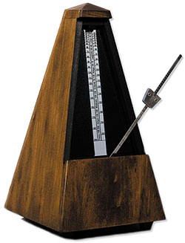
Model Gas Behavior
All collisions must be elastic
Take one step per beat of the metronome
Container
  Class stands outside tape box
Higher temperature
  Faster beats of metronome
Decreased volume
  Divide box in half
More Moles
  More students are inside box
Mark area of container with tape on ground.
Add only a few molecules of inert gas
Increase temperature
Decrease volume
Add more gas
Effect of diffusion
Effect of effusion (opening size)
Notes:
At the macroscopic level, a complete physical description of a sample of a gas requires four quantities:
1. Temperature (expressed in K)
2. Volume (expressed in liters)
3. Amount (expressed in moles)
4. Pressure (given in atmospheres)
• These variables are not independent — if the values of any three of these quantities are known, the fourth can be calculated.

Slide 50
Kinetic Molecular Theory
Particles in an ideal gas…
  have no volume.
  have elastic collisions.
  are in constant, random, straight-line motion.
  don’t attract or repel each other.
  have an avg. KE directly related to Kelvin temperature.
Courtesy Christy Johannesson www.nisd.net/communicationsarts/pages/chem

Slide 51
Molecular Velocities
molecules sorted by speed
many different molecular speeds
Fractions of particles
the Maxwell speed distribution
speed
http://antoine.frostburg.edu/chem/senese/101/gases/slides/sld016.htm

Slide 52
Real Gases
Particles in a REAL gas…
  have their own volume
  attract each other
Gas behavior is most ideal…
  at low pressures
  at high temperatures
  in nonpolar atoms/molecules
Courtesy Christy Johannesson www.nisd.net/communicationsarts/pages/chem

Slide 53
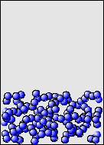
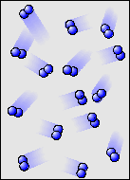
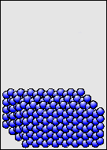
Characteristics of Gases
Gases expand to fill any container.
  random motion, no attraction
Gases are fluids (like liquids).
  no attraction
Gases have very low densities.
  no volume = lots of empty space
Courtesy Christy Johannesson www.nisd.net/communicationsarts/pages/chem

Slide 54
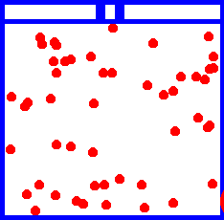
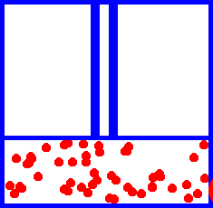
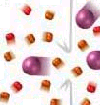

Characteristics of Gases
Gases can be compressed.
  no volume = lots of empty space
Gases undergo diffusion & effusion.
  random motion
Courtesy Christy Johannesson www.nisd.net/communicationsarts/pages/chem

Slide 55
Properties of Gases
Gas properties can be modeled using math.
Model depends on:
V = volume of the gas (liters, L)
T = temperature (Kelvin, K)
P = pressure (atmospheres, atm)
n = amount (moles, mol)

Slide 56
Pressure - Temperature - Volume Relationship
P T V
P T V
P T V
1
V
Boyle’s P
α
___
α
Charles V T
α
Gay-Lussac’s P T
Notes:
Pressure versus volume
– At constant temperature, the kinetic energy of the molecules of a gas and the root mean square speed remain unchanged.
– If a given gas sample is allowed to occupy a larger volume, the speed of the molecules doesn’t change, but the density of the gas decreases and the average distance between the molecules increases: they collide with one another and with the walls of the container less often, leading to a decrease in pressure.
– Increasing the pressure forces the molecules closer together and increases the density, until the collective impact of the collisions of the molecules with the walls of the container balances the applied pressure.
Volume versus temperature
– Raising the temperature of a gas increases the average kinetic energy and the root mean square speed (and the average speed) of the gas molecules.
– As the temperature increases, the molecules collide with the walls of the container more frequently and with greater force, thereby increasing the pressure unless the volume increases to reduce the pressure
– An increase in temperature must be offset by an increase in volume for the net impact (pressure) of the gas molecules on the container walls to remain unchanged.
Pressure of gas mixtures
– If gaseous molecules do not interact, then the presence of one gas in a gas mixture will have no effect on the pressure exerted by another, and Dalton’s law of partial pressures holds.

Slide 57
Direct vs. Indirect
Charles’ Law PV = nRT
Direct
Gay-Lussac’s Law PV = nRT
Direct
Boyles’ Law PV = nRT
Indirect

Slide 58
Pressure - Temperature - Volume Relationship
P T V
P n V
1
V
Boyle’s P
α
___
α
Charles V T
α
Gay-Lussac’s P T

Slide 59

Pressure and Balloons
B
When balloon is being filled:
P_{A} > P_{B}
A
When balloon is filled and tied:
P_{A} = P_{B}
When balloon deflates:
P_{A} < P_{B}
A = pressure exerted BY balloon
B = pressure exerted ON balloon

Slide 60




Balloon Riddle
When the balloons are untied,
will the large balloon (A) inflate
the small balloon (B); will they
end up the same size or will the
small balloon inflate the large
balloon?
Why?
A
B
C

Slide 61
Behavior of Gases
Behavior of Gases
Behavior of Gases
Keys
http://www.unit5.org/chemistry/GasLaws.html

Slide 62
Kinetic Theory and the Gas Laws
10
10
10
10
(a)
(b)
(c)
original temperature
original pressure
original volume
increased temperature
increased pressure
original volume
increased temperature
original pressure
increased volume
Dorin, Demmin, Gabel, Chemistry The Study of Matter , 3rd Edition, 1990, page 323 (newer book)
Notes:
“Kinetic Theory and the Gas Laws”
Description: This slide shows three cylinders filled with equal masses of the same gas under different conditions. In cylinder (b), the pressure and temperature both have doubled from their values in cylinder (a). In cylinder (c), only the temperature has been doubled. The velocities of the gas particles are represented graphically to help students interpret the macroscopic changes in terms of the kinetic theory.
Basic Concepts
The kinetic theory can explain the combined gas law relationships of an ideal gas.
The pressure of a confined gas increases when the particles of the gas collide with the container walls more frequently or with greater force.
Teaching Suggestions
Use this slide to review the kinetic theory as it applies to the temperature, volume, and pressure of gases. Ask students whether the velocities of the gas particles would be the same for all gases at the same temperature. Point out that the average kinetic energy would be the same for all gases, but more massive gas particles would have slower velocities because mass and velocity are inversely proportional in the formula for kinetic energy: ½ mv².
Questions
The three cylinders in the diagram contain equal masses of the same gas under different conditions. Compare and contrast the conditions of the gas in each of the cylinders with respect to the pressure, volume, and temperature of the gas.
Cylinder (b) illustrates what happens when the gas in cylinder (a) is heated at constant volume. What happens to the average kinetic energy of the gas particles? How does this affect the velocity of the particles?
Use the kinetic theory to explain why the internal gas pressure in cylinder (b) is greater than the internal gas pressure in cylinder (a). What has been done to cylinder (b) to keep the gas volume the same as in cylinder (a)? Explain in terms of the equilibrium between internal and external pressure.
Suppose you are given the information that the temperature in both cylinder (b) and cylinder c) is double the temperature in cylinder (a). Compared with cylinder (a), how much greater is the volume in cylinder (c)? Explain how your answers illustrate the combined gas law (PV/T = constant).
Predict what would happen if you doubled the mass on top of the piston in cylinder (a), with the temperature constant. Use the kinetic theory to describe how this change would affect each of the following: volume, density, temperature, average velocity of the particles, rate of collision of the particles with the container wall, energy of these collisions, and internal pressure.
Suppose you take a basketball outside on a cold winter day. At first the basketball bounces normally, but then you notice that it starts to lose some of its bounce. Use the kinetic theory of gases to explain what is happening. Think of a few explanations. How could you determine which explanation is the best one?

Slide 63

Kinetic Theory and the Gas Laws
(a)
(c)
original temperature
original pressure
original volume
increased temperature
increased pressure
original volume
increased temperature
original pressure
increased volume
Dorin, Demmin, Gabel, Chemistry The Study of Matter , 3rd Edition, 1990, page 323 (newer book)
Notes:
“Kinetic Theory and the Gas Laws”
Description: This slide shows three cylinders filled with equal masses of the same gas under different conditions. In cylinder (b), the pressure and temperature both have doubled from their values in cylinder (a). In cylinder (c), only the temperature has been doubled. The velocities of the gas particles are represented graphically to help students interpret the macroscopic changes in terms of the kinetic theory.
Basic Concepts
The kinetic theory can explain the combined gas law relationships of an ideal gas.
The pressure of a confined gas increases when the particles of the gas collide with the container walls more frequently or with greater force.
Teaching Suggestions
Use this slide to review the kinetic theory as it applies to the temperature, volume, and pressure of gases. Ask students whether the velocities of the gas particles would be the same for all gases at the same temperature. Point out that the average kinetic energy would be the same for all gases, but more massive gas particles would have slower velocities because mass and velocity are inversely proportional in the formula for kinetic energy: ½ mv².
Questions
The three cylinders in the diagram contain equal masses of the same gas under different conditions. Compare and contrast the conditions of the gas in each of the cylinders with respect to the pressure, volume, and temperature of the gas.
Cylinder (b) illustrates what happens when the gas in cylinder (a) is heated at constant volume. What happens to the average kinetic energy of the gas particles? How does this affect the velocity of the particles?
Use the kinetic theory to explain why the internal gas pressure in cylinder (b) is greater than the internal gas pressure in cylinder (a). What has been done to cylinder (b) to keep the gas volume the same as in cylinder (a)? Explain in terms of the equilibrium between internal and external pressure.
Suppose you are given the information that the temperature in both cylinder (b) and cylinder c) is double the temperature in cylinder (a). Compared with cylinder (a), how much greater is the volume in cylinder (c)? Explain how your answers illustrate the combined gas law (PV/T = constant).
Predict what would happen if you doubled the mass on top of the piston in cylinder (a), with the temperature constant. Use the kinetic theory to describe how this change would affect each of the following: volume, density, temperature, average velocity of the particles, rate of collision of the particles with the container wall, energy of these collisions, and internal pressure.
Suppose you take a basketball outside on a cold winter day. At first the basketball bounces normally, but then you notice that it starts to lose some of its bounce. Use the kinetic theory of gases to explain what is happening. Think of a few explanations. How could you determine which explanation is the best one?

Slide 64
Molar Volume
1 mol of a gas @ STP has a volume of 22.4 L
P = 1 atm
P = 1 atm
P = 1 atm
n_{O} = 1 mole
(32.0 g)
n_{He} = 1 mole
(4.0 g)
n_{N} = 1 mole
(28.0 g)
2
2
2
V_{O} = 22.4 L
V_{He} = 22.4 L
V_{N} = 22.4 L
2
273 K
2
273 K
2
273 K
Timberlake, Chemistry 7th Edition, page 268
Notes:
MOLAR VOLUME
One mole of any gas occupies 22.4 liters at standard temperature and pressure (STP).

Slide 65

Molar Volume
1 mol of a gas @ STP has a volume of 22.4 L
Timberlake, Chemistry 7th Edition, page 268
Notes:
MOLAR VOLUME
One mole of any gas occupies 22.4 liters at standard temperature and pressure (STP).

Slide 66
Volume and Number of Moles
n = 3
n = 2
n = 1
V
2 V
3 V
Zumdahl, Zumdahl, DeCoste, World of Chemistry 2002, page 413

Slide 67

Volume and Number of Moles
n = 3
n = 2
n = 1
V
2 V
3 V
Zumdahl, Zumdahl, DeCoste, World of Chemistry 2002, page 413

Slide 68

A Gas Sample is Compressed
Zumdahl, Zumdahl, DeCoste, World of Chemistry 2002, page 429

Slide 69


Avagadro's Hypothesis
Equal volumes of gases at the same T and P
have the same number of molecules.
V = n(RT/P) = kn
This means, for example, that
number of moles goes up as volume goes up.
V and n are directly related.
*Amedeo Avogadro
(1776 - 1856)
1 mole = 6.022 x 10²³
twice as many molecules
*Lorenzo Romano Amedeo Carlo Avogadro, conte di Quaregna e Cerreto
Notes:
Amedeo Avogadro (1776-1856, Italy).
In 1811, the Avogadro Hypothesis (equal volumes of gases at the same temperature and pressure contain equal numbers of molecules) was deduced from his observations of gas reactions and those reported by Gay-Lussac.

Slide 70





Avogadro’s Hypothesis
N₂
H₂
Ar
CH₄
At the same temperature and pressure, equal volumes of
different gases contain the same number of molecules.
Each balloon holds 1.0 L of gas at 20ºC and 1 atm pressure.
Each contains 0.045 mol or 2.69 x 10²² molecules of gas.

Slide 71

V vs. n (Avogadro’s hypothesis)
At constant pressure and
temperature, volume increases
as amount of gas increases
(and vice versa).
Copyright ©2007 Pearson Benjamin Cummings. All rights reserved.
Notes:
Avogadro postulated that, at the same temperature and pressure, equal volumes of gases contain the same number of gaseous particles.
Avogadro’s law describes the relationship between volume and amount of gas: At constant temperature and pressure, the volume of a sample of gas is directly proportional to the number of moles of gas in the sample.
Stated mathematically:
V = (constant) (n) or V ∝ n (at constant T and P) The relationships between the volume of a gas and its pressure, temperature, and amount are summarized in the figure below.
• The volume increases with increasing temperature or amount but decreases with increasing pressure.

Slide 72
Volume vs. Quantity of Gas
26
24
22
20
1 mole = 22.4 L @ STP
18
16
Volume (L)
14
12
10
The graph shows there is a direct
relationship between the volume
and quantity of gas.
Whenever the quantity of gas is
increased, the volume will increase.
8
6
4
2
0 0.2 0.4 0.6 0.8 1.0
Number of moles
Notes:
The pressure for this data was NOT at 1 atm.
Practice with this data: (where Pressure = 1 atmosphere)
Volume Temp (ºC) (K) V/T
63.4 L 500 773 0.0821
55.2 400 673 0.0821
47.0 300 573 0.0821
38.8 200 473 0.0821
Avogadro postulated that, at the same temperature and pressure, equal volumes of gases contain the same number of gaseous particles.
Avogadro’s law describes the relationship between volume and amount of gas: At constant temperature and pressure, the volume of a sample of gas is directly proportional to the number of moles of gas in the sample.
Stated mathematically:
V = (constant) (n) or V ∝ n (at constant T and P) The relationships between the volume of a gas and its pressure, temperature, and amount are summarized in the figure below.
• The volume increases with increasing temperature or amount but decreases with increasing pressure.

Slide 73

Same Gas, Volume, and Temperature, but…
Dorin, Demmin, Gabel, Chemistry The Study of Matter , 3rd Edition, 1990, page 316

Slide 74
Same Gas, Volume, and Temperature, but… different numbers of moles
Dorin, Demmin, Gabel, Chemistry The Study of Matter , 3rd Edition, 1990, page 316

Slide 75

Adding and Removing Gases
100 kPa
200 kPa
200 kPa
Decreasing Pressure
100 kPa

Slide 76
If you double the number of molecules
1 atm
http://www.tvgreen.com/chapt14/Chapt14.ppt#262,8,Slide 8

Slide 77
If you double the number of molecules…
You double the pressure.
2 atm

Slide 78
As you remove molecules from a container the pressure decreases.
4 atm

Slide 79
As you remove molecules from a container the pressure decreases.
4 atm

Slide 80
As you remove molecules from a container
4 atm

Slide 81
As you remove molecules from a container the pressure decreases
2 atm

Slide 82
As you remove molecules from a container the pressure decreases
Until the pressure inside equals the pressure outside
Molecules naturally move from high to low pressure
1 atm

Slide 83


Gas Cylinders
Helium
  Low pressure
Chlorine
  HIGH pressure
Oxygen
  Flammable
DANGERS: Explosion, fire, toxicity, corrosive, etc…

Slide 84
Avogadro’s Theory: Graphical Representation
+
→
hydrogen
chlorine
hydrogen chloride
+
→
carbon monoxide
oxygen
carbon dioxide
+
→
nitrogen
hydrogen
ammonia
www.chalkbored.com

Slide 85
Changing the Size of the Container
In a smaller container - molecules have less room to move.
They hit the sides of the container more often.
This causes an increase in pressure.
As volume decreases: pressure increases.

Slide 86
Theory “works,” except at high pressures and low temps.
**Two gases ^{w}/same # of particles and at same temp. and pressure
have the same kinetic energy.
KE is related to mass and velocity (KE = ½ m v²)
To keep same KE, as m , v must OR
as m , v must

Slide 87
Temperature
Always use absolute temperature (Kelvin) when working with gases.
ºF
-459
32
212
ºC
-273
0
100
K
0
273
373
K = ºC + 273
Courtesy Christy Johannesson www.nisd.net/communicationsarts/pages/chem
Notes:
Fahrenheit
Developed by the German physicist Gabriel Daniel Fahrenheit in 1724, the Fahrenheit scale sets zero as the temperature of a mixture of equal amounts of water, salt, and ice. On this scale, the freezing point of water is 32 degrees, and he named the boiling point of water at 212 degrees. (Fahrenheit also invented the mercury thermometer in 1714.) The Fahrenheit scale is the scale most commonly used in the U.S.
Celsius
The Celsius scale is named after the Swedish astronomer Anders Celsius who developed an early version of the scale -- originally called the centigrade scale ("centi" because the scale was divided into 100 degrees). The Celsius scale names the freezing point of water as 0 and the boiling point of water as 100. The Celsius scale is the scale most commonly used everywhere in the world except in the U.S..
Kelvin
The Kelvin scale was invented by Lord Kelvin, a Scottish physicist, in 1848. He set as zero on his scale the coldest any material could possibly get, a point now known as absolute zero. Nothing can ever be colder than absolute zero -- the temperature can only go up from there. That zero point corresponds to -273.15 ºC and -459.67 ºF. The Kelvin scale is the one most often used by scientists who study extremely cold temperatures.

Slide 88
STP
STP
Standard Temperature & Pressure
0°C
1 atm
273 K
- OR -
101.325 kPa
760 mm Hg
Courtesy Christy Johannesson www.nisd.net/communicationsarts/pages/chem

Slide 89
Unit Conversions for the Gas Laws
Unit Conversions for the Gas Laws
Unit Conversions for the Gas Laws
Keys
http://www.unit5.org/chemistry/GasLaws.html

Slide 90
Air Pressure

Slide 91
Pressure
Bed of Nails demonstration
Which shoes create the most pressure?
Courtesy Christy Johannesson www.nisd.net/communicationsarts/pages/chem

Slide 92


Pressure
Pressure occurs when a force is
dispersed over a given surface area.
Mass: 2000 kg 55 kg
Foot area: 5000 cm² 60 cm²
F
A
P =
If F acts over a large area…
F
=
A
P
F
P
But if F acts over a small area…
=
A
Notes:
1 pascal (Pa) = 1 n/m²
1 bar = 10⁵ Pa
1 atmosphere (atm) = 1.01325 bar

Slide 93
Find force of air pressure acting on a baseball field tarp…
At sea level, air pressure is standard pressure:
1 atm, 101.3 kPa, 760 mm Hg, 14.7 lb/in²
100 ft.
100 ft.
12 in
A = [100 ft ] ²
=
1.44 x 10⁶ in²
1 ft
F = P A
= 14.7 lb/in² (1.44 x 10⁶ in²)
= 2 x 10⁷ lb.
1 ton
=
10,000 tons
F = 2 x 10⁷ lb.
2000 lb.

Slide 94

Force = Pressure / Area
Air pressure = 14.7 psi (pounds per square inch)
Area = length x width x height
Force holding down ruler = (14.7 psi) (250 in sq)
Force = 10 tons (20,000 pounds)
To remove the tarp at Wrigley field, workers
must first shake the tarp to get air below the
tarp to create lift to balance the air pressure
above the tarp.
Notes:
Rain delay at Wrigley Fields. Go CUBS!
Every point on Earth’s surface experiences a net pressure called atmospheric pressure.
• Pressure exerted by the atmosphere is considerable.
• A 1.0-m² column, measured from sea level to the top of the atmosphere, has a mass of about 10,000 kg, which gives a pressure of 100 kPa:
pressure = (1.0 x 10⁴kg) (9.807 m/s²) = 1.0 x10⁵ Pa = 100 kPa
1.0 m²
• In English units, this is 15 lb/in^{2.}

Slide 95
Key: Gases exert pressure in all directions.
Atmospheric pressure changes with altitude:
as altitude , pressure
Demo: graduated cylinder holding column of water upside down with piece of paper

Slide 96

Can Crushing
Video
AIR PRESSURE
Steam (fast moving fluid
exerts LOW pressure)
AIR PRESSURE
(HIGH pressure)
Crush
LOW
Pressure
Water is pushed into can
by air pressure.
Can is CRUSHED!

Slide 97

Ammonia Fountain
Flask with
heated NH₃
Beaker of
hot water
Beaker of
cold water
http://www.unit5.org/chemistry/GasLaws.html

Slide 98
Pressure
Is caused by the collisions of molecules with the walls of a container
is equal to force/unit area
SI units = Newton/meter² = 1 Pascal (Pa)
1 standard atmosphere = 101,325 Pa
1 standard atmosphere = 1 atm =
  760 mm Hg = 760 torr

Slide 99

Pressure
KEY UNITS AT SEA LEVEL
  101.325 kPa (kilopascal)
  1 atm
  760 mm Hg
  760 torr
  14.7 psi
Sea level
Courtesy Christy Johannesson www.nisd.net/communicationsarts/pages/chem
Notes:
Any object exerts a force on any surface with which it comes in contact.
• Pressure is dependent on both the force exerted and the size of the area to which the force is applied:
P = F
A
• Units of pressure are derived from the units used to measure force and area
1. In the English system, the units of force are pounds and the units of area are square inches, so pressure is expressed in pounds per square inch, lb/in² (or psi).
2. For scientific measurements, the SΙ unit for pressure, derived from the SΙ units for force (newtons) and area (square meters), is the newton per square meter, N/m², called the paschal (Pa):
1 pascal (Pa) = 1 newton/meter² (N/m²)

Slide 100

Measuring Pressure
The first device for measuring atmospheric
pressure was developed by Evangelista Torricelli
during the 17th century.
The device was called a “barometer”
“We live submerged at the
bottom of an ocean of air.”
Baro = weight
Meter = measure
Evangelista Torricelli, circa 1644

Slide 101
Barometer
Vacuum
29.92 in. (76 cm)
Mercury
Height of column
Air pressure
Air pressure

Slide 102
Barometer
Vacuum
29.92 in. (76 cm)
Height of column
Air pressure
Air pressure
Mercury

Slide 103

How to Measure Pressure
Barometer
  measures atmospheric pressure
Face
Pointers
vacuum
Levers
Spring
P_{atm}
P_{Hg}
Chain
Metal drum
(partial vacuum)
Hairspring
Aneroid Barometer
Courtesy Christy Johannesson www.nisd.net/communicationsarts/pages/chem

Slide 104
vacuum
air
pressure
mercury (Hg)
barometer: device to measure air pressure

Slide 105

Barometer
Empty space
(a vacuum)
Hg
Weight of the
mercury in
the column
Weight of the
atmosphere
(atmospheric
pressure)
Zumdahl, Zumdahl, DeCoste, World of Chemistry 2002, page 401

Slide 106
Barometer
Water column
(34.0 ft. high
or 10.4 m)
Mercury filled
  760 mm = 1 atm
Water filled
  10400 mm = 1 atm
Atmospheric
pressure
Mercury column
(30.0 in. high
or 76 cm)
The barometer measures
air pressure

Slide 107


Barometers
fraction of 1 atm | average altitude
 | (m) | (ft)
1 | 0 | 0
1/2 | 5,486 | 18,000
1/3 | 8,376 | 27,480
1/10 | 16,132 | 52,926
1/100 | 30,901 | 101,381
1/1000 | 48,467 | 159,013
1/10000 | 69,464 | 227,899
1/100000 | 96,282 | 283,076
Mount Everest
Sea level
Sea level On top of Mount Everest
Notes:
Every point on Earth’s surface experiences a net pressure called atmospheric pressure.
• Pressure exerted by the atmosphere is considerable.
• A 1.0-m² column, measured from sea level to the top of the atmosphere, has a mass of about 10,000 kg, which gives a pressure of 100 kPa:
pressure = (1.0 x 10⁴kg) (9.807 m/s²) = 1.0 x10⁵ Pa = 100 kPa
1.0 m²
• In English units, this is 15 lb/in^{2.}
Atmospheric pressure can be measured using a barometer, a closed, inverted tube filled with mercury.
• The height of the mercury column is proportional to the atmospheric pressure, which is reported in units of millimeters of mercury (mmHg), also called torr.
Standard atmospheric pressure is the atmospheric pressure required to support a column of mercury exactly 760 mm tall; this pressure is also referred to as 1 atmosphere (atm).
• A pressure of 1 atm equals 760 mmHg exactly and is approximately equal to 100 kPa:
1 atm = 760 mmHg = 760 torr = 1.01325 x 10⁵Pa = 101.325 kPa
Pressure varies smoothly from the earth's surface to the top of the mesosphere. Although the pressure changes with the weather, NASA has averaged the conditions for all parts of the earth year-round. The following is a list of air pressures (as a fraction of one atmosphere) with the corresponding average altitudes. The table gives a rough idea of air pressure at various altitudes.

Slide 108

Boiling vs. Evaporation
Boiling point: atmospheric pressure = vapor pressure
AIR
PRESSURE
15psi
Revolutionary process - fast
VAPOR
PRESSURE
15 psi
Lyophilization – freeze drying
Evaporation: molecules go from liquid to gas phase
gas
Evolutionary process - slow
liquid

Slide 109

Boiling Point on Mt. Everest
Water exerts a vapor pressure of 101.3 kPa at
a temperature of 100 ºC. This is defined as its
normal boiling point:
‘vapor pressure = atmospheric pressure’
x kPa = 253 mm Hg (101.3 kPa) = 33.7 kPa
(760 mm Hg)

Slide 110
Boiling Point on Mt. Everest
Water exerts a vapor pressure of 101.3 kPa at
a temperature of 100 ºC. This is defined as its
normal boiling point:
‘vapor pressure = atmospheric pressure’
101.3
61.3ºC
78.4ºC
100ºC
93.3
80.0
66.6
chloroform
ethyl alcohol
53.3
Pressure (KPa)
40.0
water
26.7
13.3
0
10
20
30
40
50
60
70
80
90
100
On top of Mt. Everest
Temperature (ºC)
101.3 kPa
x kPa = 253 mm Hg
=
33.7 kPa
760 mm Hg

Slide 111
Boiling Point on Mt. Everest
Water exerts a vapor pressure of 101.3 kPa at
a temperature of 100 ºC. This is defined as its
normal boiling point:
‘vapor pressure = atmospheric pressure’
101.3
61.3ºC
78.4ºC
100ºC
93.3
80.0
66.6
chloroform
ethyl alcohol
Pressure (KPa)
53.3
40.0
water
26.7
13.3
0
10
20
30
40
50
60
70
80
90
100
Temperature (ºC)
x kPa = 253 mm Hg
101.3 kPa
=
33.7 kPa
760 mm Hg

Slide 112
Manometer
higher
pressure
lower
pressure
P_{a}
P₁
height
750 mm Hg
P_{a} =
+
h =
-
130 mm
higher
pressure
lower
pressure
880 mm Hg
620 mm Hg
Notes:
Manometers measure the pressures of samples of gases contained in an apparatus.
• A key feature of a manometer is a U-shaped tube containing mercury.
• In a closed-end manometer, the space above the mercury column on the left (the reference arm) is a vacuum (P ≈ 0), and the difference in the heights of the two columns gives the pressure of the gas contained in the bulb directly.
• In an open-end manometer, the left (reference) arm is open to the atmosphere here (P = 1 atm), and the difference in the heights of the two columns gives the difference between atmospheric pressure and the pressure of the gas in the bulb.

Slide 113


Manometer
  measures contained gas pressure
U-tube Manometer
Bourdon-tube gauge
Courtesy Christy Johannesson www.nisd.net/communicationsarts/pages/chem
Notes:
Manometers measure the pressures of samples of gases contained in an apparatus.
• A key feature of a manometer is a U-shaped tube containing mercury.
• In a closed-end manometer, the space above the mercury column on the left (the reference arm) is a vacuum (P ≈ 0), and the difference in the heights of the two columns gives the pressure of the gas contained in the bulb directly.
• In an open-end manometer, the left (reference) arm is open to the atmosphere here (P = 1 atm), and the difference in the heights of the two columns gives the difference between atmospheric pressure and the pressure of the gas in the bulb.

Slide 114

Manometer

Slide 115
Manometer
higher
pressure
lower
pressure
P₁ < P_{a}
P_{a}
P₁
P₁ = P_{a}
height
750 mm Hg
P_{a} =
+
h =
-
130 mm
higher
pressure
lower
pressure
880 mm Hg
620 mm Hg

Slide 116
Manometer
P_{a}
P₁
750 mm Hg
P_{a} =

Slide 117
Manometer
higher
pressure
P₁
height
750 mm Hg
P_{a} =
+
h =
130 mm
higher
pressure
880 mm Hg

Slide 118
Manometer
lower
pressure
P₁
height
750 mm Hg
P₁ =
h =
-
130 mm
lower
pressure
620 mm Hg

Slide 119
Manometer
P_{a}
P_{b}
750 mm Hg
P_{a} =

Slide 120
Manometer
P_{a}
lower
pressure
height
750 mm Hg
P_{a} =
-
h =
130 mm
lower
pressure
620 mm Hg

Slide 121
Manometer
P_{a}
higher
pressure
height
750 mm Hg
P_{a} =
+
h =
130 mm
higher
pressure
880 mm Hg

Slide 122
Manometer
P_{a}
P_{b}
750 mm Hg
P_{a} =

Slide 123
Manometer
P_{a}
lower
pressure
height
750 mm Hg
P_{a} =
-
h =
130 mm
lower
pressure
620 mm Hg

Slide 124
Manometer
P_{a}
higher
pressure
height
750 mm Hg
P_{a} =
+
h =
130 mm
higher
pressure
880 mm Hg

Slide 125
“Mystery” U-tube
AIR
PRESSURE
15psi
AIR
PRESSURE
15psi
AIR
PRESSURE
15psi
4 psi
2
HIGH Vapor Pressure
LOW Vapor Pressure
Evaporates Easily
VOLATILE
Evaporates Slowly
ALCOHOL WATER

Slide 126
‘Net’ Pressure
AIR
PRESSURE
15psi
AIR
PRESSURE
15psi
11 psi N E T P R E S S U R E 13 psi
4 psi
11
psi
13
psi
2
ALCOHOL WATER

Slide 127

Barometer
(a)
(b)
(c)
Zumdahl, Zumdahl, DeCoste, World of Chemistry 2002, page 451

Slide 128

Reading a Vernier
770
A Vernier allows a precise reading of some value.
In the figure to the left, the Vernier moves up and
down to measure a position on the scale.
This could be part of a barometer which reads
atmospheric pressure.
The "pointer" is the line on the vernier labelled "0".
Thus the measured position is almost exactly 756
in whatever units the scale is calibrated in.
If you look closely you will see that the distance
between the divisions on the vernier are not the
same as the divisions on the scale. The 0 line on
the vernier lines up at 756 on the scale, but the
10 line on the vernier lines up at 765 on the scale.
Thus the distance between the divisions on the
vernier are 90% of the distance between the
divisions on the scale.
10
Vernier
760
5
Scale
756
0
750
http://www.upscale.utoronto.ca/PVB/Harrison/Vernier/Vernier.html

Slide 129
If we do another reading with the vernier at a different position, the pointer, the line marked 0, may not line up exactly with one of the lines on the scale. Here the "pointer" lines up at approximately 746.5 on the scale.
If you look you will see that only one line on the vernier lines up exactly with one of the lines on the scale, the 5 line. This means that our first guess was correct: the reading is 746.5.
760
10
5
750
0
What is the reading now?
741.9
740
http://www.upscale.utoronto.ca/PVB/Harrison/Vernier/Vernier.html

Slide 130
If we do another reading with the vernier at a different position, the pointer, the line marked 0, may not line up exactly with one of the lines on the scale. Here the "pointer" lines up at approximately 746.5 on the scale.
If you look you will see that only one line on the vernier lines up exactly with one of the lines on the scale, the 5 line. This means that our first guess was correct: the reading is 746.5.
760
10
5
750
0
What is the reading now?
756.0
740
http://www.upscale.utoronto.ca/PVB/Harrison/Vernier/Vernier.html

Slide 131
10
Here is a final example, with the vernier at yet another position. The pointer points to a value that is obviously greater than 751.5 and also less than 752.0. Looking for divisions on the vernier that match a division on the scale, the 8 line matches fairly closely. So the reading is about 751.8.
In fact, the 8 line on the vernier appears to be a little bit above the corresponding line on the scale. The 8 line on the vernier is clearly somewhat below the corresponding line of the scale. So with sharp eyes one might report this reading as 751.82 ± 0.02.
This "reading error" of ± 0.02 is probably the correct error of precision to specify for all measurements done with this apparatus.
760
5
0
750
740
http://www.upscale.utoronto.ca/PVB/Harrison/Vernier/Vernier.html

Slide 132

Boltzmann Distributions
At any given time, what fraction of the molecules in a particular sample have a given speed; some of the molecules will be moving more slowly than average and some will be moving faster than average.
Graphs of the number of gas molecules versus speed give curves that show the distributions of speeds of molecules at a given temperature.
Increasing the temperature has two effects:
    1. Peak of the curve moves to the right because the most probable speed
    increases
    2. The curve becomes broader because of the increased spread of the
    speeds
Increased temperature increases the value of the most probable speed but decreases the relative number of molecules that have that speed.
Curves are referred to as Boltzmann distributions.
Copyright © 2007 Pearson Benjamin Cummings. All rights reserved.

Slide 133
300 K
600 K
Relative number of N₂ molecules
900 K
1200 K
0
500
1000
1500
2000
2500
3000
v (m/s)

Slide 134

Boltzmann Distribution
Ludwig Boltzmann
(1844 – 1906)
Particle-Velocity Distribution
(same gas, same P, various T)
O₂ @ 10ºC
# of
particles
O₂ @ 50ºC
O₂ @ 100ºC
(SLOW)
Velocity of particles (m/s)
(FAST)

Slide 135
More massive gas particles are slower than less massive gas particles (on average).
Particle-Velocity Distribution
(various gases, same T and P)
CO₂
# of
particles
N₂
H₂
(SLOW)
Velocity of particles (m/s)
(FAST)

Slide 136


Hot vs. Cold Tea
Low temperature
(iced tea)
Many molecules have an
intermediate kinetic energy
High temperature
(hot tea)
Few molecules have a
very high kinetic energy
Percent of molecules
~
~
~
Kinetic energy

Slide 137
X atm
112.8 kPa
0.58 atm
125.6 kPa
0.78 atm
98.4 kPa
X mm Hg
0 mm Hg
X mm Hg
Link
1. 2. 3.
X atm
X mm Hg
75.2 kPa
135.5 kPa
208 mm Hg
87.1 kPa
X mm Hg
155 mm Hg
0 mm Hg
4. 5. 6.
1.25 atm
1.42 atm
115.4 kPa
X kPa
X kPa
465 mm Hg
X atm
623 mm Hg
510 mm Hg
7. 8. 9.

Slide 138
105.9 kPa
X kPa
X mm Hg
X atm
1.51 atm
324 mm Hg
251.8 kPa
844 mm Hg
95 mm Hg
10. 11. 12.
X kPa
X atm
85.3 kPa
0.44 atm
72.4 kPa
X mm Hg
183 mm Hg
218 mm Hg
125mm Hg
13. 14. 15.
145.9 kPa
118.2 kPa
528 mm Hg
X mm Hg
712 mm Hg
106.0 kPa
783 mm Hg
X mm Hg
X mm Hg
16. 17. 18.

Slide 139
BIG
BIG = small + height
112.8 kPa
760 mm Hg
height = BIG - small
=
846 mm Hg
101.3 kPa
X mm Hg
=
846 mm Hg
-
593 mm Hg
X mm Hg
=
253 mm Hg
253 mm Hg
STEP 1) Decide which pressure is BIGGER
STEP 2) Convert ALL numbers to the unit
of unknown
small
STEP 3) Use formula Big = small + height
0.78 atm
height
X mm Hg
0.78 atm
760 mm Hg
=
593 mm Hg
1 atm

Slide 140
KEY
X atm
Because no difference in height is shown in barometer,
You only need to convert “kPa” into “atm”.
1.
125.6 kPa
0 mm Hg
112.8 kPa
760 mm Hg
= 846 mm Hg
125.6 kPa
1 atm
= 1.24 atm
101.3 kPa
101.3 kPa
2.
Convert all units into “mm Hg”
Use the formula Big = small + height
Height = Big - small
X mm Hg = 846 mm Hg - 593 mm Hg
X = 253 mm Hg
0.78 atm
X mm Hg
0.78 atm
760 mm Hg
= 593 mm Hg
1 atm

Slide 141
KEY
0.58 atm
760 mm Hg
= 441 mm Hg
1 atm
3.
Height = Big - small
X mm Hg = 738 mm Hg - 441 mm Hg
X = 297 mm Hg
98.4 kPa
X mm Hg
98.4 kPa
760 mm Hg
= 738 mm Hg
X atm
101.3 kPa
4.
135.5 kPa
208 mm Hg
1 atm
= 0.28 atm
760 mm Hg
small = Big - height
X atm = 1.34 atm - 0.28 atm
X = 1.06 atm
135.5 kPa
1 atm
= 1.34 atm
101.3 kPa

Slide 142
Manometers
Manometers
Manometers
Keys
http://www.unit5.org/chemistry/GasLaws.html

Slide 143
Vapor Pressure

Slide 144

Evaporation
H₂O(g)
molecules
(water vapor)
H₂O(l)
molecules

Slide 145
Evaporation
H₂O(g)
molecules
(water vapor)
H₂O(l)
molecules

Slide 146
Evaporation
H₂O(g)
molecules
(water vapor)
H₂O(l)
molecules

Slide 147
How Vapor Pressure is Measured
atmospheric
pressure
760 mm + 120 mm = 880 mm Hg
1 atm = 760 mm Hg
dropper
containing
a liquid
atm. pressure
120 mm
vapor from
the liquid
mercury
Animation by Raymond Chang
All rights reserved

Slide 148


Manometer
Atmospheric Pressure
Zumdahl, Zumdahl, DeCoste, World of Chemistry 2002, page 401

Slide 149
Manometer A
760 mm Hg
BIG = small + height
760 mm 120 mm
________ = small + __________
Small = 640 mm Hg
h = 120 mm
?
Zumdahl, Zumdahl, DeCoste, World of Chemistry 2002, page 401

Slide 150
Manometer B
760 mm Hg
BIG = small + height
760 mm 120 mm
BIG = ________ + _________
BIG = 880 mm Hg
h = 120 mm
?
Zumdahl, Zumdahl, DeCoste, World of Chemistry 2002, page 401

Slide 151

The Manometer and Vapor Pressure

Slide 152

Barometer & Manometer
atmospheric pressure
= 101.3 kPa
atmospheric pressure
= 100.4 kPa
atmospheric pressure
= 101.7 kPa
750 mm
confined
gas
confined
gas
confined
gas
600 mm
500 mm
200 mm
325 mm
150 mm
100 mm
(a)
(b)
(c)
(d)

Slide 153
Pressure and Temperature
STP
(Standard Temperature and Pressure)
standard temperature
standard pressure
0ºC
1 atm
273 K
101.3 kPa
760 mm Hg
Equations / Conversion Factors:
K = ºC + 273
ºC = K – 273
1 atm = 101.3 kPa = 760 mm Hg

Slide 154
Convert 25ºC to Kelvin.
K = ºC + 273
25ºC + 273
=
298 K
How many kPa is 1.37 atm?
101.3 kPa
X kPa = 1.37 atm
= 138.8 kPa
1 atm
How many mm Hg is 231.5 kPa?
760 mm Hg
X mm Hg = 231.5 kPa
= 1737 mm Hg
101.3 kPa

Slide 155
AIR
PRESSURE
higher
pressure
CONFINED
GAS
P_{a}
Hg HEIGHT
DIFFERENCE
manometer: measures the
pressure of a confined gas

Slide 156
manometer: measures the
pressure of a confined gas
AIR
PRESSURE
CONFINED
GAS
Hg HEIGHT
DIFFERENCE

Slide 157
small
Atmospheric pressure is 96.5 kPa;
96.5 kPa
mercury height difference is 233 mm.
Find confined gas pressure, in atm.
BIG
1.26 atm
X atm
SMALL + HEIGHT = BIG
233 mm Hg
96.5 kPa + 233 mm Hg = X atm
1 atm
1 atm
96.5 kPa
+ 233 mm Hg
= X atm
101.3 kPa
760 mm Hg
0.953 atm + 0.307 atm = X atm
X = 1.26 atm

Slide 158
Vapor Pressure
measure of the tendency for liquid particles to enter
gas phase at a given temp.
a measure of “stickiness” of liquid particles to each other
more
“sticky”
less likely to
vaporize
In general:
LOW v.p.
not very
“sticky”
more likely to
vaporize
In general:
HIGH v.p.
NOT all liquids have same v.p. at same temp.

Slide 159
100
80
CHLOROFORM
PRESSURE
(kPa)
60
ETHANOL
b.p. = 78ºC
40
20
WATER
b.p. = 100ºC
0
0
20
40
60
80
100
TEMPERATURE (ºC)
Volatile substances evaporate easily (have high v.p.’s).
BOILING → when vapor pressure = confining pressure
(usually from atmosphere)
atmospheric pressure is 101.3 kPa

Slide 160
Vapor Pressure
61.3ºC
78.4ºC
100ºC
101.3
93.3
80.0
66.6
chloroform
Pressure (KPa)
ethyl alcohol
53.3
40.0
water
26.7
13.3
0
10
20
30
40
50
60
70
80
90
100
Temperature (ºC)

Slide 161
BOILING → when vapor pressure = confining pressure
(usually from atmosphere)
At sea level and 20ºC…
AIR PRESSURE
(~100 kPa)
VAPOR
PRESSURE
(~5 kPa)
VAPOR
PRESSURE
(~10 kPa)
ETHANOL
WATER

Slide 162
NET
PRESSURE
(~95 kPa)
NET
PRESSURE
(~90 kPa)
ETHANOL
WATER

Slide 163

Water Molecules in Liquid and Steam

Slide 164
Microscopic view of a liquid near its surface
The high energy
molecules escape
the surface.

Slide 165

Behavior of a liquid in a closed container

Slide 166

Water rapidly boiling on a stove

Slide 167


Pressure Cooker
Copyright © 2006 Pearson Benjamin Cummings. All rights reserved.
Notes:
http://gotethnicfoods.com/pictures/Regular/AGLS020.jpg

Slide 168


120ºC
Notes:
https://www.storesonlinepro.com/files/1730690/uploaded/Presto%2001755%20Pressure%20Cooker%20Canner.jpg

Slide 169

Formation of a bubble is opposed by the pressure of the atmosphere
Zumdahl, Zumdahl, DeCoste, World of Chemistry 2002, page 452

Slide 170
Vapor Pressure
61.3ºC
78.4ºC
100ºC
101.3
93.3
80.0
66.6
chloroform
Pressure (KPa)
ethyl alcohol
53.3
40.0
water
26.7
13.3
0
10
20
30
40
50
60
70
80
90
100
Temperature (ºC)

Slide 171

Boiling Point and Pressure

Slide 172
Vapor Pressure and Boiling
Vapor Pressure and Boiling
Vapor Pressure and Boiling
Keys
http://www.unit5.org/chemistry/GasLaws.html

Slide 173
Heating / Cooling Curve of Water
140
steam
120
water and steam
100
liquid water
80
Temperature (ºC)
60
Heating
40
Cooling
ice and
water
20
0
ice
-20
Heat added at a constant rate

Slide 174

Gas Collected Over Water

Slide 175

Measuring the Vapor Pressure of a Liquid
Davis, Metcalfe, Williams, Castka, Modern Chemistry, 1999, page 376

Slide 176

Gas Mixtures and Dalton’s Law

Slide 177

Gases Dissolved in Liquids

Slide 178
Gas Law Calculations
Boyle’s Law
PV = k
Charles’ Law
V
T
= k
P and V
change
n, R, T are
constant
Ideal
Gas Law
PV = nRT
T and V
change
P, n, R are
constant
P, V, and T change
n and R are constant
Combined
Gas Law
PV
T
= k

Slide 179
The Gas Laws

Slide 180
Gas Law Calculations
Boyle’s Law
Bernoulli’s
Principle
Avogadro’s Law
P₁V₁ = P₂V₂
Fast moving fluids…
create low pressure
Add or remove gas
Manometer
Charles’ Law
Combined
Ideal
Gas Law
PV = nRT
V₁ = V₂
T₁ = T₂
P₁V₁ = P₂V₂
Big = small + height
T₁ = T₂
Gay-Lussac
Graham’s Law
P₁ = P₂
Density
T₁ = T₂
P₁ = P₂
diffusion vs. effusion
T₁D₁ = T₂D₂
Dalton’s Law
Partial Pressures
P_{T} = P_{A} + P_{B}
1 atm = 760 mm Hg = 101.3 kPa
R = 0.0821 L atm / mol K
Notes:
Any set of relationships between a single quantity (such as V) and several other variables (P, T, n) can be combined into a single expression that describes all the relationships simultaneously.
The following three expressions
V ∝ 1/P (at constant n, T)
V ∝ T ( at constant n, P)
V ∝ n (at constant T, P)
can be combined to give
V ∝ nT or V = constant (nT/P)
• The proportionality constant is called the gas constant, represented by the letter R.
• Inserting R into an equation gives V = RnT = nRT
P P
Multiplying both sides by P gives the following equation, which is known as the ideal gas law:
PV = nRT
• An ideal gas is defined as a hypothetical gaseous substance whose behavior is independent of attractive and repulsive forces and can be completely described by the ideal gas law.
• The form of the gas constant depends on the units used for the other quantities in the expression — if V is expressed in liters (L), P in atmospheres (atm), T in kelvins (K), and n in moles (mol), then
R = 0.082057 (L•atm)/(K•mol).
• R can also have units of J/(K•mol) or cal/(K•mol).
A particular set of conditions were chosen to use as a reference; 0ºC (273.15 K) and 1 atm pressure are referred to as standard temperature and pressure (STP).
The volume of 1 mol of an ideal gas under standard conditions can be calculated using the variant of the ideal gas law:
V = nRT = (1 mol) [0.082057 (L•atm)/(K•mol)] (273.15 K) = 22.41 L
P 1 atm
• The volume of 1 mol of an ideal gas at 0ºC and 1 atm pressure is 22.41 L, called the standard molar volume of an ideal gas.
• The relationships described as Boyle’s, Charles’s, and Avogadro’s laws are simply special cases of the ideal gas law in which two of the four parameters (P, V, T, n) are held fixed.

Slide 181
History of Science
Gas Laws
Gay-Lussac’s law
Dalton announces
his atomic theory
Avagadro’s particle
Number theory
Boyle’s law
Charles’s law
1650
1700
1750
1800
1850
Mogul empire in India
(1526-1707)
Constitution of the United States signed
U.S. Congress bans
importation of slaves
United States Bill of Rights ratified
Latin American countries gain independence
(1791- 1824)
Napoleon is emperor(1804- 12)
Haiti declares independence
Herron, Frank, Sarquis, Sarquis, Schrader, Kulka, Chemistry, Heath Publishing,1996, page 220

Slide 182



Scientists
Evangelista Torricelli (1608-1647)
  Published first scientific explanation of a vacuum.
  Invented mercury barometer.
Robert Boyle (1627- 1691)
  Volume inversely related to pressure (temperature remains constant)
Jacques Charles (1746 -1823)
  Volume directly related to temperature (pressure remains constant)
Joseph Gay-Lussac (1778-1850)
  Pressure directly related to temperature (volume remains constant)

Slide 183





Gas Demonstrations
Eggsplosion
Gas: Demonstrations
Effect of Temperature
on Volume
of a Gas VIDEO
Effect of Temperature on Volume
of a Gas VIDEO
Air Pressure
Crushes a Popcan
VIDEO
Air Pressure Crushes a Popcan
VIDEO
Gas: Demonstrations
Air Pressure
Inside a Balloon
(Needle through
a balloon)
VIDEO
Air Pressure Inside a Balloon
(Needle through a balloon)
VIDEO
Effect of Pressure
on Volume
(Shaving Creme
in a Belljar)
VIDEO
Effect of Pressure on Volume
(Shaving Creme in a Belljar)
VIDEO
http://www.unit5.org/chemistry/GasLaws.html

Slide 184
Self-Cooling Can

Slide 185


Self-Cooling Can
A change in phase of carbon dioxide is the key to the biggest breakthrough in soda-can technology
since the pop top popped up in 1962. The self-cooling can is able to cool its contents to 0.6ºC to 1.7ºC,
or just above freezing, from beginning temperatures of up to 43ºC. The cooling takes less than a minute
and a half. Soon, the refrigerator may be the least likely place to find a soda.
The self-cooling can looks like any other can, except it has a cone-shaped container about
5 cm long just inside the top of the can. Within the cone is a capsule containing liquid CO₂ under high
pressure. When the tab is pulled to open the can, a release valve connected to the tab opens the capsule.
As the liquid CO₂ escapes from the capsule and enters the cone, it changes to a gas. The gas rushes through
the cone and escapes through the top of the can. The phase change is caused by the change in pressure.
CO₂ is a liquid when the capsule is opened.
When a liquid changes to a gas, it absorbs energy. The energy absorbed in this case comes from the metal cone and the liquid beverage surrounding it. The cone works like a supercold ice cube. within 90 seconds, the cone is chilled to -51ºC and the beverage to 0.6ºC to 1.7ºC. After activation, the beverage remains at about 3ºC for half an hour because the cone is still quite cold. Beverages in ordinary cans gain heat much more quickly.
The cone itself takes up about 59 cm³ (2 fluid ounces) per 354 cm³ (12 ounce) can. The manufacturing
cost of the new can is expected to add 5 to 10 cents to the price of each can of soda. So the consumer will be
paying more money for less beverage. But the company that holds the patents for the can believe people will
pay the extra price because of the convenience of the self-cooling can.
Dorin, Demmin, Gabel, Chemistry The Study of Matter , 3rd Edition, 1990, page 313
Notes:
http://thelifeofshannon.net/wp-content/uploads/2006/11/sp653_zm1.jpg

Slide 186

Self-Cooling Can
THE CROWN / TEMPRA SELF-CHILLING CAN - SCHEMATIC

Slide 187

Liquid Nitrogen Tank
Notes:
http://www.bio-world.com/images/013341.jpg

Slide 188




Liquid Nitrogen Tank
Liquid nitrogen storage tank at
Illinois State University.
Notes:
Liquefaction of gases is the condensation of gases into a liquid form, which is neither anticipated nor explained by the kinetic molecular theory of gases.
• Both the theory and the ideal gas law predict that gases compressed to very high pressures and cooled to very low temperatures should still behave like gases.
• However, as gases are compressed and cooled, they condense to form liquids.
Liquefaction — extreme deviation from ideal gas behavior
– Occurs when the molecules of a gas are cooled to the point where they no longer possess sufficient kinetic energy to overcome the intermolecular attractive forces
– Precise combination of temperature and pressure needed to liquefy a gas depends on its molar mass and structure, with heavier and more complex molecules liquefying at higher temperatures
– Substances with large van der Waals a coefficients are easy to liquefy because large a coefficients indicate strong intermolecular attractive interactions
– Small molecules that contain light elements have small a coefficients, indicating weak intermolecular attractive interactions, and are difficult to liquefy ultracold liquids formed from the liquefaction of gases are called cryogenic liquids and have applications as refrigerants in both industry and biology.
• Liquefaction of gases is important in the storage and shipment of fossil fuels.

Slide 189


Liquid Nitrogen (N₂)
Physical properties:
colorless liquid
boiling point = -196 ºC
Mr. Bergmann demonstrates
properties of liquid nitrogen.
Uses: ‘flash’ freezing food (peas, fish)
cosmetic surgery (removal of moles)
size metal pieces
cryogenic freezer for genetic samples
(sperm, eggs)
WARNING: Liquid nitrogen can cause severe burns.

Slide 190

Pressure Gauge for N₂
Note frozen water vapor on pipe (bottom left) of photo.

Slide 191
Liquid Nitrogen
Freeze-dried flower (lyophylization)
VIDEO
Effect of temperature on volume of a gas
VIDEO
http://www.unit5.org/chemistry/GasLaws.html

Slide 192
Resources - Gas Laws
Objectives
Episode 17 – The Precious Envelope
Worksheet - vocabulary
Worksheet - density of gases (table)
Video (VHS) - crisis in the atmosphere
Worksheet - practice problems for gas laws
Worksheet - behavior of gases
Worksheet - gas laws review / mole
Worksheet - unit conversions for the gas laws
Worksheet - review problems for gas laws
Worksheet - Graham's law
Demonstrations - gas demos
Worksheet - gas laws with one term constant
Worksheet - manometers
Worksheet - the combined gas law
Worksheet - vapor pressure and boiling
Worksheet - Dalton's law of partial pressure
Lab - reaction of Mg with HCl
Worksheet - ideal gas law
Review – main points
Textbook - questions
Outline (general)
Notes:
Video 17: Precious Envelope
The earth's atmosphere is examined through theories of chemical evolution; ozone depletion and the greenhouse effect are explained. (added 2006/10/08)
World of Chemistry > http://www.learner.org/vod/vod_window.html?pid=809

Slide 193
KEYS - Gas Laws
Objectives
Worksheet - vocabulary
Worksheet - density of gases (table)
Video (VHS) - crisis in the atmosphere
Worksheet - practice problems for gas laws
Worksheet - behavior of gases
Worksheet - gas laws review / mole
Worksheet - unit conversions for the gas laws
Worksheet - review problems for gas laws
Worksheet - Graham's law
Demonstrations - gas demos
Worksheet - gas laws with one term constant
Worksheet - manometers
Worksheet - the combined gas law
Worksheet - vapor pressure and boiling
Worksheet - Dalton's law of partial pressure
Lab - reaction of Mg with HCl
Worksheet - ideal gas law
Review – main points
Textbook - questions
Outline (general)

