Slide 1
Classifying Chemical Equations
Visual Chemical Reactions

Slide 2
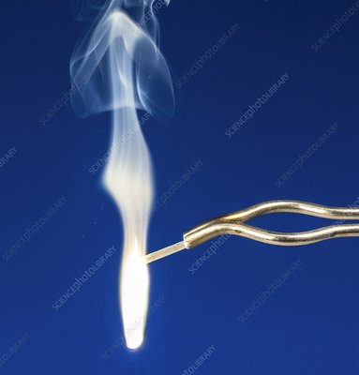
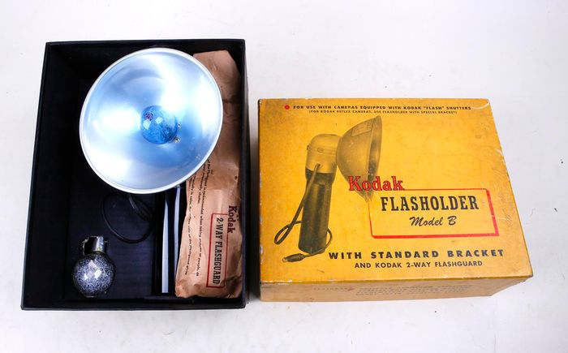
Mg + O₂ → MgO + energy (heat + light)
A + B → AB
Synthesis reaction
Exothermic
Used as flashbulbs

Slide 3
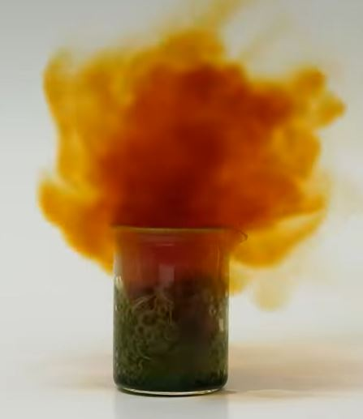
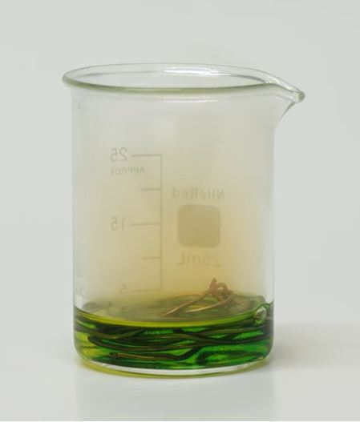
HNO₃ + Cu → Cu(NO₃)₂ + NO₂(g)
AB + C → CB + A
Single Replacement
Exothermic
NO₂ gas is an irritant
4HNO₃ + Cu → Cu(NO₃)₂ + 2HNO₃ 2NO₂(g) + 2 H₂O(l)
Start video at 6 min 30 seconds

Slide 5
Fe + HCl → FeCl₂ + H₂
A + BC → AB + C
Single replacement reaction
Exothermic
Used to clean iron (pickling)
Video: rusty garage door spring in HCl

Slide 6
Zn + CuSO₄(aq) → ZnSO₄ + Cu
A + BC → AC + B
Single Replacement

Slide 7
Decomposition of Baking Soda
NaHCO₃ (s) → Na₂CO₃ (s) + H₂O (g) + CO₂ (g)

Slide 8
Baking Soda + Hydrochloric Acid
Double Replacement Reaction
NaHCO₃(s) + HCl(aq) → NaCl(s) + CO₂(g) + H₂O(l)
Pour out candles after siphoning CO2 from one graduated cylinder to another.

Slide 9
Decomposition of Magnesium Carbonate

Slide 10
Aluminum + Mercury Amalgamation

Slide 11
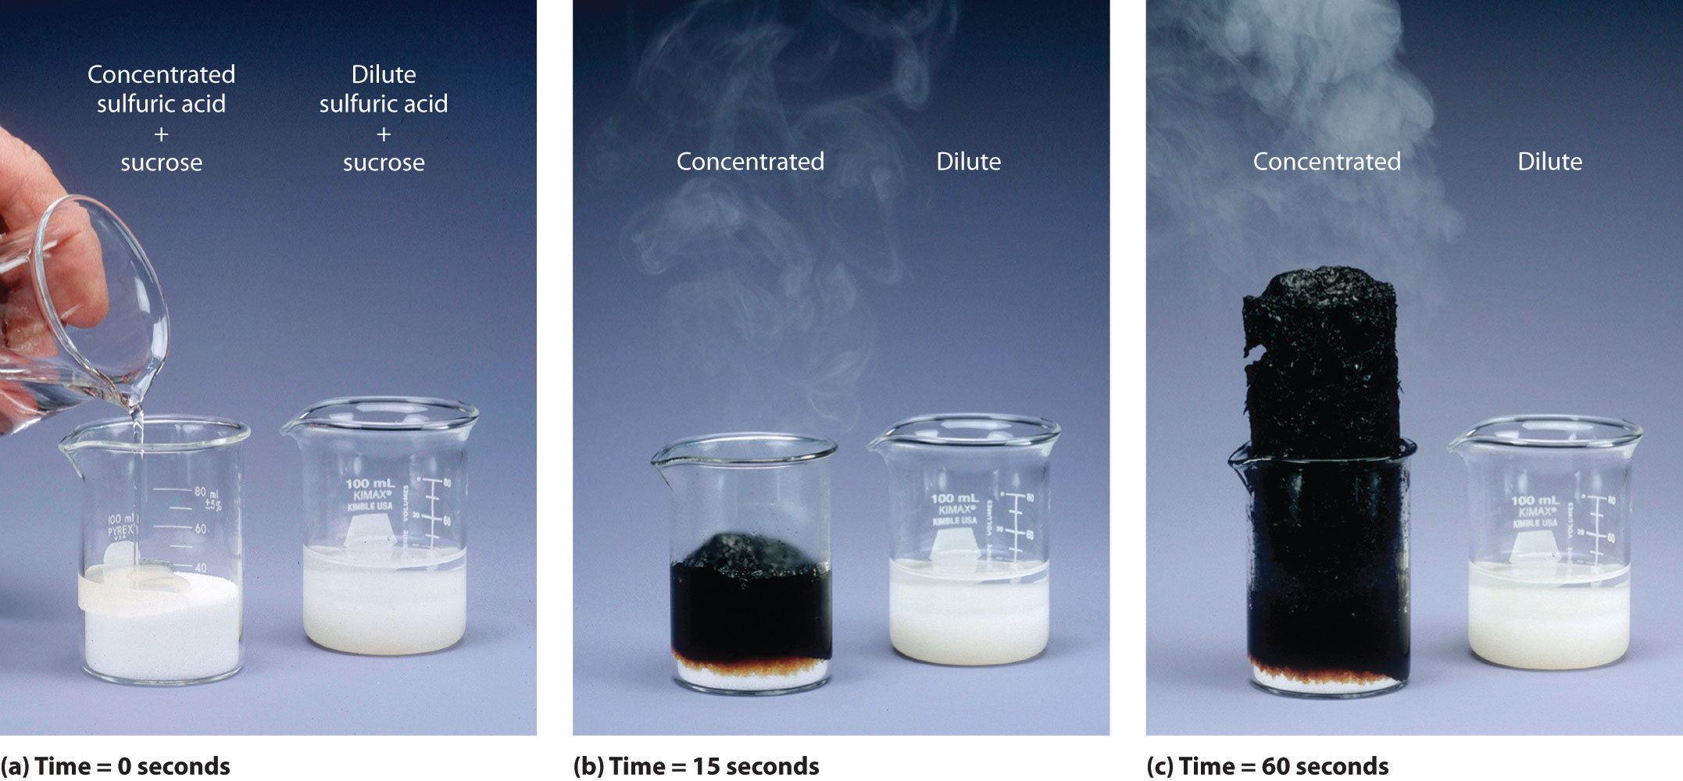
Sugar + Sulfuric Acid

Slide 12
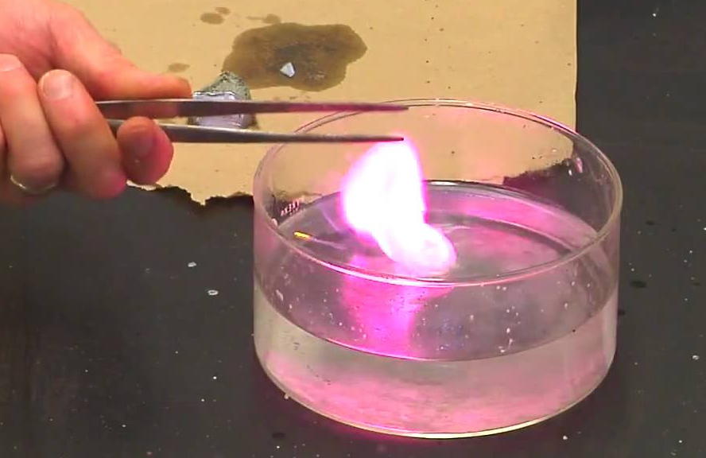
Potassium in Water
hh

Slide 13
Formation of Lead(II) Iodide

Slide 14
Decomposition of Water by Electrolysis

Slide 15
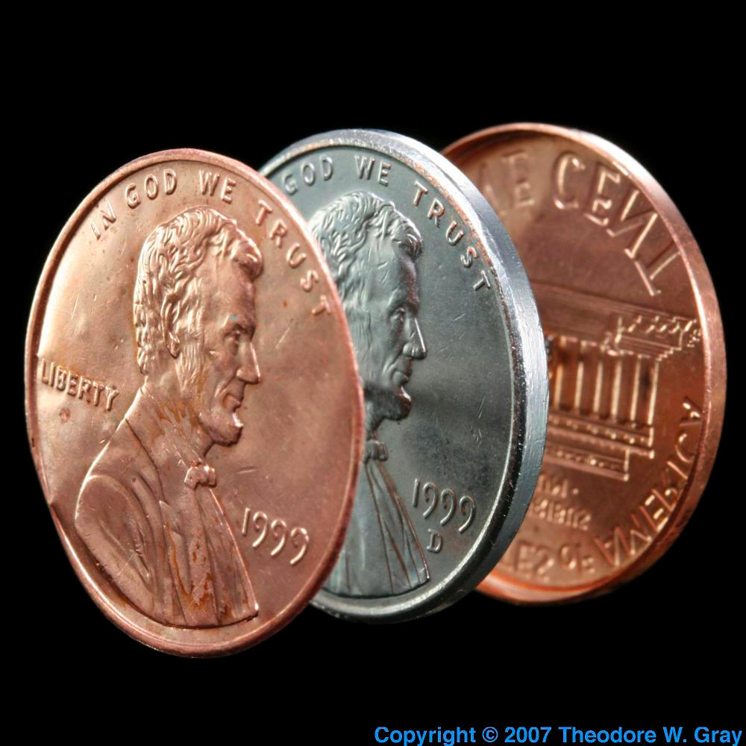
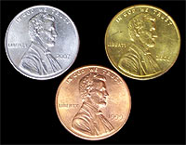
Galvanization: Zinc Coating a Penny
Penny is cleaned in a vinegar + salt solution to remove oxidation
Add powdered zinc to a 6 M NaOH solution that is heated to 80ºC
Rinse off excess zinc and base.
Hold “silver” penny over flame or hot plate until turns “gold” - COOL.
Notes:
Fill the small 50 mL beaker with 3/4 full tap water. This is your rinsing beaker. Set aside.
Dissolve 30 grams of Zinc Sulfate in 100 mL of water in the 250 mL beaker. A little heat from setting on the hot plate will hasten this dissolve.
Place mossy zinc pieces in the beaker with the zinc sulfate solution, enough pieces to almost cover beaker bottom.
Using tweezers, place two or three cleaned up pennies in step three beaker making sure pennies touch the mossy zinc pieces and are not touching each other.
Bring solution to low boil for about 10 minutes. Your pennies will slowly turn a silver color.
Using tweezers, carefully remove the pennies from the solution, rinse and cool them in small wash beaker then dry them on a paper towel.
Voila! You now have a dandy silver colored penny.
To turn the penny gold...
Place the silver penny on a hot plate heated to about 570°F (300°C). Watch as the heat diffuses the zinc with the copper to form a brass alloy. This will appear as golden in color.
Once the penny is a brassy/golden color, use tweezers to pick up the penny and transfer it into the wash beaker to rinse and cool.
Once cooled, you have a nice gold colored penny!

Slide 16
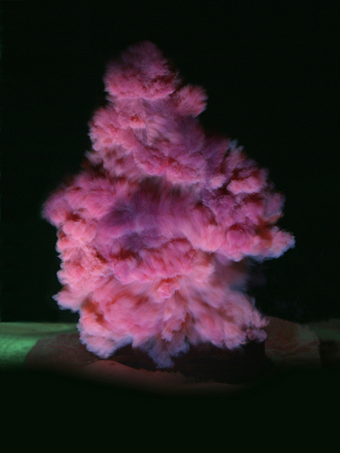
Detonation of Nitrogen Triiodide
NI₃ exploding at 1000m/s
https://www.sciencesource.com/archive/Nitrogen-triiodide-explosion-SS284955.html

Slide 17
Sodium Metal in Water

Slide 18
Sodium + Chlorine → Sodium Chloride
2 Na + Cl₂ → 2 NaCl

Slide 19
Thermite Reaction
2 Al(s) + Fe₂O₃(s) → 2 Fe(s) + Al₂O₃(s)

