Slide 1
Intro to Chemistry
The world around you is made up of trillions of particles that are too small to see.
These bits of matter follow rules and laws that allow us to identify them and to
predict how they will interact with one another. It has often been said that
chemistry is the study of matter, its properties, and its behavior.
Because we are surrounded by matter, chemistry is one of the most important
sciences in that it allows us to observe and then change our environment. The
question remains, however: How much should we change our environment,
and can we predict the results before we do so?
Name either 10 items that you could find in a typical household that are a direct
result of people studying chemistry, or 10 ways that chemistry has changed the
life of the average person, for better or for worse.
1
Notes:
Answers will vary.
Cosmetics, cleaning supplies, cosmetics, automotive fluids, medications, polymers (synthetic materials), nylon, spandex, weed killer, etc…
Medicines have extended human life. Synthetic joints for replacement in humans. Nonstick cooking surfaces (teflon (T-fal pans)).

Slide 2
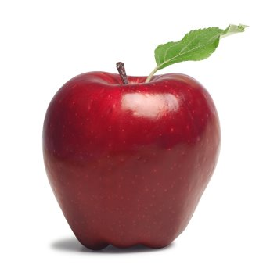
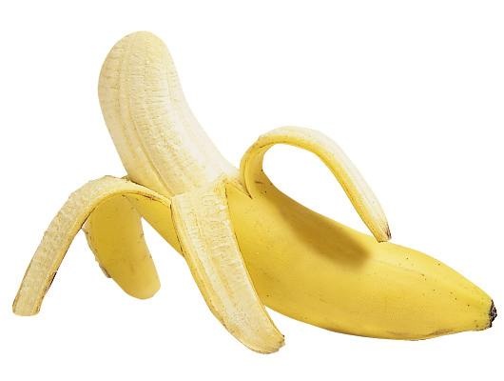
All That Matters
There are many ways to classify the materials we see around us every day.
Is it a solid, liquid, gas, or plasma? Is it an element or a compound? Is it a
pure substance or a mixture?
The answers to these questions allow us to identify the things we see.
For example, we learn to tell the difference between an apple and a banana,
or either of those from a ham sandwich. All of these items are food, they all
have nutrients, like vitamins and minerals, but they are not identical.
Without the ability to observe the environment and identify what we are
seeing, we would be unable to respond to and use the materials around us.
Name some properties that you would use to tell the difference between a
banana and a ham sandwich. Try to think of properties that could be used
to tell any banana from any ham sandwich.
2
Notes:
Any answer that contains a list of chemical and physical properties, such as color, odor, or flammability, will do.

Slide 3
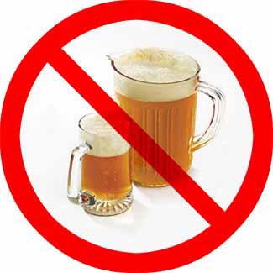
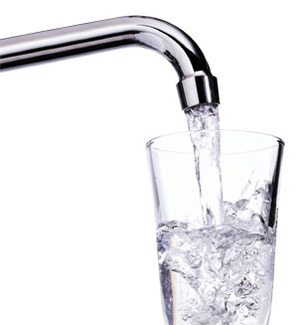
Unique Properties
We need to be able to identify the materials we see every day so that we can
use them correctly. We do this by observing physical and chemical properties
and comparing them to what we know from personal experience.
Physical properties include such things as boiling point, color, density, hardness,
melting point, odor, taste, and even electrical conductivity.
Chemical properties are usually a measure of how a material reacts or fails to react
with other substances. Will it burn? Does it dissolve in water? Does it produce
bubbles of gas dropped into acid?
All of these things allow us to tell the difference between water and alcohol, for
example, and many other substances with the use of only one or two of our senses.
List at least five of the physical and chemical properties of water and alcohol.
What simple test could you do to determine which liquid was which?
3
Notes:
Odor, flammability, density, boiling point, freezing point, etc…
DEMO: Have ice cube sink in alcohol. Remove cube and attempt to light on fire. Place several drops of alcohol on desk and ignite.

Slide 4
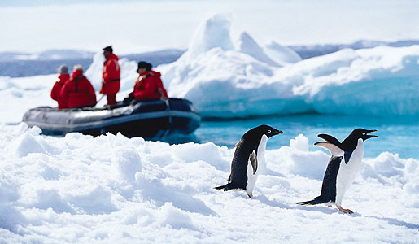
Measuring Up
In the 1790’s, a group of scientists came to the first general agreement that using
a single, worldwide system of measure would benefit all people. This system was
named the metric system, and it gave us units of measure like meters and liters.
The system was formally, and more universally, adopted in the 1960s when it
became the International System of Units, or SI system. The “SI” comes from
the French name Le Systèm International d’Unités. For example, the SI scale
of temperature is called Celsius, and it places the freezing point of water at 0ºC
and the boiling point of water at 100ºC.
What are some of the reasons why defining a temperature scale by the freezing
and boiling points of water might be useful to scientist on any part of the earth?
4
Notes:
The standard is reproducible anywhere on earth.

Slide 5
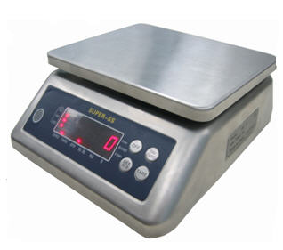
Significant Uncertainty
If you were to weigh a small rock on a scale that could measure the mass of the
rock to the nearest 0.001 grams, then the mass of the rock would be, for example,
10.871 + 0.001 grams. The last digit is really just the best estimate of what the last
digit should be.
Perhaps it was rounded or perhaps not – there is no way to be certain 0 so the last
digit is called uncertain. The first four digits were numbers about which no estimate
Was made, so they are called significant figures.
All nonzero numbers are significant; zeros between nonzeros are significant;
place-holding zeros at the beginning and end of a number are not significant;
and zeros at the end of a number after the decimal are significant.
How many significant figures are in each of the following?
8.01 b. 80.1 c. 80
d. 8009 e. 0.0083 f. 0.1040900300
5
Notes:
3 b. 3 c. 1 d. 4 e. 2 f. 10

Slide 6
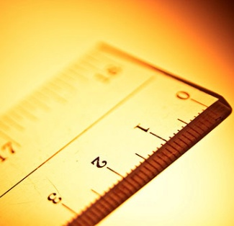
From Another Dimension
Just as there are 12 inches in one foot, there are 100 centimeters in one meter.
The labels on the ends of these numbers are called units or dimensions.
Dimensional analysis is the process of changing the units on a number, usually
to make a number more manageable.
We might say a certain event took place 20 years ago, but we would seldom say
that it took place 7,300 days ago.
The amount of time is the same, but by changing the years into days, we change
not just the unit, but the number in front of the unit.
Convert the following.
a. 600 days to years
b. 14 centuries to years
c. $3.50 to quarters
d. 900 centimeters to meters
6
Notes:
a. 1.64 years or 1 year and 235 days (1 year =365 days)
b. 1,400 years (100 years = 1 century)
14 quarters (4 quarters = 1 dollar) OR 100 pennies = 1 dollar and 5 pennies = 1 nickel and 5 nickels = 1 dime
9 meters (100 centimeters = 1 meter)

Slide 7
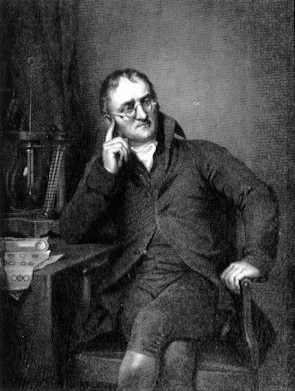
The Theory that Matters
John Dalton, and English schoolteacher, proposed the atomic theory of matter
At the beginning of the 1800s. It states
1. Each element is made of small particles called atoms.
2. All atoms of one kind of element are identical.
3. Atoms can’t e created or destroyed by chemical reaction
or changed into other kinds of atoms.
4. Compounds are formed by combining atoms of more than
one kind of element, in the same ratio each time.
What, if any, problems arise from the basic ideas of Dalton’s theory?
7
Notes:
Answers will vary, but particles smaller than atoms have been discovered, and not all atoms of a single element are identical because of isotopes.

Slide 8
Building Blocks of the Building Blocks
Not every discovery in science is the direct result of a scientist looking for a
specific item and then finding it. There are plenty of examples in which scientists
involved in research in one are surprised to find that they have made a major
advance in another.
For example, take the three major subatomic particles: the electron, the proton,
and the neutron. The proton and neutron are roughly the same size, and the
electron is over 1,800 times smaller than either the proton or neutron. These
particles were all discovered in the course of research into the nature of the atom,
but none of the scientists who found them were actually looking for subatomic
particles as such. However, in all three instances the new information led to an
explosion of new thinking and ideas about the nature of matter.
How can proper experimental methods prepare a researcher
for the event of making an unexpected discovery?
8
Notes:
Proper experimentation keeps track of as many variables as possible, and good experiments are designed to be reproducible.

Slide 9
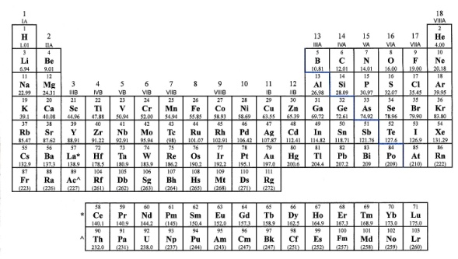
Isotopes
6
C
12.0111
The atomic mass of each element is given on the periodic table and is actually
a weighted average of all the naturally occurring isotopes of an element. An
isotope is a type of atom that has the same number of protons but a different
number of neutrons.
For example, all carbon atoms have six protons, but may have six, seven, or
eight neutrons, so there are isotopes of carbon-12, carbon-13, and carbon-14.
Because C-13 and C-14 occur in much smaller amounts than C-12, they don’t
change the atomic mass of carbon very much, but it is still 12.0111 amu and
not exactly 12 amu.
If fluorine has an atomic mass of 18.998 and there are isotopes of both fluorine-18
and fluorine-19, which of the two isotopes occurs in larger numbers naturally?
9
F
18.998
9
Notes:
Fluorine-19.

Slide 10
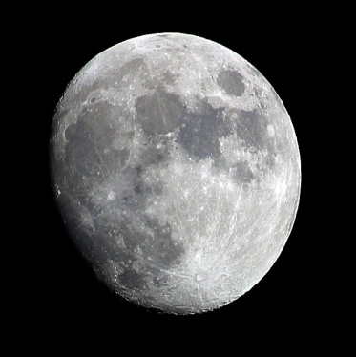
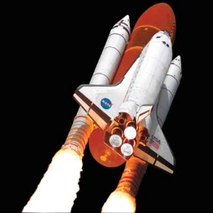
Mass and Weight
In chemistry it is important to distinguish between mass and weight. Mass is a
measure of the amount of matter in an object, while weight is the gravitational
force that pulls on the amount of matter. It is necessary to make measurements
in science in terms of mass, because mass has an unchanging standard of
measurement for a sample of matter, while weight may fluctuate from location
to location. This would apply during a chemical reaction or to a measurement made
on the equator, the moon, or in orbit around the earth, where the effects of gravity
are nullified by free fall.
Name three items people buy that are measured in mass and not weight.
Why is this an advantage to the consumer?
10
Notes:
Answers will vary, but medication is a common item measured in grams or milligrams.
Items bought by mass would be the same amount whether purchased on Earth, on the moon, or in the weightless environment of free fall.

Slide 11
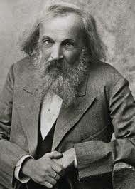
Periodicity
One of the many ways scientist classify substances is by the periodic table.
The periodic table is a chart showing the elements in order by increasing
atomic number and grouped by their similar qualities.
Russian chemist Dimitri Mendeleev is believed to be the first to
place the elements in order by their increasing atomic masses.
Mendeleev realized that the repeating patterns he saw were
grouping the elements by their properties, and he even went
so far as to leave spaces for elements that had not yet been
discovered.
Which two of the following elements should show the most similarities:
C, Se, Xe, Si, Ag, and Mg?
11
Notes:
C and Si. Both are in group 14.

Slide 12
Molecular and Empirical
A molecular formula is a representation of all the elements contained in a
molecule and the number of atoms of each element in that molecule.
For example, the substance sulfuric acid has the molecular formula H₂SO₄.
An empirical formula is the simplest ratio of the elements in a formula.
So for benzene, C₆H₆ is the molecular formula, but the ratio of carbon to
hydrogen is 6:6, or 1:1, so the empirical formula is CH.
Write empirical formulas for the following.
a. hydrogen peroxide, H₂O₂
b. glucose, C₆H₁₂O₆
c. water, H₂O
d. ethane, C₂H₆
12
Notes:
a. HO
b. CH₂O
H₂O
CH₃

Slide 13
Ions
An ion is an atom or a group of atoms that have acquired an electrical charge due
to a loss or gain of electrons. The atoms of some elements in the periodic table
tend to gain or lose one or more electrons in an effort to have an outer electron
shell like that of the closest noble gas.
They do this to become more stable, which, in a way, is a foal of all elements that
are free to react. Column 1 of the periodic table usually produces ions with a +1
charge; Column 2 usually produces +2 charges; and the transition metals in Groups
3-12 usually have a +1 or +2 charge. Column 13 often has +3 ions, and Columns
15, 16, and 17 usually produce ions with charges of -3, -2, and -1, respectively.
The noble gases don’t really form ions and almost always have a charge of zero.
What is the most likely ionic charge that each of the following elements would form?
a. Li b. Ne c. Br d. Ca e. P f. Ga
13
Notes:
a. Li¹⁺ b. 0 c. Br¹⁻ d. Ca²⁺ e. P³⁻ f. Ga³⁺

Slide 14
What’s in a Name?
A binary compound is a simple sort of compound usually made up of ions. The
compound made when a positive and negative ion combine has a collective charge
of zero and is not an ion as a whole. Table salt made up of sodium and chlorine
is an example of this. The sodium ion has a +1 charge, and the chloride ion has a
charge of -1. The salt itself has the formula NaCl and has no collective charge.
In naming such compounds, the name of the positive ion comes first and is the
same as the name of the element. The name of the negative ion comes seconds
and is changes to have an –ide ending.
For example, oxygen becomes oxide, fluorine becomes fluoride, and bromine
becomes bromide. The number of each element does not affect the name of
the compound.
Name the following binary compounds.
a. BaCl₂ b. KBr c. Li₂O d. MgO e. Na₂S f. Be₃N₂
14
Notes:
a. barium chloride b. potassium bromide c. lithium oxide d. magnesium oxide e. sodium sulfide f. berylium nitride

Slide 15
Covalent Names
Binary molecular compounds have a simple naming system. These are typically the
result of a bond forming between two nonmetals, such as sulfur and oxygen. The
number of each element present determines the name of the compound, a system
based on common prefixes. Each element gets a prefix that shows how many of
each element is available, except when there is only one atom of the first element.
The prefix mono- is never used for the first element. For example, NO₂ is nitrogen
dioxide, S₂O₃ is disulfur trioxide, and P₂O₅ is pentaphosphorus decoxide.
Number of atoms | 1 | 2 | 3 | 4 | 5 | 6 | 7 | 8 | 9 | 10
Prefix | mono | di | tri | tetra | penta | hexa | hepta | octa | nona | deca
Name the following.
a. N₂O₂ b. CCl₄ c. PBr₆ d. NO e. S₄O₉ f. C₅I₇
15
Notes:
dinitrogen dioxide b. carbon tetrachloride c. phosphorous hexabromide
d. nitrogen monoxide e. tetrasulfur nonoxide f. pentacarbon heptiodide

Slide 16
Formula Mass
Formula mass is the sum of all the atomic masses in a compound. For example,
NaCl, or sodium chloride, is made of sodium and chlorine. The atomic mass of
sodium is 22.990 amu, and the atomic mass of chlorine is 35.453 amu. So the
combined masses of 22.990 amu + 35.453 amu = 58.443 amu, which is the
formula mass of sodium chloride.
If there were subscripts in the formula of the substance, the element with the
subscript would have to be counted the same number of times as the number
of the subscript. For example, in K₂O, the potassium is counted twice and the
oxygen once, so: 39.098 amu + 39.098 amu + 16.000 amu = 94.196 amu.
Find the formula mass of each of the following.
a. KCl b. BaCO₃ c. P₄O₁₀ d. C₆H₅OH e. CaO f. KClO₄
18
Notes:
a. 74.551 amu b. 197.337 amu c. 283.896 amu d. 94.108 amu e. 56.078 amu f. 138.551 amu

Slide 17
The Mighty Mole
In chemistry the mole is a way of keeping track of a large group of particles and
also a way of determining the amount of matter in a substance. The mole can be
thought of in much the same way as the dozen. A dozen eggs is 12 eggs, a dozen
car is 12 cars, and a dozen of any kind of object is 12 of that object.
A mole is a number equal to 6.02 x 10²³ particles. So a mole of pickles would have
6.02 x 10²³ pickles in it. To give you some idea of how big a mole is, one scientist
estimated that a mole of peas would cover the entire surface of the earth, oceans
and all, to a depth of 6 inches. As you can see, the mole is not a unit we would use
in counting everyday objects; however, it is well suited for counting atoms and
molecules because there ma be trillions and trillions of them in a very small sample.
Answer the following.
a. How many moles of atoms are in 4.04 x 10²⁴ atoms?
b. How many atoms are in 3.20 moles of atoms?
c. How many moles of carbon atoms are in 1.75 x 10²⁵ carbon atoms?
19
Notes:
a. 6.71 moles b. 1.93 x 10²⁴ atoms c. 29.1 moles

Slide 18
Time to Expand
Energy is the ability to do work, usually measured in joules. Energy is found in
many forms and classifications, such as kinetic, potential, nuclear, electrical,
chemical, thermal, mechanical, and sound.
Scientists have long thought that matter is also a form of energy, and the law of
conservation of energy states that the total amount of energy in the universe is
constant, but it can change from one form to another. During a chemical reaction,
the amount of matter that is present at the beginning of the reaction should be
that same as the amount found at the end of the reaction, and the amount of
energy should remain constant throughout the reaction.
How can sound be considered a form of energy?
29
Notes:
Sound produces work by moving air particles and the mechanisms in sound receivers, such as microphones or ears.

Slide 19
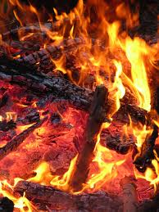
The First Law
The first law of thermodynamics states that energy is conserved. In other
words, the amount of energy in a system can change, but any energy lost
during a chemical reaction must be gained by its surroundings.
Although a fire may give off heat, the energy does not just disappear – it is
spread throughout its surrounding until it is so spread out that it can no
longer be measured by the human senses.
What is the change in internal energy of a system in a reaction in which 300 joules
are absorbed by the system from its surrounding and 120 joules of that energy are
used to do work on the surrounding?
30
Notes:
180 joules.

Slide 20
Enthalpy
Enthalpy (H) is a measure of the internal energy of a system. It can be thought
of as the sum total of all the energy in the chemical bonds of a material, the
energy of its state, the kinetic energy of its internal particles and any other way
that a substance can contain energy.
It is impossible to measure the enthalpy of a substance, but it does not change
unless energy enters or leaves the substance. The value of enthalpy if positive
when heat is absorbed by a substance and negative when given off from a
substance.
Determine whether the enthalpy of each of the following is negative or positive?
a. water boiling
b. ice melting
c. gasoline burning
31
Notes:
a. positive b. positive c. negative

Slide 21
Enthalpy and Reactions
During chemical reactions, energy is usually gained or lost by some of the
components in a reaction. Exothermic reactions give off heat while endothermic
reactions absorb heat. The sum of those changes is the enthalpy of reaction,
Given by the formula
ΔH = H_{products} - H_{reactants}
For example, in the reaction below, ΔH is negative, and therefore the reaction
is exothermic.
2H₂(g) + O₂(g) → 2H₂O(g) ΔH = - 483.6 kJ
Tell if each of the following reactions is endothermic or exothermic.
a. C(s) + O₂(g) → CO₂(g) ΔH = - 394 kJ
b. N₂(g) + O₂(g) → 2NO(g) ΔH = 180.8 kJ
c. S(s) + O₂(g) → SO₂(g) ΔH = - 297 kJ
32
Notes:
a. exothermic b. endothermic c. exothermic

Slide 22
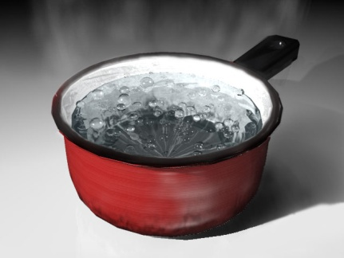
Exploding Food
Calorimetry is a method for measuring heat flow into or out of an object. For
example, we can measure the heat flow out of a potato chip by burning it rapidly
(sometimes exploding it in the process) in a bomb calorimeter and then funneling
the heat from the flame to a container of water.
Then we can observe the temperature change of the water. Using specific heat,
which is the measure of the amount of energy needed to raise the temperature
of 1 gram of substance 1ºC (1 K), we can determine the amount of heat that enters
or leave the material.
The specific heat of water is 4.19 J/gºC. How much heat is needed to raise the
temperature of 18.0 grams of liquid water 15ºC?
33
Notes:
1,131.3 Joules or 1.1313 kJ

Slide 23
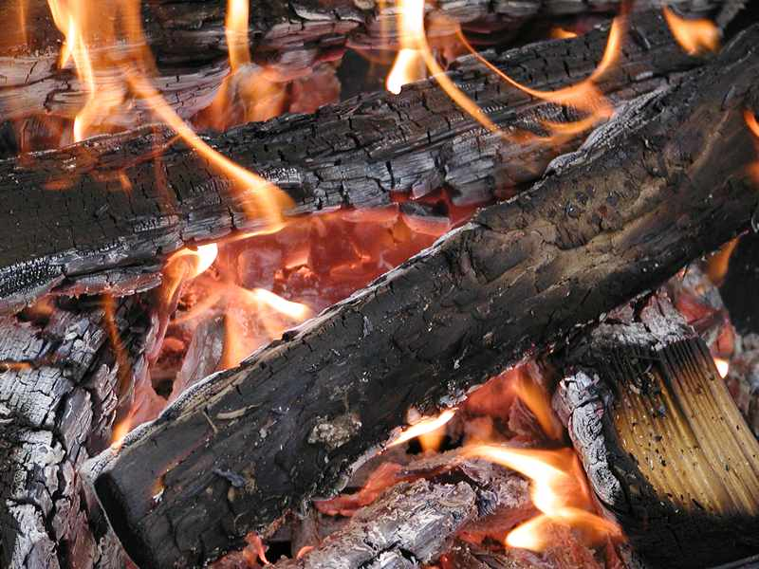
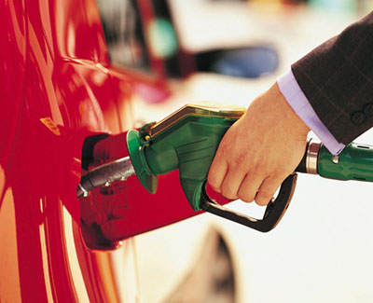
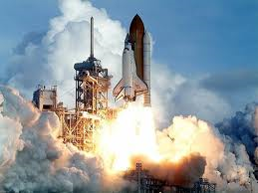
Energy to Burn
We take many materials found on Earth and use them for fuel. This fuels does
many jobs, from heating out houses to running our cars to generating electricity.
Burning wood, for example, releases about 18 kJ of energy for every gram burned.
Gasoline generates about 47 J/g when burned, and pure hydrogen can generate
more than 140 kJ/g when burned. Each of these fuels has its advantages and
disadvantages that make it useful in certain situations.
If hydrogen has the most energy to be releases per gram, why don’t we use it any
time we need to burn a fuel to make energy?
36
Notes:
Hydrogen is still not mass-produced on a large scale, and for a large amount to be moved around, it must be under high pressure or extremely low temperature.

Slide 24
A Constant Light
Light is a form of radiation that surrounds us almost all the time. Electromagnetic
radiation takes on the form of radio waves, microwaves, infrared light, visible light,
ultraviolet light, X rays, and gamma rays.
All of these forms of energy have one thing in common: When traveling through a
vacuum, they al move at the same speed, which is the speed of light. That speed is
300,000,000 meters per second, or 3.0 x 10⁸ m/s. [~186,000 miles per hour]
White
Light
γ rays
X-rays
Ultraviolet
Infrared
Microwave
Radio waves
Radar
TV
FM
Short
Wave
Long
Wave
Velocity of light is constant and equals the frequency of the wave times the wavelength.
If blue light has a shorter wavelength then red light, how do the frequencies of the two
compare?
37
Notes:
Blue light has a higher frequency than red.

Slide 25
Electromagnetic Spectrum
H
I
GH
ENERGY
Visible spectrum
Violet
Blue
Green
Yellow
Orange
Red
LOW
ENE
RGY
400 nm
500 nm
600 nm
700 nm
White
Light
γ rays
X-rays
Ultraviolet
Infrared
Microwave
Radio waves
Radar
TV
FM
Short
Wave
Long
Wave
10⁻²nm
10⁻¹nm
10⁰nm
10¹nm
10²nm
10³nm
10⁻³cm
10⁻²cm
10⁻¹cm
10⁰cm
10¹cm
1cm
10¹m
10²m
10³m
10⁴m
Wavelength, λ
10¹⁹Hz
10¹⁸Hz
10¹⁷Hz
10¹⁶Hz
10¹⁵Hz
10¹⁴Hz
10¹³Hz
10¹²Hz
10¹¹Hz
10¹⁰Hz
10⁹Hz
100 MHz
10 MHz
1 MHz
100 KHz
Frequency, ν
Electromagnetic spectrum

Slide 26
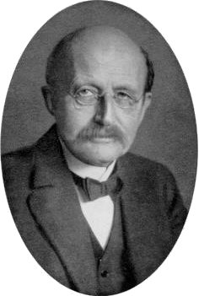
Walking the Planck
German scientist Max Planck theorized that energy could only be released
or absorbed from an atom in pieces of fixed size. He called these packets
of energy quanta and said theory were the smallest amount of energy
that an atom could emit or absorb.
He said that the energy, E, released or absorbed, has to
equal the product of the frequency and a constant that
is now called Planck’s constant. The value of the
constant is 6.63 x 10⁻³⁴ Joules/seconds.
How much energy is released by a photon of blue light
with a frequency of 6.00 x 10¹⁴ Hz?
Max Planck
38
Notes:
3.98 x 10⁻¹⁹ Joules

Slide 27
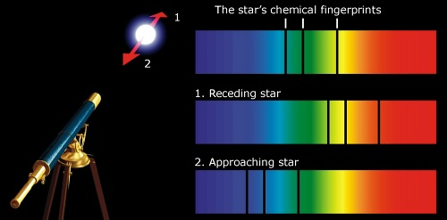
A Spectrum of Models
Different substances absorb or emit light based on their atomic or molecular
structure. Each element has a unique structure that is revealed through
spectroscopy, which allows scientists to take a complex sample, expose it
to heat, and look at the spectrum of emissions.
The spectrum in its entirety looks like a rainbow, but the spectral lines of an
individual element may consist of only four or five single lines at different
points in the spectrum. The emissions can then be compared to emissions
of known elements, and the elements that are present can be identified.
What kind of problem might arise if a person were trying to identify a large
group of substances by looking at their spectra with just the naked eye?
39
Notes:
It would be very hard to keep track of all the subtle differences that make up the millions of substances that could be identified this way.

Slide 28
Mendeleev and Masses
One of the many ways scientists classify substances is the periodic table. The
periodic table is a chart showing the elements in order by
increasing atomic number and grouped by similar qualities.
In the late 1800s, Russian chemist Dimitri Mendeleev placed
the elements in order by their increasing atomic masses and
helped determine much about the order of the elements on
the table.
He left gaps for elements that had not been discovered at the time.
Why did it turn out to be better to place elements in order on the peridic table
by atomic number instead of atomic mass?
46
Notes:
Elements placed in order by atomic mass would be disorganized because of the existence of isotopes.

Slide 29
Shielding
There is a shielding effect felt by the outermost electrons of an atom. This effect
is the result of the interactions between the core electrons of an atom and the
protons in the nucleus.
You can think of the core electrons as soaking up some of the attractive force of
the protons and not allowing their full attractive power to reach the valence
electrons.
One way to quantify this effect is to calculate the effective nuclear charge by
subtracting the number of core electrons from the number of protons in the atom.
What are the effective nuclear charges of argon and calcium?
47
Notes:
zero and two.

Slide 30
Atomic Size
There are two basic trends in atomic size on the periodic table.
1. In each column, the atomic size (radius) tends to increase
as you move from the top to the bottom of the column.
2. In each row (period), the atomic size tends to decrease
as you move from left to right.
Following the guidelines above, determine which of each pair would likely be larger.
a. Mg or Ca b. Y or Ru c. C or Ge d. Ne or Xe e. W or Au f. Zn or Hg
48
Notes:
a. Ca b. Y c. Ge d. Xe e. W f. Hg

Slide 31
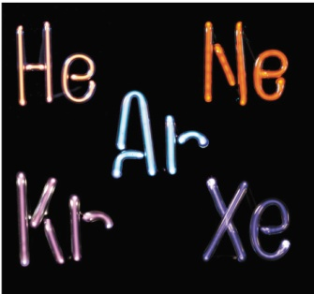
Energy to Escape
The ionization energy of an atom is the minimum amount of energy needed to
remove an electron from an atom. The atom must be in its ground state, and
must be in gaseous form. As each electron is removed, the ability of the protons
in the nucleus to hold the remaining electrons increases. Consequently, as each
subsequent electron is removed, it requires more and more energy to do so.
Ionization energy generally increases from left to right in the rows and from
bottom to top in the columns of the periodic table.
He
2
Ne
10
Ar
18
Kr
36
Xe
54
Place the following atoms in order by their increasing first ionization energy
(the energy needed to remove just the first electron): Ar, He. Kr, Ne, Xe
Rn
86
49
Notes:
Xe, Kr, Ar, Ne, He

Slide 32
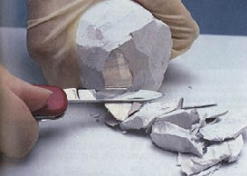
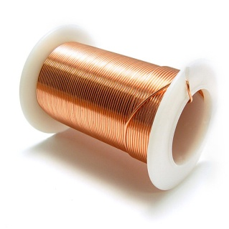
Metals
A metal is an element that loses electrons easily in a chemical change and has
the properties of high luster, electrical and thermal conductivity, malleability,
and ductility.
Some examples of metals are sodium, chromium, and copper, and such metals
are found toward the left and middle of the periodic table.
Since metals are elements that tend to lose electrons easily, what sort of ions
are metals most likely to form?
51
Notes:
Positive ions (called cations)

Slide 33
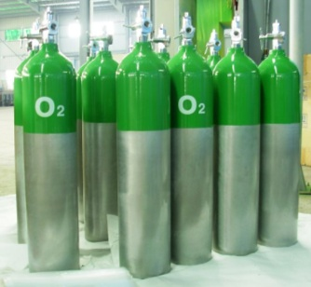
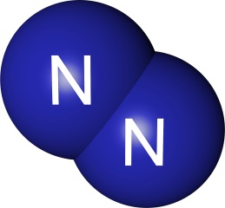
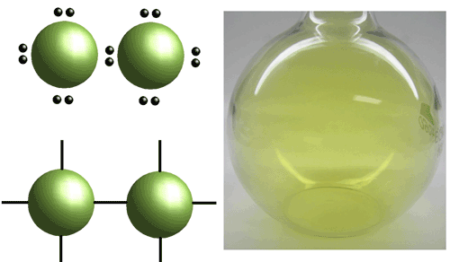
Nonmetals
A nonmetal is an element that easily gains electrons during a chemical reaction
and whose properties contrast with those of the metals. Some of the nonmetals
are oxygen, nitrogen, and chlorine. Such nonmetals are found toward the top
right of the periodic table.
Since nonmetals are elements that tend to gain electrons easily, what sort of ions
are nonmetals most likely to form?
52
Notes:
Negative ions (called anions)

Slide 34
Electronegativity
Electronegativity is a measure of the ability of an atom to attract electrons to
itself while it is chemically combined with another atom.
Electronegativity generally increases in strength as you move from left to right
on the periodic table ad from bottom to top.
The noble gases generally do not form
compounds in nature, so electronegativity
values are not usually calculated or listed.
Based on the general trends listed above, and discounting the lanthanides
and actinides, which element should have the highest electronegativity?
Which would have the lowest?
57
Notes:
fluorine has the highest, francium the lowest

Slide 35
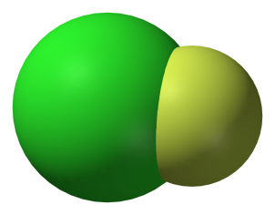
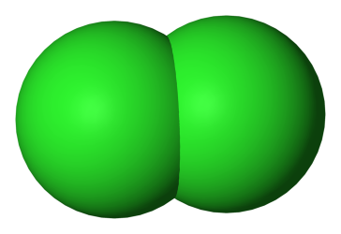
North and South?
Just as the earth and other magnetic bodies have a north and a south pole,
some molecules, because of their bonds and shapes, have poles of a different
kind.
Because the molecules have positive and negative charges, the possibility that
one end of a molecule will have more than its fair share of charge allows the
molecule to have a positive and a negative end. Because each atom in a bond
has a varying ability to attract charges to itself, some charges can get pulled to
one side or the other within a molecule.
Why is HCl a polar molecule, but Cl₂ is not?
64
Notes:
Both chlorines have the same amount of pull, but chlorine and hydrogen have different amounts of pull.

Slide 36
Hydrogen Bonding
In many molecules, hydrogen atoms that are connected on the periphery have
the ability to exert their polar nature. In a polar bond, the hydrogen atom has
a weak negative charge that can become attracted to a molecule with a weak
positive charge, allowing the two to become connected by what is called a
hydrogen bond.
The most common example of this is water. It accounts for the high surface
tension of water, which few other liquids of
similar molecular mass and density have.
Which of the following molecules is likely to form hydrogen bonds?
a. H₂ b. H₂O c. HF d. CH₄
78
Notes:
b and c; They are polar molecules with polar bonds.
Hydrogen bonds form between hydrogen and oxygen or nitrogen

Slide 37
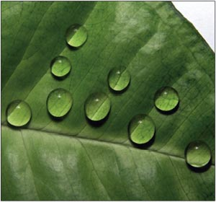
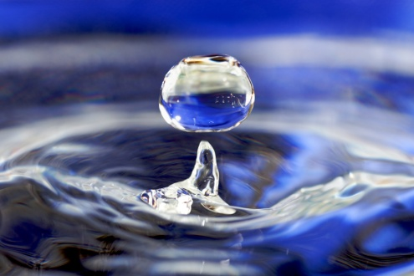
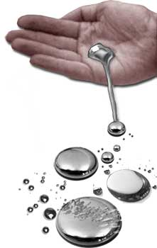
Surface Tension
Surface tension is a net inward pull of a liquid as the result of intermolecular
forces. The beading of water on a smooth surface and the formation of nearly
spherical drops of water on grass and other plants are examples of surface tension.
The surface tension of water is about three times greater than that of most other
liquids, a result of strong hydrogen bonds. The surface tension of mercury is
almost six times greater than that of water.
How do you suppose surface tension
is affected by temperature? Why?
79
Notes:
As temperature increases surface tension decreases, because the increased velocity of particles decreases intermolecular forces.

Slide 38
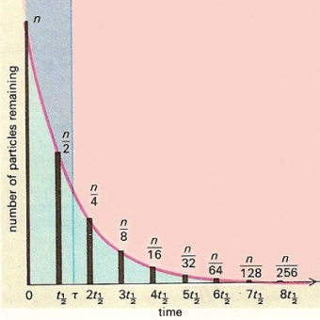
Half-Life
Each kind of radioactive nucleus has a fixed rate at which it decays. This rate
is unaffected by most normal external conditions, such as temperature, pressure,
or whether or not they are chemically combined with another substance.
The amount of time it takes for half of a sample of any such radioactive material
to decay is called the half-life. For example, if you had a 100-gram sample of
carbon-14, it would take 5,715 years for 50 grams of it to decay. After 11,430
years only 25 grams would remain, and after 17,145 years only 12.5 grams of
it would remain.
Cesium-137 has a half-life of 30 years. What percent of a 100-gram
Sample would be left after 210 years?
143
Notes:
0.78% or less than 1 gram

Slide 39
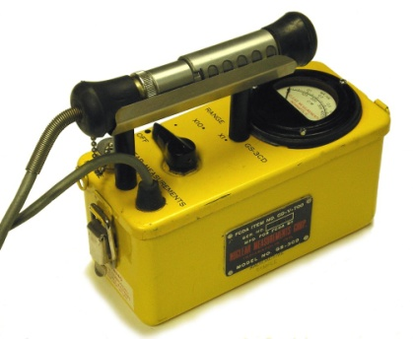
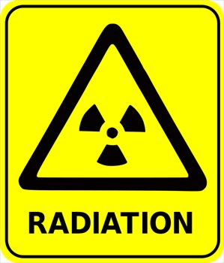
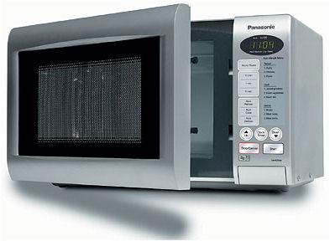
Geiger Counter
A Geiger counter is a device designed to measure radiation. The Geiger counter
detects the ionization that occurs within a low-pressure gas inside the Geiger
counter. Just as a fluorescent light bulb can be used to measure radiation leaking
from a microwave oven, the Geiger counter’s gas is ionized briefly by the passage
of a radioactive particle, which allows a brief flow of electricity. The amount of
electricity can be observed on a readout, or it can be converted into the familiar
clicking sound that is often associated with a Geiger counter.
What does the radiation from a leaky microwave do to the gas in
fluorescent light bulb that allows it to detect the microwave radiation?
144
Notes:
The brief ionization caused by the radiation would cause flashes of light in the light bulb.

Slide 40
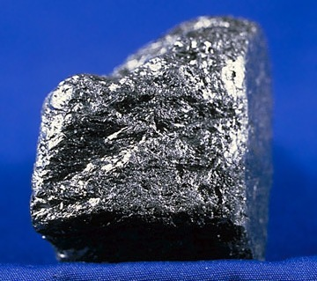
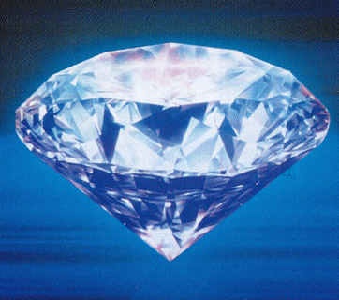
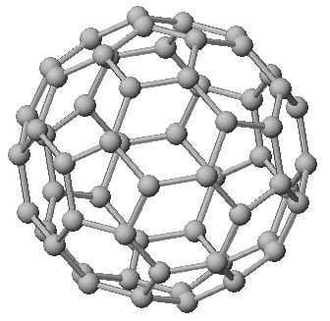
Carbon
Carbon is a very unusual element because it can exist in so many forms.
Forms that have the same atoms, but are arranged in different molecular
patterns, are called allotropes. Some allotropes of carbon are graphite,
diamond, and fullerenes, also known as buckyballs.
Carbon forms the backbone of almost every living substance, both living
organisms and nonliving sources such as petroleum.
What unusual bonding situation accounts for all the compounds
that carbon can form?
151
Notes:
Carbon has four sp³ hybrid orbitals that allow it to form four covalent bonds.

