Slide 1
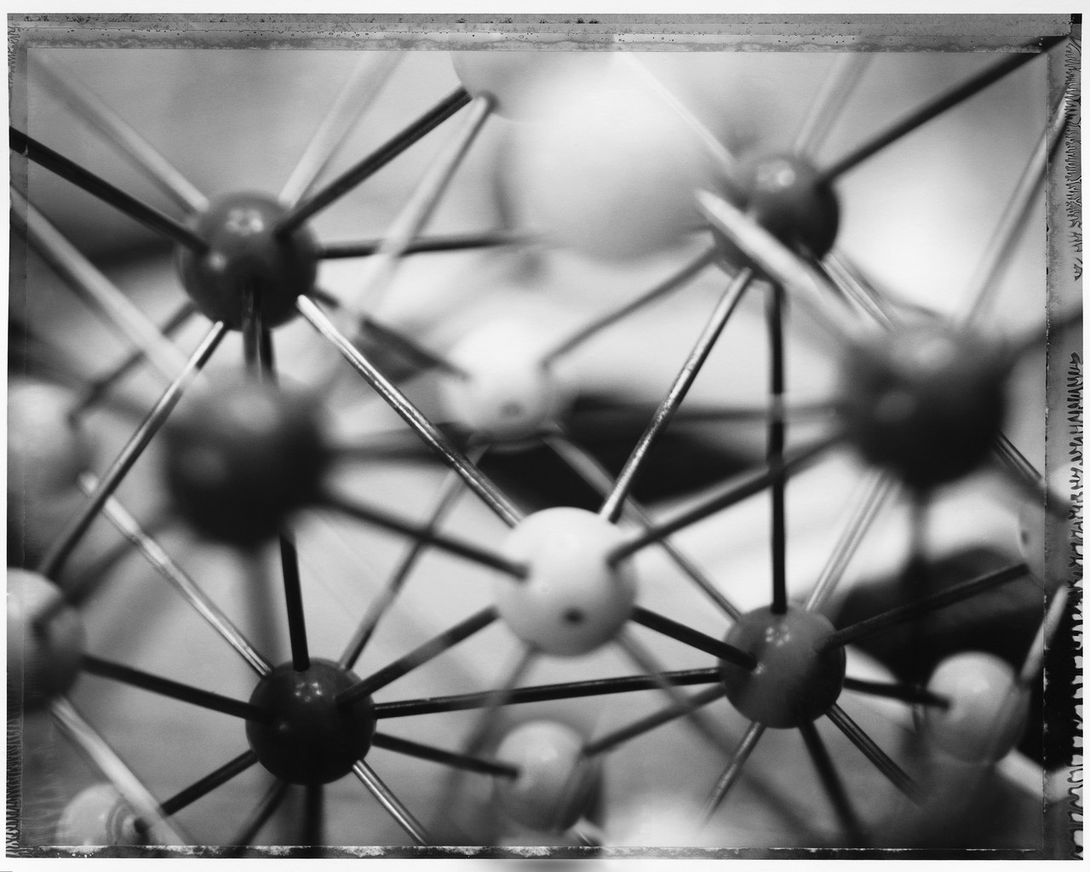

Molecular Geometry and Bonding Theories
AP Chemistry – Ch 9
Mr. Christopherson
Notes:
ALL students should;
Understand that when forming chemical bonds atoms are attempting to form more stable electronic configurations
Understand the essential difference between intra and inter bonding
Understand the concept of ionic bonding and the nature of the ionic bond
Understand the concept of covalent bonding and the nature of the covalent bond
Be able to draw Lewis structures
Understand the concept of resonance and formal charge as related to Lewis structures
Be able to predict the shape of, and bond angles in, simple molecules and ions using VSEPR theory
Understand the concept of the coordinate bond related to Lewis structures
Understand that ionic bonding and covalent bonding are at two ends of a sliding scale of bond type
Understand the concept of electronegativity
Understand that polarization caused by small highly charged cations leads to ionic compounds exhibiting some covalent character
Understand that differences in electronegativity in covalent molecules causes dipoles and some ionic character in covalent compounds
Understand under what circumstances molecules exhibit polarity
Be able to predict the shapes of simple molecules and ions using Lewis structures
Understand the occurrence, nature and relative strength of hydrogen bonds, dipole-dipole interactions and London dispersion forces

Slide 2

Molecular Geometry and Bonding Theories
AP Chemistry – Ch 9
Mr. Christopherson

Slide 3
Bonding Theories & Geometry
Molecular Geometry (shapes)
VSEPR Theory
Lewis Structures
Molecular Polarity (dipoles)
Covalent Bonds
Hybridization
Ionic Bonds
Notes:
COVALENT COMPOUNDS
The shape of a molecule can be used to predict the properties of that molecule.
The shape of a molecule is determined by the electron arrangement of the atoms that make up the molecule
More Specifically...:
Bonding Model
Define covalent bonding as a bond in which electrons are shared
Use electronegitivity difference to distinguish between polar and non-polar bonds
Contrast the intermolecular forces exhibited by ionic, polar, and non-polar bonds
a. ion-dipole interactions,
b. dipole-dipole interactions,
c. Hydrogen bonds and
d. London dispersion forces
Draw Lewis structures for covalent compounds including resonance structures
State that bonds form when orbitals overlap
Briefly describe hybridization of orbitals in methane
Use the VSEPR (Valence Shell Electron Pair Repulsion) model to predict the geometric shape of simple molecules and polyatomic ions
a. bent, linear, trigonal planar, tetrahedral, and trigonal pyramidal
Construct models of molecules and polyatomic ions to illustrate their predicted geometric shapes
Predict the polarity of molecules by using the VSEPR model for molecules containing polar covalent bonds
Nomenclature and formulas
Distinguish between empirical, molecular, and structural formulas
Name covalent compounds using the greek prefix system of mono, di, tri etc.
Write chemical formulas given the name of a compound
Choose the appropriate naming rules for a given chemical formula
Write the chemical formulas for certain common substances, such as ammonia, water, carbon monoxide, carbon dioxide, sulfur dioxide, and carbon tetraflouride.
Math
Calculate percent composition
Determine empirical and molecular formulas from experimental data
IONIC COMPOUNDS
Chemical formulas can be predicted from the periodic table and allow chemists to classify and predict properties of compounds
The general trend in the universe to strive for lower energy explains and allows for prediction of chemical properties of elements
Elements combine in whole number ratios and these molar ratios can be used to determine chemical formulas
More Specifically...:
Bonding Model
Use physical and chemical properties to distinguish between ionic and covalent compounds
Describe energy changes as elements combine to form an ionic compound
Describe ionic bonding as the transfer of electrons and the formation of a crystal lattice due to electrostatic attraction between ions of opposite charge
Predict the formation of cations and anions based on placement on periodic table
Relate formation of anion or cation with ionization energy and electron affinity
State that bonding occurs to increase stability
Contrast metallic and ionic bonding
Nomenclature and formulas
Learn the names and formulae of common anions and cations, including carbonate, sulfate, nitrate, hydroxide, phosphate, and ammonium
Write chemical formulas for ionic compounds given
a. Name of compound or
b. A pair of ions
Identify polyatomic ions
Classify compounds as being ionic or covalent.
Name ionic compounds using stock system (Roman numerals)
Math
Calculate molecular mass
Use dimension analysis to convert between moles, grams, atoms, ions and molecules

Slide 4
World of Chemistry
The Annenberg Film Series
VIDEO ON DEMAND
Episode 8 – Chemical Bonds
Elements bond to form compounds by giving, taking, or sharing electrons. The differences between ionic and
covalent bonds are explained by the use of scientific models and examples from nature.
VIDEO ON DEMAND
Episode 9 – Molecular Architecture
The shape and physical properties of a molecule are determined by the electronic structure of its elements and
their bonds. How living organisms distinguish between similar molecules (isomers) is revealed.
Notes:
Video 08: Chemical Bonds
The differences between ionic and covalent bonds are explained by the use of scientific models and examples from nature. (added 2006/10/08)
World of Chemistry > http://www.learner.org/vod/vod_window.html?pid=800
Video 09: Molecular Architecture
The program examines isomers and how the electronic structure of a molecule's elements and bonds affects its shape and physical properties. (added 2006/10/08)
World of Chemistry > http://www.learner.org/vod/vod_window.html?pid=801
Journey through the exciting world of chemistry with Nobel laureate Roald Hoffman as your guide.
The foundations of chemical structures and their behavior are explored through computer animation,
demonstrations, and on-site footage at working industrial and research labs. Distinguished scientists
discuss yesterday’s breakthroughs and today’s challenged.
Produced by the University of Maryland and the Educational Film Center.
Released on cassette: Fall 1989 The Annenberg/ / CPB Collection 1-800-LEARNER

Slide 5
H
H
CH₄
H
C
H
109.5º
C
H
H
H
H
molecular
formula
structural
formula
molecular
shape
H
C
H
H
H
tetrahedral
shape of
methane
tetrahedron
ball-and-stick
model
Notes:
Different ways of representing the structure of a molecule
1. Molecular formula gives only the number of each kind of atom present.
2. Structural formula shows which atoms are present
3. Ball and stick model shows the atoms as spheres and the bonds as sticks.
4. A perspective drawing, called a wedge-and-dash representation, attempts to show the three-dimensional structure of the molecule.
5. The space-filling model shows the atoms in the molecule but not the bonds.
6. The condensed structural formula is the easiest and most common way to represent a molecule—it omits the lines representing bonds between atoms and
simply lists the atoms bonded to a given atom next to it. Multiple groups attached to the same atom are shown in parentheses, followed by a subscript that
indicates the number of such groups.

Slide 7
109.5º

Slide 9
Tetrahedron

Slide 10
Central
Atom

Slide 11
Central
Atom

Slide 12
Substituents

Slide 13
Substituents

Slide 17
Methane, CH₄

Slide 18
Tetrahedral
geometry
Methane, CH₄
Copyright © 2007 Pearson Benjamin Cummings. All rights reserved.

Slide 19
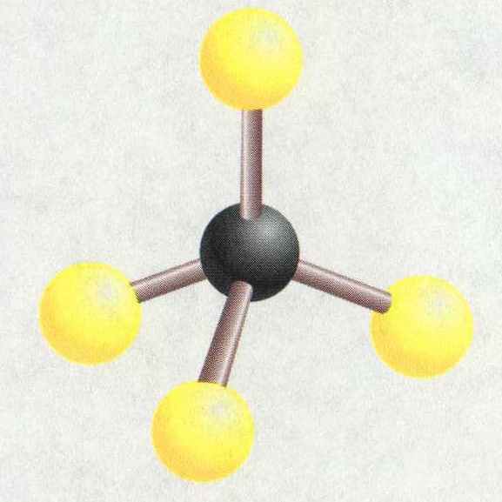
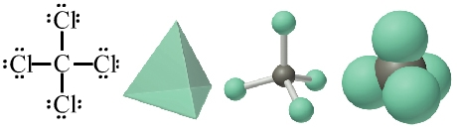
Methane & Carbon Tetrachloride
molecular
formula
structural
formula
molecular
shape
ball-and-stick
model
H
H
CH₄
H
C
H
109.5º
C
H
H
H
H
Cl
CCl₄
Cl
C
Cl
Cl
space-filling model
Notes:
The molecular geometry is predicted by first writing the Lewis structure, then using the VSEPR model to determine the electron-domain geometry, and finally focusing on the atoms themselves to describe the molecular structure.

Slide 20
Molecular Geometry
180º
H
109.5º
109.5º
C
H
H
Linear
Trigonal planar
H
Tetrahedral
104.5º
107.3º
Bent
Trigonal pyramidal
H₂O CH₄ AsCl₃ AsF₅ BeH₂ BF₃ CO₂

Slide 21
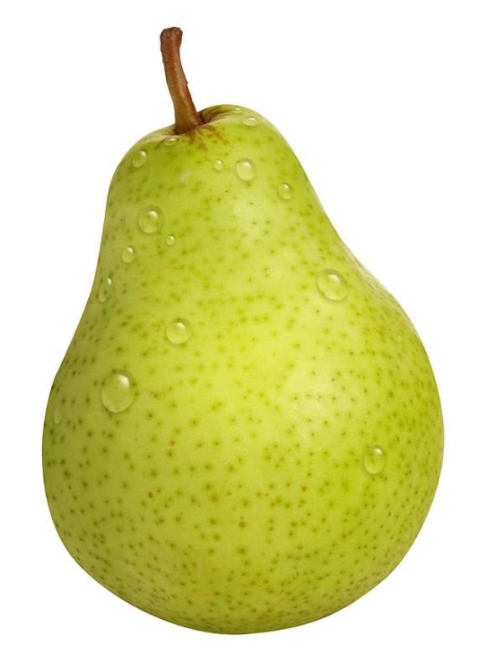
A Lone Pear
A Lone Pair
Notes:
http://k53.pbase.com/u26/dannysmythe/large/43277044.Pear.jpg

Slide 22
H
..
..
C
N
O
H
H
H
H
..
H
109.5º
107º
104.5º
H
H
H
CH₄, methane
NH₃, ammonia
H₂O, water
..
lone pair
electrons
O
O
O
O
O
O
O₃, ozone
Notes:
Oxygen contains two pairs of electrons that don’t bond at all. These electron pairs are referred to as unshared electron pairs, lone pairs or unbonded pairs.

Slide 23
Molecular Shapes
Three atoms (AB₂)
Four atoms (AB₃)
B
Linear (180º)
Bent
Trigonal planar (120º)
Trigonal pyramidal
T-shaped
A
B
A
B
B
B
linear
trigonal planar
B
Five atoms (AB₄)
Tetrahedral (109.47º)
Square planar
Seesaw
tetrahedral
A
B
Bª
B
Six atoms (AB₅)
B
B^{e}
Trigonal bipyramidal (B^{e}AB^{e}, 120º) & (B^{e}ABª, 90º)
Square pyramidal
A
B^{e}
B
B^{e}
Seven atoms (AB₆)
B
B
Trigonal
bipyramidal
A
Bª
Octahedral
B
B
Bailar, Moeller, Kleinberg, Guss, Castellion, Metz, Chemistry, 1984, page 313.
B
Notes:
Molecular formula
– Gives the elemental composition of molecules
Structural formula
Shows which atoms are bonded to one another and the approximate arrangement in space
Enables chemists to create a three-dimensional model that provides information about the physical and chemical properties of the compound
A single bond, in which a single pair of electrons are shared, is represented by a single line (–)
A double bond, in which two pairs of electrons are shared, is indicated by two lines (=)
A triple bond, in which three pairs of electrons are shared, is indicated by three lines (≡)

Slide 24
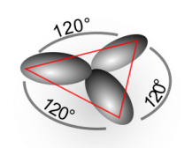
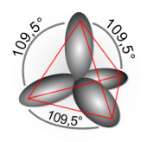
Bonding and Shape of Molecules
Number
of Bonds
Number of
Unshared Pairs
Covalent
Structure
Shape
Examples
2
3
4
3
2
0
0
0
1
2
-Be-
Linear
Trigonal planar
Tetrahedral
Pyramidal
Bent
BeCl₂
BF₃
CH₄, SiCl₄
NH₃, PCl₃
H₂O, H₂S, SCl₂
B
C
:
N
:
:
O

Slide 25
Molecular Shapes
AB₂
Linear
AB₃
Trigonal planar
AB₂E
Angular or Bent
AB₄
Tetrahedral
AB₃E
Trigonal
pyramidal
AB₂E₂
Angular
or Bent
AB₅
Trigonal bipyramidal
AB₄E
Irregular tetrahedral
(see saw)
AB₃E₂
T-shaped
AB₂E₃
Linear
AB₆
Octahedral
AB₆E
Square pyramidal
AB₅E₂
Square planar
Notes:
A hyperlink to additional information is found on the central atom of the diagrams.

Slide 26




Valence
Shell
Electron
Pair
Repulsion
Theory
Planar triangular
Tetrahedral
Trigonal bipyramidal
Octahedral

Slide 27
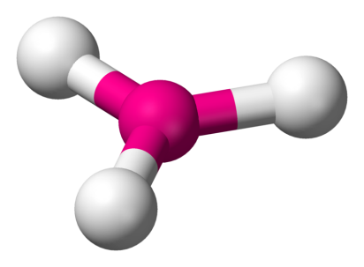
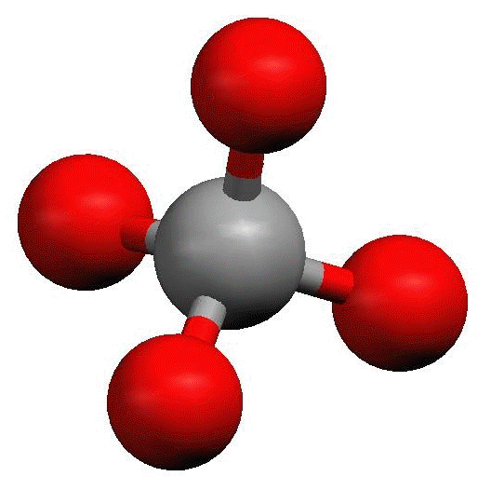
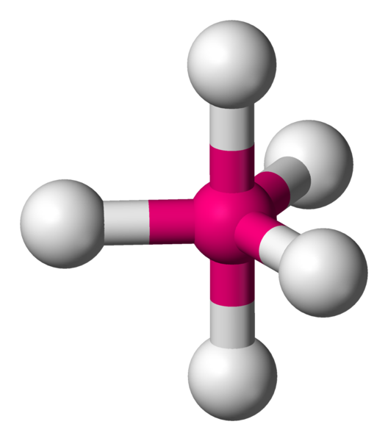
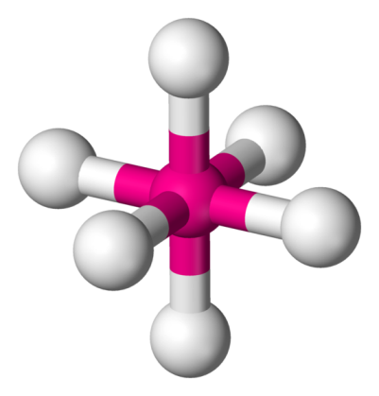
Valence
Shell
Electron
Pair
Repulsion
Theory
Planar triangular
Tetrahedral
Trigonal bipyramidal
Octahedral

Slide 28
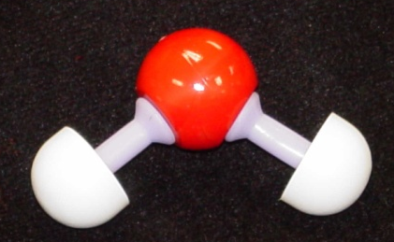
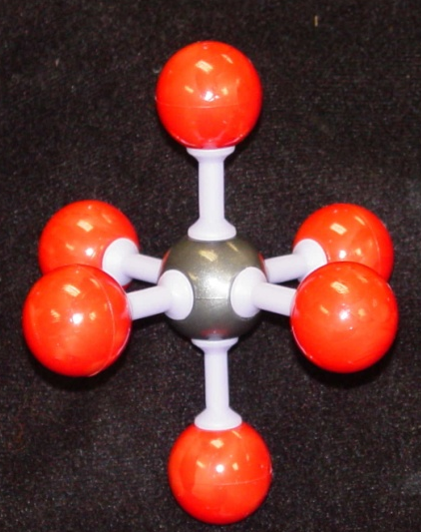
The VSEPR Model
The Shapes of Some Simple AB_{n} Molecules
..
..
..
SO₂
O
S
N
C
F
O
O
O
O
S
F
F
O
O
Linear
Bent
Trigonal
planar
Trigonal
pyramidal
SF₆
F
F
F
F
F
F
F
F
Xe
P
F
S
F
Cl
F
F
F
F
F
F
T-shaped
Square
planar
F
F
Trigonal
bipyramidal
Octahedral
Brown, LeMay, Bursten, Chemistry The Central Science, 2000, page 305
Notes:
Students often confuse electron-domain geometry with molecular geometry.
You must stress that the molecular geometry is a consequence of the electron domain geometry.
The best arrangement of a given number of electron domains is the one that minimizes the repulsions among them.
The VSEPR model can be used to predict the geometry of most polyatomic molecules and ions by focusing on only the number of electron pairs around the central atom and ignoring all other valence electrons present
• The following procedure is used:
1. Draw the Lewis electron structure of the molecule or polyatomic ion
2. Count the number of valence-electron pairs around the atom of interest, treating any multiple bonds or single unpaired electrons as single electron pairs – this number determines the electron-pair geometry around the central atom
3. Identify each electron pair as a bonding pair (BP) or lone (nonbonding) pair (LP)
4. To determine the molecular geometry, arrange the bonded atoms around the central atom to minimize repulsions between electron pairs

Slide 29
Molecular Shapes
AB₂
Linear
AB₃
Trigonal planar
AB₂E
Angular or Bent
AB₄
Tetrahedral
AB₃E
Trigonal
pyramidal
AB₂E₂
Angular
or Bent
AB₅
Trigonal bipyramidal
AB₄E
Irregular tetrahedral
(see saw)
AB₃E₂
T-shaped
AB₂E₃
Linear
AB₆
Octahedral
AB₅E
Square pyramidal
AB₄E₂
Square planar
Notes:
(Source: R.J. Gillespie, J. Chem. Educ., 40, 295, 1963.)
Predicts the structure of nearly any molecule or polyatomic ion that has a nonmetal central atom and the structures of many compounds that contain a central metal atom
In discussions of the structures of molecules or polyatomic ions, species are classified according to the number of atoms (n) of one type (B) attached to the central atom (A) using the notation AB_{n}, but not all AB_{n} species with the same value of n have the same structure
VSEPR model assumes that the electron pairs around the central atom of a Lewis structure occupy space, whether they are bonding pairs or lone pairs, and the most stable arrangement of electron pairs (the one with the lowest energy) is the one that minimizes repulsions between the electrons
VSEPR model distinguishes between the electron-pair geometry, the three-dimensional arrangement of electron pairs around the central atom, and the molecular geometry, the arrangement of the bonded atoms in a molecule or polyatomic ion
Electron-pair geometry
– Describes the arrangement of all valence electrons around the central atom, whether bonding or not
– Electrostatic repulsion between two particles that have the same charge depends on the distance between them
– Repulsions between electron pairs depend strongly on the angle between them — the smaller the angle, the closer they are and the greater the electrostatic repulsion
1. For compounds with two electron pairs around the central atom, the lowest-energy arrangement is linear and has the electron pairs on opposite sides of the central atom with a 180º angle between them
2. For compounds with three electron pairs around the central atom, the lowest-energy arrangement is trigonal planar, with electron pairs at 120º angles from each other
3. In compounds with four electron pairs around the central atom, the electron pairs point toward the vertices of a tetrahedron with 109.5º angles between adjacent electron pairs
4. In compounds with five electron pairs, the electron pairs have a trigonal bipyramidal arrangement, which has two sets of angles between adjacent electron pairs; one set contains three electron pairs at 120º
angles to one another in a plane, and a second set contains two electron pairs positioned at 90º to that plane
5. Lowest-energy arrangement for six electron pairs is an octahedron, in which adjacent electron pairs are positioned at 90º angles to one another

Slide 30
Geometry of Covalent Molecules AB_{n}, and AB_{n}E_{m}
Shared
Electron
Pairs
Unshared
Electron
Pairs
Type
Formula
Ideal
Geometry
Observed
Molecular Shape
Examples
AB₂
AB₂E
AB₂E₂
AB₂E₃
AB₃
AB₃E
AB₃E₂
AB₄
AB₄E
AB₄E₂
AB₅
AB₅E
AB₆
2
2
2
2
3
3
3
4
4
4
5
5
6
0
1
2
3
0
1
2
0
1
2
0
1
0
Linear
Trigonal planar
Tetrahedral
Trigonal bipyramidal
Trigonal planar
Tetrahedral
Triangular bipyramidal
Tetrahedral
Triangular bipyramidal
Octahedral
Triangular bipyramidal
Octahedral
Octahedral
Linear
Angular, or bent
Angular, or bent
Linear
Trigonal planar
Triangular pyramidal
T-shaped
Tetrahedral
Irregular tetrahedral
(or “see-saw”)
Square planar
Triangular bipyramidal
Square pyramidal
Octahedral
CdBr₂
SnCl₂, PbI₂
OH₂, OF₂, SCl₂, TeI₂
XeF₂
BCl₃, BF₃, GaI₃
NH₃, NF₃, PCl₃, AsBr₃
ClF₃, BrF₃
CH₄, SiCl₄, SnBr₄, ZrI₄
SF₄, SeCl₄, TeBr₄
XeF₄
PF₅, PCl₅(g), SbF₅
ClF₃, BrF₃, IF₅
SF₆, SeF₆, Te(OH)₆,
MoF₆
Bailar, Moeller, Kleinberg, Guss, Castellion, Metz, Chemistry, 1984, page 317.
Notes:
VSEPR model distinguishes between the electron-pair geometry, the three-dimensional arrangement of electron pairs around the central atom, and the molecular geometry, the arrangement of the bonded atoms in a molecule or polyatomic ion
Electron-pair geometry
– Describes the arrangement of all valence electrons around the central atom, whether bonding or not
– Electrostatic repulsion between two particles that have the same charge depends on the distance between them
– Repulsions between electron pairs depend strongly on the angle between them — the smaller the angle, the closer they are and the greater the electrostatic repulsion
1. For compounds with two electron pairs around the central atom, the lowest-energy arrangement is linear and has the electron pairs on opposite sides of the central atom with a 180º angle between them
2. For compounds with three electron pairs around the central atom, the lowest-energy arrangement is trigonal planar, with electron pairs at 120º angles from each other
3. In compounds with four electron pairs around the central atom, the electron pairs point toward the vertices of a tetrahedron with 109.5º angles between adjacent electron pairs
4. In compounds with five electron pairs, the electron pairs have a trigonal bipyramidal arrangement, which has two sets of angles between adjacent electron pairs; one set contains three electron pairs at 120º
angles to one another in a plane, and a second set contains two electron pairs positioned at 90º to that plane
5. Lowest-energy arrangement for six electron pairs is an octahedron, in which adjacent electron pairs are positioned at 90º angles to one another
Relationship between the number of electron pairs around a central atom, the number of lone pairs, and the molecular geometry is summarized in the following table
1. For molecules that have no lone pairs on the central atom, molecular geometry is the same as electron-pair geometry
2. For molecules and polyatomic ions that have one or more lone pairs on the central atom, the molecular geometry is not the same as the electron-pair geometry but is derived from it
a. Bent molecule can result from a trigonal-planar arrangement of three electron pairs (with one lone pair) or from a tetrahedral arrangement of four electron pairs (with two lone pairs)
b. Tetrahedral electron-pair geometry can produce a pyramidal AB₃ molecular structure with one lone pair on the central atom
c. Trigonal bipyramidal electron-pair geometry can produce seesaw (AB₄), T-shaped (AB₃), and linear (AB₂) molecular geometries with one, two, and three lone pairs on the central atom
d. Octahedral electron-pair geometry can produce square pyramidal AB₅ or square planar AB₄ molecular geometries, with one or two lone pairs on the central atom

Slide 31
Predicting the Geometry of Molecules
Lewis electron-pair approach predicts number and types of bonds between the atoms in a substance and indicates which atoms have lone pairs of electrons but gives no information about the actual arrangement of atoms in space
Valence-shell electron-pair repulsion (VSEPR) model predicts the shapes of many molecules and polyatomic ions but provides no information about bond lengths or the presence of multiple bonds

Slide 32
Introduction to Lewis Structures
Lewis dot symbols
  1. Used for predicting the number of bonds formed
  by most elements in their compounds
  2. Consists of the chemical symbol for an element surrounded by dots that represent its valence
  electrons
  3. A single electron is represented as a single dot
Notes:
1. Dots representing the valence electrons are placed, one at a time, around the element’s chemical symbol.
2. Up to four dots are placed above, below, to the left, and to the right of the symbol as long as elements with four or fewer valence electrons have no more than one dot in each position.
3. For elements that have more than four valence electrons, dots are again distributed one at a time, each paired with one of the first four.
4. Number of dots in the Lewis dot symbol is the same as the number of valence electrons, which is the same as the last digit of the element’s group number in the periodic table.
5. Unpaired dots are used to predict the number of bonds that an element will form in a compound.

Slide 33
Lewis Structures
1) Count up total number of valence electrons
2) Connect all atoms with single bonds
- “multiple” atoms usually on outside
- “single” atoms usually in center;
C always in center,
H always on outside.
3) Complete octets on exterior atoms
(not H, though)
4) Check
- valence electrons math with Step 1
- all atoms (except H) have an octet;
if not, try multiple bonds
- any extra electrons?
Put on central atom

Slide 34
Molecules with Expanded Valence Shells
Atoms that have expanded octets have AB₅ (trigonal bipyramidal)
or AB₆ (octahedral) electron domain geometries.
Trigonal bipyramidal structures have a plane containing three electron pairs.
The fourth and fifth electron pairs are located
above and below this plane.
In this structure two trigonal pyramids share a base.
F
F
P
F
F
F
For octahedral structures, there is a plane containing four electron pairs.
F
Similarly, the fifth and sixth electron pairs are located
above and below this plane.
Two square pyramids share a base.
F
F
S
F
F
F
Notes:
Three general exceptions to the octet rule
1. Molecules that have an odd number of electrons
a. Most molecules or ions consist of s- and p-block elements that contain an even number of electrons. Their bonding uses a model that assigns every electron to either a bonding pair or a lone pair.
b. A few molecules contain only p-block elements and have an odd number of electrons
2. Molecules in which one or more atoms possess more than an octet of electrons
a. Most common exception to the octet rule
b. These compounds are found for only elements of Period 3 and beyond
c. To accommodate more than eight electrons, molecule uses not only the ns and np valence orbitals but additional orbitals as well
d. Molecules are called expanded-valence molecules
e. No correlation between the stability of a molecule or ion and whether or not it has an expanded valence shell
f. A formal charge can be eliminated through the use of an expanded octet
3. Molecules in which one or more atoms possess fewer than eight electrons
a. Molecules with atoms that possess fewer than an octet of electrons contain the lighter s- and p-block elements
b. Tend to acquire an octet electron configuration by reacting with an atom that contains a lone pair of electrons

Slide 35
Trigonal Bipyramid
F
F
P
F
F
The three electron pairs in the plane are called equatorial.
The two electron pairs above and below this plane are called axial.
The axial electron pairs are 180º apart and 90º from to the equatorial electrons.
The equatorial electron pairs are 120º apart.
To minimize electron-electron repulsions, nonbonding pairs are always placed
in equatorial positions, and bonding pairs in either axial or equatorial positions.
F

Slide 36
Octahedron
F
F
F
S
The four electron pairs in the plane are 90º to each other.
The remaining two electron pairs are 180º apart and 90º
from the electrons in the plane.
Because of the symmetry of the system, each position is equivalent.
The equatorial electron pairs are 120º apart.
If we have five bonding pairs and one nonbonding pair, it doesn’t matter
where the nonbonding pair is placed.
  The molecular geometry is square pyramidal.
If two nonbonding pairs are present, the repulsions are minimized by pointing
them toward opposite sides of the octahedron.
  The molecular geometry is square planar.
F
F
F
F
F
Xe
F
F

Slide 37
Electron-Domain Geometries
Number of
Electron Domains
Arrangement of
Electron Domains
Electron-Domain
Geometry
Predicted
Bond Angles
2
3
4
5
6
B
A
B
Linear
Trigonal
planar
Tetrahedral
Trigonal-
bipyramidal
Octahedral
180º
120º
109.5º
120º
90º
90º
B
A
B
B
B
Bª
A
B
B
B^{e}
B
B
A
B^{e}
B
A
B
B^{e}
B
B
B
Bª
Notes:
VSEPR model distinguishes between the electron-pair geometry, the three-dimensional arrangement of electron pairs around the central atom, and the molecular geometry, the arrangement of the bonded atoms in a molecule or polyatomic ion
Electron-pair geometry
– Describes the arrangement of all valence electrons around the central atom, whether bonding or not
– Electrostatic repulsion between two particles that have the same charge depends on the distance between them
– Repulsions between electron pairs depend strongly on the angle between them — the smaller the angle, the closer they are and the greater the electrostatic repulsion
1. For compounds with two electron pairs around the central atom, the lowest-energy arrangement is linear and has the electron pairs on opposite sides of the central atom with a 180º angle between them
2. For compounds with three electron pairs around the central atom, the lowest-energy arrangement is trigonal planar, with electron pairs at 120º angles from each other
3. In compounds with four electron pairs around the central atom, the electron pairs point toward the vertices of a tetrahedron with 109.5º angles between adjacent electron pairs
4. In compounds with five electron pairs, the electron pairs have a trigonal bipyramidal arrangement, which has two sets of angles between adjacent electron pairs; one set contains three electron pairs at 120º
angles to one another in a plane, and a second set contains two electron pairs positioned at 90º to that plane
5. Lowest-energy arrangement for six electron pairs is an octahedron, in which adjacent electron pairs are positioned at 90º angles to one another
Molecular geometry
- Determined solely by the number and positions of the bonded atoms, which share one or more pairs of electrons with the central atom
- Relative positions of the atoms are given by the bond lengths and the angles between the bonds, or the bond angles
1. Geometry of an AB₂ species can be either linear (BAB bond angle = 180º) or bent (BAB bond angle < 180º)
2. Two common geometries for AB₃ species are trigonal planar and trigonal pyramidal
3. Two common geometries for AB₄ compounds are tetrahedral and square planar
4. One structure found for AB₅ compounds (trigonal bipyramidal)
5. One structure found for AB₆ compounds (octahedral)

Slide 38
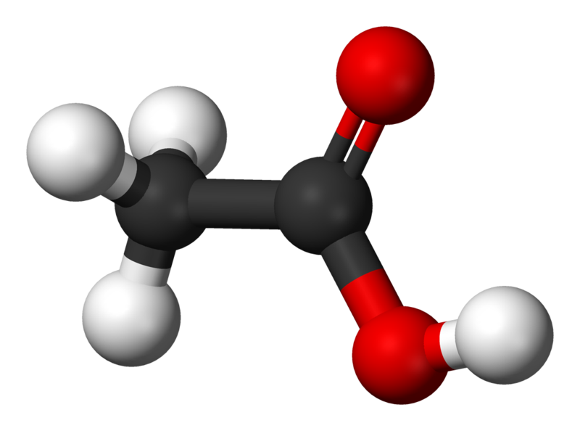
Acetic Acid, CH₃COOH
H
O
H
C
C
O
H
H
Number of electron domains
4
3
4
Trigonal
planar
Electron-domain geometry
Tetrahedral
Tetrahedral
Predicted bond angles
109.5º
120º
109.5º
Hybridization of central atom
sp³
sp²
none
Brown, LeMay, Bursten, Chemistry The Central Science, 2000, page 314

Slide 39
Intermolecular Forces
Ion-ion (ionic bonds)
Ion-dipole
Dipole-dipole
Hydrogen bonding
London dispersion forces
+
−
−
δ+ δ−
+
δ+ δ−
δ+ δ−

Slide 40
London Dispersion Forces
δ+
δ−
δ+
δ−
δ−
δ+
London dispersion forces are created when on molecule with a temporarily dipole causes another to become temporarily polar.

Slide 41
Molecular Polarity
Molecular Structure
Courtesy Christy Johannesson www.nisd.net/communicationsarts/pages/chem

Slide 42


Electronegativity
δ⁺
δ–
δ⁰
δ⁰
H
Cl
H
H

Slide 43
Ionic vs. Covalent
Ionic compounds form repeating units.
Covalent compounds form distinct molecules.
Consider adding to NaCl(s) vs. H₂O(s):
Na
Cl
Na
Cl
O
H
H
Cl
Na
Cl
Na
O
Cl
Cl
H
O
H
H
Na
Na
H
NaCl: atoms of Cl and Na can add individually forming a compound with million of atoms.
H₂O: O and H cannot add individually, instead molecules of H₂O form the basic unit.

Slide 44

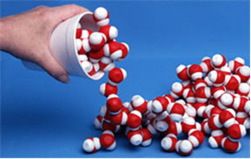
Holding it together
Q: Consider a glass of water.
Why do molecules of water stay together?
A: There must be attractive forces.
Intramolecular forces are much stronger
Intramolecular forces occur between atoms
Intermolecular forces occur between molecules
Intermolecular forces are not considered in ionic bonding because there are no molecules.
The type of intramolecular bond determines the type of intermolecular force.

Slide 45
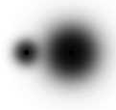
I’m not stealing, I’m sharing unequally
We described ionic bonds as stealing electrons
In fact, all bonds share – equally or unequally.
Note how bonding electrons spend their time:
H₂
HCl
LiCl
H
H
H
Cl
[Li]⁺
[ Cl ]–
δ⁰
δ⁰
δ⁺
δ–
+
–
covalent
(non-polar)
polar covalent
ionic
Bonding electrons are shared in each compound, but are NOT always shared equally.
The greek symbol δ indicates “partial charge”.

Slide 46
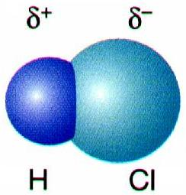
Dipole Moment
Direction of the polar bond in a molecule.
Arrow points toward the more electronegative atom.
δ⁺
δ⁻
H Cl
Courtesy Christy Johannesson www.nisd.net/communicationsarts/pages/chem

Slide 47
Dipole-induced dipole attraction
The attraction between a dipole and an induced dipole.
Notes:
London dispersion forces are strongest between very large molecules because the area of the molecule that can become temporarily polarized is larger.

Slide 49
Oxygen, O₂

Slide 50
Nonpolar
Oxygen, O₂

Slide 54
Water, H₂O

Slide 55
δ+
δ-
Water, H₂O

Slide 56
δ+
δ-

Slide 57
δ+
δ-

Slide 58
δ+
δ-
δ-
δ+

Slide 59
δ+
δ-
δ-
δ+

Slide 60
δ+
δ-
δ-
δ+

Slide 61
δ-
δ+
δ-
δ+

Slide 62
δ+
δ-
δ-
δ+

Slide 63
induced dipole
Dipole
δ+
δ-
δ-
δ+

Slide 64
δ+
δ-
δ-
δ+

Slide 65
δ-
δ+
δ-
δ+

Slide 66
δ+
δ-
δ-
δ+

Slide 67
δ+
δ-
δ-
δ+

Slide 68
δ+
δ-
δ-
δ+

Slide 69
δ+
δ-

Slide 77
δ+
δ-
δ-
δ+

Slide 78
induced dipole
Dipole
δ+
δ-
δ-
δ+

Slide 82
Polar
Nonpolar
Copyright © 2007 Pearson Benjamin Cummings. All rights reserved.

Slide 83
Copyright © 2007 Pearson Benjamin Cummings. All rights reserved.

Slide 84
Determining Molecular Polarity
δ⁺
δ–
Depends on:
  dipole moments
  molecular shape
H
Cl
δ⁺
δ–
δ⁺
δ–
δ⁺
δ–
δ⁺
δ–
Courtesy Christy Johannesson www.nisd.net/communicationsarts/pages/chem
Notes:
We have seen that molecules can have a separation of charge
This happens in both ionic and polar bonds (the greater the EN, the greater the dipoles)
Molecules are attracted to each other in a compound by these +ve and -ve forces

Slide 85
Determining Molecular Polarity
Nonpolar Molecules
  Dipole moments are symmetrical and cancel out.
F
BF₃
B
F
F
Courtesy Christy Johannesson www.nisd.net/communicationsarts/pages/chem

Slide 86
Determining Molecular Polarity
Polar Molecules
  Dipole moments are asymmetrical and don’t cancel .
O
net
dipole
moment
H₂O
H
H
Courtesy Christy Johannesson www.nisd.net/communicationsarts/pages/chem

Slide 87
Determining Molecular Polarity
Therefore, polar molecules have...
  asymmetrical shape (lone pairs) or
  asymmetrical atoms
H
net
dipole
moment
CHCl₃
Cl
Cl
Cl
Courtesy Christy Johannesson www.nisd.net/communicationsarts/pages/chem

Slide 88
Dipole Moment
Bond dipoles
In H₂O the bond dipoles are also equal in
magnitude but do not exactly oppose each
other. The molecule has a nonzero overall
dipole moment.
O
C
O
..
..
Overall dipole moment = 0
O
Bond dipoles
Nonpolar
H
H
The overall dipole moment of a molecule
is the sum of its bond dipoles. In CO₂ the
bond dipoles are equal in magnitude but
exactly opposite each other. The overall
dipole moment is zero.
μ = Q r
Overall dipole moment
Dipole moment, μ
Coulomb’s law
Polar
Brown, LeMay, Bursten, Chemistry The Central Science, 2000, page 315
Notes:
In complex molecules that contain polar covalent bonds, the three-dimensional geometry and the compound’s symmetry determine if there is a net dipole moment
• Mathematically, dipole moments are vectors; they possess both a magnitude and a direction
• Dipole moment of a molecule is the vector sum of the dipole moments of the individual bonds in the molecule
• If the individual bond dipole moments cancel one another, there is no net dipole moment
• Molecular structures that are highly symmetrical (tetrahedral and square planar AB₄, trigonal bipyramidal AB₅, and octahedral AB₆) have no net dipole moment; individual bond dipole moments completely cancel out
• In molecules and ions that have V-shaped, trigonal pyramidal, seesaw, T-shaped, and square pyramidal geometries, the bond dipole moments cannot cancel one another and they have a nonzero dipole moment

Slide 89
Polar Bonds
..
..
..
F
O
N
Cl
H
H
H
H
B
H
H
F
F
Polar
Polar
Nonpolar
Polar
Cl
Cl
F
F
F
Xe
Cl
C
H
C
F
Cl
F
Cl
H
F
F
Cl
H
Polar
Nonpolar
Nonpolar
Polar
A molecule has a zero dipole moment because their dipoles cancel one another.
Notes:
Students often confuse electron-domain geometry with molecular geometry.
You must stress that the molecular geometry is a consequence of the electron domain geometry.
The best arrangement of a given number of electron domains is the one that minimizes the repulsions among them.

Slide 90
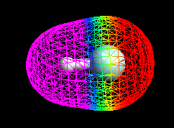
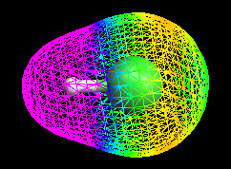
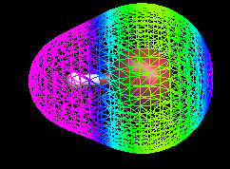
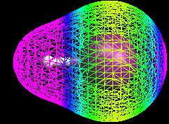
HF
HCl
HBr
HI
How is the electron density distributed in these different molecules?
Based on your comparison of the electron density distributions, which molecule should have the most polar bond, and which one the least polar?
Arrange the molecules in increasing order of polarity.
Mark Wirtz, Edward Ehrat, David L. Cedeno*
Notes:
Using Computational Chemistry to Explore Concepts in General Chemistry
Mark Wirtz, Edward Ehrat, David L. Cedeno*
Department of Chemistry, Illinois State University, Box 4160, Normal, IL 61790-4160

Slide 91

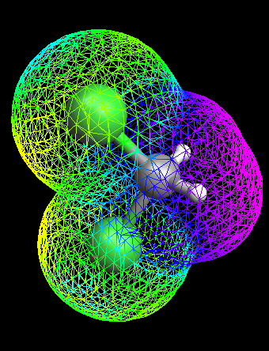
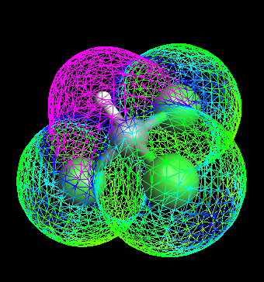
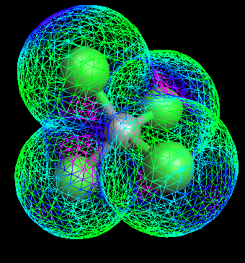
CH₃Cl
CH₂Cl₂
CHCl₃
CCl₄
Describe how is the electron density distributed in these different molecules? Based on your comparison of the electron density distributions, which molecule(s) should be the most polar, and which one(s) the least polar?
Arrange the molecules in increasing order of polarity.
Mark Wirtz, Edward Ehrat, David L. Cedeno*
Notes:
Using Computational Chemistry to Explore Concepts in General Chemistry
Mark Wirtz, Edward Ehrat, David L. Cedeno*
Department of Chemistry, Illinois State University, Box 4160, Normal, IL 61790-4160

Slide 92
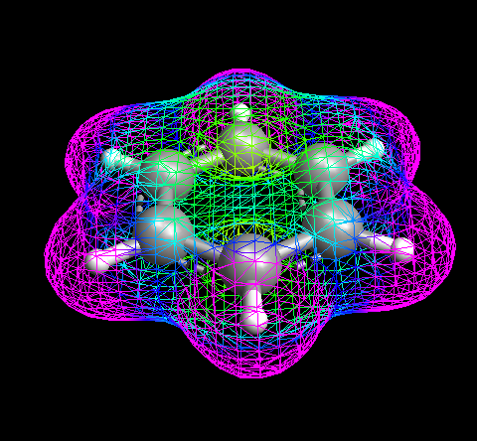
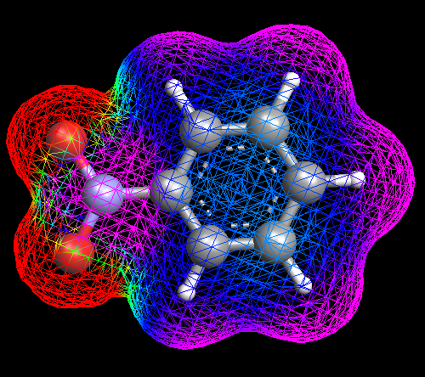

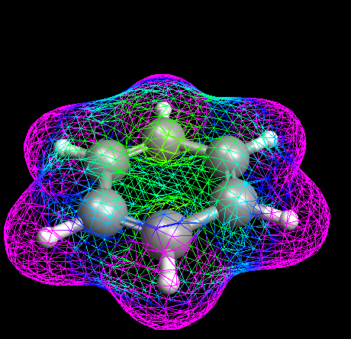
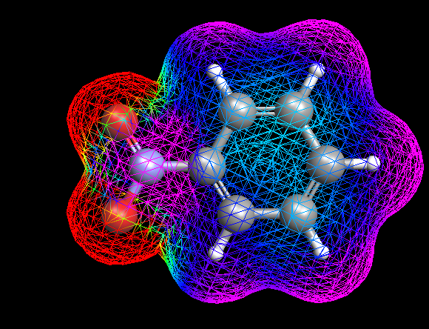

Benzene
NO₃⁻
Nitrobenzene
Mark Wirtz, Edward Ehrat, David L. Cedeno*
Notes:
Using Computational Chemistry to Explore Concepts in General Chemistry
Mark Wirtz, Edward Ehrat, David L. Cedeno*
Department of Chemistry, Illinois State University, Box 4160, Normal, IL 61790-4160

Slide 93




2s
2p (x, y, z)
carbon
Mark Wirtz, Edward Ehrat, David L. Cedeno*
Notes:
Using Computational Chemistry to Explore Concepts in General Chemistry
Mark Wirtz, Edward Ehrat, David L. Cedeno*
Department of Chemistry, Illinois State University, Box 4160, Normal, IL 61790-4160

Slide 94
How does H₂ form?
The nuclei repel
But they are attracted to electrons
They share the electrons
+
+
Notes:
Electrostatic attraction between oppositely charged particle species (positive and negative) results in a force that causes them to move toward each other.
Electrostatic repulsion between two species that have the same charge (either both positive or both negative) results in a force that causes them to repel each other
When the attractive electrostatic interactions between atoms are stronger than the repulsive interactions, atoms form chemical compounds and the attractive interactions between atoms are called chemical bonds.

Slide 95
Hydrogen Bond Formation
Potential Energy Diagram - Attraction vs. Repulsion
0
balanced attraction
& repulsion
no interaction
Energy (KJ/mol)
increased
attraction
increased
repulsion
- 436
0.74 A
H – H distance
(internuclear distance)
Brown, LeMay, Bursten, Chemistry The Central Science, 2000, page 318
Notes:
The change in potential energy during the formation of hydrogen molecule. The minimum energy, at 0.74 angstrom, represents the equilibrium bond distance.
The energy at this point, -426 kJ/mol, corresponds to the energy change for formation of the H – H bond.
Potential energy is based on the position of an object. Low potential energy = high stability.

Slide 96
Covalent bonds
Nonmetals hold onto their valence electrons.
They can’t give away electrons to bond.
Still want noble gas configuration.
Get it by sharing valence electrons with each other.
By sharing both atoms get to count the electrons toward noble gas configuration.
1s²2s²2p⁶3s²3p⁶…eight valence electrons (stable octet)

Slide 97
Covalent bonding
Fluorine has seven valence electrons
A second atom also has seven
By sharing electrons
…both end with full orbitals
8 Valence
electrons
8 Valence
electrons
F
F

Slide 98
Single Covalent Bond
A sharing of two valence electrons.
Only nonmetals and Hydrogen.
Different from an ionic bond because they actually form molecules.
Two specific atoms are joined.
In an ionic solid you can’t tell which atom the electrons moved from or to.

Slide 99
Sigma bonding orbitals
From s orbitals on separate atoms
+
+ +
+
+
+
s orbital
s orbital
Sigma bonding
molecular orbital

Slide 100
Sigma bonding orbitals
From p orbitals on separate atoms
⊕
⊕
p orbital
p orbital
⊕
⊕
⊕
⊕
Sigma bonding
molecular orbital

Slide 101
Pi bonding orbitals
P orbitals on separate atoms
⊕
⊕
⊕
⊕
⊕
⊕
⊕
⊕
Pi bonding
molecular orbital

Slide 102
Sigma and pi bonds
All single bonds are sigma bonds
A double bond is one sigma and one pi bond
A triple bond is one sigma and two pi bonds.

Slide 103
Atomic Orbitals and Bonding
Bonds between atoms are formed by electron pairs in overlapping atomic orbitals
1s
1s
Example: H₂ (H-H)
  Use 1s orbitals for bonding
E
:
1s
Example: H₂O
  From VSEPR: bent, 104.5° angle between H atoms
  Use two 2p orbitals for bonding?
2p
E
2s
1s
90°
How do we explain the structure predicted by VSEPR using atomic orbitals?
2p
1s
2p

Slide 104
Overlapping Orbitals
Draw orbital diagrams for F + F, H + O, Li + F
1s
2s
2p
2p
2s
1s
F₂
1s
1s
2s
2p
H₂O
1s
electron transfer
Li
1+
1s
2s
2p
2s
1s
F
1-
LiF is ionic (metal + non-metal)
Notes:
Slide adapted from Jeremey Schneider’s work. Chalkbored.com. All rights reserved.

Slide 105
lithium atom
Li
lithium ion
Li⁺
e⁻
e⁻
e⁻
loss of
one valence
electron
3p⁺
e⁻
3p⁺
e⁻
e⁻
e⁻
fluorine atom
F
fluoride ion
F¹⁻
e⁻
gain of
one valence
electron
e⁻
e⁻
e⁻
e⁻
e⁻
9p⁺
e⁻
10p⁺
e⁻
e⁻
e⁻
e⁻
e⁻
e⁻
e⁻
e⁻
e⁻
e⁻
e⁻
e⁻

Slide 106
Formation of Cation
lithium atom
Li
lithium ion
Li⁺
e⁻
e⁻
e⁻
loss of
one valence
electron
3p⁺
e⁻
3p⁺
e⁻
e⁻

Slide 107
Formation of Anion
fluorine atom
F
fluoride ion
F¹⁻
gain of
one valence
electron
e⁻
e⁻
e⁻
e⁻
e⁻
e⁻
e⁻
9p⁺
e⁻
10p⁺
e⁻
e⁻
e⁻
e⁻
e⁻
e⁻
e⁻
e⁻
e⁻
e⁻
e⁻
e⁻

Slide 108
Formation of Ionic Bond
fluoride ion
F¹⁻
lithium ion
Li⁺
e⁻
e⁻
e⁻
e⁻
3p⁺
e⁻
9p⁺
e⁻
e⁻
e⁻
e⁻
e⁻
e⁻
e⁻

Slide 109
First, the formation of BeH₂ using pure s and p orbitals.
Be = 1s²2s²
H
Be
BeH₂
p
H
s
No overlap = no bond!
atomic orbitals
atomic orbitals
The formation of BeH₂ using hybridized orbitals.
atomic orbitals
Be
H
H
Be
H
s
p
hybrid orbitals
H
BeH₂
Be
Be
s
p
sp
p
All hybridized bonds have equal strength and have orbitals with identical energies.

Slide 110
Hybrid Orbitals
Ground-state Be atom
1s
2s
2p
Be atom with one electron “promoted”
1s
2s
2p
hybrid orbitals
Energy
p_{x}
p_{y}
p_{z}
n = 2
1s
sp
2p
sp
s
Be atom of BeH₂ orbital diagram
n = 1
hybridize
Be
H
H
s orbital
p orbital
two sp hybrid orbitals
sp hybrid orbitals shown together
(large lobes only)
Notes:
A more sophisticated treatment of bonding is a quantum mechanical description of bonding, in which bonding electrons are viewed as being localized between the nuclei of the bonded atoms
• The overlap of bonding orbitals is increased through a process called hybridization, which results in the formation of stronger bonds According to quantum mechanics, bonds form between atoms because their atomic orbitals overlap, with each region of overlap accommodating a maximum of two electrons with opposite spin, in accordance with the Pauli principle
• Electron density between the nuclei is increased because of orbital overlap and results in a localized electron-pair bond
• Localized bonding model is called the valence bond theory and uses an atomic orbital approach to predict the stability of the bond

Slide 111
Hybrid Orbitals
Ground-state B atom
2s
2p
B atom with one electron “promoted”
2s
2p
hybrid orbitals
Energy
p_{x}
p_{y}
p_{z}
sp²
2p
sp²
B atom of BH₃ orbital diagram
s
H
hybridize
B
s orbital
H
H
p orbitals
three sp^{s} hybrid orbitals
sp² hybrid orbitals shown together
(large lobes only)

Slide 112
Hybridization
…the blending of orbitals
Valence bond theory is based on two assumptions:
  1. The strength of a covalent bond is proportional to the amount of overlap between atomic orbitals; the greater
  the overlap, the more stable the bond.
  2. An atom can use different combinations of atomic orbitals to maximize the overlap of orbitals used by bonded atoms.
Notes:
Two overlapping orbitals form what is known as a hybrid or molecular orbital. Just as in a s,p,d, or f orbital the electrons can be anywhere in the orbital
(even though the electron has started out in one atom, at times, it may be closer to the other nucleus). Each hybrid orbital has a specific shape.
You need to know that hybrid orbitals exist and that they are formed from overlapping orbitals

Slide 113
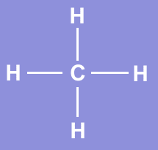
Lets look at a molecule of methane, CH₄.
We have studied electron configuration notation and
the sharing of electrons in the formation of covalent
bonds.
Methane is a simple natural gas. Its molecule has a
carbon atom at the center with four hydrogen atoms covalently bonded around it.

Slide 114
Carbon ground state configuration
What is the expected orbital notation of carbon
in its ground state?
You should conclude that carbon only has TWO
electrons available for bonding. That is not enough!
2p
2s
1s
Can you see a problem with this?
(Hint: How many unpaired electrons does this
carbon atom have available for bonding?)
How does carbon overcome this problem so that
it may form four bonds?

Slide 115
Carbon’s Empty Orbital
The first thought that chemists had was that carbon promotes one of its 2s electrons…
2p
2s
1s
…to the empty 2p orbital.
2p
2p
2s
2s
1s
1s
Non-hybridized orbital
hybridized orbital

Slide 116
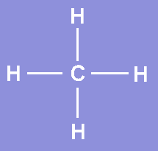
A Problem Arises
However, they quickly recognized a problem with such
an arrangement…
1s
1s
1s
1s
2p
2s
1s
Three of the carbon-hydrogen bonds would involve
an electron pair in which the carbon electron was a 2p, matched with the lone 1s electron from a hydrogen atom.
But what about the fourth bond…?
Unequal bond energy

Slide 117
Unequal bond energy #2
The fourth bond is between a 2s electron from the
carbon and the lone 1s hydrogen electron.
1s
1s
1s
1s
2p
2s
1s
Such a bond would have slightly less energy than the other bonds in a methane molecule.

Slide 118
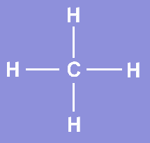
This bond would be slightly different in character than the other three bonds in methane.
This difference would be measurable to a chemist
by determining the bond length and bond energy.
But is this what they observe?

Slide 119

Enter Hybridization
The simple answer is, “No”.
Measurements show that
all four bonds in methane
are equal. Thus, we need
a new explanation for the
bonding in methane.
Chemists have proposed an explanation – they call it
hybridization.
Hybridization is the combining of two or more orbitals
of nearly equal energy within the same atom into
orbitals of equal energy.

Slide 120
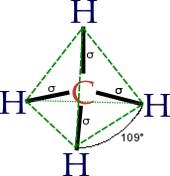
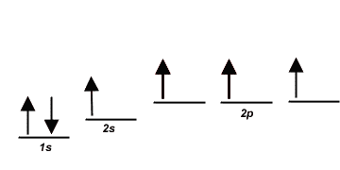
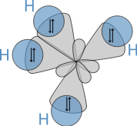
sp³ Hybrid Orbitals
In the case of methane, they call the hybridization
sp³, meaning that an s orbital is combined with three
p orbitals to create four equal hybrid orbitals.
These new orbitals have slightly MORE energy than
the 2s orbital…
… and slightly LESS energy than the 2p orbitals.

Slide 121
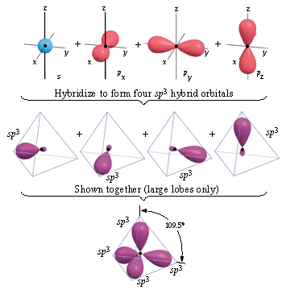
Carbon 1s²2s²2p²
Carbon could only make two bonds
if no hybridization occurs. However,
carbon can make four equivalent bonds.
B
B
A
B
hybrid orbitals
B
Energy
p_{x}
p_{y}
p_{z}
sp³
sp³
s
C atom of CH₄ orbital diagram
Brown, LeMay, Bursten, Chemistry The Central Science, 2000, page 321
Notes:
Localized bonding approach uses a process called hybridization, in which atomic orbitals that are similar in energy but not equivalent are combined mathematically to produce sets of equivalent orbitals that are properly oriented to form bonds.
• Spatial orientation of the hybrid atomic orbitals is consistent with the geometries predicted using the VSEPR model.
• New combinations are called hybrid atomic orbitals because they are produced by combining (hybridizing) two or more atomic orbitals from the same atom.
• Hybrid atomic orbitals are formed via promotion of an electron from a filled ns² subshell to an empty np or (n – 1)d valence orbital, followed by hybridization.

Slide 122
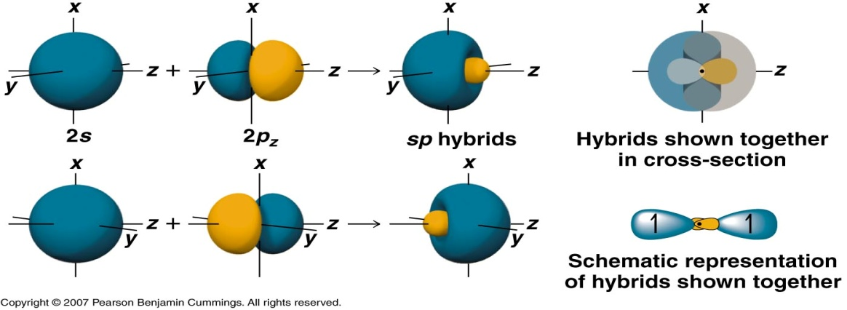
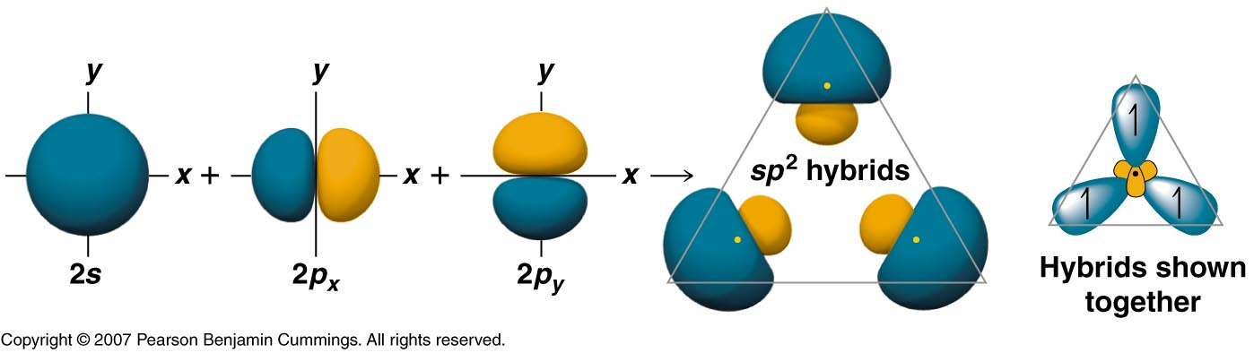
Hybridization of s and p Orbitals
• The combination of an ns and an np orbital gives rise to two equivalent sp hybrids oriented at 180º.
• Combination of an ns and two or three np orbitals produces three equivalent sp² hybrids or four equivalent sp³ hybrids.
Copyright © 2007 Pearson Benjamin Cummings. All rights reserved.
Notes:
Localized bonding approach uses a process called hybridization, in which atomic orbitals that are similar in energy but not equivalent are combined mathematically to produce sets of equivalent orbitals that are properly oriented to form bonds.
• Spatial orientation of the hybrid atomic orbitals is consistent with the geometries predicted using the VSEPR model.
• New combinations are called hybrid atomic orbitals because they are produced by combining (hybridizing) two or more atomic orbitals from the same atom.
• Hybrid atomic orbitals are formed via promotion of an electron from a filled ns² subshell to an empty np or (n – 1)d valence orbital, followed by hybridization.

Slide 123
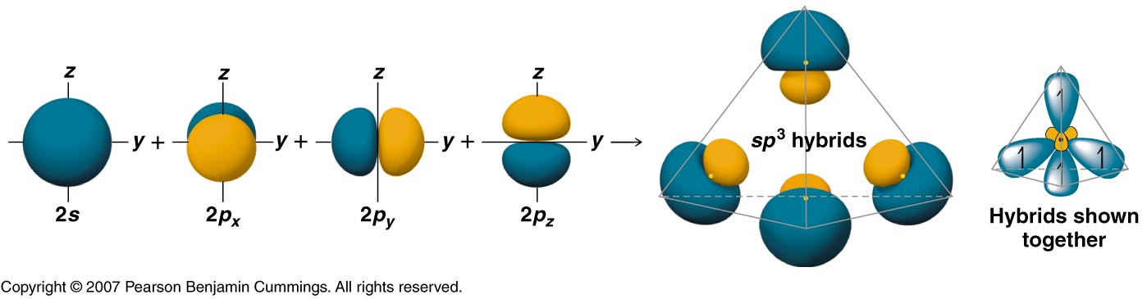
Hybridization of s and p Orbitals
• Both promotion and hybridization require an input of energy; the overall process of forming a compound with hybrid orbitals will be energetically favorable only if the amount of energy released by the formation of covalent bonds is greater than the amount of energy used to form the hybrid orbitals.
Copyright © 2007 Pearson Benjamin Cummings. All rights reserved.
Notes:
Localized bonding approach uses a process called hybridization, in which atomic orbitals that are similar in energy but not equivalent are combined mathematically to produce sets of equivalent orbitals that are properly oriented to form bonds.
• Spatial orientation of the hybrid atomic orbitals is consistent with the geometries predicted using the VSEPR model.
• New combinations are called hybrid atomic orbitals because they are produced by combining (hybridizing) two or more atomic orbitals from the same atom.
• Hybrid atomic orbitals are formed via promotion of an electron from a filled ns² subshell to an empty np or (n – 1)d valence orbital, followed by hybridization.

Slide 124
Hybridization Involving d Orbitals
promote
3s 3p 3d 3s 3p 3d
unhybridized P atom
P = [Ne]3s²3p³
vacant d orbitals
hybridize
Bª
F
F
B^{e}
five sp³d orbitals
3d
P
F
A
B^{e}
F
B^{e}
degenerate
orbitals
(all EQUAL)
F
Bª
Trigonal bipyramidal

Slide 125
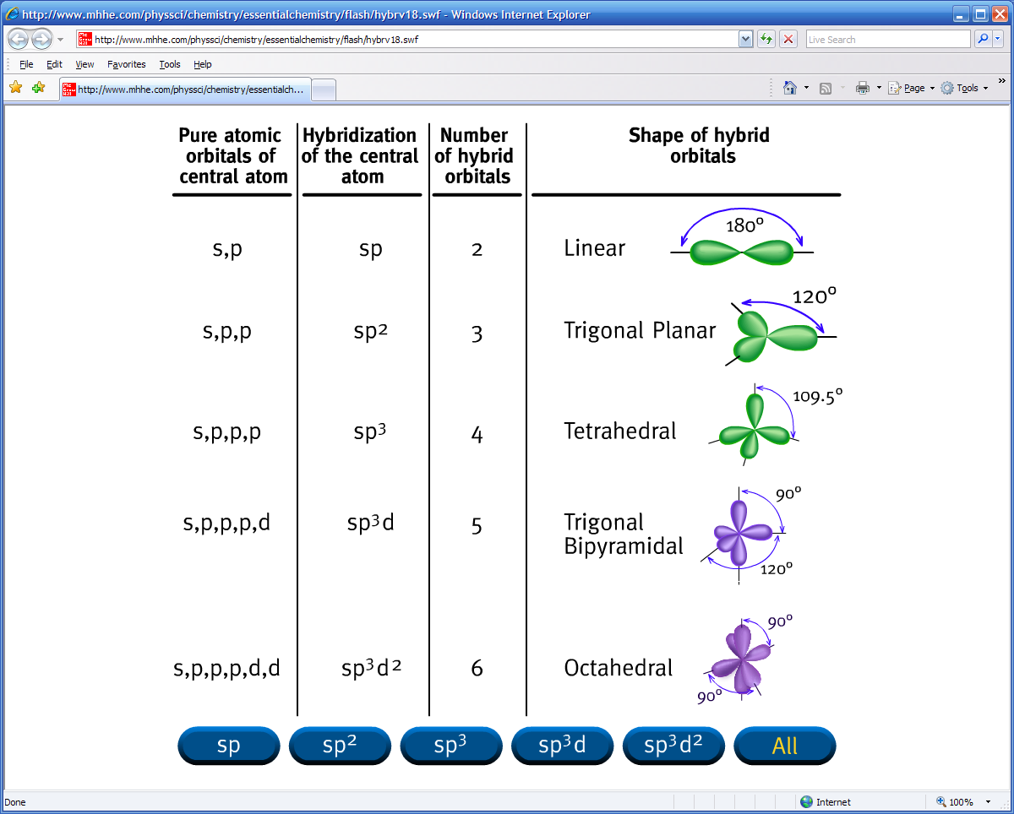
Pure atomic
orbitals of
central atom
Hybridization
of the central
atom
Number
of hybrid
orbitals
Shape of hybrid
orbitals
s,p
sp
2
Linear
s,p,p
sp²
3
Trigonal Planar
s,p,p,p
sp³
4
Tetrahedral
s,p,p,p,d
sp³d
5
Trigonal
Bipyramidal
s,p,p,p,d,d
sp³d²
6
Octahedral
Hybridization Animation, by Raymond Chang
Notes:
Adapted from http://www.mhhe.com/physsci/chemistry/essentialchemistry/flash/flash.mhtml

Slide 126
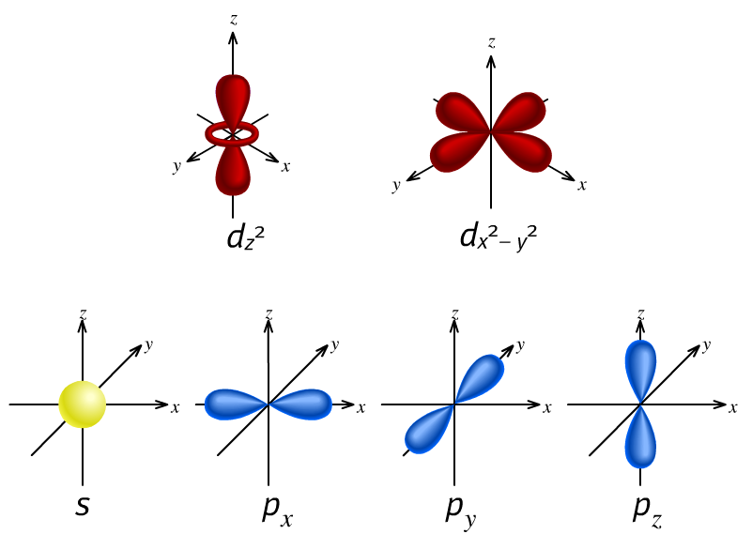
Hybridization Animation, by Raymond Chang

Slide 127
Bonding
Single bonds
  Overlap of bonding orbitals on bond axis
  Termed “sigma” or σ bonds
Double bonds
  Sharing of electrons between 2 p orbitals perpendicular to the bonding atoms
  Termed “pi” or π bonds
Bond Axis of σ bond
2p
2p
  One π bond

Slide 128
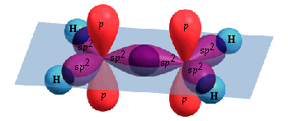
Multiple Bonds
promote
hybridize
2s 2p 2s 2p sp² 2p
C₂H₄, ethene
H
H
C
C
H
H
one σ bond and one π bond
H
H
σ
C
σ
H
H
σ
C
C
H
σ
σ
C
H
H
Two lobes of
one π bond
H
Brown, LeMay, Bursten, Chemistry The Central Science, 2000, page 325-326
Notes:
To describe the bonding in more complex molecules that contain multiple bonds, an approach that combines hybrid atomic orbitals to describe the σ bonding and molecular orbitals to describe the π bonding is used.
In this approach, unhybridized np orbitals on atoms bonded to one another are allowed to interact to produce bonding, antibonding, or nonbonding combinations.

Slide 129
Multiple Bonds
C
C
promote
hybridize
2s 2p 2s 2p sp² 2p
C₂H₄, ethene
H
H
H
p
p
H
sp²
C
C
sp²
sp²
sp²
H
sp²
sp²
H
H
p
p
H
one σ bond and one π bond
H
H
σ
C
σ
H
H
σ
C
C
H
σ
σ
C
H
H
Two lobes of
one π bond
H
Brown, LeMay, Bursten, Chemistry The Central Science, 2000, page 325-326
Notes:
To describe the bonding in more complex molecules that contain multiple bonds, an approach that combines hybrid atomic orbitals to describe the σ bonding and molecular orbitals to describe the π bonding is used.
In this approach, unhybridized np orbitals on atoms bonded to one another are allowed to interact to produce bonding, antibonding, or nonbonding combinations.

Slide 130
π bond
Internuclear axis
p
p

Slide 131
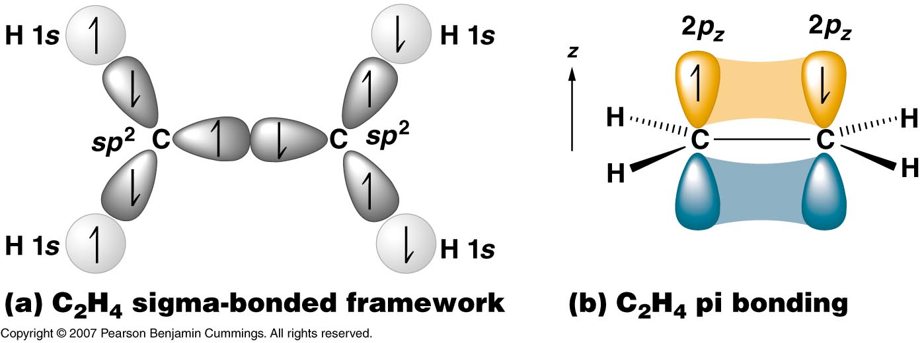
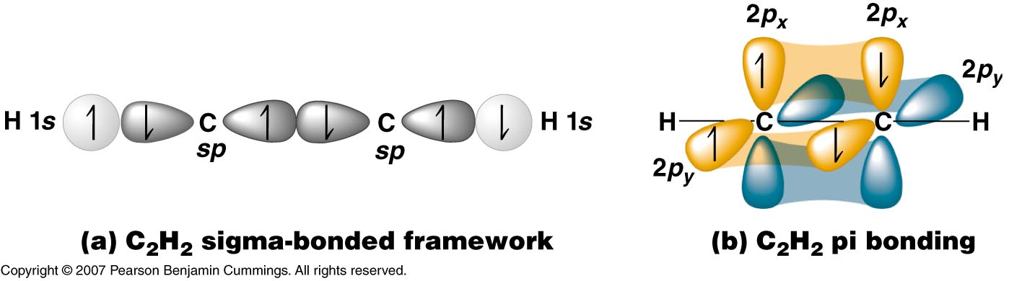

Brown, LeMay, Bursten, Chemistry The Central Science, 2000, page 326
Copyright © 2007 Pearson Benjamin Cummings. All rights reserved.

Slide 132
σ bonds
H
H
C
C
H
C
C
H
C
C
H
H
C₆H₆ = benzene
Brown, LeMay, Bursten, Chemistry The Central Science, 2000, page 329

Slide 133
2p atomic orbitals
Brown, LeMay, Bursten, Chemistry The Central Science, 2000, page 329

Slide 134
σ bonds and π bonds
H
H
C
C
H
C
C
H
C
C
H
H
Brown, LeMay, Bursten, Chemistry The Central Science, 2000, page 329

Slide 135
σ bonds
H
H
C
C
H
H
C
C
C
C
H
H
C
C
H
H
Brown, LeMay, Bursten, Chemistry The Central Science, 2000, page 329

Slide 136
σ bonds
H
H
C
C
H
H
C
C
C
C
H
H
C
C
H
H
Brown, LeMay, Bursten, Chemistry The Central Science, 2000, page 329

Slide 137
N₂O₄
hν
2 NO₂
dinitrogen tetraoxide
nitrogen dioxide
(free radical)
O
O
O
O
N
N
N
N
O
O
O
O
colorless
red-brown


Slide 138
Energy-level diagram for (a) the H₂ molecule and (b) the hypothetical He₂ molecule
(a)
σ∗_{1s}
1s
1s
Energy
H atom
H atom
σ_{1s}
H₂ molecule
(b)
σ∗_{1s}
1s
1s
Energy
He atom
He atom
σ_{1s}
He₂ molecule
Brown, LeMay, Bursten, Chemistry The Central Science, 2000, page 332

Slide 139
Bond Order
Bond order = ½ (# or bonding electrons - # of antibonding electrons)
A bond order of 1 represents a single bond,
A bond order of 2 represents a double bond,
A bond order of 3 represents a triple bond.
A bond order of 0 means no bond exists.
Because MO theory also treats molecules with an odd number of electrons,
Bond orders of 1/2 , 3/2 , or 5/2 are possible.

Slide 140
Energy-level diagram for the Li₂ molecule
σ∗_{2s}
Li = 1s²2s¹
2s¹
2s¹
Energy
σ_{2s}
σ∗_{1s}
1s²
1s²
Li
Li
σ_{1s}
Li²
Brown, LeMay, Bursten, Chemistry The Central Science, 2000, page 334
Notes:
Molecular orbital energy-level diagrams for diatomic molecules can be created if the electron configuration of the parent atoms is known, following the rules below:
1. Number of molecular orbitals produced is the same as the number of atomic orbitals used to create them
2. As the overlap between two atomic orbitals increases, the difference in energy between the resulting bonding and antibonding molecular orbitals increases
3. When two atomic orbitals combine to form a pair of molecular orbitals, the bonding molecular orbital is stabilized about as much as the antibonding molecular orbital is destabilized
4. The interaction between atomic orbitals is greater when they have the same energy
With this approach, the electronic structures of homonuclear diatomic molecules (molecules with two identical atoms), can be understood.
• Most substances contain only paired electrons like F_{2.}
• F₂ has a total of 14 valence electrons; starting at the lowest energy level, the electrons are placed in the orbitals according to the Pauli’s principle and Hund’s rule.
– Ttwo electrons each fill the σ_{2s} and σ*_{2s} orbitals, two fill the σ2pz orbital, four fill two degenerate π orbitals, and four fill two degenerate π* orbitals.
– There are eight bonding and six antibonding electrons, giving a bond order of 1.
• The O₂ molecule contains two unpaired electrons and is attracted into a magnetic field.

Slide 141
Energy-level diagram for molecular orbitals
of second-row homonuclear diatomic molecules.
σ∗_{2p}
π∗_{2p}
2p
2p
π_{2p}
σ_{2p}
σ∗_{2s}
2s
2s
σ_{2s}
Brown, LeMay, Bursten, Chemistry The Central Science, 2000, page 337
Notes:
Positions and energies of electrons in molecules can be described in terms of molecular orbitals
A molecular orbital (MO) is a spatial distribution of electrons in a molecule that is associated with a particular orbital energy
Molecular orbitals are not localized on a single atom but extend over the entire molecule
Molecular orbital approach, called molecular orbital theory, is a delocalized approach to bonding
In molecular orbitals, the electrons are allowed to interact with more than one atomic nucleus at a time
Energy-level diagram is created by listing the molecular orbitals in order of increasing energy
The orbitals are filled with the required number of valence electrons according to the Pauli principle
Each molecular orbital can accommodate a maximum of two electrons with opposite spins

Slide 142
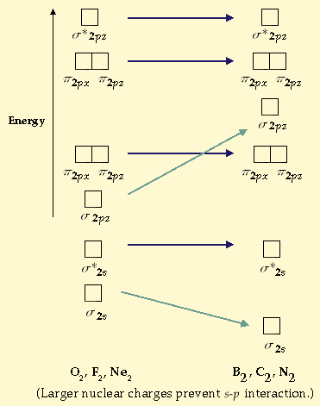
Brown, LeMay, Bursten, Chemistry The Central Science, 2000, page 338

Slide 143
Increasing 2s – 2p interaction
π2p
Energy of
molecular orbitals
σ2p
σ∗2s
σ2s
O₂, F₂, Ne₂
B₂, C₂, N₂
Brown, LeMay, Bursten, Chemistry The Central Science, 2000, page 338

Slide 144
Large 2s – 2p interaction
Small 2s – 2p interaction
B₂
C₂
N₂
O₂
F₂
Ne₂
σ∗_{2p}
σ∗_{2p}
π∗_{2p}
π∗_{2p}
σ_{2p}
π_{2p}
π_{2p}
σ_{2p}
σ∗_{2s}
σ∗_{2s}
σ_{2s}
σ_{2s}
Bond order
Bond enthalpy
(kJ/mol)
Bond length
(angstrom)
Magnetic
behavior
1 2 3 2 1 0
290 620 941 495 155 -----
1.59 1.31 1.10 1.21 1.43 -----
Paramagnetic Diamagnetic Diamagnetic Paramagnetic Diamagnetic _____
Brown, LeMay, Bursten, Chemistry The Central Science, 2000, page 339
Notes:
Molecular orbitals involving only ns atomic orbitals
– In the molecular orbital approach, the overlapping atomic orbitals (AOs) are described by mathematical equations called wave functions.
– Molecular orbitals (MOs) are constructed using linear combination of atomic orbitals (LCAOs), which are the mathematical sums and differences of wave functions that describe overlapping atomic orbitals.
– A molecule must have as many molecular orbitals as there are atomic orbitals.
1. Mathematical sums of wave functions
– Adding two atomic orbitals corresponds to constructive interference between two waves, which reinforces their intensity; the internuclear electron probability density is increased
– Molecular orbital corresponding to the sum of two 1s orbitals is called a σ_{1s} combination: σ_{1s} ≈ 1s(A) + 1s (B)
– in a sigma (σ) orbital, the electron density along the internuclear axis and between the nuclei has cylindrical symmetry — all cross sections perpendicular to the internuclear axis are circles
– Subscript 1s denotes the atomic orbitals from which the molecular orbital was derived
– Electron density in the σ_{1s} molecular orbital is greatest between the
two positively charged nuclei, and the resulting electron-nucleus electrostatic attractions reduce repulsions between the nuclei
– The σ_{1s} orbital represents a bonding molecular orbital
2. Mathematical difference of wave functions
– Subtracting two atomic orbitals corresponds to destructive interference between two waves, which reduces their intensity, causes a decrease in the internuclear electron probability density, and contains a node where the electron density is zero
– Molecular orbital corresponding to the difference of two 1s orbitals is called a σ*_{1s} combination:
σ*_{1s} ≈ 1s(A) – 1s(B)
– In a sigma star (σ*) orbital, there is a region of zero electron probability, a nodal plane, perpendicular to the internuclear axis
– Electrons in the σ*_{1s} orbital are found in the space outside the internuclear region
– The positively charged nuclei repel one another
– The σ*_{1s} orbital is an antibonding molecular orbital

Slide 145

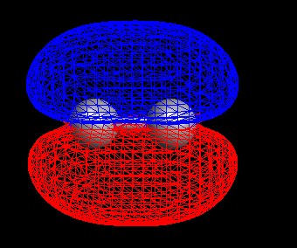
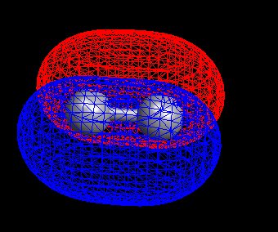
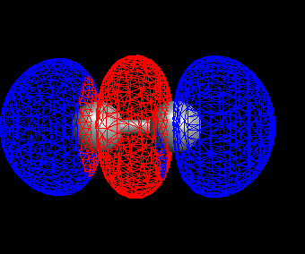

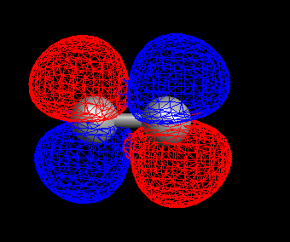
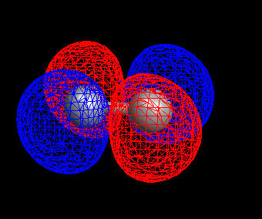

σ_{2s}
π_{2px}
π_{2py}
σ_{2p}
σ∗_{2s}
π∗_{2px}
π∗_{2py}
σ∗_{2p}
C₂
Arrange the atomic and molecular orbitals in order of increasing energy.
How many orbitals are per molecule?
Can you distinguish the bonding from the antibonding MOs?
Mark Wirtz, Edward Ehrat, David L. Cedeno*
Notes:
Using Computational Chemistry to Explore Concepts in General Chemistry
Mark Wirtz, Edward Ehrat, David L. Cedeno*
Department of Chemistry, Illinois State University, Box 4160, Normal, IL 61790-4160

Slide 146
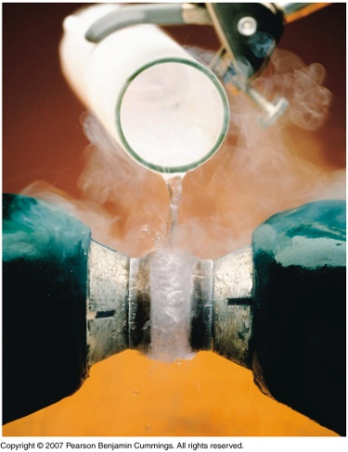
Magnetic Properties of a Sample
PARAMAGNETISM
– molecules with one or more unpaired electrons are attracted
into a magnetic field. (appears to weigh MORE in a magnetic field)
DIAMAGNETISM
– substances with no unpaired electrons are weakly repelled from
a magnetic field. (appears to weigh LESS in a magnetic field)
Notes:
Image Copyright © 2007 Pearson Benjamin Cummings. All rights reserved.

Slide 147
Experiment for determining the magnetic properties of a sample
sample
N
S
N
S
N
S
The sample is first weighed in
the absence of a magnetic field.
When a field is applied, a diamagnetic
sample tends to move out of the field
and appears to have a lower mass.
A paramagnetic sample is drawn
into the field and thus appears to
gain mass.
Paramagnetism is a much stronger effect than is diamagnetism.
Brown, LeMay, Bursten, Chemistry The Central Science, 2000, page 339

Slide 148
Experiment for determining the magnetic properties of a sample
sample
N
S
N
S
The sample is first weighed in
the absence of a magnetic field.
When a field is applied, a diamagnetic
sample tends to move out of the field
and appears to have a lower mass.
A paramagnetic sample is drawn
into the field and thus appears to
gain mass.
Paramagnetism is a much stronger effect than is diamagnetism.
Brown, LeMay, Bursten, Chemistry The Central Science, 2000, page 339

Slide 149
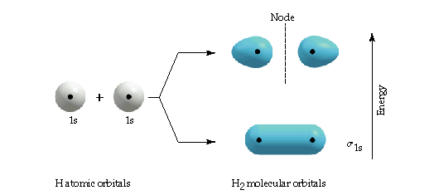



Slide 150




Slide 151
Electron Domains
lone Pair single bond double bond triple bond
Determine the shape of the BCl₃ molecule:
:
:
Cl
Cl
:
:
:
:
:
:
Cl
B
Cl
B
:
:
:
:
Cl
Cl
:
:
:
:
There are 3 electron domains about
the central atom: no lone pairs and
three single bonds. Three electron
domains arrange themselves in a
trigonal plane, with 120º angles.
We predict a trigonal planar geometry.
:
:
Electron-domain geometry:
trigonal planar
Molecular geometry (shape):
trigonal planar

Slide 152

sp² hybrid orbitals
shown together
(large lobes only)
One s orbital
Hybridize
Two p orbitals
Three sp²
hybrid orbitals

Slide 153


Slide 154


Slide 155

Molecular Geometry
Courtesy Christy Johannesson www.nisd.net/communicationsarts/pages/chem

Slide 156

VSEPR Theory
Valence Shell Electron Pair Repulsion Theory
Electron pairs orient themselves in order to minimize repulsive forces.
Courtesy Christy Johannesson www.nisd.net/communicationsarts/pages/chem

Slide 157
VSEPR Theory
Types of e⁻ Pairs
  Bonding pairs - form bonds
  Lone pairs - nonbonding electrons
Lone pairs repel
more strongly than bonding pairs!!!
Courtesy Christy Johannesson www.nisd.net/communicationsarts/pages/chem

Slide 158
VSEPR Theory
Lone pairs reduce the bond angle between atoms.
bond angle
Courtesy Christy Johannesson www.nisd.net/communicationsarts/pages/chem

Slide 159
Determining Molecular Shape
Draw the Lewis Diagram.
Tally up e⁻ pairs on central atom.
  double/triple bonds = ONE pair
Shape is determined by the # of bonding pairs and lone pairs.
Know the 8 common shapes
& their bond angles!
Courtesy Christy Johannesson www.nisd.net/communicationsarts/pages/chem

Slide 160
Common Molecular Shapes
2 total
2 bond
0 lone
B
A
B
LINEAR
180°
BeH₂
Courtesy Christy Johannesson www.nisd.net/communicationsarts/pages/chem
Notes:
Molecules with no lone pairs of electrons
The number of bonded atoms is the same as the electron pairs, and the electron-pair geometry and the molecular geometry are the same
1. AB₂: BeH₂
Step 1 — central atom, beryllium, contributes two valence electrons and each hydrogen atom contributes one. The Lewis electron structure is
H:Be:H or H–Be–H
Step 2 — there are two electron pairs around the central atom so electron-pair geometry is linear
:-----•-----:
Step 3 — both electron pairs around the central atom are bonding pairs (BP)
Step 4 — with two bonding pairs and no lone pairs, the molecular geometry is also linear

Slide 161

Common Molecular Shapes
3 total
3 bond
0 lone
B
A
B
B
BF₃
TRIGONAL PLANAR
120°
Courtesy Christy Johannesson www.nisd.net/communicationsarts/pages/chem
Notes:
2. AB₃: BF₃
Step 1 — central atom, boron, contributes three valence electrons and each chlorine atom contributes seven. The Lewis electron structure is
. .
:F:
B
:F: :F:
 
Step 2 — there are three electron pairs around the central atom and the electron-pair geometry is trigonal planar
Step 3 — all electron pairs around the central atom are bonding pairs (BP)
Step 4 — molecular geometry is trigonal planar

Slide 162
Common Molecular Shapes
3 total
2 bond
1 lone
SO₂
BENT
<120°
Courtesy Christy Johannesson www.nisd.net/communicationsarts/pages/chem

Slide 163

Common Molecular Shapes
4 total
4 bond
0 lone
B
A
B
B
B
CH₄
TETRAHEDRAL
109.5°
Courtesy Christy Johannesson www.nisd.net/communicationsarts/pages/chem
Notes:
3. AB₄: CH₄
Step 1 — central carbon atom contributes four valence electrons and each hydrogen atom has one electron. The Lewis electron structure is
H
H–C–H
H
Step 2 — there are four electron pairs around the central atom, so electron-pair geometry is tetrahedral
Step 3 — there are four electron pairs and four bonded H atoms; all electron pairs are bonding pairs (BP)
Step 4 — connecting each hydrogen atom to carbon using one of the bonding pairs gives a tetrahedral arrangement of hydrogen atoms

Slide 164

Common Molecular Shapes
4 total
3 bond
1 lone
NH₃
TRIGONAL PYRAMIDAL
107°
Courtesy Christy Johannesson www.nisd.net/communicationsarts/pages/chem
Notes:
Molecules with lone pairs of electrons
– In compounds that contain one or more lone pairs of electrons, the electron-pair geometry and the molecular geometry are not identical
AB₃: NH₃ (single lone pair on the central atom)
Step 1 — the central atom, N, has five valence electrons and each H donates one, producing the Lewis structure
H–N–H
|
H
Step 2 — there are four electron pairs around N, so the electron pair geometry is tetrahedral
Step 3 — with four electron pairs and only three bonded H atoms, one electron pair is a lone pair
Step 4 — three H atoms are in bonding electron pairs; the molecular geometry is trigonal pyramidal

Slide 165

Copyright © 2007 Pearson Benjamin Cummings. All rights reserved.

Slide 166
Ammonia, NH₃

Slide 175
Ammonia, NH₃

Slide 179
Triangular pyramidal
Copyright © 2007 Pearson Benjamin Cummings. All rights reserved.

Slide 180

Common Molecular Shapes
4 total
2 bond
2 lone
H
x
O
H
O
H
x
x
x
H
H₂O
BENT
104.5°
Courtesy Christy Johannesson www.nisd.net/communicationsarts/pages/chem
Notes:
When two hydrogen atoms share one electron each with an oxygen atom, the three atoms form a chemical compound with two covalent bonds.
You may have noticed that this figure initially shows the electrons on oxygen spread out on all four sides rather than fully paired in three positions. We show electrons unpaired whenever possible because Hund’s rule state that electrons prefer to remain unpaired.

Slide 181

Common Molecular Shapes
Bª
5 total
5 bond
0 lone
B^{e}
A
B^{e}
B^{e}
Bª
PCl₅
TRIGONAL BIPYRAMIDAL
120°/90°
Courtesy Christy Johannesson www.nisd.net/communicationsarts/pages/chem
Notes:
Compound that contains more than one lone pair on the central atom
AB₃: BrF₃
Step 1 — Br atom has seven valence electrons and each F has seven
Step 2 — there are five electron pairs around the central atom, and the electron-pair geometry is trigonal bipyramidal
Step 3 — there are five electron pairs and only three bonded F atoms; structure has two lone pairs
Step 4 — axial and equatorial positions in trigonal bipyramid are not equivalent; structure with both lone pairs in equatorial position is the most stable and the molecular geometry is
T-shaped

Slide 182

Common Molecular Shapes
6 total
6 bond
0 lone
B
B
A
B
B
B
B
SF₆
OCTAHEDRAL
90°
Courtesy Christy Johannesson www.nisd.net/communicationsarts/pages/chem
Notes:
In some cases, the location of lone pairs is important
AB₄: SF₄
Step 1 — S atom has six valence electrons and each F has seven
Step 2 — there are five electron pairs around S; electron-pair geometry is trigonal bipyramidal
Step 3 — there are five electron pairs but only four bonded F atoms; there must be one lone pair
Step 4 — in a trigonal bipyramid, the five positions are not equivalent; there are three equatorial positions separated 120º from one another and two axial positions at 90º to the equatorial plane
– The lone electron pair can be placed in either the axial or equatorial position; must choose structure that minimizes electrostatic repulsions: most stable structure is equatorial position and molecular geometry is seesaw

Slide 183
Examples
F P F
F
PF₃
4 total
3 bond
1 lone
TRIGONAL PYRAMIDAL
107°
Courtesy Christy Johannesson www.nisd.net/communicationsarts/pages/chem

Slide 184
Examples
O C O
CO₂
2 total
2 bond
0 lone
LINEAR
180°
Courtesy Christy Johannesson www.nisd.net/communicationsarts/pages/chem

Slide 185
Introduction to
Bonding
Courtesy Christy Johannesson
www.nisd.net/communicationsarts/pages/chem
Notes:
Inorganic compounds
– Compounds that consist primarily of elements other than carbon and hydrogen
– Include both covalent and ionic compounds
– Formulas are written when the component elements are listed beginning with the one farthest to the left in the periodic table with those in the same group listed alphabetically

Slide 186
Chemical bond — the force that holds atoms together in a chemical compound
Covalent bonding — electrons are shared between atoms in a molecule or polyatomic ion
Ionic bonding — positively and negatively charged ions are held together by electrostatic forces
Ionic compounds — dissolve in water to form aqueous solutions that conduct electricity
Covalent compounds — dissolve to form solutions that do not conduct electricity
Notes:
1. Atoms interact with one another to form aggregates, such as compounds and crystals, which lower the total energy of the system (aggregates are more stable than the isolated atoms).
2. Energy is required to dissociate bonded atoms or ions into isolated atoms or ions.
a. In ionic solids
– ions form a three-dimensional array called a lattice;
–energy is called lattice energy, the enthalpy change that occurs when a solid ionic compound is transformed into gaseous ions.
b. In covalent solids
– energy is called the bond energy, the enthalpy change that occurs when a given bond in a gaseous molecule is broken.
3. Each chemical bond is characterized by a particular optimal internuclear distance called the bond distance.

Slide 187
Vocabulary
Chemical Bond
  attractive force between atoms or ions that binds them together as a unit
  bonds form in order to…
    decrease potential energy (PE)
    increase stability
Courtesy Christy Johannesson www.nisd.net/communicationsarts/pages/chem

Slide 188
Vocabulary
CHEMICAL FORMULA
IONIC
COVALENT
formula
unit
molecular
formula
NaCl
CO₂
Courtesy Christy Johannesson www.nisd.net/communicationsarts/pages/chem
Notes:
Chemical bonds – two different kinds
1. Ionic — ionic compounds consist of positively and negatively charged ions held together by strong electrostatic forces.
2. Covalent — covalent compounds consist of molecules, which are groups of atoms in which one or more pairs of electrons are shared between bonded atoms. Atoms are held together by the electrostatic attraction between the positively charged nuclei of the bonded atoms and the negatively charged electrons they share.

Slide 189
Vocabulary
COMPOUND
more than 2
elements
2 elements
binary
compound
ternary
compound
NaCl
NaNO₃
Courtesy Christy Johannesson www.nisd.net/communicationsarts/pages/chem

Slide 190
Vocabulary
ION
1 atom
2 or more atoms
monatomic
Ion
polyatomic
Ion
Na⁺
NO₃⁻
Courtesy Christy Johannesson www.nisd.net/communicationsarts/pages/chem
Notes:
Ionic bonds are formed when positively and negatively charged ions are held together by electrostatic forces.
Energy of the electrostatic attraction (E) is a measure of its strength and is inversely proportional to the distance between the charged particles (r) and directly proportional to the magnitude of the charges on the ions.

Slide 191
Types of Bonds
IONIC
COVALENT
Bond Formation
e⁻ are transferred from metal to nonmetal
e⁻ are shared between two nonmetals
Type of Structure
crystal lattice
true molecules
Physical
State
liquid or gas
solid
Melting
Point
high
low
Solubility in
Water
yes
usually not
Electrical Conductivity
yes (solution or liquid)
no
Other
Properties
odorous
Courtesy Christy Johannesson www.nisd.net/communicationsarts/pages/chem

Slide 192
Types of Bonds
METALLIC
Bond Formation
e⁻ are delocalized among metal atoms
Type of Structure
“electron sea”
Physical
State
solid
Melting
Point
very high
Solubility in
Water
no
Electrical Conductivity
yes (any form)
Other
Properties
malleable, ductile, lustrous
Courtesy Christy Johannesson www.nisd.net/communicationsarts/pages/chem

Slide 193
Types of Bonds
Ionic Bonding - Crystal Lattice
Table salt
Notes:
Ions are atoms or assemblies of atoms that have a net electrical charge.
Ions that contain fewer electrons than protons have a net positive charge and are called cations.
Ions that contain more electrons than protons have a net negative charge and are called anions.
Ionic compounds contain both cations and anions in a ratio that results in no net electrical charge.
Ionic compounds are held together by the attractive electrostatic interactions between cations and anions. Cations and anions are arranged in space to form an extended three-dimensional array that maximizes the number of attractive electrostatic interactions and minimizes the number of repulsive electrostatic interactions.

Slide 194
Types of Bonds
Ionic Bonding - Crystal Lattice
Table salt

Slide 195
Lattice Energies in Ionic Solids
Ionic compounds
  1. Usually rigid, brittle, crystalline substances with flat surfaces that intersect at characteristic angles
  2. Not easily deformed
  3. Melt at relatively high temperatures
  4. Properties result from the regular arrangement of the ions in the crystalline lattice and from the strong electrostatic attractive forces between ions with opposite charges
Notes:
Lattice energy
1. Formation of ion pairs from isolated ions releases large amounts of energy
2. More energy is released when these ion pairs condense to form an ordered three-dimensional array Lattice energy, U, of an ionic solid can be calculated by the equation
U = k’ Q₁Q₂ U > 0.
r
• U, a positive number, represents the amount of energy required to dissociate a mole of an ionic solid into the gaseous ions:
MX _{(s)} → M⁺ _{(g)} + X⁻ _{(g)} ∆H = U
Q₁ and Q₂ are the charges on the ions;
r_{o} is the internuclear distance.
Lattice energy
1. Directly related to the product of the ion charges and inversely related to the internuclear distance
2. Depends on the product of the charges of the ions
3. Inversely related to the internuclear distance, r_{o} , and is inversely proportional to the size of the ions
The magnitude of the forces that hold an ionic substance together has a dramatic effect on its physical properties. Lattice energy affects the following properties:
1. Melting point
a. Temperature at which the individual ions have enough kinetic energy to overcome the attractive forces that hold them in place
b. Temperature at which the ions can move freely and substance becomes a liquid
c. Varies with lattice energies for ionic substances that have similar structures
2. Hardness
a. Resistance to scratching or abrasion
b. Directly related to how tightly the ions are held together electrostatically
3. Solubility of ionic substances in water:
a. The higher the lattice energy, the less soluble the compound in water

Slide 196



Types of Bonds
Covalent Bonding - True Molecules
Diatomic
Molecule
Courtesy Christy Johannesson www.nisd.net/communicationsarts/pages/chem
Notes:
Molecule — simplest unit that has the fundamental chemical properties of a covalent compound
Covalent compound represented by a molecular formula, which gives the atomic symbol for each component element, in a prescribed order, accompanied by a subscript indicating the number of atoms of that element in the molecule
Some pure elements exist as covalent molecules
Hydrogen, nitrogen, oxygen, and the halogens occur as diatomic molecules and contain two atoms
A few pure elements, such as elemental phosphorus and sulfur, are polyatomic molecules and contain more than two atoms

Slide 197
Types of Bonds
Metallic Bonding - “Electron Sea”

Slide 198
Bond Polarity
Most bonds are a blend of ionic and covalent characteristics.
Difference in electronegativity determines bond type.
3.3
100%
Ionic
1.7
Difference in electronegativities
50%
Percentage ionic character
Polar-covalent
0.3
5%
Nonpolar-covalent
0
0%
Courtesy Christy Johannesson www.nisd.net/communicationsarts/pages/chem
Notes:
Chemical bonding
1. Ionic — one or more electrons are transferred completely from one atom to another, and the resulting ions are held together by purely electrostatic forces
2. Covalent — electrons are shared equally between two atoms
3. Polar covalent — electrons are shared unequally between the bonded atoms
4. Polar bond — bond between two atoms that possess a partial positive charge (õ⁺) and a partial negative charge (õ⁻)

Slide 199

Types of Chemical Bonds
Copyright © 2006 Pearson Education Inc., publishing as Benjamin Cummings

Slide 200
Bond Polarity
Electronegativity
  Attraction an atom has for a shared pair of electrons.
  higher e⁻neg atom ⇒ δ⁻
  lower e⁻neg atom⇒ δ⁺
Courtesy Christy Johannesson www.nisd.net/communicationsarts/pages/chem
Notes:
Bond polarity
1. Extent to which it is polar
2. Determined largely by the relative electronegativities of the bonded atoms
3. Electronegativity (χ) — ability of an atom in a molecule or ion to attract electrons to itself
4. Direct correlation between electronegativity and bond polarity
a. A bond is nonpolar if the bonded atoms have equal electronegativities
b. If electronegativities of the bonded atoms are not equal, bond is polarized toward the more electronegative atom
c. A bond in which the electronegativity of B (χ_{B}) is greater than the electronegativity of A (χ_{A}) and is indicated with the partial negative charge on the more electronegative atom
õ⁺ õ⁻
(less electronegative) A --- B (more electronegative)
d. To estimate the ionic character of a bond (the magnitude of the charge separation in a polar covalent bond), calculate the difference in electronegativity between the two atoms
Dipole moments
1. Produced by the asymmetrical charge distribution in a polar substance
2. Abbreviated by µ
3. Defined as the product of the partial charge Q on the bonded atoms and the distance r between the partial charges
µ = Qr
Q measured in coulombs (C)
r measured in meters (m)
4. Unit for dipole moment is the debye (D)
1D = 3.3356 x 10⁻³⁰C•m

Slide 201
Bond Polarity
Electronegativity Trend
  Increases up and to the right.
Courtesy Christy Johannesson www.nisd.net/communicationsarts/pages/chem

Slide 202
Ionic bonding: Li + Cl
Ionic bonding (stealing/transfer of electrons) can be represented in three different ways
Li + Cl → [Li]⁺[Cl]–
1e⁻
3p⁺
17p⁺
3p⁺
17p⁺
2e⁻1e⁻
7e⁻ 8e⁻ 2e⁻
2e⁻
8e⁻8e⁻2e
4n⁰
18n⁰
4n⁰
18n⁰
lithium atom
chlorine atom
lithium ion
chlorine ion
chloride ion
Cl
[Li]⁺
[ Cl ]–
Li

Slide 203
Ionic bonding: Mg + O
Mg + O → [Mg]²⁺[O]^{2–}
1e⁻
12p⁺
2e⁻ 8e⁻ 2e⁻
8p⁺
12p⁺
2e⁻ 8e⁻
8p⁺
6e⁻ 2e⁻
8e⁻ 2e⁻
12n⁰
8n⁰
12n⁰
8n⁰
1e⁻
O
[Mg]²⁺
[ O ]^{2–}
Mg
Notes:
For more lessons, visit www.chalkbored.com

Slide 204
Bond Polarity
Electronegativity Trend
  Increases up and to the right.
1
18
1
H
2.1
He
--
1
2
13
14
15
16
17
Li
1.0
Be
1.5
B
2.0
C
2.5
N
3.0
O
3.5
F
4.0
F
4.0
2
Ne
--
2
3
Na
0.9
Mg
1.2
Al
1.5
Si
1.8
P
2.1
S
2.5
Cl
3.0
Ar
--
3
3
4
5
6
7
8
9
10
11
12
Period
4
K
0.8
Ca
1.0
Sc
1.3
Ti
1.5
V
1.6
Cr
1.6
Mn
1.5
Fe
1.8
Co
1.8
Ni
1.8
Cu
1.9
Zn
1.7
Ga
1.6
Ge
1.8
As
2.0
Se
2.4
Br
2.8
Kr
3.0
4
5
Rb
0.8
Sr
1.0
Y
1.2
Zr
1.4
Nb
1.6
Mo
1.8
Tc
1.9
Ru
2.2
Rh
2.2
Pd
2.2
Ag
1.9
Cd
1.7
In
1.7
Sn
1.8
Sb
1.9
Te
2.1
I
2.5
Xe
2.6
5
Cs
0.7
Ba
0.9
∗
6
La
1.1
Hf
1.3
Ta
1.5
W
1.7
Re
1.9
Os
2.2
Ir
2.2
Pt
2.2
Au
2.4
Hg
1.9
Tl
1.8
Pb
1.8
Bi
1.9
Po
2.0
At
2.2
Rn
2.4
6
Fr
0.7
Ra
0.9
ψ
Ac
1.1
∗
7
Lanthanides: 1.1 - 1.3
ψ
Actinides: 1.3 - 1.5

Slide 205
Bond Polarity
Electronegativity Trend
  Increases up and to the right.
1
18
1
1
H
2.1
2
He
--
1
2
13
14
15
16
17
3
Li
1.0
4
Be
1.5
5
B
2.0
6
C
2.5
7
N
3.0
8
O
3.5
9
F
4.0
F
4.0
2
10
Ne
--
2
3
11
Na
0.9
12
Mg
1.2
13
Al
1.5
14
Si
1.8
15
P
2.1
16
S
2.5
17
Cl
3.0
18
Ar
--
3
3
4
5
6
7
8
9
10
11
12
Period
4
19
K
0.8
20
Ca
1.0
21
Sc
1.3
22
Ti
1.5
23
V
1.6
24
Cr
1.6
25
Mn
1.5
26
Fe
1.8
27
Co
1.8
28
Ni
1.8
29
Cu
1.9
30
Zn
1.7
31
Ga
1.6
32
Ge
1.8
33
As
2.0
34
Se
2.4
35
Br
2.8
36
Kr
3.0
4
5
37
Rb
0.8
38
Sr
1.0
39
Y
1.2
40
Zr
1.4
41
Nb
1.6
42
Mo
1.8
43
Tc
1.9
44
Ru
2.2
45
Rh
2.2
46
Pd
2.2
47
Ag
1.9
48
Cd
1.7
49
In
1.7
50
Sn
1.8
51
Sb
1.9
52
Te
2.1
53
I
2.5
54
Xe
2.6
5
55
Cs
0.7
56
Ba
0.9
∗
6
57
La
1.1
72
Hf
1.3
73
Ta
1.5
74
W
1.7
75
Re
1.9
76
Os
2.2
77
Ir
2.2
78
Pt
2.2
79
Au
2.4
80
Hg
1.9
81
Tl
1.8
82
Pb
1.8
83
Bi
1.9
84
Po
2.0
85
At
2.2
86
Rn
2.4
6
87
Fr
0.7
88
Ra
0.9
ψ
89
Ac
1.1
∗
7
Lanthanides: 1.1 - 1.3
ψ
Actinides: 1.3 - 1.5

Slide 206
Bond Polarity
Electronegativity Trend
  Increases up and to the right.
H
2.1
He
--
Li
1.0
Be
1.5
B
2.0
C
2.5
N
3.0
O
3.5
F
4.0
F
4.0
Ne
--
Na
0.9
Mg
1.2
Al
1.5
Si
1.8
P
2.1
S
2.5
Cl
3.0
Ar
--
K
0.8
Ca
1.0
Sc
1.3
Ti
1.5
V
1.6
Cr
1.6
Mn
1.5
Fe
1.8
Co
1.8
Ni
1.8
Cu
1.9
Zn
1.7
Ga
1.6
Ge
1.8
As
2.0
Se
2.4
Br
2.8
Kr
3.0
Rb
0.8
Sr
1.0
Y
1.2
Zr
1.4
Nb
1.6
Mo
1.8
Tc
1.9
Ru
2.2
Rh
2.2
Pd
2.2
Ag
1.9
Cd
1.7
In
1.7
Sn
1.8
Sb
1.9
Te
2.1
I
2.5
Xe
2.6
Cs
0.7
Ba
0.9
∗
La
1.1
Hf
1.3
Ta
1.5
W
1.7
Re
1.9
Os
2.2
Ir
2.2
Pt
2.2
Au
2.4
Hg
1.9
Tl
1.8
Pb
1.8
Bi
1.9
Po
2.0
At
2.2
Rn
2.4
Fr
0.7
Ra
0.9
ψ
Ac
1.1
∗
Lanthanides: 1.1 - 1.3
ψ
Actinides: 1.3 - 1.5

Slide 207
Bond Polarity
Electronegativity Trend
  Increases up and to the right.
1A
8A
1
1
2A
3A
4A
5A
6A
7A
2
2
3
3
3B
4B
5B
6B
7B
8B
1B
2B
4
4
5
5
6
6
7

Slide 208
Bond Polarity
Nonpolar Covalent Bond
  electrons are shared equally
  symmetrical electron density
  usually identical atoms

Slide 209

Bond Polarity
Polar Covalent Bond
  electrons are shared unequally
  asymmetrical e⁻ density
  results in partial charges (dipole)
δ⁺
δ⁻
Courtesy Christy Johannesson www.nisd.net/communicationsarts/pages/chem

Slide 210


Bond Polarity
Nonpolar
Polar
Ionic
Courtesy Christy Johannesson www.nisd.net/communicationsarts/pages/chem

Slide 211
Bond Polarity
Examples:
Cl₂
HCl
NaCl
3.3
100%
3.0 - 3.0 = 0.0
Nonpolar
3.0 - 2.1 = 0.9
Polar
3.0 - 0.9 = 2.1
Ionic
Ionic
1.7
Difference in electronegativities
50%
Percentage ionic character
Polar-covalent
0.3
5%
Nonpolar-covalent
0
0%

Slide 212
Write the electron dot diagram for
Na
Mg
C
O
F
Ne
He
1s²2s²2p⁶3s¹
Na
1s²2s²2p⁶3s²
Mg
1s²2s²2p²
C
1s²2s²2p⁴
O
1s²2s²2p⁵
F
1s²2s²2p⁶
Ne
1s²
He
Notes:
Many elements have a tendency to gain or lose enough electrons to attain the same number of electrons as the noble gas closest to them in the periodic table.
Monatomic ions contain only a single atom.
Charges of most monatomic ions derived from the main group elements are predicted by simply looking at the periodic table and counting how many columns an element lies from the extreme left or right.

Slide 213
Ionic Bonding
transfer of electron
+
-
Na
Cl
NaCl

Slide 214
Ionic Bonding
All the electrons must be accounted for!
Ca
⁺²
Ca
P
⁻³
⁺²
Ca
P
⁺²
⁻³

Slide 215
Ionic Bonding
Ca²⁺
Ca₃P₂
Ca²⁺
Ca²⁺
P³⁻
P³⁻
Ca²⁺
Ca²⁺
P ³⁻
Formula Unit
Ca²⁺
P³⁻

Slide 216
Metals are Malleable
Hammered into shape (bend).
Ductile - drawn into wires.
Electrons allow atoms to slide by.
+
+
+
+
+
+
+
+
+
+
+
+

Slide 217
Ionic solids are brittle
Strong repulsion breaks crystal apart.
Force
+
-
+
-
+
-
+
-
-
+
-
+
+
-
+
-
-
+
-
+

Slide 218
How does H₂ form?
The nuclei repel
But they are attracted to electrons
They share the electrons
+
+
Notes:
The electrostatic energy of the interaction between two charged particles is proportional to the product of the charges on the particles and inversely proportional to the distance between them:
electrostatic energy = (Q₁) (Q₂₎
r
If the electrostatic energy is positive, the particles repel each other.
If electrostatic energy is negative, the particles are attracted to each other.
Electrostatic energy is negative only when the charges have opposite signs—positively charged species are attracted to negatively charged species and vice versa.
Strength of the interaction is proportional to the magnitude of the charges and decreases as the distance between the particles increases.

Slide 219
Hydrogen Bond Formation
Potential Energy Diagram - Attraction vs. Repulsion
0
balanced attraction
& repulsion
no interaction
Energy (KJ/mol)
increased
attraction
increased
repulsion
- 436
0.74 A
H – H distance
(internuclear distance)
Brown, LeMay, Bursten, Chemistry The Central Science, 2000, page 318
Notes:
The change in potential energy during the formation of hydrogen molecule. The minimum energy, at 0.74 angstrom, represents the equilibrium bond distance.
The energy at this point, -426 kJ/mol, corresponds to the energy change for formation of the H – H bond.
Potential energy is based on the position of an object. Low potential energy = high stability.
The H₂ molecule
Two identical neutral atoms
Contains a purely covalent bond with each hydrogen atom containing one electron and one proton and with the electron attracted to the proton by electrostatic forces As the two hydrogen atoms are brought together,
1. The electrons in the two atoms repel each other because they have the same charge (E > 0);
2. The protons in adjacent atoms repel each other (E > 0);
3. The electron in one atom is attracted to the oppositely charged proton in the other atom, and vice versa (E < 0);
4. a plot of potential energy of the system as a function of the internuclear distance shows that the system becomes more stable as the two hydrogen atoms move toward each other.

Slide 220
Covalent bonds
Nonmetals hold onto their valence electrons.
They can’t give away electrons to bond.
Still want noble gas configuration.
Get it by sharing valence electrons with each other.
By sharing both atoms get to count the electrons toward noble gas configuration.

Slide 221
Covalent bonding
Fluorine has seven valence electrons
A second F atom also has seven
By sharing electrons
Both end with full orbitals (stable octets)
F
F
8 Valence electrons
8 Valence electrons

Slide 222
Single Covalent Bond
A sharing of two valence electrons.
Only nonmetals and Hydrogen.
Different from an ionic bond because they actually form molecules.
Two specific atoms are joined.
In an ionic solid you can’t tell which atom the electrons moved from or to.

Slide 223
How to show how they formed
It’s like a jigsaw puzzle.
I have to tell you what the final formula is.
You put the pieces together to end up with the right formula.
For example - show how water is formed with covalent bonds.

Slide 224
Water
Each hydrogen has 1 valence electron
Each hydrogen wants 1 more
The oxygen has 6 valence electrons
The oxygen wants 2 more
They share to make each other happy
H
O

Slide 225
Water
Put the pieces together
The first hydrogen is happy
The oxygen still wants one more
H
O

Slide 226
Water
The second hydrogen attaches
Every atom has full energy levels
A pair of electrons is a single bond
H
O
H
O
H
H

Slide 227
Lewis Structures
1) Count up total number of valence electrons
2) Connect all atoms with single bonds
- “multiple” atoms usually on outside
- “single” atoms usually in center;
C always in center,
H always on outside.
3) Complete octets on exterior atoms
(not H, though)
4) Check
- valence electrons math with Step 1
- all atoms (except H) have an octet;
if not, try multiple bonds
- any extra electrons?
Put on central atom
Notes:
Procedure used to construct Lewis electron structures for complex molecules and ions
1. Arrange the atoms to show which are connected to which — atoms are grouped around the central atom, which is the least electronegative
2. Determine the total number of valence electrons in the molecule or ion
3. Place a bonding pair of electrons between each pair of adjacent atoms to give a single bond
4. Begin with the terminal atoms and add enough electrons to each atom to give all of the atoms an octet
5. Place any electrons left over on the central atom
6. If central atom has fewer electrons than an octet, use lone pairs from terminal atoms to form multiple bonds to the central atom in order to achieve an octet

Slide 228
Multiple Bonds
Sometimes atoms share more than one pair of valence electrons.
A double bond is when atoms share two pair (4) of electrons.
A triple bond is when atoms share three pair (6) of electrons.

Slide 229
Carbon dioxide
CO₂ - Carbon is central atom ( I have to tell you)
Carbon has 4 valence electrons
Wants 4 more
Oxygen has 6 valence electrons
Wants 2 more
C
O

Slide 230
Carbon dioxide
Attaching 1 oxygen leaves the oxygen 1 short and the carbon 3 short
C
O

Slide 231
Carbon dioxide
Attaching the second oxygen leaves both oxygen 1 short and the carbon 2 short
O
C
O

Slide 232
Carbon dioxide
The only solution is to share more
Requires two double bonds
Each atom gets to count all the atoms in the bond
8 valence electrons
8 valence electrons
8 valence electrons
O
C
O

Slide 233
Water
Each hydrogen has 1 valence electron
Each hydrogen wants 1 more
The oxygen has 6 valence electrons
The oxygen wants 2 more
They share to make each other happy
H
O

Slide 234
Water
Put the pieces together
The first hydrogen is happy
The oxygen still wants one more
H
O

Slide 235
Water
The second hydrogen attaches
Every atom has full energy levels
A pair of electrons is a single bond
H
O
H
O
H
H

Slide 236
Lewis Structures
1) Count up total number of valence electrons
2) Connect all atoms with single bonds
- “multiple” atoms usually on outside
- “single” atoms usually in center;
C always in center,
H always on outside.
3) Complete octets on exterior atoms
(not H, though)
4) Check
- valence electrons math with Step 1
- all atoms (except H) have an octet;
if not, try multiple bonds
- any extra electrons?
Put on central atom

Slide 237
Multiple Bonds
Sometimes atoms share more than one pair of valence electrons.
A double bond is when atoms share two pair (4) of electrons.
A triple bond is when atoms share three pair (6) of electrons.

Slide 238
Formation of Multiple Covalent Bonds
O
O
O
x
x
x
x
x
x
O
x
x
x
x
x
x
By combining more than one unpaired electron at a time, a double bond is formed.
Both oxygen atoms end up with eight valence electrons.

Slide 239
Carbon dioxide
CO₂ - Carbon is central atom ( I have to tell you)
Carbon has 4 valence electrons
Wants 4 more
Oxygen has 6 valence electrons
Wants 2 more
C
O

Slide 240
Carbon dioxide
Attaching 1 oxygen leaves the oxygen 1 short and the carbon 3 short
C
O

Slide 241
Carbon dioxide
Attaching the second oxygen leaves both oxygen 1 short and the carbon 2 short
O
C
O

Slide 242
Carbon dioxide
The only solution is to share more
Requires two double bonds
Each atom gets to count all the atoms in the bond
8 valence electrons
8 valence electrons
8 valence electrons
O
C
O

Slide 243
How to draw them
Add up all the valence electrons.
Count up the total number of electrons to make all atoms happy.
Subtract.
Divide by 2
Tells you how many bonds - draw them.
Fill in the rest of the valence electrons to fill atoms up.

Slide 244
Examples
NH₃
N - has 5 valence electrons wants 8
H - has 1 valence electrons wants 2
NH₃ has 5+3(1) = 8
NH₃ wants 8+3(2) = 14
(14-8)/2= 3 bonds
4 atoms with 3 bonds
N
H

Slide 245
Examples
Draw in the bonds
All 8 electrons are accounted for
Everything is full
H
H
N
H

Slide 246
Examples
HCN C is central atom
N - has 5 valence electrons wants 8
C - has 4 valence electrons wants 8
H - has 1 valence electrons wants 2
HCN has 5 + 4 + 1 = 10
HCN wants 8 + 8 + 2 = 18
(18 - 10) / 2= 4 bonds
3 atoms with 4 bonds -will require multiple bonds - not to H

Slide 247
HCN
Put in single bonds
Need 2 more bonds
Must go between C and N
H
C
N

Slide 248
HCN
Put in single bonds
Need 2 more bonds
Must go between C and N
Uses 8 electrons - 2 more to add
H
C
N

Slide 249
HCN
Put in single bonds
Need 2 more bonds
Must go between C and N
Uses 8 electrons - 2 more to add
Must go on N to fill octet
H
C
N

Slide 250
Another way of indicating bonds
Often use a line to indicate a bond
Called a structural formula
Each line is 2 valence electrons
H
O
H
=
H
O
H

Slide 251
Structural Examples
C has 8 electrons because each line is 2 electrons
Ditto for N
Ditto for C here
Ditto for O
H C N
H
C O
H

Slide 252
Coordinate Covalent Bond
When one atom donates both electrons in a covalent bond.
Carbon monoxide
CO
C
O

Slide 253
Coordinate Covalent Bond
When one atom donates both electrons in a covalent bond.
Carbon monoxide
CO
C
O

Slide 254
Coordinate Covalent Bond
When one atom donates both electrons in a covalent bond.
Carbon monoxide
CO
C
O

Slide 255
How do we know if
Have to draw the diagram and see what happens.
Often happens with polyatomic ions and acids.

Slide 256
Resonance
When more than one dot diagram with the same connections are possible.
NO₂⁻
Which one is it?
Does it go back and forth.
It is a mixture of both, like a mule.
NO₃⁻
Notes:
Bonding on some molecules or ions cannot be described by a single Lewis structure.
Equivalent Lewis dot structures are called resonance structures.
The position of the atoms is the same in the various resonance structures of a compound, but the position of the electrons is different.
Different resonance structures of a compound are linked by double-headed arrows (↔) that indicate that the actual electronic structure is an average of those shown and not that the molecule oscillates between the two structures.
Resonance structures differ only in the placement of valence electrons.

Slide 257
VSEPR
Valence Shell Electron Pair Repulsion.
Predicts three dimensional geometry of molecules.
Name tells you the theory.
Valence shell - outside electrons.
Electron Pair repulsion - electron pairs try to get as far away as possible.
Can determine the angles of bonds.

Slide 258
VSEPR
Based on the number of pairs of valence electrons both bonded and unbonded.
Unbonded pair are called lone pair.
CH₄ - draw the structural formula
Has 4 + 4(1) = 8
wants 8 + 4(2) = 16
(16-8)/2 = 4 bonds

Slide 259
VSEPR
H
Single bonds fill all atoms.
There are 4 pairs of electrons pushing away.
The furthest they can get away is 109.5º.
H
C
H
H

Slide 260
4 atoms bonded
Basic shape is tetrahedral.
A pyramid with a triangular base.
Same shape for everything with 4 pairs.
H
C
109.5º
H
H
H

Slide 261
3 bonded - 1 lone pair
Still basic tetrahedral but you can’t see the electron pair.
Shape is called
trigonal pyramidal.
H
N
H
N
H
H
H
H
<109.5º

Slide 262
2 bonded - 2 lone pair
Still basic tetrahedral but you can’t see the 2 lone pair.
Shape is called
bent.
H
O
O
H
H
H
<109.5º

Slide 263
3 atoms no lone pair
The farthest you can the electron pair apart is 120º
H
C
O
H

Slide 264
3 atoms no lone pair
The farthest you can the electron pair apart is 120º.
Shape is flat and called
trigonal planar.
H
120º
H
C
C
O
H
O
H

Slide 265
2 atoms no lone pair
With three atoms the farthest they can get apart is 180º.
Shape called linear.
180º
O
C
O

Slide 266
Hybrid Orbitals
Combines bonding with geometry

Slide 267
Hybridization
The mixing of several atomic orbitals to form the same number of hybrid orbitals.
All the hybrid orbitals that form are the same (degenerate = equal energy).
sp³ - one s and three p orbitals mix to form four sp³ orbitals.
sp² - one s and two p orbitals mix to form three sp² orbitals leaving one p orbital.
sp - one s and one p orbitals mix to form four sp orbitals leaving two p orbitals.

Slide 268
Hybridization
We blend the s and p-orbitals of the valence electrons and end up with the tetrahedral geometry. We combine one s orbital and three p-orbitals.
sp³ hybridization has tetrahedral geometry.

Slide 269



Slide 270


Slide 271
sp³ geometry
This leads to tetrahedral shape.
Every molecule with a total of 4 atoms and lone pair is sp³ hybridized.
Gives us trigonal pyramidal and bent shapes also.
109.5º

Slide 272
How we get to hybridization
We know the geometry from experiment.
We know the orbitals of the atom hybridizing atomic orbitals can explain the geometry.
So if the geometry requires a tetrahedral shape, it is sp³ hybridized.
  This includes bent and trigonal pyramidal molecules because one of the sp³ lobes holds the lone pair.

Slide 273
sp² hybridization
C₂H₄
double bond acts as one pair
trigonal planar
Have to end up with three blended orbitals
  use one s and two p orbitals to make three sp² orbitals.
  leaves one p orbital perpendicular

Slide 274



Slide 275


Slide 276

Where is the P orbital?
Perpendicular
The overlap of orbitals makes
a sigma bond (σ bond)

Slide 277
Two types of Bonds
Sigma bonds from overlap of orbitals
between the atoms
Pi bond (π bond) above and below atoms
Between adjacent p orbitals.
The two bonds of
a double bond

Slide 278
H
H
C
C
H
H

Slide 279
sp² hybridization
when three things come off atom
trigonal planar
120º
one π bond
trigonal planar
H
B
hybridize
B
A
s orbital
H
H
B
B
p orbitals
three sp^{s} hybrid orbitals

Slide 280
What about two
when two things come off
one s orbital and one p orbital hybridize
linear

Slide 281
sp hybridization
end up with two lobes 180º apart.
p orbitals are at right angles
makes room for two π bonds and two sigma bonds.
a triple bond or two double bonds

Slide 282
CO₂
C can make two σ and two π
O can make one σ and one π
O
C
O

Slide 283
N₂

Slide 284
N₂

Slide 285
Polar Bonds
When the atoms in a bond are the same, the electrons are shared equally.
This is a nonpolar covalent bond.
When two different atoms are connected, the atoms may not be shared equally.
This is a polar covalent bond.
How do we measure how strong the atoms pull on electrons?

Slide 286
Electronegativity
A measure of how strongly the atoms attract electrons in a bond.
The bigger the electronegativity difference the more polar the bond.
  0.0 - 0.5 Covalent nonpolar
0.5 - 1.0 Covalent moderately polar
1.0 -2.0 Covalent polar
>2.0 Ionic

Slide 287
How to show a bond is polar
Isn’t a whole charge just a partial charge
δ+ means a partially positive
δ− means a partially negative
The Cl pulls harder on the electrons
The electrons spend more time near the Cl
δ+
δ−
H
Cl

Slide 288
Polar Molecules
Molecules with ‘ends’

Slide 289
Polar Molecules
Molecules with a positive and a negative end
Requires two things to be true
The molecule must contain polar bonds
This can be determined from differences in electronegativity.
Symmetry can not cancel out the effects of the polar bonds.
  Must determine geometry first.

Slide 290
Is it polar?
..
..
..
F
O
N
Cl
H
H
H
H
B
H
H
F
F
Polar
Polar
Nonpolar
Polar
HCl
H₂O
BF₃
NH₃
Cl
Cl
F
F
F
Xe
Cl
C
H
C
F
Cl
F
Cl
H
F
F
Cl
H
Polar
Nonpolar
CCl₄
CH₃Cl
XeF₄
Nonpolar
Polar

Slide 291
Bond Dissociation Energy
The energy required to break a bond
C - H + 393 kJ C + H
We get the Bond dissociation energy back when the atoms are put back together
If we add up the BDE of the reactants and subtract the BDE of the products we can determine the energy of the reaction (ΔH)

Slide 292
Find the energy change for the reaction
CH₄ + 2O₂ CO₂ + 2H₂O
For the reactants we need to break 4 C-H bonds at 393 kJ/mol and 2 O=O bonds at 495 kJ/mol= 2562 kJ/mol
For the products we form 2 C=O at 736 kJ/mol and 4 O-H bonds at 464 kJ/mol
= 3328 kJ/mol
reactants - products = 2562-3328 = -766kJ

Slide 293
Intermolecular Forces
What holds molecules
to each other?

Slide 294
Intermolecular Forces
They are what make solid and liquid molecular compounds possible.
The weakest are called van derWaal’s forces - there are two kinds
Dispersion forces
Dipole Interactions
  depend on the number of electrons
  more electrons stronger forces
  bigger molecules

Slide 295
Dipole interactions
Depend on the number of electrons
More electrons stronger forces
Bigger molecules more electrons
    fluorine (F₂) is a gas
    bromine (Br₂) is a liquid
    iodine (I₂) is a solid

Slide 296
Dipole interactions
Occur when polar molecules are attracted to each other.
Slightly stronger than dispersion forces.
Opposites attract but not completely hooked like in ionic solids.

Slide 297
Dipole interactions
Occur when polar molecules are attracted to each other.
Slightly stronger than dispersion forces.
Opposites attract but not completely hooked like in ionic solids.
δ⁺ δ⁻
δ⁺ δ⁻
H F
H F

Slide 298
Dipole Interactions
δ⁺ δ⁻
δ⁺ δ⁻
δ⁺ δ⁻
δ⁺ δ⁻
δ⁺ δ⁻
δ⁺ δ⁻
δ⁺ δ⁻
δ⁺ δ⁻

Slide 299
Hydrogen bonding
Are the attractive force caused by hydrogen bonded to F, O, or N.
F, O, and N are very electronegative so it is a very strong dipole.
The hydrogen partially share with the lone pair in the molecule next to it.
The strongest of the intermolecular forces.

Slide 300
Hydrogen Bonding
δ⁻
δ⁺
O
H
δ⁺
δ⁺
δ⁻
H
H
O
H
δ⁺

Slide 301
Hydrogen bonding
H
O
O
H
H
O
H
H
H
H
O
H
H
H
O
H
O
O
H
H
H

Slide 302
Resources - Bonding
Objectives
Episode 8 – Chemical Bonds
Episode 9 – Molecular Architecture
Notes:
Video 08: Chemical Bonds
The differences between ionic and covalent bonds are explained by the use of scientific models and examples from nature. (added 2006/10/08)
World of Chemistry > http://www.learner.org/vod/vod_window.html?pid=800
Video 09: Molecular Architecture
The program examines isomers and how the electronic structure of a molecule's elements and bonds affects its shape and physical properties. (added 2006/10/08)
World of Chemistry > http://www.learner.org/vod/vod_window.html?pid=801

