Slide 1
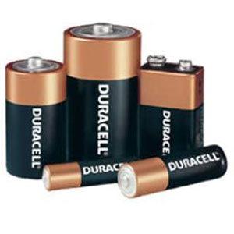
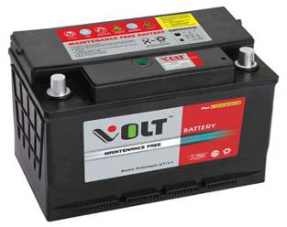
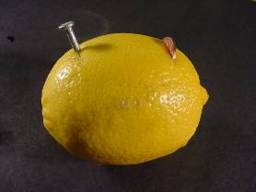
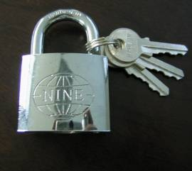
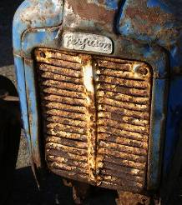
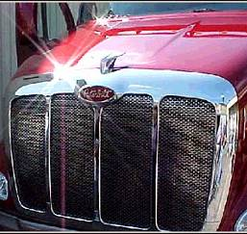
AP Chemistry
Electrochemistry

Slide 2
During oxidation-reduction (redox) reactions,
the oxidation states of two substances change.
oxidation =
loss of e–
both occur in redox
reduction =
gain of e–
“OIL RIG.”
Oxidation is loss;
reduction is gain.
LEO: “GER…”
Losing electrons: oxidation.
Gaining electrons: reduction.

Slide 3
Oxidation-Reduction Reactions
oxidizing agent (oxidant): is reduced (or has a
component that is reduced)
reducing agent (reductant): is oxidized (or has a
component that is oxidized)
0
1+
0
2+
e.g., Zn(s) + 2 H⁺(aq) →
H₂(g) + Zn²⁺(aq)
is reduced
is oxidized
(charge goes from 1+ to 0)
(charge goes from 0 to 2+)
is the oxidizing agent
is the reducing agent

Slide 4
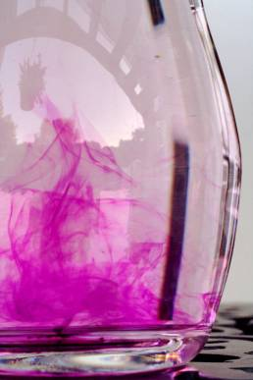
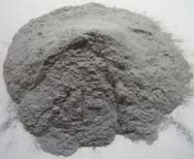
Identify the oxidant and the reductant.
0
7+
3+
4+
2 H₂O(l) + Al(s) + MnO₄–(aq) → Al(OH)₄–(aq) + MnO₂(s)
oxidant:
MnO₄–
reductant:
Al
Powdered aluminum will
speed up the reaction rate.
Permanganate ion
is a strong oxidizer.

Slide 5
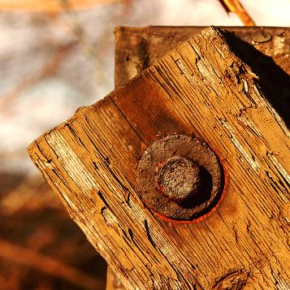
Balancing Oxidation-Reduction Reactions
-- conserve mass AND conserve charge
half-reaction: oxidation by itself, or reduction by itself
When iron rusts,
one half-reaction is:
Fe Fe³⁺ + 3 e–
(oxidation)
The reduction half-reaction
might be:
O₂ + 4 e– 2 O^{2–}

Slide 6
Write half-reactions for…
Sn²⁺(aq) + 2 Fe³⁺(aq) → Sn⁴⁺(aq) + 2 Fe²⁺(aq)
Sn²⁺(aq) Sn⁴⁺(aq)
+ 2 e–
(oxidation)
2
e– +
Fe³⁺(aq) Fe²⁺(aq)
2
2
(reduction)
The sum of the two half-rxns should be the overall rxn.
In line notation, this reaction would be written:
Sn²⁺ Sn⁴⁺ Fe³⁺ Fe²⁺
anode (oxidation) to L of , cathode (reduction) on R

Slide 7
Steps in Balancing Equations by the Method of Half-Reactions
1. Break overall equation into two half-reactions.
2. a. Balance everything but H and O.
b. Balance O by adding H₂O as needed.
c. Balance H by adding H⁺ as needed
(assuming acidic solution).
d. Add e– as needed.
e. Multiply each half-reaction by integers to
cancel e–.
3. Add the two half-reactions and simplify.
*4. BASIC SOLN ONLY: Add enough OH– to cancel
any H⁺. Simplify again.

Slide 8
Balance this reaction,
which takes place in
acidic solution.
Cr₂O₇^{2–} + Cl– → Cr³⁺ + Cl₂
6 e– +
14 H⁺ +
Cr₂O₇^{2–} → Cr³⁺
2
+ 7 H₂O
6
6
2
3
Cl– → Cl₂
+ 2 e–
14 H⁺ +
Cr₂O₇^{2–} +
6 Cl–
2 Cr³⁺ +
7 H₂O +
3 Cl₂

Slide 9
Balance this reaction,
which takes place in
basic solution.
CN– + MnO₄– → CNO– + MnO₂
6
6
3
H₂O +
3
CN– → CNO–
3
+ 2 H⁺
+ 2 e–
6
8
4
3 e– +
4 H⁺ +
2
MnO₄– → MnO₂
+ 2 H₂O
2
3 CN– + 2 MnO₄– +
2 H⁺
→
H₂O
+ 3 CNO– + 2 MnO₂
2 H₂O
+ 2 OH–
+ 2 OH–
3 CN– + 2 MnO₄– + H₂O →
3 CNO– + 2 MnO₂ + 2 OH–

