Slide 1
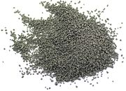
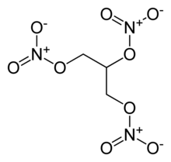
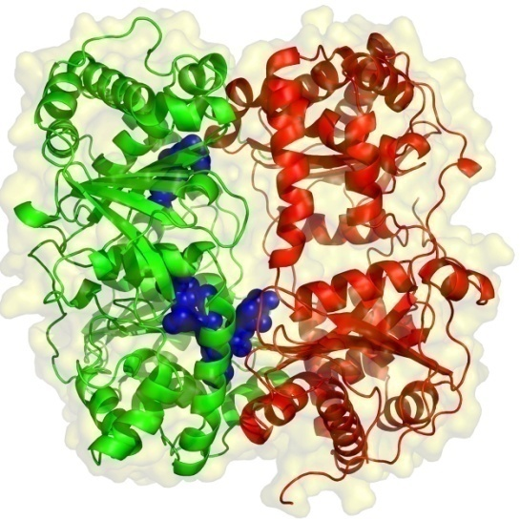
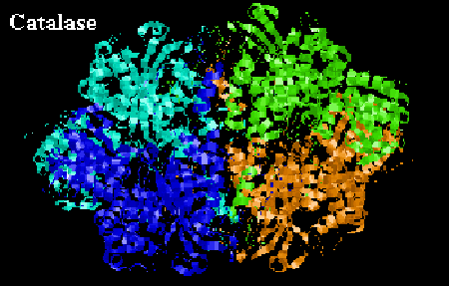
AP Chemistry – Chemical Kinetics
10 KNO₃ + 3 S + 8 C → 2 K₂CO₃ + 3 K₂SO₄ + 6 CO₂ + 5 N₂
Black powder burns quickly,
but the reaction is
much slower than
nitroglycerin detonating.
4 C₃H₅(NO₃)₃ → 12 CO₂ + 10 H₂O + 6 N₂ + O₂
Enzymes are huge
molecules that speed
up reactions in
biological systems.

Slide 2

Factors that Govern
Rates of Reactions
Generally...
(1) ...as the concentration of reactants
increases, rate ___
(2) ...as temperature increases, rate ___
(3) ...with a catalyst, rate ___
lowers activation energy
and is NOT consumed
(e.g., enzymes)
(4) ...as reactant surface area increases, rate ___
Also, as mixing increases, rate increases.

Slide 3
Reaction rates are usually expressed in M/s.
Δ[x]
rate =
Δt
Conc. of Substance x v. Time
[x] (M)
x is a product
x is a reactant
t (s)
Δ[x] is (–) if x is a…
reactant.
Δ[x] is (+) if x is a…
product.

Slide 4
instantaneous rate: the reaction rate at any given time
-- it is equal to the slope
of the [ ] – time curve
at any point
Conc. of Reactant x
v. Time
(t₁, [x]₁)
[x] (M)
P
For point P, one finds the
instantaneous rate by:
(t₂, [x]₂)
t (s)
--
constructing a tangent line
--
picking two points on the line
--
finding their coordinates
RISE
--
calculating the slope as…
RUN

Slide 5
Coeff. in bal. eq. are used when comparing rates for
substances in a rxn.
At a given time, the instantaneous rate of
appearance of nitrogen dioxide is 3.2 x 10^{–6} M/s.
Find the instantaneous rates of disappearance
of nitrogen monoxide and oxygen at that time.
2 NO(g) + O₂(g) 2 NO₂(g)
–3.2 x 10^{–6} M/s
–1.6 x 10^{–6} M/s
+3.2 x 10^{–6} M/s

Slide 6
Generally, reaction rates are proportional to the [ ] of
reactants.
rate law:
an expression that shows how the rate
depends on the [ ]s of reactants
-- contains a rate constant, k
-- A rate law has the form…
rate = k [R₁]^{m} [R₂]^{n}...
where m and n are...
reaction orders
(Their sum is the overall reaction order;
r.o.’s are determined experimentally.)
-- Usually, reaction orders are 0, 1, or 2,
but some are fractions or are (–).

Slide 7
If a reaction is zero order in a particular reactant,
changing its concentration...
does NOT affect the rate,
as long as there is SOME
of the reactant present.
1st order:
changes
(double the [ ], double the rate)
(halve the [ ], ½ the rate)
3rd order
would mean…
“cubed” changes.
2nd order:
squared changes
(triple the [ ], 9X the rate)
2X [ ]; 8X rate
(halve the [ ], ¼ the rate)
3X [ ]; 27X rate
The rate constant k is NOT affected by concentration,
but it IS affected by...
temperature and catalysts.

Slide 8
H₂(g) + Cl₂(g) 2 HCl(g)
Find...
(1) rxn order of each reactant
(2) overall reaction order
(3) units of rate constant
[H₂] (M) | [Cl₂] (M) | Init. rate of HCl formation (M s^{–1})
0.100 | 0.100 | 0.340
0.100 | 0.200 | 0.680
0.200 | 0.200 | 2.720
A
B
C
rate = k [H₂]² [Cl₂]
r.o. of H₂ = 2
r.o. of Cl₂ = 1
M
__
=
?
M²
M
s
1
___
o.r.o. = 3
units for k =
= M^{–2} s^{–1}
M² s

