Slide 1
The Kinetic-Molecular Theory
(the theory of moving particles)
1. Gas particles are in constant, random motion.
2. The volume of the particles is negligible
compared to the container volume.
3. The attractive-repulsive forces between
particles are negligible.
4. Collisions are elastic.
(i.e., no energy is lost).
5. KE_{avg} of particles is proportional to absolute
temperature.

Slide 2
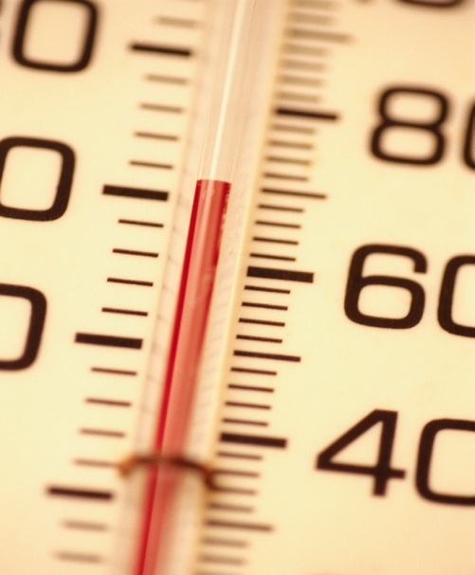


At a given temp., the gas particles
of Sample A have the same avg. KE
as the gas particles of Sample B.
pressure = “ ” and “ ” gas particles
collide with the sides of the container
how hard
how often
container
wall A
container
wall B

Slide 3
1 mol Ne @ 25ºC in
a 5.0-L container…
1 mol Ne @ 350ºC in
a 5.0-L container…
1 mol Ne @ 25ºC in
a 5.0-L container…
5 mol Ne @ 25ºC in
a 5.0-L container…

Slide 4
Particle-Velocity Distribution
(___________, same T and P)
various gases
most massive gas (e.g., CO₂)
# of
particles
a gas of intermediate
mass (e.g., N₂)
least massive
gas (e.g., He)
(SLOW)
Speed of
particles (m/s)
(FAST)
rms (root-mean-square) speed

Slide 5
Particle-Velocity Distribution
(same gas, same P, ________)
various T
coldest gas
# of
particles
warmest gas
(SLOW)
Speed of
particles (m/s)
(FAST)

Slide 6
Equation for the rms speed of a gas:
R = 8.314 J/mol-K
Μ = molar mass, in kg
KE_{avg} for a particle =
½ m u²
in kg
Find the rms speed of chlorine gas at 80.0ºC.
T = 80.0ºC
= 353 K
Μ = 71.0 g
= 0.0710 kg
= 352
m/s

Slide 7
effusion:
diffusion:
the escape of gas particles
through a tiny hole
into an evacuated space
the net movement of
a substance from high
to low conc.
[ HIGH ]
[ LOW ]
NET MOVEMENT
NET MOVEMENT
more massive = slow;
less massive = fast

Slide 8
For gases, rates of diffusion
& effusion obey Graham’s law:
** To use Graham’s Law,
both gases must be at
the… same temp.
r = rates
Μ = molar masses
t = times
The rate of diffusion of gases is slower than the
molecular speeds because of...
collisions.
--
~10 x 10⁹ collisions/sec per particle
The mean free path is the average distance
traveled by a particle between collisions.
-- it is shorter when the pressure is…
high

Slide 9

CH₄ moves 1.58 times faster than which noble gas?
mm = 16.0 g/mol
2
He
4.003
10
Ne
20.180
Ne₂
or Ar?
18
Ar
39.948
36
= 39.9 g/mol
Kr
83.80
54
Ar
“Ar?”
Xe
131.29
86
“Aahhrrrr! Buckets o’ blood!
Swab de decks, ye scurvy dogs!”
Rn
(222)

