Slide 1
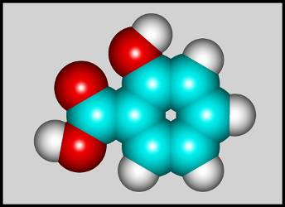
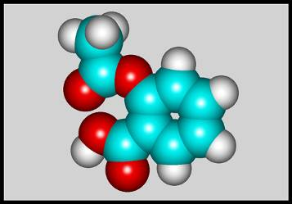
the study of carbon-containing
compounds
organic chemistry:
the chemistry of living things
biochemistry:
--
molecular shape is crucial
(aspirin)
3-D structure of
salicylic acid
3-D structure of
acetylsalicylic acid

Slide 2
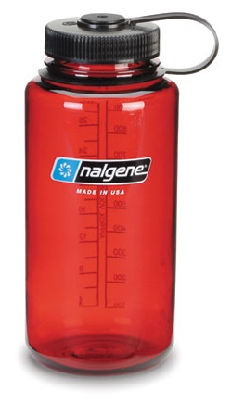
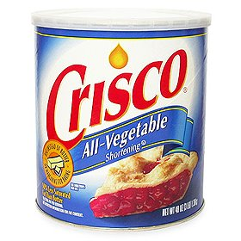
Carbon is unique among
the elements because:
--
it can have up to four bonds per C atom
→
single, double, or triple bonds
–C–C–
C=C
–C=C–
--
it can form REALLY long chains of C atoms
--
its bonds are strong
STOP

Slide 3
hydrocarbons: compounds containing only __ and __
H
C
alkanes:
single
hydrocarbons having only ______ bonds
--
ALKANES = FUEL
--
very stable; no rxn ^{w}/acids, bases, strong oxidizers
--
–anes are saturated
H
H
H
H
H
H
H
H
–C–C–C–
H
H
–C–C–C–C–
H
H
H
H
H
H
H
H
–C–
H
H
structural isomers: same molecular formula,
different…
bonding arrangements

Slide 4
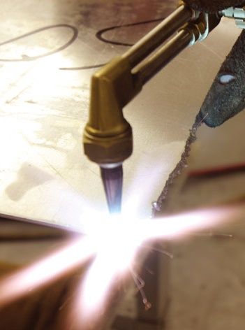
alkenes:
C=C
hydrocarbons having at least one ____ bond
H
H
C=C
H
H
C
H
H
CH₂CHCH₃
alkynes:
C=C
hydrocarbons having at least one ____ bond
H
H
H
H
H–C–C=C–C–C–C–H
H
H
H
H
The simplest alkyne,
ethyne (i.e., acetylene)
– C₂H₂ – is the fuel in oxyacetylene torches.
CH₃CC(CH₂)₂CH₃

Slide 5
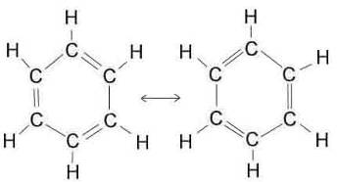
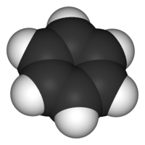
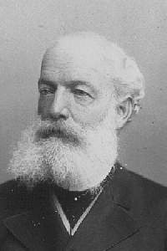
aromatic hydrocarbons: benzene and compounds ^{w}/a
benzene-related structure
6 C atoms in a planar ring
^{w}/“tweener” bonds (C₆H₆)
--
–enes, –ynes,
and aromatics
are __________
unsaturated
August Kekule
(1829–1896), who
claimed that a dream
gave him insight into the structure of benzene.
STOP

Slide 6
REVIEW: Organic Chemistry Basics
1. Alkanes have only single bonds. Because they cannot “take on” any additional atoms, alkanes are saturated hydrocarbons.
2. Alkenes have at least one carbon-carbon double bond; alkynes have at least one carbon-carbon triple bond. Aromatic compounds are based on the benzene molecule, C₆H₆. Because alkenes, alkynes, and aromatic compounds can “take on” additional atoms, they are unsaturated.
3. Structural isomers have the same molecular molecular formula, but have atoms w/different w/different bonding arrangements.

Slide 7
C₅H₁₂
Straight-chain compounds have…
a single carbon backbone.
CH₃(CH₂)₃CH₃
CH₃CH₂CH₂CH₂CH₃
Branched-chain compounds have…
a main carbon backbone
AND one or more branches
C₈H₁₈
Substituted compounds have…
one or more H atoms
removed, with other
atoms in their place(s)
(often halogens)
Br
C₅H₁₁Br

Slide 8
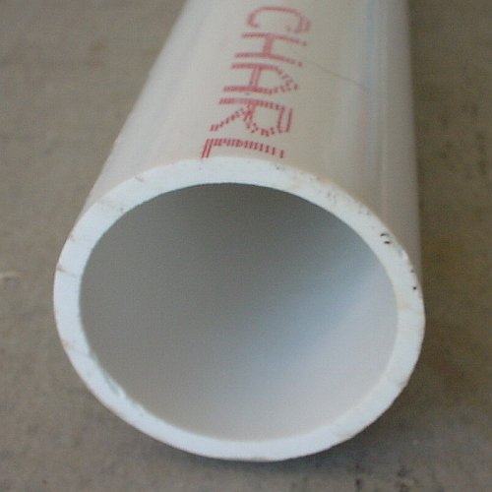
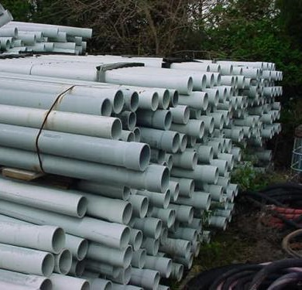
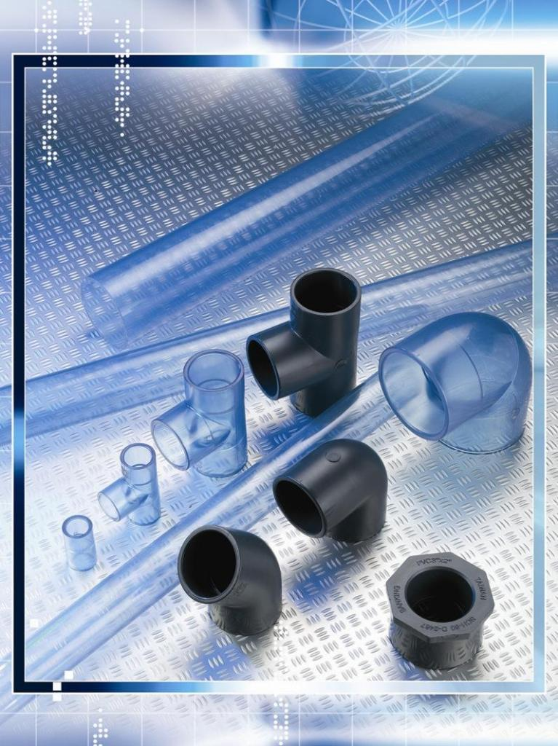
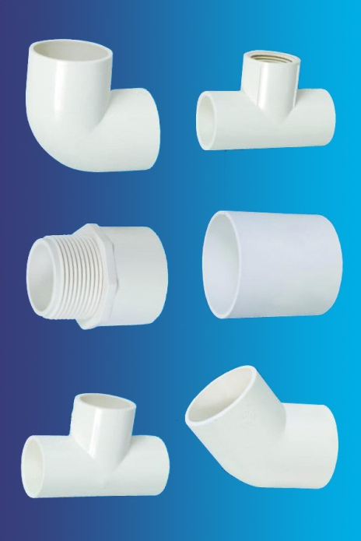
Branches and H-replacing atoms/groups
are collectively called…
substituents.
Cl
H
Cl
H
Cl
H
–C–C–C–C–C–C–
Polyvinylchloride (PVC) is a material
made of long-chain carbons that have
many chloride substituents.
H
H
H
H
H
H

Slide 9
Functional group: a characteristic pattern that makes
up a portion of a larger m’cule
--
specific atoms, specific bonding arrangements
-- importance:
fgs largely determine the behavior
of their m’cules
-- several examples of fgs:
–COOH
O
O
O
O
=
=
–OH
–C–
–C–
OH
OH
alcohols
ketones
carboxylic acids

Slide 10
C₆H₁₁Br
Many organic compounds
are combinations of
several categories.
sub.
Br
C₁₀H₂₁Cl
O
C₆H₁₂O₂
br. + sub.
fg
OH
Cl
C₉H₁₇OBr
OH
C₆H₁₃OCl
O
Br
Cl
fg + sub.
fg + sub. + br.
STOP

Slide 11
Organic Nomenclature
Memorize the prefixes that tell
the # of C atoms in a chain.
pent–
1 =
2 =
3 =
4 =
5 =
6 =
7 =
8 =
9 =
10 =
meth–
non–
eth–
prop–
but–
pent–
dec–
hex–
There are rules, but generally we will want to find the longest chain of carbons.
hept–
oct–
non–
hept–
dec–

Slide 12
Naming Straight-Chain Alkanes
1. Find the longest continuous chain of C atoms.
Choose the appropriate prefix.
2. The name ends with –ane.
Provide the counterpart to the given.
propane
(C₃H₈)
heptane
(C₇H₁₆)

Slide 13
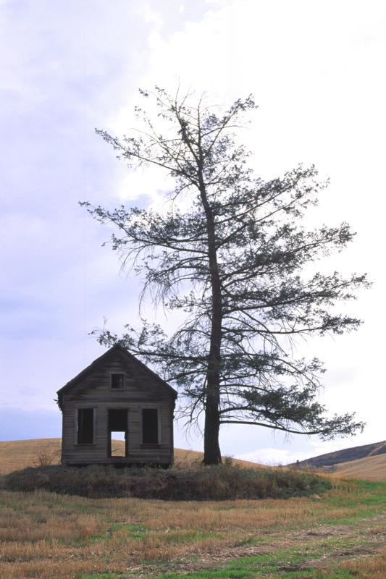
Alkanes: modification for substituent
hydrocarbon (HC) groups
(i.e., branches)
1. Number the “longest chain”
carbons. Start with the end
nearest a branch.
2. Name and give the #ed
location of each substituent.
-- HC substituent groups
use the prefixes based
on the # of Cs,
but end in –yl.
3. List substituents in
alphabetical order.

Slide 14
Provide each counterpart.
1
3
5
2
4
6
4-ethyl-2-methylhexane
(C₉H₂₀)
1
2
5-ethyl-3-methyl
octane
3
5
7
4
6
8
(C₁₁H₂₄)

Slide 15
SUMMARY: Alkanes, 1
Memorize these
prefixes:
To name branched alkanes:
1. Number the “longest chain”
carbons. Start with the end
nearest a branch.
1 =
2 =
3 =
4 =
5 =
6 =
7 =
8 =
9 =
10 =
meth–
eth–
prop–
2. Name and give the #ed
location of each substituent.
but–
pent–
-- HC substituent groups
use the prefixes based
on the # of Cs,
but end in –yl.
hex–
hept–
oct–
non–
3. List substituents
alphabetically.
dec–

Slide 16
Alkanes: modification for non-HC substituents
1. The “longest chain” MUST contain the substituent.
-- example substituents:
–NO₂
–NH₂
–F
–Br
–I
nitro
amino
fluoro
bromo
iodo
2. Number the chain carbons, starting with the end
nearest a substituent.
-- A non-HC substituent takes precedence
over an HC branch.
3. Name and give the #ed location of each substituent.
-- If necessary, choose #s so that their sum is as
low as possible.

Slide 17
Provide each counterpart.
Br
3-bromo-2-chlorohexane
Cl
2-ethyl
-1,1-diiodo
heptane
I
I
2-methyl-1-nitrobutane
NO₂
NH₂
NO₂
2-amino-
6-nitro-
3-propyl
heptane

Slide 18
Alkanes: modification for cycloalkanes
-- Use the cyclo- prefix before the “-ane” part.
Provide each counterpart.
ethyl
cyclohexane
(C₈H₁₆)
1-bromo-1-chloro-2-methylcyclopentane
(C₆H₁₀BrCl)
Br
Cl

Slide 19
SUMMARY: Alkanes, 2
In this lesson, we went through how to name alkanes that contain non-hydrocarbon substituents. The biggest ideas are:
1. The “longest chain” MUST contain the
substituent.
2. You number the chain carbons starting
with the end nearest a substituent.
-- A non-hydrocarbon substituent takes
precedence over a hydrocarbon branch.

Slide 20
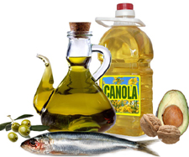
Naming Alkenes and Alkynes
1. The C-chain MUST include the multiple bond.
Use the ending –ene or –yne, as appropriate.
2. Number so that you get to the multiple bond ASAP.
-- The multiple bond takes precedence over
branching or substituents.
3. Use di- or tri- right before –ene or –yne if you have
two or three multiple bonds.
Polyunsaturated fats and oils contain
double and/or triple bonds.

Slide 21
Provide each counterpart.
1-butyne
(C₄H₆)
2-butyne
(C₄H₆)
7-methyl-
2,4-
nonadiene
(C₁₀H₁₈)

Slide 22
7-fluoro-6-methyl-3-octyne
F
(C₉H₁₅F)
Cl
Cl
Cl
3,3,4-
trichloro
cyclohexene
(C₆H₇Cl₃)

Slide 23
4. For geometric isomers (different spatial
arrangements of atoms), use cis- (same)
or trans- (opposite). Geometric isomerism is
possible only with…
alkenes.
Cl
CH₂CH₃
C=C
CH₃CH₂
Cl
3,4-dichloro
-trans-
3-
hexene
Cl
Cl
C=C
CH₃CH₂
CH₂CH₃
3,4-dichloro
-cis-
3-
hexene
STOP

Slide 24
Benzene,
Phenol,
and Toluene
(“FEE nahl” or “fn AHL”)
These are the “Big Three” aromatic compounds.
(C₆H₆)
OH
CH₃
(C₆H₅OH)
(C₆H₅CH₃)
benzene phenol toluene
For phenols and toluenes, the C to which the
–OH or –CH₃ is attached is carbon #1.

Slide 25
Provide each counterpart.
bromobenzene
(C₆H₅Br)
Br
ethylbenzene
(C₈H₁₀)
2-propylphenol
(C₉H₁₂O)
OH

Slide 26
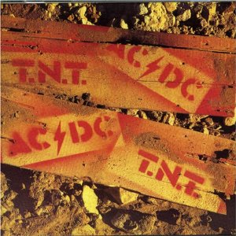
I
I
NO₂
NO₂
CH₃
3,4-
diiodo
toluene
O₂N
O₂N
NO₂
NO₂
CH₃
CH₃
2,4,6-
trinitro
toluene
H₂N
NH₂
OH
2,6-
diamino
phenol
STOP

Slide 27
ortho-
meta-
para-
dichlorobenzene
–Cl
Cl
–Cl
Cl
Cl
1,2-dichlorobenzene
1,3-dichlorobenzene
Cl
1,4-dichlorobenzene
For this class, if a benzene ring is
connected to an interior C atom in a hydrocarbon
chain, it is called a phenyl (“FENN uhl”) group. It looks
like THIS and has the formula…
–C₆H₅.

Slide 28
Provide each counterpart.
2-bromo-2-chloro-3-phenylpentane
Br
Cl
3-amino-3-phenyl-
1-butene
NH₂
NO₂
3-nitro-2,4-diphenylhexane
Br
1,1-dibromo-3-phenyl
cyclopentane
Br
STOP

Slide 29
Alcohols
Alcohols contain the hydroxyl group.
–OH
--
low molar mass alcohols are soluble in…
polar solvents, due to
the polar nature of –OH
--
all alcohols have higher BPs than their parent
alkanes
(due to HBFs btwn. adj. m’cules’ OH grps)
Primary (1º) alcohols have one “R” group;
secondary (2º) have two;
tertiary (3º) have three.
R
–
H
R
–C–
OH
R
–
–
–
H
R
–C–
OH
R
–C–
OH
–
–
H
R

Slide 30
Naming Alcohols
1. Without being redundant, specify the location of the
OH group(s); the suffix is –ol.
–OH takes lowest
possible #.
2. Use di- or tri- right before –ol if you have two or
three OHs.
Provide each counterpart.
1-propanol
–OH
OH
3-ethylphenol
3-ethylcyclohexanol
OH
OH
OH
1,1-propane
diol

Slide 31
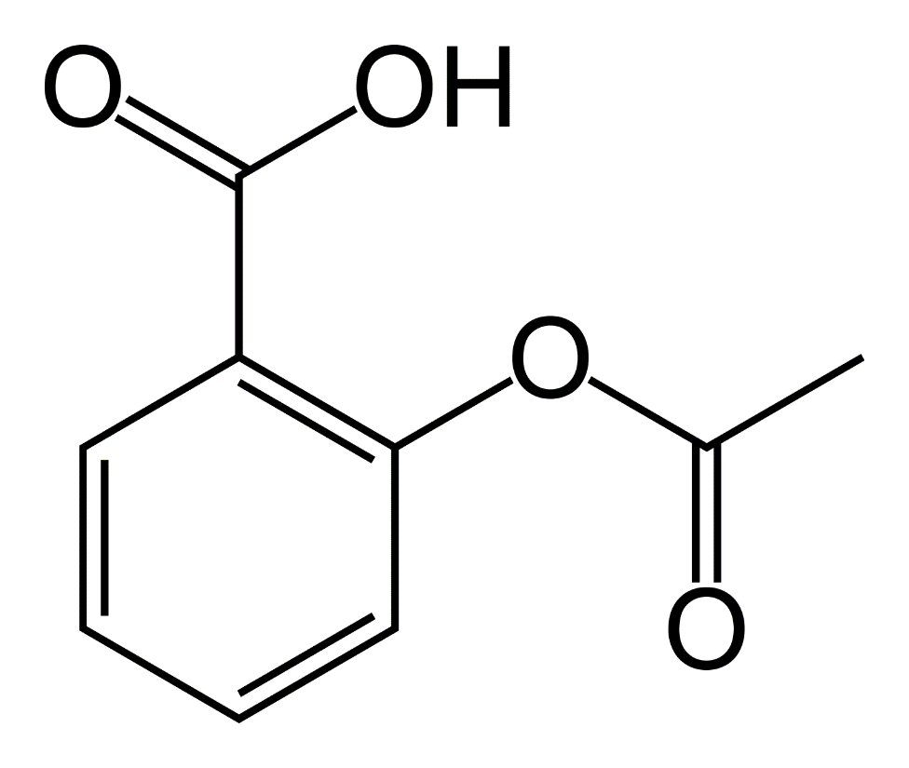
5-bromo-6-chloro-2-propyl-1-hexanol
Br
HO–
–Cl
HO
OH
HO
Many pharmaceuticals
(including aspirin, shown above)
contain hydroxyl groups.
1,2,4-
cyclopentane
triol
STOP

Slide 32
 | Ketones | Aldehydes | Esters | Carboxylic Acids
O
O
O
O
=
=
=
=
–C–
–C–
H
–C–
O–
–C–
OH
Functional groups containing the carbonyl group
Names end in –one,
^{w}/the C in the carbonyl
having the lowest possible number.
The C in the carbonyl is C #1. Whatever is attached to the
–O– is named first, then the name ends in –oate.
Names end in –al,
^{w}/the C in the carbonyl being C #1.
Names end in
–oic acid, ^{w}/the C in the carbonyl being C #1.

Slide 33
Provide each counterpart.
O
3-hexanone
O
propyl
propan
oate
O
O
3-phenylbutanal
O
H
F
F
5,6-difluoro-
2-heptanone

Slide 34
O
2-ethyl
pentanal
H
O
3-propylhexanoic acid
OH
O
methyl
-2-methyl
octan
oate
O
O
4,4,4-trifluorobutanoic acid
F
F
OH
F

Slide 35
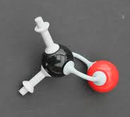
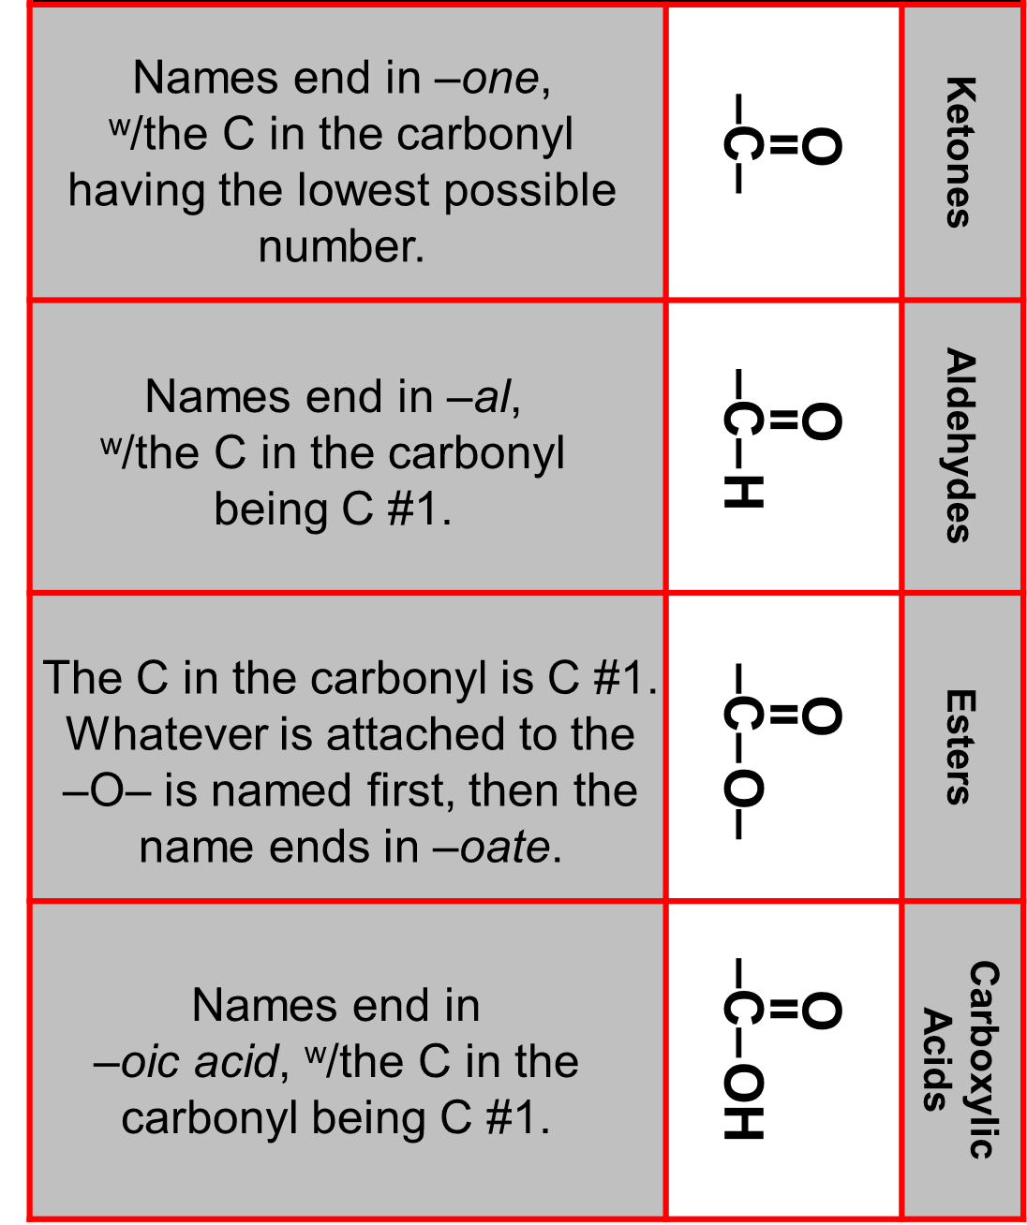
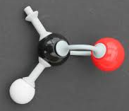
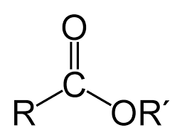
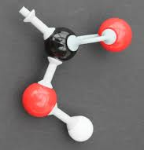
STOP

Slide 36
REVIEW: Functional Groups, so far...
Previously, we learned how to write names and draw structures of several functional groups that are common in organic chemistry and biochemistry.
O
=
O
–C–
OH
=
–C–
carboxylic acids
ketones
O
O
=
=
–C–
H
–OH
–C–
O–
aldehydes
alcohols
esters

Slide 37
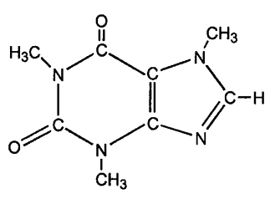
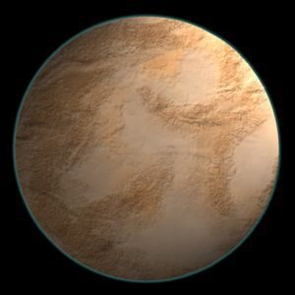
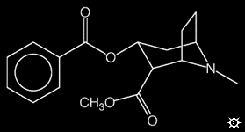
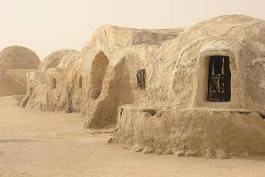
Ethers
Amines
Amides
(“EETH erz”)
(“uh MEENZ”)
(“uh MIDZ” or “AM idz”)
O
–O–
–N
=
–C–N
“coca-ine”
“Tatoo-ine”
“caffe-ine”
STOP

Slide 38
Organic Reactions
Combustion of hydrocarbons OR compounds
^{w}/only C, H, and O: products are…
CO₂ and H₂O.
Write the equation for the complete
combustion of 2-methyl-2-pentene.
C₆H₁₂ + O₂
9
→
6
CO₂ + H₂O
6
O
Write the equation for the complete
combustion of ethylbutanoate.
O
C₆H₁₂O₂ + O₂
8
→
6
CO₂ + H₂O
6

Slide 39
substitution: an H atom is removed and “something
else” is put in its place
halogen
-- In halogenation, a _______ atom replaces an H.
Write an equation for the reaction
between ethane and chlorine.
H
H
H
H
H
–C–C–H
+ Cl₂ →
H
–C–C–Cl
+ HCl
H
H
H
H
If more chlorine is provided,
the reaction will produce...
H
H
H
H
H
–C–C–Cl
+ Cl₂ →
Cl
–C–C–Cl
+ HCl
H
H
H
H
AND SO ON.

Slide 40
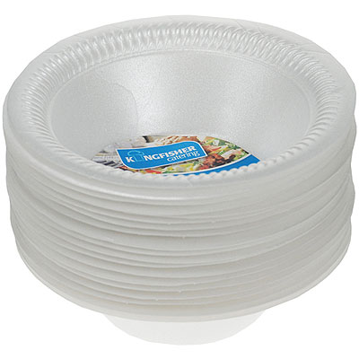
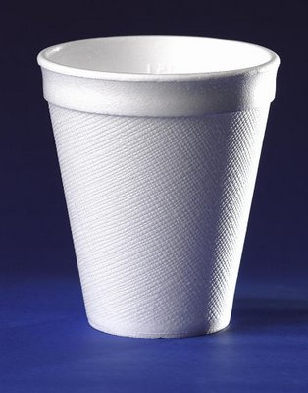
Substitution occurs with aromatic compounds, too.
Br
catalyst
+ Br₂
+ HBr
catalyst
+ CH₃CH₂Cl
+ HCl
Ethylbenzene is an important
intermediate in the production
of styrene which, in turn, is
used to make polystyrene.
Roughly 25 million tons of
ethylbenzene are produced and used every year.

Slide 41
SUMMARY: Organic Reactions, 1
In this lesson, we went through two basic types of reactions that occur with organic molecules.
The complete combustion of hydrocarbons (or of compounds containing only C, H, and O) produces carbon dioxide and water.
Substitution reactions end up removing an H and replacing it with something else. In halogenation, a halogen atom is substituted in place of a hydrogen atom.

Slide 42
REVIEW: Organic Reactions, so far...
Previously, we went through two basic types of reactions that occur with organic molecules: combustion and substitution.
The complete combustion of hydrocarbons (or of compounds containing only C, H, and O) produces CO₂ and H₂O.
Substitution reactions remove an H and replace it with something else. In one type of substitution reaction, halogenation, a halogen atom is substituted in place of an H.

Slide 43
addition: a multiple bond is broken and two “things”
are inserted
(π(s) is/are broken, σ remains intact)
H
H
H
H
+
C=C
Br₂
Br
–C–C–Br
H
H
H
H
H
H
H
H
+
H
–C–C–Br
C=C
HBr
H
H
H
H
H
H
H
H
H₂SO₄
–C–C–OH
+
H
C=C
H₂O
H
H
H
H
H
H
H
Cl
H
+
H–C–C–C–C–H
Cl₂
H
–C–C=C–C–
H
H
H
H
Cl
H

Slide 44
A specific addition rxn is hydrogenation, in which
__ is added across a multiple C-C bond.
H
-- requires a catalyst (usually a finely-divided
_____) to rupture the multiple bond
metal
H
H
H
H
catalyst
–C–C–H
+
H
C=C
H₂
H
H
H
H
Another addition reaction is polymerization.
STOP
H
H
C=C
H
H
H
H
H
H
H
H
C=C
–C–C–C–C–
H
H
H
H
H
H
H
H
C=C
H
H
polyethylene
“lots” of ethylene

Slide 45
REVIEW: Organic Reactions, so far...
To this point, we have gone through three types of reactions that occur with organic molecules: combustion, substitution, and addition.
Combustion of hydrocarbons (or of C/H/O compounds) produces CO₂ and H₂O.
Substitution reactions remove an H and replace it with something else.
Addition reactions break one of the bonds in a multiple bond and insert TWO things, one to each of the two atoms that formerly had the multiple bond.

Slide 46
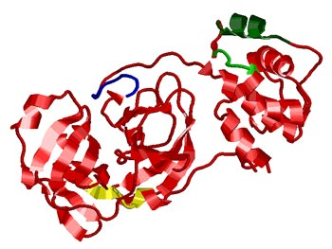
condensation
(or elimination,
or dehydration):
_____ is a product
Complex protein
molecules are
made from
condensation
reactions of
amino acids.
water
-- One reactant provides an __,
the other provides an ___.
H
OH
“What’s left” then bonds together.
NO₂
H₂SO₄
+ H₂O
+ HNO₃
CH₃CH₂OH + CH₃OH
CH₃CH₂–O–CH₃
+ H₂O
CH₃CH₂OH + CH₃OH
alcohol m’c
alcohol m’c
an ether
water

Slide 47
-- Condensation reactions polymerize amino acids
into...
proteins.
R”
O
R’
O
Note that amino
acids have amine
groups attached
to the C NEXT TO
the carboxyl group.
H–N–C–C–OH
H–N–C–C–OH
H
H
H
H
amino acid #1
amino acid #2
R”
O
R’
O
H–N–C–C–
N–C–C–OH
+ H₂O
H
H
H
H
“a bit of a” protein
water

Slide 48
-- Amides can be formed in condensation rxns
between carboxylic acids and amines.
Write the equation for the reaction between
butanoic acid and ammonia.
Ammonia is the simplest amine.
O
O
+ NH₃
+ H₂O
OH
NH₂
carboxylic acid
amine
amide
water

Slide 49
SUMMARY: Organic Reactions, 3
In a condensation reaction, two molecules join together to form a more massive molecule. One molecule releases an H (freeing up a ‘bonding spot’ on THAT molecule) and the other releases an OH (freeing up a ‘bonding spot’ on THAT molecule). The two molecules become one by connecting at their bonding spots, and the discarded H and OH come together to form water. Condensation reactions are also called elimination or dehydration reactions.

Slide 50
REVIEW: Organic Reactions, so far...
The four main organic reactions we discuss in these lessons are combustion, substitution, addition, and condensation.
Combustion of hydrocarbons (or of C/H/O compounds) produces CO₂ and H₂O.
Substitution reactions remove an H and replace it with something else.
Addition reactions break one of the bonds in a multiple bond and insert TWO things.
Condensation reactions join two molecules into one, and yield water as a by-product.

Slide 51
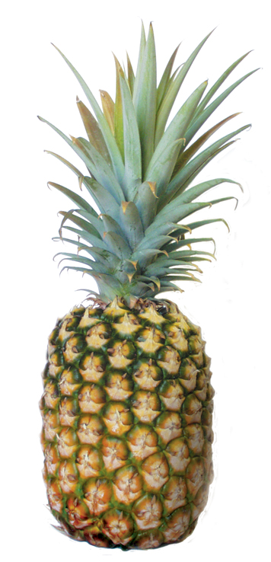
Esterification is a condensation reaction that occurs
specifically between a carboxylic acid and an alcohol.
Write the equation for the reaction between
butanoic acid and 1-butanol.
O
+
HO
OH
O
+ H₂O
O
(the active substance in
the characteristic
flavor/odor of pineapple)
butyl
butanoate

Slide 52
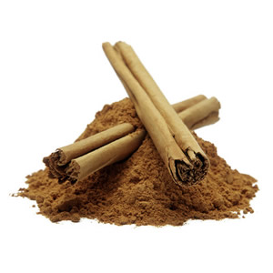
Write the equation for the reaction between
3-phenyl-2-propenoic acid and ethanol.
O
+
HO
OH
O
+
H₂O
(the active substance in
the characteristic
flavor/odor of cinnamon)
O
ethyl
-3-phenyl
-2-propenoate
“When in doubt,
make water.”
Mr. B
(i.e, ethyl cinnamate)

Slide 53
SUMMARY: Organic Reactions, 4
Condensation reactions between certain classes of molecules yield specific types of products. Here are some condensation reaction patterns we have met in these lessons:
alcohol + alcohol → ether + water
carboxylic acid + amine → amide + water
carboxylic acid + alcohol → ester + water

