Slide 1
Introduction to
Nuclear
Chemistry
Chemical processes
________________ involve changes with electrons.
Nuclear processes
________________ involve changes in atomic nuclei.
radiation
Spontaneously-changing nuclei emit ________ and
are said to be _________.
radioactive
energy and/or particles

Slide 2
nucleons:
protons (p⁺) and neutrons (n⁰)
mass number:
(p⁺ + n⁰) in a given atom
isotopes: atoms having the same
number of p⁺, but different numbers of n⁰
radioisotopes
-- radioactive ones are called ___________
-- ALL isotopes of an element
behave the same, _________
chemically
nuclide: a nucleus ^{w}/a specified
number of p⁺ and n⁰
radionuclides
-- radioactive ones are called ___________
these are unstable
and emit radiation
atomic number:
(Z); # of p⁺

Slide 3

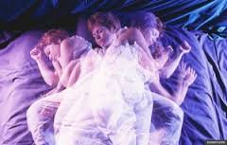

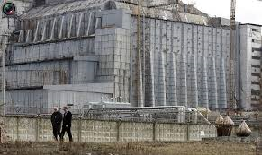
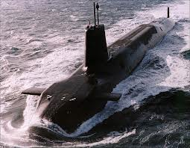
Radioisotopes (or radionuclides) have too
many or
too few n⁰.
Nucleus attempts to attain
a ______ energy state by
________ extra energy
as radiation.
lower
releasing
e.g.,
α- or β-particles,
or γ rays (these
things are “spit”
out of the nucleus)

Slide 4
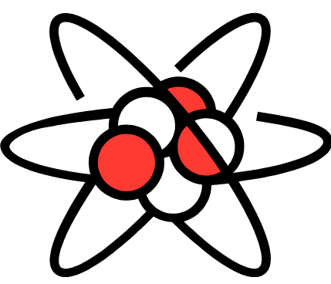
SUMMARY:
Introduction to Nuclear Chemistry
In nuclear chemistry, we focus NOT on the electrons, but instead on the nucleus and how it changes. Radioisotopes are radioactive atoms; radionuclides are radioactive nuclei. A nucleus is radioactive
(i.e., it emits radiation, as
either energy or particles)
when the RATIO of its
number of protons to
neutrons ISN’T right.

Slide 5
atoms changing into diff. types of atoms
NO outside, ‘bombarding’ particle is involved
Transmutation via
Radioactive Decay
For nuclear equations, mass (top) and charge (bottom) must balance.
alpha (α) decay:
234
4
230
U
He
+
Th
92
2
90
(go DOWN
two #s on Table)
4
α
or
2
α-particle (i.e., a He nucleus):
massive, slow-moving;
stopped by skin

Slide 6
beta (β) decay:
234
0
β
234
Pa
+
U
91
–1
92
(go UP
one # on Table)
0
e
or
–1
β-particle (i.e., a fast-moving electron):
little mass;
stops ~1 cm into body
In β-decay, the effect is that a n⁰ is converted into a p⁺, ejecting an e– from the nucleus.
1
0
1
n
e
+
p
0
–1
1
NOTE: There are no e– in the nucleus. The ejected e–
is formed when energy released from the
nucleus “congeals” into mass, via _______.
E = mc²

Slide 7
SUMMARY: Transmutation via
Radioactive Decay, 1
Here, we covered transmutation (the changing of atoms into DIFFERENT types of atoms) via alpha (α) decay and beta (β) decay.
An α particle is a slow-moving “chunk” that flies out of the nucleus and consists of two p⁺ and two n⁰; in α decay, we go DOWN TWO elements on the Periodic Table. A β particle is a fast-moving e–; in β decay, we go UP ONE element on the Periodic Table.

Slide 8
REVIEW: Transmutation via
Radioactive Decay
Previously, we covered alpha and beta decay:
In α decay, a slow-moving chunk of two p⁺ and two n⁰ flies out of the nucleus; go DOWN TWO elements on the Periodic Table.
In β decay, a fast-moving e– departs the nucleus; go UP ONE element on the Table.

Slide 9

gamma radiation:
consists of high-energy photons,
i.e., light (!!!)
-- can penetrate to internal organs
-- gamma ray:
0
(or just γ)
γ
0
emitted when nucleons
rearrange into a more
stable configuration
-- gamma radiation often
accompanies other
nuclear decays
FYI only
234
230
4
0
U
Th
+
He
+
2
γ
92
90
2
0

Slide 10
positron decay:
23
23
0
0
Mg
Na
+
e
+
ν
12
11
+1
0
positron: identical to an e–, but (+)
neutrino: “massless,” chargeless particle
FYI only
electron capture: nucleus captures orbiting e–
11
0
11
0
C
+
e
B
+
ν
6
–1
5
0
The effect of positron decay AND electron capture
is to turn a p⁺ into a n⁰.
1
0
1
1
0
1
p
e
+
n
p
+
e
n
1
+1
0
1
–1
0
POSITRON DECAY
ELECTRON CAPTURE

Slide 11
SUMMARY: Radioactive Decay, 2
In gamma (γ) decay, high-energy light is emitted as the nucleons rearrange themselves into a more stable configuration; γ decay does NOT transmute a nuclide, but often accompanies other decay modes.
A positron is the anti-particle of an electron; the two are identical, apart from having opposite charges. The effect of both positron decay and electron capture is that a p⁺ in the nucleus is transformed into a n⁰.
A neutrino is a massless, chargeless particle that often accompanies other decays. Like γ decay, neutrino emission alone does NOT transmute an atom.

Slide 12
strong force
Nucleons are held to each other by the __________.
~1.5 n⁰ : 1 p⁺
N
(i.e., # of n⁰)
Band (or Belt)
of Stability
~1 n⁰ : 1 p⁺
0
Z (i.e., # of p⁺)
83
At Z > 83, none are stable
(i.e., all are radioactive).

Slide 13
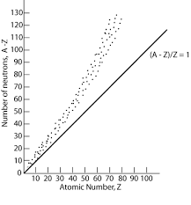
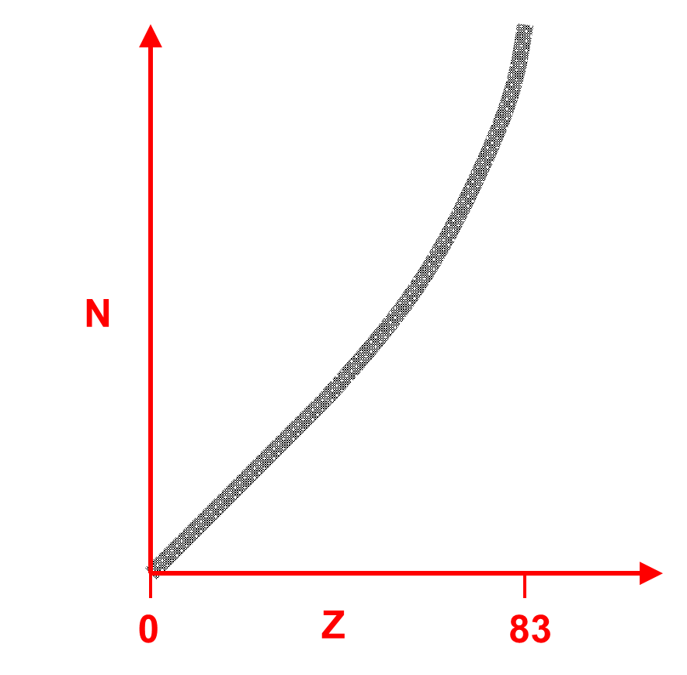
Nuclei that… | …have too many… | …and stabilize by…
…are above belt…
…are below belt…
…have Z > 83…
n⁰
β-emission
positron emission
p⁺
(or e– capture)
p⁺ and n⁰
α-emission

Slide 14
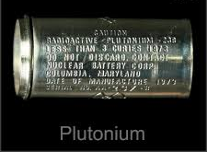
Examples:
242
4
238
(α)
Pu
α
+
U
94
2
92
(β)
163
0
163
Gd
β
+
Tb
64
–1
65
(positron emission
or e– capture)
125
0
125
Tb
e
+
Gd
65
+1
64
125
0
125
Tb
+
e
Gd
65
–1
64

Slide 15
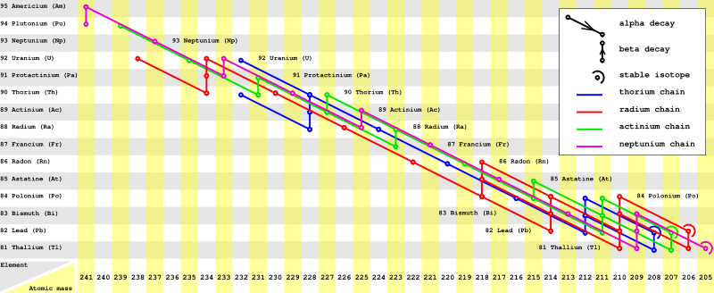
A radioactive series is the sequence a radionuclide
goes through to become stable.
α
β
e.g.,
U-238
Th-234
Pa-234
, etc.
-- there are three basic series, ending with…
Pb-206, Pb-207, and Pb-208.

Slide 16
Also, nuclei having “magic numbers” of p⁺ or n⁰ tend to
be more stable than those that don’t.
p⁺:
2, 8, 20, 28, 50, 82
n⁰:
2, 8, 20, 28, 50, 82, 126
The shell model of the nucleus, which says that the
nucleons reside in shells, has been proposed to
explain these observations. This theory is analogous
to the “shells of e–s” theory.
Finally, nuclides with an
even number of p⁺ AND
an even number of n⁰
tend to be stable.

Slide 17
SUMMARY: Nuclear Stability
Atoms are radioactive when their nuclei are unstable.
Previously, we discussed various modes of decay;
here, we introduced the belt of stability and gave likely
decay modes for various proton-to-neutron ratios.
Too many neutrons? Try β decay.
Too many protons? Try positron decay or e– capture.
Too many of both? α decay is a good first guess.
Three of the main radioactive decay series for heavier
elements all end at lead: Pb-206, Pb-207, and Pb-208.
The shell model suggests that nucleons exist in
nuclear energy levels.

Slide 18
REVIEW: Transmutation via
Radioactive Decay
In an earlier lesson, we stated that when atoms transmute via radioactive decay, radiation in the form of energy or particles is emitted, without the need for some type of inducement to do so by bombarding the nuclide with something else. Such transmutation modes of decay include α, β, and γ emission. Here, we investigate transmutation when a bombarding (i.e., a “bullet”) particle CAUSES it.

Slide 19
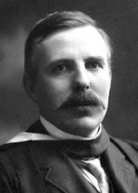
Transmutation via Nuclear Reactions
These are induced by a bombarding particle, and
typically have two reactants and two products:
27
4
1
30
Al
+
He
n
+
P
13
2
0
15
target
nucleus
bombarding
particle
ejected
particle
product
nucleus
This reaction is abbreviated…
27
30
Al
(α, n)
P
13
15
Ernest Rutherford was the first to artificially transmute elements.

Slide 20
Predict the missing species and write the shorthand.
27
1
24
Al
+
n
?
+
Na
13
0
11
27
24
4
4
α
Al
(n, α)
Na
He
or
13
11
2
2
Predict the missing species
and write the equation.
14
?
N
(α, p)
7
14
4
1
17
17
O
N
+
He
H
+
O
7
2
1
8
8

Slide 21
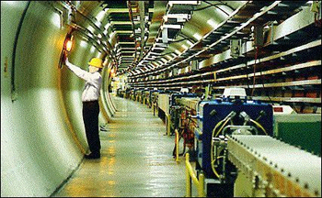
Particle accelerators are used
to accelerate charged particles
(e.g., α). We cannot accelerate
neutrons, but we can use n⁰-
emitters to produce artificial
isotopes. Often, β-emission
follows n⁰ absorption.
Inside the particle accelerator at
CERN (originally, Conseil Européen
pour la Recherche Nucléaire, now
Organisation Européenne pour la
Recherche Nucléaire)
For example:
First…
238
1
239
U
+
n
U
92
0
92
then…
239
239
0
U
Np
+
e
92
93
–1
and then…
239
239
0
Np
Pu
+
e
93
94
–1

Slide 22
SUMMARY: Transmutation via
Nuclear Reactions
Transmutation is the process of atoms changing into
other types of atoms or, alternatively, nuclei changing
into other types of nuclei. In radioactive decay,
transmutation occurs spontaneously, without bombard-
ment by an outside particle. In a nuclear reaction, on
the other hand, transmutation of an atom requires a
bombarding particle. Sometimes, transmutation via a
nuclear reaction can trigger other spontaneous radio-
active decays, as when non-fissile (but plentiful)
U-238 is transmuted into fissile Pu-239.

Slide 23
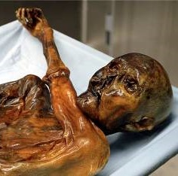
Each radioisotope has a unique rate of decay,
its half-life, t_{1/2}, which is the time required for
half of a sample of a radioisotope to decay into
something else. An isotope’s half-life is
independent of…
temperature, pressure, and its
state of chemical combination. (!!)
One purpose of transmutation
technology is to minimize risk
to humans and the environment
by changing nuclides with very
long half-lives into ones with
shorter half-lives.
“Otzi” the Iceman lived around 3300 B.C.,
according to radiocarbon dating analyses.

Slide 24
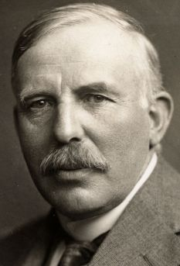
Radioactive decay is a first-order kinetic process.
Recall the first-order rate law:
In units on chemical kinetics, the
Ns could also be either [A]s or Ps.
k = decay constant
N_{o} = amt. of radioisotope initially
N_{t} = amt. of radioisotope at time t
AND the first-order
equation for half-life:
Ernest Rutherford
is given credit for
discovering the concept
of radioactive half-life.
The same math applies
to the kinetics of first-
order chemical reactions.
k t_{½} = 0.693

Slide 25
Derivation of the 1st-order
Equation for Half-Llife
From…
By definition, after
the half-life t_{½} has
elapsed, we have…
= k t_{½}
The left side is simply
the number 0.693, so...
k t_{½} = 0.693

Slide 26
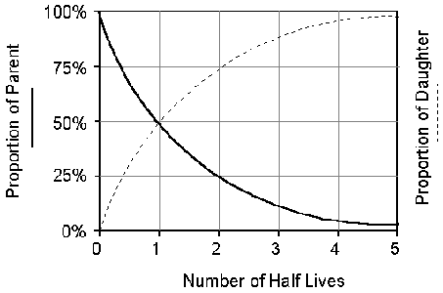
Molybdenum-99 has a half-life of 67.0 hours. How much
of a 1.000 mg sample of Mo-99 is left after 16.0 days?
384 h
k t_{½} = 0.693
k (67 h) =
0.693
→ k = 0.0103432 h^{–1}
→ ln
= 0.0103432 (384)
N_{t} = 0.0188 mg
radioactive material;
i.e., 0.9812 mg is now
other (stable?) mat’l

Slide 27
SUMMARY: Rates of Radioactive Decay
For a given radionuclide, its half-life is independent of temperature, external pressure, and its state of chemical combination. Aside from transmuting atoms into other types of atoms (i.e., using transmutation technology), there is nothing else we can do to alter a nuclide’s rate of decay, except...WAIT.
Rates of radioactive decay conform to the first-order rate law that most AP Chemistry students met for the first time in units on chemical kinetics:
k t_{½} = 0.693

Slide 28
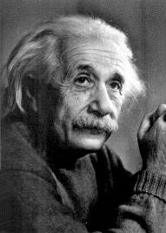
Energy and mass are two sides of
the same coin.
c = 3.00 x 10⁸ m/s
m = mass
, in kg
E = mc²
E = energy
, in J
When a system LOSES/gains energy,
it _______ / ______ mass.
LOSES
gains
In chemical reactions, the mass change is nearly
undetectable, so we speak of mass as being
“conserved,” when it really isn’t. The amount of
“mass-and-energy-together,” however, IS conserved.
Mass changes in nuclear reactions are much larger,
and are (fairly) easily measured.
All thermodynamically favorable nuclear rxns are exothermic.

Slide 29
Nuclear
Binding Energy
mass of
nucleons
mass of
nucleus
>
(when they AREN’T in a
nucleus, i.e., if they were
separated, massed
individually, and their
masses added)
“Separate: heavier.
Tighter: lighter.”

Slide 30
mass of
constituent
nucleons
mass of
nucleus
mass defect =
–
“Separate:
heavier.”
“Tighter:
lighter.”
–
(or “mass deficiency”)
This “missing” mass is converted
into binding energy, which is used to
hold the nucleus together.
rest masses:
n⁰ = 1.00866 amu = 1.67493 x 10^{–24} g
p⁺ = 1.00728 amu = 1.67262 x 10^{–24} g
e– = 0.0005486 amu = 9.113 x 10^{–28} g

Slide 31
Use mass defect, E = mc², and # of nucleons to
calculate binding energy per nucleon (BE/n).
stability
-- large BE/n means great nuclear _______
-- BE/n is largest for Fe-56, meaning:
(1) Larger-than-Fe-56-nuclei…
decay OR can undergo fission.
+
ENERGY
(2) Smaller-than-Fe-56-nuclei…
can undergo fusion.
+
ENERGY
Both fission and fusion are exothermic.

Slide 32
SUMMARY:
According to Einstein’s equivalence of mass and energy (E = mc²), an energy change IS a mass change, in both nuclear and chemical processes. Mass changes are easier to detect in nuclear processes than in chemical ones simply because the energy changes are so much larger. The mass defect between the bonded nucleons in a nucleus (LESS mass) compared to those same nucleons massed independently (MORE mass) can be converted into a number – the binding energy per nucleon – that measures the stability of that nucleus.

Slide 33
REVIEW: Energy Changes in
Nuclear Processes
According to Einstein’s equivalence of mass and energy (E = mc²), an energy change IS a mass change, in both nuclear and chemical processes. The mass defect between the bonded nucleons in a nucleus (LESS mass) compared to those same nucleons massed independently (MORE mass) can be converted into the binding energy per nucleon, which measures the stability of that nucleus.

Slide 34
Calculate the binding energy per nucleon of N-14,
which has a nuclear mass of 13.999234 amu.
7 p⁺ (1.00728 amu) = 7.05096 amu
14.11158 amu
7 n⁰ (1.00866 amu) = 7.06062 amu
m.d. =
14.11158 – 13.999234
= 0.11235 amu
0.112346
amu
= 1.8662 x 10^{–28} kg
= 1.20 x 10^{–12} J/nucleon
As a comparison, the BE/n for Fe-56 is 1.41 x 10^{–12} J/n,
which is 8.79 MeV (1 eV = 1.60 x 10^{–19} J).
STOP

Slide 35
Nuclear Fission
chain reaction: one nuclear event leads to add’l ones
“fissionable” means...
“fissile” means...
“is able to undergo fission”
“is able to sustain a
fission chain reaction”
Important fissile nuclei:
U-233, U-235, Pu-239, Pu-241
Fission probability increases when we have...
distance too big;
strong force weakens;
+/+ repulsion takes over
SLOW n⁰.
released n⁰;
free to split
more nuclei
slow n⁰
fast n⁰

Slide 36

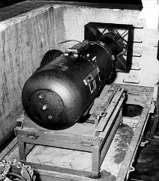
critical mass: the mass of fissile
material required to maintain a
chain reaction at a constant rate
supercritical mass: the minimum mass
for which the chain rxn accelerates
(“Run, Forrest, run!”)
critical
mass
no chain rxn
(reaction
maintained
at constant
rate)
supercritical
mass
no chain rxn
Little Boy, later
dropped on Hiroshima

Slide 37
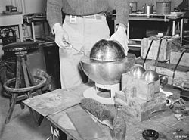
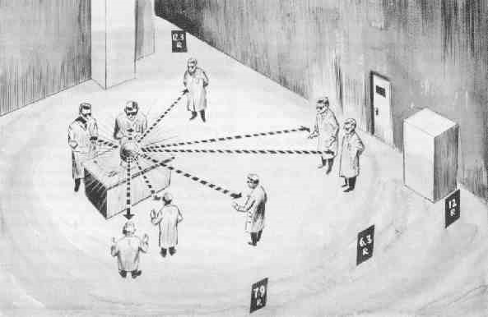
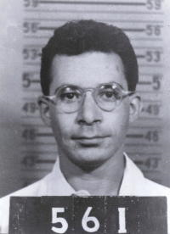

The “Demon Core,” a 6.2 kg
plutonium atomic bomb core,
so-called because it claimed
the lives of two Los Alamos
scientists before it was used
in the first post-war atomic
bomb test.
Louis Slotin
(1910-1946)
Harry Daghlian
(1921-1945)

Slide 38
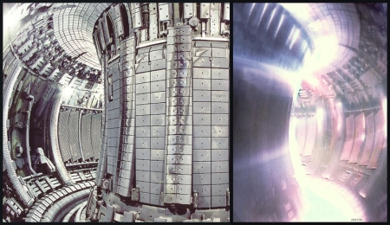
Nuclear Fusion
(a.k.a., thermonuclear reactions)
stars:
+
ENERGY
4 p⁺
He
-- products are generally NOT radioactive
-- requires high temperatures
(> 40,000,000 K)
!!!!
(because nuclei are all (+) charged)
-- Research into
controlling
fusion continues.
The tokamak uses magnetic fields
to contain and heat the reaction.

Slide 39
SUMMARY: Fission and Fusion
Fission is the splitting of larger into smaller nuclei. Only certain radionuclides are fissile and thus useful in practical applications of fission (which require chain reactions), such as nuclear power reactors. Fission is best initiated by slow-moving neutrons.
A fission reaction will start spontaneously and continue reacting if a large enough amount (the critical mass or supercritical mass) of fissile material is accumulated.
Fusion, which powers the stars, requires extremely high temps in order to overcome the electrostatic repulsive forces between positively-charged nuclei.

Slide 40
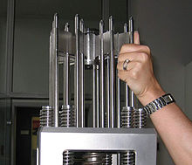
-- fuel is…
~3% U-235 (natural U is ~0.7% U-235)
-- control rods of B or Cd…
ABSORB n⁰, so fewer are
available to continue rxn.
-- moderator:
SLOWS DOWN n⁰ (to cause fission)
→ reactors in former USSR:
graphite
→ in the rest of the world:
water
Use LOW molar-mass mat’ls because they will...
slow down (NOT STOP) n⁰
-- water is heated to steam,
which spins electrical-
generating turbines

Slide 41
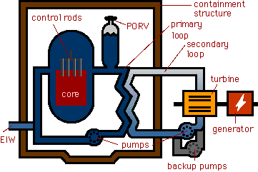
Schematic of a Nuclear Power Plant
EIW = Emergency Injection Water
PORV = Pressure Release Valve

Slide 42
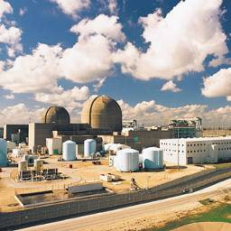
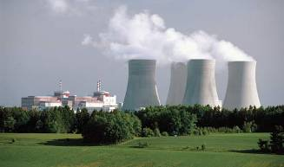
Main benefits of fission reactors:
(1)
no air pollution; does NOT
contribute to climate change
(2)
small volume of material
consumed
(3) breeder reactors: reactors that
generate new fissile material
at a greater rate than the
original fuel is consumed
-- non-fissile U-238 is trans-
muted into fissile Pu-239
β
β
n⁰ +
U-238
U-239
Np-239
Pu-239
Main problem:
What to do with waste?

Slide 43
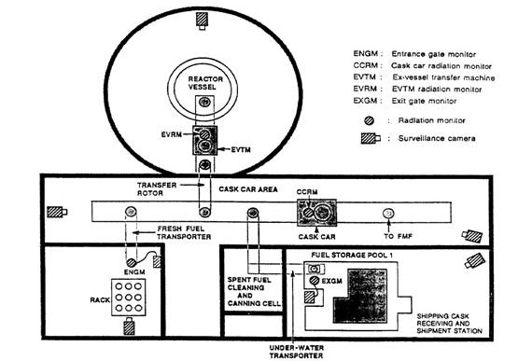
Schematic of
Breeder Reactor

Slide 44
FINAL THOUGHTS: Fission Reactors
The fuel in nuclear power reactors is some fissile material; typically U-235. Control rods in the reactor core ABSORB the neutrons that sustain the reaction; rods are lowered into the core to slow the reaction down and raised out of the core to speed it up. The moderator is the material that SLOWS DOWN neutrons so that they will cause fission in other atoms.
There are several key benefits of nuclear power: no air pollution, small volume of fuel consumed, and – in breeder reactors – the ability to actually produce new fuel while running the reactor. The huge drawback to nuclear power is the high-level radioactive waste produced.

Slide 45

non-ionizing radiation: bumps e– to higher energy
levels OR heats molecules
ionizing radiation: knocks e– OUT OF molecules;
-- e.g.,
all ‘particle’ radiation (α, β, etc.)
non-ionizing radiation
ionizing radiation
(LESS dangerous)
(MORE dangerous)
IR
UV
visible
X-rays
microwaves
radio waves
cosmic rays
gamma rays
ROYGBV
electromagnetic spectrum

Slide 46
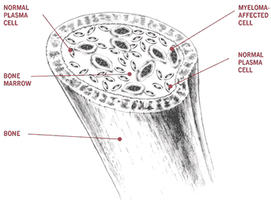
Ionizing radiation affects living tissue, thus:
:
:
(1)
creates H₂O⁺
( O–H)
.
(2)
then...
H₂O⁺ + H₂O H₃O⁺ + OH
The free-radical initiates a
number of chemical rxns.
that disrupt cell function.
neutral free-radical
^{w}/unpaired e–
-- the tissues most damaged
by radiation are the ones with
cells that rapidly reproduce:
bone marrow, lymph nodes
-- low doses over a long time can induce cancer,
which is…
the uncontrolled reproduction of cells.

Slide 47
Units for Radiation Doses
1 bequerel (Bq) = 1 disintegration/sec
1 Curie (Ci) = 3.7 x 10¹⁰ disintegrations/sec
1 gray (Gy) = absorbing 1 J/kg of tissue
1 rad = absorbing 1 x 10^{–2} J/kg of tissue
“radiation absorbed dose”
Since the various types of radiation damage tissue
with various degrees of efficiency, each type has
its own relative biological effectiveness (RBE).
rem = RBE x rad
photon or β RBE = 1
n⁰ RBE = 10
“roentgen equivalent – man”
α RBE = 20

Slide 48
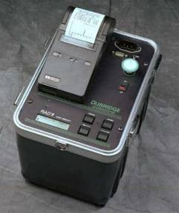
Radon
-- an α-emitter from the decay of
radium in rocks and soil
-- very dense; seeps into basements
and is readily inhaled
α
α
Ra-226
Rn-222
Po-218
radon
formed
radon
emits α
radiation
this, too,
is an
α-emitter
-- estimated to be responsible for ____ of U.S.
lung cancer deaths
10%

Slide 49
SUMMARY: Biological Effects of Radiation
Non-ionizing radiation includes all wavelengths from low-freq. UV through radio waves. Non-ionizing radiation is safe and results in the heating of molecules. Ionizing radiation is more dangerous; it includes all ‘particle’ radiation (e.g., α, β) and the light from high-freq. UV through cosmic rays. Ionizing radiation produces free radicals in living tissue and is related to incidents of cancer.
There are several units for quantifying radiation dose. NOT all types of radiation have an equally-negative effect on living tissue.
Radon gas is an α-emitter. If you have a basement, have it checked for the presence of radon.

