Slide 1
Solubility Guidelines for Selected Ions
in Aqueous Solution
CH₃COO–, Alk⁺,
Soluble
no exceptions
NO₃–, NH₄⁺
Br–, I–, Cl–
except with Hg₂²⁺, Ag⁺, and Pb²⁺
SO₄^{2–}
except with Hg₂²⁺, Ba²⁺, Sr²⁺, and Pb²⁺
Insoluble
PO₄^{3–}, CrO₄^{2–}, CO₃^{2–}
except with Alk⁺ and NH₄⁺
S^{2–}, OH–
except with NH₄⁺ and “strong base cations”
Saul ‘Chuck’ Cooawlkay knows exceptions? Naaaah.
Saul Brickell double-hugged Agatha… and Paul Bunyan, too.
Saul Sulf ate two huge bars… and peanut butter, too.
The poor crow was cold; he huddled with everyone, but Al K. said, “Naaaah.”
‘Soooooo… You two are always combined.’ “Naaaaht when we’re strongly basic.”

Slide 2
CH₃COO–, Alk⁺,
Soluble
no exceptions
NO₃–, NH₄⁺
Br–, I–, Cl–
except with Hg₂²⁺, Ag⁺, and Pb²⁺
SO₄^{2–}
except with Hg₂²⁺, Ba²⁺, Sr²⁺, and Pb²⁺
Saul ‘Chuck’ Cooawlkay knows exceptions? Naaaah.
sol
CH₃COO– Alk⁺
NO₃–
NH₄⁺
Saul Brickell double-hugged Agatha… and Paul Bunyan, too.
sol
Br–, I–, Cl–
Hg₂²⁺
Ag⁺
Pb²⁺
Saul Sulf ate two huge bars… and peanut butter, too.
sol
SO₄^{2–}
Hg₂²⁺
Ba²⁺
Sr²⁺
Pb²⁺

Slide 3
Insoluble
PO₄^{3–}, CrO₄^{2–}, CO₃^{2–}
except with Alk⁺ and NH₄⁺
S^{2–}, OH–
except with NH₄⁺ and “strong base cations”
The poor crow was cold; he huddled with everyone, but Al K. said, “Naaaah.”
PO₄^{3–}
CrO₄^{2–}
CO₃^{2–}
Alk⁺
NH₄⁺
‘Soooooo… You two are always combined.’ “Naaaaht when we’re strongly basic.”
S^{2–}
OH–
NH₄⁺
SBCs

Slide 4

Saul ‘Chuck’ Cooawlkay knows exceptions? Naaaah.
sol
CH₃COO– Alk⁺
NO₃–
NH₄⁺
the honorable, no-nonsense judge: Saul ‘Chuck’ Cooawlkay

Slide 5


Saul Brickell double-hugged Agatha… and Paul Bunyan, too.
sol
Br–,I–,Cl–
Hg₂²⁺
Ag⁺
Pb²⁺
Saul Brickell
double-hugging Agatha
Saul Brickell double-hugging
the Paul Bunyan trophy

Slide 6

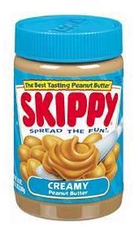
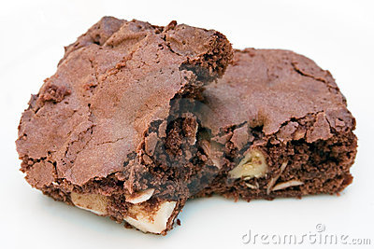
Saul Sulf ate two huge bars… and peanut butter, too.
sol
SO₄^{2–}
Hg₂²⁺
Ba²⁺
Sr²⁺
Pb²⁺
the slightly sickened
Saul Sulf
two HUGE, “I’m-going-
into-a-sugar-coma” bars
peanut
butter

Slide 7
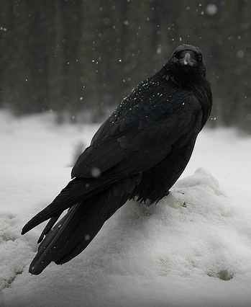
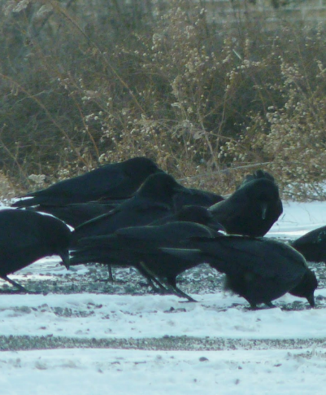

The poor crow was cold; he huddled with everyone, but Al K. said, “Naaaah.”
PO₄^{3–}
CrO₄^{2–}
CO₃^{2–}
Alk⁺
NH₄⁺
the poor
crow who
was cold
the poor crow
who was cold
attempting to
huddle with
everyone
the somewhat aloof
Al K. politely
declining the
crow’s overtures
to huddle

Slide 8





‘Soooooo… You two are always combined.’ “Naaaaht when we’re strongly basic.”
S^{2–}
OH–
NH₄⁺
SBCs
“OH!”

Slide 9
Saul ‘Chuck’ Cooawlkay knows exceptions? Naaaah.
sol
CH₃COO– Alk⁺
NO₃–
NH₄⁺
Saul Brickell double-hugged Agatha… and Paul Bunyan, too.
sol
Br–,I–,Cl–
Hg₂²⁺
Ag⁺
Pb²⁺
Saul Sulf ate two huge bars… and peanut butter, too.
sol
SO₄^{2–}
Hg₂²⁺
Ba²⁺
Sr²⁺
Pb²⁺
The poor crow was cold; he huddled with everyone, but Al K. said, “Naaaah.”
PO₄^{3–}
CrO₄^{2–}
CO₃^{2–}
Alk⁺
NH₄⁺
‘Soooooo… You two are always combined.’ “Naaaaht when we’re strongly basic.”
S^{2–}
OH–
NH₄⁺
SBCs
STOP

Slide 10
Solubility Guidelines for Selected Ions
in Aqueous Solution
CH₃COO–, Alk⁺,
Soluble
no exceptions
NO₃–, NH₄⁺
Br–, I–, Cl–
except with Hg₂²⁺, Ag⁺, and Pb²⁺
SO₄^{2–}
except with Hg₂²⁺, Ba²⁺, Sr²⁺, and Pb²⁺
Insoluble
PO₄^{3–}, CrO₄^{2–}, CO₃^{2–}
except with Alk⁺ and NH₄⁺
S^{2–}, OH–
except with NH₄⁺ and “strong base cations”
Are the following compounds
soluble or insoluble in water?

Slide 11









1. strontium chloride
2. silver chloride
3. lithium phosphate
4. gold(III) phosphate
5. cobalt(II) nitrate
6. tungsten(VI) sulfate
7. lead(II) sulfate
SrCl₂
(aq)
AgCl
insol.
Li₃PO₄
(aq)
AuPO₄
insol.
Co(NO₃)₂
(aq)
W(SO₄)₃
(aq)
PbSO₄
insol.

Slide 12

8. ammonium cyanide
9. copper(I) sulfide
10. barium sulfide
11. sodium hydroxide
12. platinum(III) hydroxide
13. cadmium carbonate
14. calcium carbonate
NH₄CN
(aq)
Cu₂S
insol.
BaS
(aq)
NaOH
(aq)
Pt(OH)₃
insol.
CdCO₃
insol.
CaCO₃
insol.

Slide 13
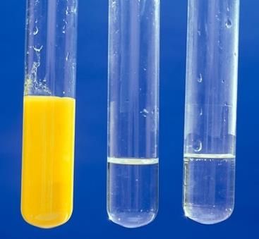
Precipitation reactions are reactions in solution that
form an insoluble product.
The insoluble product is called a...
precipitate.
Suppose you mix
solutions of lead(II) nitrate
and sodium iodide.
Pb(NO₃)₂
NaI
Pb²⁺, NO₃–,
Na⁺, I–
The ions present are...
Write the overall ionic equation…
Pb²⁺ + 2 NO₃– + 2 Na⁺ + 2 I–
PbI₂ + 2 NO₃– + 2 Na⁺
(aq)
(aq)
(aq)
(aq)
(ppt)
(aq)
(aq)
Cancel the spectator ions to
get the net ionic equation…
Pb²⁺ + 2 I–
PbI₂
STOP

Slide 14
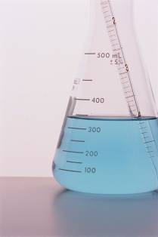
solution: a homogeneous mixture of
two or more substances
-- The ______ is present in greatest
quantity.
solvent
-- Any other substance present is
called a ______.
solute
aqueous solutions: solutions in which water is the
dissolving medium (i.e., the solvent)
electrolyte: any substance whose aqueous solution
will conduct electricity
e.g.,
HCl, NaCl, KOH
-- as opposed to a nonelectrolyte,
e.g.,
any sugar (C₆H₁₂O₆, C₁₂H₂₂O₁₁)
or any alcohol (CH₃OH, CH₃CH₂OH)

Slide 15
As a general rule, ionic solids dissociate into ions in
aqueous solution. The partial (–) charge on the O and
the partial (+) charge on the H atoms allow H₂O to
interact strongly with, and “pull out,” ions in the crystal
lattice. Thus, ionic compounds are often strong
electrolytes.
δ⁺
δ⁺
H
H
H
H
“The dudes split
up AND they
lose their hats.”
O
O
+
H
H
H
δ–
H
H
H
O
O
H
H
–
–
–
O
–
–
–
+
+
+
O
+
+
+
–
+
–
+
–
+
–
+
–
+
–
+

Slide 16
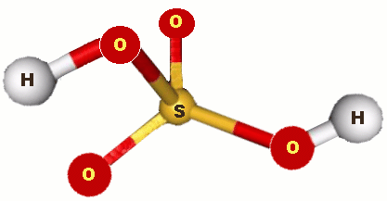
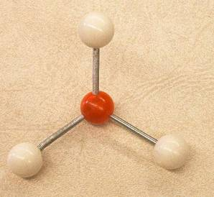
For molecular compounds, structural integrity of
molecules is maintained. Substance may dissolve,
but generally won’t split into
ions. Thus, mol. comps.
tend to be nonelectrolytes.
-- major exceptions:
“The dudes
split up
BUT DON’T
lose their hats.”
acids and NH₃ (ammonia)
** When molecular compounds DO form ions,
it is called ionization, not dissociation.

Slide 17
Solution Definitions and Dissociation v. Ionization
1. A solution is a homogeneous mixture consisting of
one or more solutes dissolved in a solvent. The most
common solvent is water; thus, the most common
solutions are aqueous solutions.
2. An electrolyte is any substance, the aqueous solution
of which will conduct electricity. Solutions of
nonelectrolytes (e.g., sugars and alcohols) do NOT
conduct electricity.
3. Dissociation occurs when ionic substances split into
ions. Ionization occurs when molecular substances
– like acids – which DON’T consist of ions are split
apart and END UP PRODUCING ions in solution.

Slide 18
Strong electrolytes exist almost completely as ions
in aqueous solution.
e.g.,
HCl(aq) H⁺(aq) + Cl–(aq)
lots of
product
KCl(aq) K⁺(aq) + Cl–(aq)
(note the one-sided arrow)
Weak electrolytes produce only a small concentration
of ions in reaching equilibrium.
e.g.,
CH₃COOH(aq) CH₃COO–(aq) + H⁺(aq)
HF(aq) H⁺(aq) + F–(aq)
lots of
reactant
(note the double arrow)

Slide 19

Some of the strong electrolytes are the
strong acids and strong bases.
STRONG ACIDS
STRONG BASES
the hydroxides of...
hydrochloric, HCl
hydrobromic, HBr
hydroiodic, HI
Li, Na, K, Rb,
Cs, Ca, Sr, Ba
chloric, HClO₃
perchloric, HClO₄
“strong base cations”
nitric, HNO₃
(SBCs)
sulfuric, H₂SO₄

Slide 20
Be careful to distinguish between
dissolution and dissociation/ionization
in regard to strongs or weaks. For
example, CH₃COOH dissolves completely, but ionizes
only slightly; it is therefore a weak electrolyte. On the
other hand, Ba(OH)₂ dissolves relatively little, but the
amount that does dissolve dissociates almost
completely. Ba(OH)₂ is a strong electrolyte.
The question is: Of the amount that dissolves, what fraction dissociates/ionizes?
If… “most”
STRONG
If… “not much”
WEAK

Slide 21
Classify as a…
strong electrolyte,
weak electrolyte,
or nonelectrolyte.
LiOH
strong
HClO₃
strong
C₆H₁₂O₆
non-
HClO
weak
If 0.40 mol of each of the following are dissolved in
2.5 L of water, rank them from least to greatest
electrical conductivity.
HBrO₂
Ca(CH₃COO)₂
CH₃OH
KNO₃
CH₃OH
<
HBrO₂
<
KNO₃
<
Ca(CH₃COO)₂

Slide 22
FINAL THOUGHTS: Strong v. Weak Electrolytes
1. Strong electrolytes dissociate or ionize 100%. Weak
electrolytes dissociate or ionize to a small degree.
Equations for ‘strongs’ have a unidirectional arrow;
those for ‘weaks’ have arrows in both directions.
2. Memorize the seven strong acids and the eight
strong bases that contain the hydroxide ion (OH–).
3. We distinguish between a strong and a weak
electrolyte by looking at what is the principal
species in the solution. If the principal species is in
the ionized state, it is strong; if the principal species
is a neutral substance, it is a weak electrolyte.

Slide 23
Acids and Bases
For now, acids ionize in aqueous solutions to form
a hydrogen ion (H⁺).
-- “proton donors”
-- monoprotic acids
e.g.,
HCl, HNO₃, CH₃COOH
-- diprotic acids
e.g.,
H₂SO₄
H₂SO₄(aq) H⁺(aq) + HSO₄–(aq)
In soln…
HSO₄–(aq) H⁺(aq) + SO₄^{2–}(aq)
(only first ionization is complete)
With weak acids, the first ionization isn’t even close to complete.

Slide 24
For now, bases are substances that accept
hydrogen ions (i.e., protons).
-- OH– is very basic
-- equation:
H⁺(aq) + OH–(aq) → H₂O(l)
H⁺ + OH– → H₂O
The most common weak base is ammonia, NH₃;
it ionizes only about 1%.
-- equation:
NH₃(aq) + H₂O(l) NH₄⁺(aq) + OH–(aq)

Slide 25
A neutralization reaction has the form:
ACID + BASE → SALT + WATER
-- recall that “salt” means an ionic compound
Write the balanced molecular equation when
nitric acid reacts ^{w}/barium hydroxide.
2
HNO₃
+
Ba(OH)₂
→
Ba(NO₃)₂
+
2
H₂O
(aq)
(aq)
(aq)
(l)
H⁺
NO₃–
Ba²⁺
OH–
Ba²⁺
NO₃–
H₂O
Write the net ionic equation for the above reaction.
H⁺ + OH– → H₂O

Slide 26
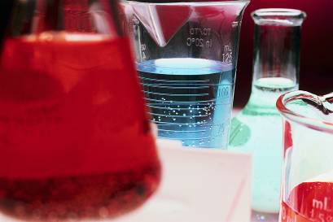
Write the balanced molecular eq. when perchloric acid
reacts ^{w}/potassium hydroxide.
HClO₄
+
KOH
→
KClO₄
+
H₂O
(aq)
(aq)
(aq)
(l)
H⁺
ClO₄–
K⁺
OH–
K⁺
ClO₄–
H₂O
Write the net ionic equation for the above reaction.
H⁺ + OH– → H₂O
** For EVERY strong acid/strong
base rxn, the net ionic equation
is… H⁺ + OH– → H₂O.

Slide 27
FINAL THOUGHTS: Acids, Bases, and Neutralization
1. For now, acids are proton (i.e., H⁺) donors; bases
are proton acceptors. The most common weak base
is ammonia, NH₃.
2. A neutralization reaction between an acid and base
has the following general form:
ACID + BASE → SALT + WATER
3. A molecular equation shows all substances in a
chemical reaction as neutrals. We also reviewed in
this lesson the net ionic equation, which shows only
the species that participate in a chemical change.

Slide 28
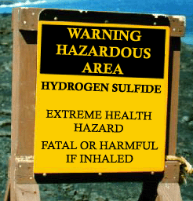
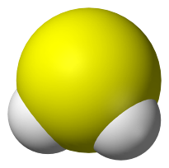
Three other anions that act as bases (i.e., as p⁺
acceptors) are the sulfide ion (S^{2–}), the carbonate
ion (CO₃^{2–}), and the bicarbonate ion (HCO₃–). All
react ^{w}/acids to form gases.
-- sulfide ion: reacts ^{w}/acids to form H₂S(g)
HCl(aq) + K₂S(aq)
H₂S(g) + KCl(aq)
2
2
Net ionic eq…
2 H⁺ + S^{2–} → H₂S
Hydrogen sulfide is produced by
anaerobic bacteria associated with water
collection and treatment processes.
It is corrosive, odorous, toxic, and
contributes to the formation of acid rain.

Slide 29
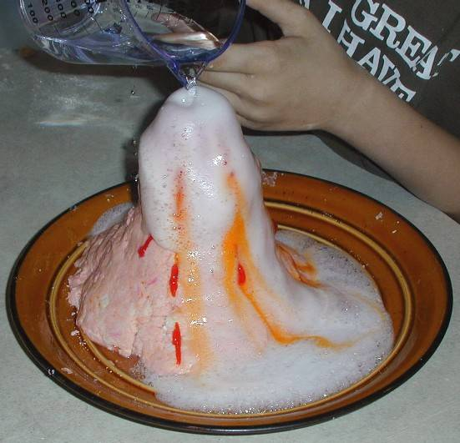
-- carbonate and bicarbonate ions:
react ^{w}/acids to form CO₂(g)
2
HNO₃(aq) + CaCO₃(s)
CO_{2(g)} + H₂O(l) + Ca(NO₃)₂(aq)
HCl(aq) + NaHCO₃(s or aq)
CO_{2(g)} + H₂O(l) + NaCl(aq)
The acidification of baking soda (i.e., sodium
hydrogen carbonate or sodium bicarbonate) with
vinegar (i.e., acetic acid) is a well-known reaction
that has carbon dioxide as one of the products.

Slide 30
SUMMARY: Other Anions Acting as Bases
1. The first anion we must know that tends to act as
a base (i.e., a proton or H⁺ acceptor) is the
hydroxide ion, OH–. When OH– acts as a base and
accepts a proton, water H₂O is produced.
2. Three other common anions that act as bases – and
the key product produced when accepting H⁺ – are:
-- sulfide ion, S^{2–} → H₂S gas
-- carbonate ion, CO₃^{2–} → CO₂ gas
-- bicarbonate ion, HCO₃– → CO₂ gas

Slide 31

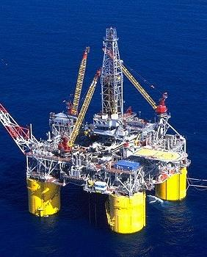
Oxidation-Reduction (a.k.a., Redox) Reactions
In redox reactions, electrons
are transferred between species.
increases.
Oxidation is the loss of
e–s, so when a substance
is oxidized, its charge…
LEO: “GER…”
Losing electrons: oxidation.
Gaining electrons: reduction.
Think about what O wants to
do when it gets near stuff.
decreases.
Reduction is the gain of
e–s, so when a substance
is reduced, its charge…
“OIL RIG.”
Oxidation is loss;
reduction is gain.

Slide 32
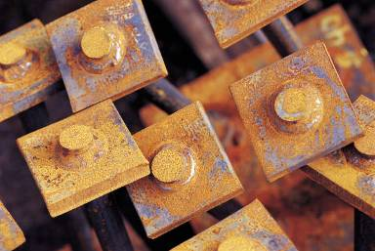
Mg(s) + 2 H⁺(aq) Mg²⁺(aq) + H₂(g)
0
1+
2+
2+
0
(oxidized)
(reduced)
“reductant”
“oxidant”
Whenever one substance
is oxidized,
another is reduced.
“reducing
agent”
“oxidizing
agent”
NOTE: A substance is
oxidized/reduced if ANY
PART of it is oxidized/reduced.
oxidation
rust, from the ________
of Fe to Fe³⁺
(and the reduction of O₂ to O^{2–})

Slide 33
Rules for Assigning Oxidation Numbers
1. Atoms in their elemental form have
an oxidation number of zero.
F₂, Al, Mo
2. For a monatomic ion, the oxidation
number is the charge on the ion.
Ca²⁺, Pb⁴⁺, N^{3–}
3. Nonmetals can have variable oxidation numbers.
a. Oxygen is usually 2–, but in the peroxide ion
(O₂^{2–}) it is 1–.
(extremely
rare)
b. Hydrogen is 1+ when bonded to nonmetals,
1– when bonded to metals.
** H– occurs ONLY w/SBC (i.e., ) metals.
c. Fluorine is 1–. Other halogens are usually 1–, but are +
when combined ^{w}/oxygen.
in BrO₂–, Br is… 3+
4. The sum of the oxidation numbers in a
neutral compound is zero.
H₂O, Fe₂O₃

Slide 34

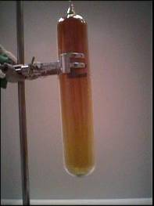

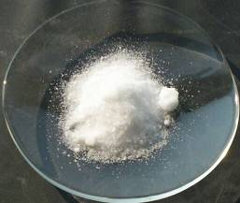
Determine the oxidation number
of nitrogen in each of the following.
N₂O₄
NH₃
4+
3–
N₂O₄ is a key
component of
smog.
NH₃ is used
in many types
of cleaners.
N₂
NO₃–
0
5+
N₂ makes up nearly 80%
of Earth’s atmosphere.
Potassium nitrate (saltpeter) is
used in the making of black powder.

Slide 35
REVIEW: Redox Reactions and Oxidation Numbers
1. A substance undergoes reduction when it gains
electrons; this results in a decrease in its oxidation
number. A substance undergoes oxidation when it
loses electrons; this results in an increase in its
oxidation number. Both processes occur in any
oxidation-reduction reaction (or redox reaction).
2. Two mnemonics for remembering what happens in
oxidation and reduction are OIL RIG and
LEO...GER
3. Be sure you know the rules for assigning oxidation
numbers to various elemental species.

Slide 36
Single replacement reactions have the following form:
A + BX → AX + B
Write molecular and net ionic equations for the
calcium/hydrochloric acid reaction.
Ca + 2 HCl CaCl₂ + H₂
Ca + 2 H⁺ Ca²⁺ + H₂

Slide 37
Li
Rb
K
Ba
Sr
Ca
Na
Mg
Al
Mn
Zn
Cr
Fe
Cd
Co
Ni
Sn
Pb
H₂
Sb
Bi
Cu
Hg
Ag
Pt
Au
The activity series is a list of metals.
At the top of the list
are the highly-
reactive active metals.
At the bottom are the
not-so-reactive noble metals.
easily lose e–
don’t like losing e–
The activity series is readily available
in standard references.
(i.e., …will change Pb²⁺ to Pb?)
Which of the following metals
will reduce PbCO₃? Ag Mg Hg
STOP

Slide 38
Molarity
mol
A solution’s concentration tells us
the amount of solute per solvent.
M
L
A common unit of concentration
is molarity.
-- equation:
What mass of magnesium nitrite is needed to make
3.25 L of a 0.35 M solution?
Mg²⁺
NO₂–
Mg(NO₂)₂
mol = M L
= 0.35 M (3.25 L )
= 1.1375 mol
1.1375 mol
= 130 g Mg(NO₂)₂

Slide 39
Steps for Properly Mixing an Aqueous Solution
1. In an appropriate container, pour water in so that
you have ~80% of your final, desired volume. This
is an approximate technique and takes little time.
2. Weigh out the
proper amount
of solute and
mix it into the
water from Step 1.
3. “Top off” the solution to your
final, desired volume and mix.
DONE.

Slide 40
What is the conc. of sodium ions in a 0.025 M
solution of sodium phosphate?
strong electrolyte
Na⁺
PO₄^{3–}
Na₃PO₄
Na₃PO₄(aq)
3 Na⁺ + PO₄^{3–}
0.025 M
0.075 M

Slide 41
FINAL THOUGHTS: Molarity
1. Molarity is the ratio of the number of
moles of solute to the liters of solution.
2. When mixing a solution, start with a large volume of
solvent, then add your measured solute, then top off
the mixture to its final volume. The initial large
volume of solvent acts as a good heat sink, in case
the later mixing is greatly exothermic. You can also
also think of the initial large volume of solvent as
allowing plenty of space for the solute to ‘spread out’
so it mixes evenly.

Slide 42
Dilutions
Aqueous acids (and sometimes bases) can be
purchased in concentrated form and diluted to any
lower concentration. A purchased bottle of acid is
called a concentrate or a stock solution.
-- **Safety Tip: When diluting, add acid or base
to water, not the other way around.
C = conc.
D = dilute
Dilution Equation:
M_{C}V_{C} = M_{D}V_{D}
Conc. phosphoric acid is 14.8 M. What volume of
concentrate is req’d to make 25.0 L of 0.500 M acid?
14.8
(V_{C})
=
0.500
(25.0)
V_{C} = 0.845
L
STOP

Slide 43
Solution
Stoichiometry
mass
mass
vol.
vol.
mol
mol
M
L
M
L
part.
part.
NaOH
H₂SO₄
V of gases
at STP
V of sol’ns
What volume of 0.150 M sulfuric acid is needed to neutralize
26 g sodium hydroxide?
H₂SO₄
+
2
NaOH
→
Na₂SO₄
+
2
H₂O
26 g NaOH
= 0.325 mol H₂SO₄
= 2.2 L of 0.150 M H₂SO₄

Slide 44
What mass of lead(II) nitrate will consume
85.0 mL of 0.45 M sodium iodide?
mol
Pb(NO₃)₂
+
2
NaI
→
PbI₂
+
2
NaNO₃
M
L
mol NaI = M L
= 0.45 M (0.085 L )
= 0.03825 mol NaI
NaI
Pb(NO₃)₂
0.03825 mol
NaI
= 6.3 g Pb(NO₃)₂
STOP

Slide 45
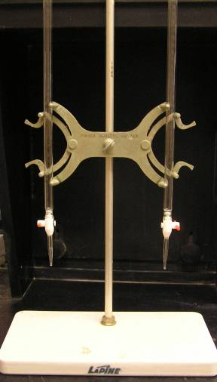
Titrations
If we don’t know a solution’s
concentration, we react a
second solution of known
concentration – called a standard
solution –with the first. Based on
the stoichiometry of the reaction,
we can determine the unknown
solution’s concentration.
-- This procedure is called a titration.

Slide 46
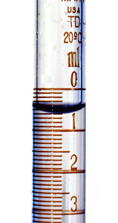
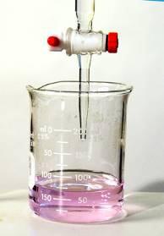
The equivalence point of a titration occurs
when stoichiometrically equivalent
quantities are brought together. This
point is identified by using indicators,
which are chemicals whose color
depends on the pH. A sudden color
change indicates the end
point of the titration, which
coincides closely with
the equivalence point, and
is usually considered to be
“good enough.”

Slide 47
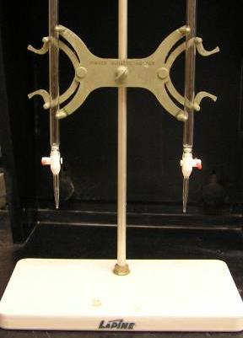
If 56.0 mL of sodium hydroxide
neutralize 19.0 mL of 0.235 M
nitric acid, find the concentration
of the base.
mol H⁺ = mol OH–
HNO₃
H⁺ + NO₃–
0.235 M
0.235 M
NaOH
Na⁺ + OH–
X M
X M
[ H⁺ ] V_{A} = [ OH– ] V_{B}
0.235 M
(19.0 mL)
=
[ OH– ]
(56.0 mL)
[ OH– ]
= M_{NaOH}
= 0.0797 M NaOH
STOP

Slide 48


Ways of Expressing Concentration
qualitative:
concentrated v. dilute
quantitative:
ppm =
x 10⁶
ppb =
x 10⁹
ppt =
x 10¹²

Slide 49
Unlike molarity, molality doesn’t
change with temp. because...
mass remains constant ^{w}/
changing T.
(V changes ^{w}/T.)
To go between molarity and
molality, you need…
the soln’s density.

Slide 50



A 5.5-g sample of well water contains 0.75 μg of
lead ions. In ppm, find the concentration of lead ions.
= 0.14 ppm
140 ppb
(!!!)
The federal limit for lead in
drinking water is 15 ppb.

Slide 51
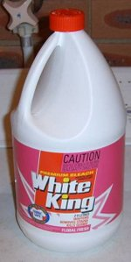
If a commercial bleach is 4.35% sodium hypochlorite
by mass, calculate the bleach’s mole fraction and
molality of the sodium hypochlorite.
4.35 g NaClO
= 0.05839 mol NaClO
100 g
bleach
95.65 g H₂O
= 5.3139 mol H₂O
= 0.0109
= 0.610 m

Slide 52
REVIEW: More Ways to Quantify Concentration
While mass percentage and molarity will be the most
common ways you will quantify soln concentration,
there are many others that I believe are worth knowing:
ppm =
x 10⁶
ppb =
x 10⁹
ppt =
x 10¹²

Slide 53
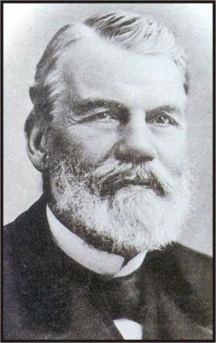
Colligative Properties
-- these depend on the concentration of particles in a
solution, but not...
the kind of particles
(A) Adding a volatile/nonvolatile
solute to a solvent increases/
decreases the solution’s
vapor pressure (VP).
Raoult’s law:
Francois
Marie Raoult
(1830 – 1901)
VP_{soln, T in q} = X_{A} . VP_{A, T in q} + X_{B} . VP_{B, T in q} + …

Slide 54


Ideal solutions obey Raoult’s law. Such solutions
have...
-- a low concentration
(i.e., are relatively dilute)
-- solute and solvent particles that are similar
in size and have similar IMFs

Slide 55
A solution of sodium chloride and water has a vapor
pressure of 0.854 atm at 100.ºC. Find the mole
fraction of sodium ion in solution.
VP_{soln, T in q} = X_{A} . VP_{A, T in q} + X_{B} . VP_{B, T in q} + …
(Key: The VP of H₂O @ 100.ºC should be recognizable.)
0
0
0.854 atm = X_{H2O}(1.00 atm) + X_{Na+}(VP) + X_{Cl–}(VP)
X_{H2O} = 0.854
Because ΣX = 1.00… X_{Cl–} = X_{Na+} = 0.0730

Slide 56
A solution contains 89.7 g ethanol and 241.4 g water.
What is the vapor pressure above the mixture at 100.ºC,
if ethanol’s vapor pressure at this temp. is 1694 torr?
CH₃CH₂OH
VP_{soln, T in q} = X_{A} . VP_{A, T in q} + X_{B} . VP_{B, T in q} + …
( )
( )
1.95
13.41
_____
_____
VP_{soln} = (1694) + (760)
15.36
15.36
VP_{soln} = 879 torr
89.7 g eth
= 1.95 mol eth
241.4 g H₂O
= 13.41 mol H₂O
STOP

Slide 57
(B) Adding a nonvolatile solute to a solvent decreases
the solution’s freezing point (FP) and increases its
boiling point (BP).
Phase diagram
(not water’s)
P
pure solvent
solid
solution
liquid
1 atm
Note that FP
and BP .
gas
T
NFP
NBP

Slide 58
The freezing point depression and
boiling point elevation are given by:
ΔT_{x} = K_{x} m i
ΔT_{x} = FP depression or BP elevation
K_{x} = K_{f} (molal FP depression constant) or
K_{b} (molal BP elevation constant)
-- they depend on the solvent
-- for water:
K_{f} = 1.86ºC/m
K_{b} = 0.52ºC/m
m = molality of solution

Slide 59
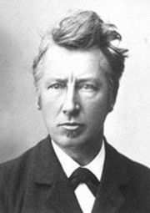
i = van’t Hoff factor
(accounts for # of
particles in solution)
In aq. soln., assume that…
1
-- i = __ for nonelectrolytes
2
-- i = __ for KBr, NaCl, etc.
3
-- i = __ for CaCl₂, etc.
Jacobus Henricus van’t Hoff
(1852 – 1911)
ΔT_{x} = K_{x} m i
STOP
In reality, the van’t Hoff factor isn’t always
an integer. Use the guidelines unless
given information to the contrary.

Slide 60
REVIEW: Boiling Point Elevation
and Freezing Point Depression
The number of degrees by which a solution’s boiling
point or freezing point differ from those of the pure
solvent is given by:
ΔT_{x} = K_{x} m i
ΔT_{x} = FP depression or BP elevation
K_{x} = K_{f} (molal FP depression constant) or
K_{b} (molal BP elevation constant)
-- they depend on the solvent
-- for water: K_{f} = 1.86ºC/m, K_{b} = 0.52ºC/m
m = molality of solution

Slide 61
Find the FP and BP of a soln. containing 360. g barium
chloride and 2.50 kg of water.
K_{f} = 1.86ºC/m
ΔT_{x} = K_{x} m i
K_{b} = 0.52ºC/m
360 g BaCl₂
= 1.725 mol BaCl₂
0.690 m
i = 3
ΔT_{f} = K_{f} m i
= 1.86(0.690)(3)
= 3.85ºC
FP = –3.85ºC
ΔT_{b} = K_{b} m i
= 0.52(0.690)(3)
= 1.08ºC
BP = 101.08ºC

Slide 62
Camphor, C₁₀H₁₆O, has an NFP of 179.8ºC and a
K_{f} of 40.0ºC/m. When 0.186 g of a nonelectrolytic
substance is dissolved in 22.01 g of camphor, the
mixture’s new freezing point is 176.7ºC. Find the
unknown’s molar mass.
ΔT_{f} = K_{f} m i
3.1ºC
40.0
1 (organic = nonelec.)
(Multiply by
0.02201 kg
camphor to get…)
mol unknown
Solve for m = 0.0775
kg camphor
1.71 x 10^{–3} mol unk.
1 mol unk.
=
X = 109 g/mol
0.186 g unk.
X g unk.
STOP

Slide 63
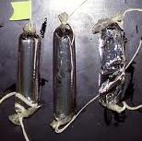
(C) Adding a nonvolatile solute to a solvent increases
the solution’s osmotic pressure.
more conc. (in terms of solute) = higher osmotic pres.
Osmosis is the net movement of solvent away
from a soln. ^{w}/a lower solute [ ] toward a soln. ^{w}/a
higher solute [ ]. Another way
to say this is that osmosis is
the diffusion of a solvent
– i.e., from an area of higher
solvent [ ] to an area of lower
solvent [ ] – through a
semipermeable membrane.
Dialysis tubing used with
various sugar solns.

Slide 64
π
osmotic pressure, π:
the external pressure
req’d to prevent osmosis
π
Solvent A
(pure solvent)
Solution B
(mixture)
;
application of π...
solvent tends to flow ;
prevents flow
A soln’s osmotic pressure π can be thought of as a
negative pressure; that is, the greater a soln’s π, the
greater is the tendency for solvent to flow _____ the
solution.
π
INTO
π

Slide 65
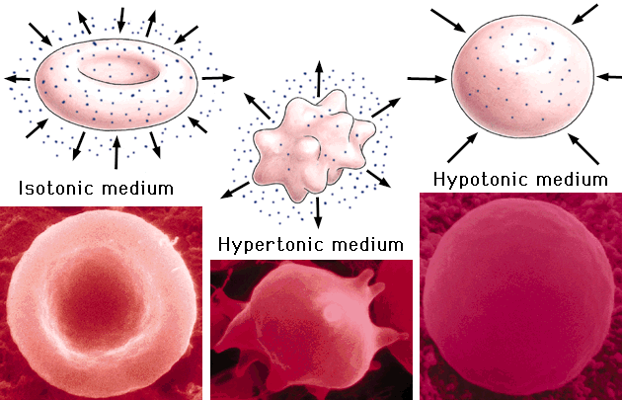
hypertonic solns:
hypotonic solns:
small π; “dilute” (in terms of solute)
large π; “conc.” (in terms of solute)

Slide 66
conc. in salt
dil. in salt
dil. in H₂O
conc. in H₂O
net H₂O flow
semipermeable
membrane
hypertonic
hypotonic

Slide 67
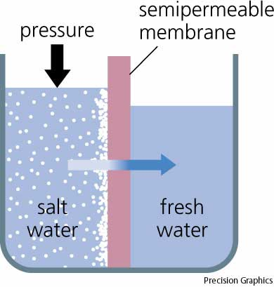
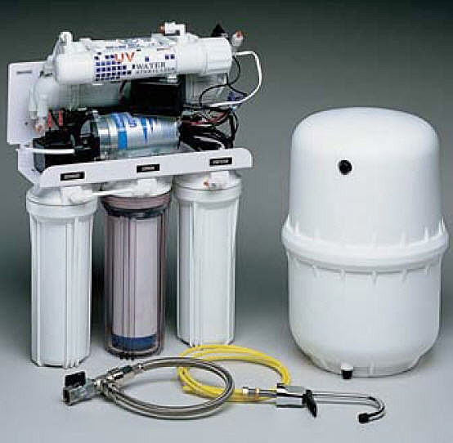
Reverse osmosis is the process of applying a pressure (P > π) such
that solvent is forced to flow (“against its will”) from low solvent conc.
to high solvent conc. Reverse osmosis is sometimes used in the
desalination of seawater.
STOP

Slide 68

osmotic pressure equation:
π V = n R T i
n = # of moles of solute
V = solution volume, in L
R = 8.314 L-kPa/mol-K = 0.08206 L-atm/mol-K
T = absolute temp. (i.e., in K)
i = van’t Hoff factor
An early form of the osmotic pressure
equation was proposed by van’t Hoff.
The equation was improved to its
current form by Harmon Northrop
Morse, an American chemist who
lived from 1848 to 1920.

Slide 69
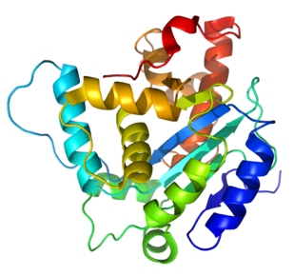
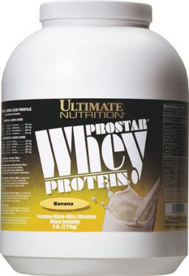
1.5 mg of a certain protein are dissolved in water
to make 10.0 mL of soln. The soln’s osmotic pressure
was found to be 2.35 torr at 25ºC. Calculate the
protein’s molar mass.
298 K
0.3133 kPa
π V = n R T i
= 1.2645 x 10^{–6} mol
X = 1200 g/mol
STOP

