Slide 1
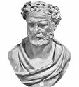

Historical Development of the Atomic Model
Greeks (~400 B.C.E.)
-- Democritus Leucippus (and others)
Matter is discontinuous (i.e., “grainy”).
Greek model
of atom
-- Plato and Aristotle disagreed,
saying that matter was continuous.

Slide 2
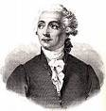

Hints at the Scientific Atom
-- Antoine Lavoisier:
law of conservation of mass
-- Joseph Proust (1799):
law of definite proportions: every compound has a fixed proportion
by mass
“mass units”
e.g., water………………….
8 “m.u.” O : 1 m.u. H
chromium(II) oxide…..
13 m.u. Cr : 4 m.u. O

Slide 3
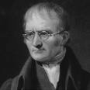
Hints at the Scientific Atom (cont.)
-- John Dalton (1803):
law of multiple proportions: When two different compounds have same two elements, equal mass of one element results in integer multiple of mass of other.
e.g., water……………………..
8 m.u. O
1 m.u. H
:
hydrogen peroxide..…….
16 m.u. O
1 m.u. H
:
13 m.u. Cr
4 m.u. O
chromium(II) oxide……..
:
chromium(VI) oxide…….
13 m.u. Cr
12 m.u. O
:

Slide 4
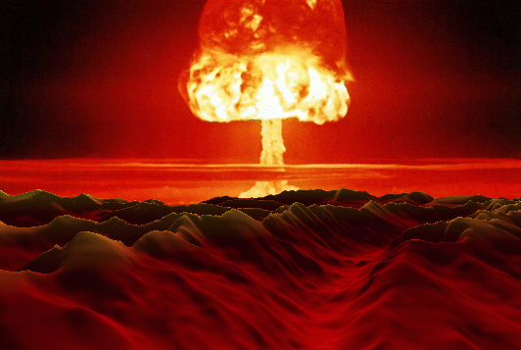
John Dalton’s Atomic Theory (1808)
1. Elements are made of
indivisible particles called atoms.
Atoms are not indivisible.
2. Atoms of the same element are exactly
alike; in particular, they have the same mass.
Isotopes!
3. Compounds are formed by
the joining of atoms of two
or more elements in fixed,
whole number ratios.
Dalton’s model
of atom
e.g.,
1:1, 2:1, 1:3, 2:3, 1:2:1
Dalton’s was the first atomic theory that had… evidence to support it.
NaCl, H₂O, NH₃, Fe₂O₃, C₆H₁₂O₆

Slide 5
John Dalton’s Atomic Theory (1808)
1. Elements are made of
indivisible particles called atoms.
Atoms are not indivisible.
2. Atoms of the same element are exactly
alike; in particular, they have the same mass.
Isotopes!
3. Compounds are formed by
the joining of atoms of two
or more elements in fixed,
whole number ratios.
Dalton’s model
of atom
e.g.,
1:1, 2:1, 1:3, 2:3, 1:2:1
Dalton’s was the first atomic theory that had… evidence to support it.

Slide 6
FINAL THOUGHTS: Atomic Theory, 1
1. The ancient Greeks were the first known humans
to theorize about matter on the scale of the very
small. Some Greeks (by no means all) concluded
that matter was particulate in nature; thus was born
the Greek ‘BB’ model of the atom.
2. In the early 19th century, John Dalton formulated his
atomic theory, based on his own scientific work and
that of Lavoisier and Proust. While Dalton’s model of
the atom differed little from the Greek ‘BB’ model,
Dalton’s was supported by empirical evidence, while
the Greek model was pure conjecture.

Slide 7
Law of Electrostatic Attraction
opposite charges attract; like charges repel
ATTRACTIVE REPULSIVE
+
–
+
+
–
–
(also called coulombic attraction)

Slide 8
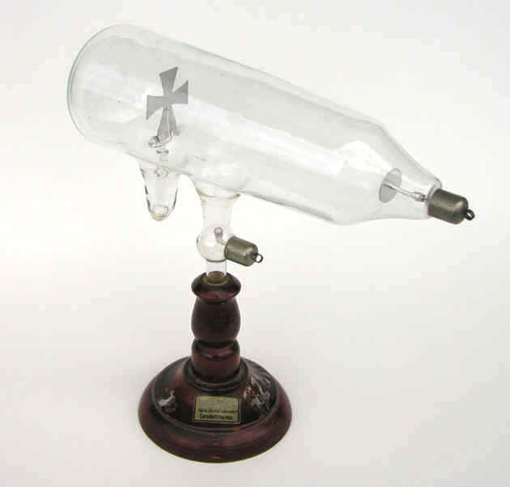
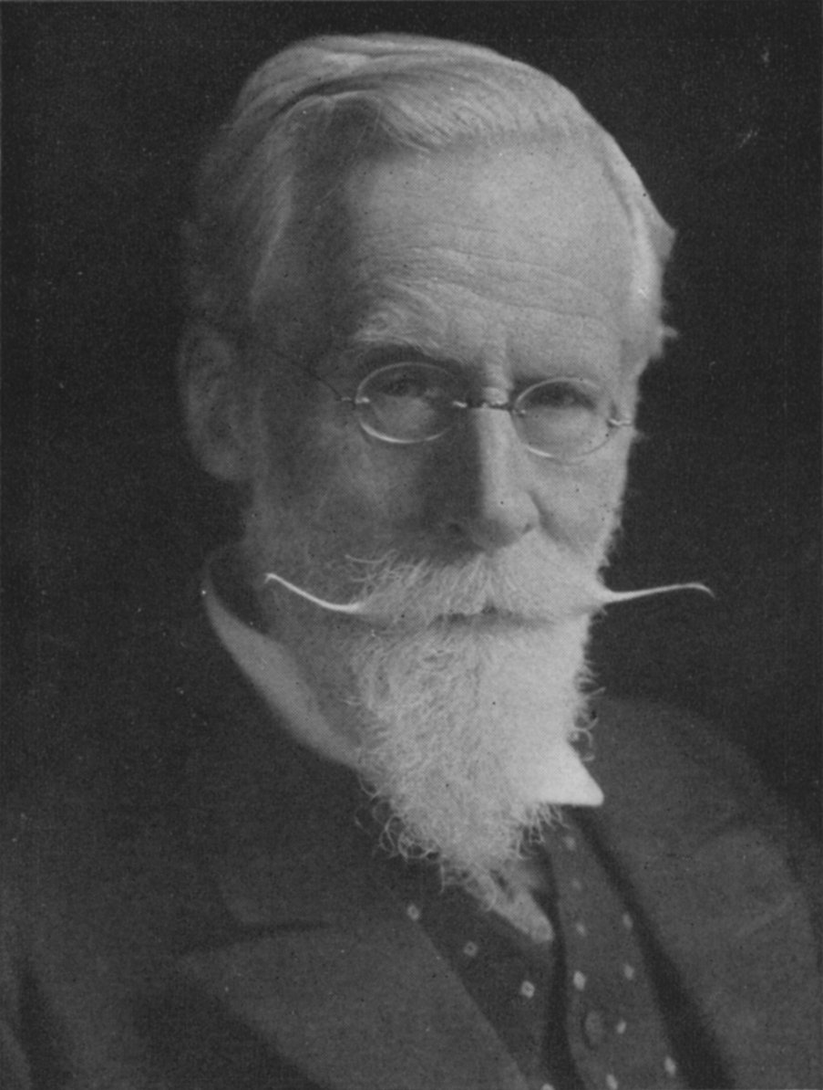



-- William Crookes
(1870s):
“Rays” causing
shadow were
emitted from
the cathode.
Maltese cross CRT
computer monitor
radar screen
television

Slide 9
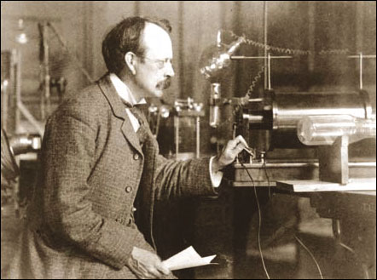
-- J.J. Thomson (1897) discovered
that “cathode rays” are deflected
by electric and magnetic fields.
He found that “cathode rays” were particles (today, we call them electrons) having a charge-to-mass ratio of 1.76 x 10⁸ C/g.
electric field lines
“cathode rays”
+ + + + + +
Crooke’s tube
– – – – – –
(–) particles
electrons
phosphorescent
screen

Slide 10
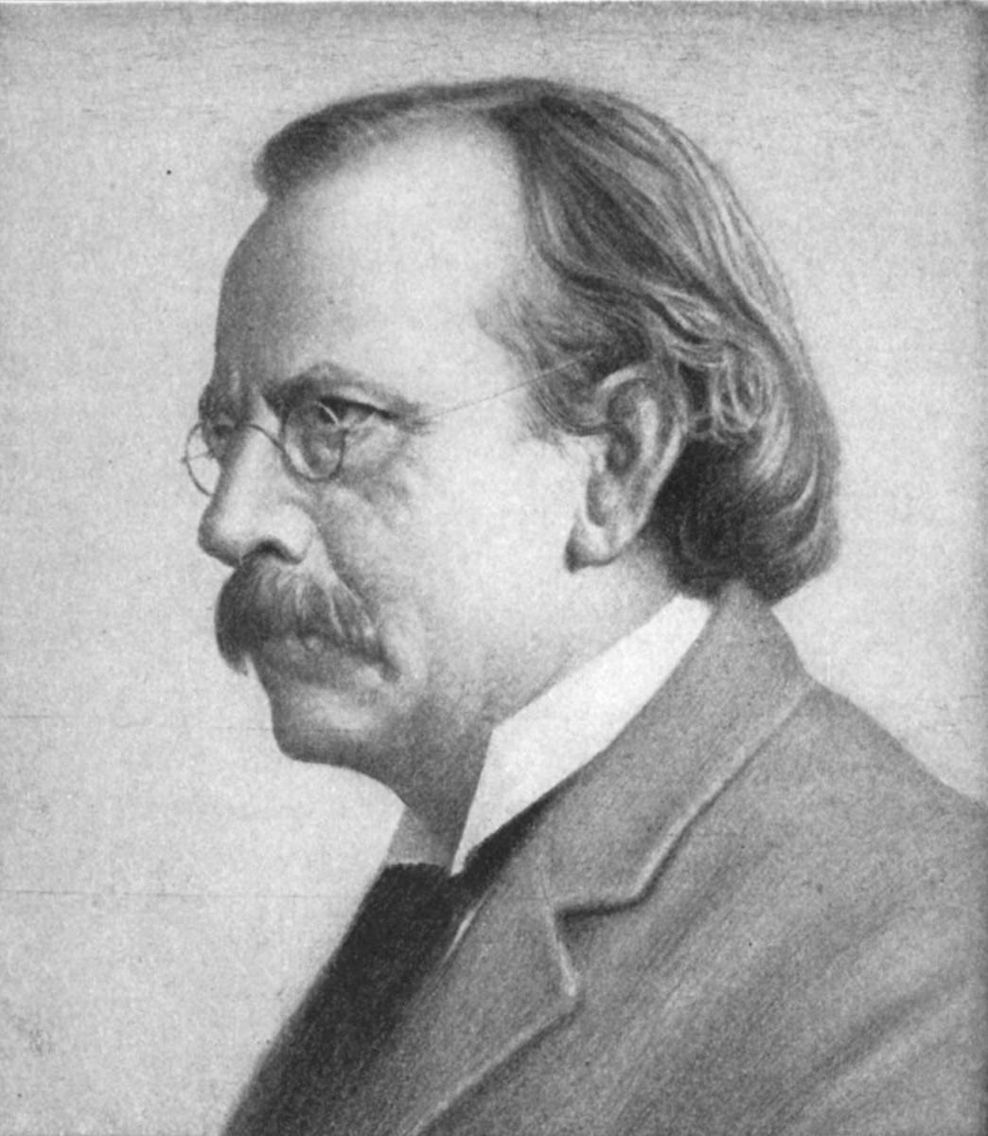
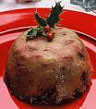
Since atom was known to be
electrically neutral, he proposed the plum pudding model.
-- Equal quantities of (+) and (–)
charge distributed uniformly
in atom.
+
+
–
+
–
+
-- (+) is ~2000X more massive
than (–).
–
+
+
–
+
–
+
–
–
–
+
–
+
+
–
–
(plum
pudding)
Thomson’s plum pudding model

Slide 11
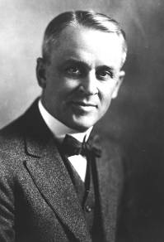
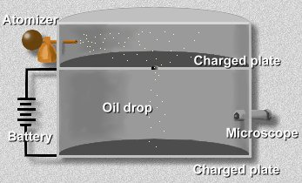
-- Robert Millikan (1909) performed
the “oil drop” experiment. Oil
drops were given negative
charges of varying magnitude.
(using x-rays)
x-rays

Slide 12
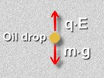

Charges on oil drops were found to be integer
multiples of 1.60 x 10^{–19} C.
6.40 x 10^{–19} C
4.80 x 10^{–19} C
1.60 x 10^{–19} C
3.20 x 10^{–19} C
6.40 x 10^{–19} C
1.60 x 10^{–19} C
m g = q E
8.00 x 10^{–19} C
9.60 x 10^{–19} C
4.80 x 10^{–19} C
1.60 x 10^{–19} C
8.00 x 10^{–19} C
9.60 x 10^{–19} C
3.20 x 10^{–19} C
6.40 x 10^{–19} C
He reasoned that this must be the charge on a
single electron. He then found the electron’s mass:
charge
1.60 x 10^{–19} C
=
charge per mass
1.76 x 10⁸ C/g
previously
discovered
by Thomson
= 9.09 x 10^{–28} g

Slide 13
FINAL THOUGHTS: Atomic Theory, 2
1. Thomson modified Dalton’s model of the atom when
he realized that atoms contain smaller, subatomic
particles: some with a (+) charge, and electrons,
with a (–) charge. Thus, Dalton’s ‘solid blob’ model
gave way to Thomson’s ‘mushy-squooshy’ plum
pudding model. J.J. didn’t figure out either the e–’s
charge nor mass, but did find its charge-to-mass ratio.
2. In his oil-drop experiment, Millikan was able to
determine the charge on an electron. Then, from
Thomson’s charge-to-mass ratio, he calculated the
electron’s mass.

Slide 14
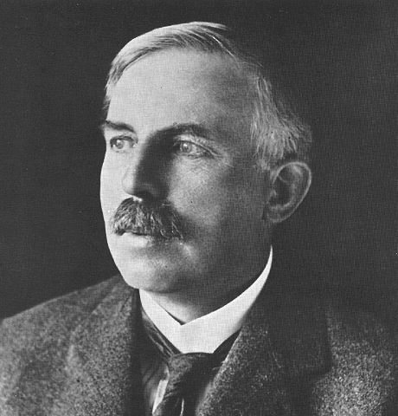
Ernest Rutherford (1910):
Gold Leaf Experiment
A beam of α-particles (+) was directed at a gold leaf surrounded by a phosphorescent (ZnS) screen.
gold
leaf
particle beam
α-source
lead block
ZnS screen

Slide 15
Most α-particles passed through, some angled slightly, and a tiny fraction bounced back.
Conclusions:
1.
Atom is mostly empty space.
2.
(+) particles are concentrated at center.
nucleus = “little nut”
3.
(–) particles orbit nucleus.

Slide 16
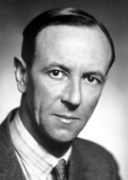
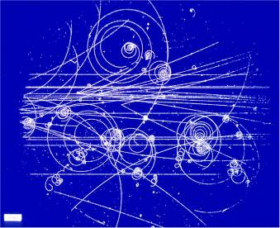
-- James Chadwick
discovered neutrons in 1932.
Purpose of n⁰ =
help to bind p⁺
together in nucleus
And now we believe in many other subatomic particles:
quarks,
muons,
positrons,
neutrinos,
pions, etc.
photo from liquid H₂ bubble chamber

Slide 17
Thomson’s Plum Pudding Model
Dalton’s (also the Greek) Model
Rutherford’s Model
–
+
–
+
–
+
+
–
–
–
+
+
–
–
+
N
+
–
–
–
–
–
+
+
–
–
–
+
–

Slide 18
FINAL THOUGHTS: Atomic Theory, 3
1. In his gold leaf experiment, Rutherford showed that
that the atom was mostly empty space, and that the
atom’s (+) particles were concentrated at the center.
Rutherford is thus credited with the concept of the
nuclear atom.
2. Chadwick determined that the atomic nucleus
contained more than just (+) particles; there are
also uncharged particles, which we call neutrons.
3. We’ll discuss the current-best model of the atom,
the quantum-mechanical model, in some detail in
a later unit.

Slide 19
electronic charge =
1.602 x 10^{–19} C
-- In chemistry, charges are expressed as unitless
multiples of this value, not in C.
e.g.,
2+ (as in Ca²⁺), not 2 (1.602 x 10^{–19} C)
= 3.204 x 10^{–19} C
-- atomic mass unit (amu): used to measure masses
of atoms and subatomic particles
1 p⁺ = 1.0073 amu
1 n⁰ = 1.0087 amu
1 e– = 0.0005486 amu
~
~
i.e., m_{p+} = m_{n0} = 1 amu
Conversion:
1 g = 6.02 x 10²³ amu (MEMORIZE.)

Slide 20
Angstroms (A) are often used to measure
atomic dimensions.
Conversion:
1 A = 1 x 10^{–10} m = 1 x 10^{–8} cm
atomic number:
# of p⁺
-- the whole number on Periodic Table;
determines the identity of an atom
mass number:
(# of p⁺) + (# of n⁰)
isotopes: different varieties of an element’s atoms
--
same # of p⁺, diff. #’s of n⁰ (thus, diff. masses)
-- some are radioactive; others aren’t
-- A nucleus of a specific isoto
called a…
nuclide.
All atoms of an element react the same, chemically.
STOP

Slide 21

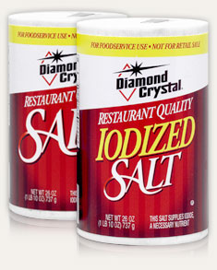
Complete Atomic Designation
…gives precise info about an atomic particle
mass #
charge (if any)
element
symbol
atomic #
125
–
I
53
Goiter due to lack of iodine
iodine is now added to salt

Slide 22
Complete
Atomic Designation
Protons
Neutrons
Electrons
238
92
146
92
U
92
23
+
11
12
10
Na
11
79
2–
34
45
36
Se
34
59
3+
27
32
24
Co
27
37
–
17
20
18
Cl
17
55
7+
25
30
18
Mn
25
STOP

Slide 23
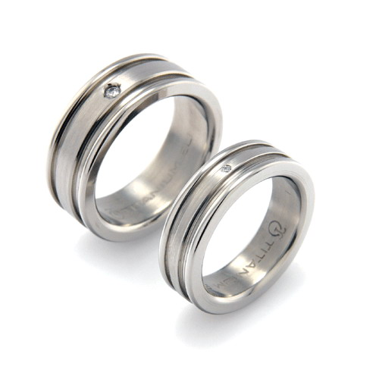
Average Atomic Mass
(a.k.a., Atomic Mass or Atomic Weight)
This is the weighted average mass of all atoms of an element, measured in a.m.u.
For an element with
isotopes A, B, etc.:
Ti has five naturally-occurring isotopes
AAM = Mass A (% A) + Mass B (% B) + …
% abundance
(use the decimal form of the %;
e.g., use 0.253 for 25.3%)

Slide 24
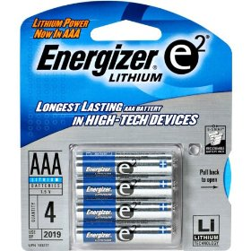
Lithium has two isotopes.
Li-6 atoms have mass 6.015 amu;
Li-7 atoms have mass 7.016 amu.
Li-6 makes up 7.5% of all Li atoms.
Find AAM of Li.
Li batteries
AAM = Mass A (% A) + Mass B (% B)
AAM = 6.015 amu (0.075) + 7.016 amu
(0.925)
AAM = 0.451 amu
+ 6.490 amu
AAM = 6.94 amu
** Decimal number on Table refers to…
molar mass (in g) OR AAM (in amu).
6.02 x 10²³ atoms
1 “average” atom

Slide 25
% abundance
Isotope
Mass
Si-28
27.98 amu
92.23%
Si-29
28.98 amu
4.67%
Si-30
?
3.10%
AAM = M_{A} (% A) + M_{B} (% B) + M_{C} (% C)
28.086
= 27.98 (0.9223) + 28.98 (0.0467) + X (0.031)
28.086 = 25.806 + 1.353 + 0.031X
28.086 = 27.159 + 0.031X
0.927 = 0.031X
0.031
0.031
X = M_{Si-30} = 29.90 amu
STOP

Slide 26
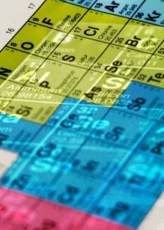
The
Periodic
Table
group: a vertical column; elements in a
group share certain phys. and
chem. properties
metals
nonmetals
metalloids
-- group 1 = alkali metals
-- group 2 = alkaline earth metals
-- group 16 = chalcogens
-- group 17 = halogens
-- group 18 = noble gases

Slide 27
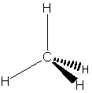
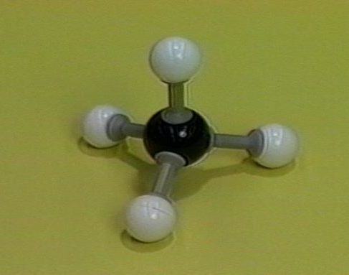
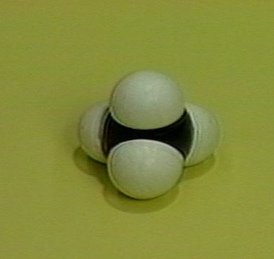
Molecular compounds contain only… nonmetals.
empirical formula:
shows relative #s of each type
of atom in m’cule (CH₂)
molecular formula:
shows actual #s & types of
atoms in m’cule (C₃H₆)
F
structural formula:
shows which atoms
are bonded
to which
F–C–F
Just like a Lewis structure,
but w/o unshared pairs.
F
Also… perspective ball-and- space-filling
drawing stick model model

Slide 28
Nomenclature of Binary Molecular Compounds
(two types of nonmetals)
FORGET CHARGES!
Use Greek prefixes to indicate how
many atoms of each element, but
don’t use “mono” on first element.
1 –
mono
6 –
hexa
Also, don’t use any prefixes
if H is the first element
2 –
di
7 –
hepta
e.g., H₂S
HF
HCl
3 –
tri
8 –
octa
4 –
tetra
9 –
nona
5 –
penta
10 –
dec

Slide 29
carbon dioxide
CO₂
CO
carbon monoxide
dinitrogen trioxide
N₂O₃
N₂O₅
dinitrogen pentoxide
carbon tetrachloride
CCl₄
NI₃
nitrogen triiodide
STOP

Slide 30

ion:
a charged particle
(i.e., a charged atom or
group of atoms)
Ions and Ionic
Compounds
anion: a (–) ion
cation: a (+) ion
--
more e– than p⁺
--
more p⁺ than e–
--
formed when…
atoms gain e–
--
formed when…
atoms lose e–
a cation
a fish
a cat
keeping
anion
a fish
A
n
ions
are
negative
ions.
“When I see a cation, I see a positive ion;
that is, I…
C
A
+
ion.”

Slide 31
polyatomic ion: a charged group of atoms
Memorize:
NH₄⁺
CH₃COO–
PO₄^{3–}
MnO₄–
ammonium
acetate
phosphate
permanganate
NO₃–
ClO₃–
BrO₃–
IO₃–
nitrate
chlorate
bromate
iodate
CrO₄^{2–}
Cr₂O₇^{2–}
chromate
dichromate
CN–
OH–
cyanide
hydroxide
CO₃^{2–}
HCO₃–
SO₄^{2–}
HSO₄–
carbonate
bicarbonate
sulfate
bisulfate

Slide 32

Ionic compounds, or salts,
consist of oppositely-charged
species bonded by
electrostatic forces.
You can describe salts as
“metal-nonmetal,” but
“cation-anion” is better.

Slide 33
Nomenclature of Ionic Compounds
chemical formula:
has neutral charge;
shows types of atoms
and how many of each
To write an ionic compound’s formula, we need:
1. the two types of ions
2. the charge on each ion
Na⁺ and F–
NaF
Ba²⁺ and O^{2–}
BaO
Na⁺ and O^{2–}
Na₂O
Ba²⁺ and F–
BaF₂

Slide 34
Parentheses are req’d only with multiple
“bunches” of a particular polyatomic ion.
Ba²⁺ and SO₄^{2–}
BaSO₄
Mg²⁺ and NO₂–
Mg(NO₂)₂
NH₄⁺ and ClO₃–
NH₄ClO₃
Sn⁴⁺ and SO₄^{2–}
Sn(SO₄)₂
Fe³⁺ and Cr₂O₇^{2–}
Fe₂(Cr₂O₇)₃
NH₄⁺ and N^{3–}
(NH₄)₃N

Slide 35
SUMMARY: Introduction to Ionic Nomenclature
1. An ion is a particle with an unequal number of p⁺
and e–. Anions have gained one or more e–, and so
have a net (–) charge; cations have lost one or
more e–, and so have a net (+) charge.
2. A polyatomic ion is a covalently-bonded GROUP of
atoms that have an unequal number of p⁺ and e–.
3. Ionic compounds, or salts, consist of cations and
anions ionically bonded to each other.
4. Parentheses are used in chemical formulas only
when we have more than one ‘clump’ of a particular
polyatomic ion.

Slide 36
Fixed-Charge Cations with Elemental Anions
i.e., “pulled-off-the-
Table” anions
For this class, the fixed-charge cations are
groups 1, 2, 13, and Ag⁺, Zn²⁺, Cd²⁺, Sc³⁺,
Y³⁺, Zr⁴⁺, Hf⁴⁺, Ta⁵⁺.

Slide 37
Na
A. To name, given
the formula:
Ba
1. Use name of cation.
2. Use name of anion (it has the ending “ide”).
NaF
sodium fluoride
BaO
barium oxide
Na₂O
sodium oxide
BaF₂
barium fluoride

Slide 38
Zn
Ca
Ag
B. To write formula,
given the name:
1. Write symbols for the two types of ions.
2. Balance charges to write formula.
silver sulfide
Ag⁺
S^{2–}
Ag₂S
zinc phosphide
Zn²⁺
P^{3–}
Zn₃P₂
calcium iodide
Ca²⁺
I–
CaI₂
STOP

Slide 39
Variable-Charge Cations with Elemental Anions
i.e., “pulled-off-the-
Table” anions
For this class, the variable-charge cations are
Pb²⁺/Pb⁴⁺, Sn²⁺/Sn⁴⁺, and all transition elements not listed above.

Slide 40
A. To name, given the formula:
Cu
Fe
Figure out charge on
cation.
2. Write name of cation.
3. Write Roman numerals
in ( ) to show cation’s charge.
Stock System
of nomenclature
4. Write name of anion.
Fe²⁺
FeO
Fe?
O^{2–}
iron(II) oxide
Fe₂O₃
Fe?
Fe³⁺
O^{2–}
Fe³⁺
Fe?
O^{2–}
O^{2–}
iron(III) oxide
CuBr
Cu?
Br–
copper(I) bromide
Cu⁺
CuBr₂
Cu²⁺
Br–
copper(II) bromide
Cu?
Br–

Slide 41
B. To find the formula, given the name:
1. Write symbols for the two types of ions.
2. Balance charges to write formula.
Co
Sn
cobalt(III) chloride
Co³⁺
Cl–
CoCl₃
tin(IV) oxide
Sn⁴⁺
O^{2–}
SnO₂
tin(II) oxide
Sn²⁺
O^{2–}
SnO
STOP

Slide 42
Insert name of ion
where it should go
in the compound’s
name.
But first...
oxyanions: polyatomic ions containing oxygen
“Most common” oxyanions:
BrO₃–
bromate
PO₄^{3–}
phosphate
IO₃–
iodate
SO₄^{2–}
sulfate
ClO₃–
chlorate
CO₃^{2–}
carbonate
NO₃–
nitrate

Slide 43
If an oxyanion differs from the above by the # of O
atoms, the name changes are as follows:
one more O = per_____ate
“most common” # of O = _____ate
one fewer O = _____ite
two fewer O = hypo_____ite

Slide 44

Write formulas:
iron(III) nitrite
Fe³⁺
NO₂–
Fe(NO₂)₃
ammonium phosphide
NH₄⁺
P^{3–}
(NH₄)₃P
ammonium chlorite
NH₄⁺
ClO₂–
NH₄ClO₂
zinc phosphate
Zn²⁺
PO₄^{3–}
Zn₃(PO₄)₂
lead(II) permanganate
Pb²⁺
MnO₄–
Pb(MnO₄)₂

Slide 45
Write names:
(NH₄)₂SO₄
ammonium sulfate
AgBrO₃
silver bromate
(NH₄)₃N
ammonium nitride
CrO₄^{2–}
U⁶⁺
uranium(VI) chromate
U(CrO₄)₃
U?
CrO₄^{2–}
CrO₄^{2–}
Cr₂(SO₃)₃
Cr?
chromium(III) sulfite
Cr³⁺
SO₃^{2–}
Cr³⁺
SO₃^{2–}
Cr?
STOP
SO₃^{2–}

Slide 46
Acid Nomenclature
binary acids: acids ^{w}/H and one other element
Binary Acid Nomenclature
1. Write “hydro.”
2. Write prefix of the other element,
followed by “-ic acid.”
HF
hydrofluoric acid
HCl
hydrochloric acid
HBr
hydrobromic acid
hydroiodic acid
HI
hydrosulfuric acid
H₂S

Slide 47
oxyacids: acids containing H, O,
and one other element
Oxyacid Nomenclature
For “most common” forms of the oxyanions,
write prefix of oxyanion, followed by “-ic acid.”
HBrO₃
bromic acid
HClO₃
chloric acid
H₂CO₃
carbonic acid
sulfuric acid
H₂SO₄
phosphoric acid
H₃PO₄

Slide 48
If an oxyacid differs from the above by
the # of O atoms, the name changes are:
one more O = per_____ic acid
“most common” # of O = _____ic acid
one fewer O = _____ous acid
two fewer O = hypo_____ous acid
HClO₄
perchloric acid
“most common” →
HClO₃
chloric acid
HClO₂
chlorous acid
HClO
hypochlorous acid
phosphorous acid
H₃PO₃
hypobromous acid
HBrO
persulfuric acid
H₂SO₅
STOP

